Slide 1
Post-War Mental Health

Slide 2
Aims of the lecture
Examine the expansion of ‘psychological medicine’ beyond the asylum to the broader population
Suggest the significance of the WWII as a turning point, and to provide examples of its impact in shaping life in post-war Britain
Highlight reasons for a critique of this development and the seeds of a crisis
Introduce consideration of the degree to which this became a global phenomenon in the post-war period

Slide 3
1. The move beyond the asylum

Slide 4
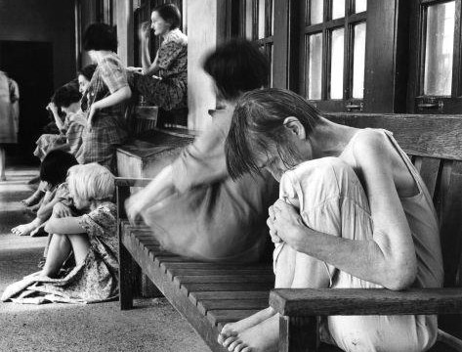
The limits of asylumdom
Early optimism of asylum had faded
Problems of growing size (1000+), overcrowding, incurablity
Cost in face of rising broader demands of welfare
Rise of eugenics

Slide 5
The move to ‘mental health’
Disillusion of doctors with asylum medicine
Desire to reach out to the milder cases who may be easier to cure
Rise of outpatient treatment, clinics, and child guidance services
Development of new ‘psychotherapies’
Interest too in prevention – promotion of ‘mental health’ and ‘mental hygiene’
But problems of resource, limited expertise, and reticence to talk about problems
Needs moment of crisis to make mental health a national priority

Slide 6
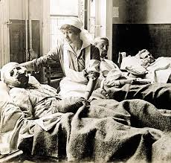

Slide 7
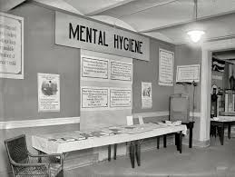

Slide 8
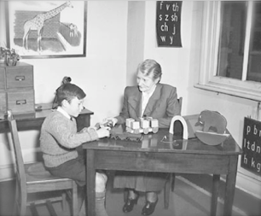

Slide 9
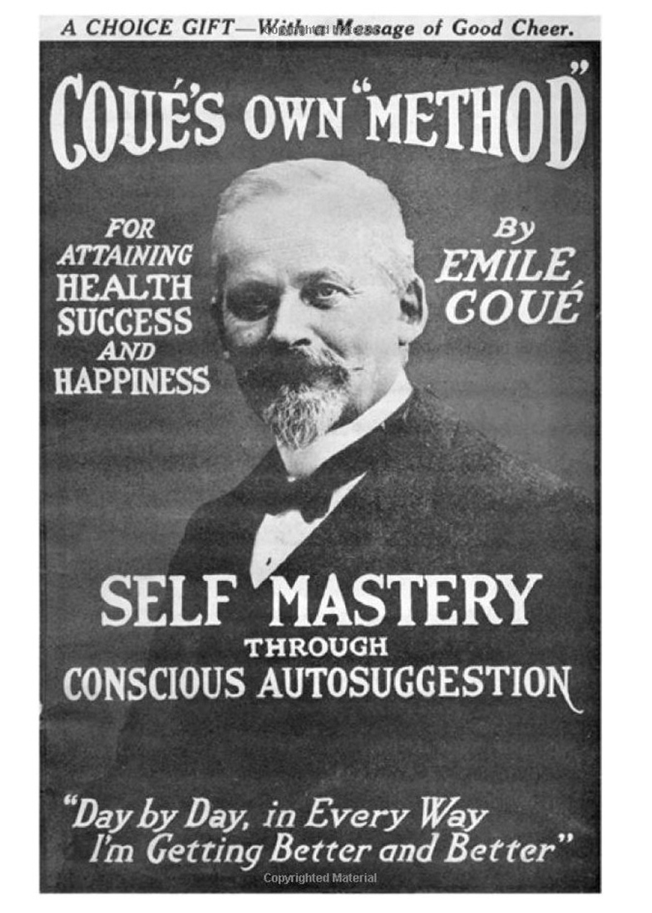

Slide 10
2. Impact of the World War II

Slide 11
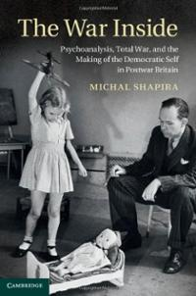
Democracy, War, and Mental Health
Political extremism, economic irrationality, and violence of war in mid-century encourages governments to consider psychology
In Britain, democracy now seen as a result and necessary condition for mental health

Slide 12
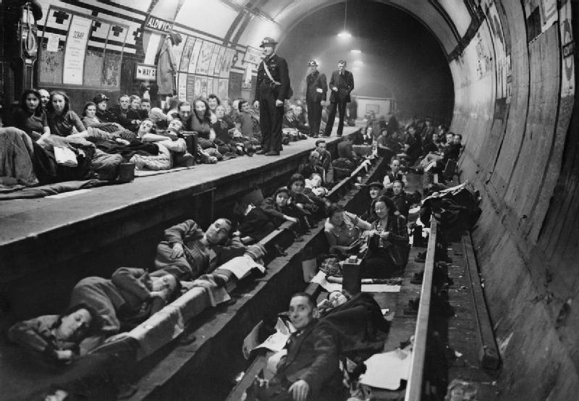
The battle of morale
Fear of mass mental breakdown via air attack following Guernica (legacy of ‘shellshock’)
Psychological strength (morale) seen as key to victory
Need for the state to resource expansion of psychological medicine to whole population

Slide 13
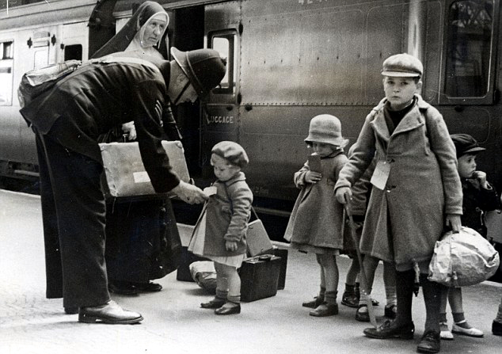
Evacuation, the Blitz, and Separation
Psychological ‘experiment’ of mass evacuation focuses attention on children and separation
Studies of withdrawn children and emotional abuse in children’s homes
Evidence on children from camps
Children show capacity to cope in Blitz

Slide 14
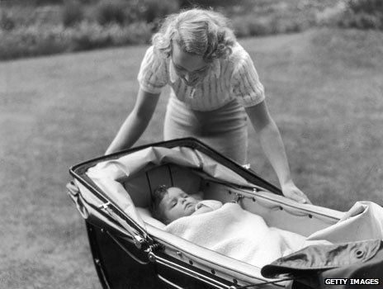
Implementing the psychological reproduction of democratic subjects
Via BBC radio and child-rearing literature reaches into family home (Donald Winnicott and John Bowlby)
Post-war withdrawal of support from nurseries
Progressive pedagogy in schools
Psychological advice on plans for a welfare state

Slide 15
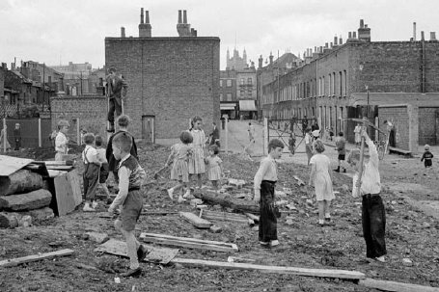
The adventure playground
Model of the wartime bombsite
A space for children (under supervision) to explore, make things from junk, and to develop through freedom and play

Slide 16
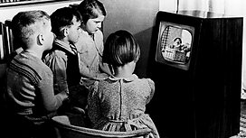
The virtual landscape of children’s television
Psychology informs efforts to design an ideal virtual environment for the child: safe, suited to the way the child sees the world, bringing the outside world into the protected realm of the family home

Slide 17
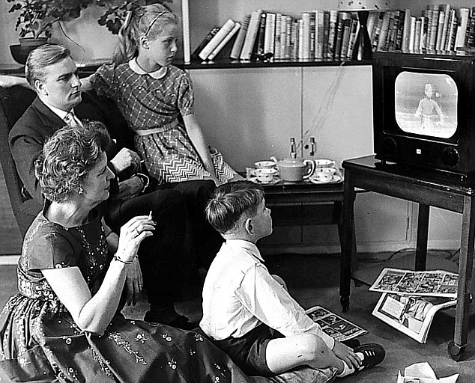
The post-war family
Thinking on mental health fosters ‘golden’ era of family life: increasingly focused on domestic space; home-bound mother; new expectations of fatherhood; smaller families
Historically, this is not the norm but instead rather unique (Pat Thane)
Nuclear family just as central as welfare state to post-war settlement

Slide 18

A new form of governance
Pre-war efforts to control and regulate through the imposition of outside controls (eg via eugenics and mental hygiene) limited via lack of resources and expertise, and by culture that supports individual liberties
The post-war culture of normative mental health works via advice and internalisation of norms: self-government
Nikolas Rose argues this is a more powerful form of biopolitical power

Slide 19
3. The roots of a mental health crisis

Slide 20
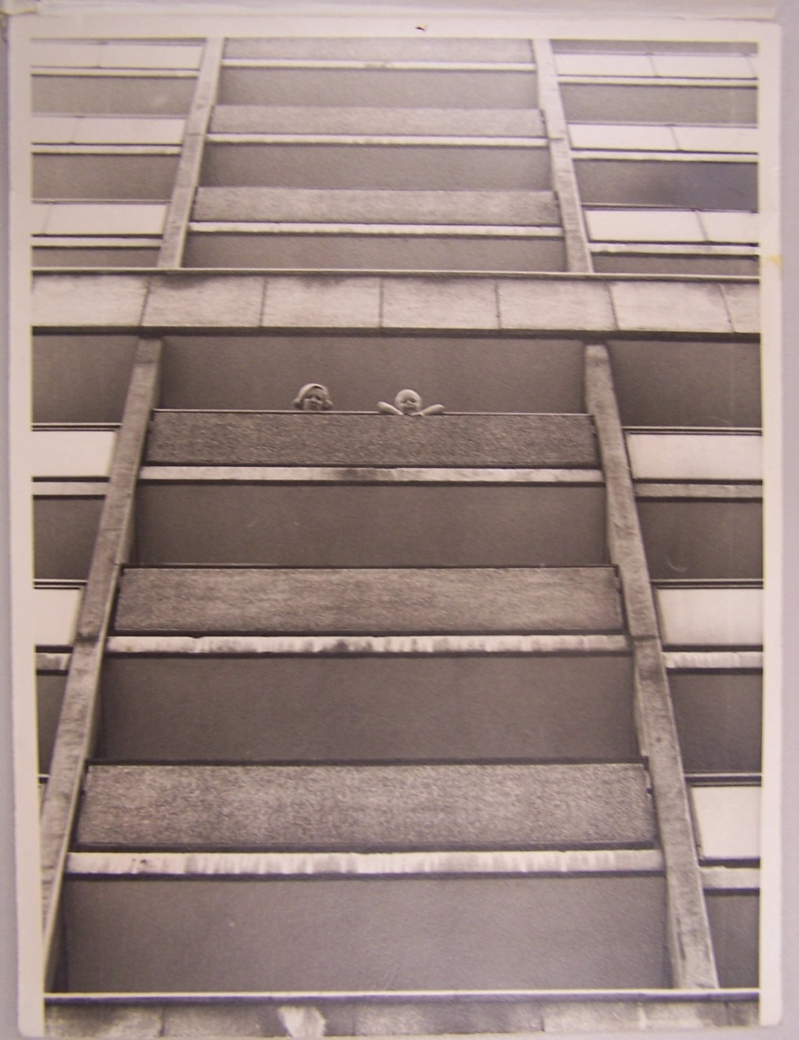
Social change creates new mental stress
Post-war immigration
Breakdown of community with destruction of slums and relocation to high rise buildings
Rising divorce rates and instability of family structure
Close of asylums and move to ‘community care’ places responsibility on families at time of social breakdown

Slide 21
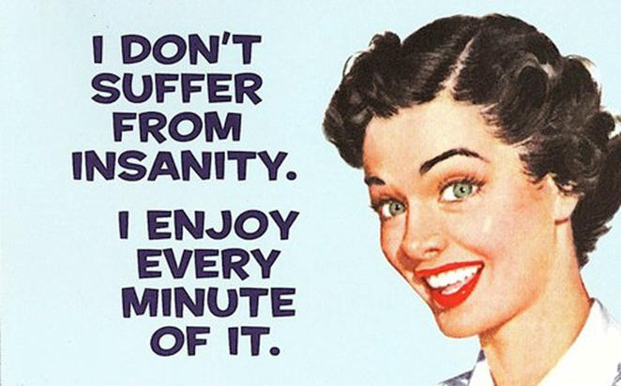
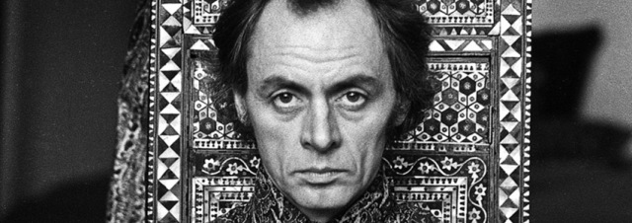
Critiques of medical power
Normative family (& gender roles) challenged by feminism
‘Anti-psychiatry’ eg R.D. Laing questions ‘madness’ and sees family as cause rather than solution
Critiques of medical power: psychoanalysis; Electric Shock; tranquillisers
Challenge from transcultural perspective (high BME rates in mental health system)

Slide 22
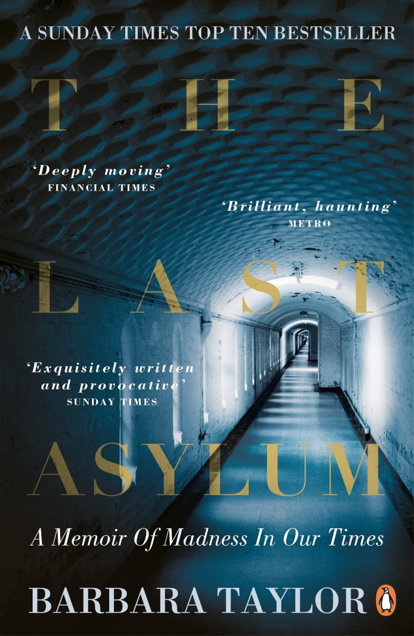
‘Cinderella’ of NHS
Destigmatisation creates demand
NHS fails to up: mental health 25% of ‘burden of disease’ UK but 11% NHS funding; only 28% of those with mental health difficulties receive treatment; 1/3 GP consultations mental health related (NHS England, 2013)

Slide 23
4. Globalisation

Slide 24
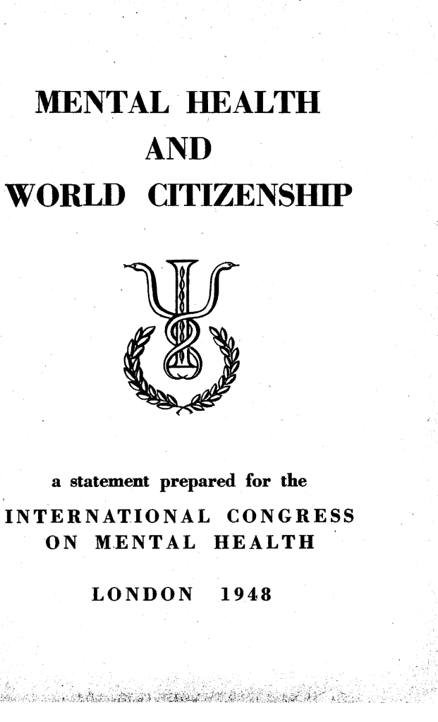
World Mental Health
1948 World Health Organisation defines health as ‘a state of complete physical, mental, and social well-being and not merely the absence of disease or infirmity’

Slide 25
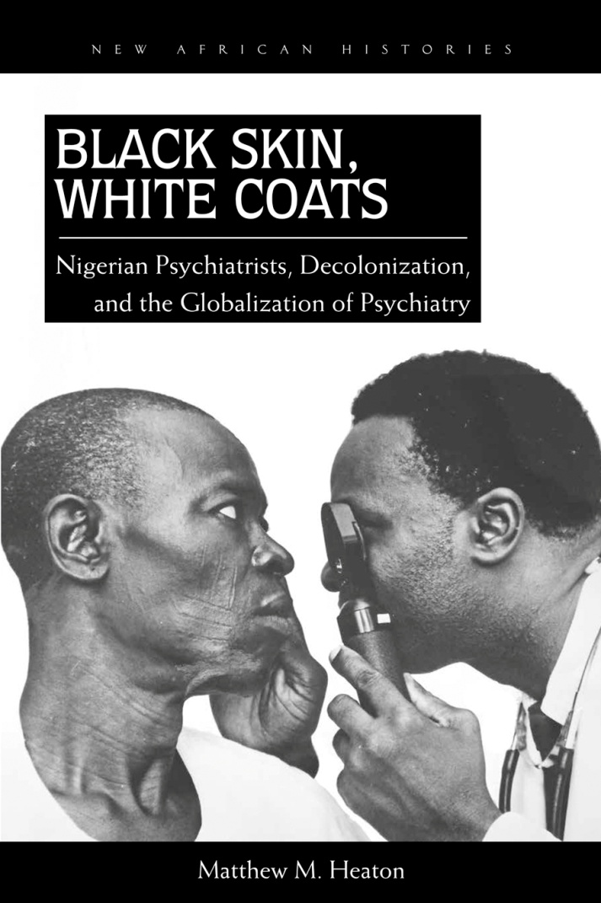
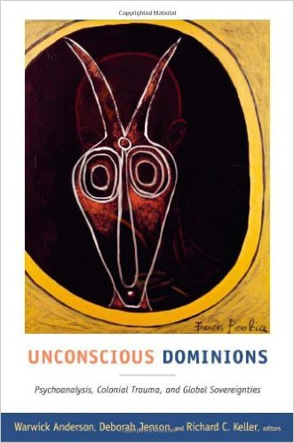
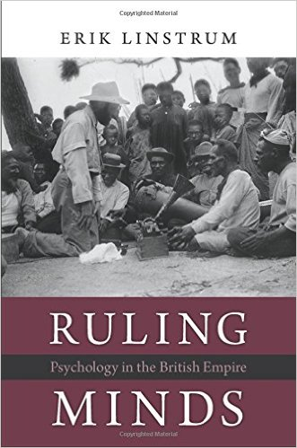
Globalisation of expertise

Slide 26
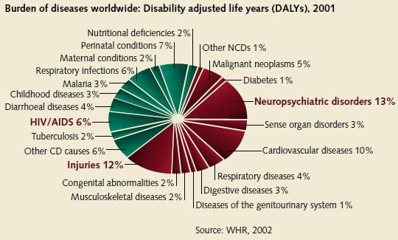
Global ‘burden of disease’

Slide 27
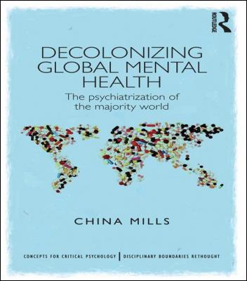
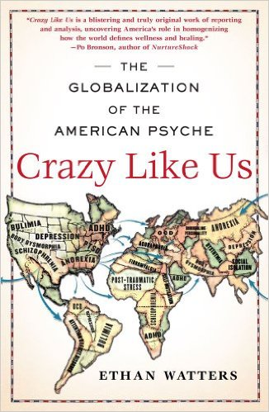
Critiques of Global Mental Health

Slide 28
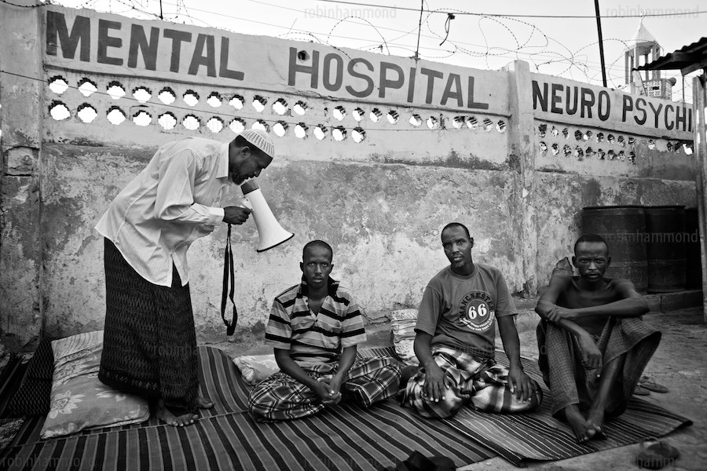
Global mental health inequalities

Slide 29
Concluding thoughts/questions
Is the history of mental health the history of progress to uncover something previously hidden and unaddressed; or is it a failed project, with rising levels of chronic mental illness (anxiety, depression, eating disorders …), and inadequacies in response?
What explains the rise? Is mental illness a ‘disease of civilisation’? Has recognition resulted from decline of stigma and better understanding? Or is it driven by the stress of modern life, inequality, and economics?
Why has the expansion of mental health been viewed critically by some, and to what extent is this justified?

