Slide 1
Pregnancy and Giving Birth in Early Modern Europe
HI176: Mind, Body, Society
Dr Sophie Mann

Slide 2
The Historicized Body
Is bodily experience a fixed biological phenomenon or socially and culturally constructed?
Are the processes of pregnancy and childbirth transhistorical or are the meanings, expectations and sensations of pregnancy historically specific?
I argue that what it meant to be pregnant and give birth in early modern Europe won’t bare a straightforward resemblance to the meanings and experiences of pregnancy and labour today.

Slide 3
Lecture Structure
Understanding the maternal body
Pregnancy and childbirth as social events
Agency or constraint?

Slide 4
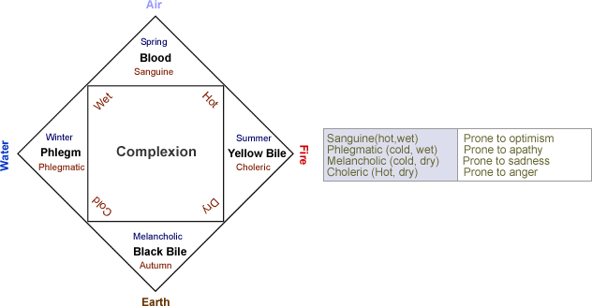
the six-non naturals: air, food and drink, sleeping and waking, motion and rest,
excretions and retentions, and the passions of the soul

Slide 5
The Humoral Body: A Gendered Physiology
Men had a more ‘perfect’ humoral complexion, dominated by blood or yellow bile. Their bodies were conceived as hotter, drier and associated with stability, firmness and strength.
Women had a lesser humoral complexion, dominated by phlegm. Their bodies were conceived as colder, moister and associated with weakness, instability and emotional variability.
Women’s bodies were conceived as more open, porous and unstable. They were more vulnerable to impressions from the outside world.
Bodily sensitivity and the maternal imagination (Ulinka Rublack article).

Slide 6
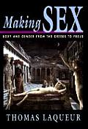
The Generative Organs of Each Sex
Galenic framework: a homology between the generative organs of men and women. A mirror structure where the female body was the reverse of the male, or an inverted version.
Thomas Laqueur, in Making Sex (1990), famously argued that early modern thinkers operated with a “one-sex” rather than a “two-sex” model of the body.
Laqueur’s view qualified by medievalists and early modernists. Inverting one didn’t simplistically make the other. People understood things like: the neck of the womb is structured differently from the penis. The womb did not look like, or function exactly like, the scrotum, nor the ovaries like the testes.

Slide 7
The Generative Powers of Each Sex
The uterus and the testes embodied the main differences between the sexes, differences defined in terms of generative function.
Debates about how conception worked centred on the relative significance of male and female contributions. A major question since antiquity was whether women produced seed.
Aristotle proposed a “one-seed” model: only men produced generative seed, while women supplied the passive material, the menstrual blood, out of which the child was formed. Galen, by contrast, argued for a “two-seed” model, where both sexes contributed generative matter.
By the later seventeenth century generation had become a sustained subject of experimental inquiry. From the 1670s, a consensus was emerging that women contributed eggs rather than semen to generation. But it’s important to note that the existence of human eggs was not visually proven until 1827.
Despite these debates, the assumption that men produced more active and perfect generative material remained intact. Therefore, issues related to fertility/infertility focused much more on the body and behaviour of the mother.

Slide 8
Religion, Morality and the Maternal Body
Early modern concepts of the cosmos, the natural world and the human body, were bound up inseparably with beliefs about God’s governorship.
Childbirth pain, for instance, was commonly interpreted through the lens of Genesis.
Conduct literature and spiritual manuals emphasised that successful pregnancy and healthy babies depended on the social and moral behaviour of the mother-to-be.

Slide 9
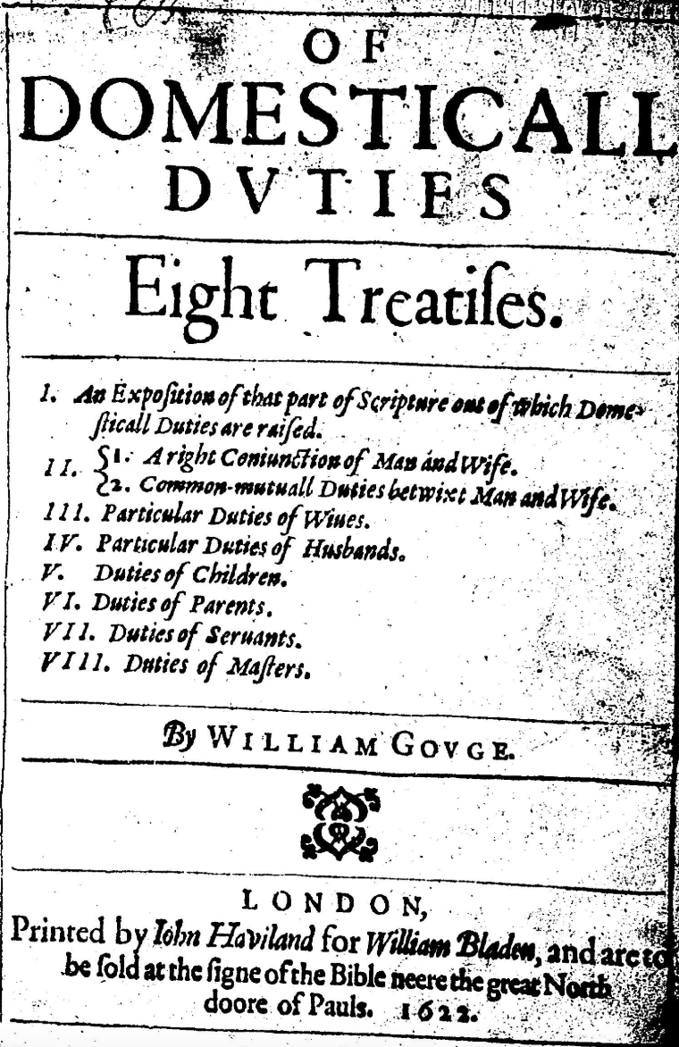
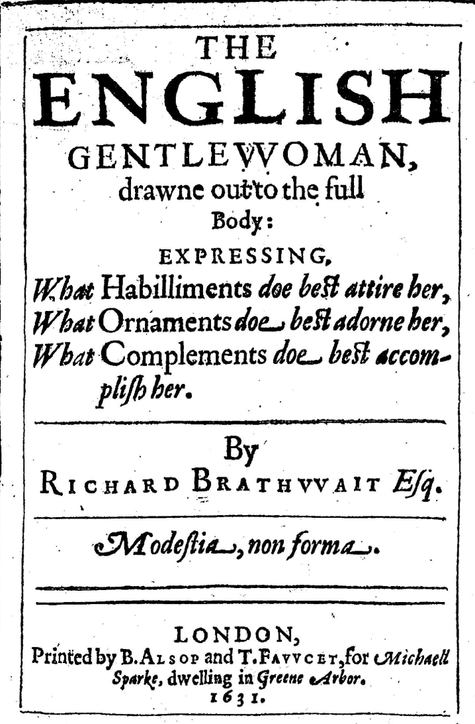

Slide 10
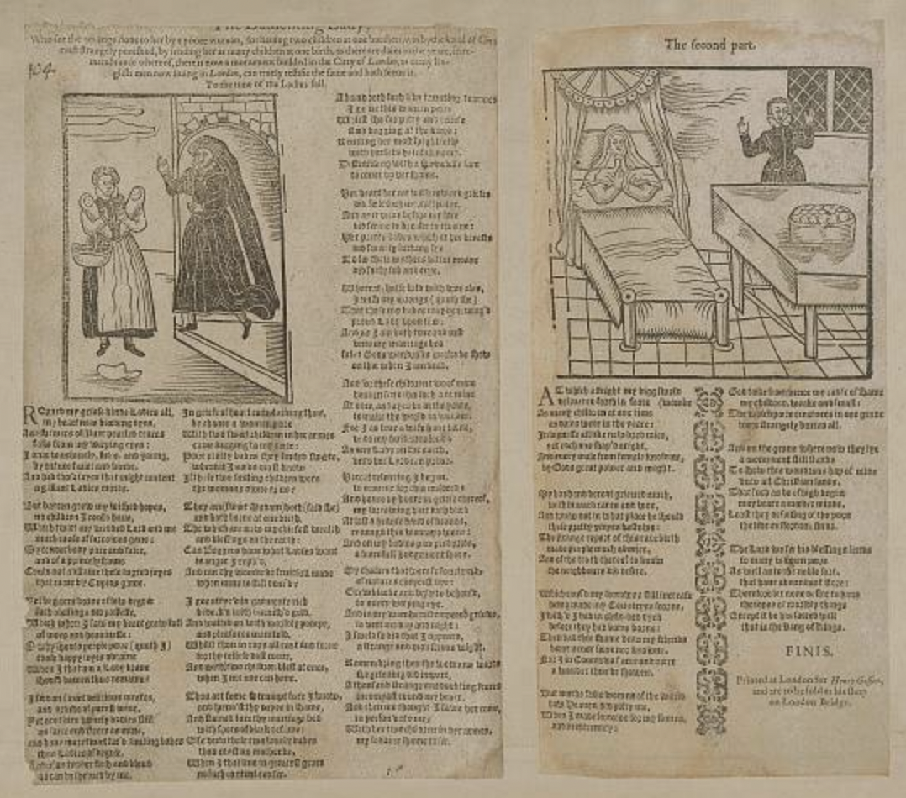
The Lamenting Lady, 1620
The ballad tells the story of a noblewoman whose overindulgence and laziness left her inwardly barren. It contrasts her with the humble poor, whose ‘homely’ bodies bring forth children with ease.
The noblewoman behaves uncharitably to a poor woman with twins.
The words uttered by the wronged mother:
As I am both true and just unto my marriage bed, So let God’s wondrous works be shown on thee when I am dead.
The noblewoman’s sins have material effects… she dies birthing 365 children.

Slide 11
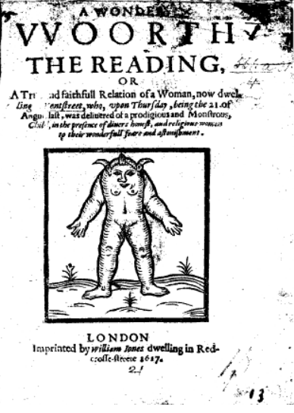
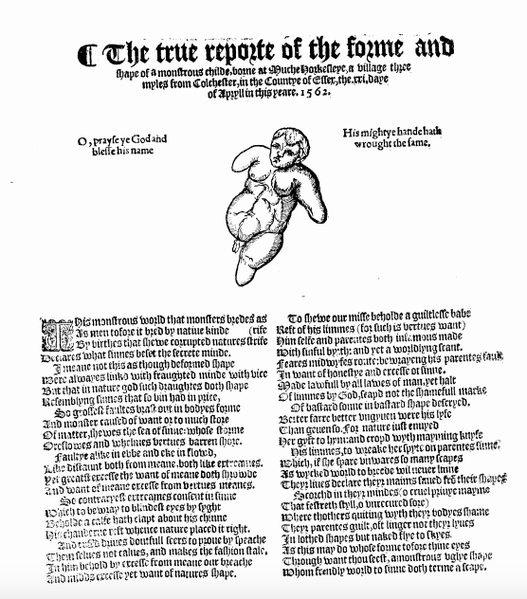

Slide 12
The true reporte of the forme and shape of a monstrous childe, borne at Much Horkesleye, a village three myles from Colchester, in the county of Essex, the xxi daye of April in this yeare, 1562 (1562)
John Barker, A discription of a monstrous Chylde, borne at Chychester in Sussex, the xxiiii day of May. This being the very length, and bygnes of the same(1562)
The Description of a Monstrous Pig the which was farrowed at Hamsted besyde London, the xvi day of October (1562)
William Fulwood, The Shape of ii Monsters (1562)
John Barker, The true description of a monsterous Chylde, borne in the Isle of Wight (1564)
The true discription of two monsterous chyldren Borne at Herne in Kent (1565)
William Elderton, The true fourme and shape of a monsterous chyld, whiche was borne in Stony Stratforde, in Northamptonshire (1566)
John Mellys, The true description of two monsterous children, laufully begotten betwene George Steuens and Margerie his wife, and borne in the parish of Swanburne in Buckynghamshyre (1566)
The true discripcion of a Childe with Ruffes borne in the parish of Micheham in the Countie of Surrey (1566)
The discription of a rare or rather most monstrous fishe taken on the East coste of Holland, the xvii of November (1566)
The forme and shape of a Monstrous Child born at Maydstone in Kent, the xxiiii of October (1568)
Pierre Boaistuau, Englished by Edward Fenton, Certaine Secrete Wonders of Nature, containing a description of sundry strange things (1569)
John Brooke, trans. (attributed to Martin Luther and Philip Melanchthon), Of two Woonderful Popish Monsters (1579)
A right strange example of the handie worke of God, by the birth of three children, born in Paskewet in Monmouth (1585)
A Most certaine report of a monster borne at Oteringham in Holdernesse, the 9 of Aprill last past (1595)
I.R., A Most straunge, and true discourse, of the wonderfull iudgement of God. Of a Monstrous, Deformed Infant … borne at Colwall, in the County and Diocesse of Hereford (1600)
A True Relation of the birth of three Monsters in the City of Namen in Flanders(1608)
Strange Newes out of Kent, of a Monstrous and mishapen Child, borne in Olde Sandwich, upon the 10 of Iulie last (1609)
William Leigh, Strange News of a prodigious Monster, borne in the Towneship of Adlington in the Parish of Standish in the Countie of Lancaster, the 17 day of Aprill last (1613)
Gods Handy-worke in Wonders. Miraculously shewen upon two Women, lately deliuered of two Monsters … within a quarter of a mile of Feuersham in Kent, the 25 of Iuly last, being S. Iames his day (1615)
A Wonder Woorth the Reading, or, A True and faithfull Relation of a Woman, now dwelling in Kent Street, who, upon Thursday, being the 21 of August last, was deliuered of a prodigious and Monstrous Child (1617)
Thomas Bedford, A Trve and Certaine Relation of a Strange Birth, which was borne at Stone-house in the Parish of Plimmouth, the 20 of October (1635)
John Vicars, Prodigies and Apparitions. Or Englands warning Pieces (1643)
Edward Fleetwood, A Declaration, Of a Strange and Wonderfull Monster: Born at Kirkham Parish in Lancashire (1645).

Slide 13
Pregnancy and Childbirth as Social Events
A woman’s pregnancy was a matter of great interest to the wider community.
The birthing room as a semi-public space (midwives and ‘gossips’).
Lying in period and ‘churching’ – rituals of purification, thanksgiving and reintegration into the community.

Slide 14
Women’s Knowledge and Authority
The experience of marital relations and childbirth gave some women a unique knowledge and authority.
Wives and widows claimed to be able to tell virgins from whores by sight, to recognise the signs of pregnancy, to estimate the maturity of the foetus, the paternity of a newborn child, and to distinguish between stillbirth and infanticide.

Slide 15
Women’s Knowledge and the Judicial System
Courts relied on ‘expert matrons’ to adjudicate in cases of infanticide, disputed paternity and disputed virginity.
Midwives and matrons could also be summoned to examine the pregnancy of a recent widow, if her pregnancy threatened the inheritance of the presumptive heir.
The jury of matrons and ‘pleading the belly’.

Slide 16
Theft; theft from a specified place. 11th October 1676.
A Woman that had several times troubled the Court at former Sessions, was now brought in again; the Crime she was charged with being thus: She had for some time lodged at a house in St. Sepulchres Parish , and on the 22th February last taking an opportunity, whilst her Landlord and his Wife were gone forth to a Funeral, cut away the posts of the door where they used to lie, and with a piece of Iron put back the Spring-lock, and stole away a silver Cup to the value of 5l. a Tankard worth 9l. and several other Goods, wearing Apparel, &c. There came in Evidence against her, that they saw a light in the Chamber where the Robbery was committed at the same time, and Knock'd at the door, but no body would answer; and that immediately after she was seen to come out of the house with a bundle or a heap in her Apron, &c. After Conviction she pleaded her Belly, but a Jury of Matrons gave in their Verdict that she was not with Childe .
Punishment summary. 7th December 1687.
Margaret Smith , pleaded her Belly, upon which a Jury of Women were sworn and gave their Verdict that she was with Child.
From the Proceedings of the Old Bailey: https://www.oldbaileyonline.org/

Slide 17
Agency or Constraint?
Did women enjoy a privileged position during pregnancy, or was the maternal body subject to greater surveillance and control?
Was the birthing chamber a space of female solidarity and empowerment? Or were these gatherings beset by conflict and tension?
What about the experiences of single women and poor women?

