Slide 1
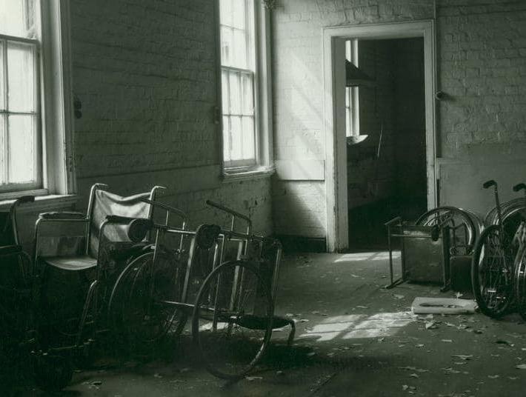
Medicine, Body and Society
Psychology and Empire
Dr James Poskett

Slide 2
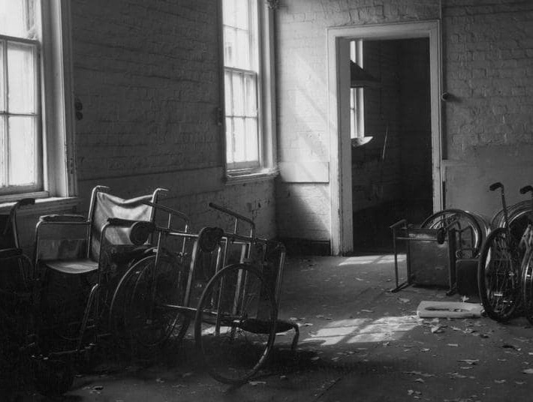
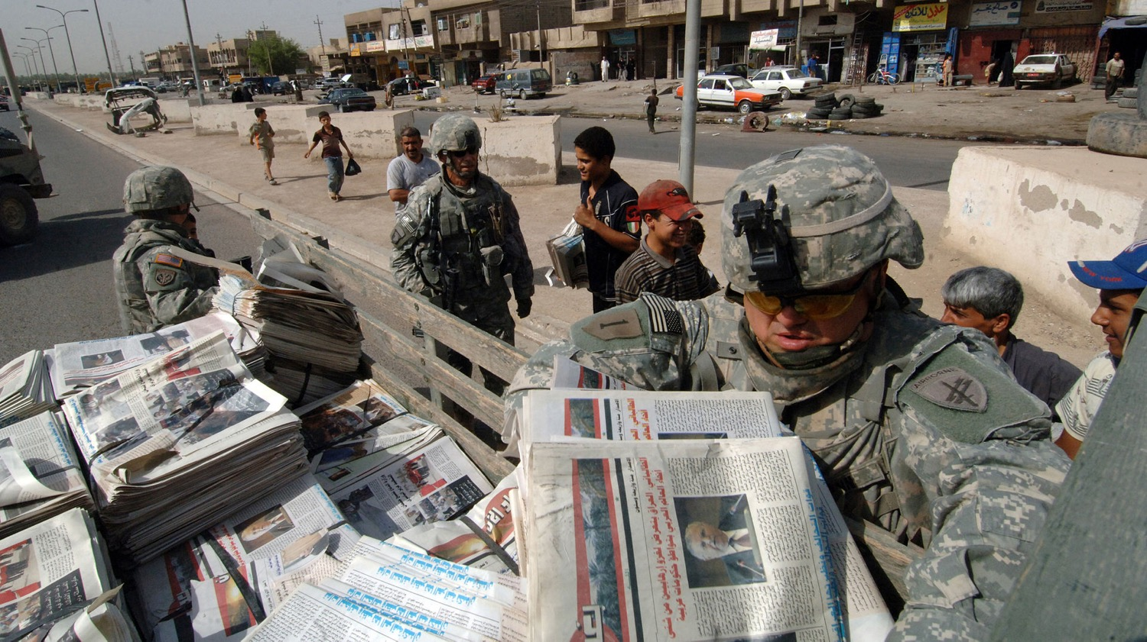
U.S. Army PSYOP soldiers with Detachment 1080, 318th Psychological Operations Company distribute newspaper Baghdad Now in the East Rashid region of Baghdad, Iraq, July 11, 2007. Wikimedia.

Slide 3
Argument
History of psychology best explained through the history of empire.
Psychological sciences are often also racial sciences.
Historians of psychology need to recover role and agency of colonised people.

Slide 4
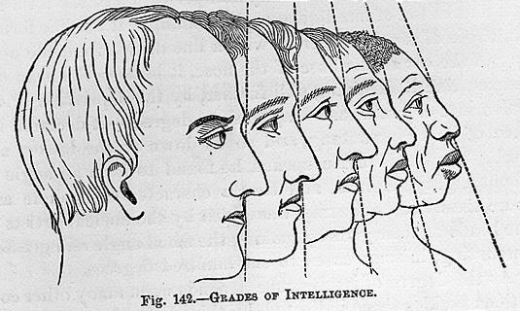
Phrenology

Slide 5
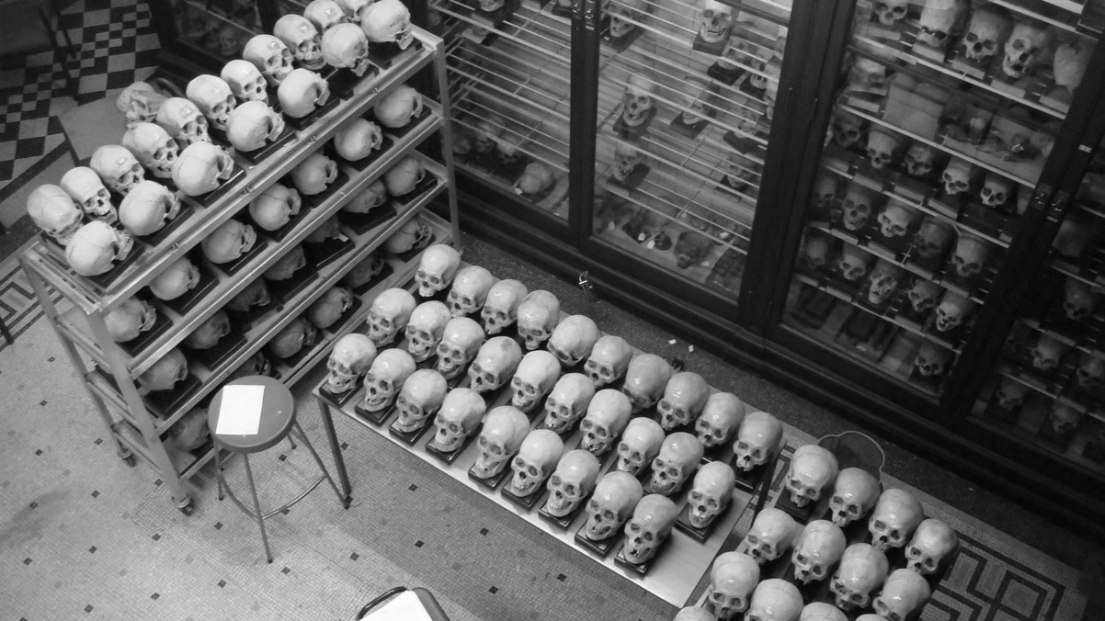
Phrenology
Phrenological collection of skulls at the University of Edinburgh

Slide 6
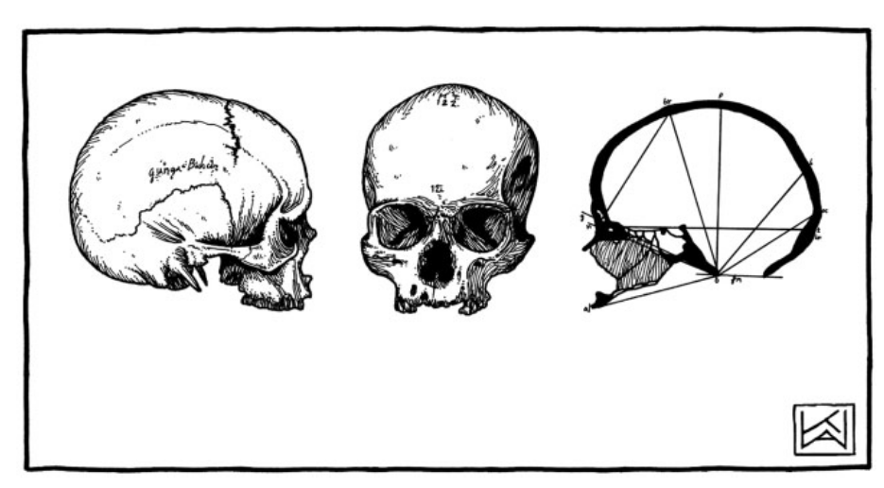
Phrenology
Skull of Gunga Bishun ‘Thug’ (Edinburgh Phrenological Society, HT 122/J34), image taken from Kim Wagner, “Confessions of a Skull,” History Workshop Journal (2010)

Slide 7

Psychiatry
Marthi Mental Hospital, Nairobi, Photograph: Daily Nation

Slide 8
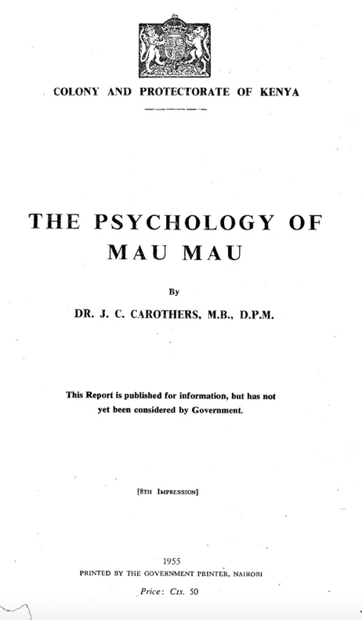
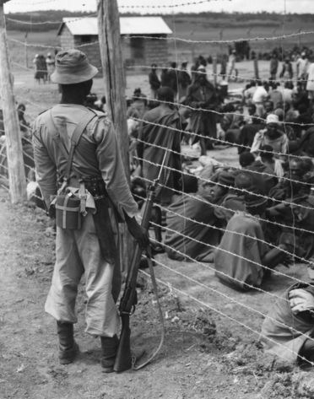
Psychiatry
Carothers, The Psychology of Mau Mau (1955)
Mau Mau internment camp, Kenya, c.1950s

Slide 9
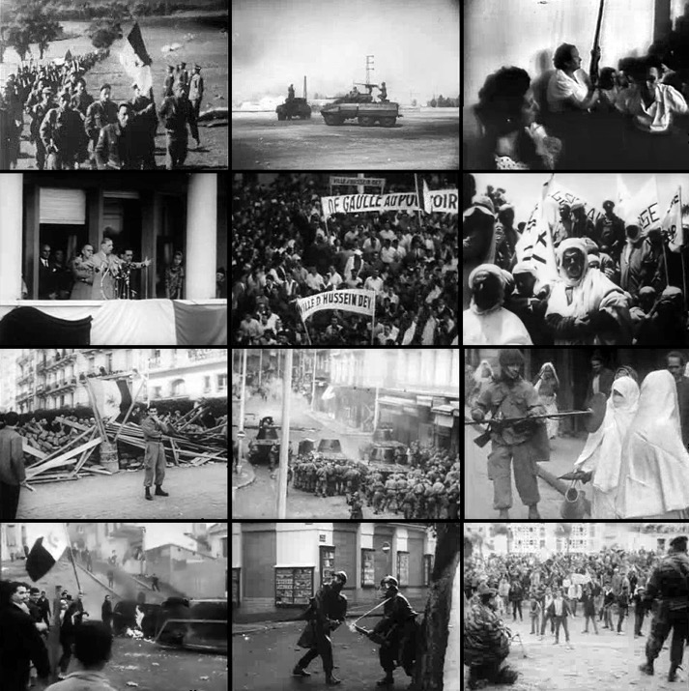
Psychiatry
Algerian War of Independence (1954-62)

Slide 10
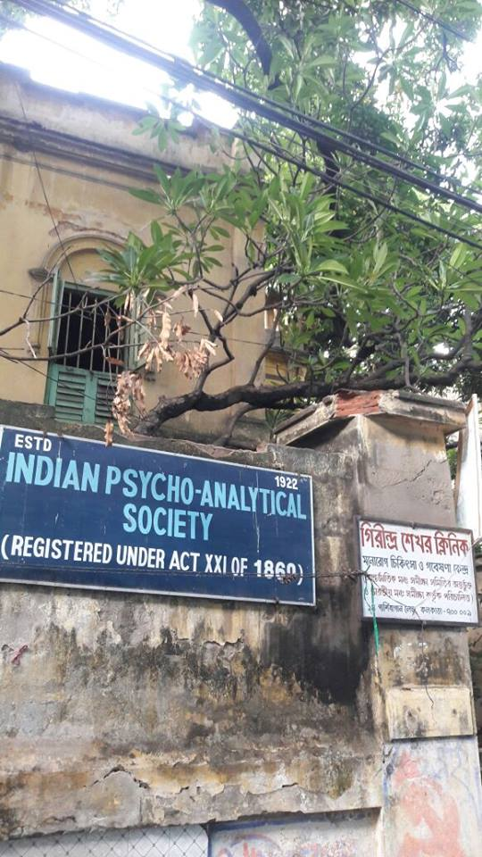
Psychoanalysis
Indian Psychoanalytic Society, Kolkata

Slide 11
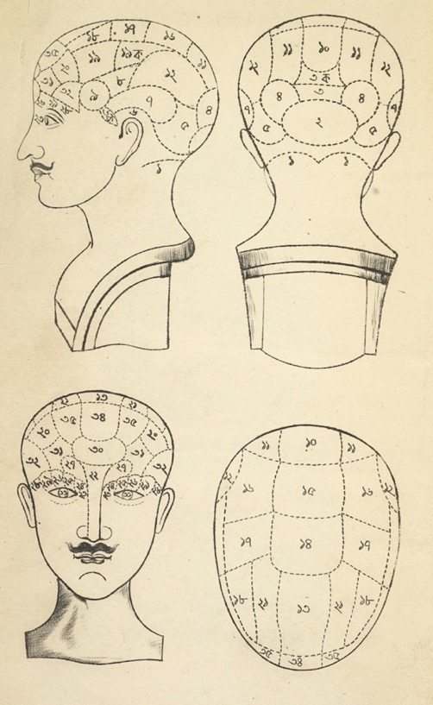
Psychology, Anticolonialism, and Antiracism
Bengali phrenological chart, from R. Das, Manatatva Sarsangraha (Calcutta, 1849)

Slide 12
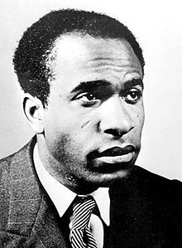
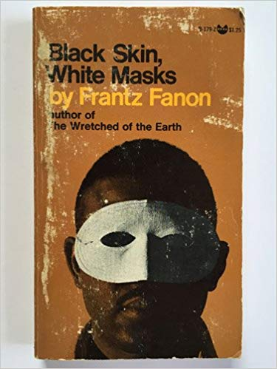
Psychology, Anticolonialism, and Antiracism
Frantz Fanon (1925-61)
Black Skin, White Masks (1952)

Slide 13
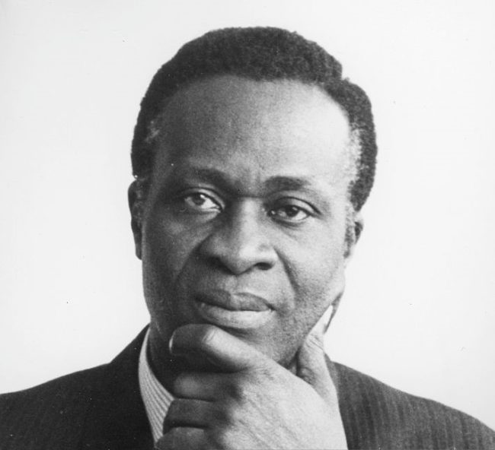
Psychology, Anticolonialism, and Antiracism
Thomas Adeoye Lambo (1923-2004)

Slide 14
Conclusions

