Slide 1
The Medical Renaissance c. 1500-1700
17 October 2017
Michael Bycroft

Slide 2
The old medicine – 500bc-200ad, Athens and Rome
The ‘new’ medicine – 1500-1600, Europe
Limits of the ‘new’ medicine – 1600-1700, Europe

Slide 3
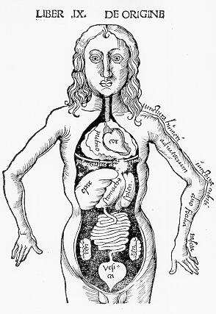
Body diagram showing three venters, separated by neck and diaphragm
G. Reisch, Margarita Philosophica (1512)
The three-venter theory of the body
UPPER VENTER
MIDDLE VENTER
LOWER VENTER

Slide 4
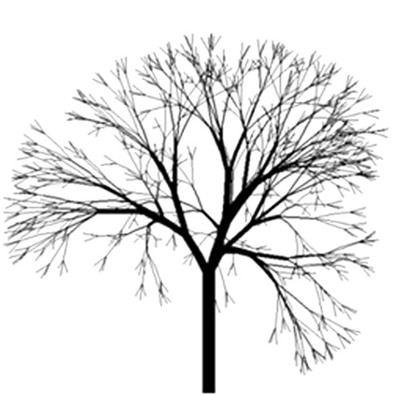
UPPER VENTER
Sense and movement
Animal spirits
Nerves
BRAIN
MOUTH
NERVES
RETE MIRABILE = ‘amazing net’
NECK ARTERIES
TRACHEA = ‘rough artery’, ‘windpipe’
P. VEIN
P. ARTERY
ARTERIES
MIDDLE VENTER
Respiration
Vital spirits
Arteries
R
C
L
VENA CAVA
AORTA
LIVER
LOWER VENTER
Nutrition and growth
Natural spirits (in blood)
Veins
STOMACH
INTESTINES
KIDNEYS
VEINS

Slide 5

BRAIN
MOUTH
NERVES
ANIMAL SPIRITS
P. VEIN
P. ARTERY
ARTERIES
VITAL SPIRITS
R
C
L
VENA CAVA
AORTA
NATURAL SPIRITS
LIVER
STOMACH
INTESTINES
KIDNEYS
VEINS

Slide 6
Sources of the three-venter system
the philosophy of Plato – reason, passion, and the appetites, esp. the dialogue Timaeus (4cbc, Athens)
animal dissection and vivisection by Aristotle – heart and blood key to human life, blood only runs out from heart (4cbc, Athens)
human dissection and vivisection [!] by Herophilus and Erasistatus (3cbc, Alexandria) – veins/arteries
animal dissection by Galen – arteries, not just veins, contain blood; pores in septum (2cad, Rome)

Slide 7
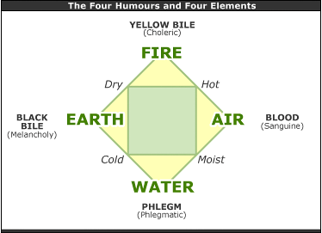

Slide 8
How to think like a humouralist
melons are cold and wet, ham is warm and dry → eat them together for a balanced meal
spring is hot and wet → risk of blood excess → avoid eating red meat during spring…
…or if you are young, or have a “sanguine temperament”
mild fevers occur often in spring → must be due to warmth and wetness of the season → treat with blood-letting

Slide 10
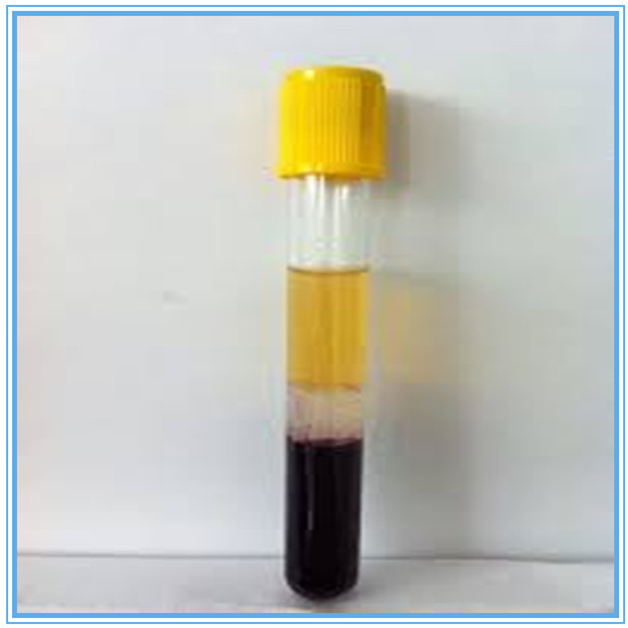
‘Yellow bile’
‘Phlegm’
‘Black bile’

Slide 11
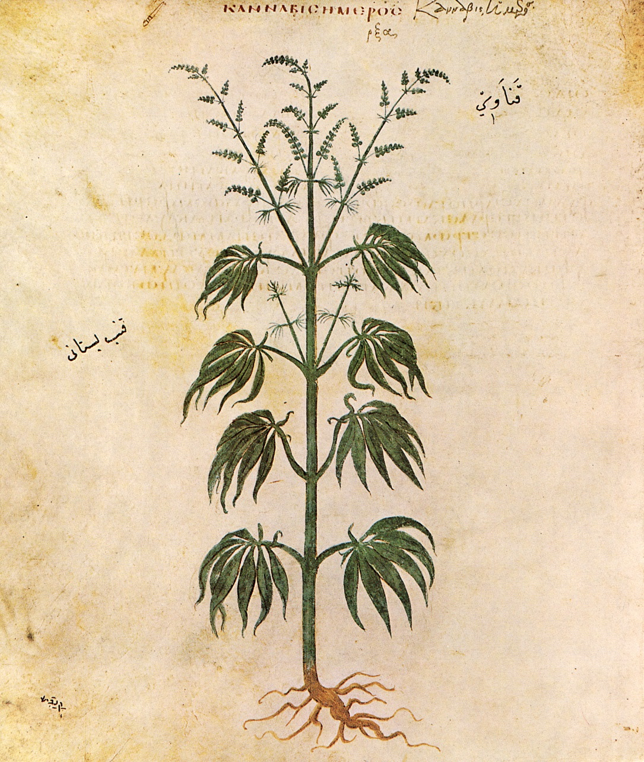
Dioscorides’ De materia medica, 1cad
army physician (?) in present-day Turkey (?)
‘by far the largest pharmaceutical guide in antiquity’ (DSB)
600 plants + a few animal and mineral substances
‘exercised the greatest precision in getting to know most of my subject through direct observation [autopsia]’ (preface)
about 1 mineral for every 10 plants

Slide 12
2. The ‘new’ medicine – Vesalius, Harvey, Paracelsus

Slide 13
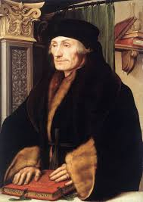
there is nothing here which is not redolent of Galen, whose doctrine I deliberately follow: there is nothing asserted which I have not seen him write
-- Johann Guenther, Four Books of Anatomical Institutions, 1536
Desiderius Erasmus (1466-1536)
Published Latin translations of 3 of Galen’s works

Slide 14
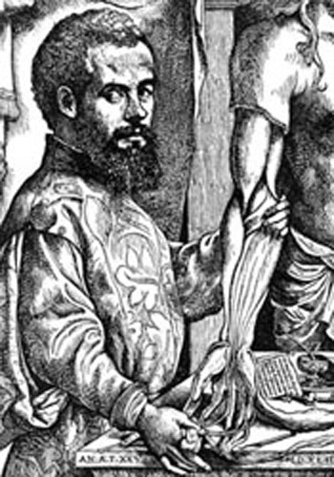
Andreas Vesalius, b. Brussels 1514, d. Greece 1564 -> studied in Paris, taught in Padua then Bologna
‘[ancient Arab and Greek wisdom was recommended by] the excellent Parisian physicians [such as Guenther] to their students, in the hope that soon the ancient art of medicine starting from Hippocrates will be, to the great advantage of mortals, recalled to the memory and will come to flourish…’
-- Vesalius

Slide 15
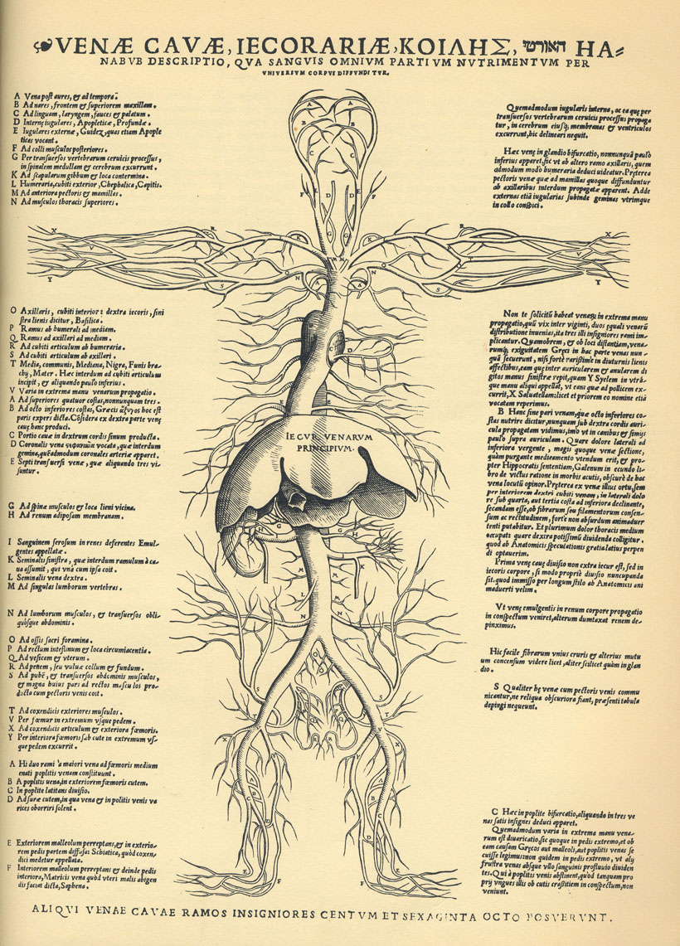
Table two of Tabulae Sex.
‘Description of the Vena Cava, by which the blood, the nutriment of all the parts, is spread through the whole body’
Venice 1538

Slide 16
Medieval order of dissection:
Lower venter, middle venter, upper venter (belly, chest, head)
Vesalius’ order in his demonstrations to students and Bologna, 1540:
Bones
Muscles
Arteries
Veins
Nerves
Organs of lower venter
Organs of middle venter
Organs of higher venter
Cf. Galen’s order in his On anatomical procedures –
edited by Vesalius 1539-40 for new edition of Galen’s Complete Works

Slide 17
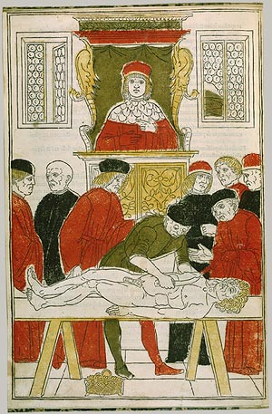
The [professor] is perched on a high pulpit like a crow and with an air of great disdain, he repeats to the point of monotony accounts concerning facts that he has not observed…Thus the students are confusedly taught less than what a butcher, from his meat-block, could teach the doctor
-- Andreas Vesalius, preface to On the Fabric of the Human Body (1543)
Anatomical demonstration, from Johannes de Ketham, Fasciculo di Medicina (1493)

Slide 18
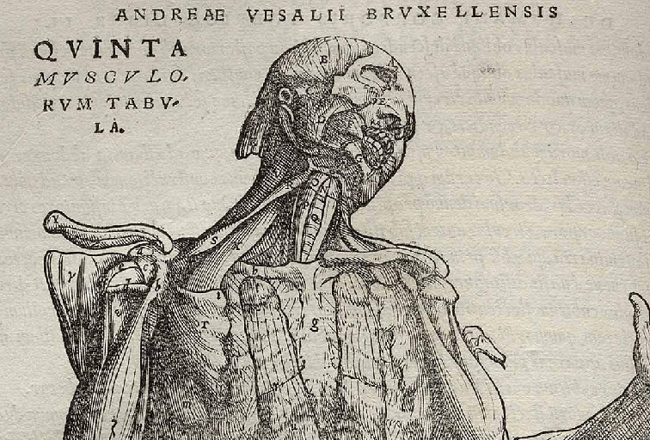
Muscle X is in dogs but not humans
‘Fifth table of muscles’, Vesalius, On the Fabric of the Human Body (1543)

Slide 19
BRAIN
NERVES
RETE MIRABILE = ‘amazing net’
NECK ARTERIES
TRACHEA = ‘rough artery’, ‘windpipe’
P. VEIN
P. ARTERY
ARTERIES
PORES IN SEPTUM
R
C
L
LIVER
STOMACH
INTESTINES
KIDNEYS
VEINS

Slide 20
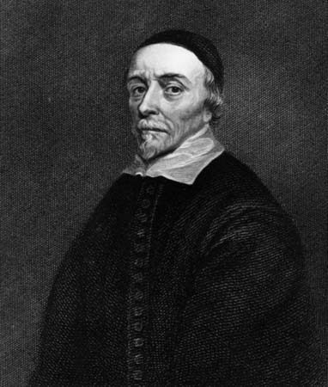
BRAIN
NERVES
RETE MIRABILE = ‘amazing net’
NECK ARTERIES
TRACHEA = ‘rough artery’, ‘windpipe’
P. VEIN
P. ARTERY
ARTERIES
R
L
LIVER
STOMACH
INTESTINES
KIDNEYS
VEINS
William Harvey, 1578-1657

Slide 21
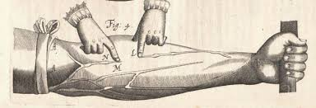
Ligature diagram, from William Harvey, Anatomical exercises on the motion of the heart and blood in animals (1628)

Slide 22
Aristotle on the soul
‘that which has soul (anima) is distinguished from that which has not by living’
study of soul = study of all aspects of soul in all living beings
  vegetative soul = growth and reproduction
  motile soul = movement
  sensible soul = five senses
  rational soul
key question: what is the telos of the parts of living beings?
method: observation, dissection, vivisection of as many animals as possible

Slide 23
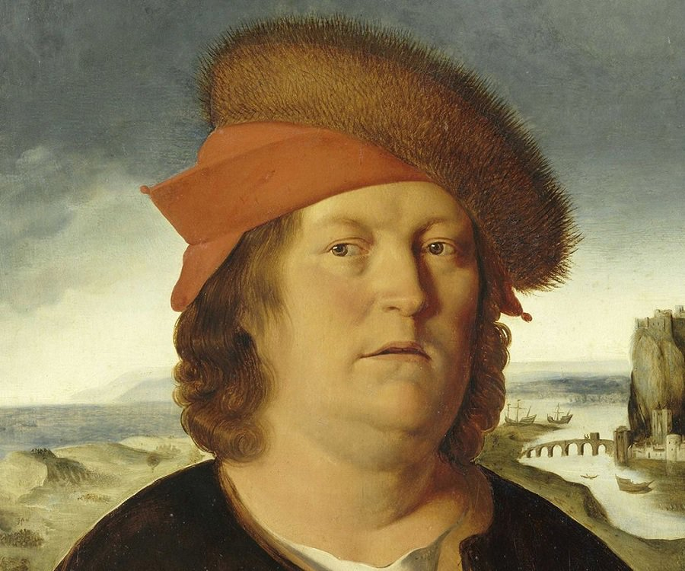
‘I have not been ashamed to learn from tramps, butchers, and barbers’
Theophrastus Bombastus von Hohenheim,
aka Paracelsus 1493-1541

Slide 24
Chemical medicine
the body is like a mine
diseases are substances not imbalances
metals are the fundamental substances
minerals are more effective than plants
art perfects nature
→ artificial remedies are more effective than natural ones

Slide 25
3. The limits of the new medicine

Slide 26
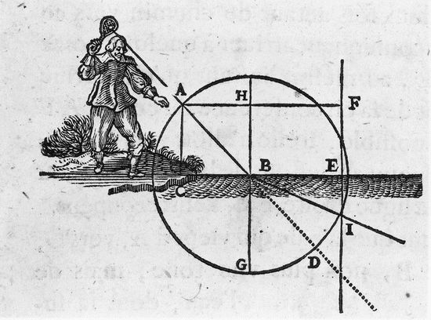
Descartes’ ‘tennis ball’ theory of light
Dioptrics (1637)

Slide 27
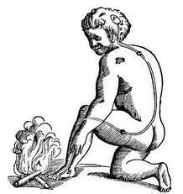
A mechanical explanation of pain
Descartes, L’homme (1662)

Slide 28
Embattled, delayed and partial acceptance
1567 – first French translation of a work by Paracelsus
1589-1610 – Henry IV engages Paracelsians as court physicians, makes spa-going respectable among French elite
1628 – first chemical professor at the Jardin du Roi in Paris
1603 – Paris Faculty of Medicine issues decree ordering physicians to ‘remain faithful to the doctrine of Hippocrates and Galen’
1666 – Faculty physicians officially accept antimony as a purgative
1670 – blood circulation accepted in student theses of Paris physicians
c. 1670-1720 – eclecticism in student theses

Slide 29
Limited effect on medical practice
mineral spas – Spa (Germany), Vichy (France), Tunbridge Wells, Epsom…
bottled waters – delivered to Paris from provinces from at least 1671
salts extracted from mineral waters – patent for Epsom salts granted to Nehemiah Grew in 1690s
bottled water ‘is like a corpse that no longer moves’ – L. D. Linand, in 1697 treatise on the chemical analysis of mineral waters
blood-letting continues in spite of Harvey’s discovery
books on materia medica still dominated by plants

Slide 30
‘The sixteenth and seventeenth centuries brought no revolution in medical services or treatments’
- Roy Porter, The Greatest Benefit to Mankind

Slide 31
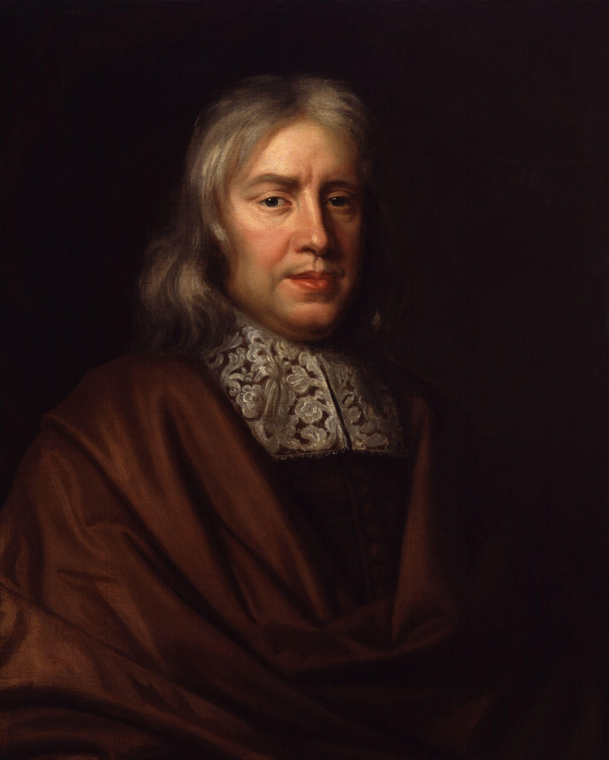
‘You must go to the bedside, it is there alone you can learn disease’
‘the self-same phenomena that you would observe in the sickness of a Socrates you would observe in the sickness of a simpleton’
But ‘the new Hippocrates’ attributed summer fevers to action of heat of sun on ‘humours’ in blood!
Thomas Sydenham, 1624-1689

