Slide 1
State Medicine and the National Health Service
Professor Mathew Thomson
Mind, Body and Society 2021-2

Slide 2
Questions
Q1: What factors encouraged a rise of state medicine in the 20th century?
Q2: Why has state medicine encountered difficulties since the 1970s?
Q3: What accounts for the longevity and popular appeal of Britain’s National Health Service?

Slide 3
Key idea & Reading
John Pickstone, ‘Production, Community and Consumption: The Political Economy of Twentieth-Century Medicine’ in Roger Cooter and John Pickstone (eds), Medicine in the Twentieth Century (2000), pp. 1-20.

Slide 4



Q1: What factors encouraged a rise of state medicine in the 20th century?

Slide 5
i) Was the state really absent from pre 20th century medicine?

Slide 6
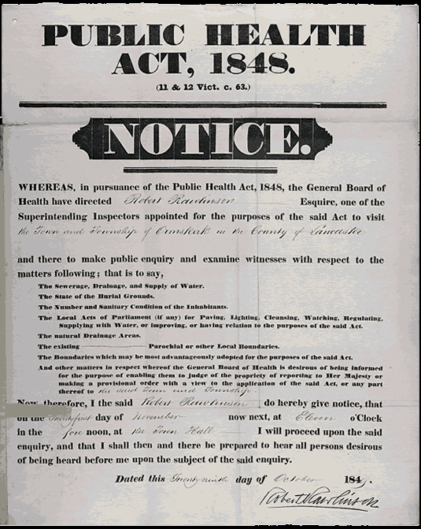
Contagion, sanitary reform, local government and vital statistics

Slide 7
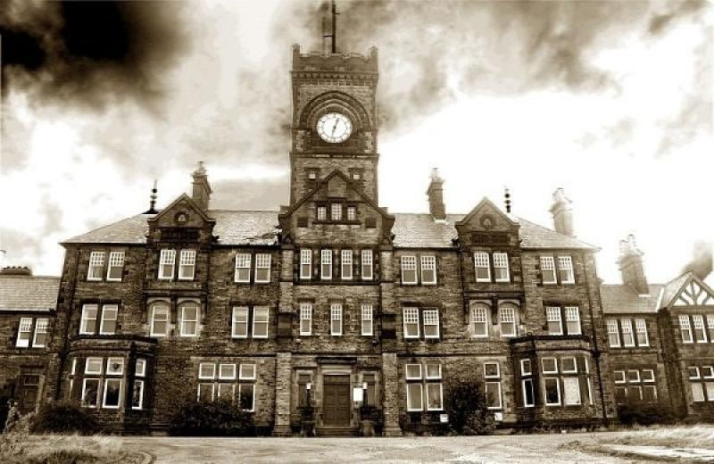
A national mental health service?

Slide 8
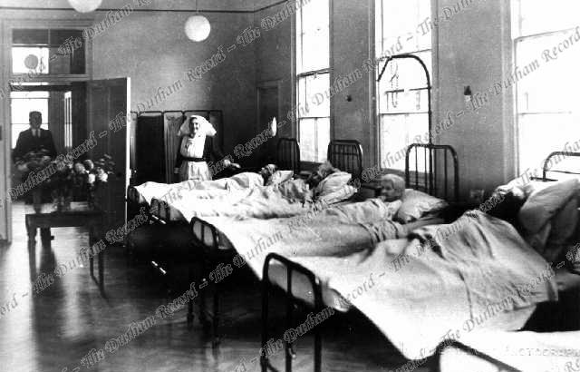
Poor law hospitals

Slide 9
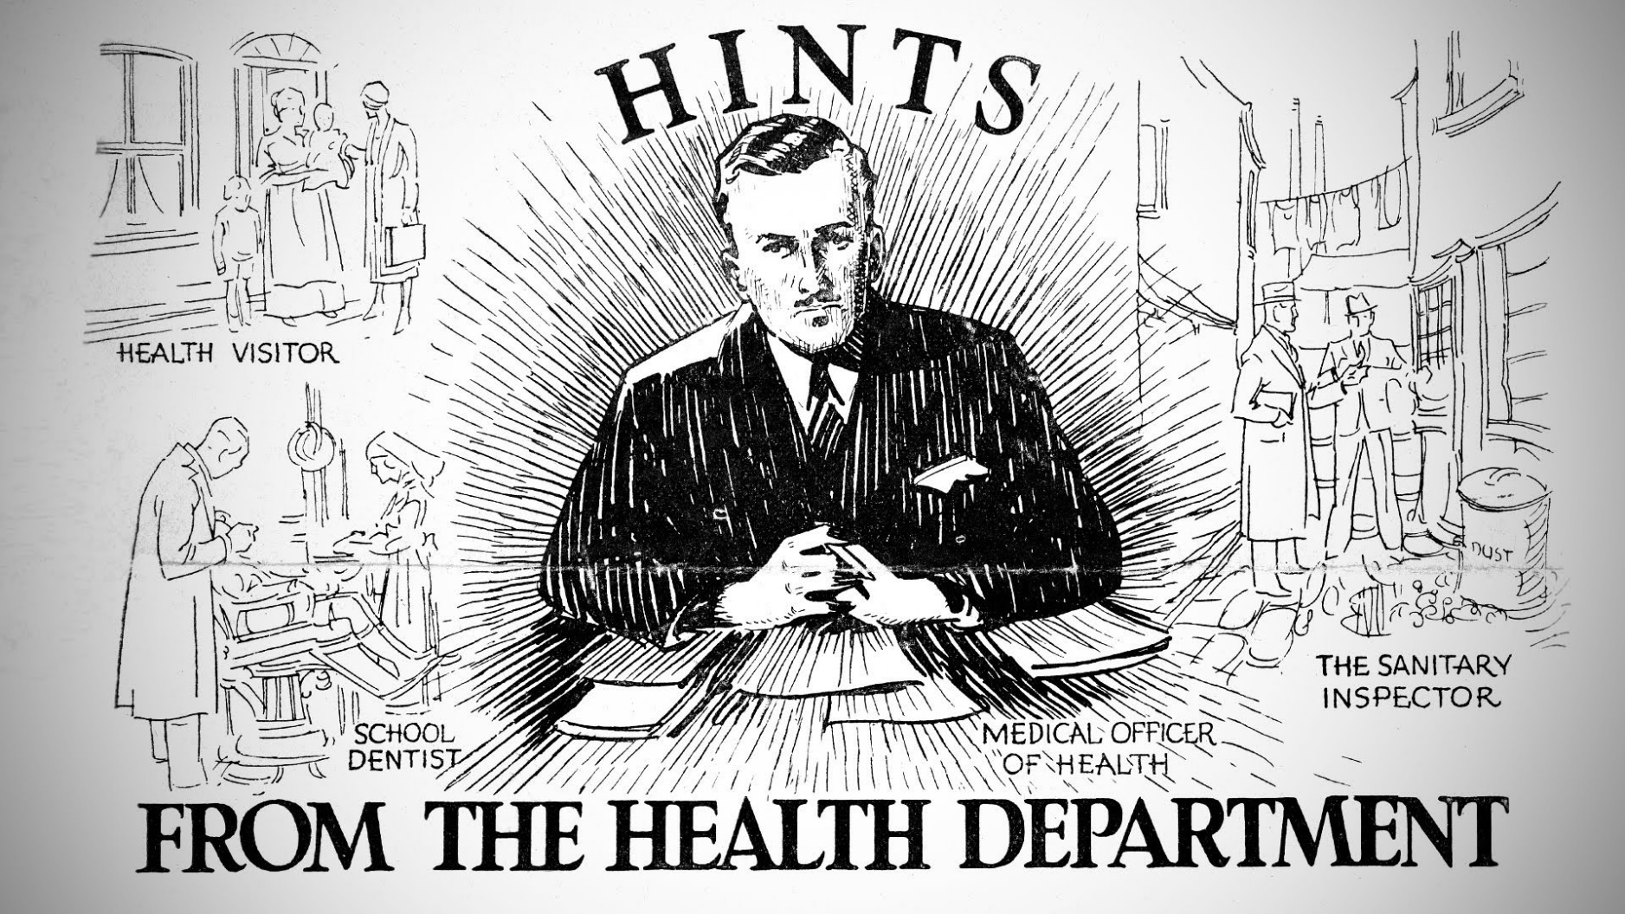
The local Medical Officer of Health

Slide 10
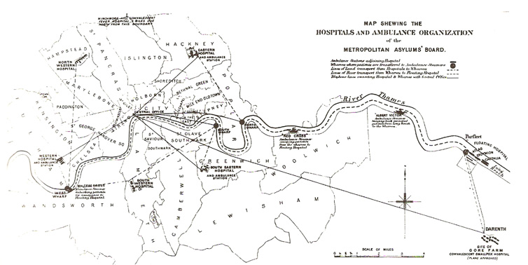
Making the LCC into the largest hospital authority in the world

Slide 11
ii) Keeping the state at arms length

Slide 12
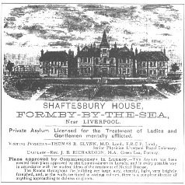
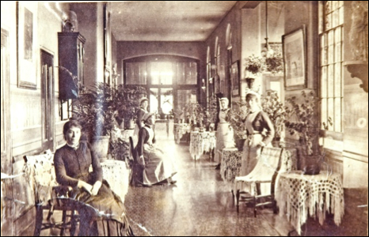
Private asylums and convalescent homes

Slide 13
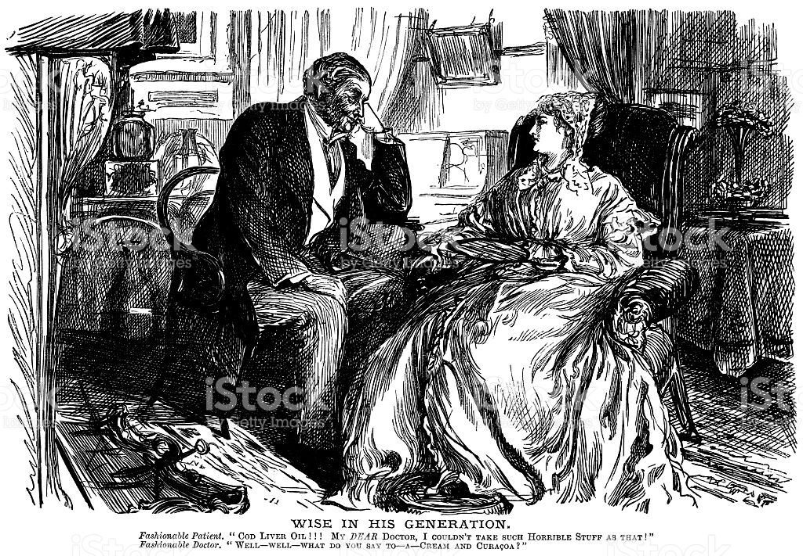
The doctor-patient relationship

Slide 14
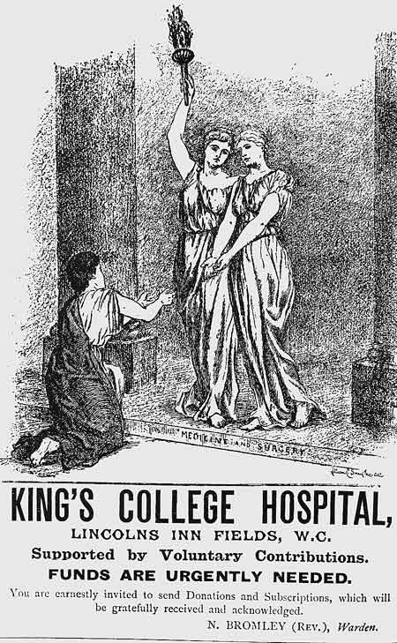
Charity, class and the alternative to the state

Slide 15
iii) Why does the state step in and the alternatives fade?

Slide 16
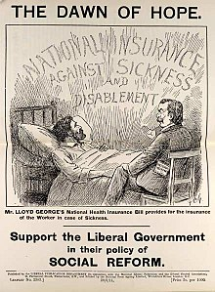
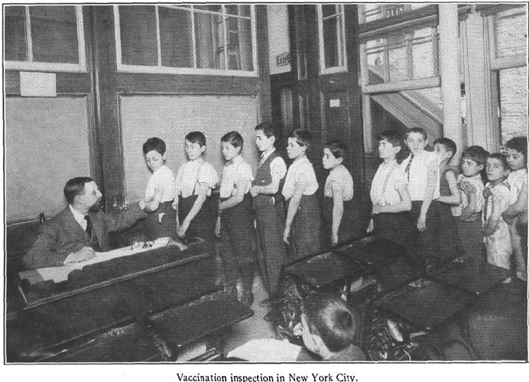
National efficiency (productionism)

Slide 17
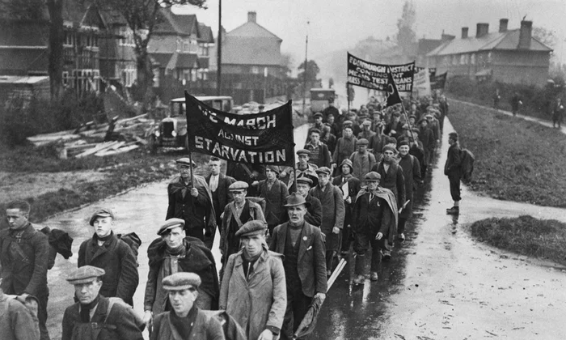

Communitarianism?

Slide 18
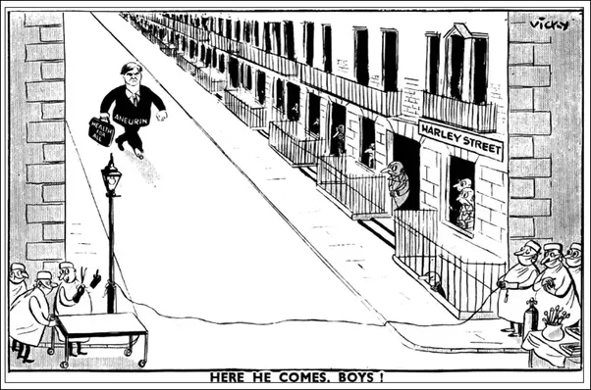

Self-interest?

Slide 19
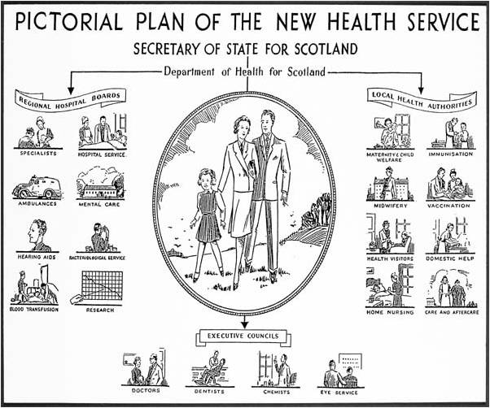
The first compromise: the illness service

Slide 20
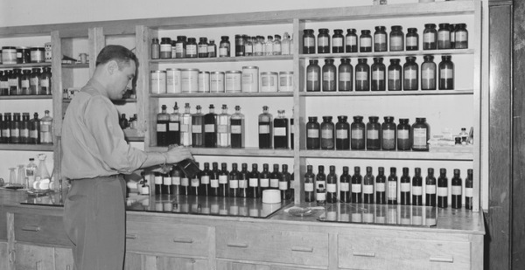
The second compromise: a mixed economy of healthcare?

Slide 21

Q2: Why has state medicine encountered difficulties since the 1970s?

Slide 22
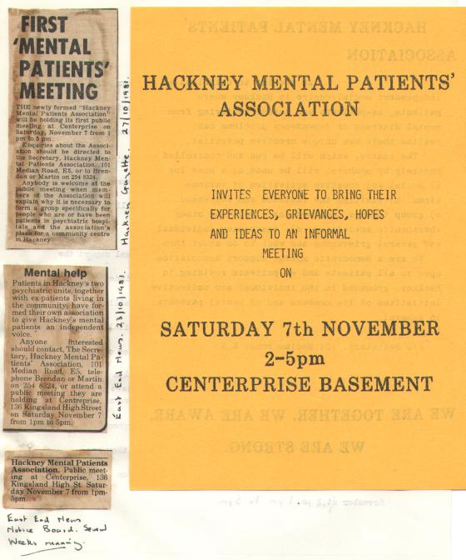
Consumerism and Rights

Slide 23
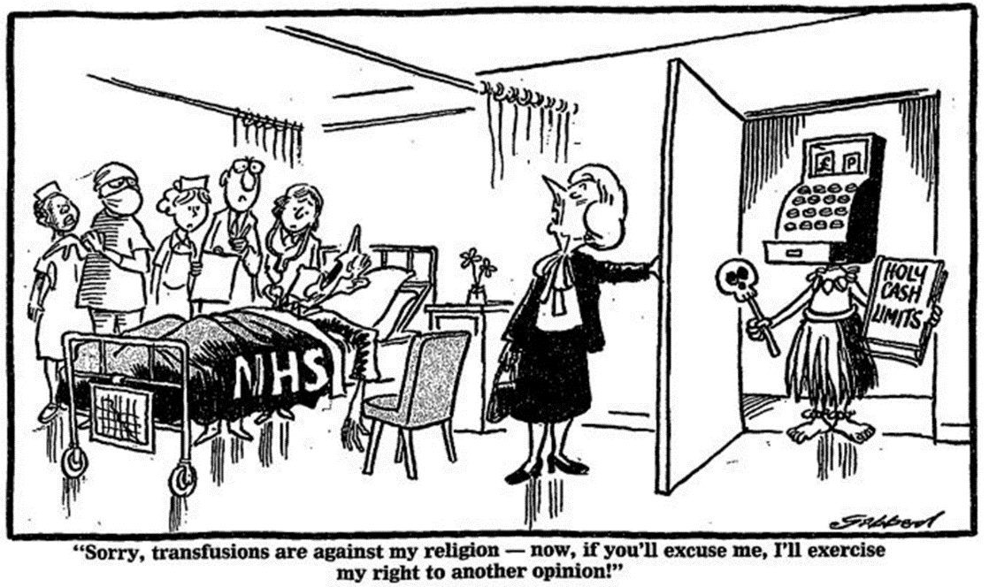
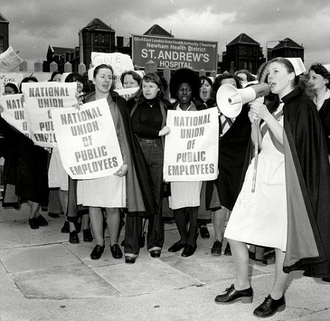
Collapse of post-war socio-economic settlement

Slide 24
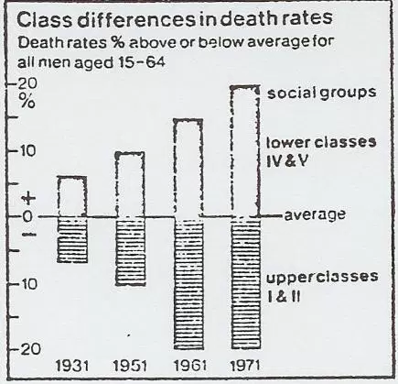
Critiques of the mid-century compromises

Slide 25
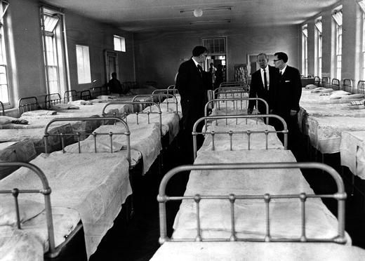
The shadow of the poor law

Slide 26
Q3: What accounts for the longevity and popular appeal of Britain’s National Health Service?

Slide 27


consumerism

Slide 28
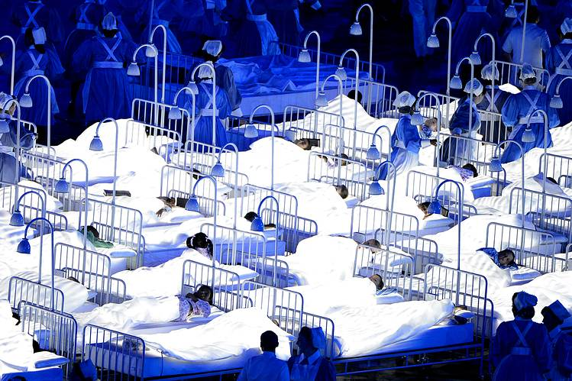
communitarianism

Slide 29

productionism

