Slide 1
Politics and Parties after Independence, 1957-1975
HI177 | Africa and the Cold War
Term 2 | Week 7

Slide 2

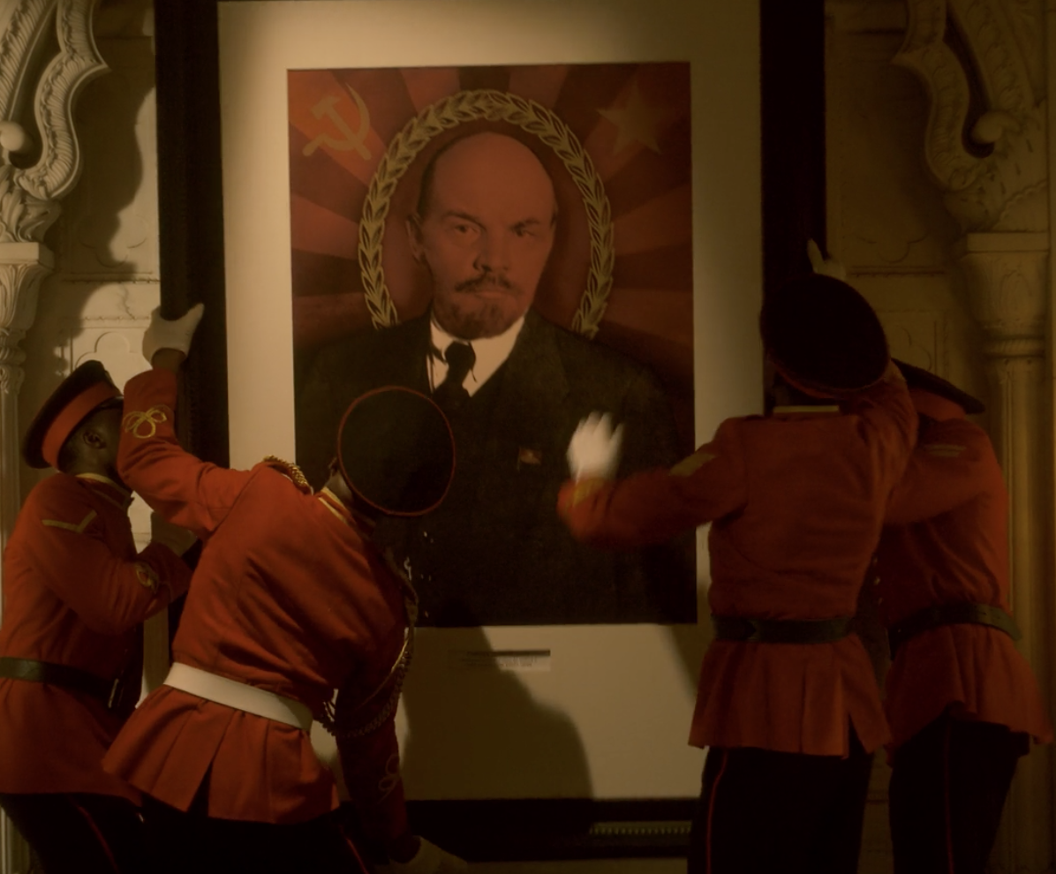
Introduction: Popular Perceptions
Scene from a popular show the Crown: a portrait of the Queen Elizabeth II (played by Clare Foy) is replaced by that of Vladimir Lenin (right) in Ghana after independence

Slide 3
Lecture Outline
International Environment: Global Economy and the Cold War.
African Socialism. Examples: Ghana and Tanzania
Outcomes and Concluding Thoughts

Slide 4
1. International Environment: Global Economy
Legacy of colonialism:
dependency on cash crops
low-levels of industrialisation
high taxation
infrastructure geared towards export
Still, optimism about economic growth after independence
How could one overcome the legacy of colonialism?

Slide 5
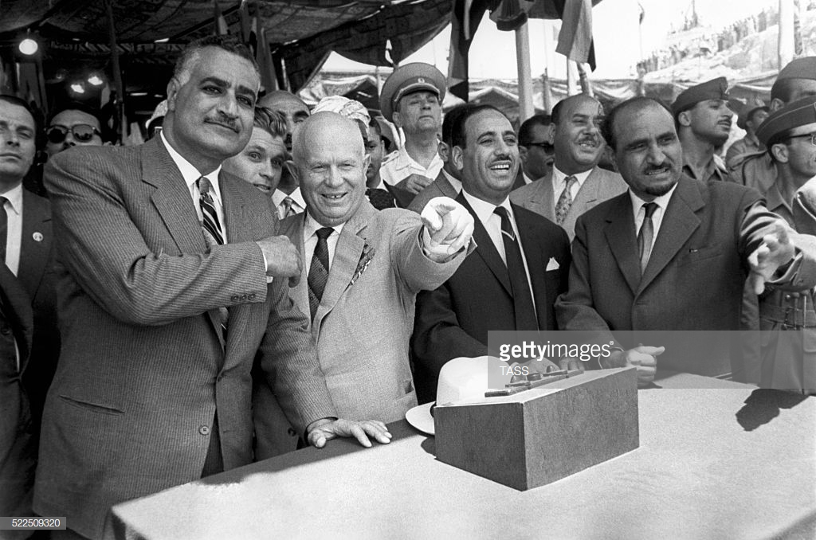
1. International Environment: Cold War/SOVIET UNION
Khrushchev’s Motives: finding allies, spreading socialism (optimism)
The Suez Crisis, 1956
The 'Soviet Model of Development': mechanization of agriculture; collective farms; nationalisation
Pic: Nasser and Khrushchev inspecting the site for the construction of the Aswan Dam, 1964. Aswan became one of the biggest Soviet ‘prestige projects’ in Africa’

Slide 6
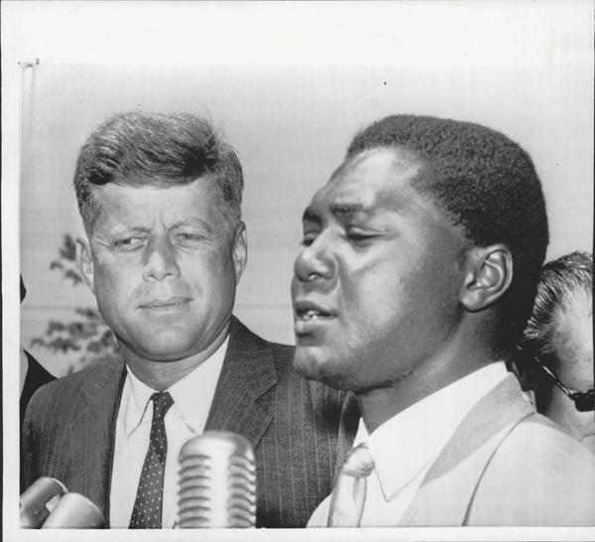
1. International Environment: Cold War/USA
Nixon’s Trip to Africa, 1957
Walt Rostow and Modernisation Theory, “The Stages of Economic Growth: A Non-communist manifesto”
John Kennedy and ‘Decade of Development’
Pic: Tom Mboya with John F. Kennedy, 1960. Mboya secured Kennedy’s agreement for scholarships for hundreds of Kenyan students in the USA

Slide 7
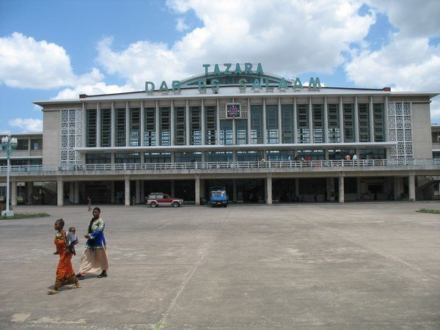
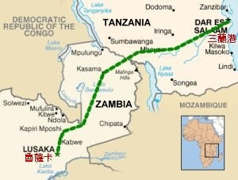
1. International Environment: Cold War/CHINA
China’s appeal: non-white, non-European country; history of imperialism
China’s competition with the Soviet Union
1967-1975: TAZARA Railway ($415m Chinese loan)
TAZARA Railway station in Dar Es Salaam. Right corner: map of the railway line, connecting Dar es Salaam (Tanzania) and Lusaka (Zambia). About 30,000-40,000 Chinese workers were involved in the building of the railway

Slide 8
2. African Socialism/DEFINITION
'African socialism’: political project, dedicated to the construction of a socialist state, rooted in tradition.
Congo Crisis and ‘Neo-Colonialism’.
African socialism as a way to find ‘indigenous form of development’. However, concept understood and implemented differently
Pic:Patrice Lumumba’s arrest in September 1960. Shortly afterwards, Lumumba was flown to Katanga where he was murdered. His murder and Belgium’s intervention in the Congo had far-reaching consequences. They heightened fears of ‘neocolonialism’ in Africa

Slide 9
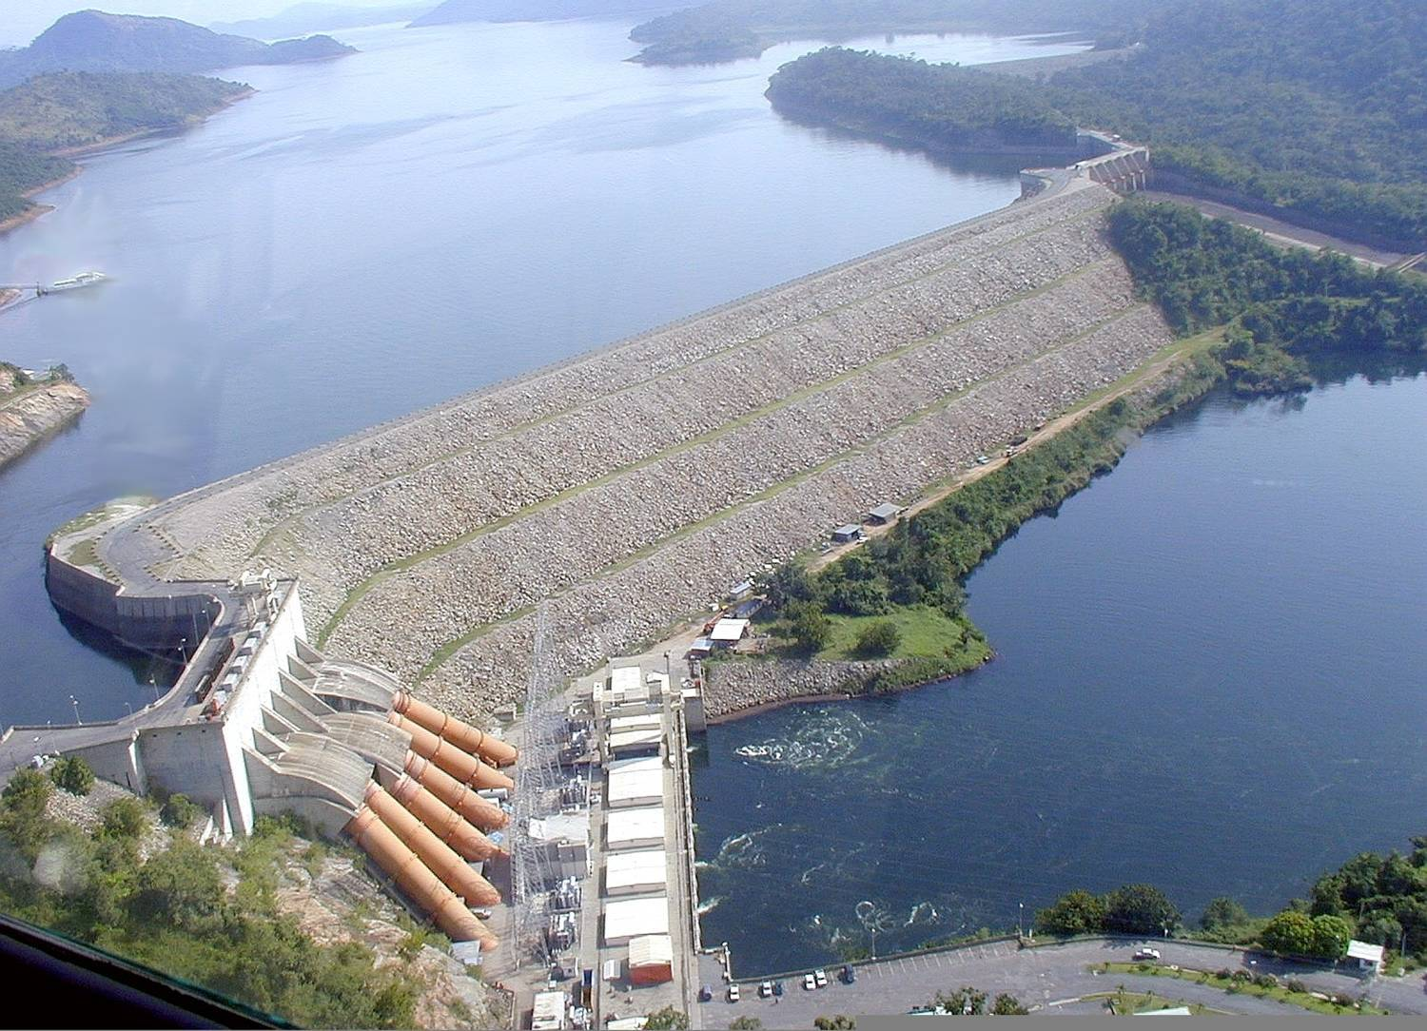
2. African Socialism: Ghana
Arthur Lewis’s plan
1958: Trip to the USA. Support for the Volta River Project
1961: Nkrumah moves to the left. Authoritarian Rule
February 1966: Nkrumah toppled
Location and aerial view of Akosombo dam on the Volta River. The dam became Nkumah’s most important development project

Slide 10
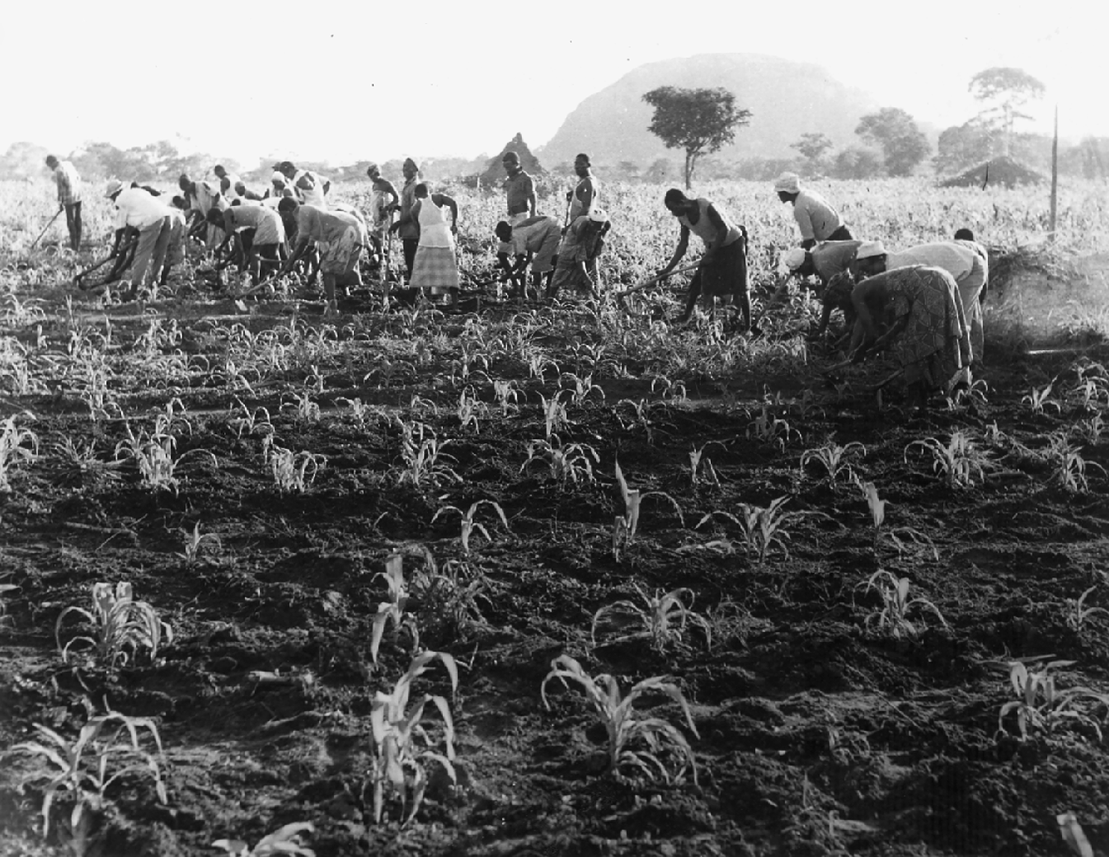
2. African Socialism: Tanzania
1961-3: Modernization Theory and World Bank
Nyerere’s dissatisfied with pace of change
1967: Arusha declaration. Mass resettlement into ujamaa villages
Pic: Women working in a communal village in Tanzania.
Ujamaa initially brought better access to government services, to health, education and clean water. However, many were still unwilling to participate. In between 1973 and 1975, Tanzania forcefully resettled 5 mn. people into communal villages.

Slide 11
Outcomes and Concluding Thoughts
By 1970s: indebtedness, exemplified by demographic growth and periods of drought
Rise of one-party states and growing pessimism
Negative Image of the Continent
African Socialism as a way to find ‘indigenous forms of development’. Multiple influences
How much were the modernisation schemes (their conception and failures) shaped by the legacies of colonialism?

