Slide 1
Ethnicity and the Colonial State

Slide 3
Indirect Rule
‘Hegemony on a shoestring’
1906: one European official per 7,500km² of African territory; one European official per 45,000 Africans
Frederick Cooper and the ‘gatekeeper state’
Frederick Lugard and ‘indirect rule’
Appointed High Commissioner of the Protectorate of Northern Nigeria in 1900
The Dual Mandate in Tropical Africa (1923)
Successful in Sokoto Caliphate – strong existing structures
Less successful where no clear chiefs through which to rule, e.g. East of Niger Delta

Slide 4
Africans Exploit the Colonial Order
Gaps in colonial knowledge – problem of twin sources of authority: colonial government and local ‘custom’
Peasants unable to meet tax obligations in Mozambique often forced to work the chief’s private plantations
Power held by African intermediaries
Clerks, messengers, translators
Taxation and the limits of colonial rule
Hut and poll taxes introduced to raise revenue for colonial government
Colonial law and ‘customary law’
Codification of ‘customary’ law, dismissal of practices which colonists disliked

Slide 5
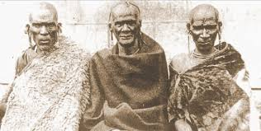
Who were the chiefs through which the colonial regime would rule?
And who did chiefs claim to represent?
Crucial role of ethnicity
Kikuyu elders in British East Africa Protectorate, c. 1910

Slide 6
Approaches to Ethnicity 1
Instrumentalism
Iliffe: ‘Europeans believed Africans belonged to tribes; Africans built tribes to belong to’
Patronage politics – Bayart and the ‘politics of the belly’
Kinship ties migrants and rapid urbanisation
Primordialism
Ethnicities always existed in Africa
Thawed out and instrumentalised under colonial rule
Constructivism
Desire for classification - e.g. Darwin and The Origin of Species
Merging ethnic groups – e.g. ‘Nyakusa’ in Tanganyika
Ethnicities as the product of colonial forces and agents

Slide 7
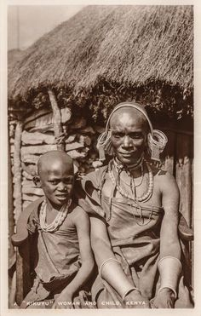
Approaches to Ethnicity 2
Politicisation and the colonial public sphere
e.g. ’newspaper wars’ in colonial Zanzibar (Glassman)
’Moral ethnicity’ and ‘political tribalism’ (Lonsdale)
Ethnicity as a moral sensibility – historic sense of selfhood
Competitive politics over state-distributed resources

Slide 8
Approaches to Ethnicity 3
Emphasising fluidity and agency
Waller: ‘Ethnicity is at once ‘traditional’ and thoroughly modern; apparently fixed and coherent… conflicted and constantly redefined; inclusive… and exclusive… an instrument of domination and a defence against it; a means to power and a profoundly moral critique of how power is exercised; a political contrivance and a social foundation’
Bruce Berman: ‘Ethnicities are the ambiguous, constantly contested and changing results of cultural politics; the outcome of an endless process in which they are always simultaneously old and new, grounded in the past and perpetually in the process of creation.

Slide 9
Invented Traditions
Terence Ranger, ‘The Invention of Tradition in Colonial Africa’
Too static?
Feierman: tradition is not a fixed set of values, but fluid discourse – colonial authorities had little control over it
Harries: traditions are assembled from existing bodies of knowledge – but must have some sense of resonance
Too Eurocentric? Not enough African agency?
The limits of invention
e.g. Embu (Kenya) incorporated pre-colonial traditions into new rituals in order to consolidate their claims to land in the face of colonial intervention

Slide 10
Conclusions
Ethnicity interacted with other identities, including race, gender and class
Challenges of colonial rule and opportunities for Africans
Ethnicity did not fade away with independence – still the key marker in parts of contemporary Africa
Endurance of ethnicity shows it has deeper roots?
Chiefs mostly swept away by the post-colonial state

