Slide 1
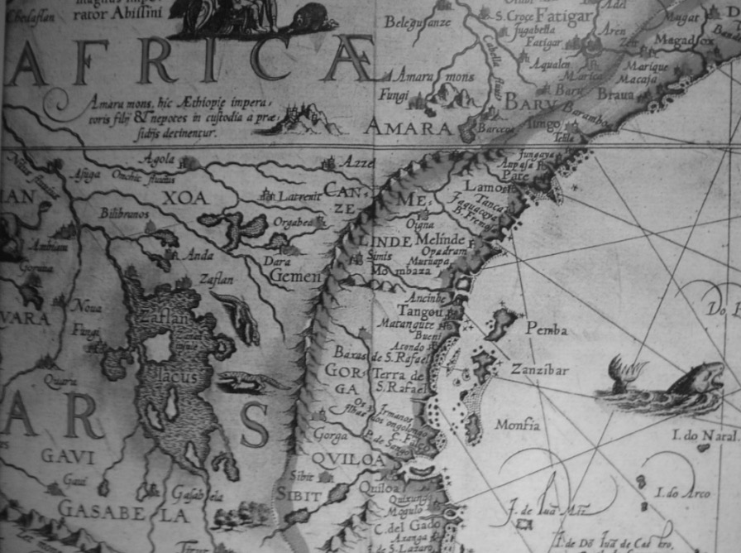
Map at Beit-al-Ajaib, Zanzibar. Photograph by George Roberts.
State, Society, and Trade in East Africa

Slide 2
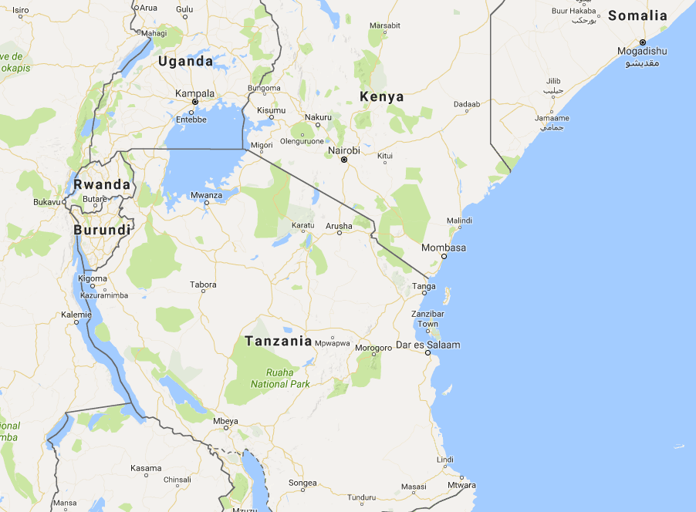
Google

Slide 3
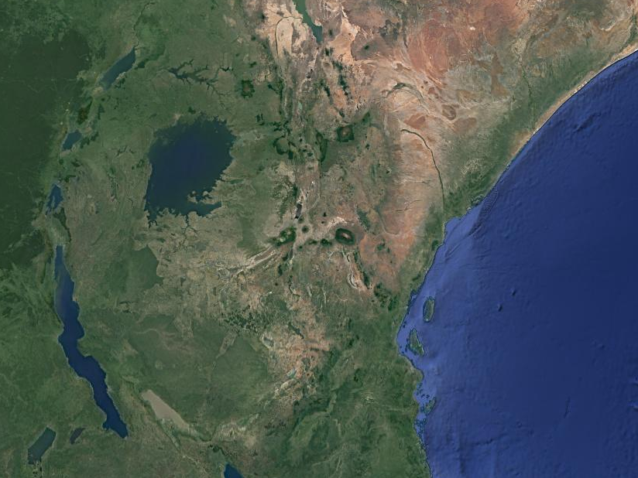
Google

Slide 4
Smithsonian

Slide 5
The Rise of Zanzibar
1820s: cloves introduced to Zanzibar – plantations and slavery
1830s: Sultan Seyyid Said moves Omani capital to Zanzibar
Growth of Swahili city-states along East African coast
Zanzibari trade routes expand into interior
Dominant power until 1880s

Slide 6
http://www.diaspora.illinois.edu/

Slide 8
The Ivory Trade
Ivory a prized luxury good in Europe and North America
European demand increased in C19th – increasingly important after opening of Suez Canal (1869)
1820s-1890s: Price of Ivory in Zanzibar increased x6
Thousands of elephants killed, as population declines, hunting moves into interior
Ivory trade became increasingly competitive and violent

Slide 9
Consequences of the Ivory Trade
Commercialisation
  Porterage and Nyamwezi
  Market-oriented agriculture
    Agrarian cropping along trade routes
    Cattle rearing → driven towards coastal markets
    ‘Modern’ economic concepts – banking
Demographic change?
  New epidemics versus food security
  Population growth and ecological pressure

Slide 10
The East African Slave Trade
Rise in slave trade in Zanzibar
  6,000 per year in 1800 → 70,000 per year in 1860s
  Demand from Arabia, Brazil, Indian Ocean islands
  Clove plantations in Zanzibar
Abolition in Zanzibar in 1873
  Rise of plantations on mainland coast and interior

Slide 11
The Economics of Power
‘Protocolonial’ trade relationships?
Or foreign traders responding to African demands?
Controlling trade as a means of power
  Undermined gendered political order
Guns as instruments and symbols of power
Trade, conflict, and state-building
  Succession conflict in Bunyoro and Khartoumer traders
  Mirambo, the Nyamwezi, and the ruga ruga
  Gendered distribution of social and economic power challenged: negative impact on women and girls

Slide 12
Religion, Ethnicity, Culture
Islam and traditional forms of power
  Kingalau mwana Shaha and the Wobena: mixing traditional rainmaking authority and Islam
Kabaka Mutesa and the impact of religion on Buganda
  Encounters with Zanzibari traders
  Henry Morton Stanley and the Bible
  Church Mission Society and the White Fathers
  Buganda civil wars and the coming of colonialism
Nyamwezi porters and the spread of Swahili language
Ethnicity beginning to become more fixed?

Slide 13
Conclusions
A world connecting… but through varied encounters and with diverse consequences
Markets and commodification
Demographic change and urbanisation
’Traditional’ power structures and the impact of trade: change, continuity, resilience, destruction
The context in which formal European colonialism arrived…

