Slide 1
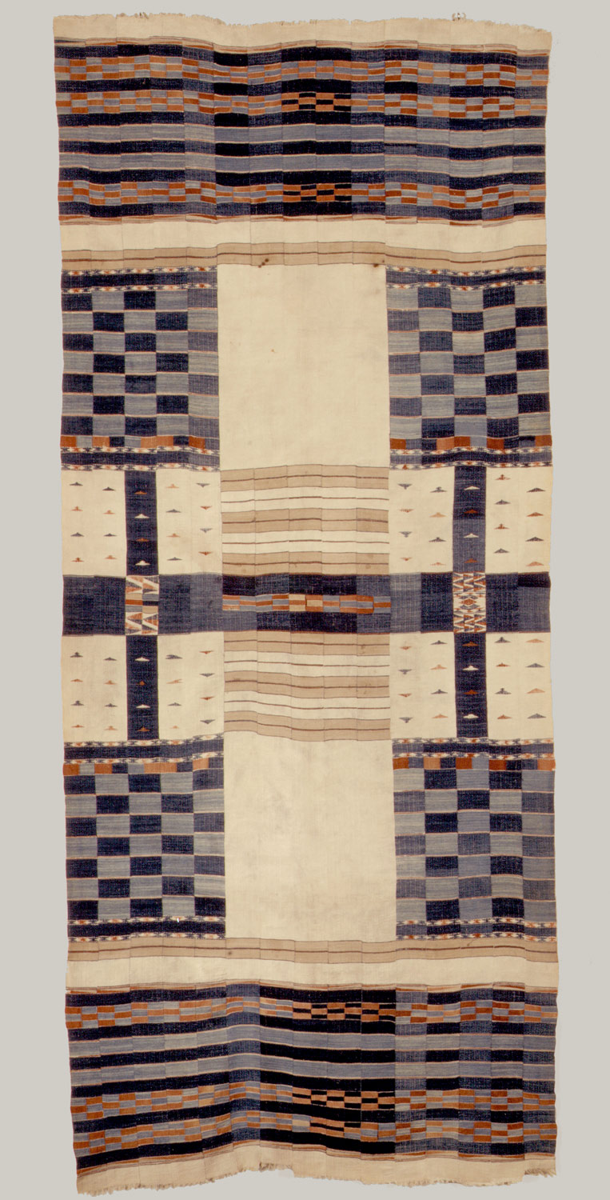
Jihad in the West African Savannah
Fulani cloth, 19th century
metmuseum.org

Slide 2
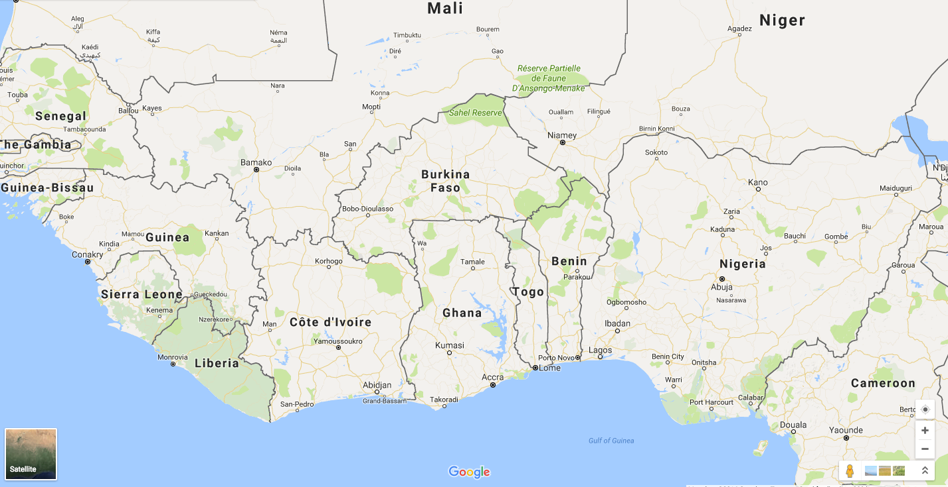

Slide 3
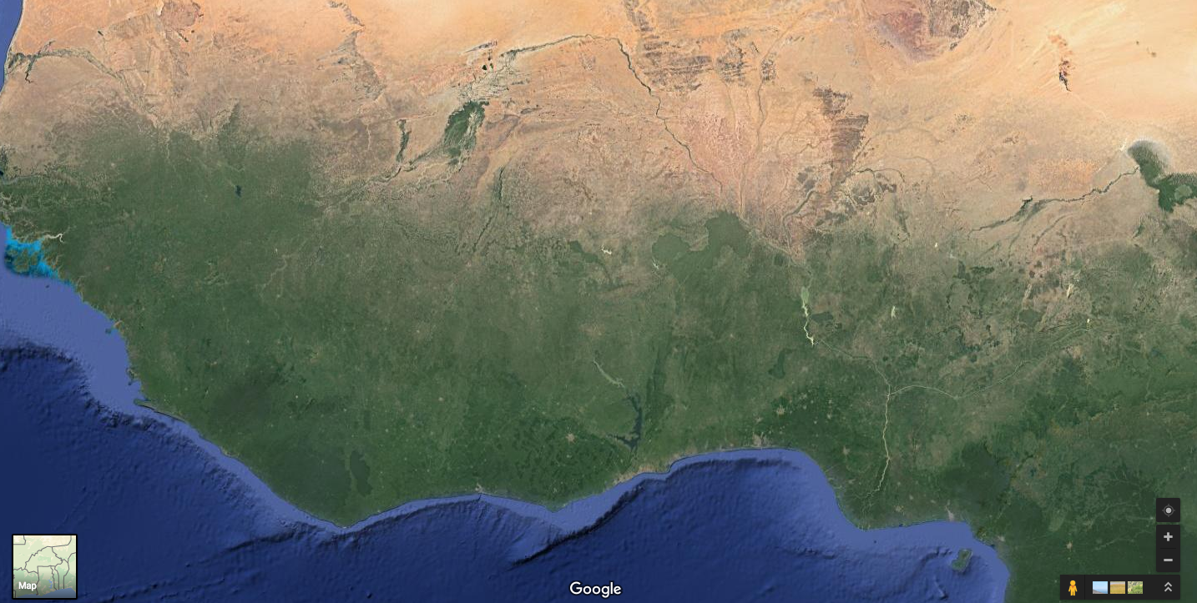

Slide 4
The West African Savannah
Pastoral Fulani (Fulbe) people, highly mobile and drifted eastwards due to changing climate
Hausaland (area of modern day northern Nigeria)
Hausa people practiced agriculture, plus some manufacturing and traders
Fulani and Hausa were connected with societies north of the Sahara and on the coast – but not fully integrated into such systems

Slide 5
The Coming of Islam
Role of Berber traders from north of the Sahara
Islam initially taken up by ruling elites, urbanites and traders, e.g. Hausa elites in the C14th
Benefits of Islam: literacy, brotherhood and cooperation
Booming Hausa economy → expansion of Islam in 17th/18th centuries
Urban, literate phenomenon
Islamic states of C18th: Futa Jalon (1725-c.1750) and Futa Toro (1769-1776).

Slide 6
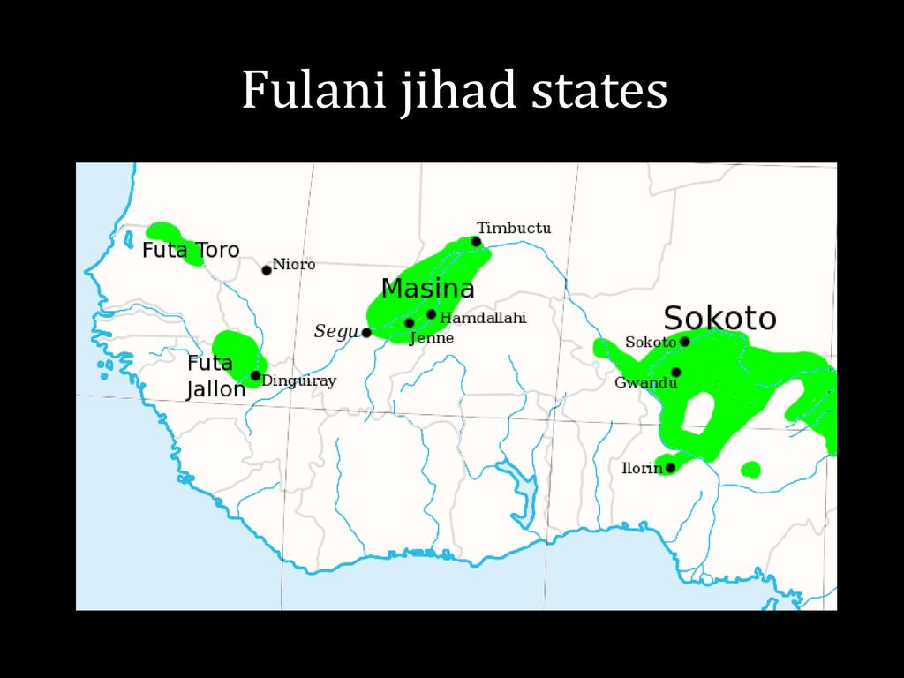
Insert map of Futa Jalon and Futa Toro, with Hausaland marked on to ideally

Slide 7
Emergence of the Sokoto Caliphate
Usman (Usuman, Uthman…) dan Fodio (1754-1817)
1870s onwards: Usman dan Fodio teaches and preaches in Gobir; criticism of un-Islamic practices of ruling elites
Early 1800s: repression of Usman and his followers
1804: outbreak of war with Gobir
1809: proclamation of Sokoto Caliphate
1817: Usman dies, suceeded by his son Muhammad Bello – expansionist jihad continues

Slide 8
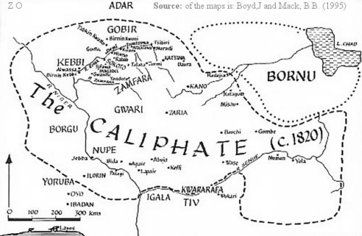
The Sokoto Caliphate, c. 1820

Slide 9
What Inspired Jihad?
Possible causes of 1804 jihad:
Islamic faith
Religious beliefs of leaders and followers
Global connections – imitating Prophet Muhammad, influence of Saudi Wahhabism?
Fulani ethnicity
Socioeconomic grievances
Enslavement of Muslims
Cattle tax (jangali) and restrictions on grazing
Likely a combination of factors

Slide 10
The Jihadic State 1: Politics
Enormous size of Caliphate required decentralized administrative structure – emirates administered by local leaders
Central authority rooted in religious authority (baraka) of Usman and later his son Muhammed
Structure of Caliphate built on older Hausa monarchical system?
Careful balance between centre and periphery, old and new, elite and masses.

Slide 11
The Jihadic State 2: Society
Urbanisation: cities as fortified centres of power
Genuine commitment to Islam
Austerity; Education
Spread of language
Arabic as administrative lingua franca
Writing in local languages
Role of women
Commitment to education, but also seclusion
Prominent role Nana Asmau, Usman’s daughter

Slide 12
The Jihadic State 3: Economy
Sokoto economy was highly monetised
Growth of plantations
Textile production and regional trading networks
Slavery
50%-70% of population of cities were slaves
Jihad and slave-raiding
Female slaves, for domestic service and as concubines

Slide 13
Relationship to Colonial Rule
Islam provided a sense of unity in resistance to colonial rule
British principle of ‘indirect rule’ originated in colonial policy towards the conquered Fulani and Hausa
British transferred substantial authority back to the emirs
‘Indirect rule’ later used as model in other British colonies

Slide 14
Conclusion
Connections and similarities with other processes of change in Africa
Islam as a state-building ideology
Reform, revival or revolution?
How significant was the role played by leaders?
Longer term impact: rejuvenation of Islam in West Africa, foundation of new states, model of indirect rule under colonialism

