Slide 1
Social and Political Change in Nineteenth-Century Southern Africa

Slide 2
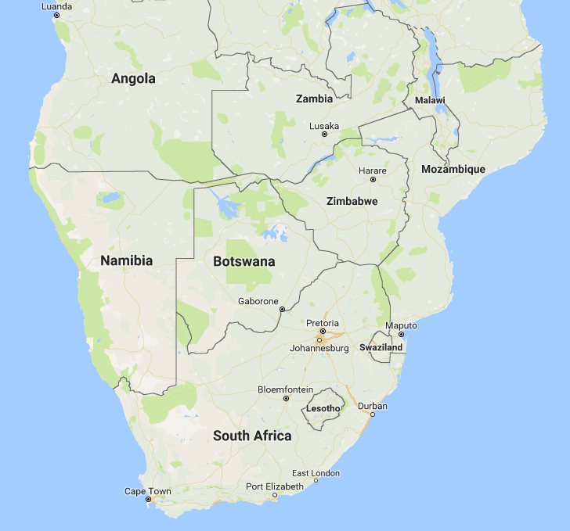

Slide 3
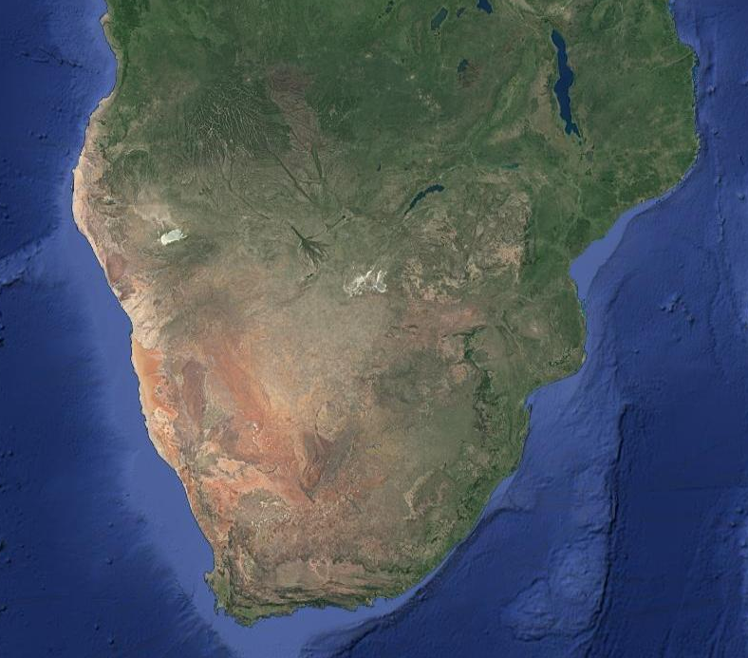

Slide 4
The Mfecane
From Xhosa ’destitution’ and ‘hunger’, also Sotho difaqane (‘scattering’)
Originated in the Nguni-speaking chiefdoms of southeastern southern Africa, late 18th/early 19th centuries
Limited resources > war > waves of migration > absorption of chiefdoms into larger states
Increasingly centralised and militarised leaderships
Refugees fled as far north as modern Zimbabwe, Malawi, and Tanzania
Displacement of peoples and depopulation in southern Africa

Slide 5
The Mfecane thesis
Escalation of violence and population displacement in early C19th southern Africa resulted from of 3 factors:
Increased competition for land and resources that began during the C18th
Increased competition between Nguni chiefdoms for the control of trade routes and access to ivory
Efforts of powerful and talented individuals like Shaka in leading these conflicts and founding new polities

Slide 6
The Rise of the Zulu Kingdom
Zulu became most powerful Nguni kingdom
Shaka became ruler of Zulu state by 1819
  New identity based on political and military power
  Creation of permanent military regiments (ambutho)
  Tactical innovation - short stabbing spear became predominant
Zulu were dominant power in region until British conquest (1879)
Model of Nguni kingdoms adopted by other states in region
Shaka Zulu (1824)

Slide 7
http://blog.londolozi.com/

Slide 8
Julian Cobbing: ‘The Mfecane as Alibi’
Julian Cobbing at ‘The Mfecane Aftermath’
Johannesburg, 1991

Slide 9
Cobbing’s Arguments
Disturbances in southern Africa not solely result of the emergence of the Zulu Kingdom
Root causes of violence and migrations lay in external, European causes
  Rise of Delagoa Bay slave trade in Portuguese Mozambique
  Afrikaner and British settlers and missionaries pursued slave-raiding, pushing Africans north
Mfecane as legitimating ‘modern apartheid propaganda’
  Mfecane as having no root in African language
  Settlers justifying land grabs
  Justifying the creation of African Bantustans

Slide 10
Cobbing’s Arguments in Context
1948-1994: a period of harsh racial segregation and discrimination in South Africa known as apartheid
1980s a period of political transformation and violence in South Africa with popular protest against apartheid regime
Cobbing’s arguments sparked controversy:
  He downplayed role and agency of Africans in C19th South African history and emphasised role of European settlers
  Political implications of such ideas – debates about history of colonialism, race and power

Slide 11
Criticising Cobbing 1
Misrepresenting the evidence
  Unproven hypotheses rather than empirical evidence?
  Extensive slave trade at Delagoa Bay did not begin until after regional conflicts began in 1817 (Eldredge)
  ‘Slave-raiding’ argument misreads evidence and lumps together too many diverse actors (Eldredge)
  But how much evidence do Cobbing’s critics offer in response?
Misrepresenting the historiography
  Does Cobbing caricature the existing historiography? (Saunders, also Peires)

Slide 12
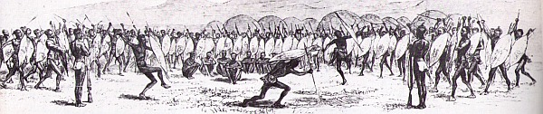
Criticising Cobbing 2
Etherington: was there even an mfecane to speak of?
  Problem of Zulucentricity remains
Denying African agency? Perpetuating stereotypes of an undynamic precolonial Africa (Reid)
Africans developing concept of mfecane to further own interests, e.g. related lifaqane found in 19th century texts
Zulu regiments at Shaka’s kraal (1827)

Slide 13
Beyond the Cobbing Debate
Ecological factors
  Land unable to support cattle farming without drastic reorganisation of productive forces (Guy)
Ivory trade
  Decline around 1900 forced turn to cattle farming, leading to conflict over land and centralisation of the state (Smith and Hodges)
Impact of drought (Eldredge)
Social developments
  Role of women?

Slide 14
Conclusions
No consensus – demonstrates problem of monocausal arguments
Revitalisation of the debate on precolonial southern African history
Mfecane cannot be understood without reference to internal and external factors

