Slide 1
The 'Scramble' for Africa
Maji Maji troops, German East Africa

Slide 3
European Imperial Ambitions
Late 1870s and early 1880s
  French sought to consolidate their position along the coast and in Congo, bringing them into conflict with
    British interests in the Niger Delta
    Belgian King Leopold II’s interests on lower Congo River
Berlin Conference, 1884-85
  Recognised Leopold’s claim to Congo Free State
  Claims of a European government to a particular region would only be recognised if the power in question was already effectively in control of the territory – Germany seeks to undermine Britain?

Slide 4
‘Carving up the continent’
‘Everyone gets his share’ – French caricature from 1885

Slide 5
The Partition of Africa
East Africa:
1886 treaty creates German East Africa (Tanzania) and British East Africa (Kenya)
1893-4: British establish protectorate over Buganda (Uganda)
Southern Africa:
1877: Britain annex Transvaal; Boers retake control in 1880; gold discovered in 1886.
1884: Bismarck creates German South West Africa (Namibia)
1885: British declared protectorate over Bechaunaland (Botswana)
1889-1902: second Boer War/South African War
1890s: British South Africa Company expeditions north (Zimbabwe, Malawi, Zambia)

Slide 8
Why Conquest? 1
European power politics?
  Franco-Prussian War (1870-71)
  Unification of Germany (1871)
  ‘Scramble’ part of European competition for power
Economic development in Europe?
  Industrialization in Britain, Western Europe, USA
Consolidating trade relations?
  Robinson and Gallagher – ‘The Imperialism of Free Trade’
The search for natural resources?
  E.g. oil and rubber in West Africa, diamonds and gold in southern Africa

Slide 9
Why Conquest? 2
Control over strategic positions?
  The Nile Valley and Anglo-French confrontation at Fashoda, 1896
Technological developments
  Development of quinine prophylaxis to combat malaria in 1850s
  Firearms
Development of racial thought in nineteenth-century Europe
  Demarcating racial boundaries
  ‘Civilization’ and ’modernisation’ required further intervention – the ‘white man’s burden’
  Racism to justify the use of violence

Slide 10
Armed Conquest
Superiority of European firearms
  e.g. Omdurman, 1896
Divided African societies – European conquest took place at a time of flux
  e.g. consequences of German intervention for Swahili port towns
  e.g. authority of the Imerina elite undermined in Madagascar by missionary presence
European use of African mercenary forces
Occasional African victories over European armies
  Zulu defeated British at Isandlwana, 1879
  Ethiopians defeated Italians at Adwa, 1896

Slide 11
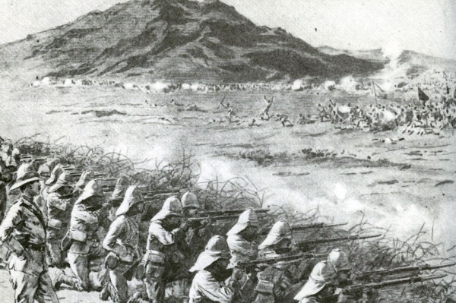
Omdurman, Sudan, 1898

Slide 12
Armed Conquest
Superiority of European firearms
  e.g. Omdurman, 1896
Divided African societies – European conquest took place at a time of flux
  e.g. consequences of German intervention for Swahili port towns
  e.g. authority of the Imerina elite undermined in Madagascar by missionary presence
European use of African mercenary forces
Occasional African victories over European armies
  Zulu defeated British at Isandlwana, 1879
  Ethiopians defeated Italians at Adwa, 1896

Slide 13
Ethiopian victory over the Italians at Adwa, 1896

Slide 14
African Responses: Fight
Violent resistance most prevalent in:
  Dominant, militarised polities
    Sokoto Caliphate
  Stateless peoples, fighting guerrilla wars
    Somalis
  Islamic societies – common cause for resistance
    Sokoto Caliphate held out against British until 1903
Cannot simply be seen as ‘Europeans versus Africans’
Scramble embedded in African ‘military revolution’ of C19th? Continuity as well and change…

Slide 15
Maji Maji (1905-07)
Pressure from German colonial authorities on Tanganyikan farmers to grow cotton for export
No evidence of prior planning
Religion providing a sense of coherence, through the maji water
Brutal German response: 26,000 Africans killed in conflict, plus 50,000 in the famine which followed
Complicating Maji Maji…
  Gender relations
  Shifting alliance structures
  Environmental degradation and demographic change
  Colonial restrictions – e.g. elephant hunters and ivory trade

Slide 16
African Responses: Negotiate
Africans signing treaties without fully understanding their implications
  French reneged on agreements with Tukolor and Mandinke
Negotiation should not necessarily be understood as capitulation to colonial rule?
Internal unrest could lead to colonialists being welcomed as liberators
  e.g. Gambia, following 40 years of civil war
Demonstrative effect of European firearms

Slide 17
Complicating Resistance
‘Primary resistance’ and ‘secondary resistance’
Problems of organising mass resistance – ‘Africa’ existed only in the European imagination
’Resistance’ as a problematic term
Historiographic evolution…
  1960s – ‘nationalist’ histories
  1970s – more materialist, Marxist-inspired histories
  1990s – towards a more nuanced interpretation
Socioeconomic grievances
  Hut Tax War in Sierra Leone, 1896
  Herero uprising in Nambia, 1904-08
  ‘Everyday resistance’ – tax avoidance

Slide 18
Conclusions
Situating colonial conquest in longer patterns of change
European interventions in African affairs
A world connecting: economic globalisation
African patterns of violence and state-building
How useful are labels like ‘precolonial’ and ’colonial’?
Lines in the sand: colonial borders and their consequences
Colonialism did introduce a new order of sorts

