Slide 1
What is the History of Emotions: An Archeological Investigation
Dr Claudia Stein
History Department
University of Warwick

Slide 2
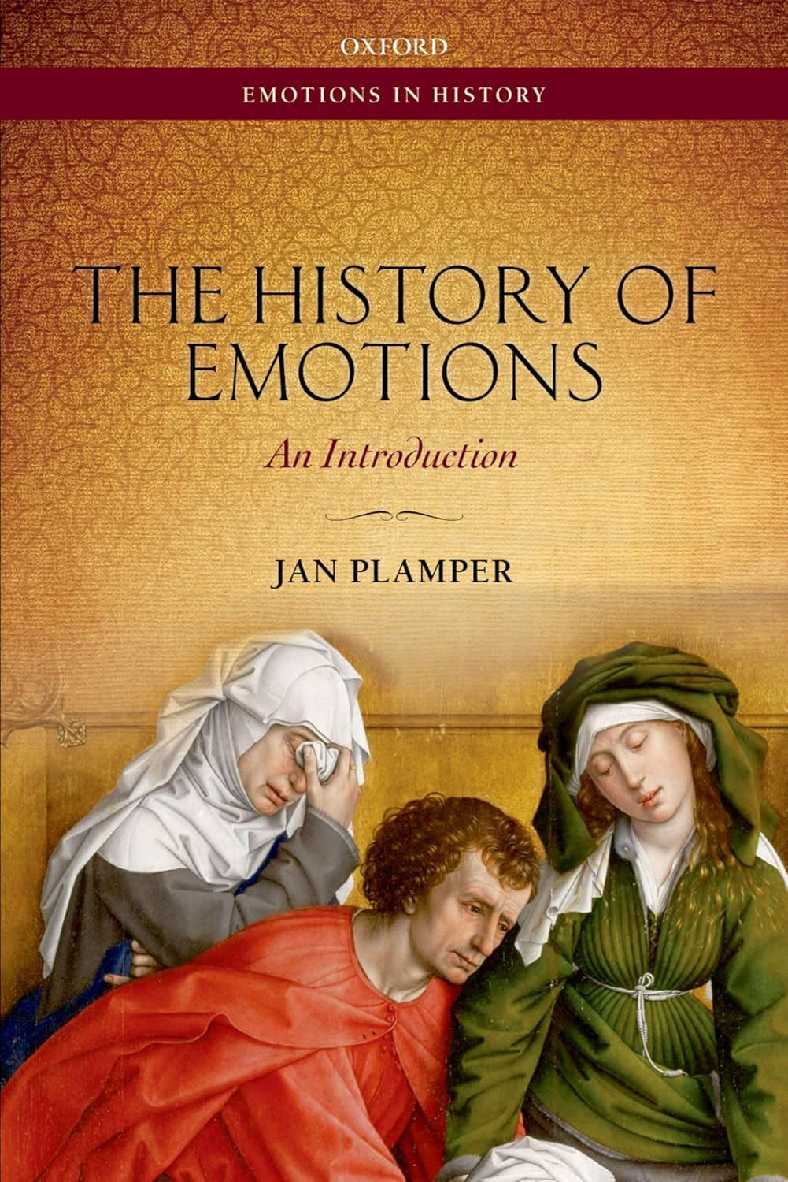
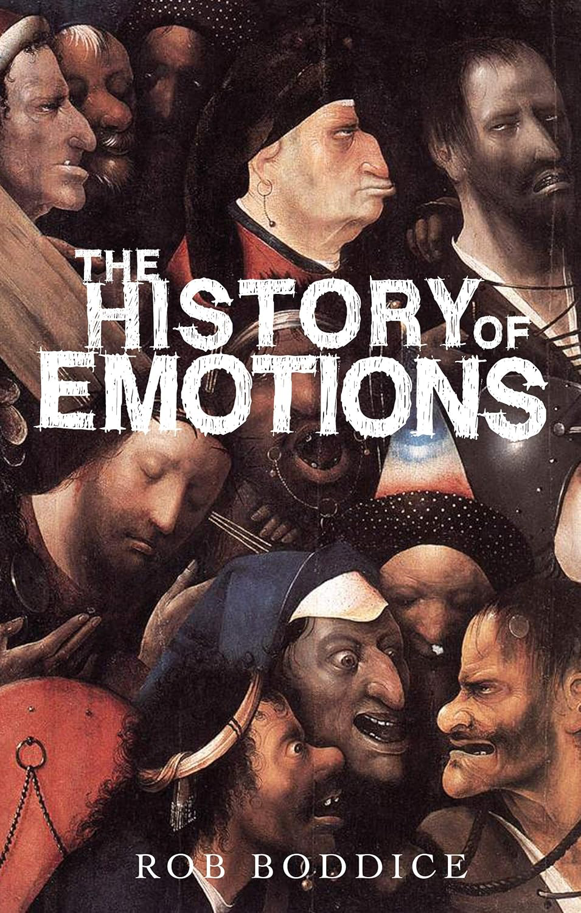
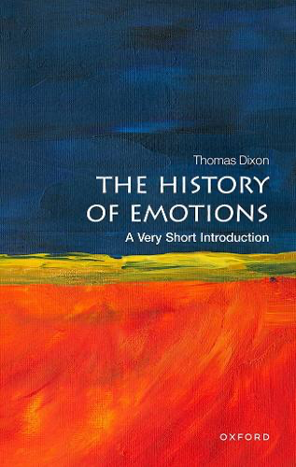
General histories of emotion
Claim: Synthesis of current debates in the history of emotions and its development in history writing
Help to ‘navigate’ the huge field of historical research which uses emotions as an analytical tool to understand the past.
History of emotion in different historical periods
In different subfields of history writing
Various theoretical/method- logical approaches used, stemming from outside of the discipline of history (e.g. anthropology,
sociology, cognitive neuro-
sciences)
(German 2012.2015 English
2018

Slide 3
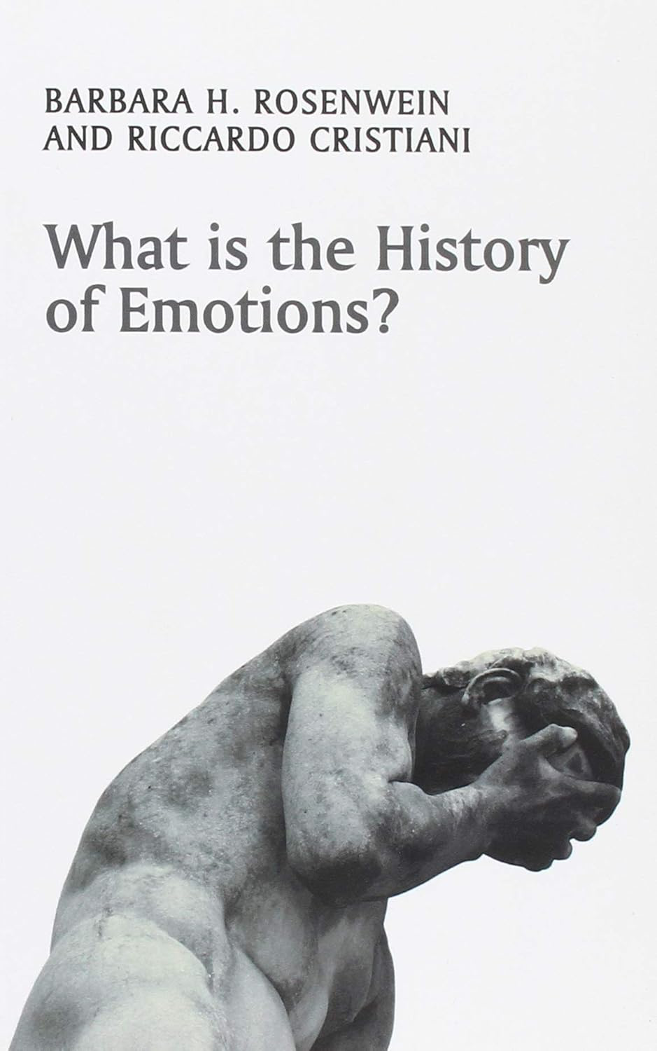
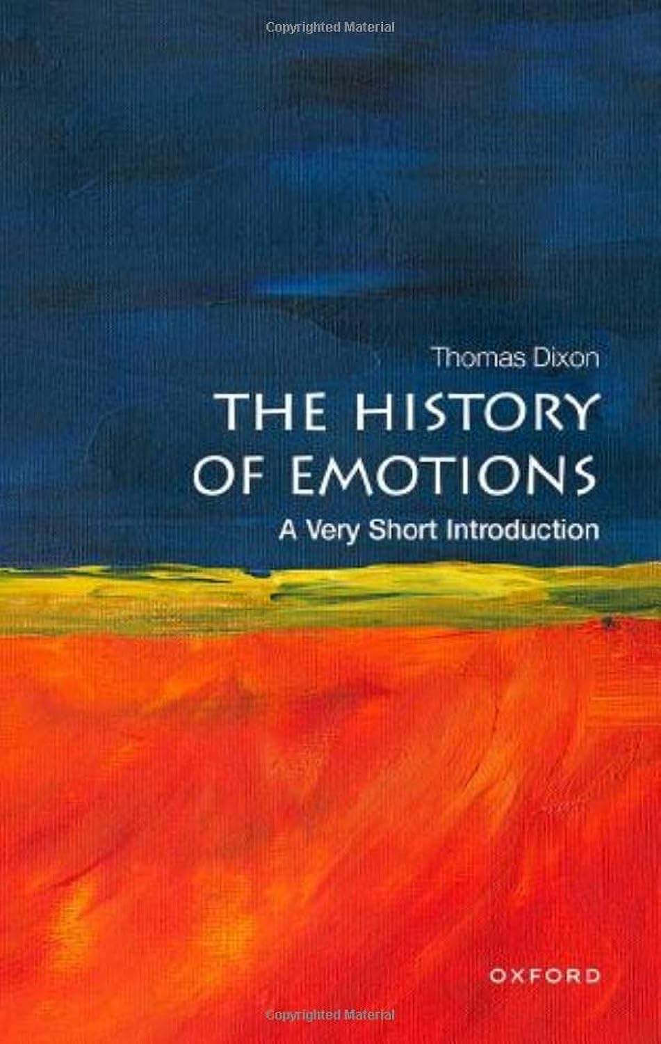
Why are such general introductions of particular interest to me?
Claim that they get to the core
of what the history of emotion is
Confidence of a field that was only ‘born’ during the 1990s in the US (story of success)
On what analytical/
methodological innovation is this confidence build?
What does the history of emotion achieve that other trends in history writing didn’t in regard to the understanding of the past? why is a success and victory (having overcome many obstacles/dead ends?). Why should all historians adopt an emotional approach?
What
2018
2023

Slide 4
What is the benefit of the history of emotions? Why should all historians adopt an emotional approach?
‘It has the potential to unlock – at the level of experience – that thing that historians have always searched for: namely, what it means to be human.’
(Boddice, History of Emotions, p. 7)
Emotion is the history of all human experience and allows historians to finally understand what has been standing at the core of their discipline all along (but they might have not realised it).

Slide 5
Emotions/felt experience is human experience
Note: ‘emotions’ are not understood in the traditional Cartesian sense as the opposite of ‘reason’; within the Enlightenment ‘grand narrative’ a human character trait that needed to be controlled and even eliminated
Definition used in the Introductions:
Emotions/felt experiences are ‘cognitive judgements’ .
Assume that emotions are not merely raw, instinctual feelings, but intelligent, value-laden responses to our sensory perceptions of the world; emotions are intrinsic to all human reasoning. The binary mind/body is obsolete.

Slide 6
The definition of emotions/felt experience as emotional judgment allows historians
to do their ‘natural’ job
To detect difference in emotional behavior and understanding of emotions between the past and present and to draw attention to the great diversity of emotional behavior in a past societies – the emotional past is different from the present
To detect similarities and communalities in emotional behaviour between
and the past and present; to detect the ‘common emotional repertoire’. The common emotional repertoire
allows historians do understand emotional ‘change’ through time; this also links the emotionality of the historian
to that if their actors in the past.

Slide 7
Historian of emotions need to unite all knowledge about emotions
In order to overcome the division between disciplines in the natural sciences and the humanities in terms of knowledge production about emotions (to put a final end to division of knowledge about human experience; end of ‘nature /culture divide’
Following on from here:
The practice of the history of emotion requires close collaboration with current research in the evolutionary cognitive brain sciences of emotion.

Slide 8
Historians as cognitive neuro scientists?
‘We do not have to be competent in running neuroscientific experiments. We do not have to appropriate all of the technological jargon of that discipline. We do, however, a duty to understand the implications of neuroscience and its variety of research agendas…
Neuroscience is much more open now to biocultural interpretations of brain function and meaning-making. We have entered the age of brain plasticity -- the shaping and making of brain patterns in the world – and the possibilities for historians are immense. As neuroscience confirms the contingency of experience, the prospects for historical revisionism become manifest.’
(Boddice, Emotion, p. 34).
‘Critical’ neurosciences and the plastic brain
Recent approaches that conceptualizes the brain not as universal and transhistorical (let’s say as a computer or divided into different ‘functional areas)) but has an evolutionary object that is malleable, constantly reconfigured throughout evolutionary history of the human species. history and cultural engagement of the brain bearer. The brain is every changing; it is ‘plastic’, shaped by genetic heritage of the brain bearer but also the culture and historical natural environmenment and interactions with other brain bearers.

Slide 9
What does such united knowledge allow historians to do?
‘At the core of this project is an understanding that human beings – human bodies/minds – are made and making meaning in the world…
Knowledge of the human brain is increasingly proving to be a key source for historians of emotions. It is not that we empirically examine the brains of the dead and gone, but rather that we can extrapolate from the living what synaptic development might have been like in the past in order to say something about the way in which culture inscribes the brain as the brain creates experience.
We can also speculate on the ways in which experiences were altered by psychotropic effects of coffee and chocolate, alcohol and opium, as well as by the less obvious psychotropics such as reading and writing, new forms of transport and new media, up to and including the Internet.’
(Boddice, Emotions, p. 39)

Slide 10
What is the point of it all?
Historians will finally understand what it means to be human
‘We cannot understand our emotions without their history.’ (Rosenwein/Cristiani, Emotion, p. 123) ‘
‘ …our own emotional lives will improve or at least become more understandable and pleasurable in the light of the history of emotion.’ (Rosenwein/Christiani, Emotions, p. 121)

Slide 11
Historian as a critique of the present: the past as resource of liberation and empowerment in the present
‘To discover how radically different the interpretations, expressions, and the categories of feelings were in the past is to loosen the hold of our contemporary psychological notions over us. The awareness of radical difference in human emotional understandings, can open our eyes to a much richer set of affective possibilities than the theories of 21st-century psychology at first seem to allow.’ (i.e. usage makes historians critical vis-à-vis their own understanding of emotions)
(Dixon, Emotions, p.18)
The historian as political activist
‘Let us be blunt. We believe it is time to revolutionise the way we think about our emotional lives. We believe that it is time for educators, politicians, religious leaders, and media educators to consider the history of emotions. This is not theoretical; it has been everything to do with our practical lives.’ (Rosenwein/Cristiani, 119).

Slide 12
A reminder of Foucault’s idea of a critical ‘history of the present’
‘A critique is not a matter of saying that things are not right as they are. It is a matter of pointing out on what kinds of assumptions, what kind of familiar, unchallenged, unconsidered modes of thought the practices we accept rest.’
(Foucault, ‘Is it Really Important to Think?’)
‘To see what is in front of one’s nose needs a constant struggle.’
George Orwell, In Front of Your Nose)
Is the history of emotion a critical history of the present? No
The history of emotions takes the endless utterings of individual and collective emotions in current liberal democratic society simply ‘for granted’; there is nether an attempt to ’denaturalize’ such chatter (nor an attempt to investigate why the evolutionary cognitive evolutionary sciences hold such a grip over the imagination of the authors and society at large when it comes to understand human nature); emotions are presented as the ‘natural’ expression of human experiences in democratic discourse; emotions are assumed to be the true expressions of freedom and the basis of empowerment for equality.
There is no analysis of what makes emotion such a ‘natural’ currency in our current world to understand individual and social action and notions of individual and collective freedom and equality.

Slide 13
Emotions as core drivers of ‘neoliberal governmentality’ striving for individual and collective ‘happiness’ within an ‘affective state apparatus’, organized around competition
‘Neoliberalism refers here to the reinvention of liberal ideas and commitments in ways that have profoundly
transformed the fabric of identity and social life. In today’s neoliberal society, the capitalistic market is no
longer imagined as a distinct area of value and exchange. Rather the market is, or ideally should be, the basis for all of society. Thus, neoliberalism works aggressively to infuse competition into the nook and crannies who we are and the environment we inhabit.
Every aspect of our lives, even those facets that do not necessarily have anything to do with money or the economy, become geared towards the market competition, from education to our friendships to our very sense of self-worth.’
Julie Wilson, Neoliberalism, p. 3)
All human experiences have been commericalised and up for sale!

Slide 14
Emotions Drives Today’s Happiness Industry
Happiness and its industry has become part of a commonsensical discourse through which the neoliberal ideology of individualism is rekindled, legitimized, and institutionalized in a seemingly non-ideological way through the discourse of science (e.g. cognitive neurosciences of emotions)
20 March is the International Day of Happiness
Gross National Happiness index (GNH) to go beyond or even replace GNP
Behavioral economics (winning most Nobel Memorial Prize in Economic Sciences since 1992)
Policies of ‘nudging’ – libertarian paternalism (Richard Thaler and Cass Sunstein)
The Individuals as ‘citizens’ have been turned into fully functioning psytizens (Edgar Cabanas)

Slide 15
The history of emotion? A critique? A revolution?
The history of emotion is writing the present of our happiness economy into the past.
By pointing to the differences of understanding emotions in the past and tracing communalities, the history of emotions neither liberates or empowers the reader but rather reinforces ‘confidence’ in the capitalized emotionality of our neoliberal present.
While they present the past a sites that are emotionality, individuality and interiority not yet ‘free’ and in need of individual ‘empowerment’, they are ironically implementing and performing the very premises of an economic and capitalistic subjectivity that governs us today.

Slide 16
The End

