Slide 1
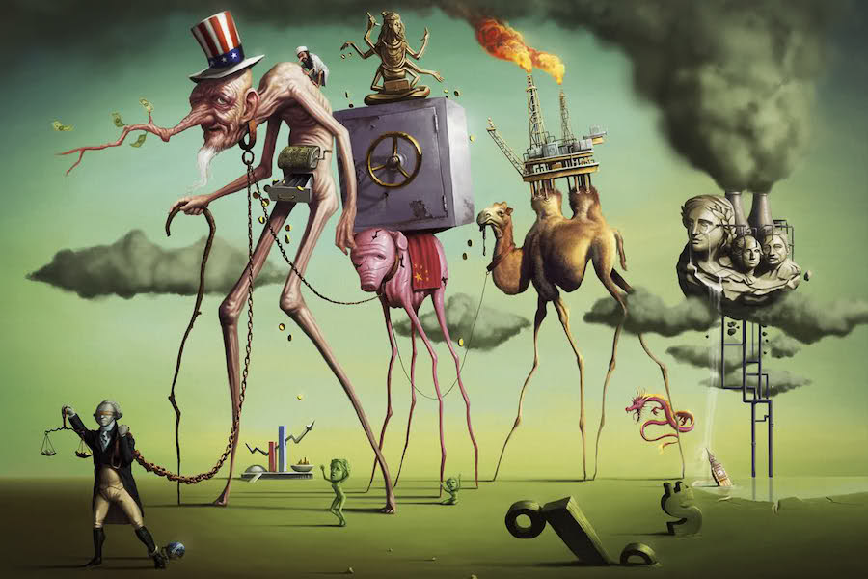
A Short History of Neoliberalism: Market, State and Human Nature, 1920 to Today
Dr Claudia Stein

Slide 2
Lecture outline
What is ‘governmentality’?
The history of behavioral economics – some facts
What does behavioral economics do?
Latest forms of neoliberal governmentality: Nudging and libertarian paternalism
Nudging: a form of ‘surveillance capitalism’

Slide 3
How did we approach the ‘beast’ of neoliberalism so far? recap
Aled Davies, Ben Jackson, and Florence Sutcliffe-Braithwaite eds, The Neoliberal Age: Britain Since the 1970s (London, 2021) – (see lecture 1 slides)
Neoliberalism as a political ideology
Written by intellectual historians (such as Slobodian, Stedman Jones) identifying origins
and then tracing the transfer of its ideas into politics and public policy throughout the
second half of the twentieth century; identifying both diversity and coherence within
neoliberal thought; how it infiltrates all parties, left and right.
2. Neoliberalism as a type of capitalism
‘Marxist scholarship and alternative explanations that emphasise economic factors in
the rise of neoliberalism. Neoliberalism is interpreted as a response to or even function
of, the changing material conditions of capitalism in the late twentieth century.’ (e.g.
Harvey and our session in week 9!)

Slide 4
How to theoretically understand the rise and success of behavioral economics, nudge economics, and libertarian paternalism in?
3. Neoliberal ‘governmentality’
Inspired by Michel Foucault’s lectures series Security, Territory, Population: Lectures at the Collège de France, 1977–1978’ (English 2007) and ‘The Birth of Biopolitics: Lectures at the College de France, 1978-1979’ (English 2008)
Neoliberalism should be understood as a ‘rationality’ in which ‘generalised competition has become the societal norm, and in which individual subjectivity has been reformed according to the ideal of competitive entrepreneurialism.
‘…neo-liberal governmental intervention is no less dense, frequent, active, and continuous than in any other system (…) (government) has to intervene on society as such, in its fabric and depth. Basically, it has to intervene on society as such so that competitive mechanism can play a regulatory role at every moment and every point in society and by intervening in this way its objective will become possible, that is to say, a general regulation of society by the market.’ (Foucault, 2008, p. 145).
‘
According to Wendy Brown, Undoing the Demos (2015), neoliberalism is not simply a strand of ideas or policies or a state of the economy but rather the ‘governing rationality’ of our times.’

Slide 5
Governmentality: what does it mean?
‘Governmentality’ defines the ‘art of government’ as the ‘conduct of conduct’—a form of power that shapes, guides, or affects the actions of individuals and populations.
Works through what Foucault calls an apparatus of power/knowledge; all power is directed at the human body via:
Discipline of individual bodies (in Discipline and Punish: The Birth of the Prison (1975); different forms of bodily discipline.
Regulation of large populations (in History of Sexuality, 1984)
Central to governmentality is the concept of ‘biopower/biopolitics’:
According to Michel Foucault , biopower is a modern form of power that manages, optimizes, and controls human biological life at both individual and population levels. Biopower develops from the 17th century and replaces older sovereign power (i.e. the power of an absolutist ruler to ‘take life’ of any subject). Governments begin to ‘foster life’.
It acts through mechanisms like health (via statistics), turning biological features into political targets. The overall aim is the creation of to ‘docile bodies’ – human beings that do what the government wants them to do without even realising it -- and to regulate large population health, fertility, and longevity.
Why ‘governmentality’? New forms of taxation, labour force, war and territorial security (e.g. rise of nation states, empires, food security)

Slide 6
Claim
Behavioral economics questions of governance – inspired by libertarian paternalism – is a form of ‘governmentality -- neoliberal governmentality – it creates ‘docile’ bodies that do what they are supposd to do without being asked
‘Behavioral economics should be understood as a political economic as a political apparatus of neoliberal governmentality that has the objective of using the state to manage and regulate individuals, interests and population – by attempting to correct their derivation from rational, self-interested, utility-maximizing cognition and behavior – such that they more effectively and efficiently conform to market logics and processes. In doing so it intensifies processes of neoliberalisation.’
(John McMahon, ‘Behavioral Economics as Neoliberalism’ (2015), p. 138)
Behavioral economists have been fundamentally shaping British society since the 2000s in fundamental ways.

Slide 7
2 . The history of behavioral economics – some facts of its history
‘Behavioral economics increases the explanatory power of economics by providing it with more realistic psychological foundations’ (Camerer and Loewenstein, 2004, p.3)
Behavioral economics:
History of economics; the rise of neoclassical economics
History of experimental psychology
The love/hate relationship of these two disciplines begins at the end of the 19th century, the moment when both discipline start to carve out their respective ‘territories’ as independent disciplines.

Slide 8
History of the rise of neoclassical economics late 19th century (see lecture 2)
Late nineteenth century political economist aimed to make their field a ‘hard’ natural science that demonstrated the laws of value in ‘utility’ (e.g. Jeremy Bentham’s philosophy of utilitarianism which values ‘hedonism’, that is ‘the pursuit of happiness and greatest happiness of all’ (hedonistic calculus: hope that it will be possible to scientifically measure how to increase human pleasure and reduce pain)
‘Marginal Revolution’ in political economy (e.g. Jevson, Walras and Menger) – new definition of ‘utility’
‘subjective value theory’; The value of things is measured by their ‘usefulness’ for the consumer (reflection of such utility is the price the consumer is willing to pay).
Problem: There is, therefore, no ‘objective’ standard of value, since the utility of a consumer good may vary between individual and at different times
What became of great interest is to understand consumer ‘preferences’ – later called ‘choices’ What makes them do their choices?
Market equilibrum: portrays capitalism mathematically as a peaceful system driven that is self-equilibrating
competitive mechanisms (from physics, note; Marx would have turned in his grave; but reflected political
context)
2. Scarcity
Model of the homo economicus: ‘the rational, utility-maximizing human economic actor’ (expressed in a mathematical formula)

Slide 9
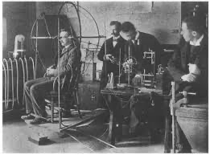
The history of experimental psychology; the rise of ‘psychophysics’ in the late 19th century
Emerges in the late 19^{th-}century in Germany by Gustav Fechtner, Ernst Weber, and particularly Wilhelm Wundt
Although the term ‘psychology ‘meaning “study of the soul” goes back to antiquity, its modern use arose in the 19th century when philosophers, physiologists and physicians applied the scientific methods to studying the mind.
The key step in this was the acceptance that conscious mental life was linked to biological processes in the body -- a consequence of Darwin’s theory of evolution.
1879 Wundt (1832-1920) opened the first experimental laboratory in Leipzig to investigate the human mind. His research focused on analysing the structure of the mind by breaking down consciousness into basic, measurable sensations and feelings through highly controlled introspection techniques.
His theories and methods distinguished psychology from biology and philosophy. It remained the question what whether there are internal as well as external influence on the mind and human behavior. What creates happiness for example?
Surprise, surprise…Jevons, Walras and Menger were not only aware of such new research but super keen on using such ‘scientific foundations’ of human mind for their ‘subjective value theory’; how nice to be able to scientifically pin down human preferences and choice! BUT economist on the whole are cautious….and the budding psychology discipline have little interest. They are after ‘the soul’ of people!

Slide 10
Behaviouralism and Samuelson’s ‘Revealed Reference Theory’ in the 30s and 40s in the US
Behaviour should be studied scientifically using experiments. Developed by John Briadus Watson and Burrhus Frederick Skinner in the US.
Behaviour is the result of stimulus–response (i.e., all behaviour, no matter how complex, can be reduced to a simple stimulus–response association). All that needs to be done is to ‘observe’ behavior
The major influence on human behaviour is learning from the environment (e.g., conditioning and active learning) (according to this view, people are not born with pre-set traits or instincts that drive behaviour.
There is little difference between the learning that takes place in humans and that in other animals. Therefore, research can be carried out on animals as well as humans. (animal experimentation). This is very controversial at the time!
Paul Samuelson (1915–2009) was not a behavioural economist in the modern sense. Rather, his work in the 1930s and 1940s was aimed at removing psychological concepts from economics to create a more mathematically rigorous ‘positivist’ science. He is best known for developing Revealed Preference Theory, which sought to explain consumer behaviour solely through observed actions (preference or choices) rather than unobservable internal motivations like ‘utility’ or ‘happiness’. He aimed to base demand theory on observable, objective and rational preference or choices.

Slide 11
Challenging the boundaries of the disciplines
By the 1940s and 1950s ‘behavioral economics’ was used but it remained fuzzy and the problem of psychological
approaches remained. There are many econonomists who use psychological theories but the disciplines remain
more or less distinct. But it is a period of undirected discussions of how best to formulise human decision making
Economist aimed to understand ‘market, first and foremost. To that end and use psychology to explain how to steer behavior towards a competitive equilibrum in which all economic actors behave optimally and in which welfare of society is maximized. The market and the market actor where highly formulised. (define it again for them)
Experimental psychologists were not interested in the explaining actors in a ‘market’.
But they begin to work on how hmans make descision via experimentations.

Slide 12
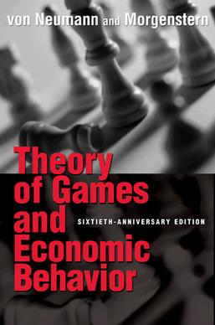
One of the most influential contribution in that begin to break the wall between
the two disciplines
John Neumeier and Oskar Morgenstern, Theory of Games and Economic Behavior (1944)
Creates the interdisciplinary field of game theory
Game theory is the study of mathematical models of strategic decision -making among rational utility-maximising agents. It suggests that the best course of action for a participant depends on the anticipated actions of others. It provides a framework for analysing scenarios—"games"—where individuals, firms, or nations have competing or conflicting interests.
Note: Game theory is ‘testing’ public choice theory. It was not only discussed in economics but further developed extensively in the 1950s/60s/70s in the natural sciences and social sciences. (e. g. evolutionary models). It is applied to all kinds of areas: policies, military, computer science and increasingly to understand the financial market analysis to detect the ‘imperfections’ of market strategies.

Slide 13

3. What do these behavioral economists do?
Research in experimental psychology moves to the investigation of the brain’s functions from the 1970s
Cognitive psychologists focused on the functioning of the brain and aimed to open the mind’s ‘black box’. How did and investigate how different components of the brain – memory, cognition and perception – interact to produce human behavior.
Daniel Kahnemann and Amos Tversky’s collaboration stands out among the most influential researchers (Daniel Kahnemann receives as the first psychologists the Nobel Memorial Prize in 2002ö’ Tverskz died in 1996).
Their research introduces the idea that although rational individuals should adhere to the normative theories of logic and expected utility calculation and optimisation in their decision-making, fact is that individuals is systematically and predictably deviate from these norms. So, humans are naturally biased.
Daniel Kahnemann’s bestselling
Thinking Fast and Slow (2011)
.
By the 1980s cognitive behavioral
decision-making becomes
relevant for, and was
incorporated into, economics

Slide 14
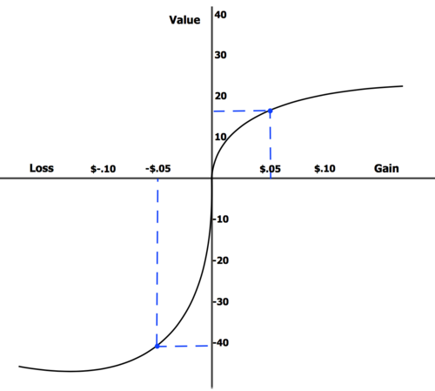
Prospect Theory
Prospect theory challenges central claims of John von Neumann and Oskar Morgenstern game theory from 1944 and constitutes one of the first economic theories built using psychological experiments.
It is a mathematical theory that aimed to identify fallible human behaviour and aimed explicitly to engineer solutions to improve human decision making.
Thus, contrary to the strategic expected utility theory (which models the decision that perfectly rational agents would make), prospect theory aims to describe the actual behaviour of people.
Well….

Slide 15

Redefining the homo economicus: the US business economists Richard Thaler
During the 1990/2000a he used saw in ‘prospect theory’ the proof for observed anomalies in financial markets/ He used it to relace traditional microeconomics model of human behavior (rational, utility-maximizing homo economicus) with the new model:
Humans are always, by nature, prone to mistakes.
Thaler understands that psychological findings of prospect theory shed light on
the irrationality of individual choice and drew direct links from the irrational choices
to irrational features of the behavior of (financial’) markets.
He also questions the long-standing belief that the markets were always moving towards ‘equilibrium’.
2017 Memorial Prize in Economics:
‘…for his pioneering contributions to behavioural economics, specifically for incorporating psychological, more realistic assumptions into economic decision-making analyses. His work bridged economics and psychology, demonstrating how limited rationality, social preferences, and lack of self-control affect individual decisions and market outcomes.’
Richard Thaler

Slide 16
Is the economic actor ‘fully rational’? Or is he/she limited by a ‘bounded rationality’?
How do neoclassical economists understand ‘rational homo economicus:
People have well defined preferences (or goals) and me decision to maximise those preferences
Those preferences accurately reflect (to the best of the person’s knowledge) the true costs and benefits of the available options
In situation that involve uncertainty people have well-formed beliefs about uncertainty about how uncertainty will resolve itself
And when new information is available, people update their beliefs – using Bayes’ mathematical law – the presumed ability of to update
Probability assessment in light of new information.
Behavioral economist accept that this ‘should’ be the norm but most of the time, it isn’t.
How do behavioral economists understand the rational economic actor?
Bounded rationality is the idea that rationality is limited when individuals make decisions and under these limitations, rational individuals will select a decision that is satisfactory rather than optimal. The individual decision-making is limited due to biases, errors of judgement, miscalculations.

Slide 17
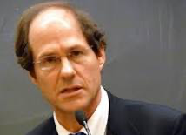
4. Nudging Economics as Libertarian Paternalism – a neoliberal form of governmentality
Behavioral economists turned their interests to the area of law and policy, particularly welfare policies (pension schemes, taxation, health care, developing programmes). They promised more efficiency (in terms of success, of manpower and costs). They aim to ‘de-biase’ people, to help them to make less errors so that they can fully take advantage of the welfare system. They say….
Libertarian Paternalism, The American Economic Review 93,2 (2003), 175-179.
Nudge: Improving Decisions About
Health, Wealth and Happiness (2008)
Sold over 2 million times
Richard Thaler
Cass Sunstein, legal scholar,
Harvard University
Why Nudge? (2014)
Note: 2008 is the middle of the financial crisis! Recent scholarship claims that it was
so attractive due to the crisis and the following ‘austerity politics’.

Slide 18
What is libertarian paternalism?
Definition of ‘paternalism’
‘(Paternalism) is the interference of a state or an individual with another person, against their will, and defend or motivated by a claim that the person interfered with will be better off or protected from harm.’
(Gerald Dworkin, “Paternalism” in Stanford Encyclopedia of Philosophy (http:// plato. Stanford. edu/ entries/ paternalism/)
Definition Libertarianism: libertarianism s a subset of liberalism , it is a political philosophy prioritising maximum individual liberty, autonomy, and free choice in both personal and economic affairs. It advocates for minimal state intervention, strong private property rights, and adherence to the non-aggression principle. Key views include free-market capitalism, limited government, and civil liberties.
Libertarian paternalism is a ‘soft’ form of government paternalism that operates without coercion and which seeks to
influence individuals to make better consumer and lifestyle choices
in opposition to ‘harder’ forms’ of government paternalism that restricts the range of choices on offer
(e.g. access to the internet for kids, having to wear a seatbelt)
Libertarian paternalism ‘corrects’ the deficiencies of both libertarianism and paternalism. It aims to improve the individual choices Ppeople make without coercion.

Slide 19
What is ‘nudging’?
‘Because humans are humans ..they make predictable errors. If we can anticipate those errors, we can
device a policy that will reduce the error rate’
‘Our goal ….(is)..to defend libertarian paternalism, an approach that preserves freedom of choice but that
authorises both private and public institutions to steer people in directions that will promote their welfare.’
(Thaler/Sunstein, 2003, 179).
‘Libertarian paternalists want to make it easy for people to go their own way; they do not want to burden those
who want to exercise their freedom.’
How? People are helped by specifically designed ‘choice architects’ which creates a ‘landscape of choice’ that makes it easier for people to navigate in their decision making – they design clever ‘nudges’ to push people into the right directions without the ‘nudged’ knowing it.
‘We favour nudges over commands, requirements, and prohibitions…’
Claim: Nudge economics safeguards against governments coercion because it works by preserving individual
freedom of choice and, more than this, it can enhance such freedom by enabling individuals to navigate life-choices in ways that will bring greater benefits to themselves.

Slide 20
Is this just a theory? UK’s ‘Nudge Unit’
The Behavioural Insights Team (BIT), widely known as the "Nudge Unit," was established by David Cameron’s government in 2010, advised by Richard Thaler (UK as the ’laboratory’ of libertarian paternalism; other countries followed suit; Covid was the most ‘successful testcase’ of libertarian paternalism… they claim).
Started with 7 people in Cabinet Office; 2015 it ‘branded’ out of government and became a globally operating company, half owned by the Cabinet office; 2021 bought by Nesta (https://www.nesta.org.uk/).
‘The UK's independent innovation agency for social good, established to design, test, and scale solutions for major social challenges. Focused on three main missions—a fairer start for children, healthier lives, and a sustainable future—Nesta supports, encourages, and inspires innovation.’
Based on behavioural economics the BIT relies mainly on research in cognitive neuroscience (of emotion). It trains civil servants, council staff, and staff in private companies in ‘behavioural insights’ (e.g. apply to letter writing, emails, design of websites and documents, telephone calls, dynamic of interviews and group meetings, emotional management, advertisement and PR, policy design and testing; election paper design; health campaigns (e.g. anti-smoking, anti-sugar, medication), all forms of activism campaigns AND it runs algorithms on all social medial platforms.

Slide 21
‘Don’t worry, e Know your interest better than you do’
Can they actually ‘deliver’? (e.g. when people are nudged into eating more vegetables, for example, can this be taken as a proof that the nudged worked by simply assuming that people wanted to eat more vegetables all along but somehow ‘couldn’t’ because of some cognitive defect’, i.e. rational limitations ?
What counts as ‘limitations’ of rational decision-making’? Who decides what they are? And who decides what the ‘norm’ is (e.g. all people want to each more vegetables; no body wants to smoke; too much internet is bad for you)
What counts as as a decision that is ‘optimal’ or at least ‘satisfactory’?
Are they suggesting that once the’ limited rationality of individuals’ (biases, errors or miscalculations) are corrected, only then an individual can realise his own self-interest?
How to determine peoples’ interests? The people or the nudge economists? Are interests of people only based on measurable ’choices’ they do (presented by economists to them)? Or do they include everything a person cares about? Aren’t all the reasons a person makes choices and takes action, and are an important part of the person himself or herself? Doesn’t every choice has countless possible explanations and change according to specific situations?
Are the choices that arise from ‘nudging’ really really ‘voluntary’?
What about individual ‘autonomy’? What about human freedom?
Who is defining what people’s ‘true’ interests are? Who has the authority? The behavioral economist? The government?
Question: is this model (based on mathematical formula) more accurate of human decision-making?
Isn’t it still within the broader model of neoclassical economics in which an individual is understood as being driven by
the allocation of scares resoures to varied ends (in the behavioral model no longer optimal but ‘satisfarctory’ ends? Who is deciding what is satisfactory or, even

Slide 22
Behavioral economics, libertarian paternalism nudging as a form of neoliberal governmentality
’Paternalistic interference involves the claim of one person to know better what is good for another person that that other person him- or herself does. It involves the substitution by the paternalistic interferer of his or her conception of what is good for another for that other’s own conception of his or her good. It it involves a claim to know the objectively correct conception of another’s good – what ultimately values and aims define another competent individual’s good, independent of whether that other accepts its – then it is ethically problematic.’
Although they claim nudge economics and libertarian paternalism is not ‘coersive’, isn’t the coersive nature of these practices and ideas that they are designed to change people’s behavior in someone else’s interest by claiming to rely on some unconscious anomalies of decision-making? Isn’t nudge to ‘trick’ and fool people into a decision – for their own good of course? Is it really soft paternalism?
Claim: Behavioral economics, nudge economics is the latest form of governmentality, surveillance capitalism’
our understanding of ourselves, our selfhood and identity, our understanding of good and bad, is entirely defined
by someone else.
Is this the identity that suits today’s ‘surveillance capitalism’?

