Slide 1
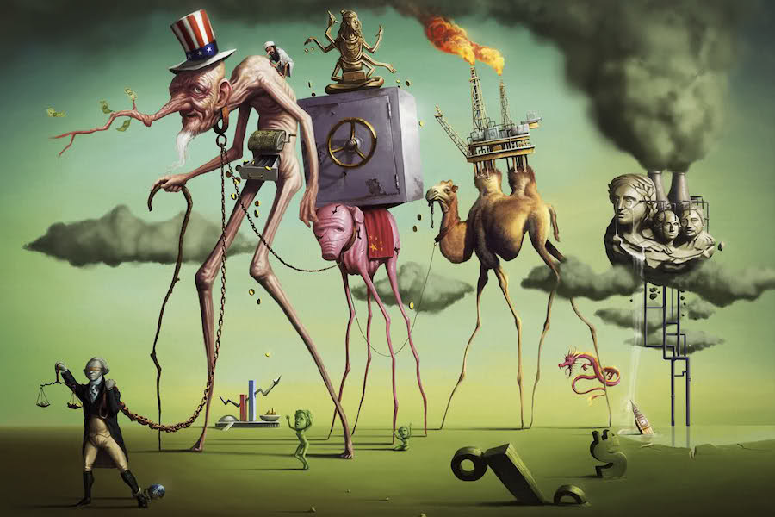
A Short History of Neoliberalism: Market, State and Human Nature, 1920 to Today
Dr Claudia Stein

Slide 2
Lecture 2, Term 2
Classical Economics and 19th-Century Marginal Revolution
Dr Claudia Stein

Slide 3
Lecture outline
Classical economics and the matter of ‘objective value’ theory: Smith, Ricardo, Marx
The ‘Marginal Revolution’ and the rise of ‘subjective value’ theory and neoclassical economics
Mariana Mazzucato, The Value of Everything: Making and Taking in the Global Economy. London, 2018.
‘At it heart economics is a social science’, p. 11.
‘Political economy’: a branch of social sciences that studies the relationship between politics and the
economy and how each influences the other. All classical thinkers we deal with today are ‘political economists’.
Only from 1930s the term ‘economics’ replaces ‘political economy’.

Slide 4
What is value?
Value: the production of new goods and services.
How these outputs are produced (production) , how they are shared across the economy (distributed) and what is done with the earnings that are created from their productive reinvestment? Is that is what is produced ‘useful’?
‘Value creation’: The ways in which different types of resources (human, physical, an intangible) are established
And interact to produce new goods and services.
‘Value extraction’: activities focused on moving around existing resources and outputs, and gaining disproportionately from the ensuing trade
Claim: Today, subjective value theory reigns with ‘the market ‘driven by supply and demand.

Slide 5
To understand different theories on ‘value’ turn around a fundamental issue:
Division between ‘productive’ and ‘unproductive’ activities and how this distribution has influenced ideas about which economic actors deserve what – how the spoils of value creation is distributed in society. Productive activities are conceptually ‘fenced’ off from unproductive activities
unproductive
activities
productive
activities
Producers of wealth
Beneficiaries of produced wealth, created by productive activities, distributed to them (e.g. welfare), or unearned income (e.g. rent)
Mazzucato, Value, p. 9

Slide 6
Classical economics and the ‘objective value theory’
Adam Smith (1723-90), David Ricardo (1772-23), and Karl Marx (1818-83)
They share two central ideas:
Value derived from the cost of production, principally labour
Therefore, activity subsequent to value created by labour (e.g. finance), did not in itself create value.

Slide 7
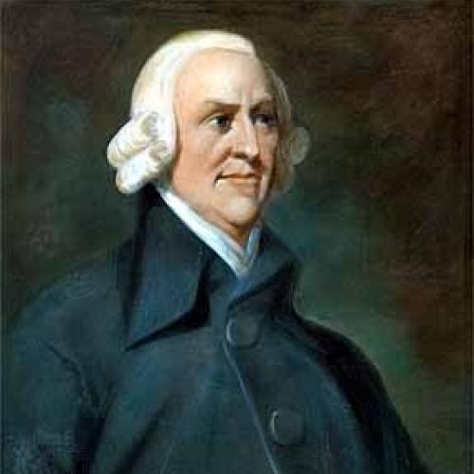
Context of Smith’s political economy
Acts of Union 1707: The Acts joined the Kingdom of England and the Kingdom of Scotland (previously separate states with separate legislatures, but with the same monarch) into a single, united kingdom named ‘Great Britain’
Results
No longer a political government in Scotland; managed by English ‘agents’; a country without a political head
But access to English trade at home and abroad; Britain leading Industrial Revolution
Adam Smith,
Aim: how to reconceptualise a prosperous society without a political leader of its own, held together by the through commerce and trade?
Adam Smith, 1723-1790

Slide 8
What is Smith working against?
1. Mercantilism
It is the economic counterpart of political absolutism.
An economic theory and practice, dominant in Europe from the 16th to the 18th century which promoted the idea that a nation’s wealth was the amount of money or gold that it possessed.
This implied that to become richer, a nation needed to sell as much as possible to others, in order to get as much coin/gold as passible in return; and it needed to buy as little as possible from others, in order to prevent its cash reserves leaking abroad.
The view of trade led to the creation of a vast network of important tarifs, export subsidies, taxes and preference for domestic industries, all designed to limit important and promote exports.

Slide 9
2. Physiocrats
First effort to find a formal theory wealth and value in the mid-eigtheenth century, designed
by Francois Quesnay, adviser of Louis XV (e.g. Tableau Economique, 1758); directed against
mercantilism and is obsession with coins and gold. But, let’s not forget that he works for the aristocracy!
Main claim: Land is the source of all value. Everything that nourishes humans come from the soil.
Nature produces value; humans can only transform the wealth/value provided by nature.
He defined for the first time in history what was ‘productive’ and what was ‘unproductive’
Productive: agriculture, husbandry, fishing, hunting and mining
Unproductive: households, governments, services, and even industry – unproductive

Slide 10
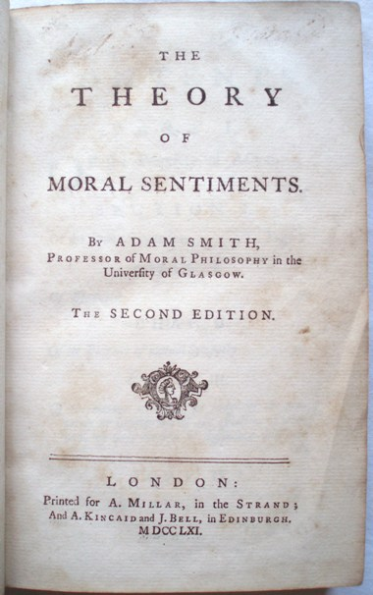
Smith is NOT an economist (often claimed today) but first and foremost a moral philosopher:
The Theory of Moral Sentiment (1759):
An attempt to develop a coherent and plausible account by which humans learn the principles of morality from their experience of common life without descending into wanton religious scepticism like some important moral philosophers at his time suggested (e.g. Mandeville: everyone is always corrupt; Rousseau: humans are born good but then corrupted by society
Central concept is ‘sympathy’:
Smith achievement is that he turned sympathy into the governing principle of a theory of sociability on which a theory of commerce could be based.

Slide 11
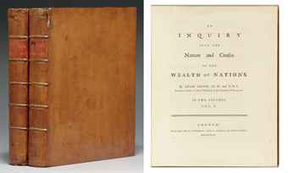
Smith’s The Wealth of Nations is entirely based on his idea that humans are guided by ‘sympathy’ and self-interest that develops from it – so, it is not about ‘greed’ but about ‘sympathy’
The Wealth of Nations, 1776

Slide 12
Smith’s ideas of wealth and value --- The Birth of labour theory of value
A theory that involves a universal idea of human nature: self-interest and competition, based on sympathy; addressed to politicians and policymakers (i.e. not leave it all to the market)
Key: Manufacturing labour (not land, or gold/coins at the core of wealth/value growth and
    Technological change and organisation of labour (e.g. mechanization)
    Division of labour (famous ‘pin factory’ example)
    When harnessed to the division of labour, mechanisation would radically increase productivity
    the principle agent of growth. Also, the simple reorganization of labour – without the help of machinery
    will have the same effect.
    ‘Value’ is proportional to the time spent by workers on production,
    Labour is productive when it is ‘realized’ in a permanent object’

Slide 13
    Theory of value:
    ‘He was convinced that growth depended on increasing the relative share of ‘manufactures’ – factories employing formerly independent artisans and agricultural workers as dependent wage workers – in the overall make-up of industry and believed that free trade was essential to bring this about.’ (Mazzucato, Value, p. 36)
household production
government
tertiary sector (services: merchants, lawyers, priests, doctors, artists, government officials…)
Primary sector
(agriculture, mining..)
Secondary sector (industry)
Note: government is
unproductive
The unproductive parts are kept alive by the surplus of production (not needed to sustain the workers)
Material production:
How much work does it take
to produce
Immaterial production. Useful to manufacturers but not involved in production itself.

Slide 14
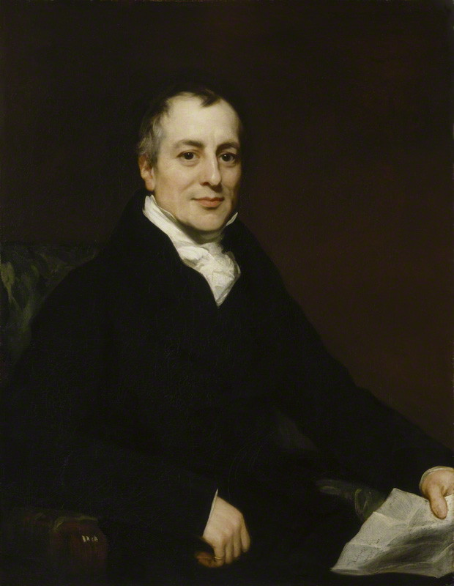
David Ricardo: Grounding Smith’s Value Theory
Question: How was wealth/value distributed throughout society?
Smith had observed that the value of labour, when sold, is distributed as wages, profit and rents. But he had no coherent theory for the way in which wages were apportioned, or why they differed between professions and countries over time.
On the Principles of Political Economy and Taxation (1821)
For Ricardo the distribution of wages was the principal problem in political economy and ultimately regulated growth and wealth of a nation.
1819 – 1823

Slide 15
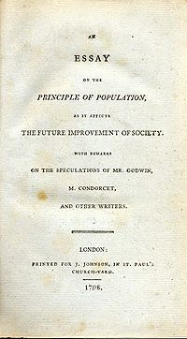
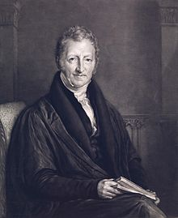
Richardo’s thinking is shaped by a contemporary thinker who dominated British political economy in the first half of 19th century
Reverend and political economist Thomas Robert Malthus, 1766 – 1834
1798

Slide 16
Malthus writes against the optimism of the
Enlightenment that everything will work out in harmony
according to God’s will and benevolent human action
in society (Jean-Jacques Rousseau and social reformers
such as William Godwin)
Main idea: society is a struggle and only the strongest survive in the competition over available resources (mainlyover food).
‘The power of population is so superior to the power of the earth to produce subsistence for man…’
‘ongoing struggle of existence over subsistence ’ (according to Malthus God directed this struggle!!!!)
Thomas Robert Malthus, 1766 – 1834
Note: We shall later see that Darwin took these ideas for
this theory of evolution!

Slide 17
Malthus ideas on wages and their dependency on agriculture
Whenever real wages are above subsistence level, the population will grow until it is so large that demand for food will push up food prices enough to bring wages back to subsistence level.
Ricardo follows largely Malthus ideas:
  Wages depend heavily on the production of agriculture: if productivity rose and food became cheaper, wages would fall. And in manufacturing and the other branches of economy, whatever did not have to be paid to the workers would flow to the capitalist as profit. Profit are the residual from the value that workers produce and do not need to consume for their own ‘maintenance’, as Ricardo puts it, ‘to subsist and perpetuate their race’. (p. 42)
  Land (or nature as he calls it) land is the key that restricts the economy in the progress of capital accumulation. Less good land makes corn prises rise.
  Technological advance in manufacture, he believed, cannot overcome diminishing returns in agriculture. If rising productivity in manufacture can overcome the diminishing returns in agriculture, then declining prices in the manufacturing industry will exceed rising prices in agriculture. Ricardo regards that ‘the price of necessaries chiefly [depends] on the price of food’, and the rising price of corn enhances wages – profits are lost of capitalists and nations income goes to landowners

Slide 18
Theory of rent or ‘differential rent’
Rent is a payment to landlords for the use of land's "original and indestructible powers," arising from differences in soil fertility and scarcity (not labour or capita) – monopoly on scarce asset.
The price of corn is set by the least fertile land, so more fertile lands generate a surplus (rent) for the owner.
Increasing as population grows inferior lands are cultivated; more profit (rent) to the landowners.
Rent is essentially a surplus payment for a naturally superior resource, not a cost of production, benefiting landowners at the expense of workers and capitalists as society progresses.
Today his ideas of rent are transferred to other areas of economy.

Slide 19
Value for Ricardo
Essence of value: industrial production in general leads to surpluses, but for him the real question is how those
surpluses are used. If the surpluses in finance, for example, productive consumption, they are productive; if not, they are unproductive.
By drawing attention to the differences between by wages, profit and rent to the question: how are the profits divided? Share of the amount of effort they put in?
Is he interested in the question of sharing profits? NO
The profits are pocketed (e.g. rent) by the those who own the good land (which will yield higher corn prizes).
His view helped to abolish the Corn Laws in 1846 and embrace free trade
The pool of unskilled workers held the losing ticket! Heroes are the industrial capitalist ‘those who reproduce’ who can ensure that workers subsist and generate a surplus that is free for the capitalist to use as he or she sees fit. His villains are those ‘who do not reproduce’ – the landlord nobility, the owners of scarce land who charge very high rents and appropriate the surplus. Capitalist must produce surplus
Government is the ultimate example of unproductivity (no concern about part of government in productivity in the first place: infrastructure, national defense or rule of law.)

Slide 20
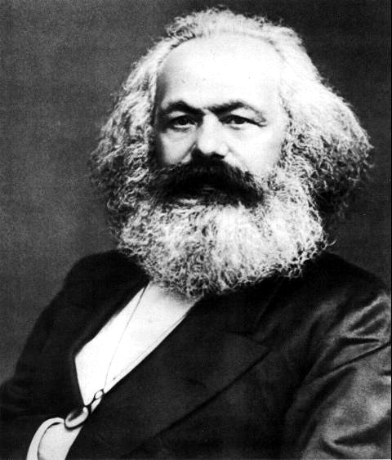
Karl Marx’ labour theory of value as an analytical tool to critique society
As the Industrial Revolution progressed, its excesses
became dramatically visible: mass poverty, particularly in cities; excessive wealth accumulation, environmental destruction, imperialism, driven by wars
Marx theory of value is not simply an intellectual theory but
an active critique of the specifical capitalistic system that he saw developing around him.
new:
Definition of productivity depend on historical circumstances –
the society at a given time
Capitalism is dynamic and constantly changing throughout history
Brings together specific forms of society with the changing nature of capitalism
Smith/Ricardo saw ‘capital’ as purely physical and surplus as positive –
Marx gives capital a social dimension and ‘surplus’ a negative connotation –
as exploitation
Karl Marx, 1818-1883

Slide 21
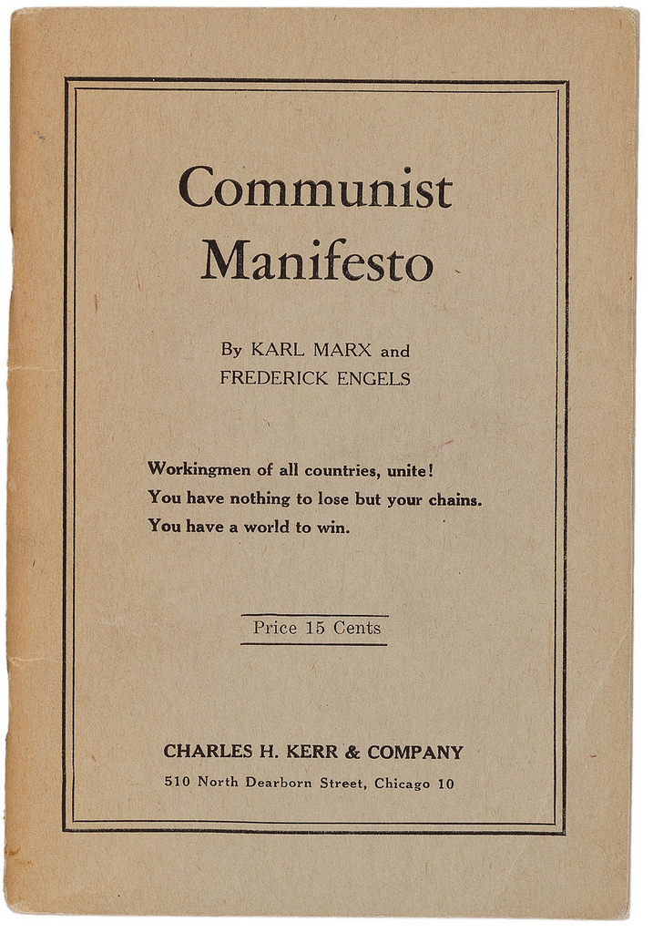
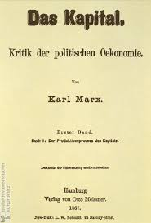
Most famous works
1848
Vol. 1-3
1867-1894

Slide 22
Historical Materialism (note: Marx never used the term himself!)
Historical materialism is Karl Marx's theory of history, which argues that economic conditions (the "mode of production") are the primary drivers of social, political, and intellectual change throughout history.
It posits that all societal institutions, from government and law to religion, family, and culture, are shaped by the underlying economic system and the resulting class struggles between those who own the means of production and those who do not.
Social change (and historical change) occur as contradictions within the mode of production lead to a new system, progressing history from one stage to the next.

Slide 23
Superstructure:
Superstructure:
comprises the cultural, ideological, political, legal, and social institutions (like governmental agencies, culture, family, or religion, ideology, etc.) that are shaped and determined by the economic base (the mode of production and class relations). The superstructure's primary function is to reproduce and legitimize the interests of the ruling class by promoting ideologies that obscure class conflict and maintain the existing power structure.
Societies in each stage are organized from the bottom up. The ‘modes of production’ produce social reality of people (superstructure)
Relations of production: the social relationships that emerge between people during the process of production, distribution, and exchange of material wealth, fundamentally based on the owner-
ship or lack of owner-
ship of the
means of
production
Relations of Production
Class: class is defined by a person’s/groups relationship to the forces of production—either owning them or selling their labour to survive (in capitalism:proletaria -
bourgeoisie)
Forces of Production
Forces and means of production: These are the tools, technology, and raw materials society uses to produce goods, as well as the collective labour and knowledge of the laboring people.

Slide 24
‘Historical Materialism’
Communism
Society free of class
Socialism
Dictatorship of the Proletariat
SOCIALIST REVOLUTION
Expropriation of Expropriators
Capitalism
Bourgeoisie against Proletariat
Feudalism
Feudal lords against Peasants
Slaveholder Society
Slaveholders against Slaves
Primitive Communism
Hunter-gatherer societies

Slide 25
His idea on value and labour
Marx agrees that ‘value; is to be found labour but suggests an invariable standard of labour from which to
determine the value of all other products could be determined
The solution lies in the worker themselves:
  labour expended in production – the daily work the worker does to produce something
  labour power – the capacity to work
  ‘humans can create more value than the need to restore labour power. For instance, if a worker
  has to work five hours to produce the value needed to restore labour power per day, the labour
  power’s value is equivalent to the five hours of work. However, if the working day lasts ten hours,
  the additional five hours will create value over and above that needed to restore labour power.
  Labour power creates surplus value.’
  (Mazzukato, Value, p. 48)
  Big question for Marx: What happens to this surplus? And how is it distributed?

Slide 26
On the basis of these new definitions Marx creates his own value theory
Instead of defining production by sector or occupation (agriculture, manufacturing or lawyers and civil servants) Marx defines production boundary in terms of how profits are made.
Big question: by owning the means of production, the capitalists could appropriate surplus value while the workers who provided the labour didn’t have enough to live on?
    Key issue: Who participates in the capitalistic production ? And who receives the surplus that is produced?
Household government
unproductive
primary sector
productive sphere
secondary sector
Industry
circulation sphere
Circulation sphere: some aspects of finance, for example, are
Important to production and are therefore on the productive
side of the economy
Tertiary sector
service

Slide 27
New idea: class struggle to set wages
The wages of unskilled workers and the poor (wage share) were historically at subsistence level.
Class struggle, Marx argues, set workers wages. The side with more power could force through a wage rate favorable to itself.

Slide 28
The ‘marginal revolution’ and the rise of ‘subjective value’ theory and neoclassical economics
At first sight there is a strange contradiction here:
‘subjective value theory’ is the result of a radical ‘scientification’ of political economy by late 19th/early 20th century; no longer philosophy or history was to stand at the core of it but natural sciences and mathematics/physics
Note: Smith, Ricardo, and Marx drew on moral debates, philosophy and history to make their arguments!
Late nineteenth century political economist aimed to make political economy a natural science that demonstrated the laws of value in ‘utility’.

Slide 29
The rise of marginalism
Leon Walras (1834-1910), professor of economics, Lausanne
economics is a true mathematical science that is devoted to objective study of data; not fuzzy philosophy or history.
William Stanley Jevons, London (1835-82)
‘…if it is to be a science at all, it must be a mathematical science’. There are laws in economics discovered by statistics and mathematical equations, based on Newtonian physics.
He called his economic theory: ‘the mechanics of utility and self-interest’
Carl Menger (1840-1921), founder of ‘Austrian school of economics’
Value arises from utility for buyer, the cost of production. Including the cost of labour, did not determine value. He is not so keen on scientification though.
marginalism:
is an economic theory and method of analysis that suggests that individuals make economic decisions by weighing the benefits of consuming an additional unit of a good or service against the cost of acquiring it. In other words, value is determined by the additional utility of satisfaction provided by each extra unit consumed.

Slide 30
Marginal utility and ‘marginal revolution’
All income is reward for a productive undertaking; ‘just prices’ are reflected in an object’s utility
Central to the redefinition of value is ‘utility’
Modern history of utility begins with the formulation of ‘individual utility;
Individual utility is not simply explained by acting ‘bad’ or ‘good’ but how common goals could be
reached through individual trying to maximise the benefit to him-or herself.
Utilitarianism spills over into labour theory (e.g. value of commodity resides in its utility to a buyer
prodcutive labour is labour which produces utility.
What is utilitarianism? Where does it come from?

Slide 31
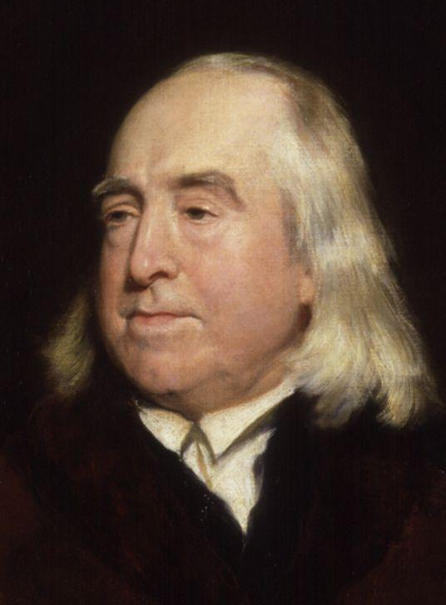
Back to Britain and a new theory of human action: utilitarianism
Utilitarianism: an ethical theory holding that the proper course of action is the one that maximizes the overall good of the society
‘the pursuit of happiness and greatest happiness of all’
‘Nature has placed mankind under the governance of two sovereign masters, pain and pleasure. It is for them alone to point out what we ought to do, as well as to determine what we shall do. On the one hand the standard of right and wrong, on the other the chain of causes and effects, are fastened to their throne. They govern us in all we do, in all we say, in all we think ..’
(The Principles of Morals and Legislation)
Jeremy Bentham 1748 – 1832
Hedonistic calculus: the appropriate mode of action is the one that maximizes utility -- maximizing total benefit and reducing suffering or the negatives effects of human action.

Slide 32
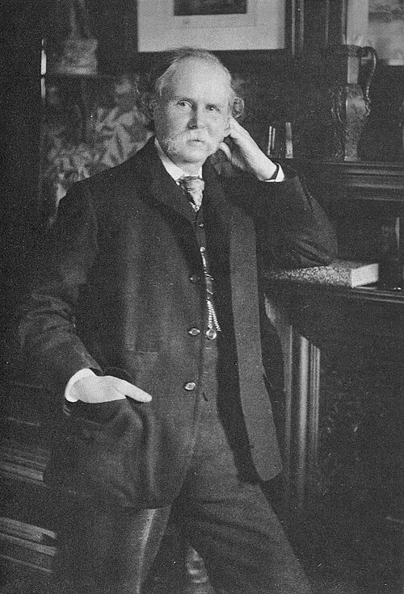
Subjective value theory – rise of neoclassic economics
Principles of Economics (1890)
Shifted thinking in political economy from value from the study of broad quantities of capital (labour or technology’) to small incremental quantities.
Using mathematics (borrowed from Newtonian physics) the focused moved on how small – or ‘marginal - a change in one variable causes a change in another.
New value theory
1. It is based on the notions of utility and scarcity and its subjective: the value
of things is measured by their usefulness to the consumer. There is, therefore
no ‘objective’ standard of value, since utility may vary between individual sand at different times
2. The utility decreases at the moment of a thing that is held or consumed increases.
Alfred Marshall, professor of political economy, Cambridge, 1842-1924

Slide 33
Marginalism stands at the core of neoclassical economic theory, and also of today’s economic theory (e.g. microeconomics)
Central:
Price reflects the utility that buyers get from them. The scarcer they are – the higher their marginal
utility – the more consumers will be willing to buy them. Price is the direct measure of value, defined as
consumer preferences.
Introduction of new concepts:
equilibra: portrays capitalism mathematically as a peaceful system driven that is self-equilibrating
competitive mechanisms (from physics, note; Marx would have turned in his grave; but reflected political
context)
2. Evolutionary theory: human preference are explained through evolutionary theory
3. Scarcity: famous diamond and water example
Lionel Robbins, LSE (1898-1984). First definition of neoclassical ‘economics’
‘Economics is the study of allocation of resources under conditions of scarcity’

Slide 34
Value is now relative; labour cannot be measured any longer, nor can we measure
the wealth of nations
Further assumptions needed to be added to marginal utility and scarcity models:
All humans have to be one-dimensional utility calculators who know what is best
for themselves, what price to pay for what commodity and how to make an economically
‘rational’ choice.( e.g. rational choice model, ‘homo economicus’)
There cannot be any interferences in price-setting; equilibrium with perfect competition,
in which supply and demand are exactly balanced
We will revisit these question when we discuss today’s behavioral economics

Slide 35
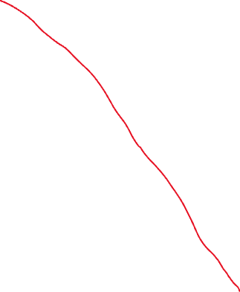

Value in the eye of the beholder
Receivers of transfers not earned in the market
Market exchange of commodities at prices expressing subjective value and produced with scare factors (labour, capital and land)
Taxes and other transfer
Production boundary

Slide 36
Bits and pieces – might be useful for you

Slide 37
Smith line of Argument:
Sympathy stands at the core of all human action, including the accumulation and distribution of wealth
humans are anxious animals – but we naturally want to know each other
why? Because humans have an innate curiosity concerning the business of all human beings. Satisfying our natural curiosity involves a process of evaluating the conduct of another person. We are attracted by our curiosity and we always tacitly or overtly rewarding that person with our approval or disapproval and expressions of affection or dislike. We judge and we want to be liked!
We thus learn to temper our passions vis-a-vis others to the point where any typical, disinterested person – an impartial spectator – says Smith would emphasize with us. Likewise when we show concern for other people, we know that an ‘impartial spectator’ would approve and we take pleasure from it being ‘liked’ by this ‘impartial spectator’;
and through experience with others, guided by the impartial spectator (in us), we gradually built up a system of behavioural norms – or morality. This is the glue of society and the foundation of its progress, Smith argues.
Smith believes that ‘greatest human happiness arises from the consciousness of being beloved’ – personal gain and greed is NOT his aim but our innate urge to being loved!

Slide 38
We even sympathize with the super rich because distribution of wealth in a society depends on it! it is an absurd feeling, Smith argues but ….
This inborn sympathy also explains immoral, negative or even absurd feelings in us, for example, our admiration of wealth
Although it is known that wealth cannot buy us happiness, we still believe that it helps to make us happy and that the rich must be happy (we assume)we assume. Indeed, he argues, we feel an empathetic pleasure in their good fortune, and their lives and affairs capture our interest.
Being the focus of attention is, of course very agreeable: for the rich, the main benefit of wealth is the flattering interest that is generates in those who look at them ‘sympathetically’.
Of course, this flattery is shallow and not deserved but the rich believe it is real.
That triggers positive outcomes for the economy:
Our empathy with these rich fools has the profound and unintended consequence of fuelling the spirit of improvement and competition on which the progress of civilisation relies. The rich are flattered, produce, consume, fuel the economy and thus help the poorer echelons of society to survive. (trickle-down effect!)
We see the rich, we envy their lives of comfort and ease. And paradoxically, Smith argues, as a consequence, we commit ourselves to a lifetime of discomfort and hard work to achieve the same.

Slide 39
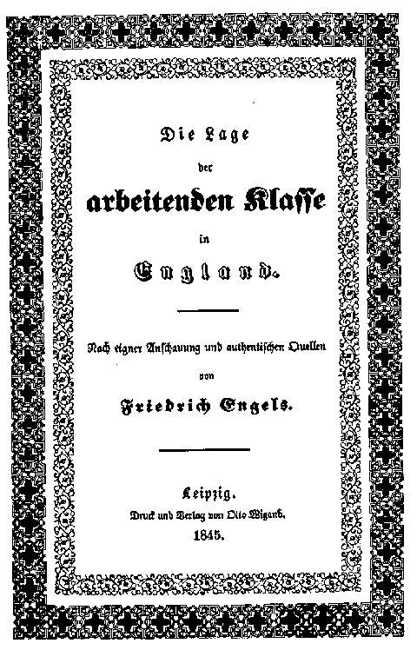
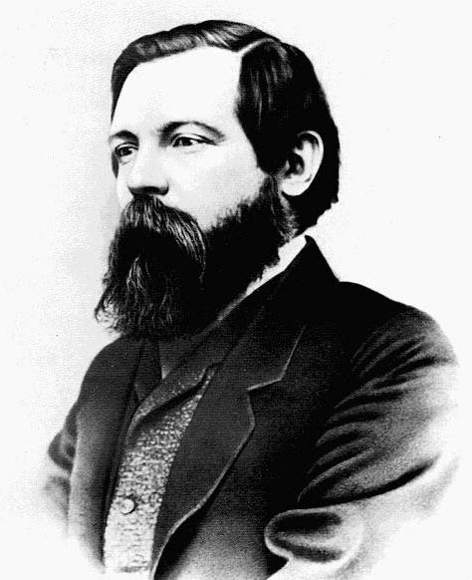
Marx has a lifelong
friendship and working
relationship with
Friedrich Engels
Friedrich Engels (1820-1895)

