Slide 1
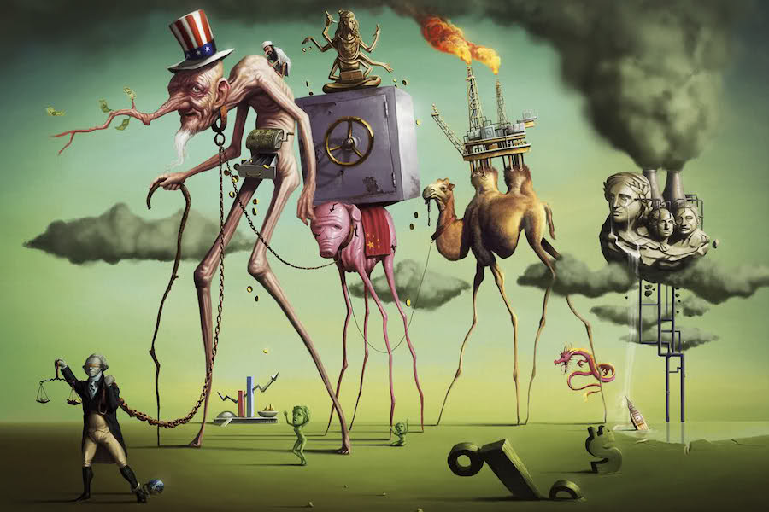
A Short History of Neoliberalism: Market, State and Human Nature, 1920 to Today
Dr Claudia Stein

Slide 2

Methodological approach: the iceberg metaphor
What are we doing here?

Slide 3
Lecture outline
Postwar developments
Chicago school
Virgina school
2. Globalising neoliberalism
‘Ordoglobalisation’

Slide 4
Approach 1: How to explain rise of neoliberalism in individual countries?
neoliberalism as a European, US intellectual product
favored by historians. Understands neoliberalism up to 1970s as a European intellectual product and framework (e.g. Austrian school of economics, Walter Lippmann Colloquium, Paris 1938, British universities, expecially LSE in UK; Mount Pellerin Society as an international neoliberal hub. Ideas move to the US (e.g. University of Chicago, University of Virginia) where new economic and political theories further develop neoliberal framework which, in turn, are then re-imported to Europe and the rest of the world; US and UK are a particular focus in view of Thatcher and Reagan taking over in the 1980s and established ‘neoliberal’ ideas and practices in national politics, policy and economic practice. Note: FRG, the first success of Ordoliberalism is often neglected in these accounts as are issues of how neoliberalism shapes global and international governance. (readings: Daniel Stedman Jones)

Slide 5
2nd. Approach: how to explain historically a neoliberal inspired global and international governance?
Historians have not yet focused on rise of global and international governance and neoliberalism. Political scientists and sociologists did and investigated the many attempts undertaken by neoliberism-inspired ’planning’ to insulate market actors from democratic pressures in a serious of institutions. (e.g. IMF and the World Bank to port authorities ad central banks worldwide, including the European central bank, governance structures such as the EU, trade treatise such as North American Free Trade Agreement (NAFTA), and the WTO.
They investigates the extension of international investment law to protect foreign investors from forms of expropriation and to provide a parallel global legal systems known as ‘the transnational law merchant’. They looked at the rise of off-shore tax havens, all designed to provide safe harbors for capital, free from fear of infringement by politics and progressive taxation or redistribution. (‘insulation of markets’ and supra-nationalization’, driven by fear, suspicion and rejection of the democratic processes such as universal suffrage; how to bring economic and political agenda of liberalism together? )
So, one approach is showing how liberty is increasingly defined by market forces on a national level; while the other one shows that that sort of individual liberty is at the same time trying to be silenced by supranational institutions!

Slide 6
Approach 1: neoliberalism as intellectual history which is Europe-centred
Mount Pellerin Society, 1947: 6 core principles enunciated at the founding of
1. The analysis and explanation of the present crisis so as to reflect its essential moral and economic origin.
2. The redefinition of the state’s functions so as to distinguish more clearly between the totalitarian and the liberal order.
3. Methods of reestablishing the rule of law and of assuring its development so that individuals and groups are not in a position to encroach upon the freedom of others and private rights are not allowed to become a basis of predatory power.
4. The possibility of establishing minimum standards by means not inimical to initiative and the functioning of the markets.
5. Methods of combating the misuse of history for the furtherance of creeds hostile to liberty.
6. The problem of creating an international order conducive to the safeguarding of peace of liberty and permitting the peace and liberty and permitting the establishing of harmonious international economic relations.
(Mirowsky/von Horn, ‘The Rise of the Chicago School of Economics’, in Mirowkski/Plehwe eds, The Road from Mont Pelerin, The Making of the Neoliberal thought Collective, 2009), pp. 159/160.
Note: the overwhelming message of Hayek’s ‘The Road to Serfdom’ is mirrored in all of these claims!

Slide 7
Key argument in The Road do Serfdom
In 19th century Britain had set forth liberalism in theory and practice (John Stuart Mill’s ‘On liberty’ ) and in practice (free trade, limited government, parliamentary sovergnity).
‘German’ developments – the supremacy of the state (Hegel), socialism (Marx), economic nationalism (List), German historicism (Schmoller), cultural critique of capitalism (Weber and Sombart and the new social sciences (Mannheim) began to roll back the diffusion of liberalism in the later part of the 19th century, a process that was accelerated by the defeat of Germany in 1918.
In general terms he underlines the dangers inherent in the consequent belief that government could provide for the welfare of their citizens more efficiently than the citizens themselves. The Road to Serfdom is a ‘German Road’.
He defends an especially English model of liberalism that defined the relationship between the individual and the state that – in reality -- didn’t survive the development of parliamentary based on universal suffrage (e.g. Labour party).

Slide 8
What sort of ‘liberalism’ is The Road to Serfdom talking about? What does Hayek suggest to return to?
The Road to Serfdom’s central new idea about liberalism and modernity:
the demise of the liberal tradition which he sees emerging in Britain during the 18th and then more forcefully during the 19th century was due to ‘foreign’ ideas concerning the impact of centralized planning on economic life. His narrative is an ‘European cast’ – in fact ‘German cast’.
The Road to Serfdom is a political tract more than a work of economic analysis and it is strangely silent on the contribution of democratic institutional developments to the demise of classical liberalism (e.g. Britain)
Keith Tribe, Liberalism and Neoliberalism in Britain, 1930-1980, in in Mirowkski/Plehwe eds, The Road from Mont Pelerin, The Making of the Neoliberal thought Collective, 2009), pp. 68-97.

Slide 9
Aims: How to forge a ‘neo-liberalism’ better suited to radically changed political conditions and how to bring economic liberalism together with political liberalism (e.g universal suffrage in democratic societies)
Ultimately institutions such as the MPS and the Chicago School were not so much about reviving a ‘dormant’
liberalism (as so often claimed by them, including Hayek and their endless historical works trying to claim classical economics for their project ( e.g. Smith, Burke, Mills) but to forge a neo-liberalism better suited to the conditions of their time.
These MPS’s themes were progressively worked out the period of 1946 to 1980s. Key places were MSP, Chicago School of Economics and Virgina School of Economics. Why? the rise of US as an almost hegemonic power in terms of economic dominance, a strong historical commitment to certain idea of ‘individualism’ and political liberalism but also as the new ‘Imperial’ power after WWII.

Slide 10
The Rise of Chicago School of Economics, 1950-60
The rise of a transatlantic neoliberalism networks
By the 1950s the neoliberal project – philosophically, political, economic -- moves from Britain and Europe to the US, Chicago and Virginia in particular. New networks of people (think tanks, and neoliberal minded journalists and private business) spread these ideas and implemented them in the wider public.
Little influence in 1950/60s yet: Immediate postwar politics, economics/politics in US/UK are shaped by forms of interventionist liberalism (e.g. German ordo-liberalism, Keynesianism, Beverige welfare state, social democracy). Neoliberalism flowered next to other critiques of such ‘collectivist’ politics (e.g. anti-communism, anti-immigration, and traditional conservative streams). Politics and economics are driven by the idea of a ‘common good’ that would provide the basis of individual freedom.
New in US: rethinking of the relationship between economic and political liberalism. Neoliberalism at the center both civil rights and Cold War debates (e.g. anti-communism hysteria in US), about the nature of ‘freedom’.
Note: the experience of Soziale Marktwirtschaft established in the FRG was absent in US debates: a strong state supervision of the competitive order of the market. The recognition of the unsettling effects of the market and the need of the state to address the social impact of markets.

Slide 11
Transatlantic neoliberalism Chicago style
‘The state is set forth to the growth of a new current of opinion to replace the old, to provide the philosophy that will guide the legislators of the next generation; even though can hardly hardly affect those of this one’.
Milton Friedman, ‘Neo-liberalism and Its prospects (1951)
All theories produced are ultimately based on the idea of ‘ neoclassical economy’ : a concept of individual as a rational-utility maximiser; consumers maximise their utility by matching their consumptions to the prices of the various good they wanted according to a rational order of preference.
aim: ideas of rational and public choice theory *based on the belief in the rational actor model) extended to hitherto untouched area of politics, regulation and government. The effort goes into re-defining these areas as a ‘market’ run by the individuals, modelled as ‘rational-utility maximisers.
‘Everybody is one’s own entrepreneur’ – and competition is the universal driver of all these new markets.

Slide 12
Chicago school of economics
As of 2022, the University of Chicago Economics Department has been awarded 15 so-called ‘Nobel memorial prizes’ in economic science since the prize was first awarded in 1968. (Real title is: Sveriges Riksbank Prize in Economic Sciences in Memory of Alfred Nobel. The prize has nothing to do with Alfred Nobel’s original wishes, in fact it acted entirely against them – Philipp Mirowski calls is it therefore, the ‘fake’ Nobel prize or ‘Ersatzpreis’ Nobel Prize).
Two schools:
1. Chicago School: During the interwar period1920-1940: Frank Knight, Jacob Viner, Lloyd Mines, Henry Simmons
important because they became the inspirational teachers of leading later economist of second generation
Chicago School 1950s/1970s: Milton Friedmann, Aaron Director, George Stigler, Gary Becker, Ronald Coarse, Edward Levi
Aim: Free market analysis need to occupy new areas such as law, regulation, family, welfare, sex (!) and so on which had been until then considered outside of realm of markets.
Central role of Friedrich Hayek in setting up a coherent agenda and getting the appropriate people in; originally they
aimed at coordinating a Free Market project (became the Free Market Study), to produce an American version of ‘The Road to Freedom’ (Hayek’s work was too difficult for American public to understand). The project takes ages and is finally delivered by Friedmann’s Capitalism and Freedom in 1962. Helped with substantial funding of William Volker Foundation (WVF).

Slide 13
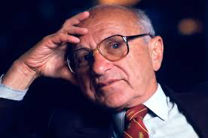
Key claim: a new theory of liberalism is needed in which the state plays a central role in the establishment and maintenance of the free market. The theory would need to
‘accept the nineteenth century liberal emphasis in the fundamental importance of the individual, but it would substitute for the nineteenth-century goal of laissez-faire as a means this end, the goal of competitive order.
It would use competition among producers to protect the consumers from exploitation, competition among employers to protect workers and owners of property and competition among consumers to protect the enterprises themselves.
The state would police the system, establish conditions favorable to competition and prevent monopoly, provide a stable monetary framework, and relieve acute misery and distress.
The citizens would be protected against the state by the existence of a private market; and against one another by the preservation of competition. ‘
(Friedman, Neoliberalism an Its Prospects, p. 4)
‘
Milton Friedman, 1902-2006
‘Ersatz’ Nobel Prize, 1976
1951 ‘Neoliberalism and its Prospect’

Slide 14
Capitalism and Freedom, 1963 (jointly written with Anna Jacobsen Schwartz)
Friedman’s kay contribution to neoliberal thought was to connect economic freedom with political freedom
Claim: the common opposition of separate economic and political sphere is ‘false’. Political freedom depends on economic freedom of the market.
Free markets and liberal democracy cannot be separated! (note: repeated by Francis Fukuyama in his famous ‘The End of History’ article at the fall of the Berlin wall in 1989).
What do free markets do, according to Friedmann? Well, everything….
An economy free from government intervention meant that political power was divorced from economic power. The market protects the citizens ability to dissent. The market guaranteed basic political freedoms by ensuring that alternatives were always available.
Free market also provides a barrier to the worst kinds of discriminations and prejudices. The market is an impersonal force that guarantees equality to all because, it ‘separates economic activities from political views and protects men from being discriminated against in their economic activities for reasons that are irrelevant to their productivity – whether these reasons are associated with their views or their color.’
He argues for the privatization of social security and marketisation of all school education.
Note: No consideration of the question of market failure! That is all in the past, according to him.

Slide 15
Human freedom to be grounded in the competitive marketplace
As man is a rational-self-interested actor, human liberty depended on the economic
individual whose freedom in the marketplace was commensurate with human freedom more generally.
Human nature is impossible to nail down by any observers, so the only certain observable part of that nature was that people operated according to their own interest to maximise their utility (Note: that is what neoclassical economics ‘invented’, we remember but they take for granted!).
It is the market where prosperity is delivered most efficiently. It does not mean that neoliberals hold the view that human nature is ‘evil’ (simply selfish)
‘Laissez-faire does not mean: let the evil last It means: let the consumer, i.e. people, decide by their buying and by their abstention from buying what shoud be produced and by whom. The alternative to laissez-faire is to entrust these decisions to a paternal government. There is no middle way. Either the consumer is supreme or the government.
Von Mises,
Crucial: the market place is the primary place in which freedom is experience and expressed to the fullest. It is organized around the wishes of the consumer and the actions that follow. The market place is where human action is ‘real’. Government, aside from its primary duty to protect the physical safetey of citizens, should be limited to the supervision of competition and thriving markets.
Problem: Do people always know what they want?

Slide 16
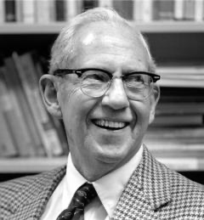
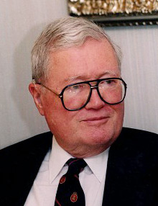
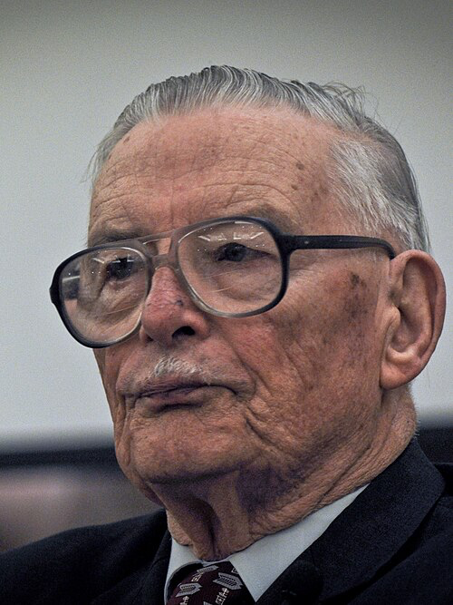
On the basis of these considerations new research directions: regulatory capture, public choice, and rational choice theory
Extend the analysis of man as a utility-maximizing individual into the realm of politics, government,
buerocracy, and regulation through their elaboration of public choice theory and ‘constitutional economics’ during the 1960
Gordon Tullocks, 1922-2014
James Buchanan,1919 2013
George Stigler, 1911-1991
Politics and government formed an arena in which the same principles and interceptives applied as those that were reflevant to the market and the wider economy.

Slide 17
Economic theory of tegulation (1971) (or regulatory capture)
It argues that interest groups and other political participants will use the regulatory and coercive powers of government to shape laws and regulations in a way that is beneficial to them.
Profit-maximising methodology
The idea of a neutral public administration and government is wrong!
Regulatory capture: proposition that regulation would be dominated by the interest of the regulated.
It is an important dimension of public choice theory of the 1960s.
George Stigler, 1911-1991
Ersatz Nobel Prize, 1982

Slide 18
Public choice theory; rational choice theory
Public choice theory, is "the use of economic tools to deal with traditional problems of political science. It includes the study of political behaviour.
Developed from the 1940s by different economists
Gordon Tullocks, 1922-2014
James Buchanan,Gordon, Tullocks, The Calculus of Consent (1962)
"about the political organization" of a free society. But its methodology, conceptual apparatus, and analytics "are derived, essentially, from the discipline that has as its subject the economic organization of such a society".
‘
The aim is to set rules for limited government
Members of the MPS and often invited to the UK; Buchanan in Economics of Politics (1978) lays out the basic principles of Virginia school of public choice o a British audience
James Buchan,
‘Ersatz’ Nobel Price, 1986

Slide 19
Public choice theory is base don rational choice theory and modelling
Rational choice theory refers to a set of mathematics-based understanding of understanding economic and social behaviour. The theory tries to approximate, predict, or mathematically model human behaviour by analyzing the behaviour of a rational actor.
Rational choice models are most closely associated with economics, where mathematical analysis of behaviour is standard. However, they are widely used throughout the social sciences, and are commonly applied to cognitive neurosciences, criminology, political science, life science, sociology.
‘Constitutional rules have as their central purpose the imposition of limits on the potential exercise of political authority’. (Buchanan, Public Choice, p.4)
This links well to the idea of Friedman (but also German ordo-neliberals) that the state is the guarantor of a competitive framework to govern the market.

Slide 20
2. approach: The Geneva school and the establishment of supranational institutions and networks
Question: does a world economy exists? And how can we realise a global world economy?
enemy is the national state and the idea of a nation
Against ‘collectivism’; focus from national political sovereignity to individual consumer ‘sovereignity’ (which will undermine the idea of the ‘nation’;
denationalisation programmes in order to oppose mass democratisation, proletarisation and economic nationalism
Monetary nationalism
The democratisation of the world is a huge problem for them!
Based on the philosophical and legal idea of ‘double government’ that needed to be enshrined by new legal frameworks and institutions that operate on these framework
administration of economic issues would be separated from cultural issues and the economy would be depolitised through supranational state form
Division between government and private world of property and commerce; not so much about economics per changes in law and international governance.
Despite the reiative small imput of neoliberals on national politics, their international efforts are more successful:
In terms of economic framework International Monetary Fund (IMF, 1944), Geneva agreement on Tariffs and Trad (GATT),
1947. GATT works towards free trade version ‘ reduction of tariffs and other barriers to trade and to the elimination
of discriminatory treatment in international commerce’. Final success WTO in 1995.

