Slide 1
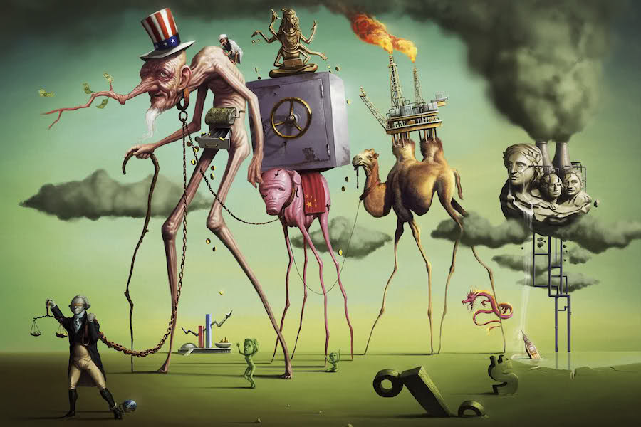
A Short History of Neoliberalism: Market, State and Human Nature, 1920 to Today
Dr Claudia Stein

Slide 2
Overview of Lecture Structure
Some ‘house keeping’ issues
Introduction to module
Methodology used in the module: A history of the present
Introduction readings

Slide 3
1. Some housekeeping Issues
Lecture format
Lectures slides
Assessment:
Assignment 1: Seminar Contribution (20%). For marking criteria, 'Seminar Contribution Guidelines'.
Format: groups work and presentations in class
Assignment 2: 3000 Word Essay (80%)
(Deadline is on your tabula page)
Office hours: Wednesday 11.30-12.30 pm; Thursday 1-2 pm (FAB. 3.18)
Please book via my staff website (‘booking button’ on left side top corner)

Slide 4
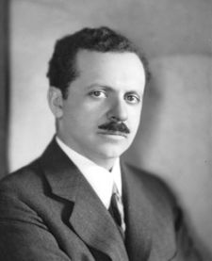
2. Introduction to the module: the unexpected inspiration of Edward Bernays…
All his works shows that in mass democracy the manipulation of public opinion is necessary
Propaganda (New York,(1928)
Universities—Pathfinders in Public Opinion (1937)
What the British Think of Us: A Study of British Hostility to America and Americans and Its Motivation, with Recommendations for Improving Anglo-American Relations (1950).
The Engineering of Consent (1955)
On Bernays, his uncle Sigmund Freud and the engineering of consent in liberal democracies until c. 2000
Please watch award-winning documentary by Adam Curtis, The Century of the Self
https://www.youtube.com/watch?v=gT_edvJieEI)

Slide 5
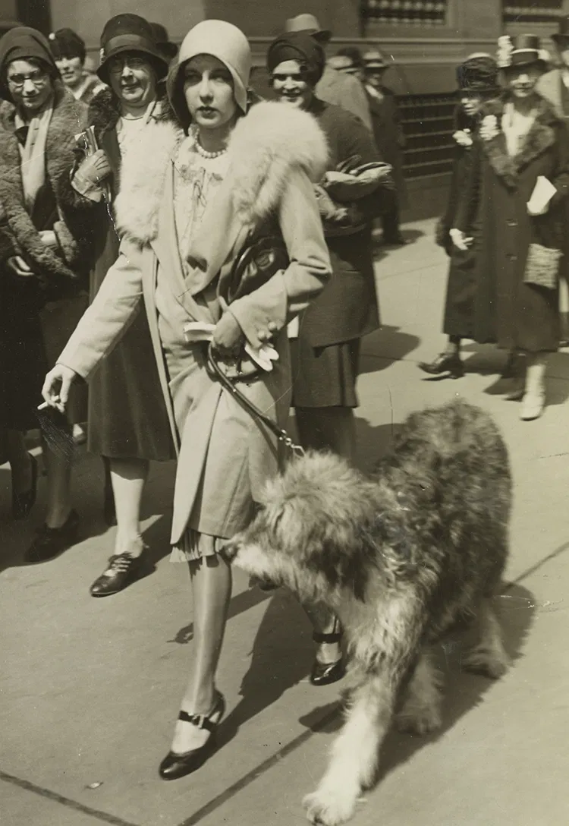

Some of Bernay’s campaigns
‘Torches of freedom’ (1930s)
Telegram from a young New York debutante to her friends:
:
‘In the interests of equality of the sexes and to fight another sex taboo I and other young women will light another torch of freedom by smoking cigarettes while strolling on Fifth Avenue Easter Sunday.’
‘Banana health campaign’ for United Fruits (1950s)
Using public relations to shape perceptions, notably by promoting bananas for health and creating a "communist threat" narrative around Guatemala's democratically elected President Jacobo Árbenz in the 1950s, which paved the way for a U.S.-backed coup that benefited United Fruit. Bernays' tactics included journalist tours, fake news agencies, and celebrity endorsements to manipulate public and political opinion against Árbenz, who threatened the company's land holdings through land reform

Slide 6

2. Methodological approach: the iceberg method

Slide 7
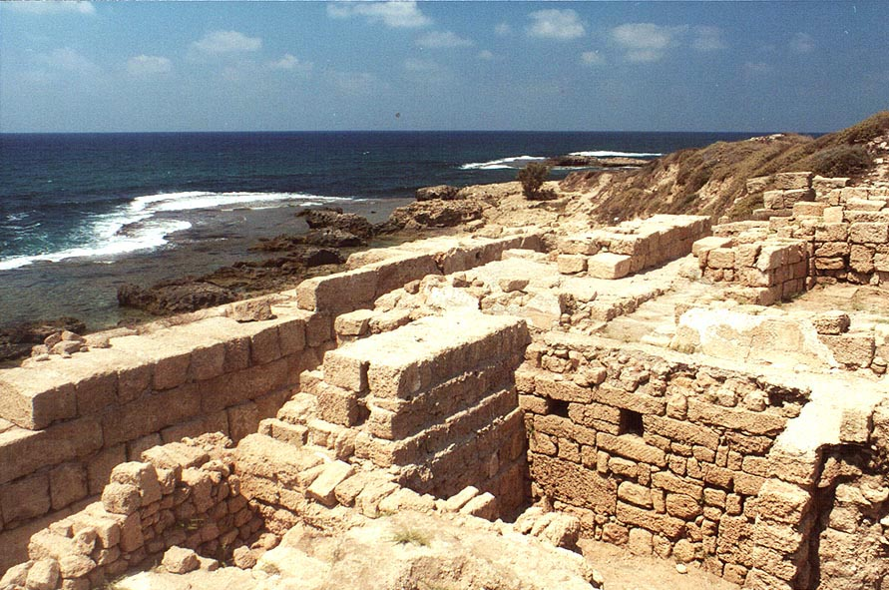

The iceberg metaphor is inspired by one of the most famous historical methods of the French philosopher
Michel Foucault (1929-1984)
Method of Archaeology to understand what rules thinking and doing at a particular moment in time
The archaeological method Investigation of the rules of language at a given moment
in time. These rules, he argues, ‘create’ a certain kind of reality about the human subject and the world.
Question: What are the rules of neoliberalism at different moments in time? What are the rules today that makes us certain kind of human being today?

Slide 8
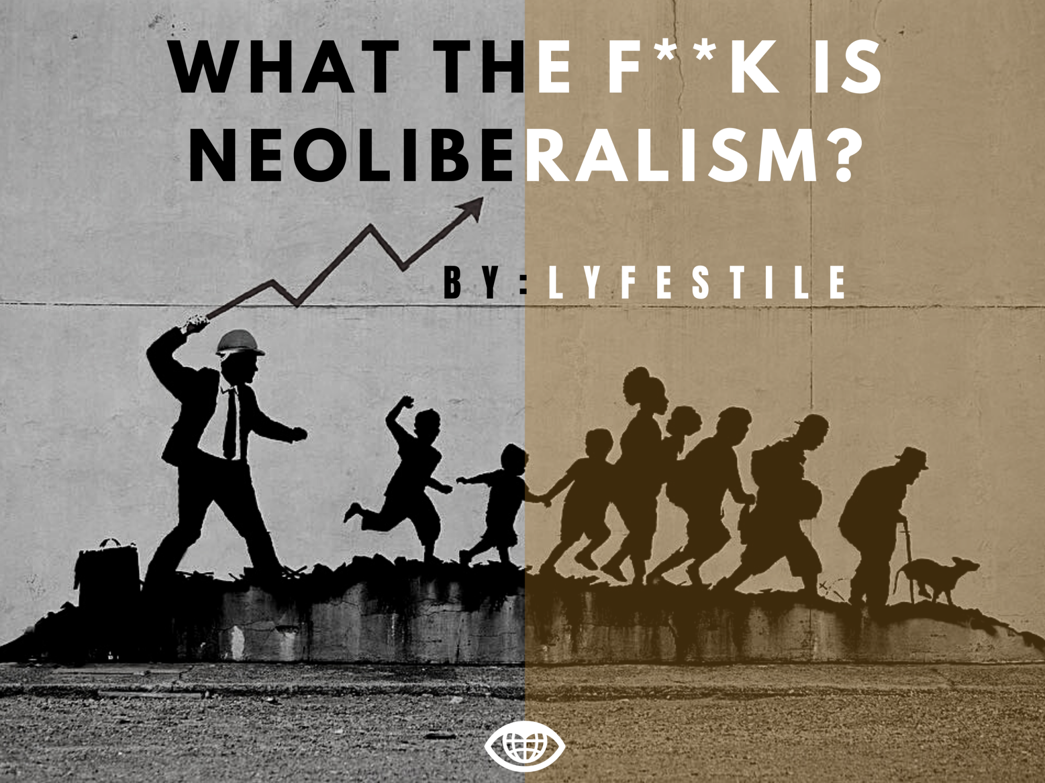
In other words…..

Slide 9
4. Introduction to readings
Daniel Rodgers, The Uses and Abuses of “Neoliberalism, Dissent, Volume 65, Number 1, Winter 2018, pp. 78-87
Neoliberalism” was a term advanced by different groups for different purposes and at several times left orphaned. And then, suddenly, in the mid-1990s, it took off.’
But the problem with neoliberalism is neither that it has no meaning nor that it has an infinite number of them. It is that the term has been applied to four distinctly different phenomena.
Finance capitalism: Neoliberalism as economy
  ‘It stands for the economic regime that global finance capital has unleashed upon the world. Neoliberalism (1) inscribes on politics and culture the needs of a global capitalism that sustains itself on the free flow of capital, goods, disembbeded labor, and market-friendly state policies. It does not rely on the state in the same way that the “embedded” corporate capitalism of the mid-twentieth century did, but it is not a creature of the minimal state either. It depends, rather, on complex structures of institutional supports, business-friendly regulations, and free-range investment opportunities arrayed in different ways across the globe.’

Slide 10
2. Market fundamentalism: Neoliberalism as an intellectual project
‘Neoliberalism (2) refers not to an economic structure but to a strand of ideas, an intellectual project: the restructuring of late-twentieth-century economic thought around the paradigm of the efficient market. Theories of political economists, political thinkers etc.’
3. Disaster capitalism: Neoliberalism as policy Neoliberalism
‘It points to the bundle of business-friendly policy measures that has circulated more and more widely through domestic and global politics since the 1970s. Some of these policy measures originated with the economic theorists. Many were the work of freelance policy entrepreneurs. Increasingly, they now issue from policy think tanks and advocacy groups, to NGOs.’
4. Commodifying the self: Neoliberalism as cultural regime
‘Neoliberalism (4), the latest entry into this parade, is the most enveloping of them all. It names a cultural regime that stamps price and profit onto the very souls of those who live under it. In the terms Wendy Brown takes from Foucault in her witheringly critical Undoing the Demos (2015), neoliberalism is not a stage of the economy, a strand of ideas, or a set of policies but, rather, the “governing rationality” of our times.’

Slide 11
Aled Davies, Ben Jackson, and Florence Sutcliffe-Braithwaite eds, The Neoliberal Age: Britain Since the 1970s (London 2021)
Overall aim: What is neoliberalism in Britain? Is it actually the correct term or concept to describe the situation in Britain?
‘The aim of all the contributions in this volume is to submit recent British history to a more sustained and in-depth analysis, suggesting that the standard account of neoliberalism oversimplifies in several regards, and identify other ‘metanarratives’, we must attend in order to understand Britain in that period.’

Slide 12
The Introduction identifies three areas of research on neoliberalism in Britain
Neoliberalism as a political ideology
written by intellectual historians (such as Rodgers) identifying origins and then tracing
the transfer of its ideas into politics and public policy throughout the second half of the
twentieth century; identifying both diversity and coherence within neoliberal thought.
2. Neoliberalism as a form of capitalism
‘Marxist scholarship and alternative explanations that emphasise economic factors in
the rise of neoliberalism. Neoliberalism is interpreted as a response to or even function
of, the changing material conditions of capitalism in the late twentieth century.’
3. Neoliberal ‘governmentality’: inspired by Michel Foucault’s lectures ‘The Birth of
Biopolitics: Lectures at the College de France, 1978-1979’, on the topic in the late 1970s,
first published into English in 2008, and by his concept of ‘governmentality’.
‘Neoliberalism should be understood as a ‘rationality’ in which ‘generalised competition has become the societal norm, and in which individual subjectivity has been reformed according to the ideal of entrepreneurialism.‘

Slide 13
Julie A. Wilson, Neoliberalism (New York, 2018)
Aim:
‘The purpose of the book is to help you understand in a deep and meaningful way why life today appear and feels as it does by cultivating a thick holistic, and critical understanding of neoliberalism.’
What is neoliberalism:
Generally speaking, neoliberalism is a set of social, cultural, and political-economic forces that puts competition at the centre of social life. According to neoliberalism, government’s charge is not the care and security of citizens, but rather the promotion of market competition….Competition is heralded to ensure efficiency and incite creativity. Spurred by competition, individual organisations, companies, and even the government itself, will seek to optimize and innovate, creating a truly free social world where the best people and ideas come out at the top.
Put it little differently, neoliberalism aims to create a market-based society, where there are only competing private enterprises. Since the 1970s, neoliberal ideas have increasingly guided the politics and practices of government and other social institutions, and as a result, we have come to live in competition with ourselves, others, and our social world.’ (p. 2)

Slide 14
‘It is vital that we clear something up right away. Neoliberalism is not simply a new form of political liberalism.
It should not be confused with …political parties. Rather ‘liberalism’ in neoliberalism refers to a
Belief in individual liberties, property rights, and free markets…
Neoliberalism refers to to the reinvention of liberal ideas and commitments in way sthat have profoundly transformed the fabric of identity and social life. In a neoliberal society, the capitalist market is no longer imagined in way that have profoundly as a distant area where goods are valued and exchanged; rather, the market is, or ideally should be the basis for all of society.
Thus, neoliberalism works aggressively to infuse competition into the nooks and crannies of who we are and the environments we inhabit. Every aspect of our lives, even those facets that do not necessarily have anything to do with money or the economy, become geared towards market competition, from our education to our friendships to our very sense of self and self-worth.’

Slide 15
Neoliberalism makes us certain kinds of people…
‘Anxiety has spread to the whole social field. All forms of intensity, self-expression, emotional connection, Immediacy and enjoyment are now laced with anxiety. It has become the linchpin of subordination.’

Slide 16
Two aims of the module:
Neoliberalism isn’t over. It grasp of liberal capitalistic societies has even grown since the economic crisis in 2007/8 . Some had hoped that would kill ‘the beast’.
  ‘Never let a crisis go to waste’ (Philip Mirowski about neoliberals)
Let us ‘denaturalize’ the present. Present perceptions and understanding of who we are as human beings and what the world around is are not ‘natural’.
Rather what we came to think in today’s neoliberal times about ourselves and our world is a problem (e.g. flexible, competitive, creative, entrepreneurial, happy) but’ a problem’ that needs a historical investigation.
We are doing a here is a ‘history of the present’

