Slide 1
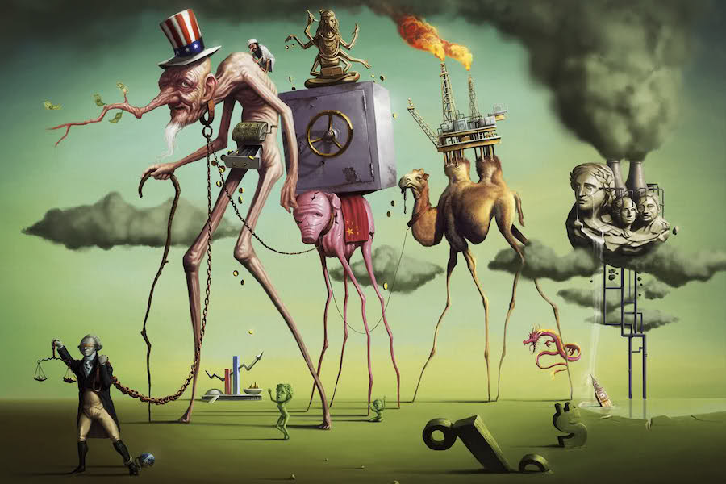
A Short History of Neoliberalism: Market, State and Human Nature, 1920 to Today
Dr Claudia Stein

Slide 2
Lecture 9:
The End of Love?
Sex, Romance, and Love in Times of Neoliberalism

Slide 3
Lecture overview
Sexuality and governmentality
Negative freedom in neoliberal times
3. The end of sexuality, romance and love?
4.resistance -- revolution – or only resilience?

Slide 4
Modern governments exercise power as bio-power
From ‘Sovereign power’ to ‘bio-power’:
Foucault traces a shift from sovereign power (power over death) to bio-power (power over biological life of individuals and populations).
Human sexuality became the ‘pivot’ between the two axes of bio-power:
    the disciplinary management of individual bodies (e.g. goal of sex (procreation), how to do it; what not to do)
    and the regulatory control of populations (statistics on birth rates, health/well-being, old age ).
    The human body becomes the key target of power
Sexuality became the ‘pivot’ between the two axes of bio-power in modern forms of government

Slide 5
Sexuality as the key element of modern ‘governmentality’
Michel Foucault conceptualizes sexuality as a key element of governmentality—the art of governing, encompassing both the state's management of populations and the individual's self-regulation.
Contrary to the "repressive hypothesis" that claims sex was hidden in the 17th/18th/19th centuries, Foucault argues in The History of Sexuality that power never supressed sexuality but always produced new forms of sexual categories into which individuals and population are squeezed. Categorisations, although not coercive, is a forceful act of power, he claims. (knowledge/power)
He demonstrates how particularly since the 19th century the discourse about sexuality have been exploding, creating a ‘dense transfer point’ or ‘joint’ for bio-power. Any discussion about ‘sexuality’ grasp for control of the ‘the individual’ (via ‘discipline) and ‘the population’ (via regulting policies in which the individual is perceived as part of a population).
Foucault aimed to critique his own time in the 1960/70s(e.g. feminism, gay movement) and warned against the widespread belief that ‘more talk’ about sexuality will produce sexual ‘freedom’ and, following on from having achieved freedom, more ‘equality’. He suggests while it produces more talk – and more sexual categories – such talk might achieve the opposite: it might inhibit the achievement of freedom.
In fact, he debunks the strong belief in self-emancipation and freedom through the expression of one’s sexuality.

Slide 6
Since Foucault, the debates (this includes also policies) that centre on human sexuality have exploded
even more. And many more sexual categories have emerged since the 1980. Sexual ‘difference’, one may argue,
has become normative.
https://warwick.ac.uk/services/wss/topics/sexuality_and_coming_out/
Have we reached the state of sexual ‘freedom’? Has the ‘Sexual Revolution’, announced in the 1960/70s by women’s and gay ‘liberation movements’ finally arrived?
Have we finally and successfully overcome moralism and prudery in relation to sexuality?
How does the aim of ‘sexual freedom’ relate the aim of ’sexual equality’?

Slide 7
What is ‘freedom in today’s liberal society
Philosophy and legal organization of liberal politics have privileged one specific type of liberty:
Negative liberty
Negative liberty is defined as the freedom of actors to do what they please without hinderance from the external world, as long as they do not hurt others or obstruct their freedom. Such freedom is guaranteed by law and cultivated
Problem
Negative freedom, or negative liberty, refers to freedom from external constraints, obstacles, or interference by other people, particularly the government/state.
It is ‘freedom from’ rather than ‘freedom to’, focusing on the absence of coercion rather than the capacity to act towards individual/collective freedom.
Negative liberty tends to conform a ’status quo’.

Slide 8
‘Emptiness of negative’ freedom: how to act in this empty space?
(Negative) freedom is guaranteed by law and cultivated by many institutions supposed to guarantee one’s rights and privacy and that contains little or no normative content.
Negative freedom creates a space – a space of ‘non-hinderance’ but how the space itself is structured is not defined. In other words, how to behave in the space?
But is the space left by ‘negative freedom’ really empty?
But this ‘space’ is not empty as we have seen in the module, it is ‘’silently’ structured by norms and values and assumptions of what human nature is (e.g behavioral economics, nudging).

Slide 9
The empty space that is left by negative freedom has been colonized by the market, its values and technologies
‘This empty space left by the negative definition of freedom could be easily colonized by the values of the capitalistic market, consumer culture, and technology, which have become the most powerful institutional and cultural areas of modern society.’
(Illouz, Love, p. 13)
‘(Negative freedom’ has let the language and the practices of the consumer market reshape the vocabulary and grammar of subjectivity.
The same language of interests, utilitarianism, instant satisfaction, ego-centred action, accumulation, variety, and diversity of experience now pervades romantic and
sexual bonds.’
All forms of human relationships have been thoroughly commercialize; here too ‘competition’ is the driver of human behavior.

Slide 10
How to critique this commercialisation and competition in
sexual, romantic or family relationships today?
Tricky business…
Why?
Because we do not ever wish to put into the question
the historical and moral progress that has been made in regard to the historical redefinition of such relationships in modern liberal societies (e.g. the struggle of feminists, and LGBTQ movements)
But I do share Illouz view that..
‘To endorse the historical accomplishments of these
movements and to continue their struggle should not prevent us from examining the ways in which the moral idea of freedom has been deployed historically and empirically in market forms, which also appeal to freedom.’
In fact, understanding how ideas and values, once institutionalized have a trajectory that is not always the one intended by their proponents will help to reclaim the initial idea of freedom, which was the impulse of these movements.’
Illouz, Love, p. 13)

Slide 11
Has sexual/emotional freedom in relationships in particular become the neoliberal philosophy of the private sphere? (Eva Illouz)
‘While freedom itself has been a powerful normative claim to oppose the institution of forced or loveless marriage, to assert the right for divorce, to conduct one’s sexual and emotional life according to one’s inclinations, to grant full equality to all sexual minorities, we may wonder if today that same freedom has not unmoored sexual relations from the moral language in which it was initially steeped (for example by disposing of the language of obligation and reciprocity in which all or at least most social interactions had been traditionally organized).’
(Illouz, Love, p. 14)
Example: Marriage is traditionally a ‘contract’ in which both sides agree to fulfill certain obligation and duties vis-à-vis the other side for the rest of the couples life. It requires to respect these obligation and duties (e.g. legal, religious, economic)
Claim: Contemporary sexuality, particularly heterosexual sexualility, is the vector of a number of social forces, which undermine the values that animated the struggle for sexual emancipation.
Illouz focuses on hetersexual relationships. Why? Study of heterosexuality is sociologically more urgent
Heterosexuality translates gender into difference and difference into inequality. Gender divisions are also between
biological labour and economic labor that has characterized the heterosexual family.

Slide 12
Choice
Sexuality has become the site of psychological human techniques, of technology and the consumer market. What they have in common is that they translate ‘desire’ and interpersonal relation into a sheer matter of ‘choice’.
Choice – sexual, consumer, or emotion – is the chief trope under which the self and the will in liberal politics are organized.
To have a modern or late-modern self is to exercise choice and to increase the subjective experience of choice.
Two sides of choice which presents the best way to understand how the formidable structure of the market translates into cognitive and emotional properties of action:
  supply of goods, to choose from something which is in large supply
  Related to subjectivity; when an individual faced with these possibilities makes a decision also called ‘choice’ (did I make the ‘right’ choice?).
Question: When we speak about our ‘lived experience’, are we in fact only speaking about our lived experience of making ‘choices’ on an open market? What is authentic about our sexual/romantic ‘lived experience’ in this world of choice?

Slide 13
The choice to unchoose: negative choice in networked modernity
Under the influence of economic thought/practice, we have been mostly interested in positive acts of choice – what is called ‘decision-making’ (e.g behavioral economics!).
But what about ‘negative choice’ , the rejection, avoidance, or withdrawal from commitments, entanglements, ad relationships in the name o freedom and self-realization?
‘This dissolution of relationships occurs not through a direct breakdown of relationships – alienation, reification, instrumentalization, exploitation -- but through the moral injunctions that constitute the imaginary core of the capitalist subjectivity, such as the injunction of to be free and autonomous, to change, to optimize the self and realize one’s hidden potential: To maximise pleasure, health and productivity.’
Negative choice – the choice to ‘unchoose’ – based on lrager institutional changes
  The no-fault divorce
  Contraceptive pill; reproductive technologies
  Large consumer market for leisure
  Technology afforded by internet (dating websites) – subject becomes consumer of sex and emotion
  Platforms that multiply relationships and allow quick ‘unfriending’ via the software.

Slide 14
Downside of negative choice: a ‘crisis of care’
Rise of single households, rise of divorces (42% of all marriage end in divorce, (2023), fewer children
More people live in multiple relationships (polyamorous or other types), putting in question centrality of monogamy’ enter and leave relationships throughout one’s live.
Sologamy
Loneliness epidemics, depression
neoliberal capitalism hijacked sexual and romantic relationships.

Slide 15
Is resistance impossible within ‘governmentality’?
‘Where there is power, there is resistance’ (Foucault).
It is the inevitable, often local, tactical, and creative refusal to be defined or governed by established norms, acting as a ‘handle; or ‘support’ that constantly challenges and reshapes power.
Never Exterior to Power: Resistance does not exist outside of power, waiting to attack it. It happens "in the folds" of power relations, meaning it occurs within the same structures it challenges,
Is resilience all we have left?
resilience: the ability to adapt well to adversity, trauma, tragedy, threats, or significant stress—essentially "bouncing back" from difficult experiences. It involves mental, emotional, and behavioural flexibility, allowing individuals to cope with challenges and recover from hardship without being permanently overcome by them.

