Slide 1
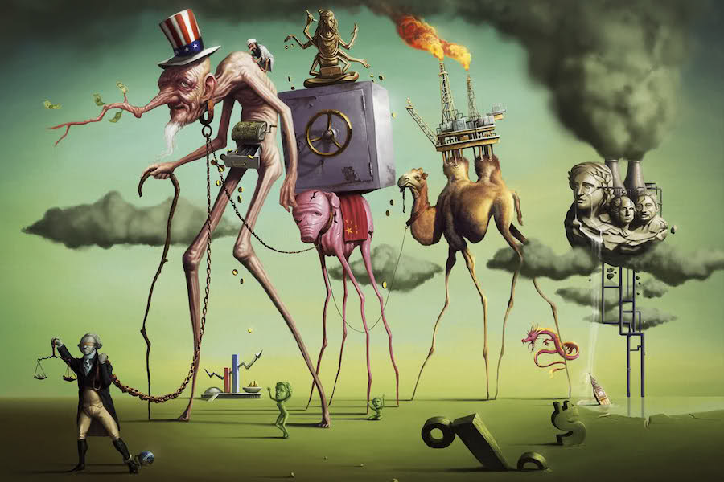
A Short History of Neoliberalism: Market, State and Human Nature, 1920 to Today
Dr Claudia Stein

Slide 2
Lecture 5
Neoliberal Breakthrough: the Complicated Story of Britain (1970s-2000s)
Dr Claudia Stein

Slide 3
Lecture outline
Brief history of ‘the market’
Recap monetarism and market ideas from Friedman
Brief overview of government actions between 1960-1990 in regard to monetarism
What happens to ‘social solidarity’ when the individual is defined as self-interested utility-maximising?

Slide 4
A very brief history of ‘the market’ in classical and neoclassical liberal economic thinking
18th Century - The Natural Market: Classical liberalism (Smith, Ricardo but also Marx’s historical materialism) saw the market as a natural, self-regulating mechanism that produced "true" prices, and thus, the state should not interfere (laissez-faire, political and social/cultural activity as separate from the ‘market’, against mercantilism or physiocrats, which heavily interfered in what is considered a ‘natural’ market.
20th Century - The Constructed Market : Breaking with ‘the market’ of classical liberalism its idea. of the market. Political economists suggest that ‘the market’ is not ‘natural’. Rather must be actively and constantly constructed, regulated, and maintained by a strong legal-constitutional framework. (e.g. Austsrian school of economics, Hayek, Mises, neoclassical economics (Marshall), ordoliberalism in Germany: focus on how to establish a regulatory framework to stimulate competition in the market. These ideas are not shaping politics and policy at the time.
The Market as a Regime of Truth: Elevation of markets as the ultimate, universal truth-setting regime, meaning that not just the economy, but all political and all social life life need to be evaluated by market standards and policies (e.g. 1960s/70s Chicago/Virgina school of economics, public choice/rational choice theory which suggests how to expand economic considerations (e.g. competition) into policy (which in turn, then shape the whole of society along the line of competition). Extending market logic into all aspects of human life and the definition of liberty: freedom is increasingly understood as ‘freedom’ that is chosen in a competitive market. Citizens are ‘the freest’ when making choices in a free market (in itself regulated by government policy around competition).
Homo Œconomicus & Society: At the core of all this stands neoliberalism’s reframing of what an individual is: the individual as the "entrepreneur of the self," extending market logic into all aspects of human life. The market becomes a model for society, transforming all social relations into competitive exchanges. From 1980s the idea of the rational individual self-interested and utility-maximising individual shapes economics and politics and policy, and human relations.

Slide 5
An example: ‘Marketisation’policies in higher education in UK and the model of the ‘consumer student’
1976: Labour settlements with universities, initiating the erosion of university autonomy (e.g. part of planning obsessions)
1979–1980s: The Thatcher government introduces market logic, forcing universities to compete for funding amidst budget cuts.
1986: Introduction of regular sector-wide audits of research (precursor to the Research Excellence Framework, REF), focusing on institutional competitiveness of research and establishment of national/global ranking system.
1990: Introduction of 'top-up' loans for students, marking a shift from grants to private debt.
1992: Abolition of the "binary line" separating universities from polytechnics. Polytechnics gain university title, creating a unified, competitive, market-driven sector.
1994: as a reaction: ‘Russel group concept’ for research intensive universities introduced; the group was formed to provide a formal, unified voice to represent the interests of its members to government and Parliament, particularly in relation to research funding.
1997–1998: The ‘Dearing Report’ leads to the abolition of free education and the introduction of top-up tuition fees (£1,000/year).
2004: Rules for "University title" modified to allow non-research colleges to become universities, accelerating marketization. It meant a significant lowering of the barrier for higher education institutions to call themselves a ‘university’.
2006: Introduction of "variable" tuition fees up to £3,000, promoting a market in fees; intensified search for international students who pay more tuition fees.
2007: UK universities were placed within dedicated, explicitly-titled government department focusing on skills and innovation ‘Department for Innovation, Universities and Skills’ (DIUS). Before this, higher education was typically housed within the broader Department for Education and Skills (DfES) or its predecessors (e.g., Department for Education and Science).
2007-2009 Government funding increases for STEM (Science, Technology, Engineering, and Mathematics) subjects in the UK while funding for humanities are increasing cut.
2010–2012: The Browne Review results in the removal of the student cap and a rise in tuition fees to up to £9,000 per year in England, cementing the "student as consumer" model; Students invest in their ‘human capital’ (Gary Becker’s (Chicago, Ersatz Nobel Price)
2017: Implementation of the Teaching Excellence Framework (TEF), further entrenching metrics, data-driven management, and competition for students.

Slide 6
Human capital at the core of university policy today
University education is now based on the idea of self-interested ‘consumer students’ who invests into their individual ‘human capital’ to maximise their utility in the neoliberal market economy.
Def. Human capital refers to the economic value of an individual's skills, knowledge, experience, health, and education, which enhance productivity and contribute to economic growth.
Concept invented by Chicago economist Gary Becker (Nobel ‘Ersatz prize’ 1992)
Human Capital: A Theoretical and Empirical Analysis, With Special Reference To Education (1964).

Slide 7
2. Recap
The ‘the market’ as proposed by neoliberal thinking in the 1950/60s: move from Europe to the US
In the 1960s/70s the political/policy tide had not yet begun to turn in favour of free markets (in the neoliberal sense) – postwar economic boom, the Golden Age of Capitalism
Manage capitalism using tools of demand management developed by Keynes and followers whose aim was not to get rid of capitalism but to reform it.
Based on accurate macroeconomic information (which remains a huge problem) politicians and policy-makers make correct adjustments to policy planning.
Highest priority: full employment
Relationship between full employment- inflation: If employment is low, inflation would rise but only in the long term. A particularly rate of inflation was accepted to maintain the aim of full employment. All managed by the manipulation of budgets, policy (e.g. tax cuts), and expansion and contraction of money.
International monetary system increasingly shaky but still in place: Bretton Woods Agreement 1944 which aimed at preventing competitive devaluations and promote long-term global growth.
international monetary system of fixed exchange rates, pegging currencies to the U.S. dollar. The US dollar acted as the primary reserve currency, the only one directly convertible to gold. Signed by 44 nations in New Hampshire, it aimed to promote monetary stability. (Many European countries stored their gold in US!)
The conference in New Hampshire resulted in the creation of the International Monetary Fund (IMF) to manage exchange rates and the International Bank for Reconstruction and Development (IBRD), which is now part of the World Bank Group.
.

Slide 8
.
Monetarism, promoted by Milton Friedman
Ideas increasingly floating around originating from Chicago/Virginia and supported by rising networks of national and international neoliberal-enthusiast think tanks and journalists (increasingly acting as politics and policy advisers) – presented as alternatives to Keynesianism
In short, monetarism argues against active, day-to-day government intervention (Keynesianism), suggesting that ‘long and variable lags’ in monetary policy often cause more harm than good.
Aggressive positioning against fixed exchange rates and Bretton Woods agreement – aim: floating exchange rates
Monetarism – Friedman: By keeping a steady hand on the monetary tiller, the worst extremes of economic fluctuation would be evened out. The error of Keynes and followers’ policies is that they underestimated the importance of a stable supply of money. Monetary theory emphasises that the money supply is the primary determinant of nominal GDP and inflation in the long run.
Inflation Control:
Friedman famously stated that "inflation is always and everywhere a monetary phenomenon" in the sense
that it is produced by a more rapid increase in the quantity of money (e.g. MV=PQ)
Monetary Rule:
To avoid erratic economic cycles caused by fluctuating money supply, Friedman proposed that central banks should
increase the money supply at a fixed, predictable rate, consistent with stable economic growth.
During the 1970s these ideas increasingly attract attention by politicians and policy makers during the 1970s in the UK and US – but it is not entering policy-making
.
.

Slide 9
The Neoliberal breakthrough 1970s-1980; close interaction between US and Britain in the face of global crises
1964-1970: Labour government under Harold Wilson (following conservative government Macmillan/Home)
Continues planning activities (intensified critical activities in transatlantic neoliberal network)
Devaluation of the British pound – fiscal and budgetary austerity
Instability of the international monetary system – collapse of Bretton Woods in 1971 (e.g. Vietnam war, decline of American Gold reserves, social programmes of New Deal) countries, including Britain opt for ‘floating currencies’ – fixed exchange rates were ‘dead’.
Inflation: in UK inflation is rising but continue wage and income control measures
1969 attempt to reform government – union relationship
:1970-1974 Edward Heath Conservative government echoes Keynesian state interventionism; but voices for changes to regard to economic policies becomes louder
Inflationary boom increased through1973 Oil crisis: boycott of OPEC states of America and punishment of the West in response to support for Israel in the Yom Kippur war against Egypt
Struggles with unions; strike of coal miners in 1973; electricity cuts; three-day week as economy nosed-dives

Slide 10
End of postwar consensus
1974-1979: Labour government under Harold Wilson/James Callagan; wins by promising to deliver social contract between trade unions and government
Opposition: Thatcher elected conservative leader; development of new economic policy programme; focus: the trade union problem
Steep rise of unemployment and inflation: fear of stagflation (rise of unemployment, rise of inflation, zero growth); inflation rises to above 20% between 1975-1976: change of direction in budget: full employment not main aim (version of monetarism);
1976 loan from IMF (c. 4 billion); UK at brink of economic collapse (conservatives against it) – severe austerity measures attached from IMF
‘Winter of discontent’ 1978-1979 : austerity cuts provoke union strikes across country
‘full employment’ promise abandoned and the post war concensus – introduction of monetarism

Slide 11
Versions of monetarism and neoliberal policies were already established in British politics/policy when Thatcher arrived…
1979-1997: Margaret Thatcher conservative government;
At election conservative party still dominated by those who embraced Keynesianism, involvement of government in social and economic policies (postwar consensus)
Trade union reforms but too radical departure seemed unpopular; reform unplanned (according to observers)
1984-1885 miner strikes (government had stocked up coal in readiness for long and bitter struggle, which they eventually won)
Deep recession ; austerity measures to bring the deficite under control and created conditions for economic recovery
1981 budget: taxes increased and spending dramatically cut (MPS member US economist Alan Walters Thatcher’s adviser; supports Friedman’s monetary ideas)
Acceptance of monetarism and supply-side reforms (supply-side economics invented by Chicago school).
Supply-side economics is an economic theory that postulates tax cuts for the wealthy to result in increased savings and investment capacity that trickle down to the overall economy. It also involves deregulation and privatisation as key stimuli for economic growth.
1989 fall of the Berlin wall; boost of belief in Western neoliberal capitalism
shock therapy is a group of policies intended to be implemented simultaneously in order to liberalize an economy, including liberalisation of all prices, privatisation, trade liberalisation and stabilisation via tight monetary policies and fiscal policies in all post-communist states

Slide 12
1997-2010 ‘New’ Labour government Tony Blair, Gordon Brown
New Labour, New Life for Britain (1997)
Alteration of old Clause IV (which stressed common ownership of industry) and instead endorsed market economics. Clause IV is part of the Labour Party Rule Book which sets out the aims and values of the British Labour Party. The original clause, adopted in 1918, called for common ownership of industry, and proved controversial in later years.
‘Third way’ (shaped by sociologist Antony Giddens): The Third Way is a reconceptualisation of social democracy (or welfare state). It supports workfare instead of welfare, work training programs, educational opportunities (as investments into individual human capital), and other government programs that give citizens a 'hand-up' instead of a 'hand-out'.

Slide 13
3. What happens to social solidarity in a society arranged around the self-interested utility maximising individual?
What happens to a society when politics and policy begin to re- organize society around the the idea of the human as a ‘self-interested and utility-maximizing individual’ (as suggested by neoliberal thinkers)?
What happens to the notion and practice of ‘social solidarity’ which is key to democratic liberal societies
Solidarity, def.: Originates in France, referred primarily to a joint or collective liability. No longer the case but remains a term that designates collectivity and joint action. No agreement on meaning but all definition today share the feature that it involves a group of agents involved in completing some task together.
‘social solidarity requires ‘individuals to tolerate views and practices they dislike, to accept democratic decisions that go against belief or interests, and to moderate the pursuit of their own economic self- interest to help the disadvantaged.’ (DuFord, 176)
In democratic societies ‘solidarity’ serves an integrated function – it brings the members of the demos together by being subjected to the same political institutions and laws.
What happens to solidarity when ‘greed’ becomes sexy? (e.g. the Apprentice; Wall Street bankers)
What happens to activist movements – such as activism or black activist movement which have a long history – when such notions of solidarity give way to a new idea of the individual and an atomized society?

Slide 14
4. What happens to social solidarity?
Neoliberal feminism – individualized solidarity?
Focus on broad material conditions and economic condition have declined in recent decades, women’s focus on individual women’s success and representation increased --- autonomous or individualizing feminism.
‘each individual women’s success becomes a feminist success, which can then be attributed to the United States’ enlightened political order as well as to its moral and political superiority.’ (DuFord, p. 8)
Lacks any critique of either traditional liberal theory or of alienation and exploitation under late capitalism.
Neoliberal feminist thought, instead, focusses on placing women in key positions of power. As it main goal building
The power of women to act in the world as if they are men. (ur-text of neoliberal feminism Sheryl Sandberg,
Lean In (2013)
’If we can succeed in adding more female voices at the highest level, we will expand opportunities and extend faire treatment to all.’(Sandberg, Lean In, p. 10).
Claim by DuFord: the goals of neoliberal feminism praxis are atomizing and alienating – they are inappropriate to building
any form of solidarity with others – ultimately build on competition.

Slide 15
What happens to democratic life as a collective project in times of neoliberalism?

