Slide 1
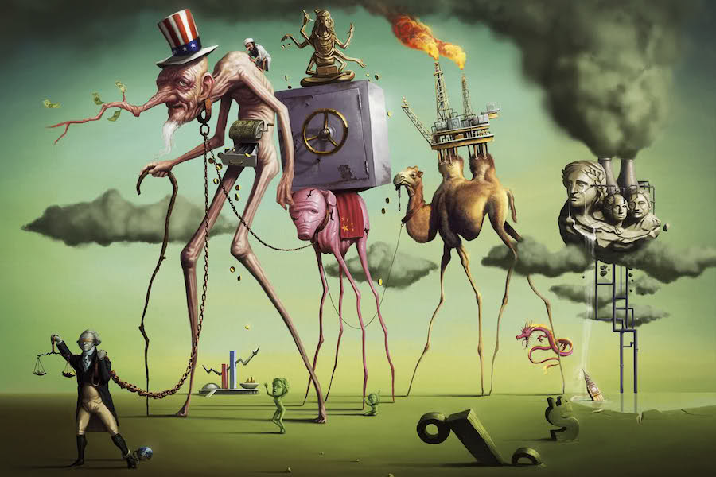
A Short History of Neoliberalism: Market, State and Human Nature, 1920 to Today
Dr Claudia Stein

Slide 2
Term 2, Lecture 3
The Formation of Neoliberal Intellectual Critique
in the Early 20th Century

Slide 3
‘Masters of the Universe’: how to understand the argument of the book
Why was the book written? What is the ambition of the writer and the event that made him do his research?
  Global economic crisis 2007/8 and to investigate some of the unquestioned myth of ‘the naturalness’ of the unregulated financial sector – (after crisis: nothing really changes but business as usual)
Neoliberalism it taken as an international phenomenon but how did it become so international? At the core of the books stand an interest in economic theory but also to show how such theories arose from a different historical context.
  Intellectual history of the political development of neoliberal thought
  Question the myth of the historical inevitably of neoliberalism and linkage to rise of conversative politics (e.g. Thatcher, Reagan).
  Question the idea of a monolithic and pernicious manifestation of U.S power over global policy (e.g. left critics such as David Harve: neoliberalisation is a highly effective form of class warfare on behalf of US finance capital)
  To explain neoliberalism(s) in its proper transatlantic context and close collaborations (e.g. politics, think tanks, business etc)
  Note: No interest in the ‘cultural’ aspects of neoliberalism: What sort of humans did it turn us into.

Slide 4
Central claims: 3 phases of neoliberalism
1. 1920s to 1950s: term of neoliberalism acquires meaning in interwar Europe (Austrian school of economics, German ordoliberal school begin to define contours of new market-based society, assumed to be the best way of organizing economy and guarantee individual liberty in soceity; Walter Lippmann Colloquium, Paris 1938, to discuss Lippmann’s book ‘The Good Society’; aim: to reformulate liberalism and address concerns of 1930s; 1947 founding of Mont Pellerin Society which reflects move beyond Europe.
2. 1950s to 1980s: period of little direct influence on national politics and economy (outside of ordoliberal Germany)
Neoliberalism generates intellectual coherence and matured politically. Zenit of US New Deal liberalism and British social democracy and welfare state; Keynsian approaches to economy dominated; but in the background a group of thinkers, scholars, businessmen and policy entrepreneurs refined a radical set of market prescriptions and promoted their ideas. (note: the term ‘neoliberalism’ was hardly used during that period).
3. After 1980s: driven by the advance of an agenda of market liberalization and fiscal discipline into development and trace policy; end of Cold War, followed by radical globalization of neoliberalism, particularly into former communist countries(e.g. Shock Doctrine); move away from academic elites and US and European national concern; reorganization of many global institutions, adopted by neoliberal economists and policymakers (e.g. International monetary fund (IMF), The world bank, the World trade organization (WTO), the EU, and as part of the North American Free trade Agreement (NAFTA); note: rise of strong activist movements against such neoliberal globalization tendencies.

Slide 5
What was the neoliberal critique critiquing?
Political settlement of the early and mid-20th century
-
‘
collectivist’ character of US and British politics by 1945
political culture, public debate, and elections were dominated by thinkers and parties of the center and left in 1945
Shaped by:
Trauma of economic collapse of 1930s Great Depression – Keynsianism economics: focus on macroeconomic management of fiscal and monetary policies; large scale investments aiming at full employment as the foundation of national prosperity; nationalisation of key industries, cooperation with workers unions
progressive liberal project born out of desire to preserve and defend liberal democracy and capitalistic system. Belief in a ‘middle way’ (Keynes)
Profound fear of totalitarianism, and its threat to liberalism, left and right, since turn of 20th century
Trauma of WWII; UK end of empire
top-down elite reforms for the benefit of society as a whole; elites in US and UK shared set of assumptions about many of the most important elements of economic and social policy and strategies (e.g. ‘planning’, rise of managerialism)

Slide 6
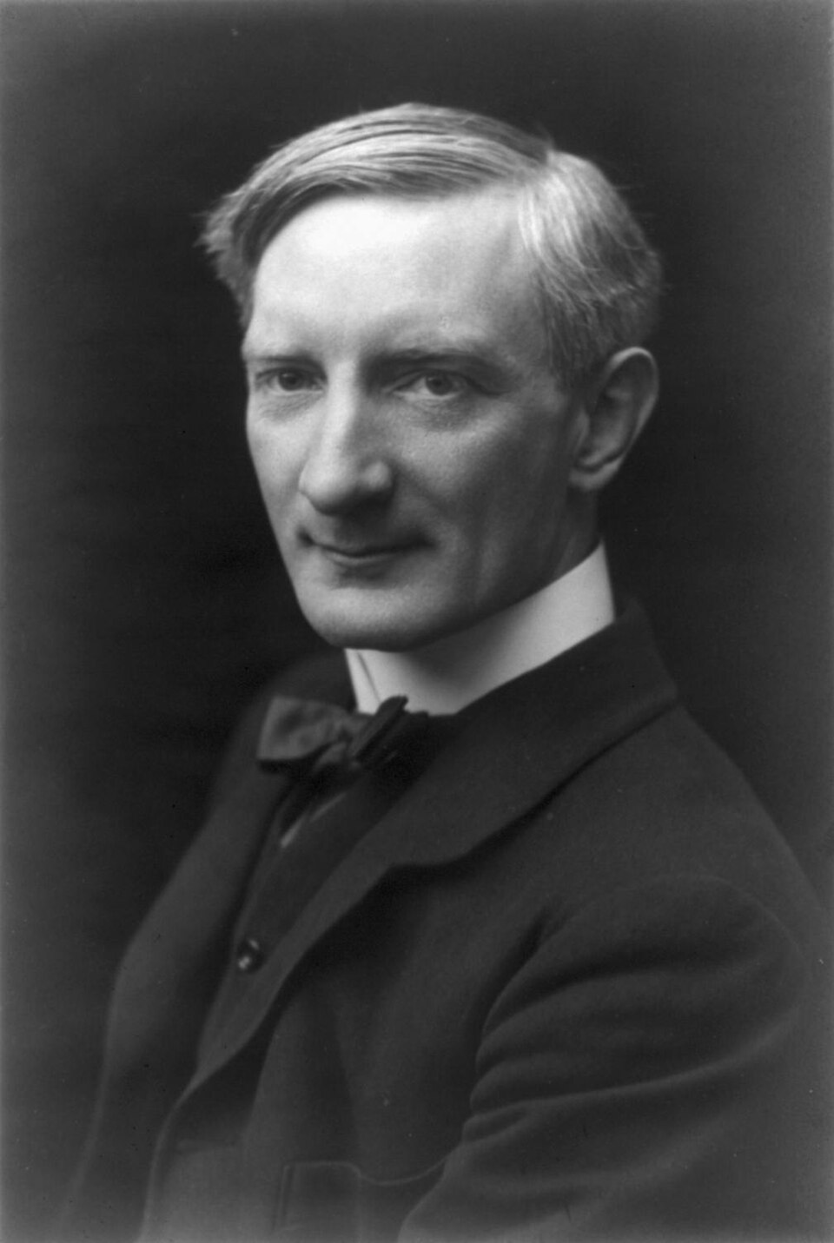
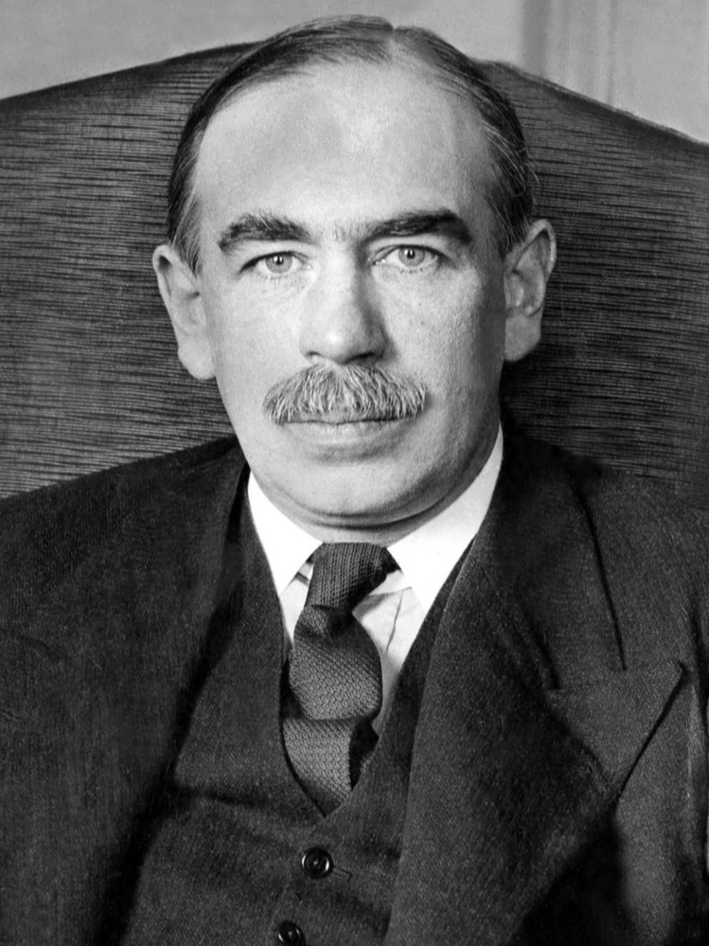
British so-called postwar consensus
Social democratic/welfare state, combining planning, collectivism with civil liberties
Britain emerged from the 1939-1945 war triumphant, but economically exhausted. It was one of the top three superpowers, although in reality a distant third behind the United States and the Soviet Union. Nonetheless, its political system and the British state had been vindicated by success in war, and over the next few years Britain emerged as a model social democracy/welfare state, combining planning and collectivism with civil liberties.
The 1945 Labour government was largely responsible for what is called the 'post-war consensus'. However, some of the key elements can trace their origins to the war-time coalition government and the influence of Liberals like William Beveridge and John Maynard Keynes.
Economists and liberal politicians

Slide 7
Keynesian economics
Challenges fundamental ideas of neoclassical economics that free markets are self-correcting and would in the short to medium term, automatically provide full employment, as long as workers were flexible in their wage demands.
Aggregate demand focus: Total spending—by households, businesses, and the government—is the primary driver of economic output and employment.
Countercyclical policy:
Idea that governments should use deficit spending during recessions to stimulate demand (e.g., infrastructure projects) and run surpluses during booms to cool the economy
Sticky wages and prices: Prices and wages do not adjust instantly to changes in supply and demand, leading to involuntary unemployment during downturns
Government interventions: When private sector spending fails, public spending must fill the gap to prevent depression.
Tooks of interventions:
Fiscal policy: Increased government spending and tax cuts to put more money in consumers' hands.
Monetary policy: Central banks reducing interest rates to encourage borrowing and investment.
.
John Maynard Keynes, 1886-1946
‘father’ of macroeconomics

Slide 8
The UK ‘welfare state’
Britain’s leading specialist on unemployment insurance,; 1911 National Insurance Act
By 1919 director of LSE (- 1937), founded by the Fabian Society in 1895
Fabian Society: founded in 1884 in London organisation whose purpose is to advance the principles of social democracy and democratic socialism through gradualist and reformist efforts in liberal democracies, rather than revolutionary overthrow.
Social Insurance and allied Services (Beveridge Report),
published in 1942,influential in the founding of the welfare state in the UK
expansion of National Insurance;
recommendation to create "comprehensive health and rehabilitation services
for prevention and cure of disease",
launch of NHS 5 July 1948, based on three core principles:
        to meet the needs of everyone,
        free at the point of delivery,
        based on clinical need, not ability to pay.
William Beveridge
1879 – 1963

Slide 9
The major features of postwar consensus politics in UK, supported by Conservative and Labour governments
Governments commitment to maintain full employment by Keynesian techniques of economic management. Ministers would use their levers, such as cutting taxes and boosting state spending, to increase the level of economic activity.
Acceptance and some encouragement of the role of the trade unions. In contrast to the pre-war years, governments recognised and consulted them regularly on workplace relations and economic policy. The unions’ access to government was increased partly by full employment and partly by governments turning, post-1961, to income policies as a way of curbing inflation.
The mixed economy, with a large role for state ownership of the utilities (such as gas, electricity, coal, rail, etc) and intervention and planning in the economy).
The welfare state: The object of the national insurance system and the National Health Service was to provide an adequate income and free health when a family’s income was hit by, for example, sickness, old age, unemployment or death of the main breadwinner. The services were provided out of general taxation, or insurance, and represented social citizenship.
There was a belief that government could play a positive role in promoting greater equality and individual freedom through ‘social engineering’, for example, by progressive taxation, redistributive welfare spending, comprehensive schooling and regional policies.

Slide 10
‘Consensus politics’ of UK on an international level
the transition of the empire to the British Commonwealth, an association of independent states
British membership of the North Atlantic Treaty Organisation (NATO), pressure Cold War politics
Agreement on nuclear weapons, (regarded as a mark of being a major power)
Agreement that Britain should join the European Community
Note: Consensus is not an ideal term because it may be read as suggesting that there were no differences between the parties. In fact, the above ideas and policies were often challenged by the left of the Labour party and by the free market or right wing of the Conservatives. But much of the political elite – the media, civil service and the leaderships of the parties, particularly when they were in government - shared many of these ideas.
Soure: Dennis Kavanagh, Consensus Politics from Attlee to Thatcher (1989).

Slide 11
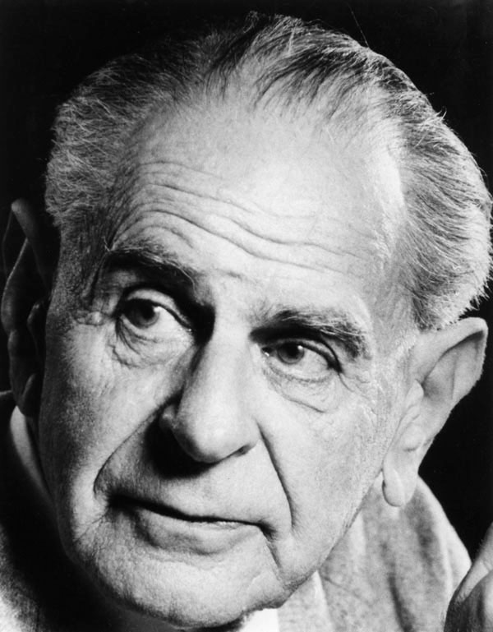
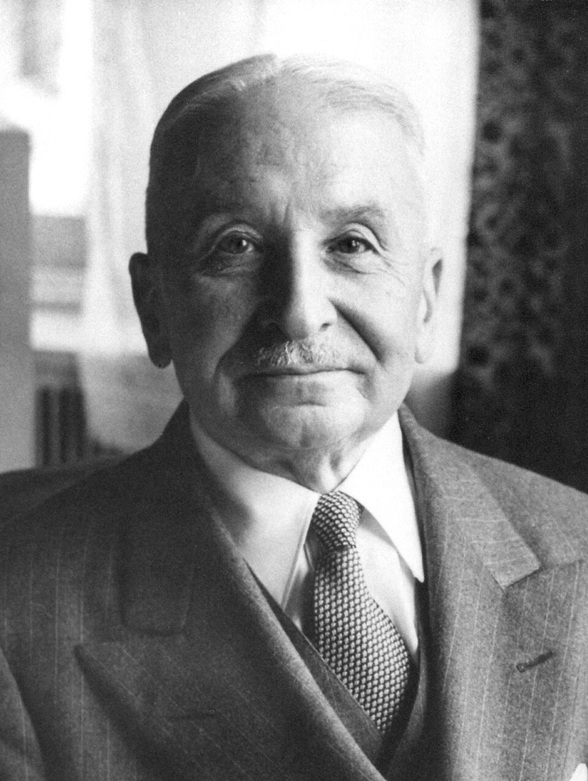
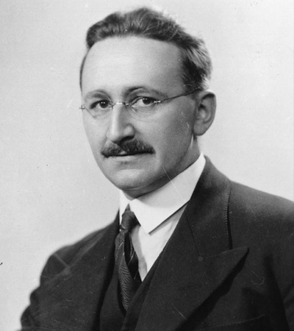
Key intellectuals and their works during the 1940s that shaped the rise of a neoliberal critique
Karl Raimund Popper, 1902-199
Ludwig Heinrich (Edler) von Mises, 1881-1973
Friedrich August (von) Hayek, 1899-1992

Slide 12
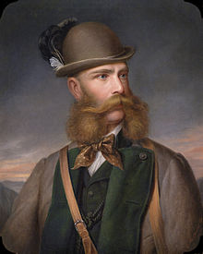
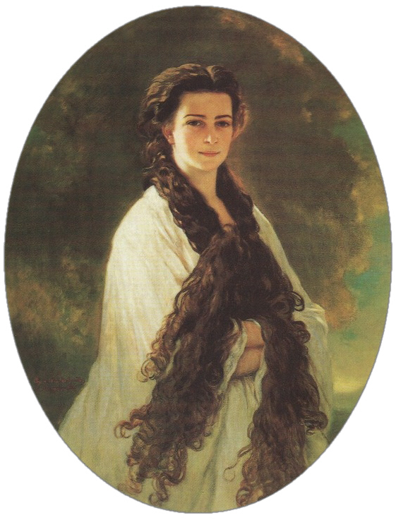
The upbringing of thes three men is important to understand their amibition
T
he Habsburg monarchy – keeping the old aristocratic system going, avoidance of any democratic modernization or liberalism
Franz Joseph I of Austria, 1848-1916
Elisabeth of Austria, called ‘Sissy’

Slide 13
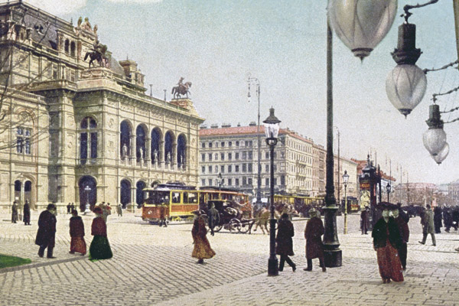

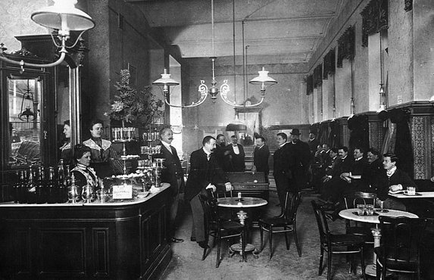
Fin-de siecle Vienna when von Mises famous evening seminars took place….
Grand city, focus on culture, excessive focus on classical education, the arts and history ….and full of the ‘sexually’ suppressed (according to Sigmund Freud who ‘invented’ psychoanalysis in Vienna.
Vienna 1900

Slide 14
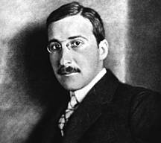
If it comes to education everything that was ‘old’, cultured, and history, was celebrated: no youth culture; in fact, young people tried to skip youth and behave like older people
Why is that attractive: authority, superior knowledge, and greater social recognition, ability to marry etc.)
The World of Yesterday (1942)
Stefan Zweig, 1881-1942;
in the 1920s and 1930s, he was one of the most popular writers in the world – it was back the still rare to be translated into English;, committed suicide in exile

Slide 15
Historicism – German Historicist Tradition
The fundamental historisation of all human thinking about the human condition, human culture and human values.
The realization that everything in the human world – culture, values, institutions, practices, modes of thinking (e.g. rationality, emotions) is made by history. so that nothing has an eternal form, permansdnt essence of constant identity which transcents historical change.
(Frederic Beiser, The German Historicist Tradition (Oxford, 2011), p. 2.
Note: Popper’s definition that historicism is about following the ‘laws’ of history is problematic; it is Popper’s own and limited interpretation of the term and movement in his, The Poverty of Historicism, Popper’s interpretation became common in the anglophone world after WWII (i.e. historicism is fascism)

Slide 16
The German Historical School of Economics (dominant in Germany speaking lands more or less until WWII)
‘The idea that economic life has ever been a process mainly dependent on individual action – an idea based on the impression that it is concerned mainly with methods of satisfying individual need – is mistaken with regard to all stages of human civilization.
(Gustav Schmoller, 1887)
Members of German Historical School that dominated political economic thinking in the 19th and early 20th century, rejected universal theorizing. They rejected deductive theory, with theory at most applicable in special circumstance that needed to be firmly rooted in reality, and qualified, across, time, place and activity.
Polar opposite of Riccardo’s liberal theory of political economy (very much adopted by John Stuart Mill) and the Marginalists; today forgotten or laughed at by main stream economists.
Wilhem Roscher, ‘Outline of Lectures on Political Economy Following the Historical Method’ (1843)
Famous members: Werner Sombart (1863-1941) and Max Weber (1864-1920)

Slide 17
Economics as a social and political science NOT a natural science and the rejection of economic laws
'…as our science has to do with men (Menschen), it must take them and treat the as they actually are, moved
At once by very different and non-economic motives, belonging to an entirely definitite people, state, age etc.’
‘ to be historical meant to be context-bound. Economic facts and theories must be interpreted in the context of the place and the time period of the society or people in question, not in the light of a larger developmental scheme or timeless causal law. This differenciated economics from other natural sciences.’
Scientific theories are based on abstract reasoning and takes no notice of historical situation.

Slide 18
Historicism is also present in political economy
Two objectives of German historical economy
Social reform -- German social welfare state
the transition of economics into a historical science – against making it a natural science; history is key to investigate social phenomena as economic production and exchange
Rejecting capitalism as lived at their time and the theories explaining it (classical political economy a la Ricardo); policy is focus.
Historical economy was a policy-orientated empirical economics which viewed history as an essential. Source of data and knowledge and the national past as the principle inspiration for understanding patterns of change and for devising appropriate policies to accommodate that change.
German society is late in industrializing and in gaining national unity:
British theories and accompanying methods were not applicable to the context of most German political economists. German industrialization and social questions only pressing from last third of 19th century
‘No laissez-faire capitalism and not centralized despotism in the form of Marxism’

Slide 19
Marginalism and the Methodenstreit (‘battle of methods’ ) from 1883
Carl Menger, Principles of Economics (1871), which suggest ‘subjective value theory’ -- rejected by the majority of German historical economics
Investigations into the Method of the Social Sciences with Special References to Economics’ (1883) -- attack on the Historical School of Economics
From 1883 ‘Methodenstreit’ between Carl Menger (and friends, including von Mises) and the leader of historical school of economics Gustav Schmoller
Goes on for years; ends with the victory of marginalists, the historical school disappears in 20th century.
For a good overview on these issues: See, Dimitris Milonaki and Ben Fine, From Political Economy to Economics: Method, the Social and the Historical in the Evolution of Economic Theory (Abington, 2009) pp. 71-118.

Slide 20
Books that shaped the neoliberal project
The Logic Scientific Discovery (germ.1934; engl. 1959)
falisifiabilty to distinguish between true and false scientific theories ; genuine scientific knowledge is always provisional
The Poverty of Historicism (1936)
The Open Society and its Enemies, vol. 1/2 (1945)
What is an open society according to Popper?
A society in which ‘in which an individual is confronted with personal decisions’ as opposed to a magical or tribal or collectivists society’.
Enemies:
Ideologies that deny individual freedom in the name of destiny, tradition, or class struggle
Karl Raimund Popper, 1902-199

Slide 21
Chief economist of the Austrian Chamber of Commerce where he holds an evening
seminar; 1934 Switzerland, 1940 US (university chair was paid by US business)
Human Action: A Treatise on Economics (1949)
Theory of praxeology, a deductive theory how to understand
human decision-making and human behavior
Bureaucacy (New Haven,1944)
the spread of socialism and the increasing buerocraticsation of
economic life
Ludwig Edler von Mises, 1881-1973

Slide 22
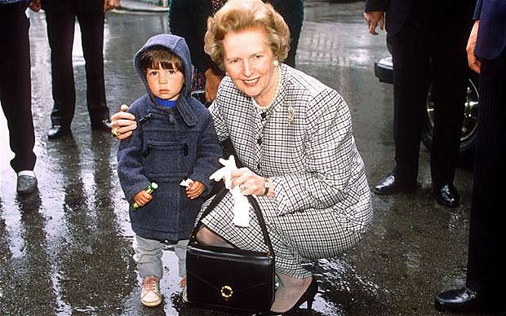
Margaret Thatcher and her famous handbag
According to a minister in her cabinet, the handbag, ‘was in part a portable filing cabinet, but was also used to remind people of her power’.
It contained her favorite book which, she claimed. A book that gave her the courage to change Britain forever…..

Slide 23

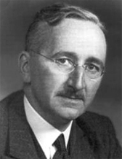
The Road to Serfdom
The book argues that the abandonment of individualism and classical liberalism inevitably leads to a loss of freedom, the creation of an oppressive society, the tyranny of a dictator, and the serfdom of the individual.
What is classical liberalism: a political philosophy, emerging during the 17th and 18th century, emphasizing individua liberty, limited government, the rule of law, and free-market capitalism (e.g. John Locke, Adam Smith, David Hume, John Stuart Mill, Jeremy Bentham, Alexis de Tocqueville, David Ricardo etc.)
Friedrich August (von) Hayek 1899-1992

Slide 24
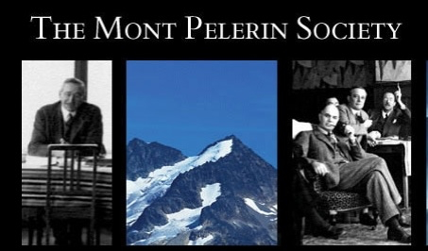
Mount Pelerin Society (founded in 1947)
Currently meets on biennial basis
Hayek invited 39 scholars – economists, though some historians, writers and philosophers
Were invited to discuss the fate of liberalism. iI has ‘no official views, formulates no policies, publishes no manifestos, aligns itself with no party, and accepts no political or public funding.’
Founding members were: Karl Popper, Ludwig von der Mises. George Stigler, Milton Friedmann, Walter Eucken, Wilhem Röpke (the last two stand behind the Germany economic miracle after WWII)
Based on Walter Lippmann Colloquium in Paris in 1938. Named after the American journalist Walter Lippmann and his book, An Enquiry into the Principles of the Good Society (1937)

