Slide 1
European World Lecture: Catholicism Beyond Europe
Peter Marshall

Slide 2
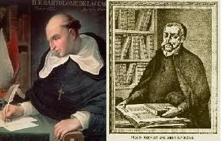
Were Amerindians rational souls or “natural slaves”?: Las Casas vs Sepulveda

Slide 3
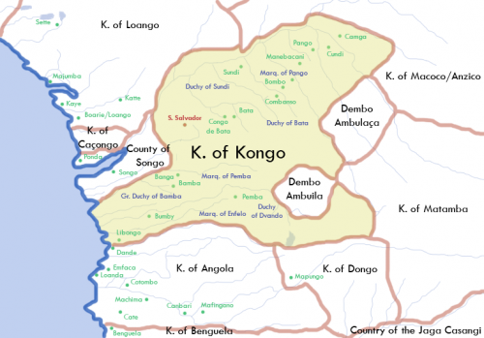
A Catholic Kingdom in Africa: Kongo in the early 18th Century

Slide 4
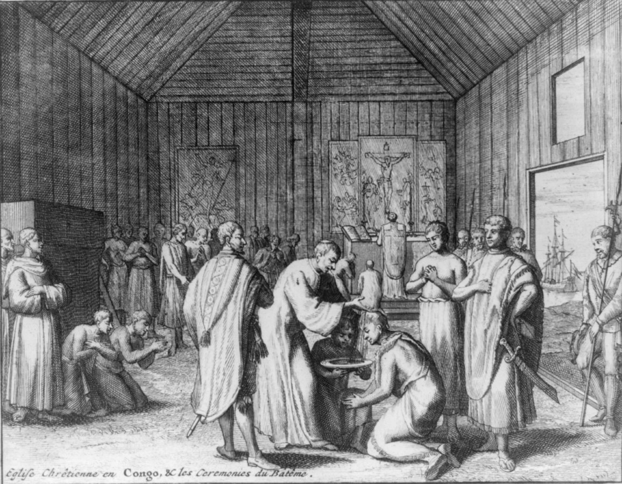
Sacraments in a Kongolese Church

Slide 5
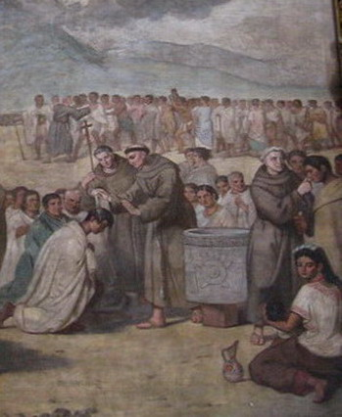
Franciscan Friars Baptising Native Converts in Mexico

Slide 6
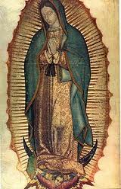
Symbol of Mexico: Our Lady of Guadalupe

Slide 7
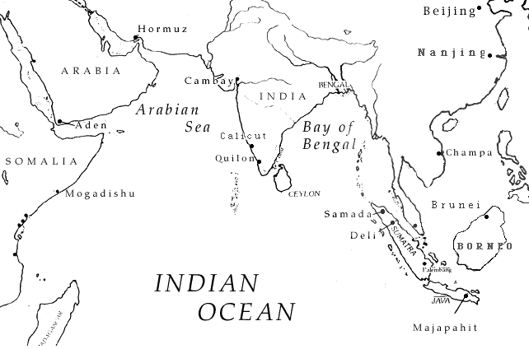
The Portuguese Ocean:

Slide 8
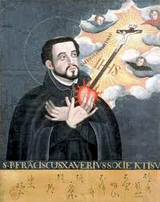
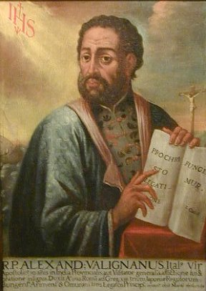
Jesuit ‘Accomodationists’
Francis Xavier
Alessandro Valignano

Slide 9
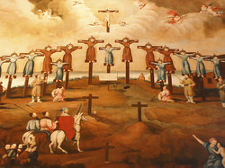
Reversal: Persecution in 17th c. Japan

Slide 10
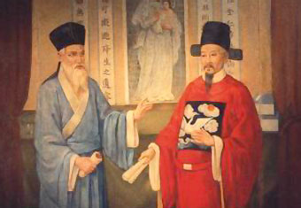
Catholicism with a Chinese face: Matteo Ricci and the convert Xu Guanqi

