Slide 1
European World:
Christian Humanism

Slide 2
•What was, and wasn’t, humanism?
•How did the Italian Renaissance influence northern Europe?
•How did humanism develop in northern Europe?
•What was the contribution of Erasmus?
•What was the importance of humanism for the Reformation?

Slide 3
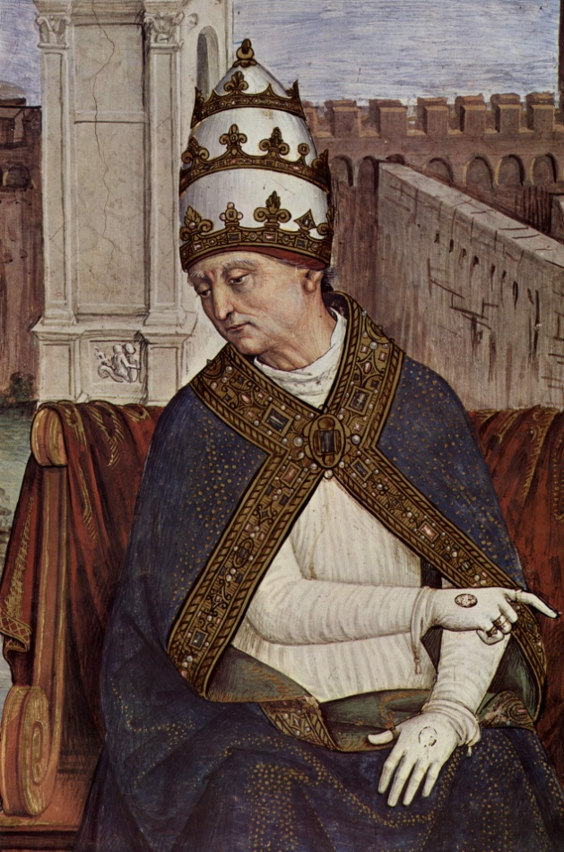
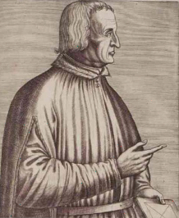
Italian Humanists in the North
Polydore Vergil
Aeneas Sylvius Piccolomini (Pope Pius II)

Slide 4

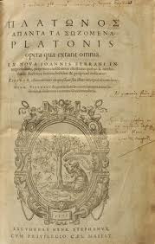
Classical texts from the Aldine Press, Venice

Slide 5
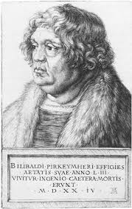
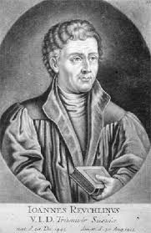
German Humanists
Johann Reuchlin
Willibald Pirckheimer

Slide 6
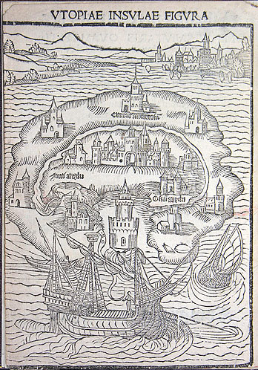
Thomas More’s Utopia (1516): a humanist ‘no place’

Slide 7
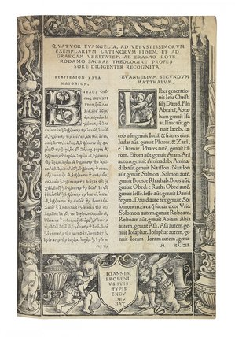
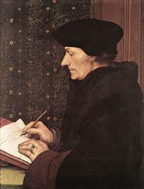
Erasmus and his Novum Instrumentum of 1516 (with parallel Greek and Latin texts)

