Slide 1
From ‘Authority’ of the Ancients to ‘Experience’ of Nature in the Early Modern Period

Slide 2
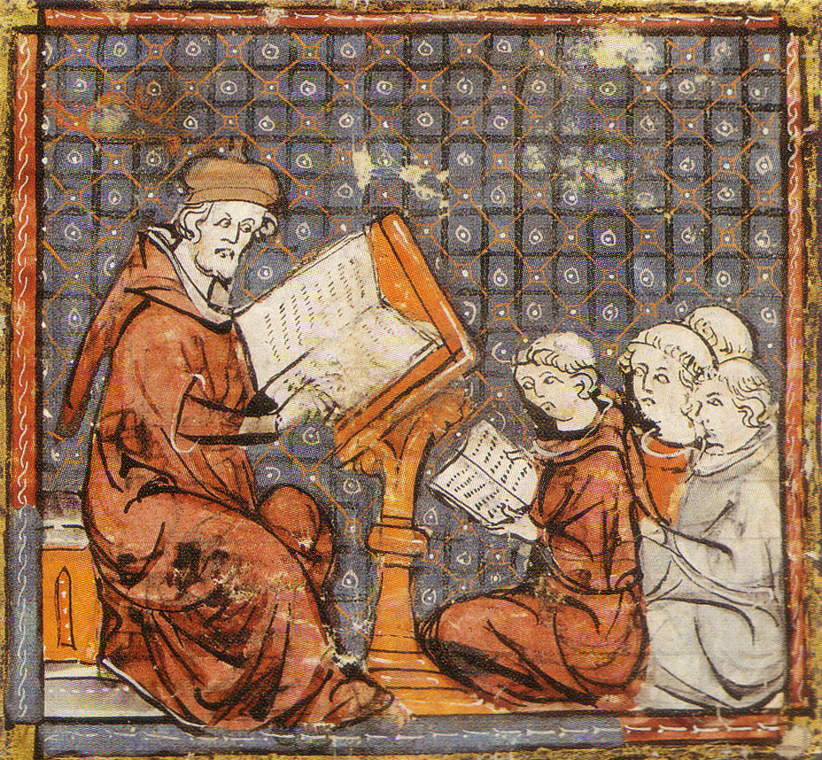
How did one learn about medicine and nature around 1500?
Scholasticism; scholastic: A term applied to the intellectual and academic style of the medieval universities, a style stressing debate , disputation, and the effective use of canonical text (such as Aristotle) in the making of arguments. A ‘scholastic’ is a practitioner of this style
1. At university
Natural philosophy: a category, known
as “physics”. It referred to systematic
knowledge of all aspects of the natural
World, including living things. In the sixteenth and seventeenth century it was routlinely understood that the world was God’s Creation. Natural philosophy therefore possessed strong theological implications.

Slide 3
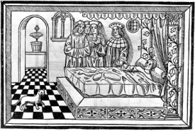
Academic physicians and their medical practice:
interpreting ancient books rather than actively engaging with the body

Slide 4
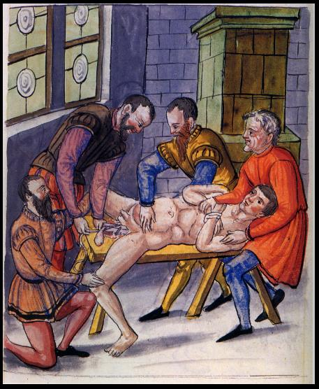
2. Apprenticeship with a surgeon or barber-surgeons within the local guild system
Cutting a the stone (lithotomy)

Slide 5
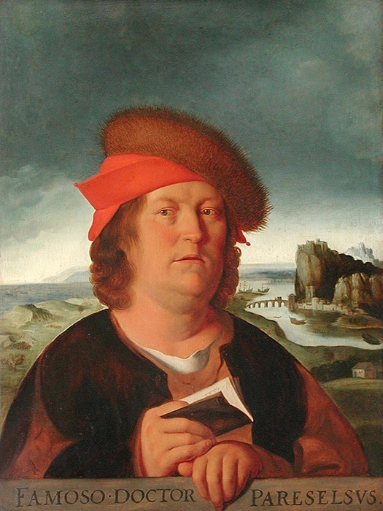
From books to first hand experience
‘
Philippus Aureolus Theophrastus Bombastus
von Hohenheim, 11 1493 – 1541), known as Paracelsus
Propagates that surgery and academic medicine need to be practiced together

Slide 6
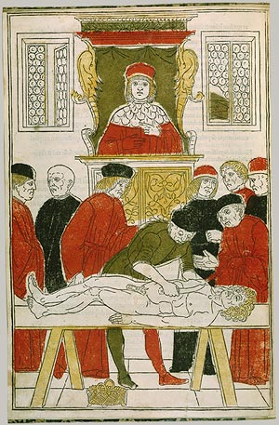
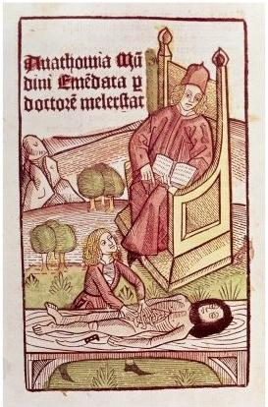
Anatomy: from books to practice
Example: Anatomy

Slide 7
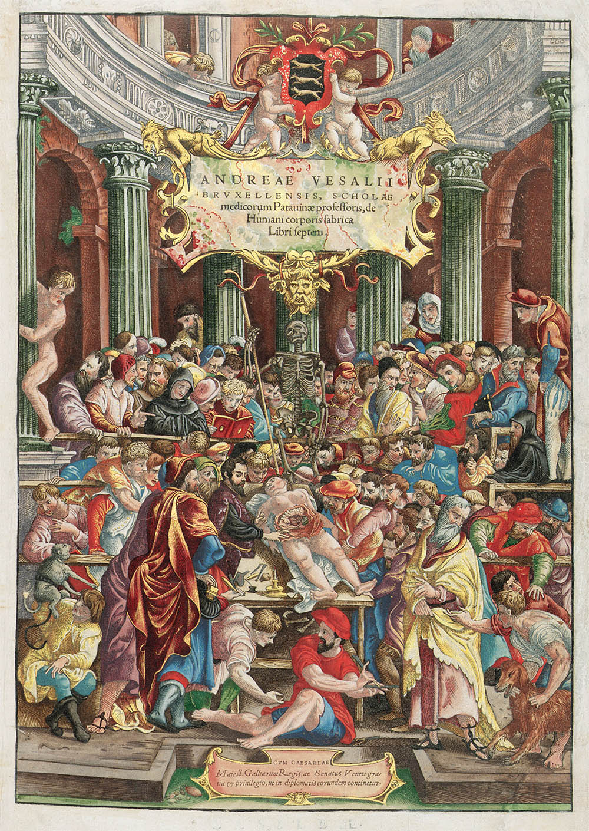
Reform of Anatomy
Andreas Vesalius:
De humani corporis fabrica libri septem (On the Fabric of the Human Body in Seven Books), 1543
reforms in how anatomy is taught
reforms in how it is presented (

Slide 8
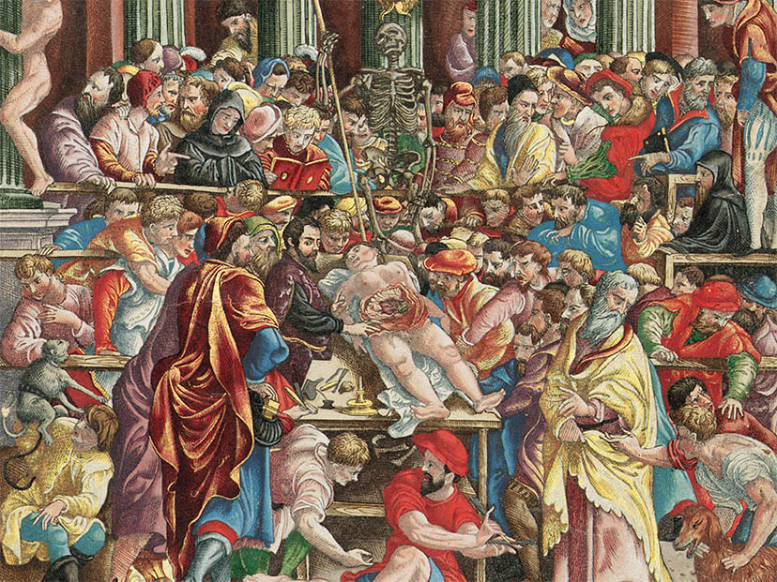

Slide 9
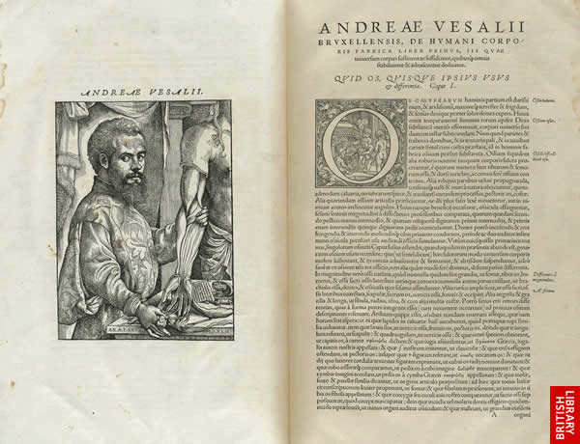
De Fabrica
tries to bring together ancient knowledge (Galen) and hand—on practice
A physicians needs to know the classical literature AND be able to use his own experiences with the body

Slide 10
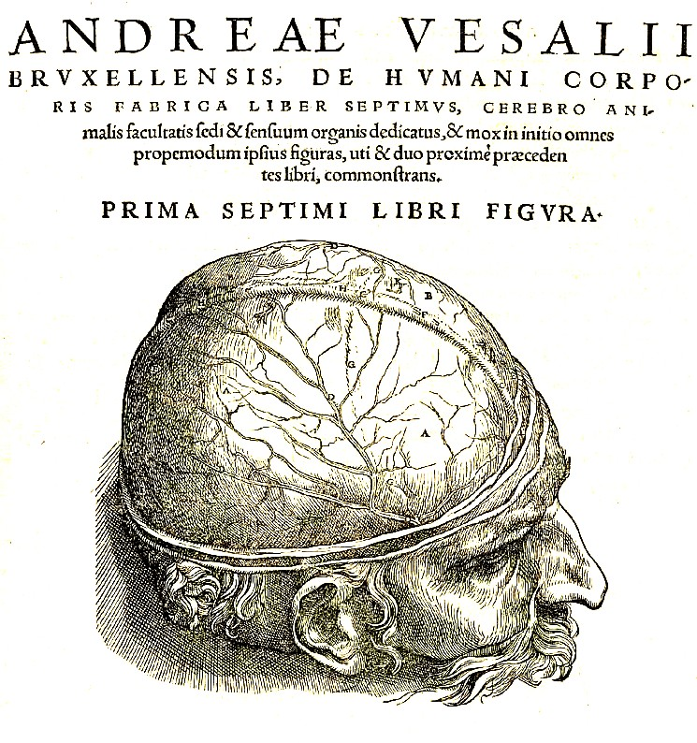

Slide 11
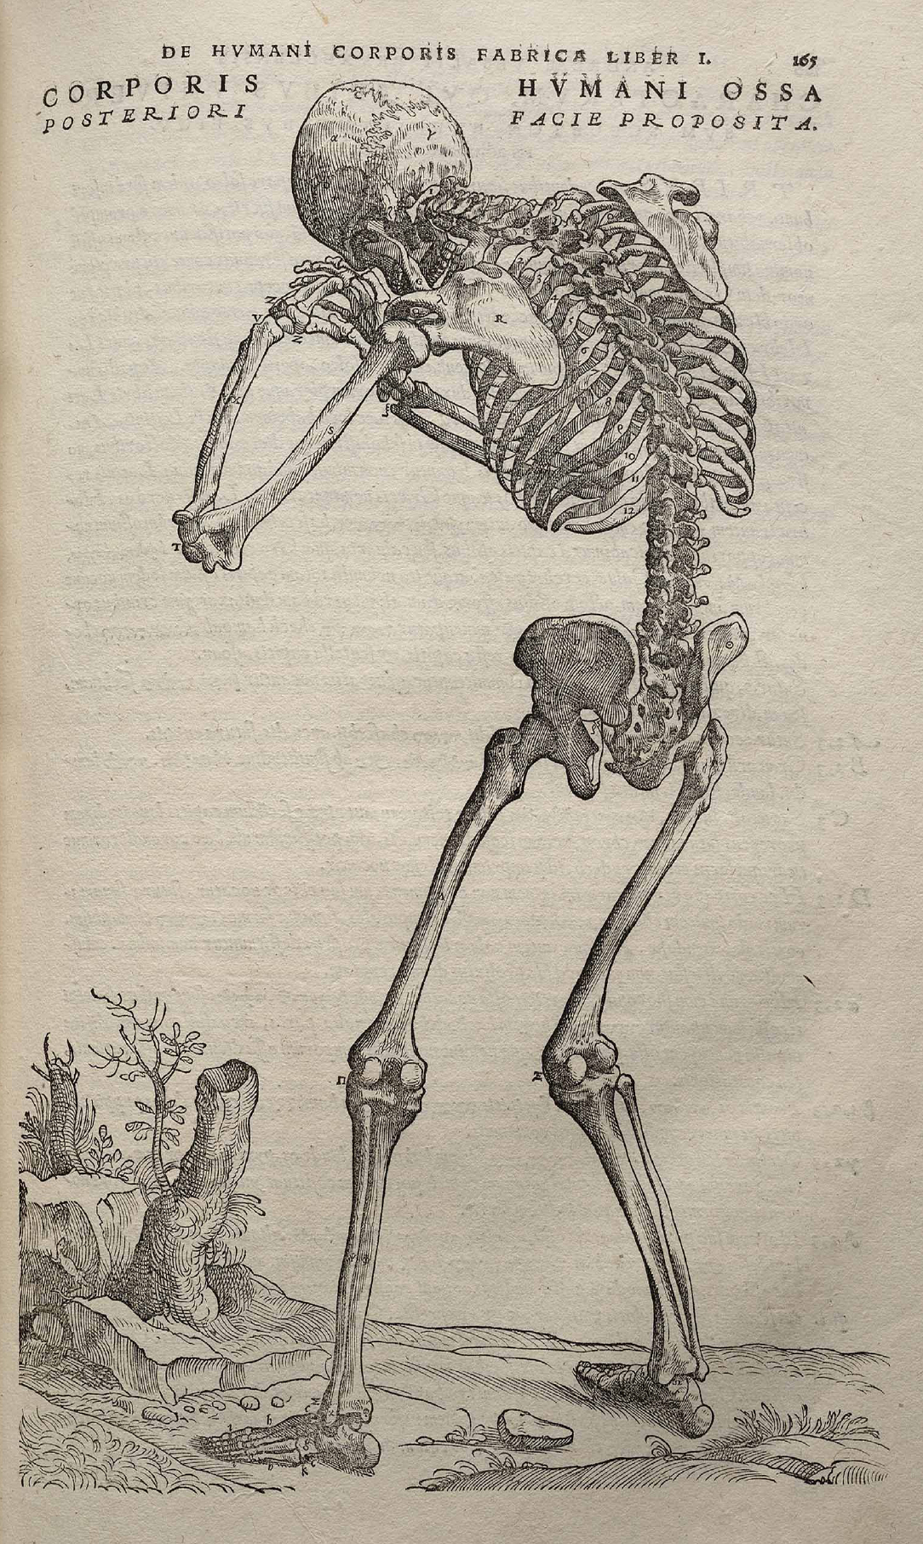
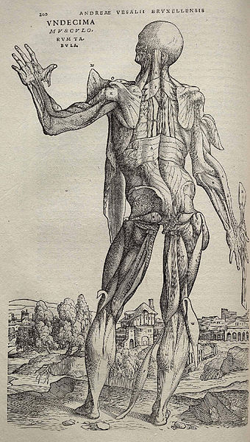
New: Collaborations between artists and natural philosophers

Slide 12
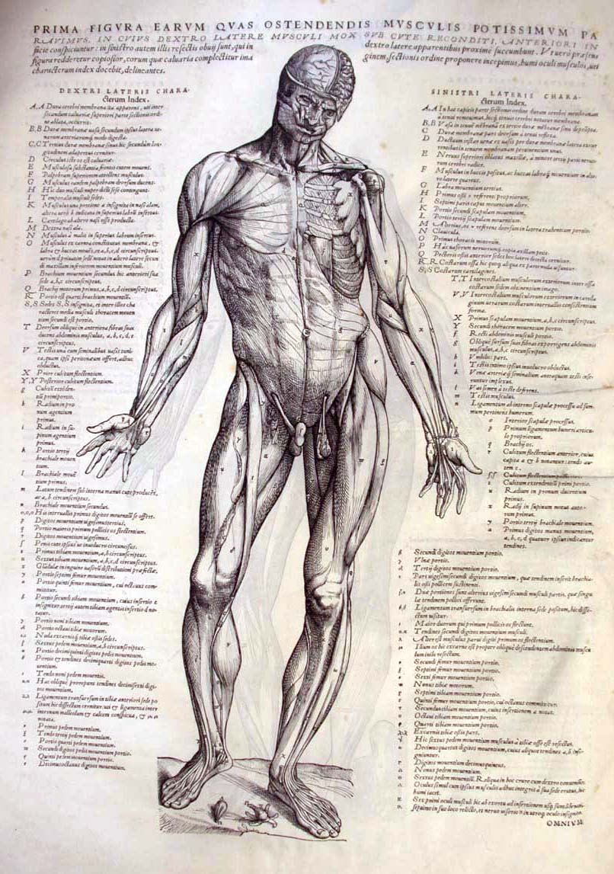
‘De Fabrica’ aims to reform medicine
by correcting ancient authorities such as Galen
New: collaborations with artists!

Slide 13
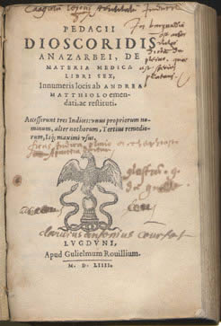
Reforms in materia medica
Dioscorides, c. 40 – 90 AD
Materia Medica: something from which medicine can be produced

Slide 14
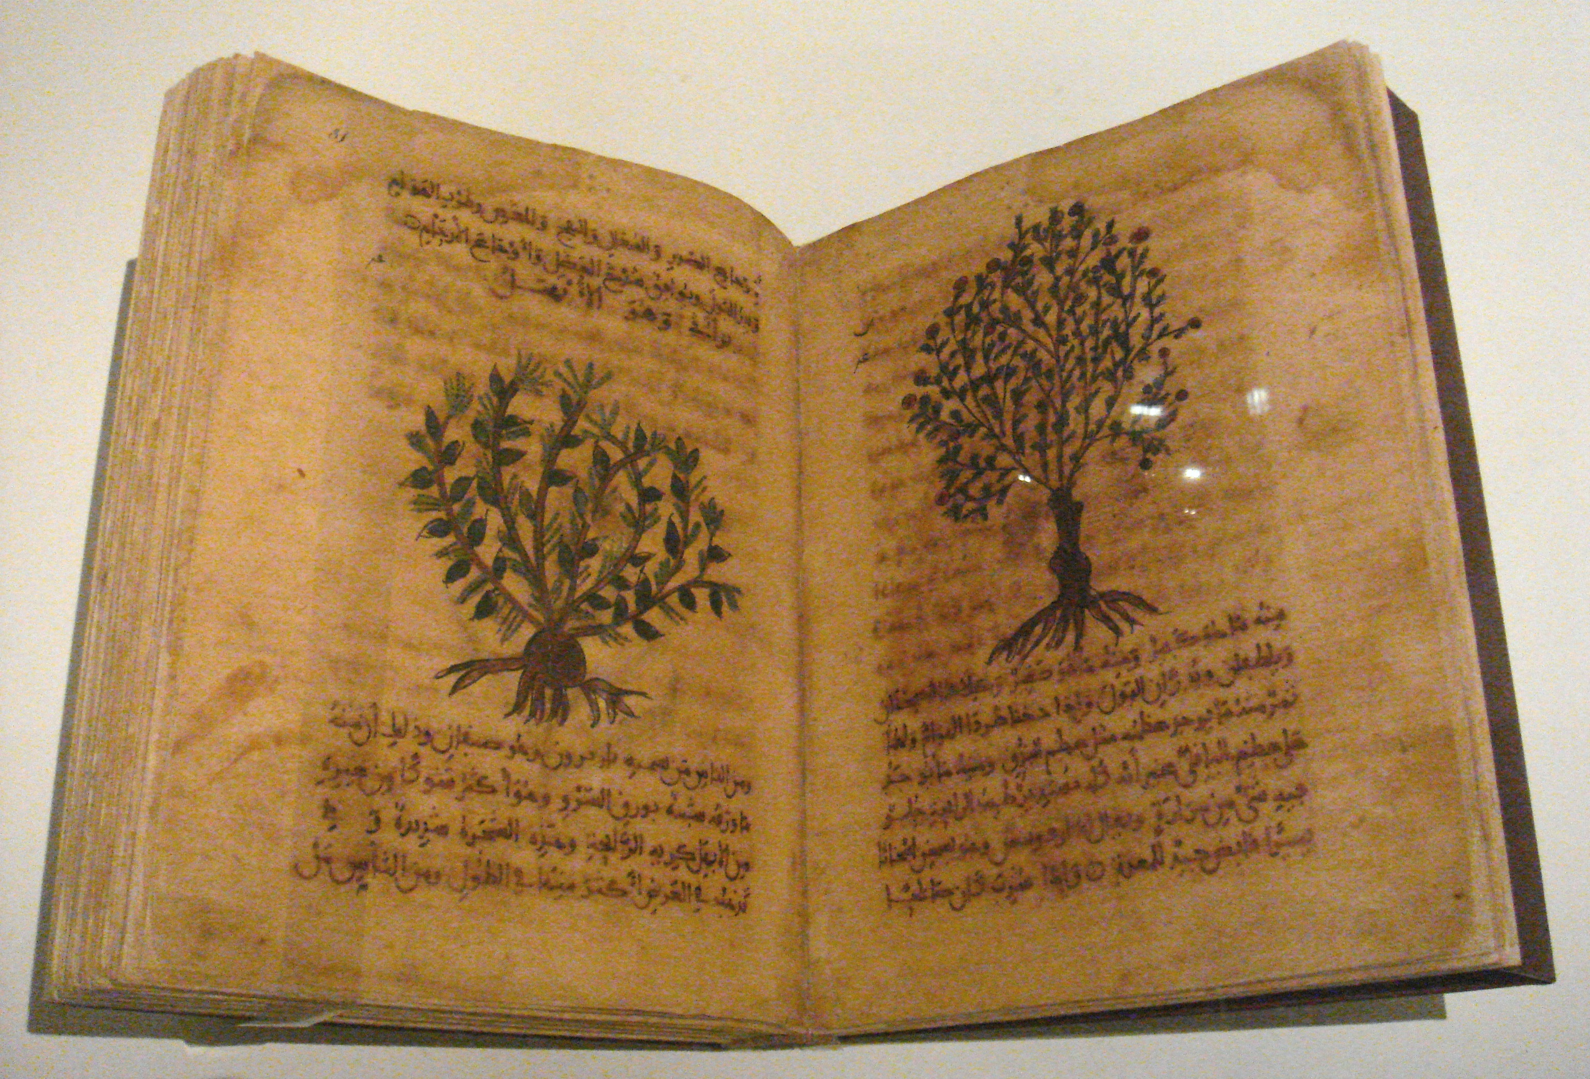
here too: Focus on classical literature; text over visual image

Slide 15
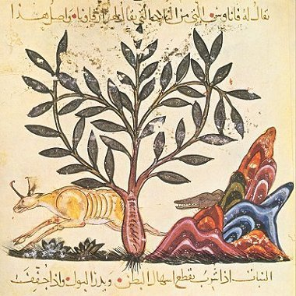

Slide 16
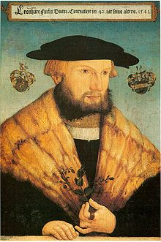
Reforms in the 16th century:
Leonhard Fuchs, 1501-1566
De Historia Stirpium Commentarii Insignes
(Notable commentaries on the History of Plants,
Basel, 1542)

Slide 17
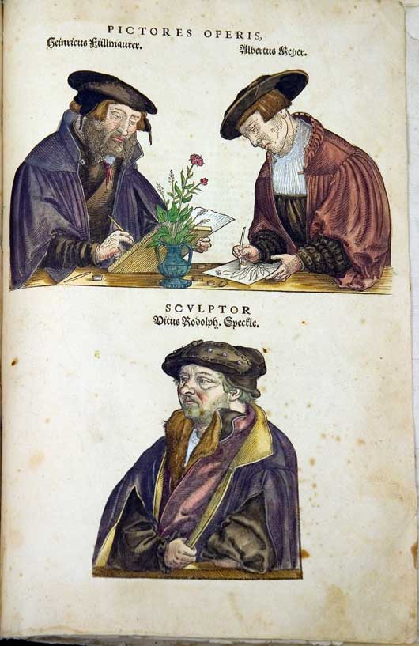
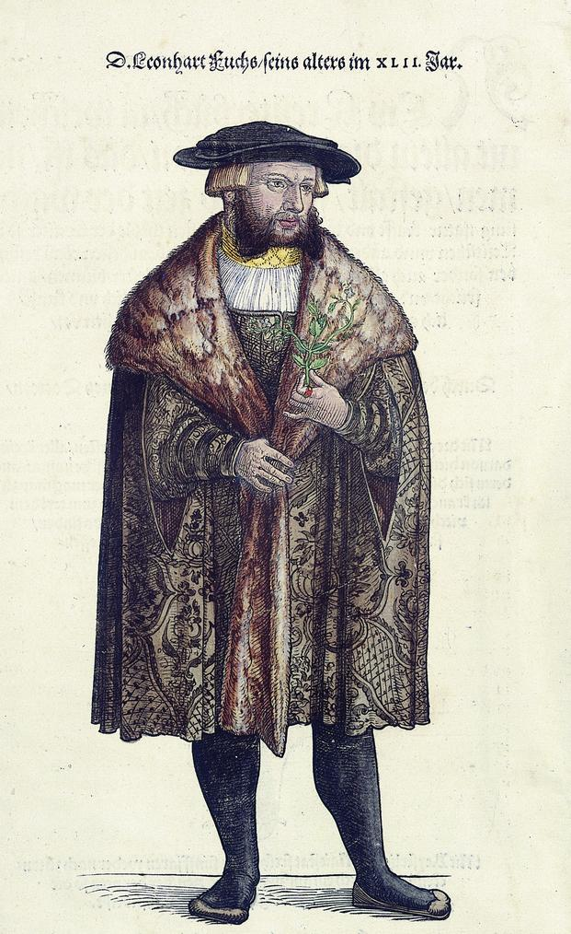
Collaboration with artists

Slide 18
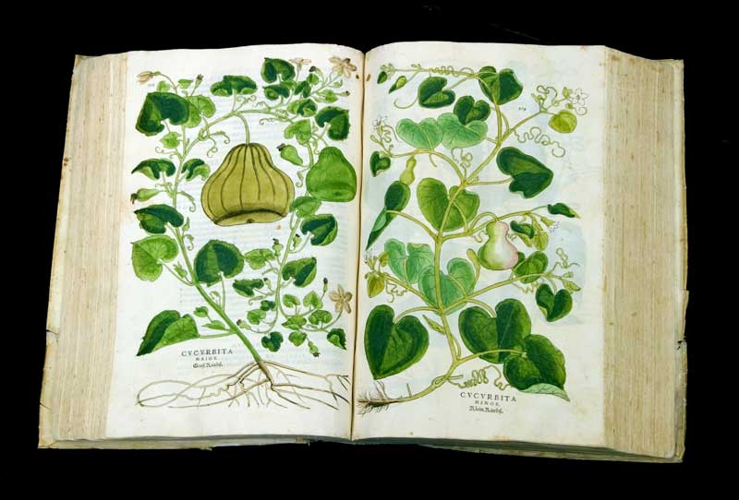

Slide 19
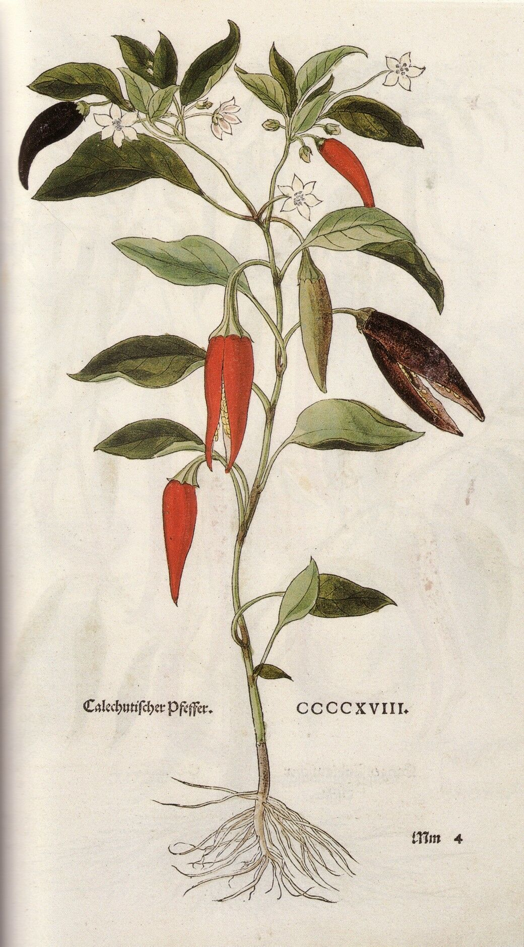
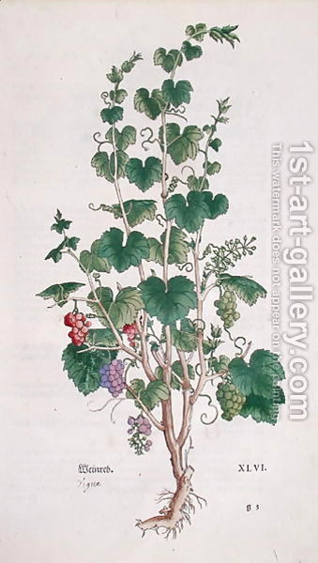

Slide 20
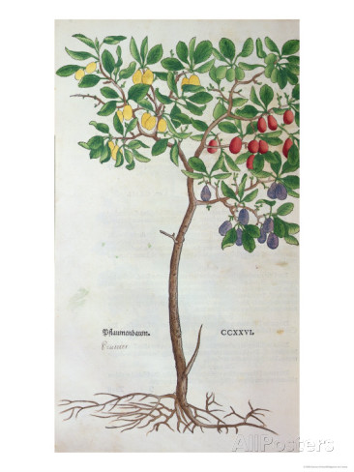
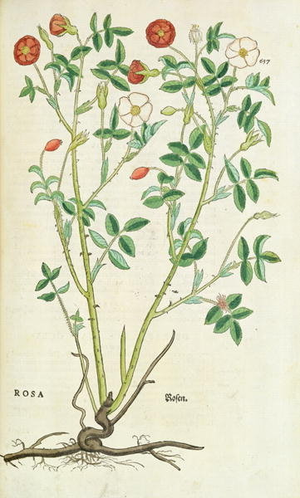

Slide 21
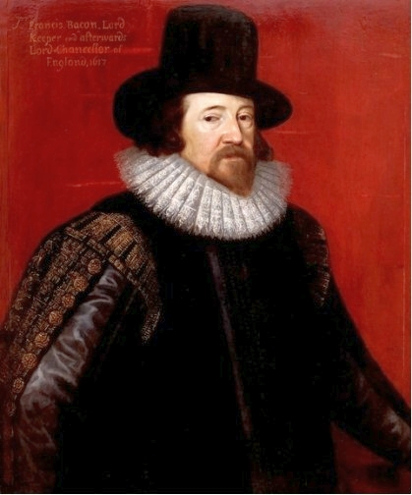
Empiricism: a philosophical stance that
holds that all knowledge is rooted in the
senses and the experience that they
provide
Novum organum (New Organon), 1620
Francis Bacon, 1561-1726

Slide 22
‘We do not think that it is any more relevant
to the present subject whether the
discovery to come were once known to the
ancients…that it should matter to the men
whether the New World (i.e. America) is the
famous Island Atlantis which the ancient world
knew…for the discovery of things is to be taken
from the light of Antiquity.’
Francis Bacon, 1561-1726

