Slide 1
The European World 1500-1750
Theme 3: Culture
WITCHES
Jonathan Davies
(Powerpoint and handout are on the website)

Slide 2
…One of the most difficult tasks facing historians of European witchcraft is to account for the variations in the intensity of witch-hunting at different times and places. Why, for example, did more European prosecutions take place between 1560 and 1630 than between 1520 and 1560? Any why was witch-hunting so much more intense in German than in Spain or in Scotland than in England? [Brian P. Levack, The Witch-Hunt in Early Modern Europe, 3rd edition (Harlow, 2006), p. 204]

Slide 3
Questions
What were the chronological patterns of witchcraft prosecutions?
What were the geographical patterns of witchcraft prosecutions?
What were the beliefs about witches?

Slide 4
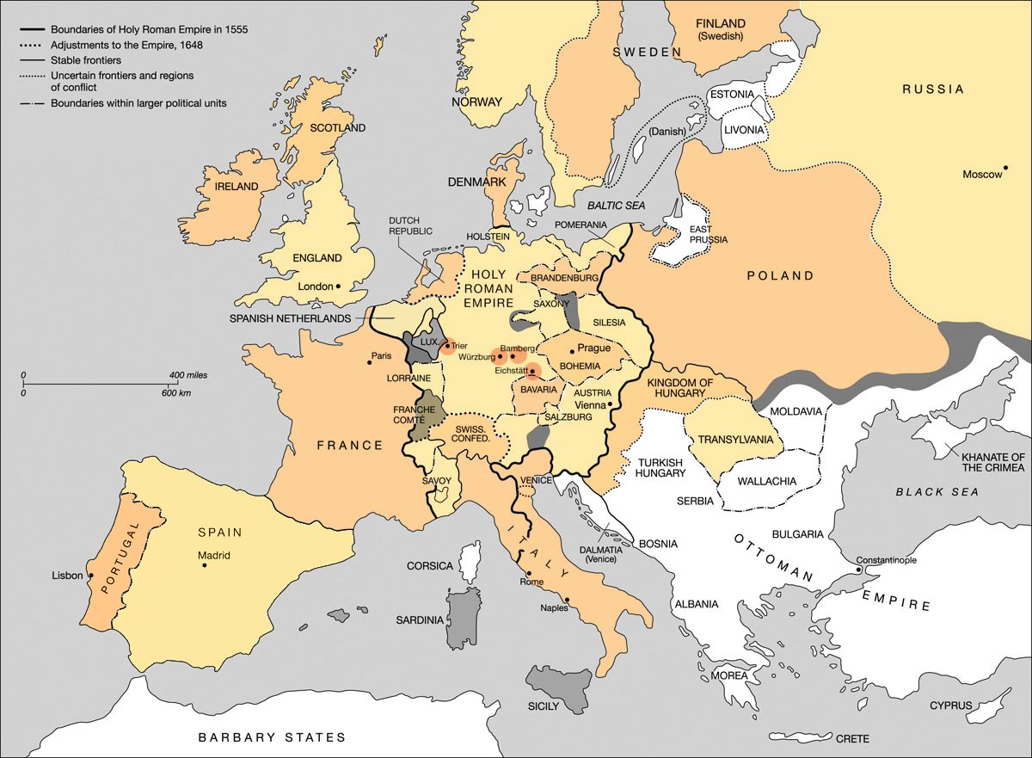

Slide 5
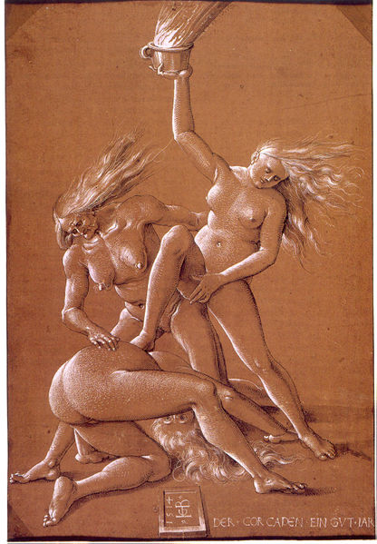
Hans Baldung, Three Witches, c. 1514

Slide 6
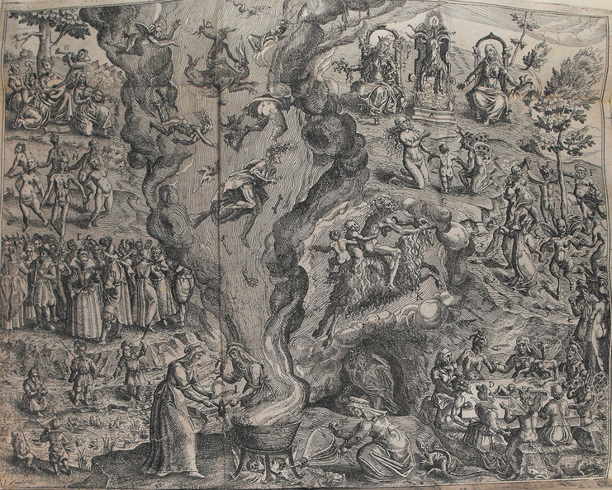
Jan Ziarnko, A Witches’ Sabbath, 1613

Slide 7
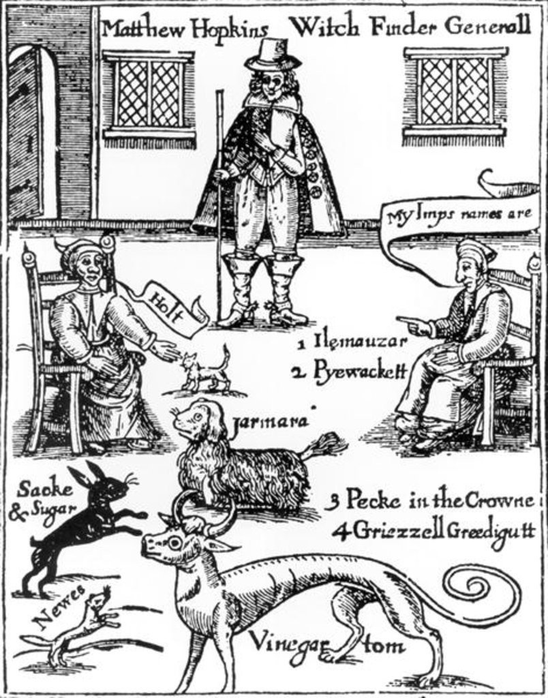
Matthew Hopkins, The Discovery of Witches,
1647

