Slide 1
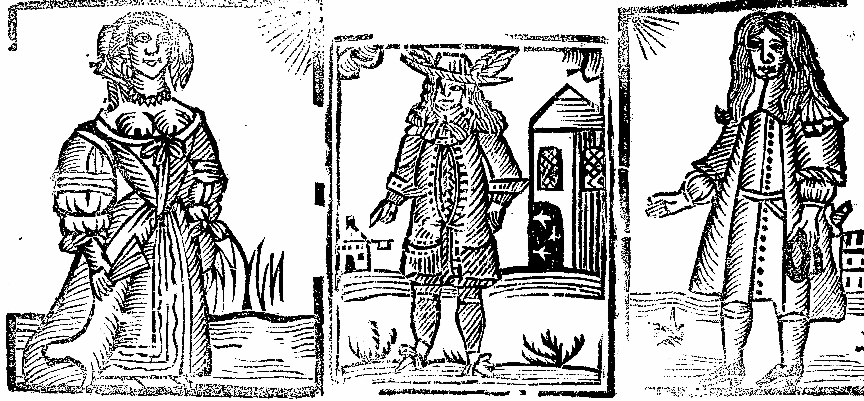
Gender
Prof Mark Knights

Slide 2
Aims
Think about what gender means
To stress the importance of the household as a conceptual and practical unit
To examine the anxieties contemporaries had about gender roles but also the entertainment they derived from them
Examine the extent of change over time

Slide 3
Gender is a category in its own right but also something that shaped how people in early modern Europe saw the world around them
Religion Witchcraft
Politics Economics
Consumption Science
Art crime

Slide 4
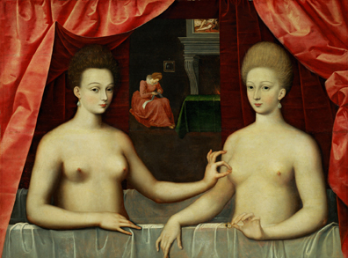
Other cross-currents
History of sexuality
History of civility and politeness
History of literature
History of science
Gabrielle d'Estrées (mistress of Henry IV) and one of her sisters,
1594 unknown artist

Slide 5
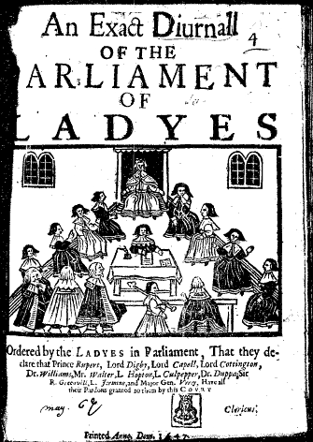
What is ‘Gender’?
Is it shorthand for women?
Feminist historiography esp of 1970s and 80s
Recovery of women from historical obscurity and archival silences
History of subordination and inequality (patriarchy)
Examples of rejection or defiance of that – a pre-history of modern feminism

Slide 6
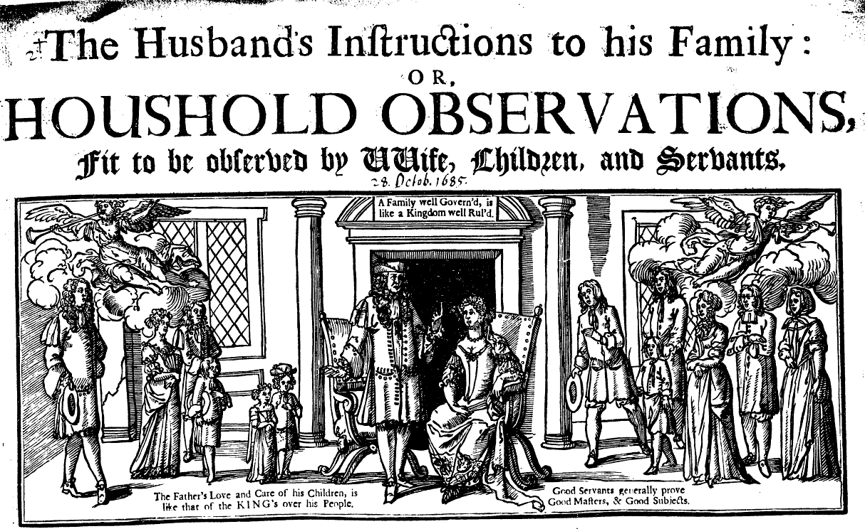
Politics/society: patriarchalism – household and sexual relations as a metaphor of the state

Slide 7
Household roles
Public and private spheres
Importance of marriage. Advice literature
Importance of the life-cycle
Women as part of the household economy
Did women have agency within the household?
Women as consumers, educators
Patriarchal power extended over men as well as women

Slide 8
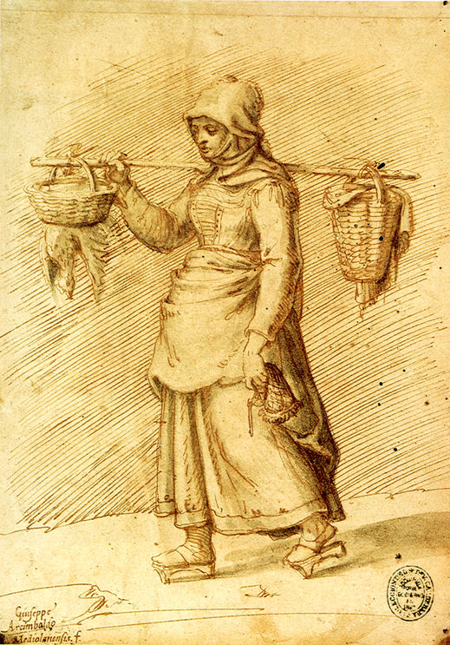
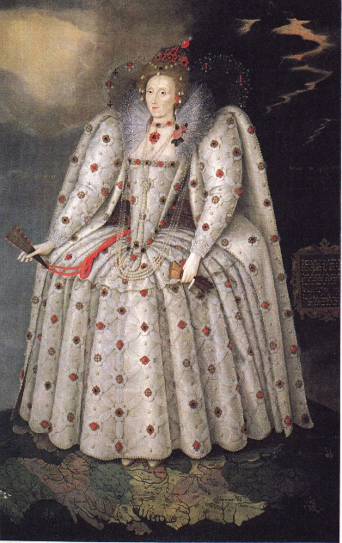
some complexities: Women were not alike: class, race, nationality, religion

Slide 9
Joan Scott and gender as a useful category of analysis
Joan Scott (1986): ‘women’ were a cultural construct ie women (and men) were identified in relation to men (and women) or the culture around them. This meant, in Scott’s essay title, 'Gender: a useful category of analysis'
Gender ‘means knowledge about sexual difference... Such knowledge is not absolute or true, but always relative. It is produced in complex ways... Its uses and meanings become contested politically and are the means by which relationships of power - of domination and subordination - are constructed...’

Slide 10
‘It follows then that gender is the social organization of sexual difference.... Gender is the knowledge that establishes meanings for bodily differences. These meanings vary across cultures, social groups, and time...’
The key question is how hierarchies of gender ‘are constructed or legitimated. The emphasis on how suggests a study of processes, not of origins, of multiple rather than single causes, of rhetoric or discourse rather than ideology or consciousness’

Slide 11
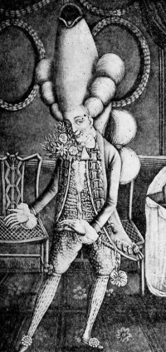
Masculinity
It follows that gender is also about the history of the construction of masculinity [Elizabeth Foyster, Anthony Fletcher, Alex Shepard]
How were ideas about manhood shaped? How did men behave?
Is there a danger that this focus might return the gaze to the men that feminist historians were trying to challenge?
Randolph Trumbach (1998): the emergence by the early C18th of a ‘third gender’.

Slide 12
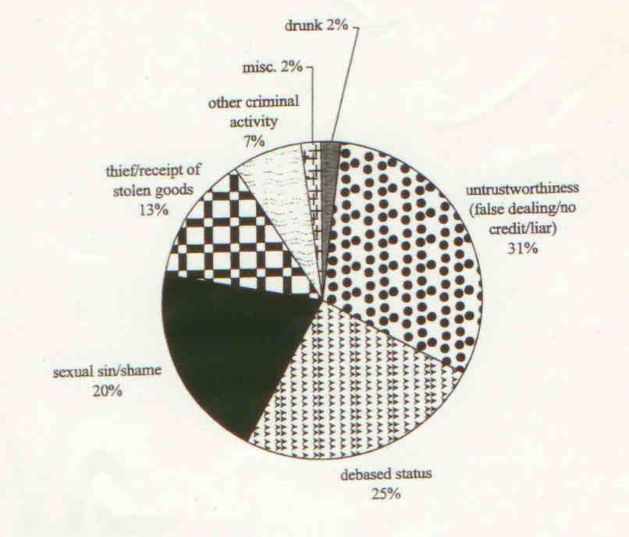
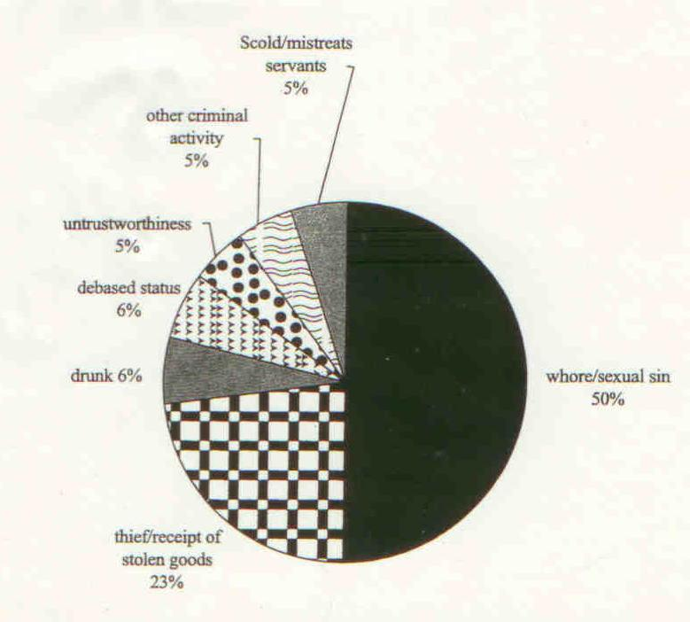
The pie chart on the left shows insults against men in Cambridge 1581-1640; the one on the right shows insults against women

Slide 13
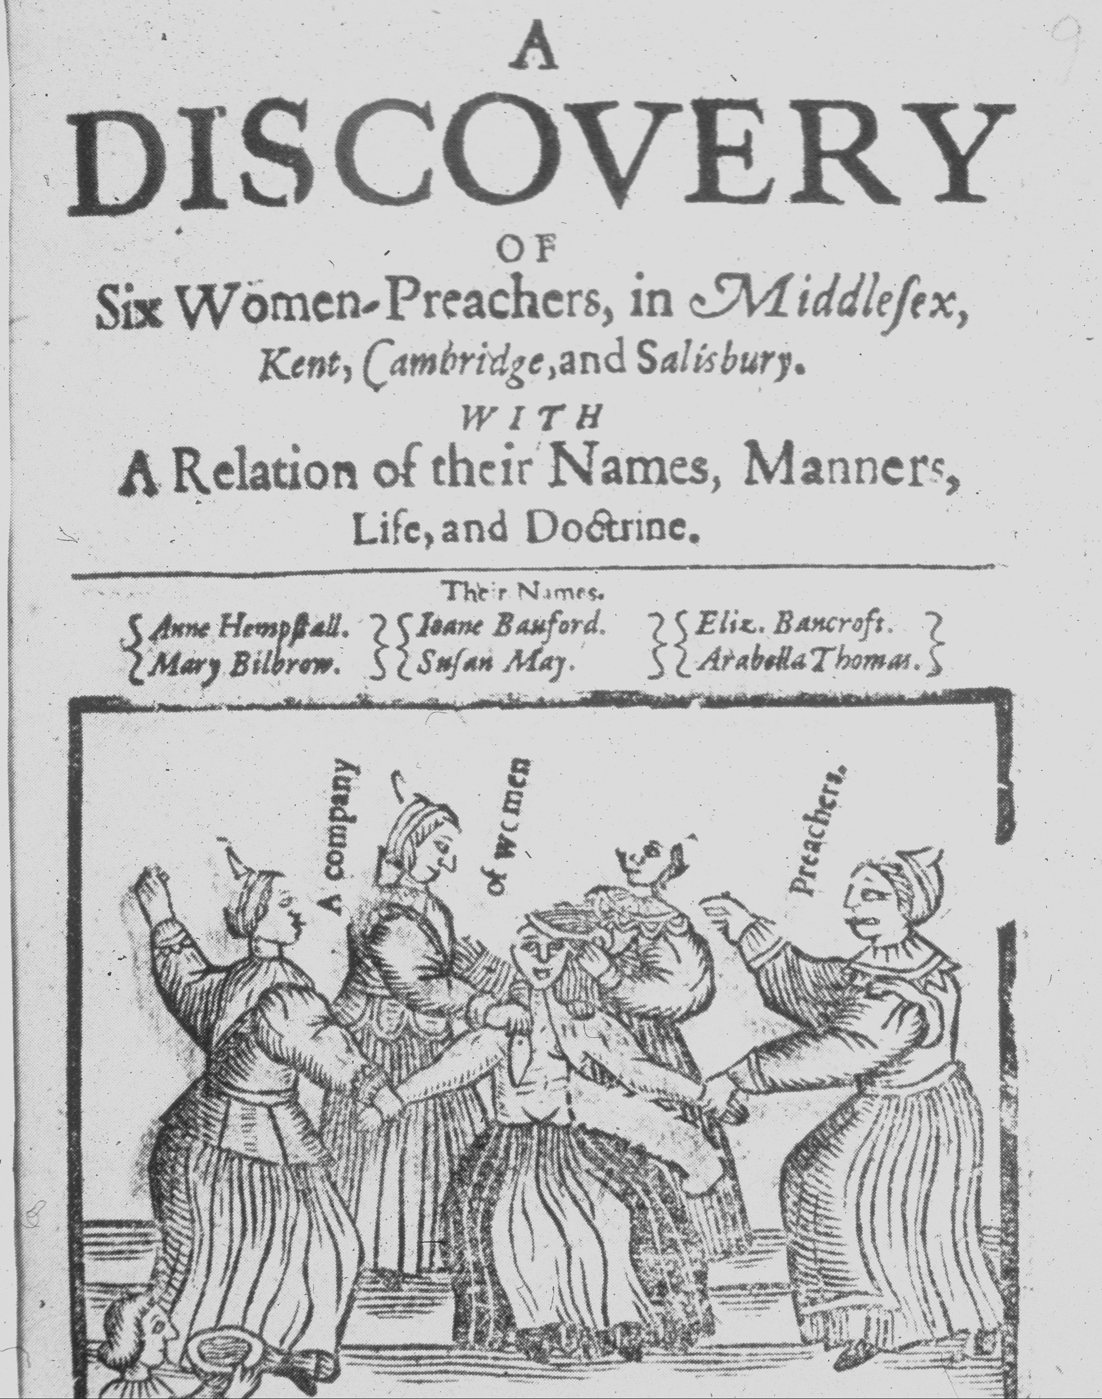
Religion
Biblical views of women
Protestant Reformation
Destruction of cult of Virgin Mary; abolition of nunneries
Protestant social conservatism though some groups challenged (Anabaptists and polygamy; Quakers)

Slide 14
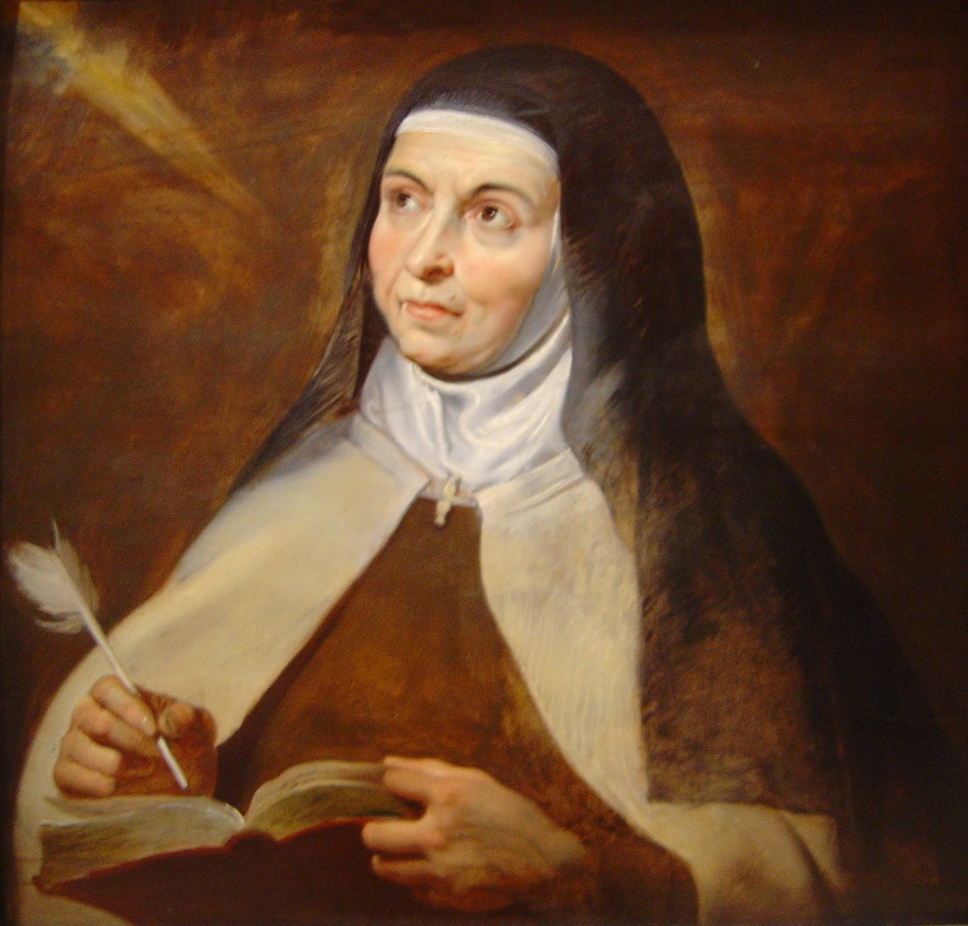
Catholic Reformation
Stress on order and obedience; but also Teresa of Avila in C16th – mystic who had deep interaction with her God that resulted in trances and paralysis; prompted by the Spanish Inquisition, she wrote an account of them.
‘Lord of my soul, you did not hate women when you walked in the world; rather you favoured them always with much pity and found in them as much love and more faith than in men. Is it not enough, Lord, that the world has intimidated us … so that we may not do anything worthwhile for you in public?’

Slide 15
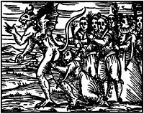
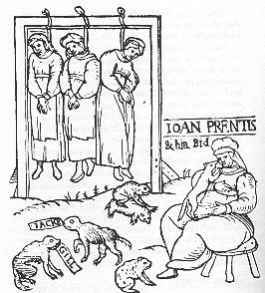
Witchcraft
About 80% of prosecutions for witchcraft were against women. Why?
Malleus Maleficarum (1486):
Women as more credulous
more impressionable
Slippery tongues
More carnal
Skilled in deception
She is ‘an imperfect animal’

Slide 16
Debate over women (‘querelle des femmes’)
Defences of women, from misogynystic attack
Eg Lucrezia Marinelli, The Nobility and Excellence of Women and the Defects and Vices of Men (1600); Mariele Jars de Gournay, L’Egalité des hommes et des femmes (1622)
Joseph Swetnam, The Arraignment of Lewd, Idle, Forward and Unconstant Women (1615) provoked two counter-attacks, one by Rachel Speght (1617) and another by Esther Sowernam, The Worming of a Mad Dog (1617)
How serious? Entertainment?

Slide 17
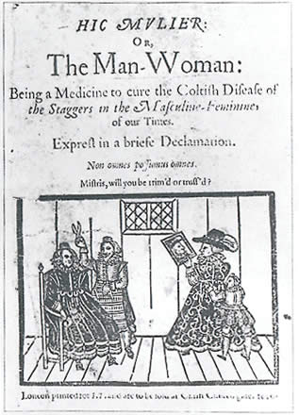
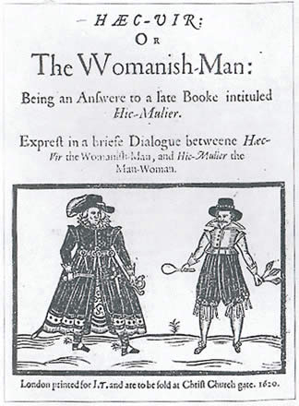
Two pamphlets were published in 1620 which debated the fashion of women wearing men's clothing. The King and Church condemned it.
Notes:
"Yesterday the Bishop of London called together all his Clergy about this town, and told them he had express commandment from the King to will them to inveigh vehemently and bitterly in their sermons against the insolency of our women, and their wearing of broad-brimmed hats, pointed doublets, their hair cut short or shorn, and some of them stilletos or poinards. (Swords) The truth is the world is very far out of order." John Chamberlain, reported to his friend Dudley Carleton on January 25, 1620 "Yesterday the Bishop of London called together all his Clergy about this town, and told them he had express commandment from the King to will them to inveigh vehemently and bitterly in their sermons against the insolency of our women, and their wearing of broad-brimmed hats, pointed doublets, their hair cut short or shorn, and some of them stilletos or poinards. (Swords) The truth is the world is very far out of order." John Chamberlain, reported to his friend Dudley Carleton on January 25, 1620 "Yesterday the Bishop of London called together all his Clergy about this town, and told them he had express commandment from the King to will them to inveigh vehemently and bitterly in their sermons against the insolency of our women, and their wearing of broad-brimmed hats, pointed doublets, their hair cut short or shorn, and some of them stilletos or poinards. (Swords) The truth is the world is very far out of order." John Chamberlain, reported to his friend Dudley Carleton on January 25, 1620

Slide 18
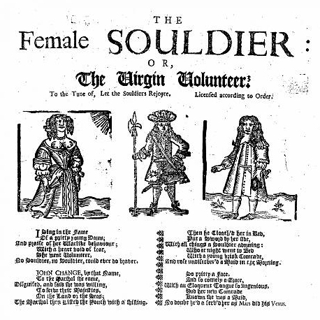
Ballad literature

Slide 19
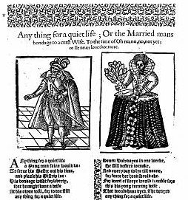

Slide 20
Anything for a Quiet Life: or the married man’s bondage to a curst wife. c. 1620
Any thing for a quiet life
a yong man faine would do;
to serve his master out his time
and please his mistris too
his bondage wisht for liberty
that he might have a wife
at his owne will, for to doe still
any thing for a quiet life.
In haste he chose himselfe then one
and quickly was he wed
but crooked cares of household charge
molested much his head.
His wedding shoes no sooner off
but his commanding wife
did make him pray and often say
any thing for a quiet life
His wife (yong lasse) grew wanton sick
within a day or two
and long’d she knew not well for what
as many women doe.
The daintiest things that could be got
he gave unto his wife
and for her sake, did undertake
any thing for a quiet life.
….
Let yong-men all take heed by this
how they doe match and marry
he leads a life of liberty
that doth the longest tarry.
It is the foremost step to woe
to wed unto a wife
that will have still, at her owne will,
any thing for a quiet life

Slide 21
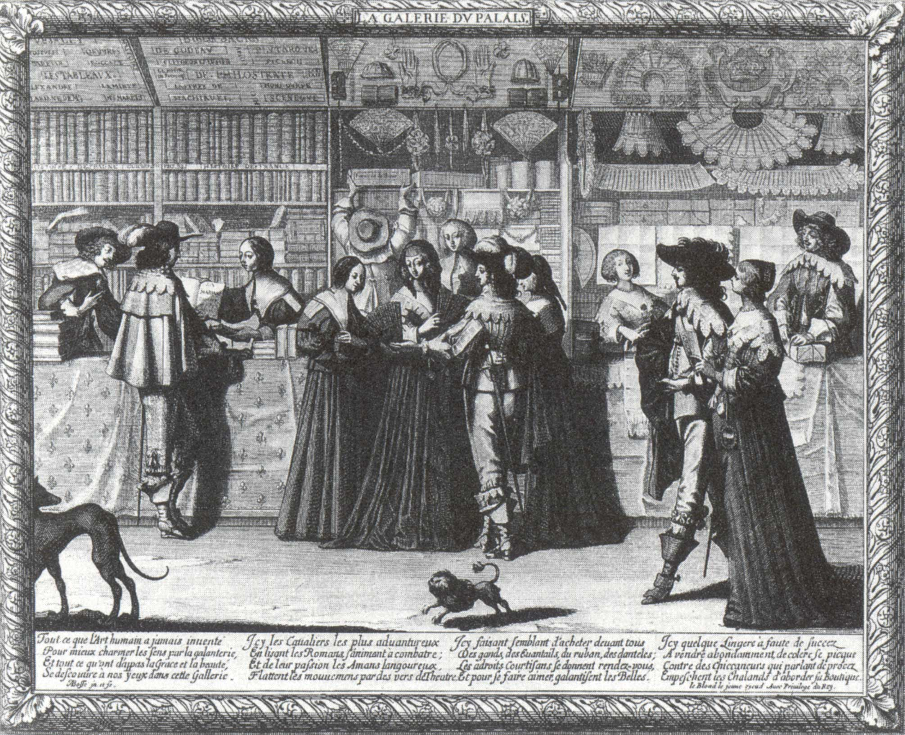
Did women have greater access to print?
Education and literacy
The world of print
Proto-feminists – Mary Astell – the language of slavery
La Galerie du Palais (c.1640). Etching by Abraham Bosse (1602–1676)

Slide 22
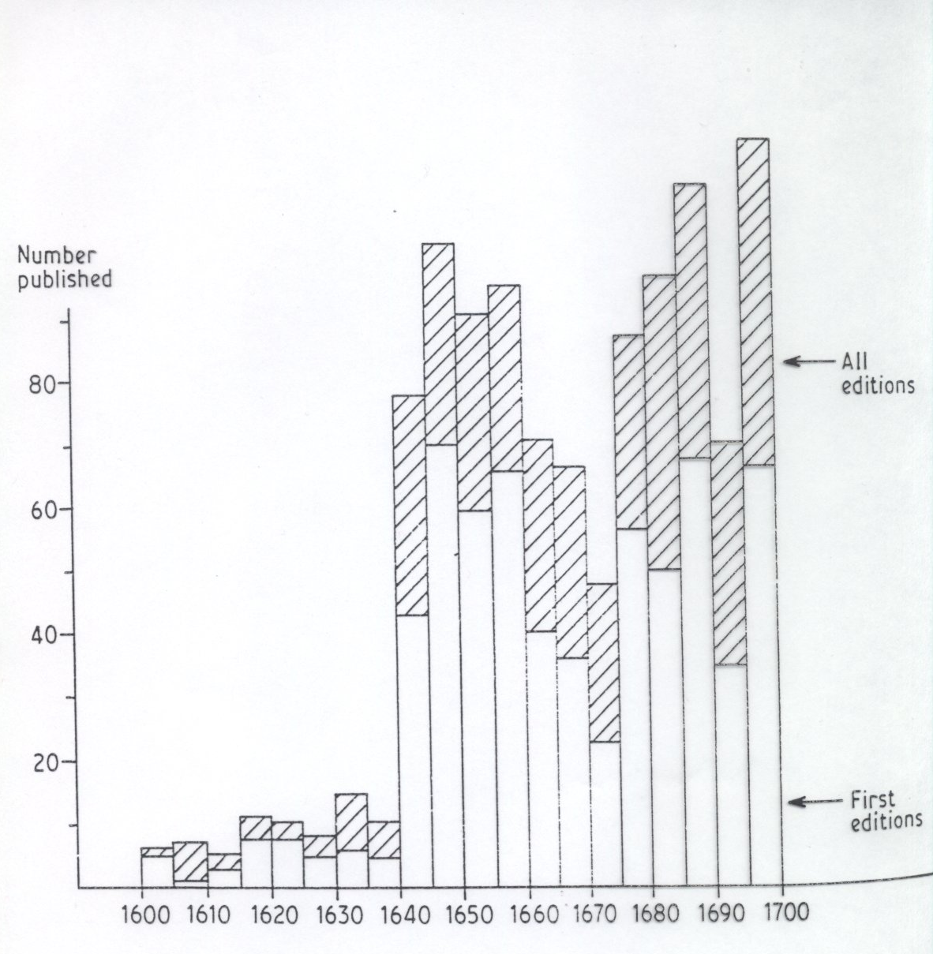
Women as authors
There was no recognised role for a woman writer
Up to 1640 very few women wrote for publication
Graph shows five yearly totals
22 women account for almost ½ output
231 female authors in all (but nb anon)

Slide 23
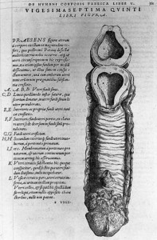
Change and Continuity: Science
Humoural theory – women as cold and moist
Aristotle: men and women as different but women as imperfect men
Galen: men and women were isomorphic – alike except in terms of reproduction
Women as essentially the same but inverted and organs internalised (hence Shakespeare can have men and women easily confused).
Vesalius, Fabrica (1544)
diagram of female reproduction

Slide 24
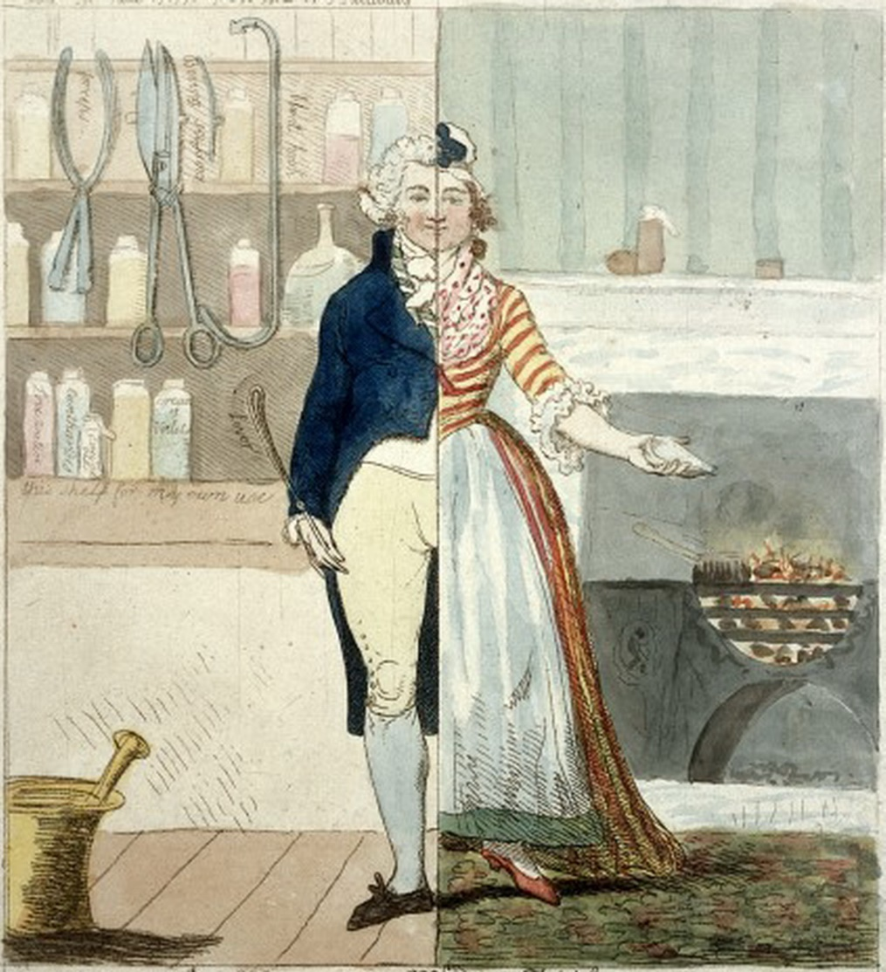
Continuity and change: one sex or two?
Thomas Laqueur, Making Sex (1990): There was a shift, in C18th, from a one-sex to a two-sex model. The two-sex model subordinated women.
Michael Stolberg in Isis, (2003) and Winfried Schleiner in Renaissance Quarterly (2000) suggest a two-sex model of skeleton and genitals existed in C16th and C17th. Women as mothers.

Slide 25
Pervasive patriachalism that subordinated women (and some men)?
Did gendered spheres become more sharply defined?
How did ideas about sexuality change – is sexuality as culturally determined as gender?

