Slide 1
Mineral waters in seventeenth-century France
HI203 European World
31 January 2018
Michael Bycroft

Slide 2
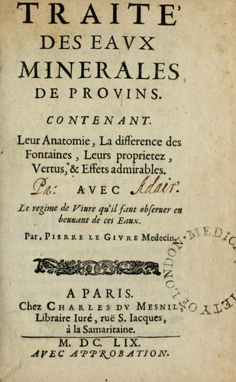
‘Treatise on the mineral waters of Provins,
Containing their anatomy, the difference between the springs, their properties, virtues, and admirable effects
By Pierre le Givre, doctor
Paris, 1659’

Slide 3
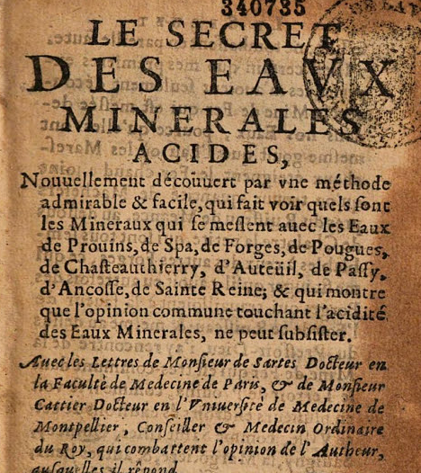
‘The secret of acidic mineral waters
Newly discovered by an easy and admirable method…
Pierre le Givre, 1767’
The secret:
They contain alum and iron, but not vitriol
And they contain eight times as much iron as alum

Slide 4
Rainwater + iron filings
Povins mineral water

Slide 5
‘Earthy principle’ of vitriol: brown
‘Earthy principle’ of alum: white
‘Earthy principle’ of iron: yellowish-white
Extracted by distilling, dissolving, filtering, evapourating

Slide 6
Rainwater + iron filings
Provins mineral water

Slide 7
The chemical philosophy
Theophrastus Bombastus von Hohenheim, aka Paracelsus (early 16c)
Swiss-German anti-establishment icon – Aristotle, four elements, medical profession
extends sulphur-mercury theory of metals to ALL substances
extends chymical analogies to many phenomena
extends mineral remedies to many new diseases

Slide 8
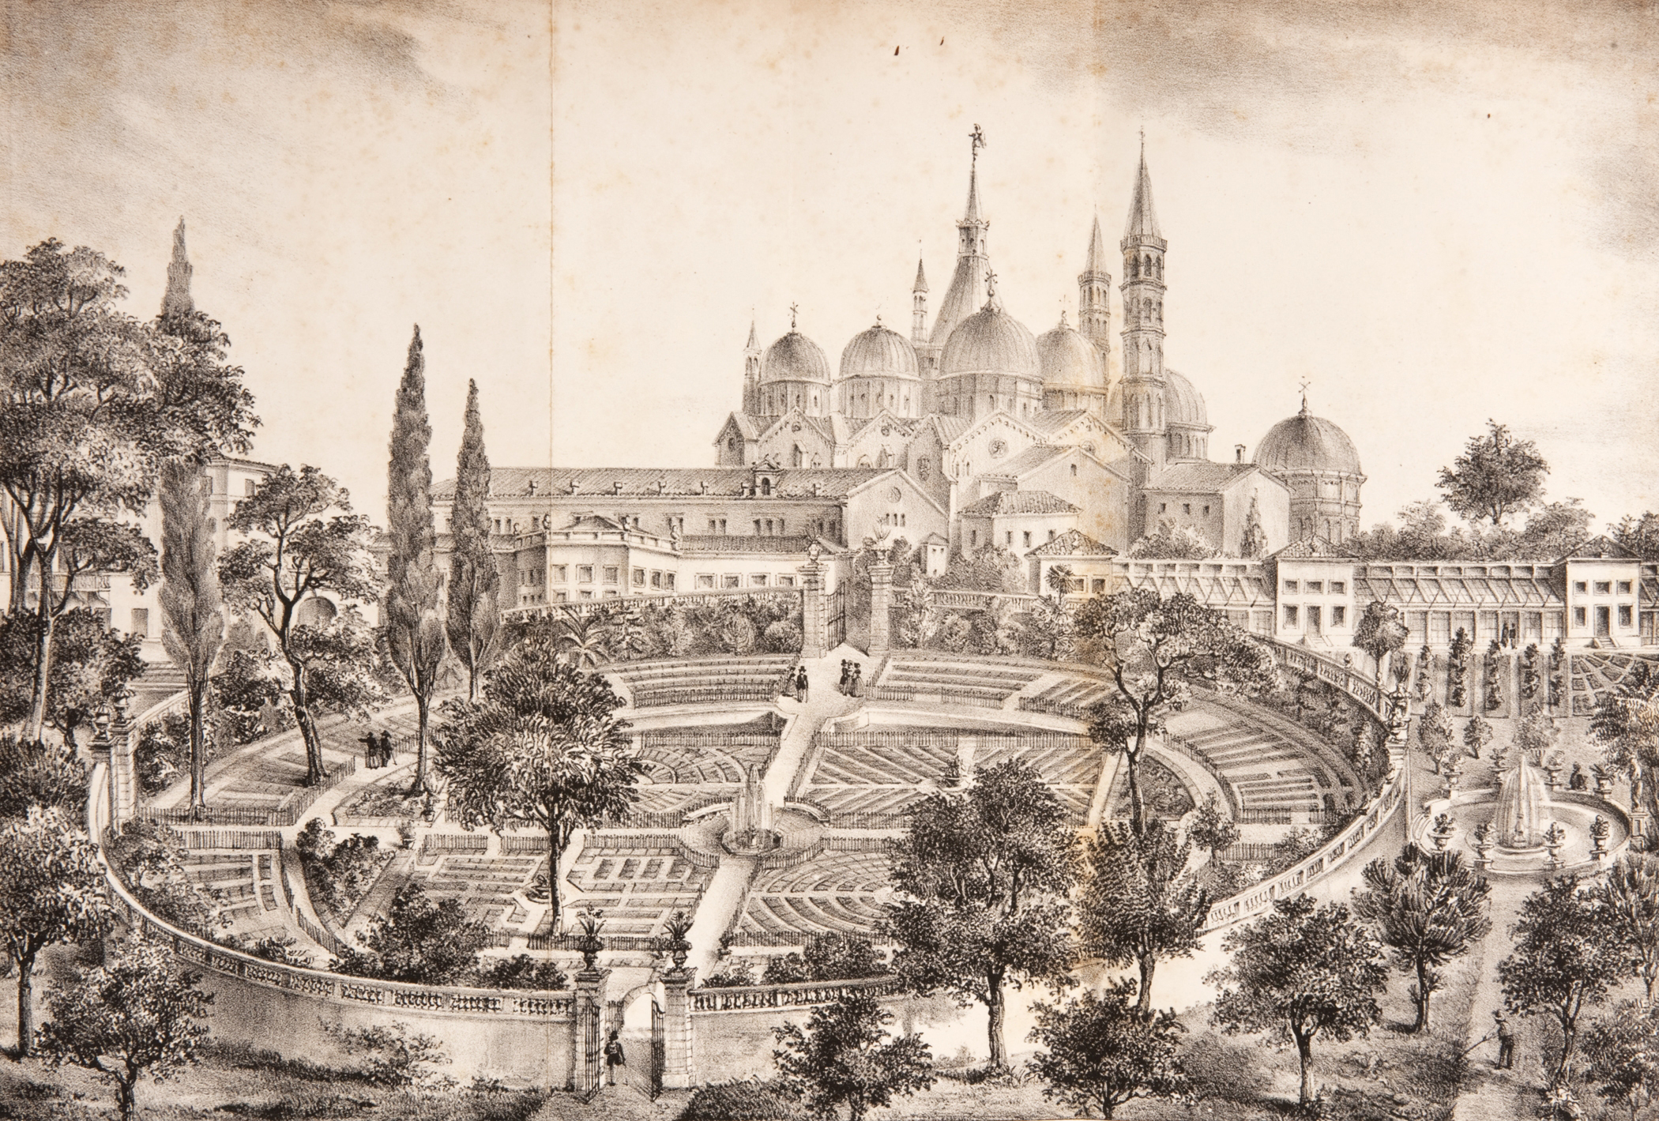
Botanical garden of the University of Padua, 1545
(19th-century print)

Slide 9
‘With letters from Monsieur de Sartes Doctor in the Faculty of Medicine of Paris, and Monsieur Cattier Doctor at the University of Medicine of Montpellier’
dissertations
new posts
pharmacopoeia

Slide 10
Lessons from the mineral waters case
the new science made a difference to ordinary people
medical doctors were crucial to the new science – and especially in combining new theories with medical practice
the profit motive often drove the application of new ideas
institutions helped to spread the new science – new institutions (botanical gardens) as well as old ones (universities)

