Slide 1
Louis XIV and absolute monarchy
HI203 The European World
15/3/2018
Dr. Michael Bycroft

Slide 2
1. Absolute monarchy in theory
2. Absolute monarchy in practice
3. Limits to absolute monarchy

Slide 3
‘the principle mark of sovereign majesty and absolute power is the right to impose laws generally on all subjects regardless of their consent’
-- Jean Bodin, Les six livres de la République (1576)
‘The prince need account to no-one for what he ordains’
-- Jacques-Benigne Bossuet, Politics Drawn from the Very Words of Holy Scripture (1709), book IV, article 1, prop. 1

Slide 4
‘[God] made the great only to protect the small’
‘Government is a work of reason and intelligence…Wisdom saves states sooner than force’
‘Kings must tremble in using the power that God gives them’
‘Kings are subject to the equity of the laws…but they are not subject to the penalties of the laws’
-- Bossuet, Politics Drawn From Holy Scripture

Slide 5
‘no matter how unworthy a king, a revolt by his subjects is always infinitely criminal…It is His will that, whoever is born a subject, must obey without question’
-- Louis XIV, Memoirs for the Instruction of the Dauphin (completed 1672)

Slide 6
2. Absolute monarchy in practice

Slide 7
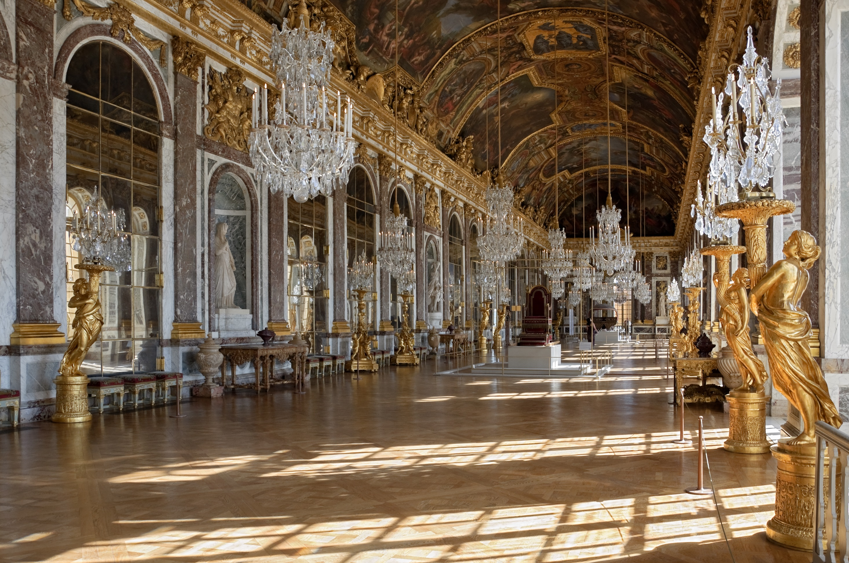
Hall of Mirrors, Palace of Versailles

Slide 8
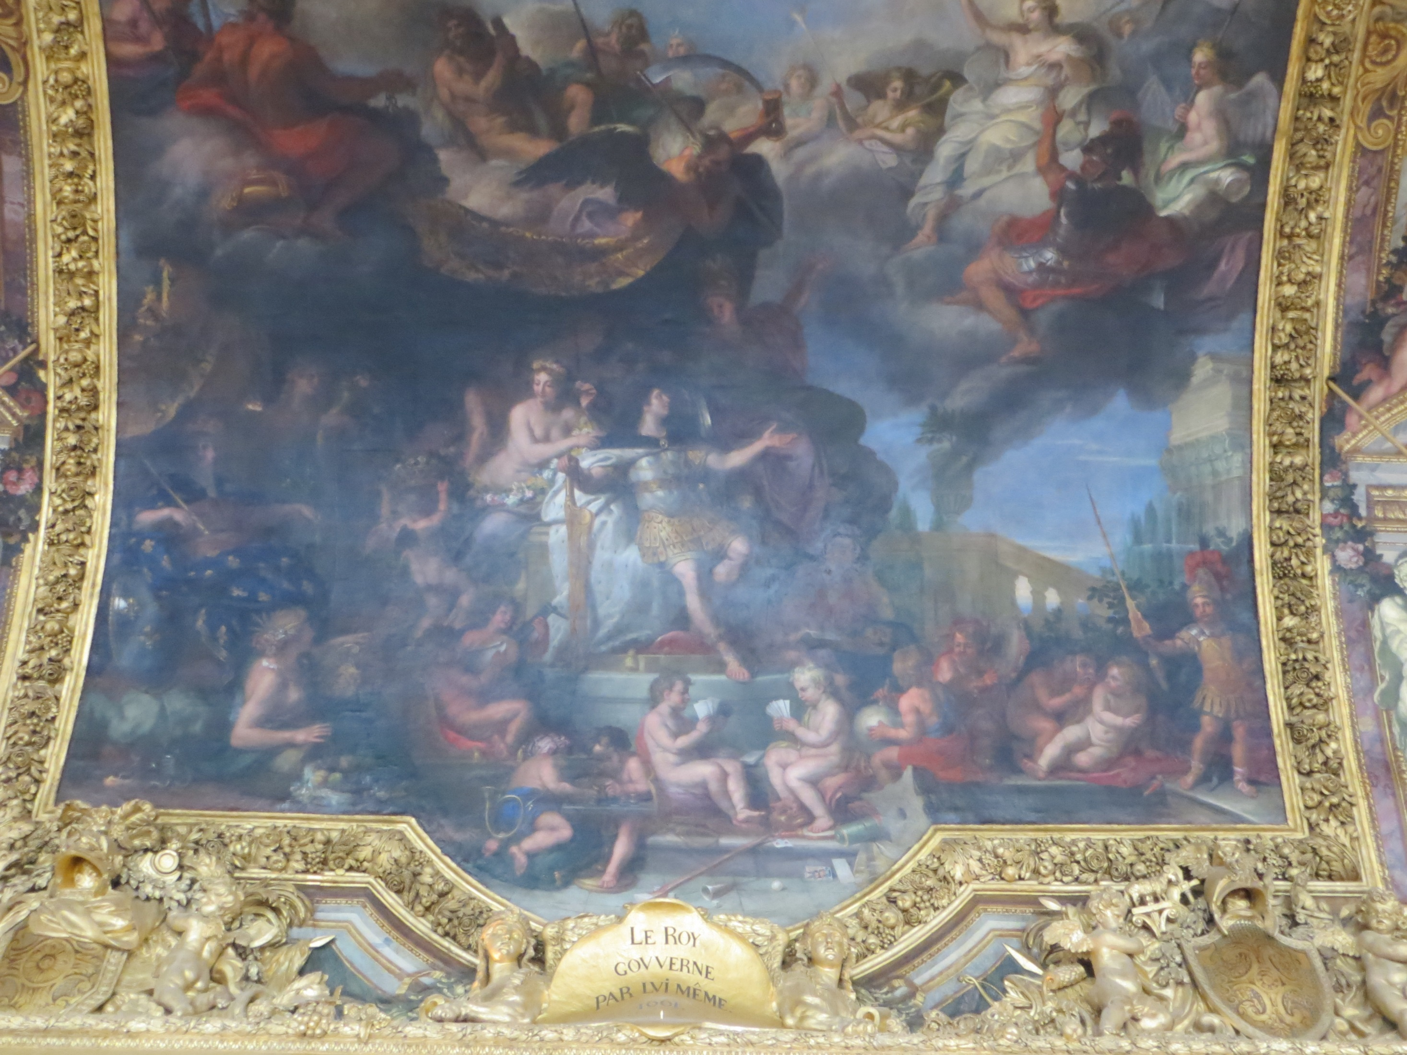
‘The King Governs by Himself, 1661’ – ceiling painting from Hall of Mirrors, Palace of Versailles

Slide 9
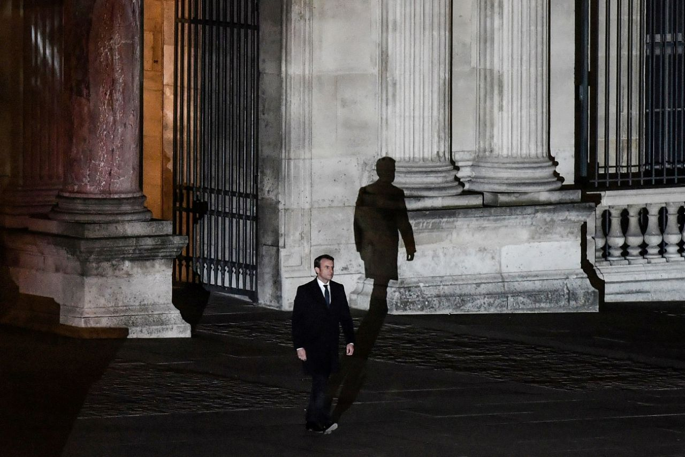
Emmanuel Macron, election night, 7 May 2017, at the Louvre (formerly the royal palace)

Slide 10
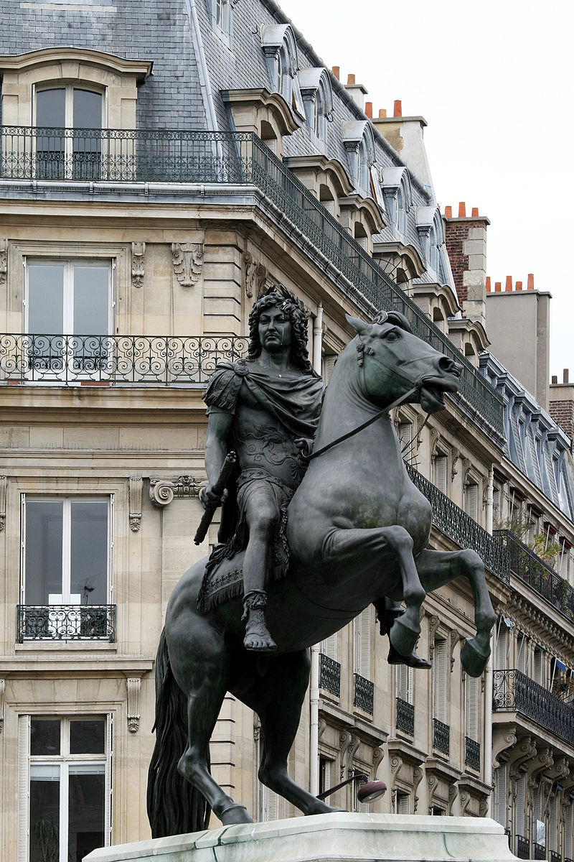
Equestrian statue of Louis XIV at the Place des Victoires. Built in 19th century to replace similar statue erected 1686

Slide 11
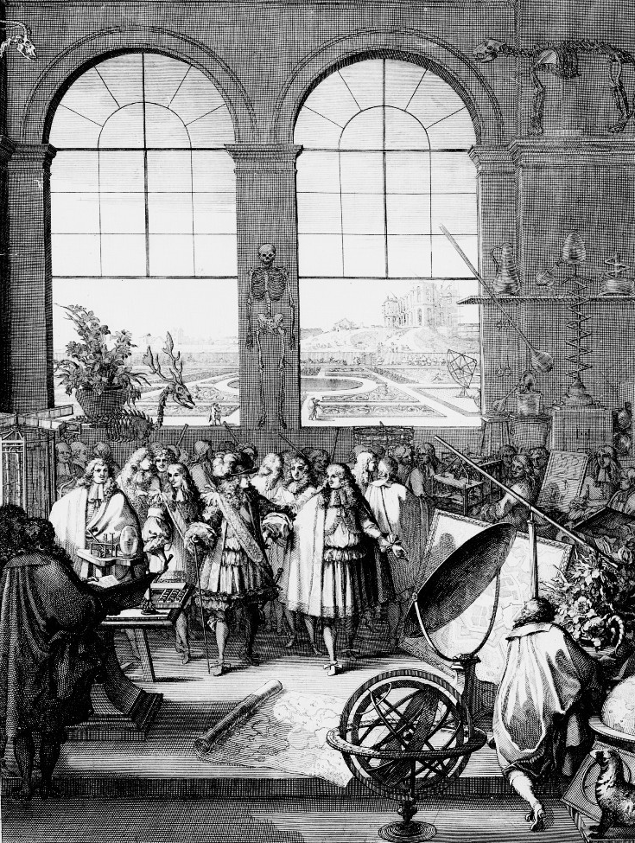
Louis XIV in (fictional) visit to a meeting of the Paris Academy of Sciences, showing King’s Garden, Royal Observatory, and Jean-Baptiste Colbert.
Frontispiece of botanical work published by Academy in 1676

Slide 12
‘The King Governs by Himself, 1661’ – ceiling painting from Hall of Mirrors, Palace of Versailles

Slide 13
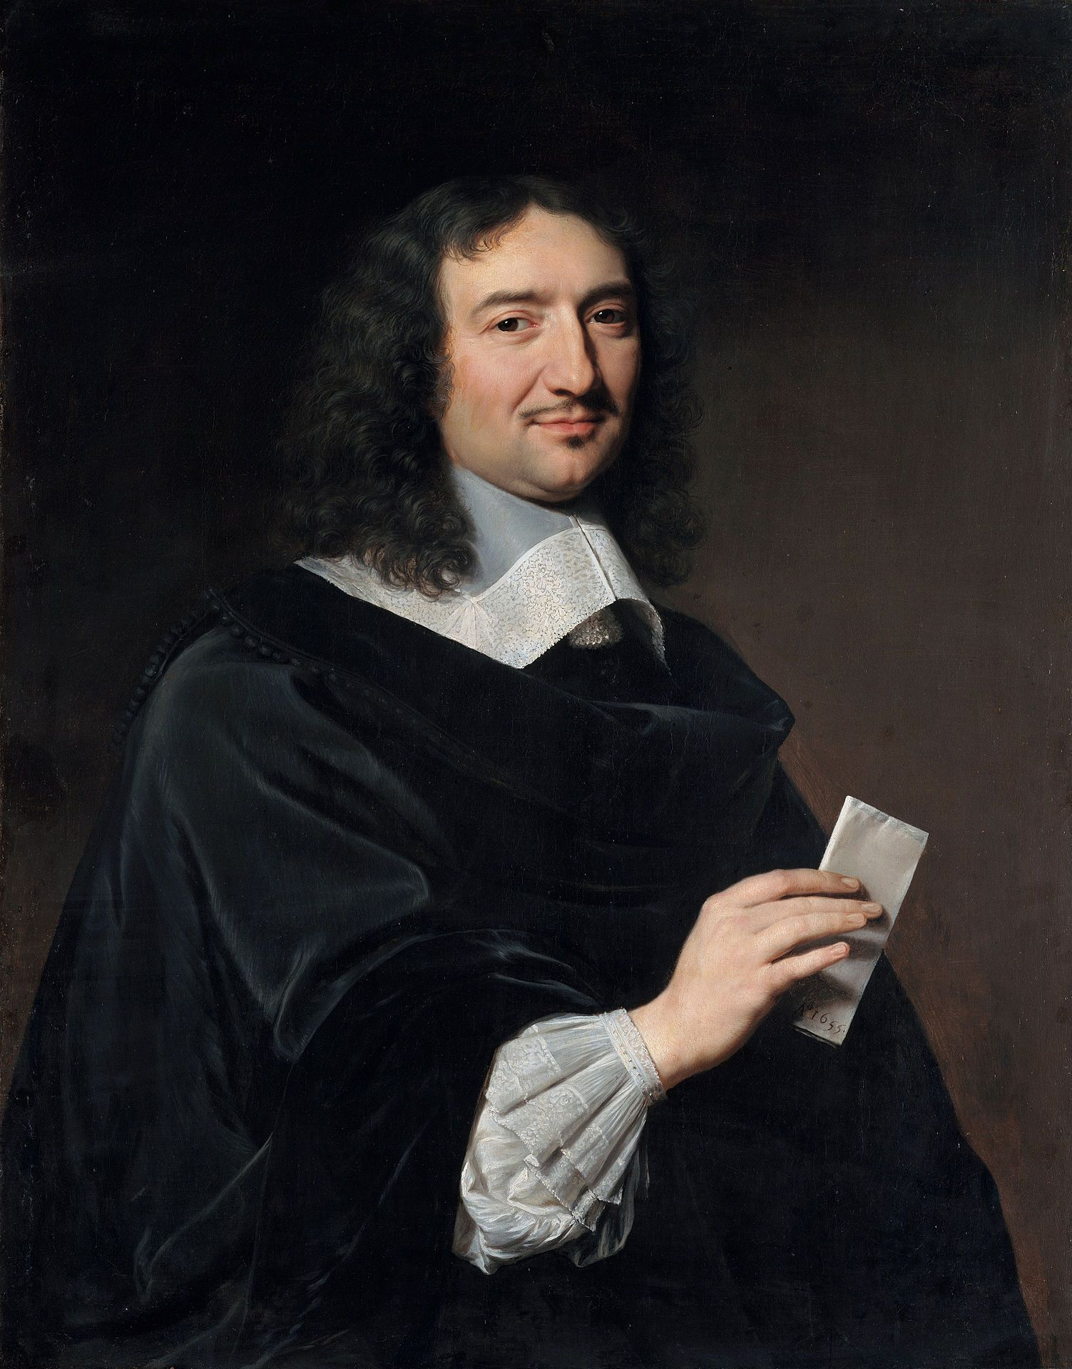
Jean-Baptiste Colbert (aka ‘Le Nord’), painted 1655, while Cardinal Mazarin’s personal accountant

Slide 14
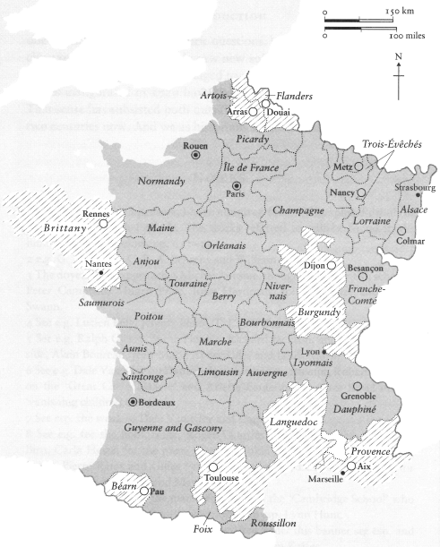
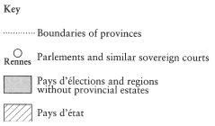
Key administrative boundaries in seventeenth-century France
From Colin Jones, The Great Nation

Slide 15
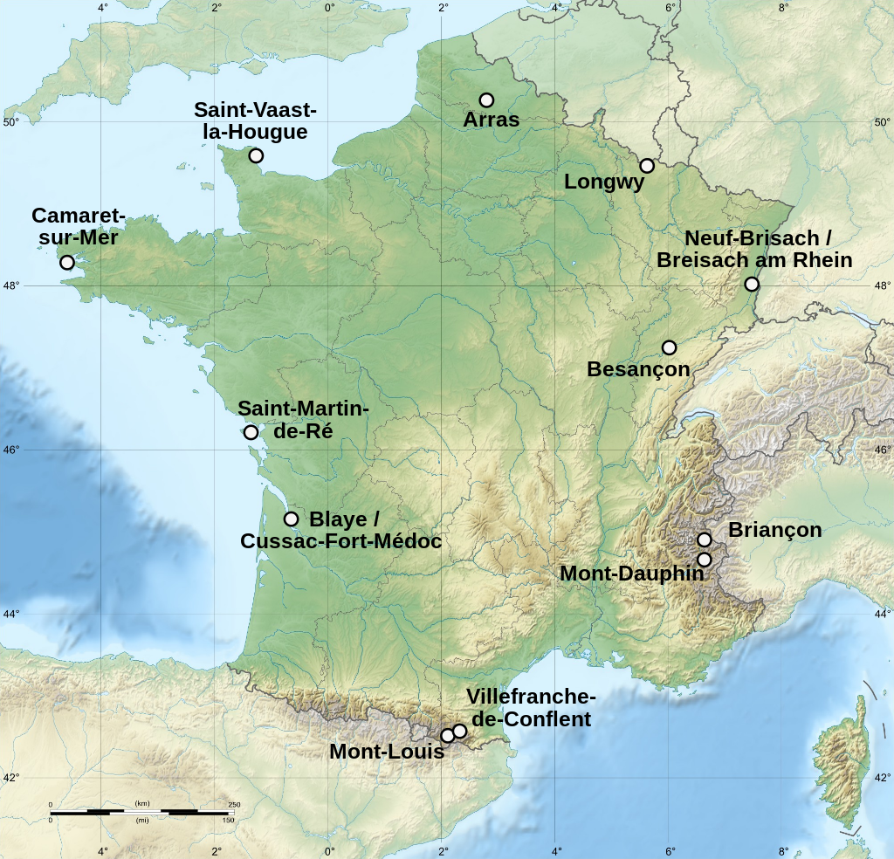
Locations of the twelve fortified buildings erected by the military architect Sébastien Le Prestre de Vauban (1633-1707), and now classed as UNESCO World Heritage sites

Slide 16
2. Limits of absolute monarchy

