Slide 1
Material Culture
The European World, 2017, week 5
Michael Bycroft

Slide 2
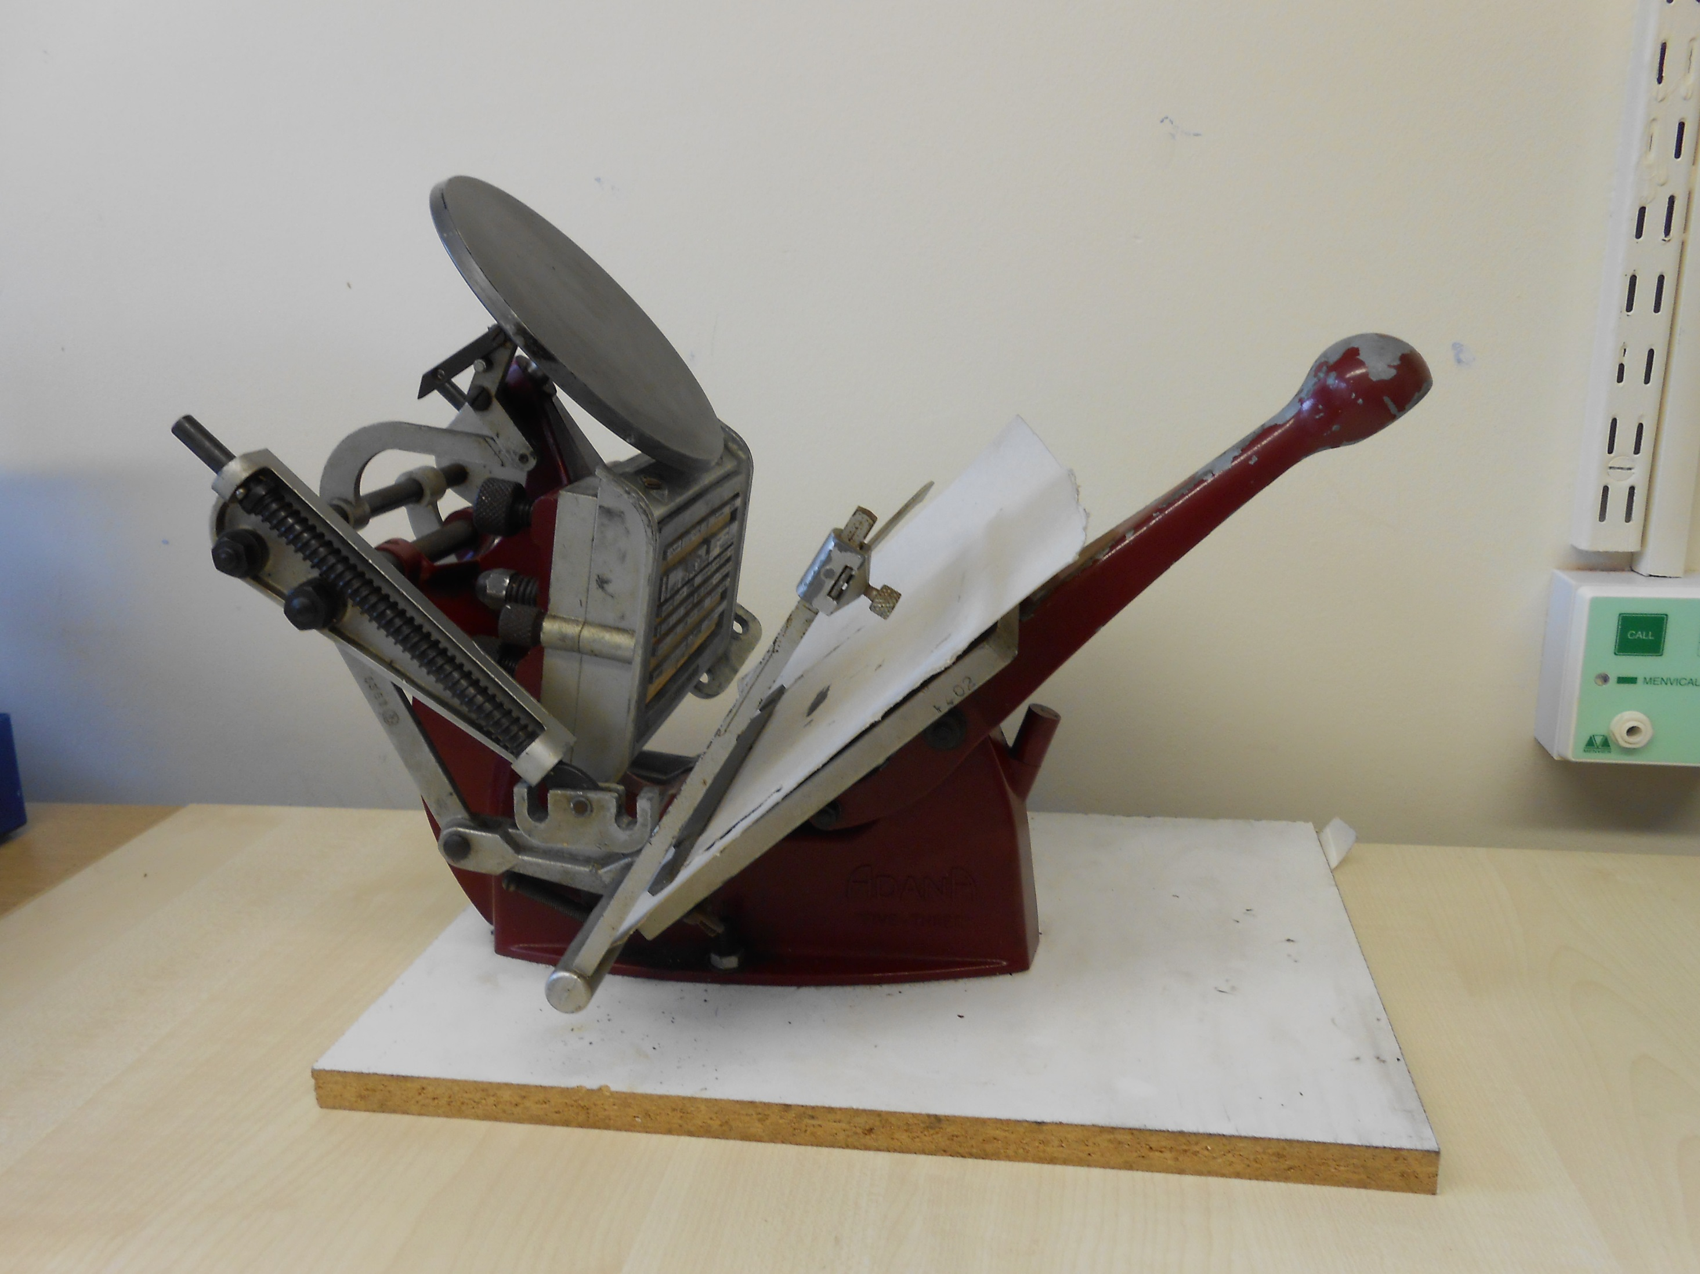
1930s Adana platen printing press
Courtesy of James Poskett

Slide 3
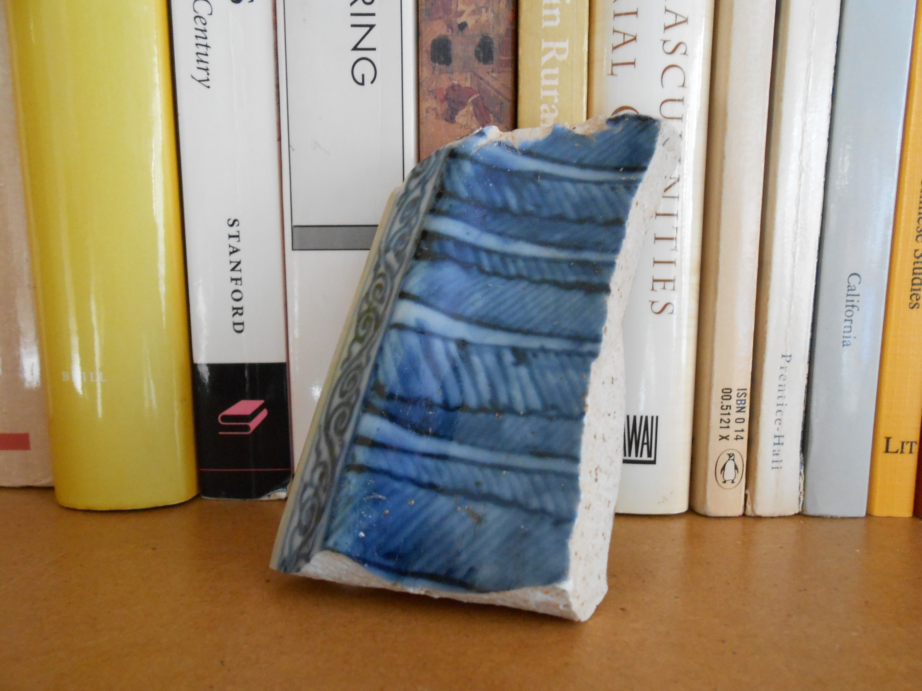
Fragment of 14th-century Chinese porcelain
Courtesy of Anne Gerritsen

Slide 4
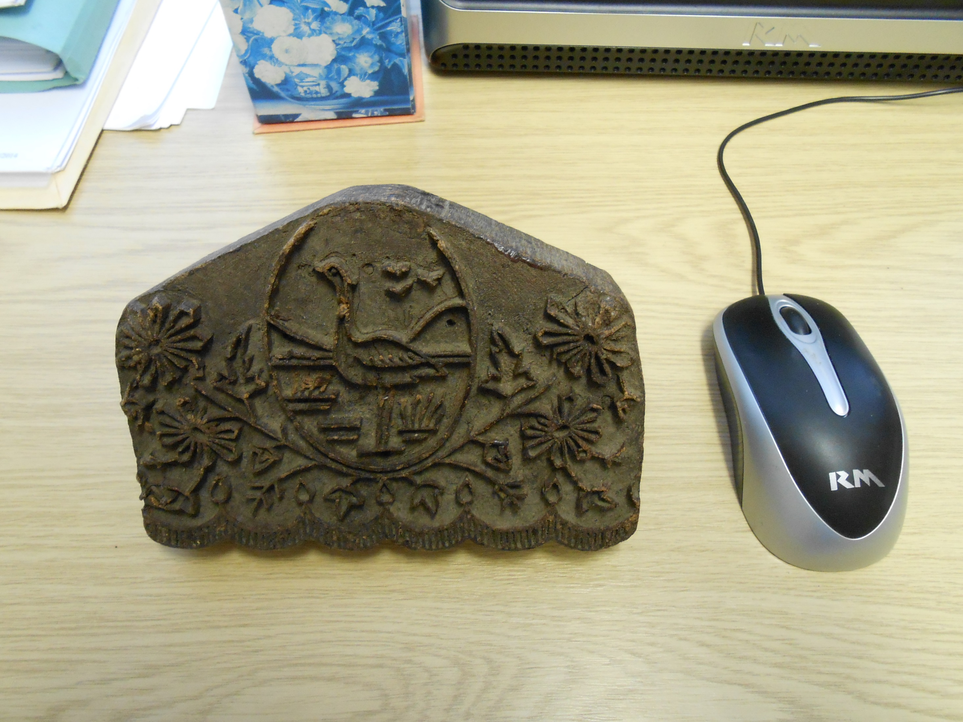
Wood-block for printing textiles, of a kind used in India since ancient times
Courtesy of Maxine Berg

Slide 5
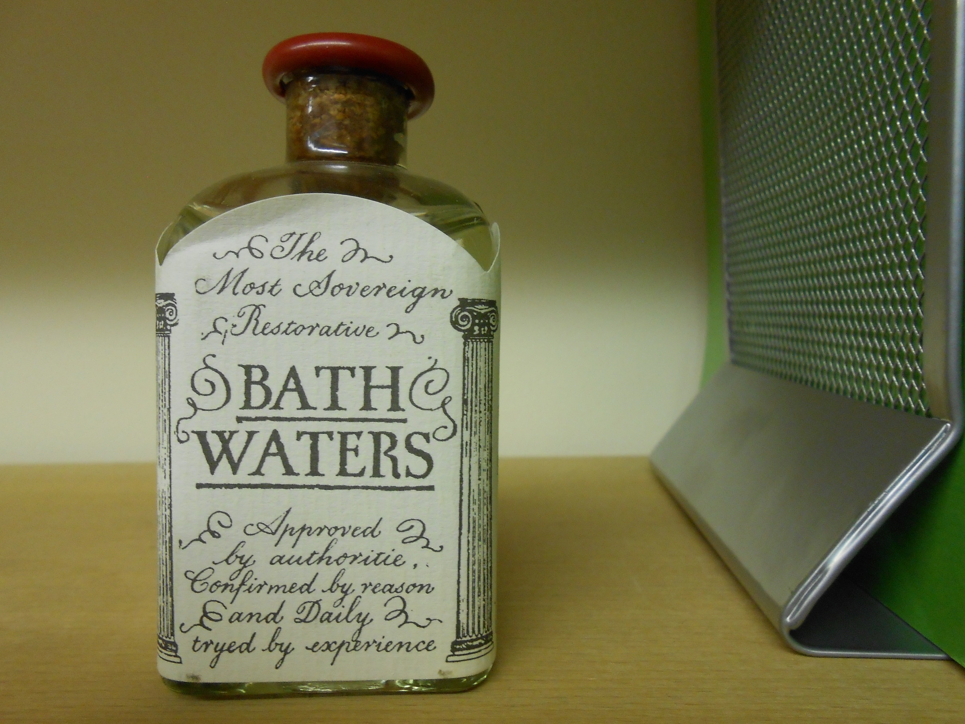
20th-century imitation of 18th-century bottled water from Bath, with text based on an 18th-century advertisement
Michael Bycroft

Slide 6
The study of material culture may be most broadly defined as the investigation of the relationship between people and things
- Journal of Material Culture, vol. 1, issue 1 (1996)

Slide 7
1930s Adana platen printing press
Courtesy of James Poskett

Slide 8
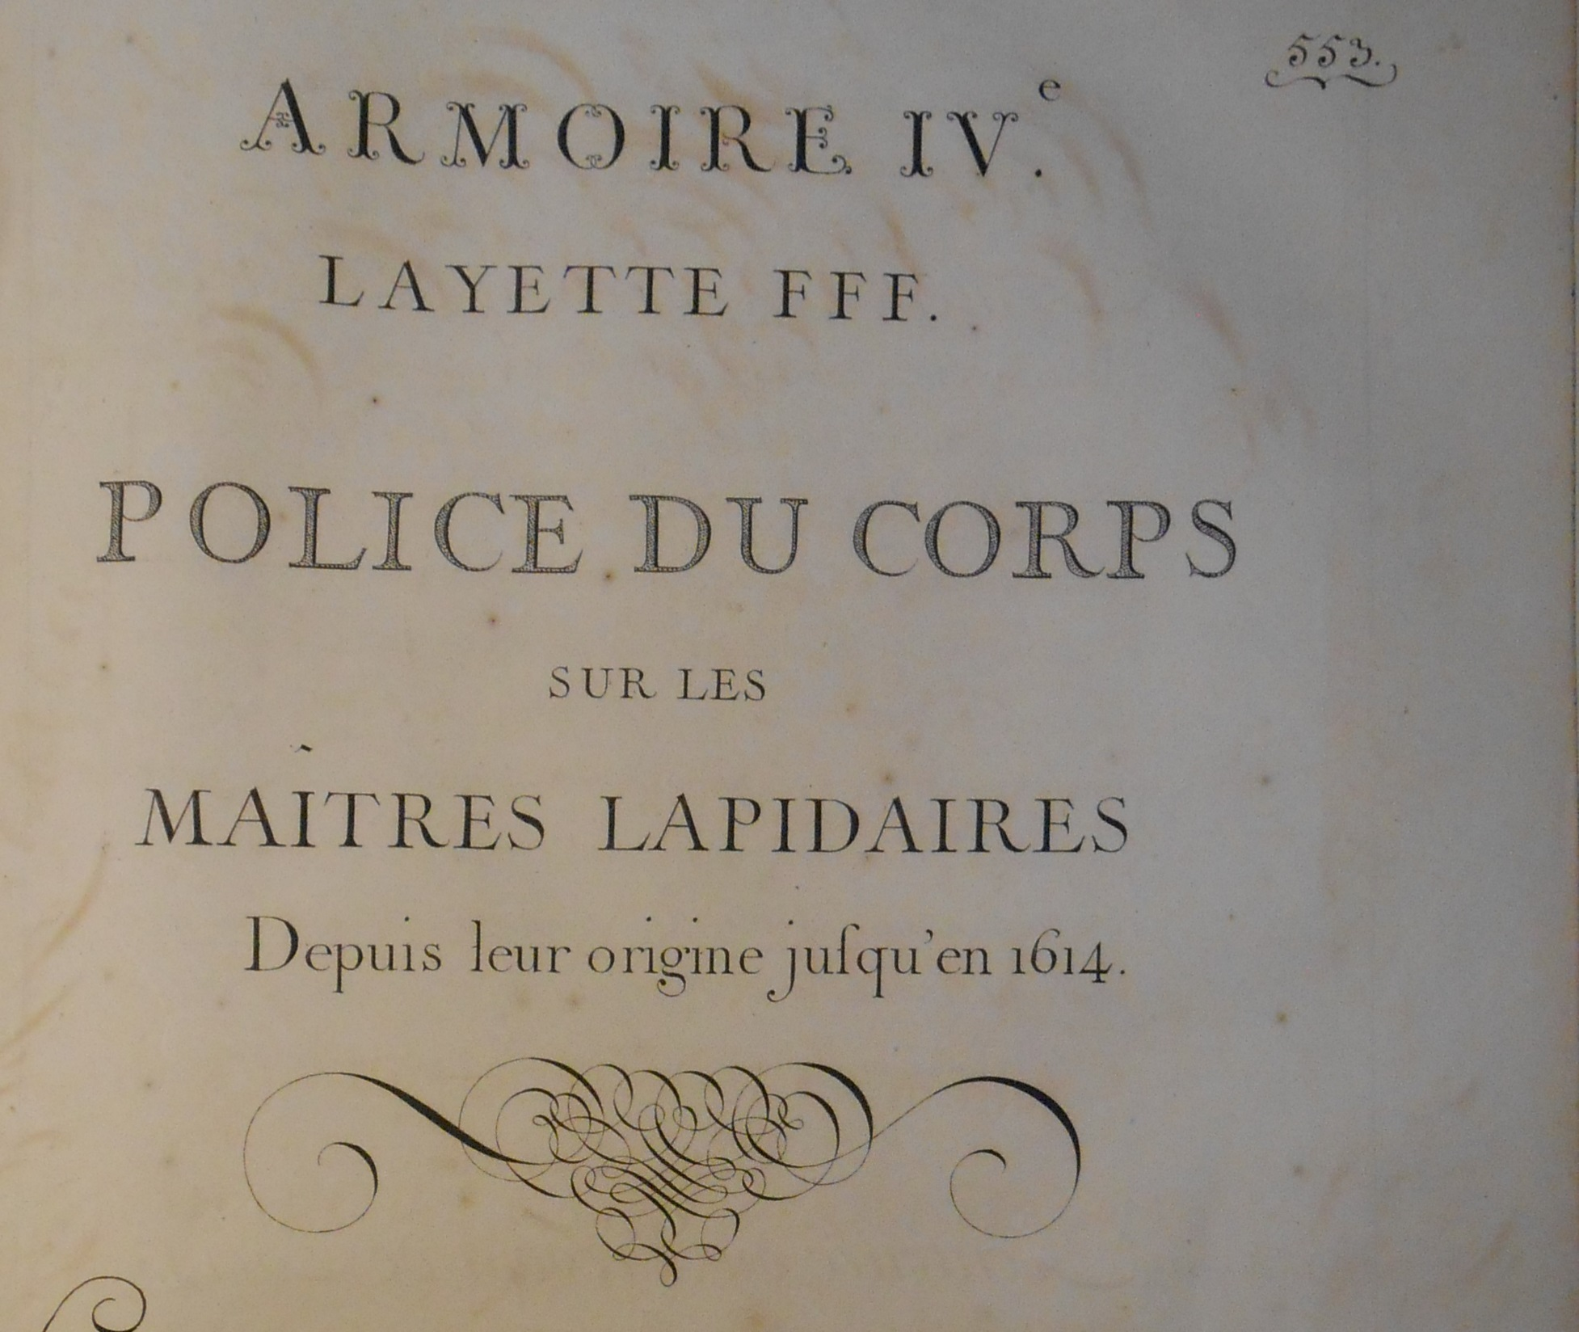
‘Wardrobe IV
Drawer FFF
Regulations concerning the Master Lapidaries from their origin until 1614’
From an inventory of the archives of the goldsmith’s guild in Paris, compiled 1704

Slide 9
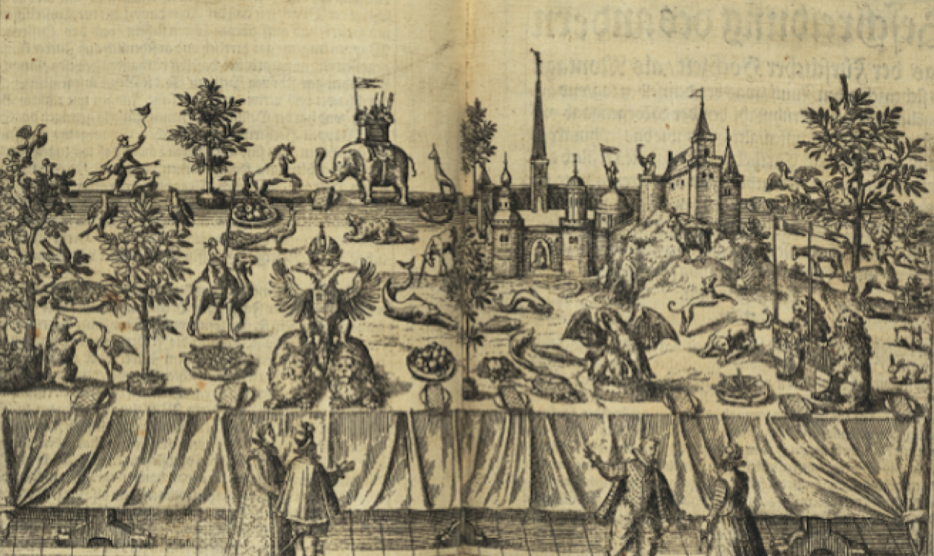
Engraving of ‘sugar collation’ on occasion of a ducal marriage, Italy, 1587

Slide 10
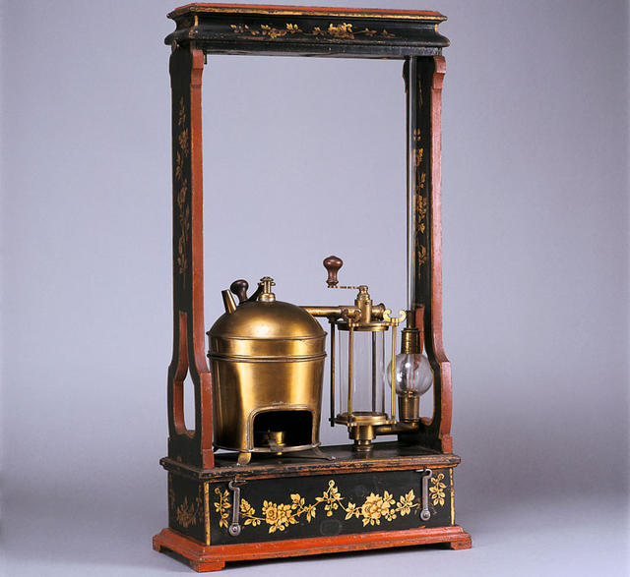
Left: air pump designed by Jean-Antoine Nollet, c. 1750, now housed in the Conservatoire des Arts et Métiers, Paris
Below: silk stocking such as those used by Robert Symmer in the 1750s

Slide 11


Slide 12
[traditional natural history] contains the variety of natural species only, and not experiments of the mechanical arts
For even as in the business of life a man's disposition and the secret workings of his mind and affections are better discovered when he is in trouble than at other times, so likewise the secrets of nature reveal themselves more readily under the vexations of art than when they go their own way
-- Francis Bacon, New Organon (1620)

Slide 13
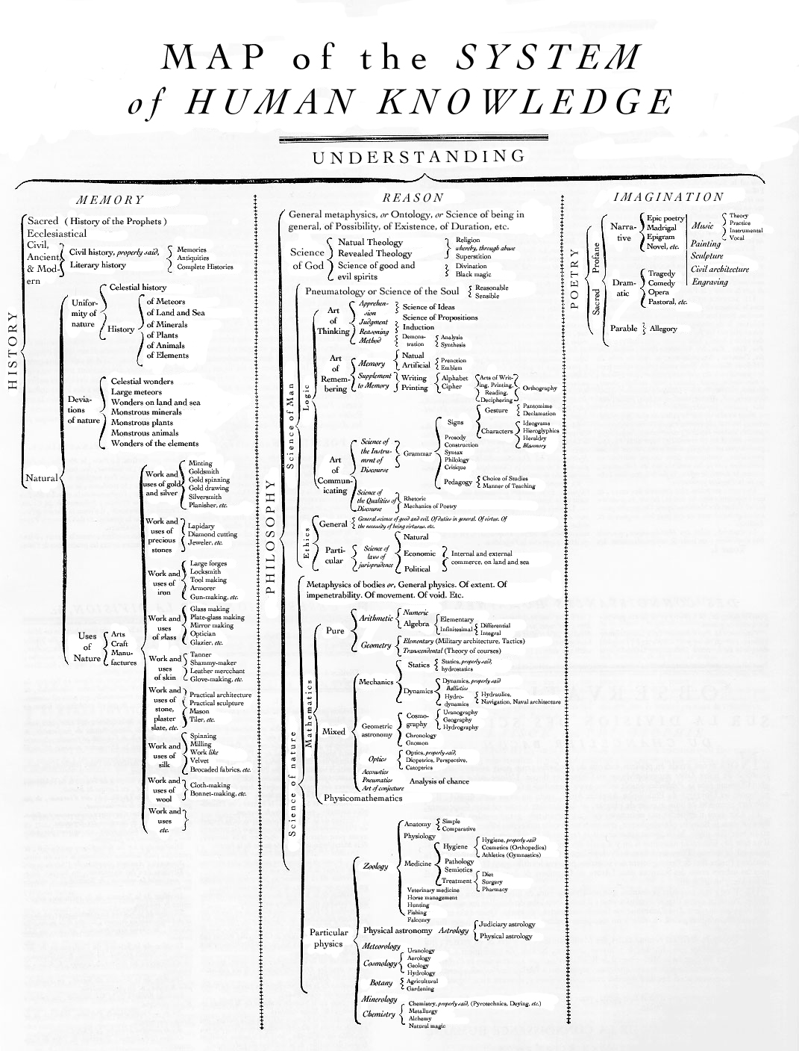
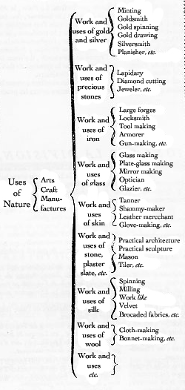
From English translation of Diderot and d’Alembert, Encyclopédie, 1750-1772

Slide 14
What is material culture?
Why is early modern material culture important?
What was the ‘consumer revolution’ in early modern Europe?

Slide 15



‘Affluence had moved the United States onto a new historical trajectory where consumption fuelled growth, defined identities, and shaped public and private life’
– Trentmann, ‘Introduction’, Oxford Handbook of the History of Consumption

Slide 16
J. Thirsk, Economic Policy and Projects: The Development of a Consumer Society in Early Modern England (1978)
McKendrick, N., Brewer, J., Plumb, J., (eds.), The Birth of a Consumer Society: the Commercialization of Eighteenth-Century England (1982)
J. Brewer and R. Porter, Consumption and the World of Goods (1993)
M. Berg & H. Clifford (eds), Consumers and Luxury: Consumer Culture in Europe, 1650-1850 (1999)
D. Roche, A History of Everyday Things: The Birth of Consumption in France, 1600-1800 (2000)
E. Welch, Shopping in the Renaissance: Consumer cultures in Italy, 1400-1600 (2005)
J. De Vries, The Industrious Revolution: Consumer Behavior and the Household Economy, 1650 to the Present (2008)
Frank Trentmann, ed., The Oxford Handbook of the History of Consumption (2012)

Slide 17
Textile consumption in England
Linen consumed:
1710: 28 million yards
1756: 80 million yards
1770: 103 million yards
Price of linen textiles: falls by two-thirds, 1574-1774
# clothes per person: triples as fraction of assets of poor, 1550-1750
underwear and sheets per household: doubled, 1500-1800
-- R. Sarti, Europe at Home: Family and Material Culture, 1500-1800 (2002)

Slide 18
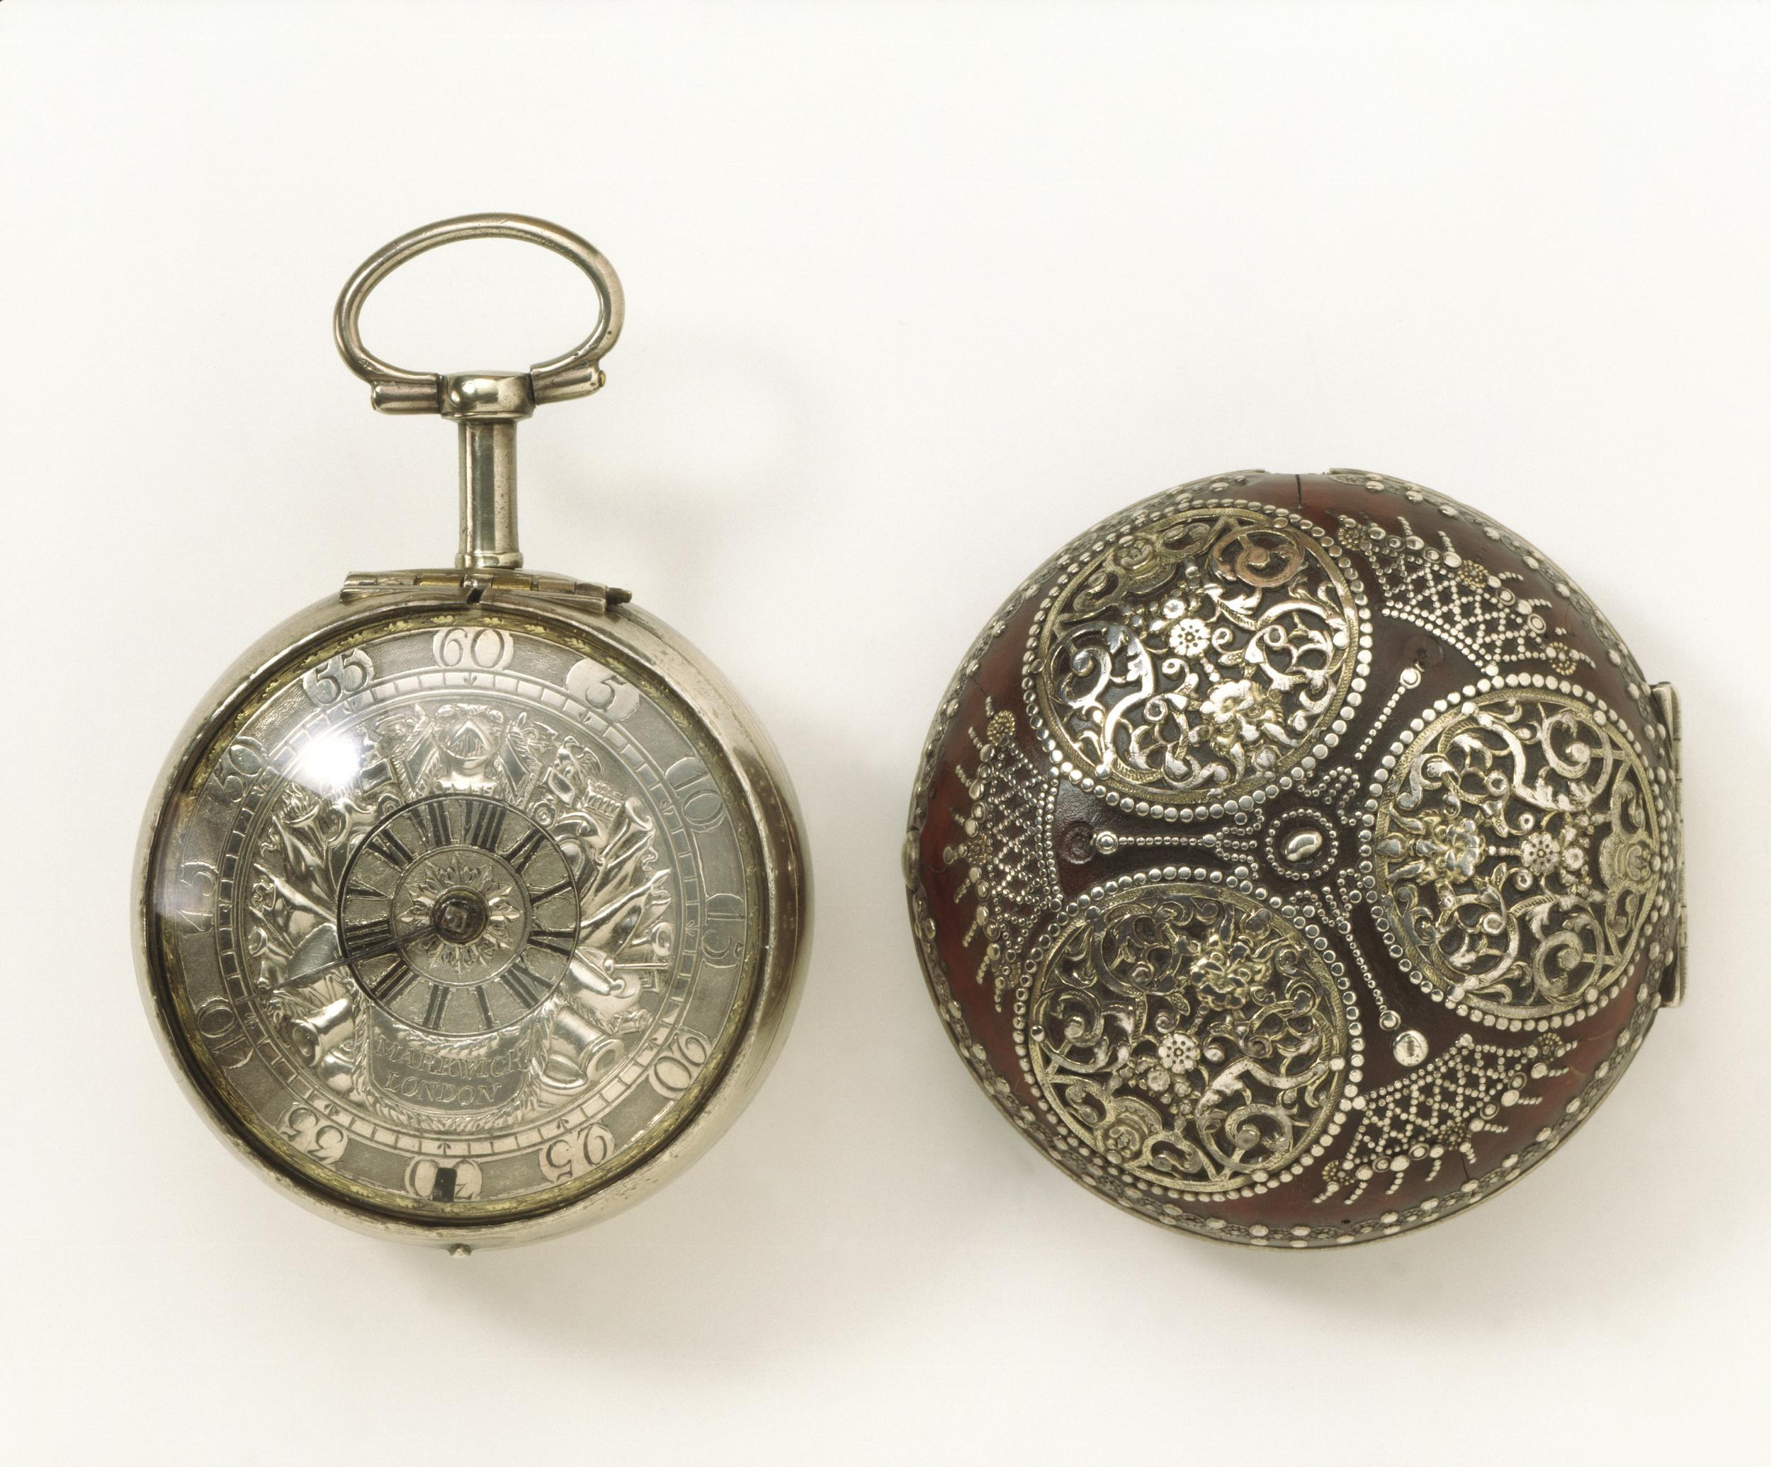
Pocket watch, made c. 1700
Silver dial and inner case; tortoiseshell outer case
V&A Museum

Slide 19
Pocket watches across Europe
number made in Europe: c. 50,000 in 1697 → 400,000 in 1745
English poor: 38% of English pauper probate inventories have them 1770-1812
French poor:
13% servants and 5% wage earners have them in 1700
70% servants and 32% wage earners have them in 1780s

Slide 20
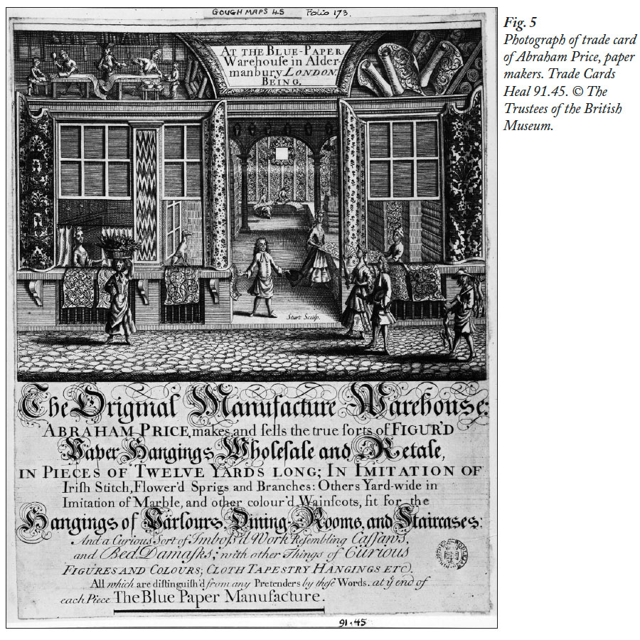
Trade Card of Abraham Price, London wallpaper seller, c. 1715
British Museum

Slide 21
See Claire Walsh, “Shop Design and the Display of Goods in Eighteenth-Century London”, Journal of Design History, 1995

Slide 22
Goods from the East
‘The luxury goods imported from Asia [especially porcelain, tea, and painted cotton] brought to Europe a new knowledge of an export ware sector. These goods introduced Europe to lessons of complexity and simplicity in product design and technology.’
- Maxine Berg, ‘Luxury, the Luxury Trades, and Industrial Growth’, 2012

Slide 23
The industrious revolution
‘north-western Europe and British North America experienced an ‘industrious revolution’ during the long eighteenth century, roughly 1650-1850, in which a growing number of households acted to reallocate their productive resources (which were chiefly the time of their members) in ways that increased both the supply of market-oriented, money-earning activities and the demand for goods offered in the marketplace.’
- Jan de Vries, The Industrious Revolution (2008)

Slide 24
1. What is material culture?
2. Why was material culture important in early modern Europe?
3. What was the ‘consumer revolution’ in early modern Europe?

