Slide 1
The European World: Trans-cultural Contacts, The Ottoman Empire
Dr Aysu Dincer

Slide 2
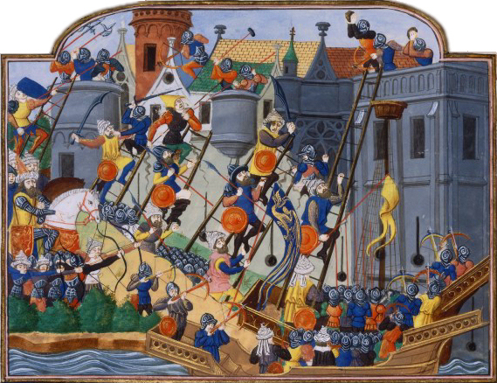
The Fall of Constantinople 1453

Slide 3
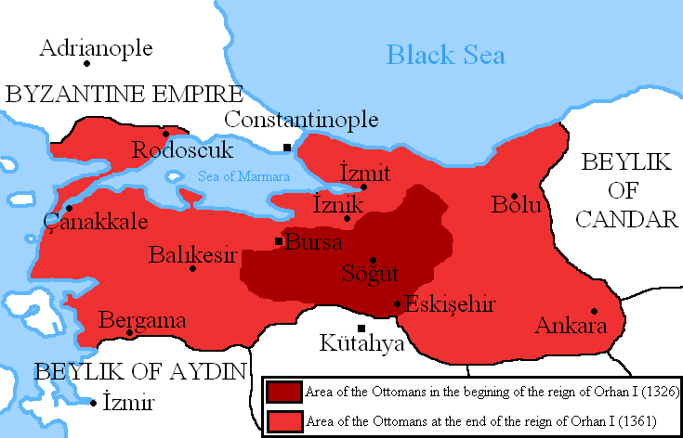
Notes:
Expansion: Ottomans start growing especially after Osman’s death. His son, Orhan extended the Ottoman rule over significant territories. Bursa (1326) became their first capital.

Slide 4
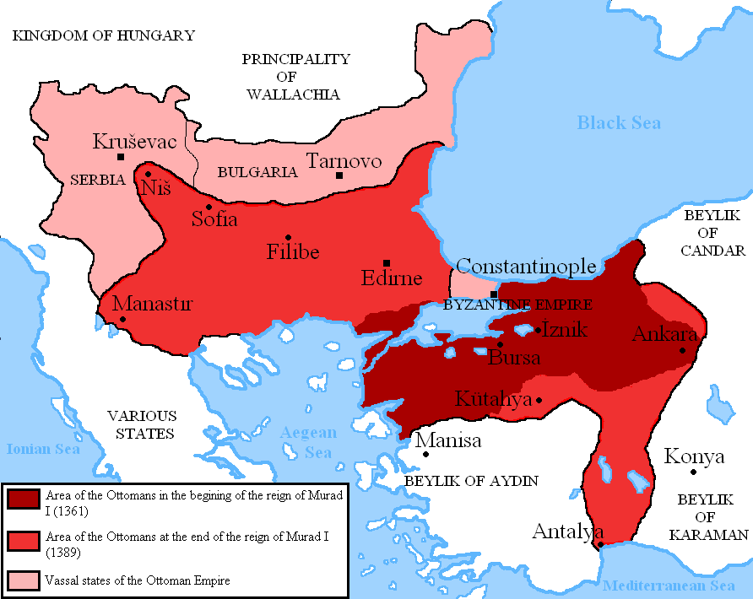
Notes:
His successor, Murad I, and the first person to be called a Sultan, stretched the Ottoman rule into the Balkans, capturing Adrianople/Edirne by 1369 and moving the capital there. There was a brief ‘respite’ to Ottoman expansion, caused in part by the invasion of the Timurids (with Timur, or Tamerlane as their leader) into Anatolia. They defeated the Ottomans at the Battle of Ankara in 1402, captured Sultan Beyazid I who died in captivity. After a short interregnum, the Ottomans were able to consolidate their presence in the Balkans and Anatolia

Slide 5
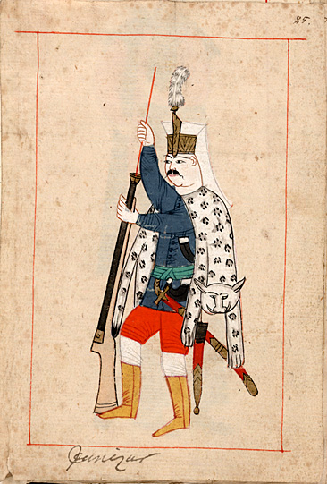
Military Organisation
Timar system
Janissaries: devshirme system

Slide 6
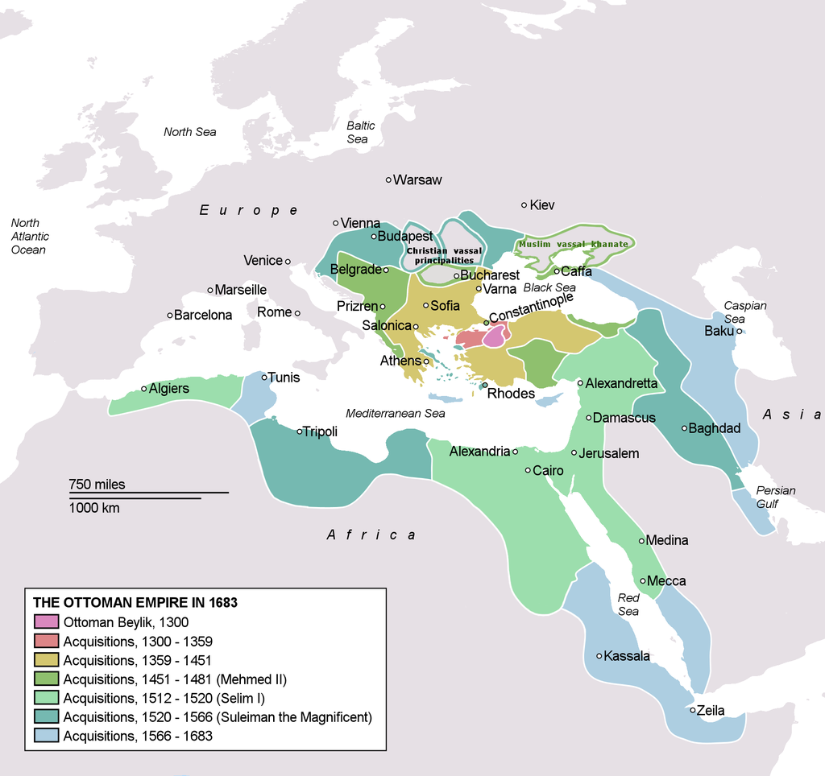
Territorial Expansion

Slide 7
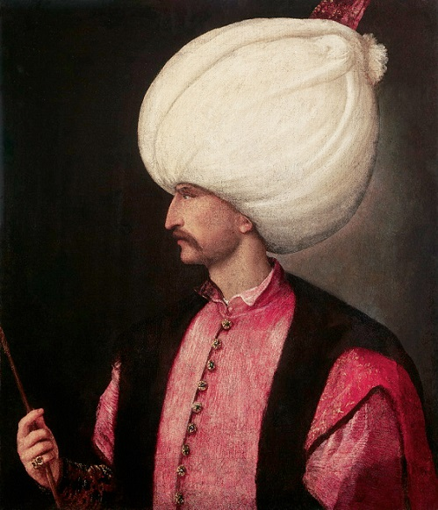
Sultan Suleyman the Lawgiver (Kanuni) or Magnificent (r. 1521-1566)
conquered Hungary, including Budapest
besieged Vienna(without success) in 1529
pushed the Ottoman borders to the Red Sea, and the Indian Ocean.
consolidating all past sultanic judgements into a code, called the Kanunname
Notes:
Sultan Suleyman the Magnificent, the subject of Magnificent Century for those who watched it, pushed the boundaries of the OE up to Vienna, which he besieged (without success) in 1529. Vienna became a long-term target for Ottoman expansion. He also conquered Hungary, including Budapest, pushed the Ottoman borders to the Red Sea, and the Indian Ocean. He also brought about legal reform, consolidating all past sultanic judgements into a code, called the Kanunname, critically important to Ottoman administration. His reign is seen to be the zenith of Ottoman greatness, and traditionally the period after was characterised as ‘decline’-an idea which has since been also abandoned in favour of less teleological approaches.

Slide 8
The Ottoman System of Governance
‘reaya’ or ‘askeri’
A multi-cultural and multi-faith state
Multilingual
Law: Sharia courts which implemented Islamic law; also recourse to the kanun, Sultanic law
Trade is very important

Slide 9
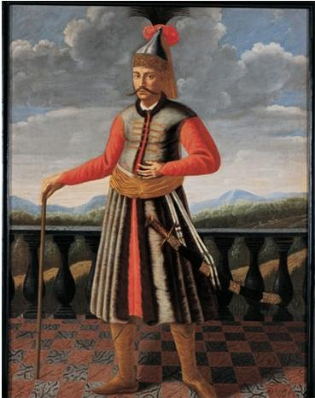
Oppositional framework: French traveller Jean Dumont (1696)
“The Turks are opposite to us in almost all respects. We content ourselves with one wife they marry several wives. Our habit is short, theirs is long and we wear our hair long and our beards shaved, they shave their hair and suffer their beards to grow: we write in a straight line from left to right and they in a crouched form from right to left”

Slide 10
John Speed, A Prospect of the most famous parts of the World (1631)
“The […]Turkes savour still of their barbarous ancestors. They are for the most part:
broad-faced
strong-boned
well proportioned
dull and heauie headed
of grosse vnderstanding
idlely disposed
greedie of wealth
luxurious in their diet
beastly in their lustfull affections
Without distinction of kindred or sexe
base minded
slaues to themselves, and their superiours in their owne Country”
Speed (1627)

Slide 11
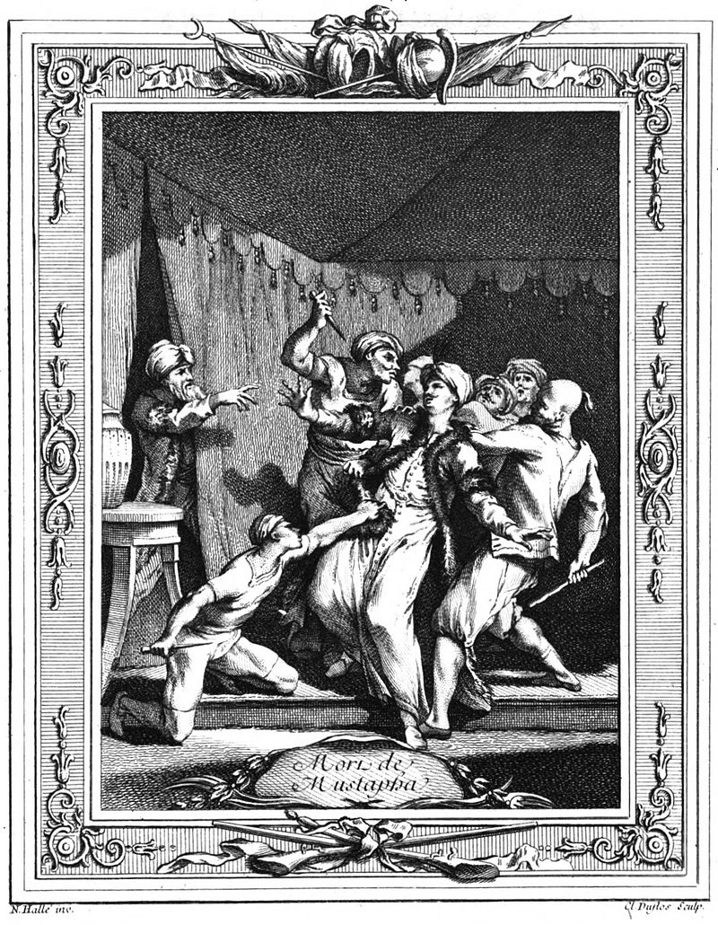
Death of Prince Mustafa
a fascination with Ottoman brutality
'In 1553, Prince Mustafa was strangled by his father’s (Sultan Suleyman I) ‘mutes’ using a silk cord on suspicion of treason.' (Busbecq, p. 117)

Slide 12
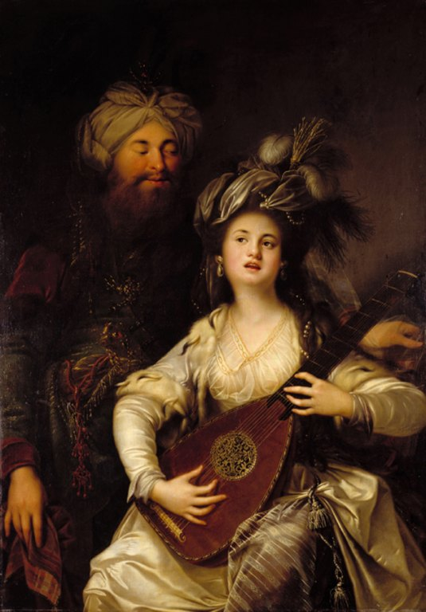
Hurrem Sultan
the first woman who rose to prominence in Ottoman politics, as Suleyman’s wife and advisor.
played a part in succession politics
rumoured to have a role in the execution of Prince Mustafa (Suleyman's son from another woman) to favour her own sons.

Slide 13
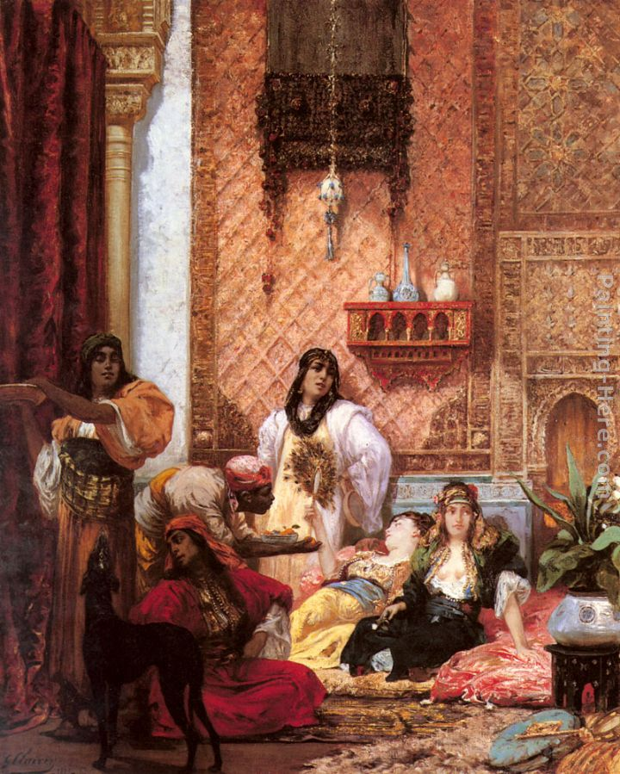
Georges Clairin, ‘The Sultan’s Favourite’
“the most charming creatures in the world”, “made for love”, “all their actions are amorous”, “Since they have nothing else to do, they make it their only business to please, which they do successfully and in so natural a manner” (Dumont, 1696)

Slide 14
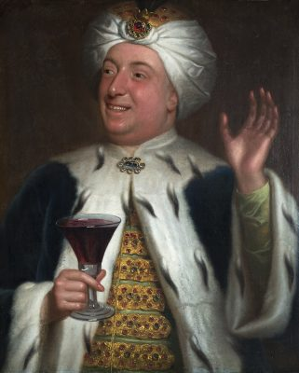
Edward Dashwood (by Adrien Carpentier)

Slide 15
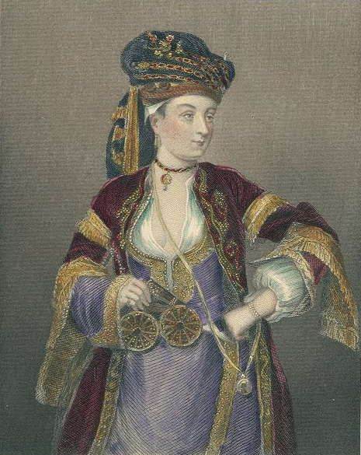
Lady Mary Wortley Montagu

Slide 16
Credits
Siege of Constantinople as depicted between 1453 and 1475: attributed to Philippe de Mazerolles - Bibliothèque nationale de France Manuscript Français 2691 folio CCXLVI https://en.wikipedia.org/wiki/Fall_of_Constantinople#/media/File:Siege_constantinople_bnf_fr2691.jpg
Sipahi http://www.sakipsabancimuzesi.org/en/node/283
Jean Dumont (Baron de Carlscroon, 1667-1727) A new voyage to the Levant containing an account of the most remarkable curiosities in Germany, France, Italy, Malta, and Turkey : with historical observations relating to the present and ancient state of those countries / by the Sieur du Mont ; done into English, and adorn'd with figures. (London: Printed by T.H. for M. Gillyflower, T. Goodwin, M. Wotton, J. Walthoe, and R. Parker, 1696)
John Speed, A Prospect of the Most Famous Parts of the World (London, 1631)
Hurrem: By Anton Hickel - Mittelrhein-Museum Koblenz, original located at the Landesmuseum Mainz, Public Domain, https://commons.wikimedia.org/w/index.php?curid=2558833
Edward Ashwood http://www.countrylife.co.uk/luxury/art-and-antiques/my-favourite-painting-edward-dashwood-134533

