Slide 1
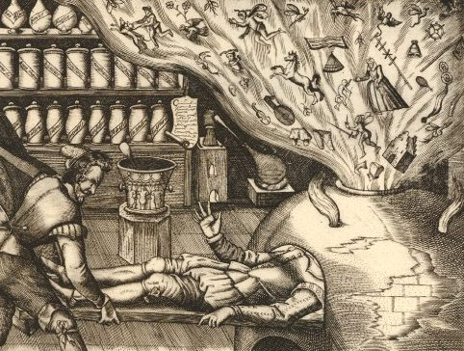
Political Thought: Ideas and Contexts
Mark Knights

Slide 2
Ideas and contexts
Is ‘political thought’ a very useful term?
It tends to stress ‘great thinkers’ and examine their ideas (Machiavelli, Hobbes, Locke) but
Political ideas are also inherent in everyday actions, conflicts and beliefs
Ideas don’t change in isolation (Cambridge School’s contextualisation: Quentin Skinner, John Pocock)
Moreover ‘politics’ can be a very artificially restrictive word (esp. re religion)
thought related to the state

Slide 3
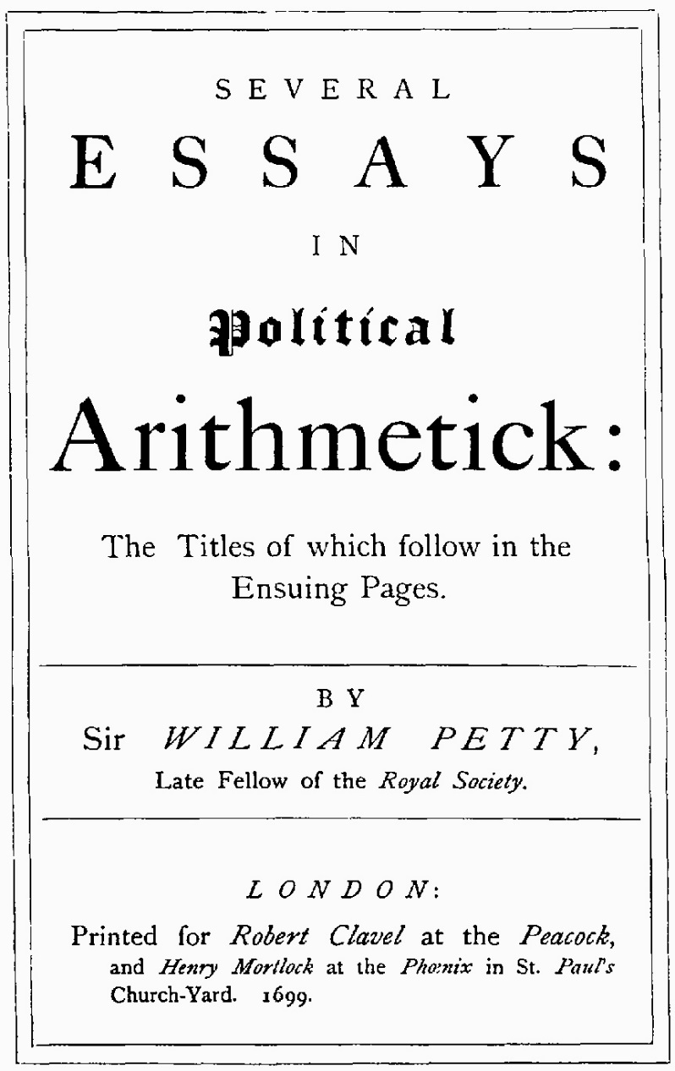
‘Languages’ of Political Discourse
Scriptural
Legal/customary: the ancient constitution
  History as a political discourse
‘Political arithmetic’/scientific
Natural rights and contract
Reason and politeness

Slide 4
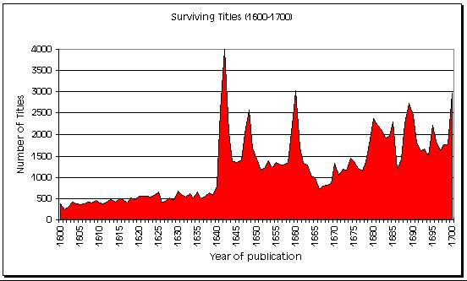
Who participated in ‘political discourse’?
Not just an intellectual elite
Why? change affected all
Print

Slide 5
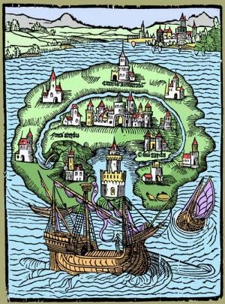
Political discourse and ideas can be found in literary texts and images
Sir Thomas More’s Utopia (1516)
Depicts ideal commonwealth. Eutopia = well place
Republic rather than a monarchy
Social commentary and critique esp rich vs poor, tax extortion, war-mongering, property as the key. No private property. Money as evil
Travel and discovery
After-life: 1551 English translation
Utopian genre

Slide 6
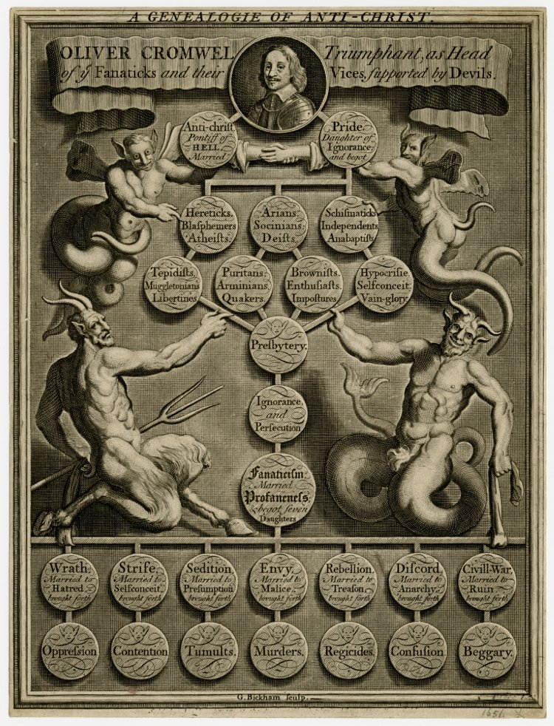
Visual culture as a vehicle for the discussion of political ideas

Slide 7
The importance of context
Context creates the need for political thought and provokes works (eg Bodin in the French Wars of Religion);
Some contexts affect nearly everyone, not just the ‘great thinkers’;
And canonical figures are appropriated to answer pressing needs

Slide 8
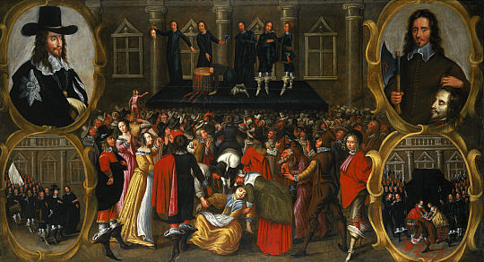
The British Civil Wars

Slide 9
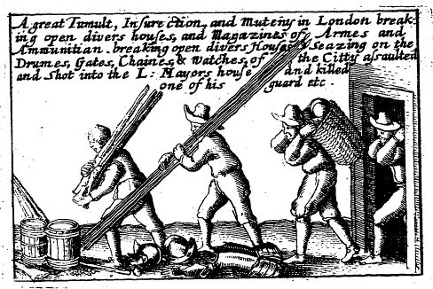
The impact of war
Loss of life: larger percentage of population may have died than in First World War
Deeply divisive – being sent to Coventry
Destruction of property
Notes:
Coventry was used to house Royalist prisoners. It is believed that the phrase "sent to Coventry" grew out of the hostile attitude of residents of the city to either the troops billeted there, or the Royalist prisoners held in St. John's church.

Slide 10
What issues were raised?
What are the legitimate powers of a monarch?
Is it legitimate to raise force against a monarch?
If yes, under what circumstances? And does this imply that political authority rests in the people?
If no, what is the appropriate response? What authority might you be prepared to fight for?

Slide 11
What issues were raised once the war had ended?
What is the best way to reconstruct authority?
1649 declaration of a ‘free state and commonwealth’. Republican form of government – but this requires justification and vindication.
Does this free state mean social revolution? The redistribution of land?
Does this free state mean the end of a national church and the beginnings of religious toleration?
Does this free state mean the end of state controls over the press?

Slide 12
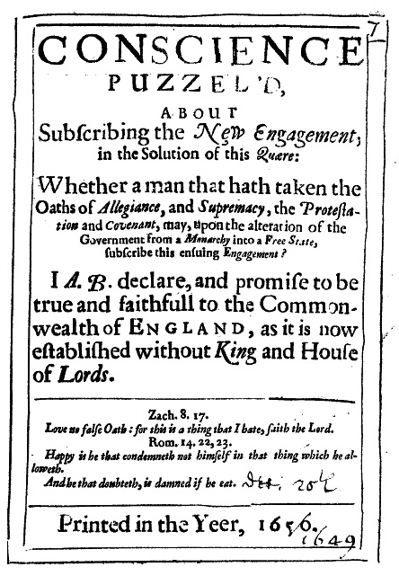
‘Engagement’ 1649
"I do declare and promise, that I will be true and faithful to the Commonwealth of England, as it is now established, without a King or House of Lords.“
Most office-holders were asked to take it
Provoked extensive debate. Hundreds of tracts1649-1652.
Was it possible to acknowledge the legitimacy of the new regime? Amongst them was Thomas Hobbes.

Slide 13
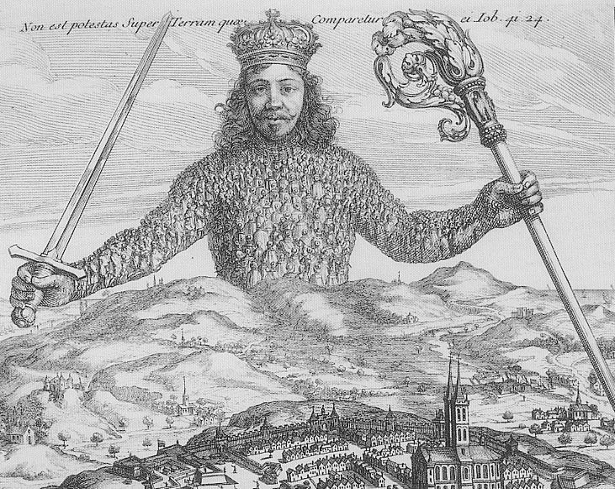
Thomas Hobbes
Leviathan (1651)
How to reconstruct political obligation
Man in a state of nature and natural rights
A form of contract and incorporation, involving the transfer of power to the sovereign in order to achieve security.
Contract: marriage contract; market

Slide 14
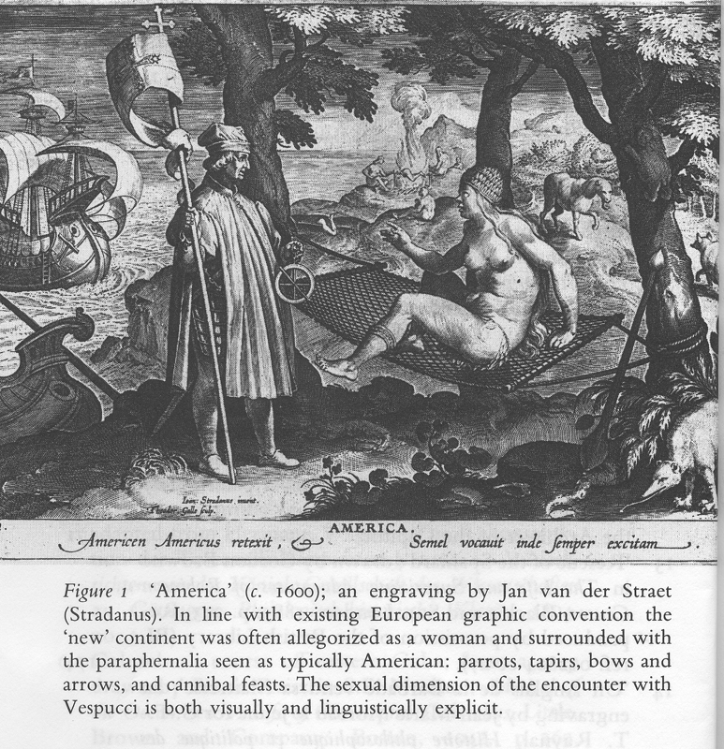
Precedents: A radical French Protestant theory
Vindiciae Contra Tyrannos or Defence of Liberty against Tyrants (1579):
Possibly by Philippe Duplessis Mornay. He escaped 1572 massacre and fled to England, returning to France to aid Henri de Navarre (Henry IV); an active philosopher.
contract; natural liberty and equality; natural law; consent as basis for civil society; popular sovereignty; right of resistance; moral not religious theory.
State of nature [NB influence of overseas exploration and colonisation; Locke ‘in the beginning all the world was America’], natural freedom and equality

Slide 15
Hobbes’ ideas were contested
E.g. by Sir Robert Filmer (1588-1653)
Stressed importance of deriving political ideas from scripture, the law of nature and the constitution
King alone was law-maker
The people had no right of resistance
The Necessity of the Absolute Power of All Kings (1648).

Slide 16
Hobbes and religion
Hobbes also considered the relationship between church and state
private conscience was dangerous and the sovereign power ought to decide what religion was followed.
There were many, however, who vigorously opposed this point of view and argued for liberty of conscience.

Slide 17
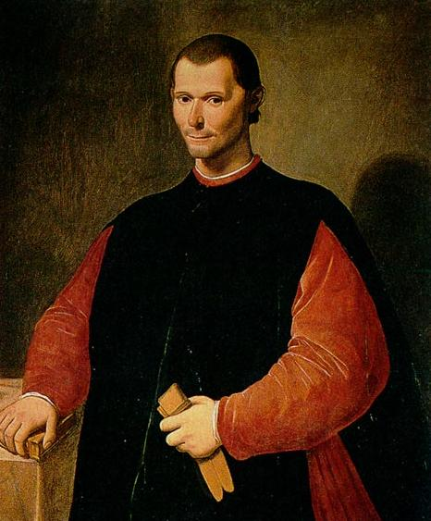
The influence of Machiavelli
Hobbes was influenced by Nicholas Machiavelli
Why was this early sixteenth century Italian writer useful in the mid-century British context?
John Pocock
The Prince (written 1513, published 1532)
The Discourses on Livy (written 1517, published1531)

Slide 18
The English face of Machiavelli
He had written about both princes and republics, with a marked preference for the latter and for mixed and balanced government
He was seen as anti-clerical
He wrote about human nature rather than ideal forms
His republic was one that encouraged virtue – the two were linked
Liberty was preserved by periods of conflict and even violence; states were organic and decayed and then had to be rebuilt

Slide 19
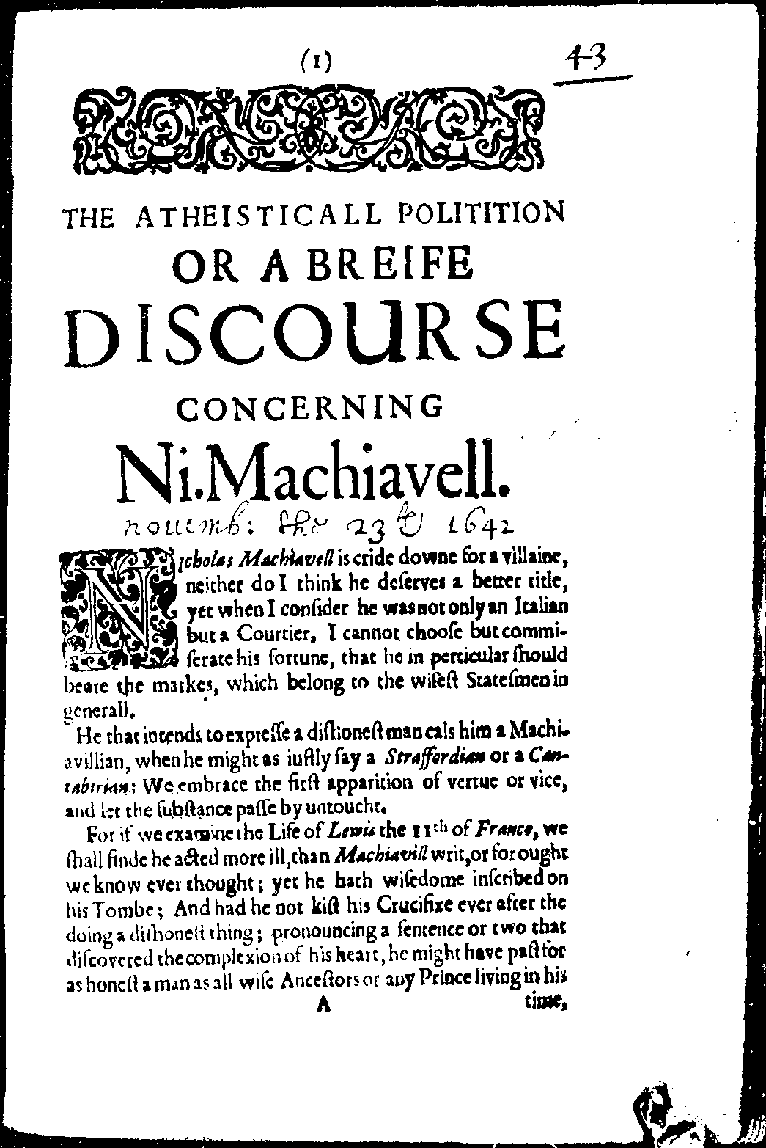
Machiavelli’s ideas were appropriated and debated
Many pamphlets embraced Machiavellian ideas; but many condemned his ideas.
1642 ‘Is any prince named in any chronicle but in red letters’?
James Harrington, a republican, was very influenced.
Harrington’s friend, Henry Neville, may have had written a vindication of Machiavelli in 1675; but it could also be the work of the publisher John Starkey, another example of how political thought was not just linked to canonical authors.

Slide 20
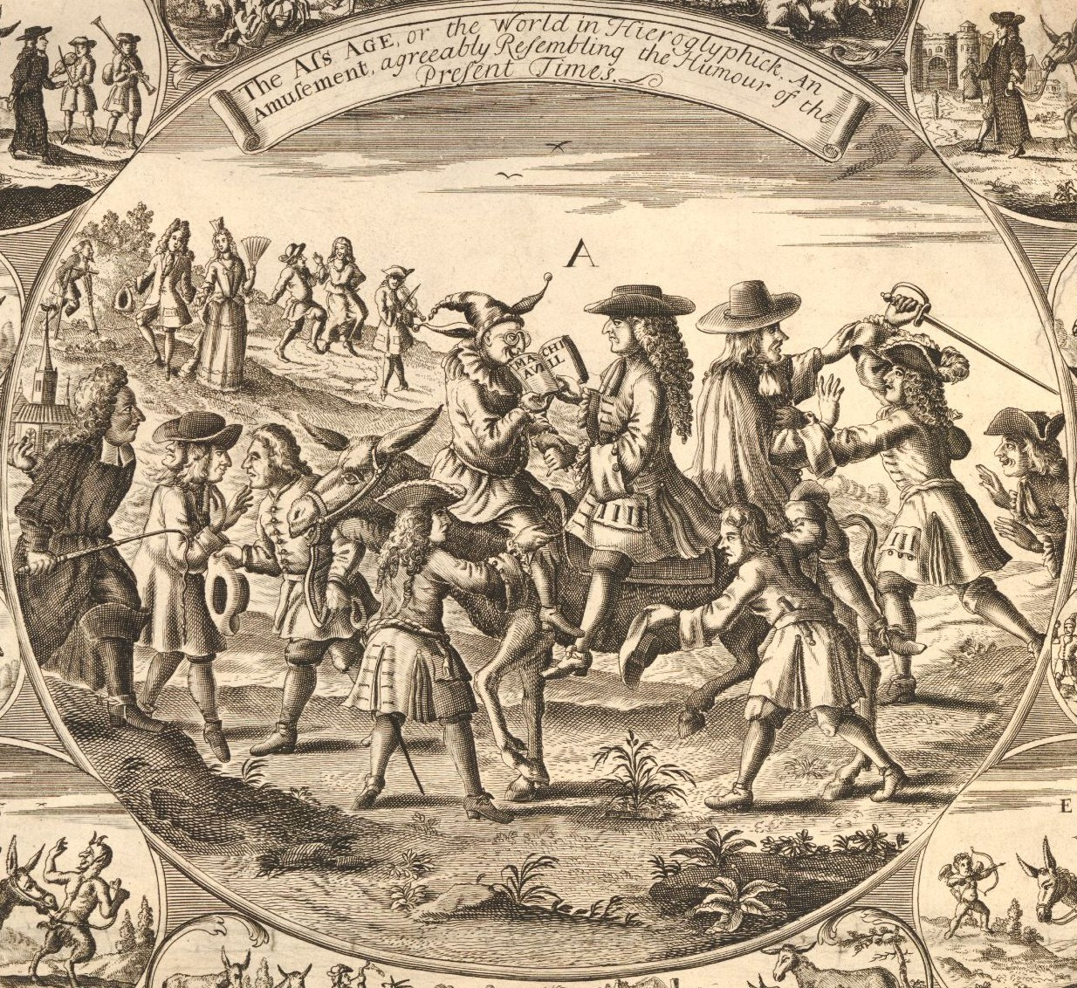

Slide 21
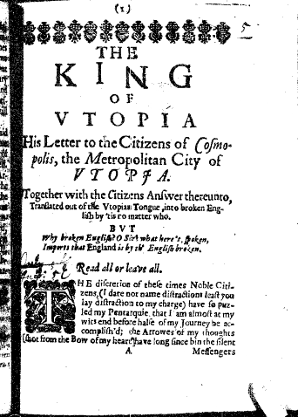
More’s Utopia was also re-used
1639 as The Commonwealth of Utopia
A 1647 tract about the civil wars

Slide 22
Conclusion
Ideas about resistance; the origin of political authority; the relationship between church and state were extensively discussed.
Key thinkers played a part in this but the debate was much wider.
Important concepts were ones of state of nature; society as the result of man-made artifice and contract; resistance theory; freedom of conscience and the limits of secular authority over private belief.
They remained contested ie this is an on-going conflict of ideas

