Slide 1
The Catholic Reformation
European World

Slide 2
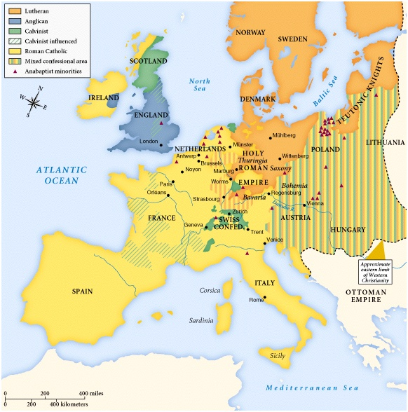
Religious Allegiances c. 1560

Slide 3
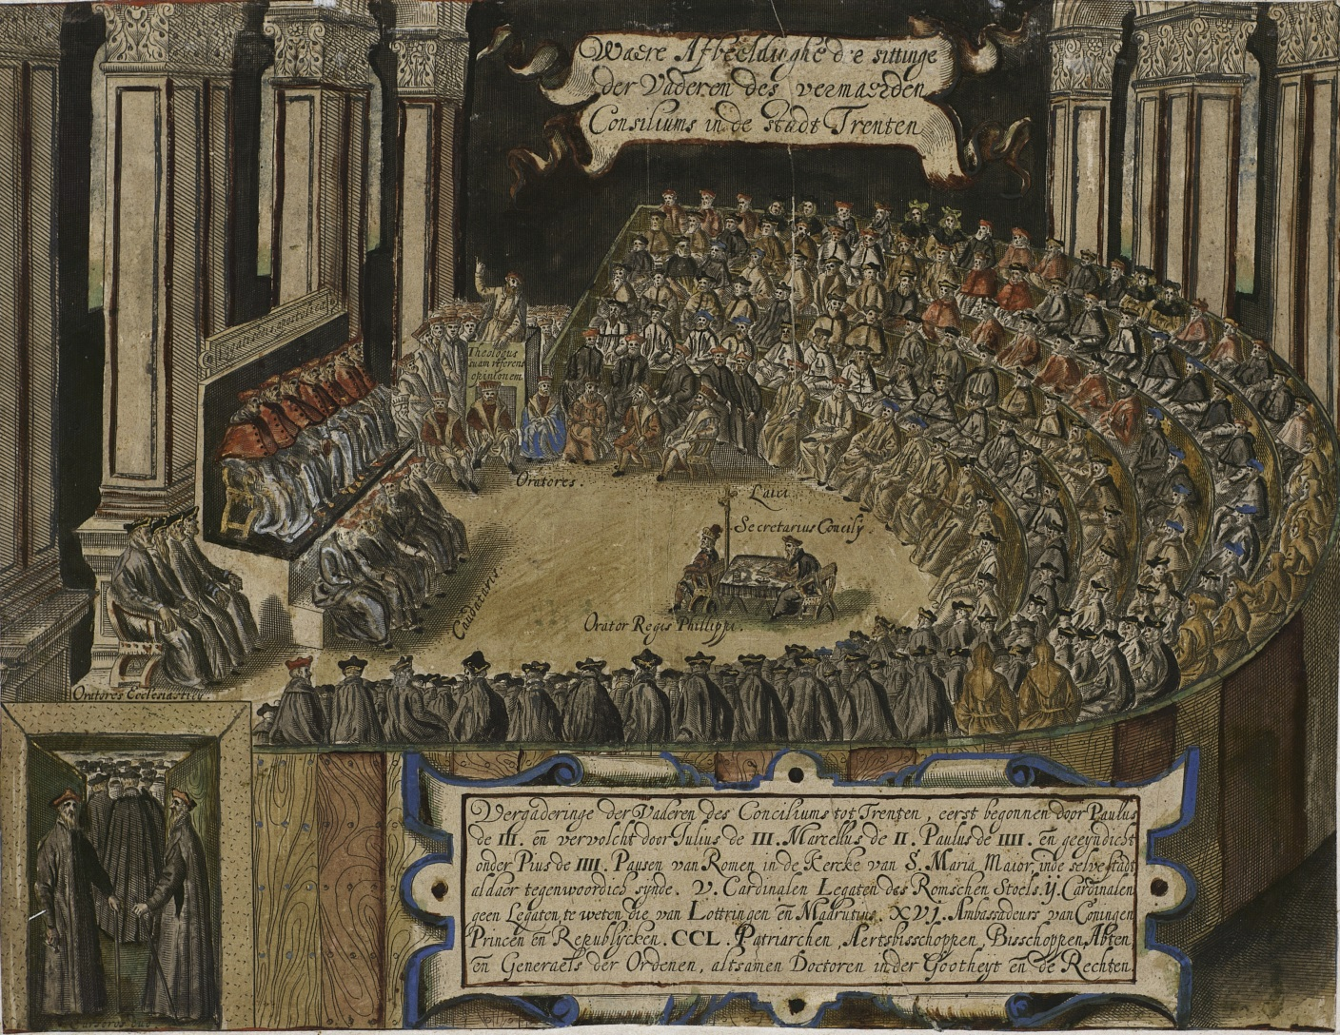
Reform from the Top: The Council of Trent, 1545-63

Slide 4
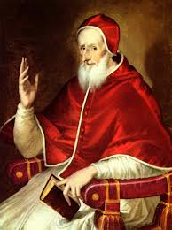
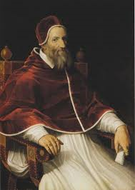
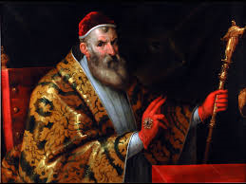
Serious Looking Popes: Pius V, Gregory XIII, Sixtus V

Slide 5
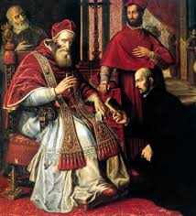
The Pope’s Army
Paul III confirms the Society of Jesus, 1540

Slide 6
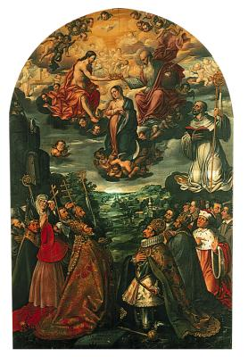
‘Political Catholicism’
Emperor Ferdinand II and the Coronation of the Virgin

Slide 7
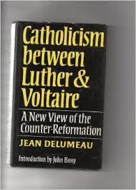
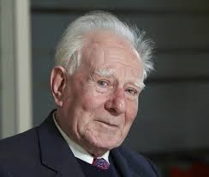
Jean Delumeau: Christianization Thesis

Slide 8
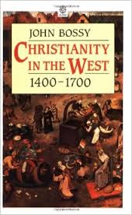
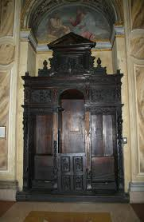
John Bossy: Catholic Transformation

Slide 9
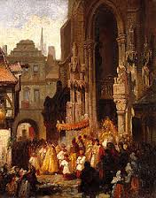
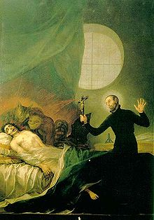
Catholic Reformers and Popular Religion: Accommodation not Acculturation
Corpus Christ Procession
Exorcism

Slide 10
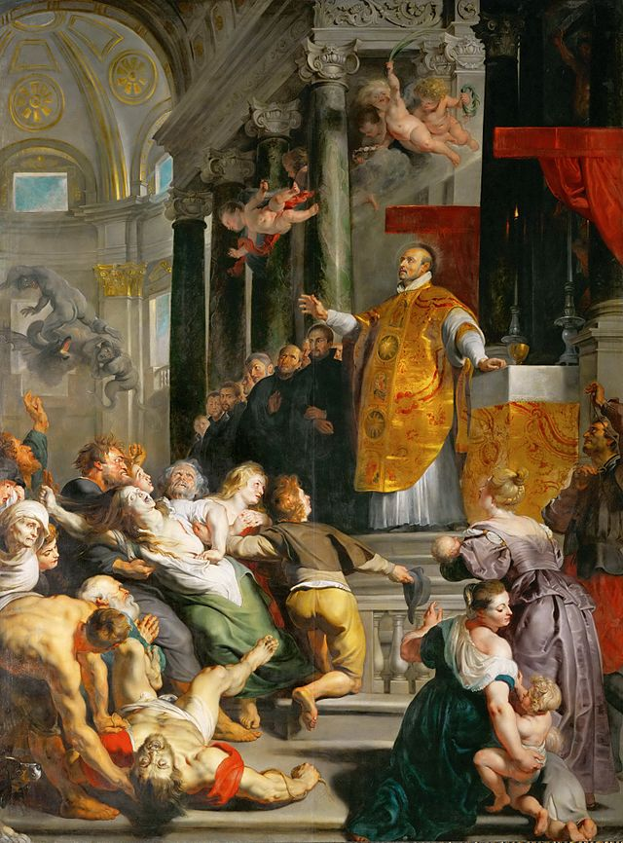
New Model Sainthood: Peter Paul Rubens, Miracles of St Ignatius, 1618-19

