Slide 1
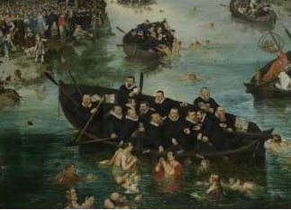
The Unfolding of the European Reformation
Mark Greengrass
(m.greengrass@Sheffield.ac.uk)
University of Warwick
HI203:- The European World, 1500-1750
Thursday 30 November 2017

Slide 2
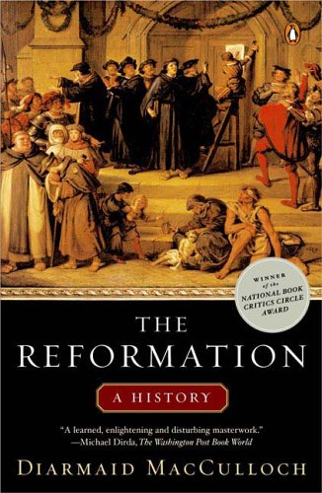
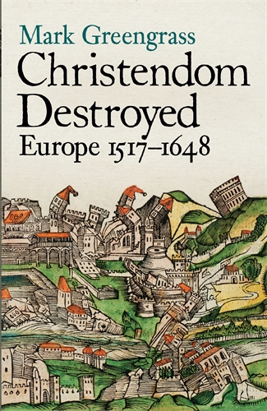

Slide 3
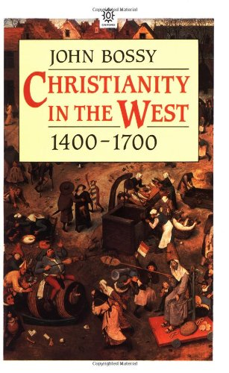
‘Reformation: term discussed’
Something important happened in the sixteenth century ‘and the term “Reformation” is probably as good a guide as any to investigating what it was’. …But it should be used as sparingly as possible, ‘not simply because it goes along too easily with the notion that a bad form of Christianity was being replaced with a good one, but because it sits awkwardly across the subject without directing one’s attention anywhere in particular’. …It is ‘too high-flown to cope with actual social behaviour, and not high-flown enough to deal sensitively with thought, feeling or culture.’

Slide 4
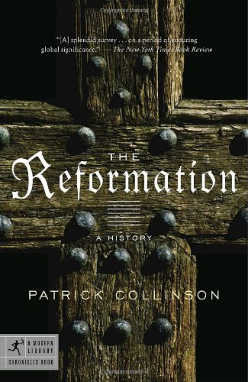
‘There is a tension here between event and process which, presented on a larger screen is the tension between the Reformation as part of the continuum of history and the Reformation as an extraordinary historical moment - as it were, a meteor strike at history’ (p. 6)
A ‘meteor-strike’, but when?
1515 Publication of Erasmus’ Novum Testamentum (Basel)
1517 (supposed) nailing of the Luther’s 95 Theses on the door of Wittenberg Cathedral
1520 Papal excommunication of Luther
1521 Edict of Worms, the Imperial ban on Luther and his works
1523 Beginning of the Reformation in Zurich (Huldrych Zwingli)

Slide 5
The European Reformation: Generational Chronology
1490-1530: (1st Generation: schism - chaotic dynamism)
1530-1560: (2nd Generation: repression, reaction, consolidation. Beginnings of Counter-Reformation; cementing of Protestant confessional divisions)
.
1560-1620 (3rd/4th Generations: wars of religion; experiments in religious pluralism. The ‘further (Calvinist) reformation’ of some initially Lutheran areas of Germany. The Impact of religious divisions in war, politics and international diplomacy)
?

Slide 6
The European Reformation: ‘Layered Processes in Time’
Political/Polemical
Strengthening forces of political order
Weakening forces of political order
Ecclesiastical/Confessional
Establishing churches, ‘confessionalisation’
Reality of religious pluralism; resistance to demands of churches and orthodoxy
Cultural Impact of the Reformation

Slide 7
The Cultural Impact of the European Reformation: ‘Open Questions’
the Reformation and marriage, the family, women and children
…..and literacy
….and art and music
…and people’s hopes and fears
…and money and wealth
….and work and leisure
….and the sacral landscape

Slide 8
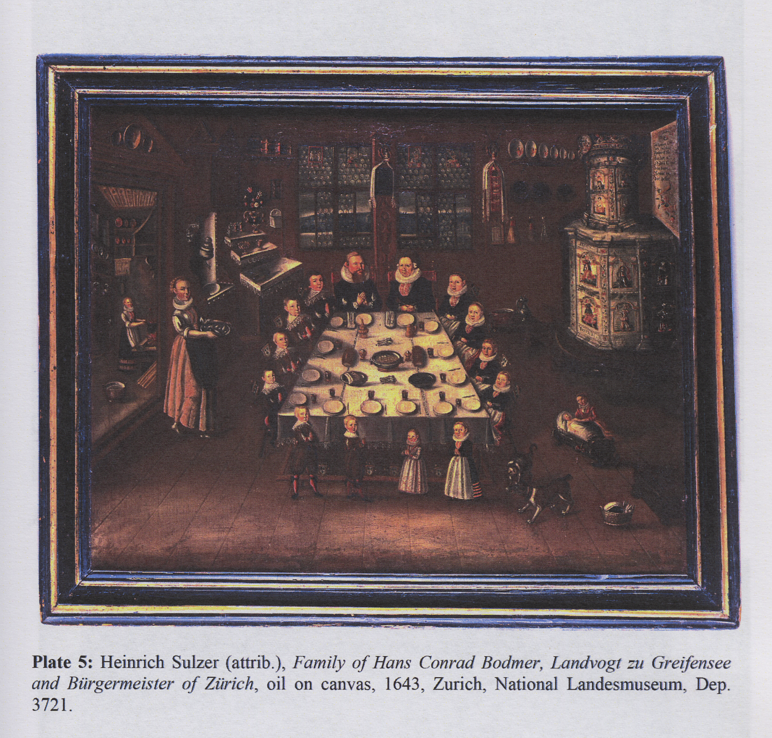

Slide 9
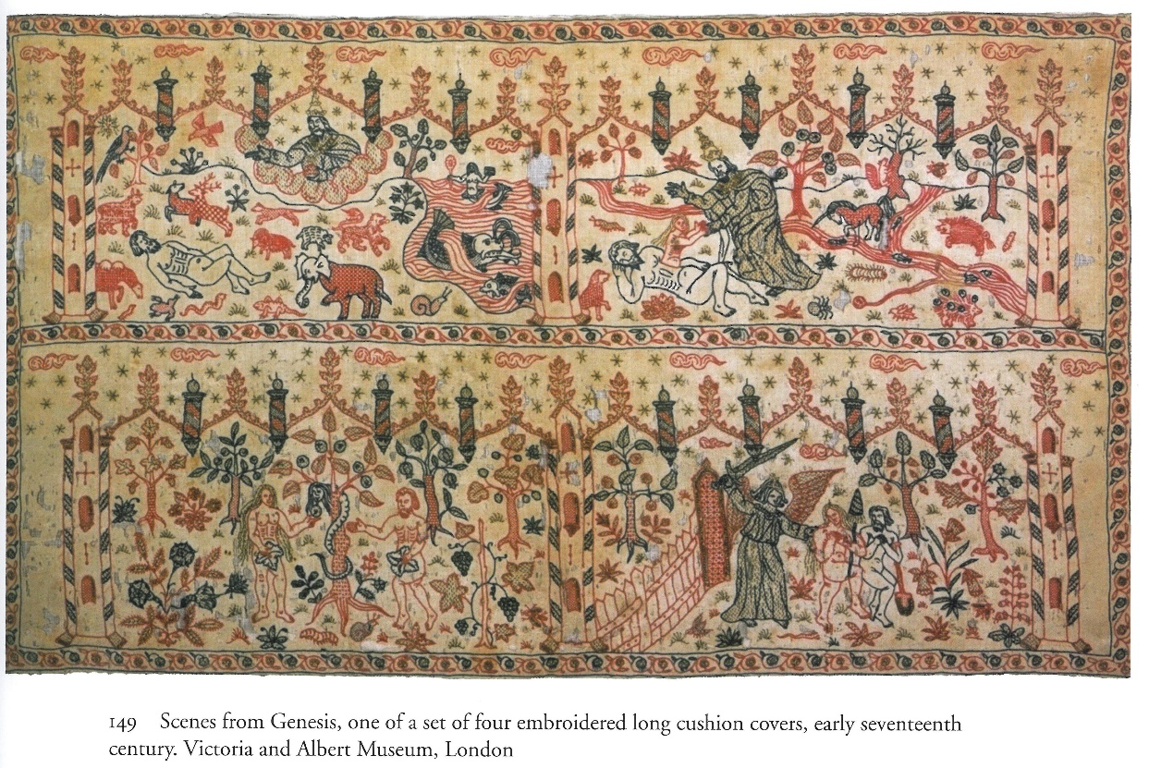
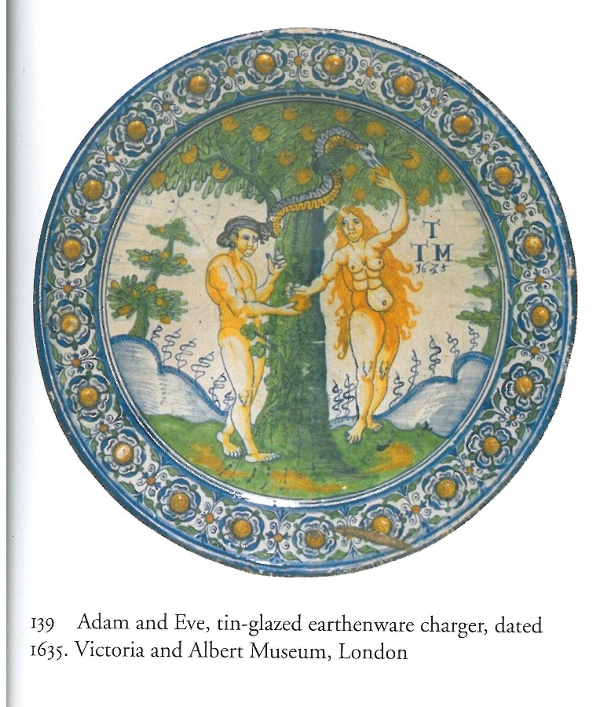

Slide 10
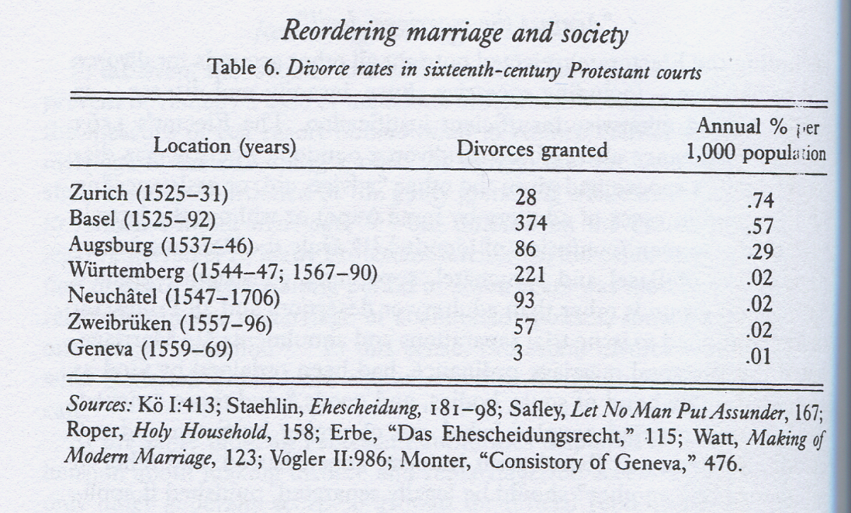
From Joel F. Harrington, Reordering Marriage and Society in Reformation Germany (Cambridge: Cambridge University Press, 1995), p. 167

Slide 11
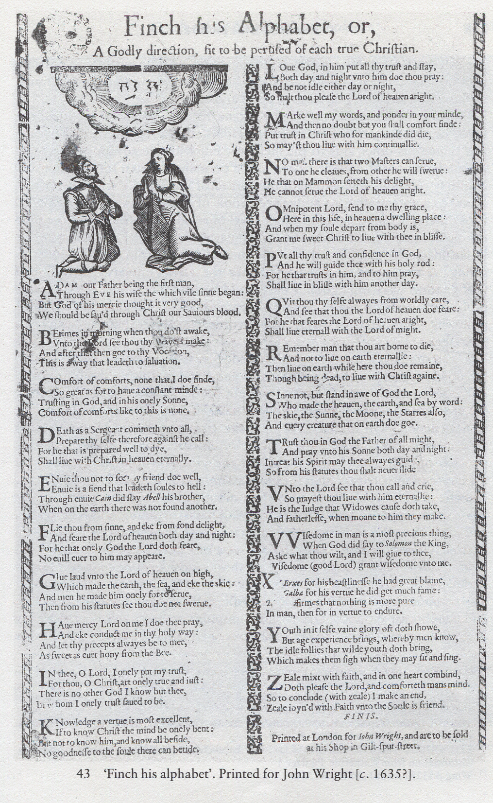
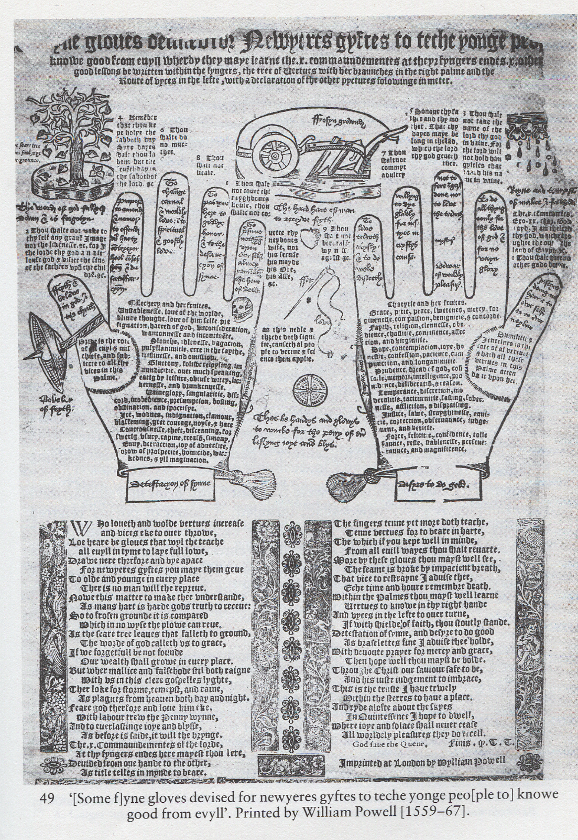

Slide 12
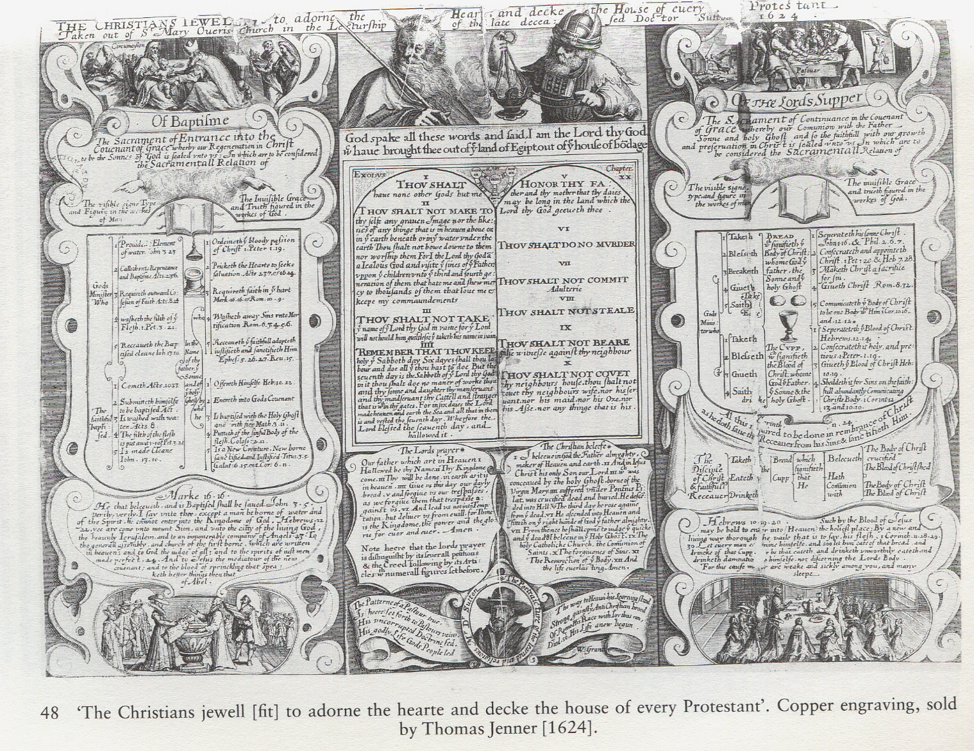

Slide 13
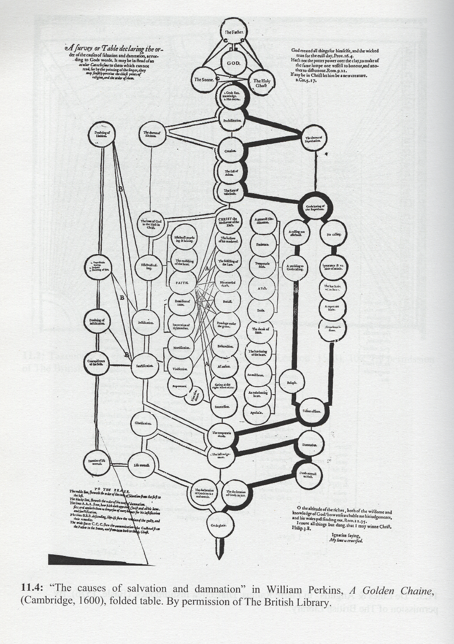
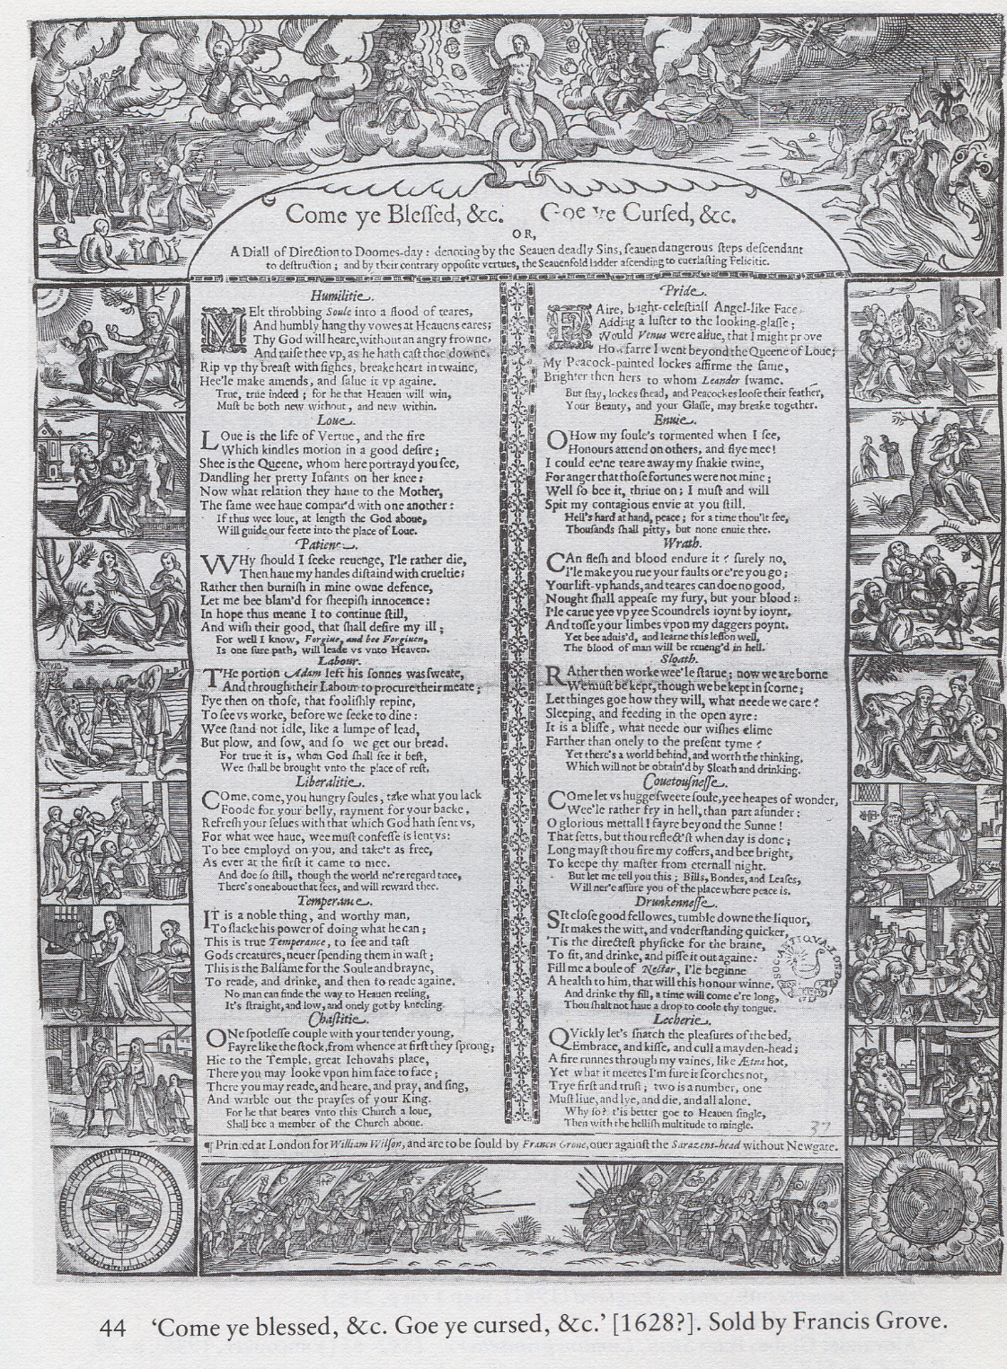

Slide 14
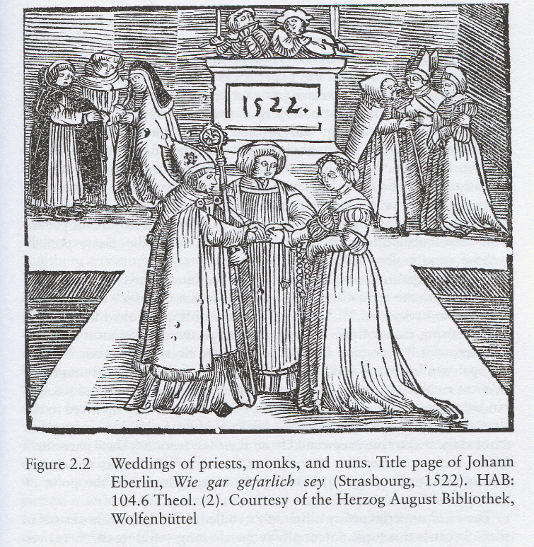
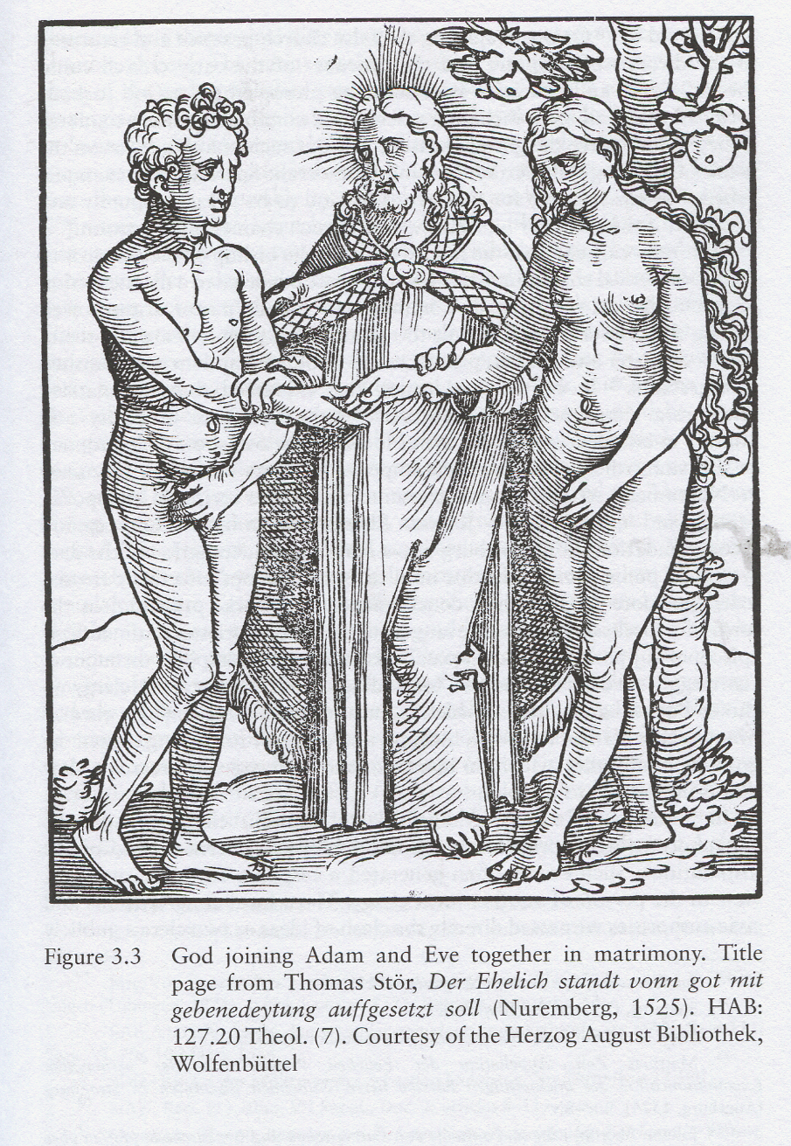
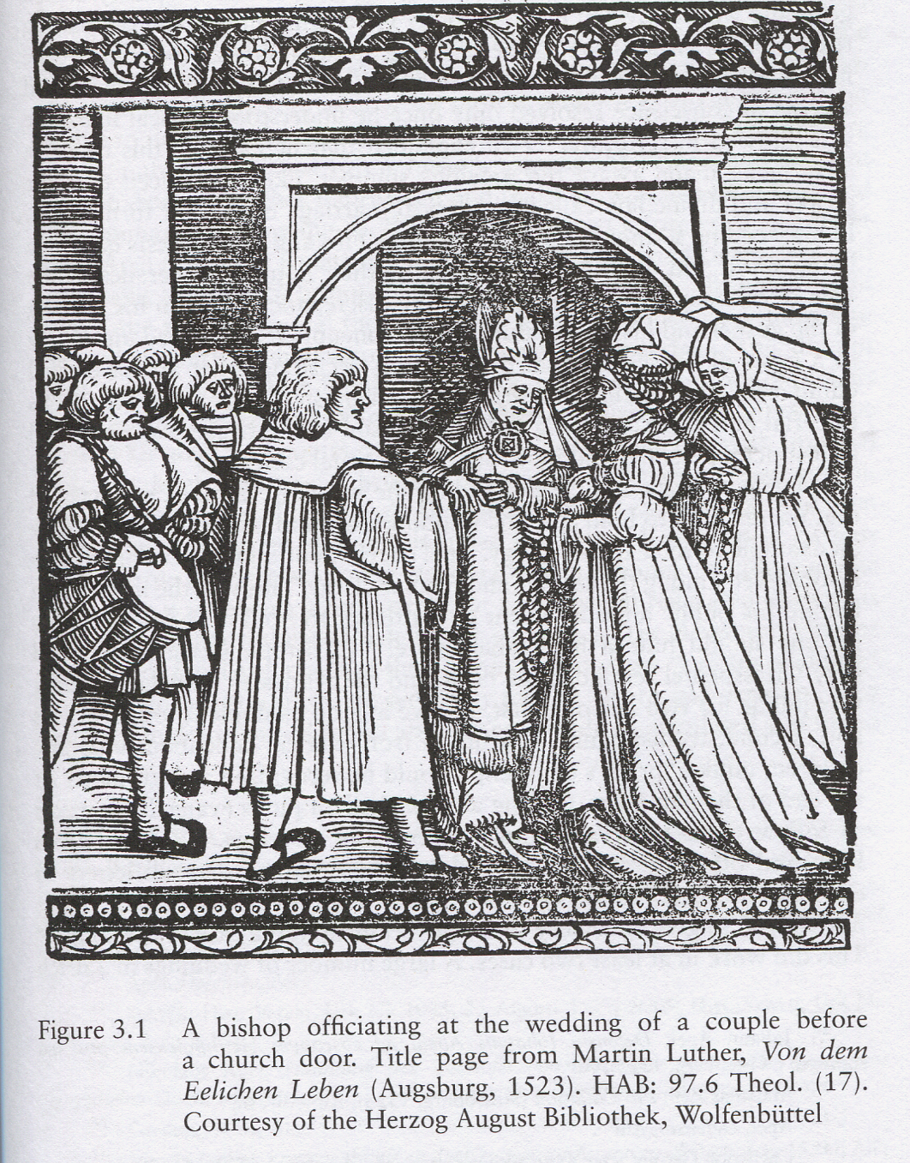

Slide 15
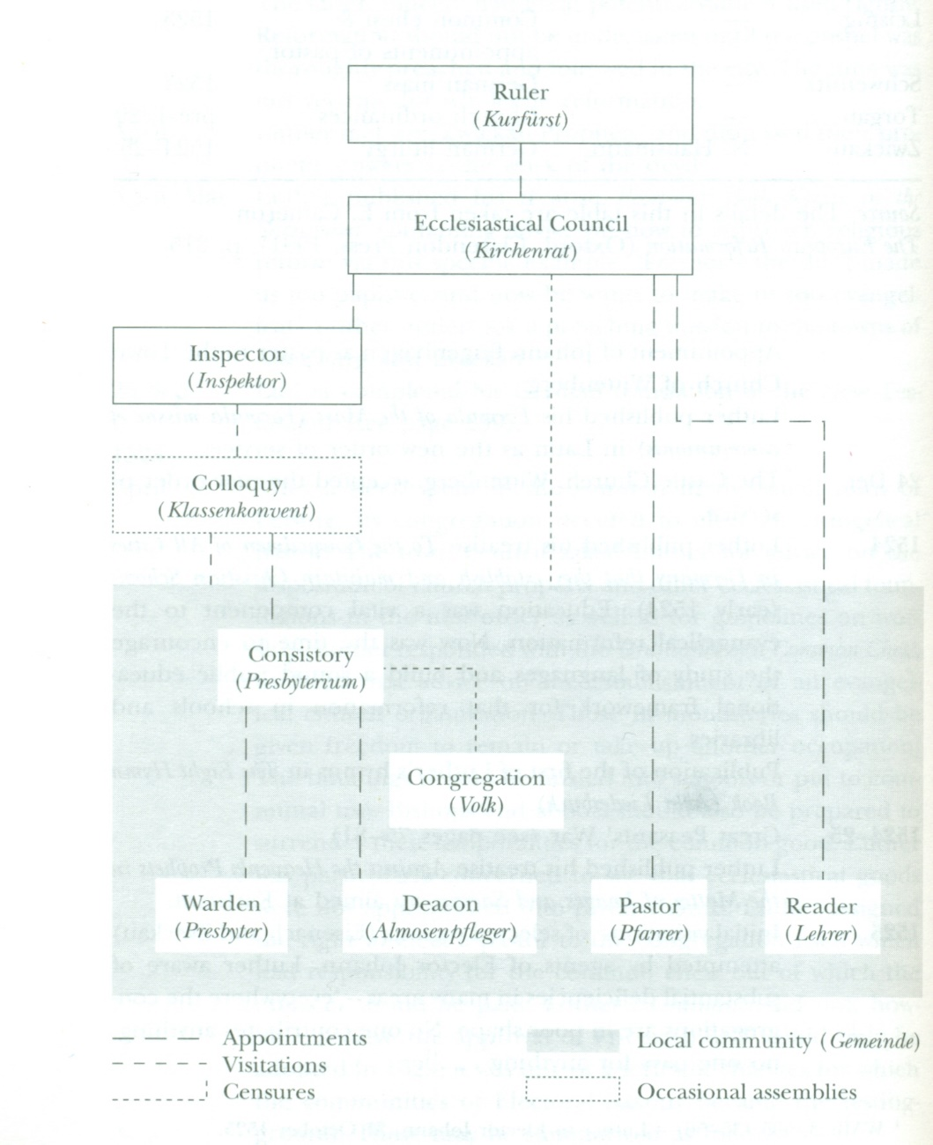
Diagram of a princely reformation church organisation: Saxony

Slide 16
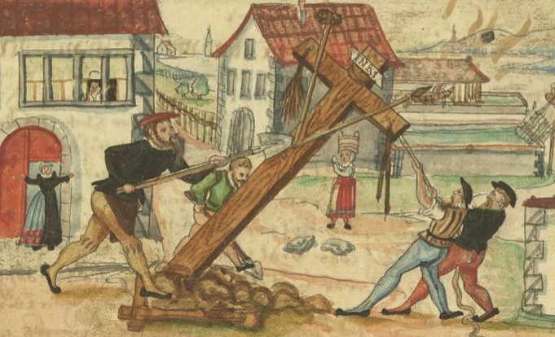
The destruction of Christendom’s sacral landscape accompanied the Protestant Reformation from an early stage. The removal of this crucifix from outside the city dates of Zurich inn 1524 was organised by Claus Hottinger, a supporter of Huldrych Zwingli, with help from a weaver and carpenter. They wanted to sell the wood to aid the poor

Slide 17
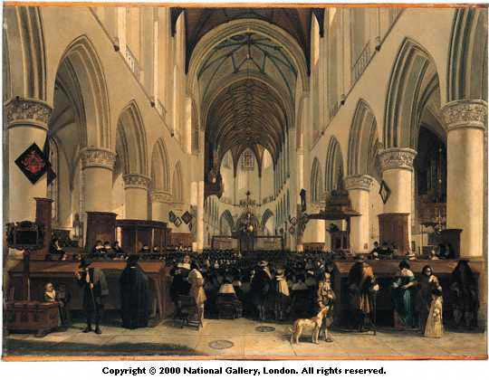
The Calvinist Church of St Bavo, Haarlem in the seventeenth century

Slide 18
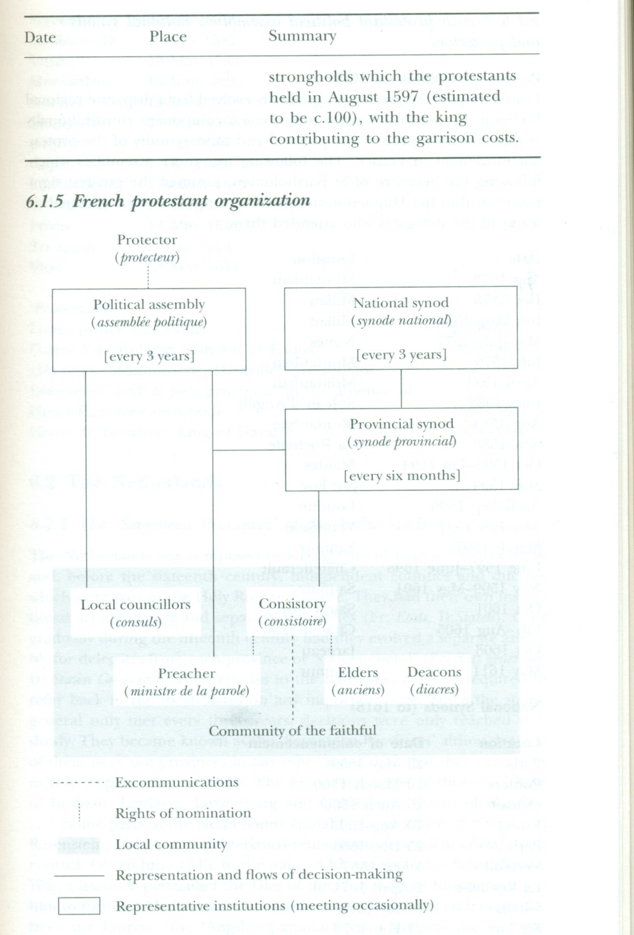

Slide 19
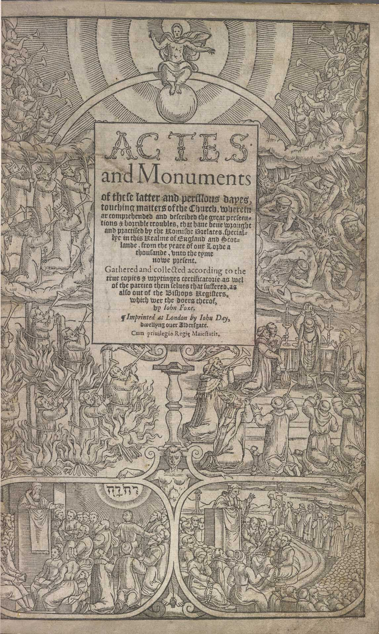
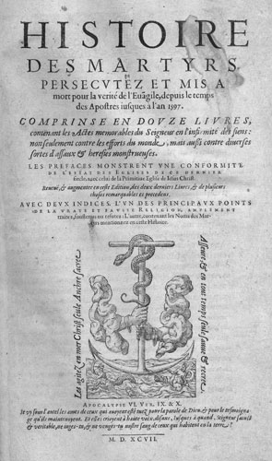

Slide 20
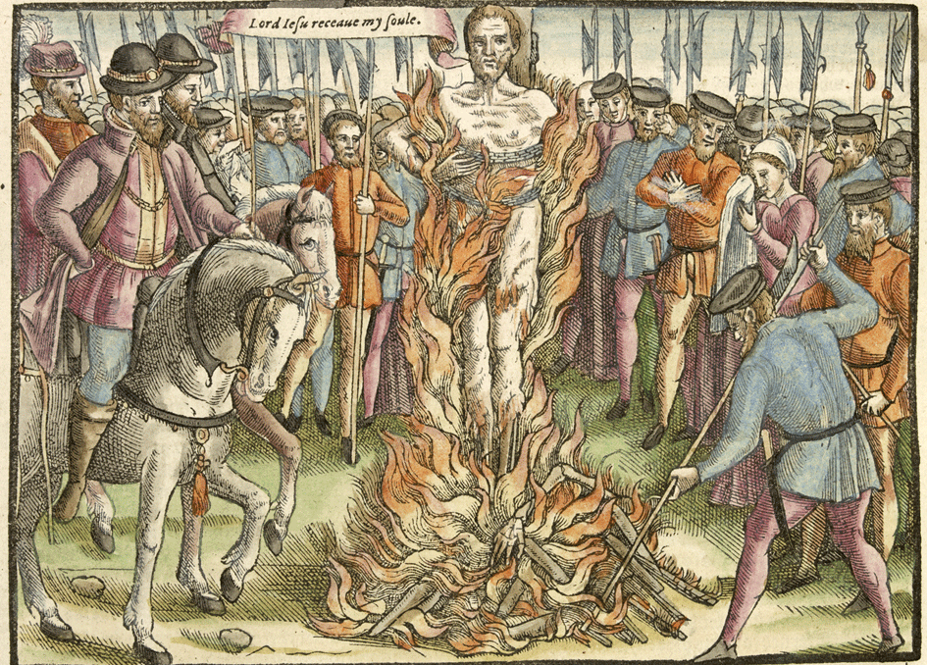

Slide 21
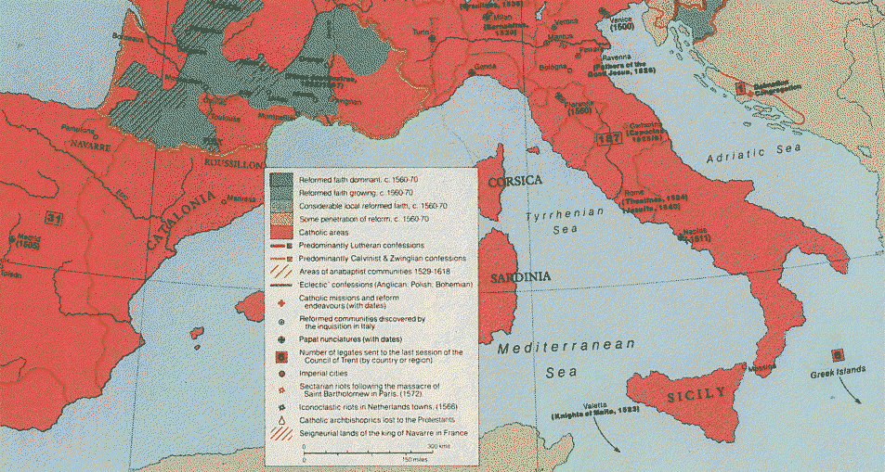

Slide 22
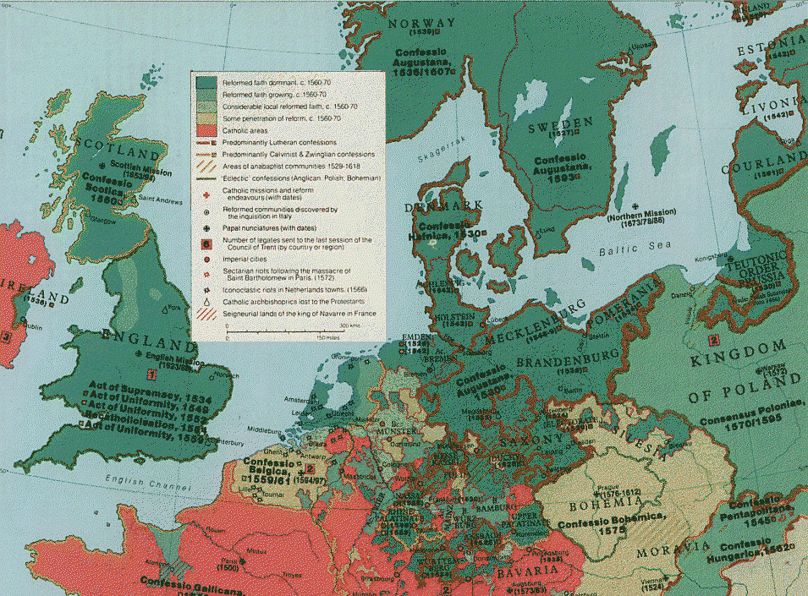

Slide 23
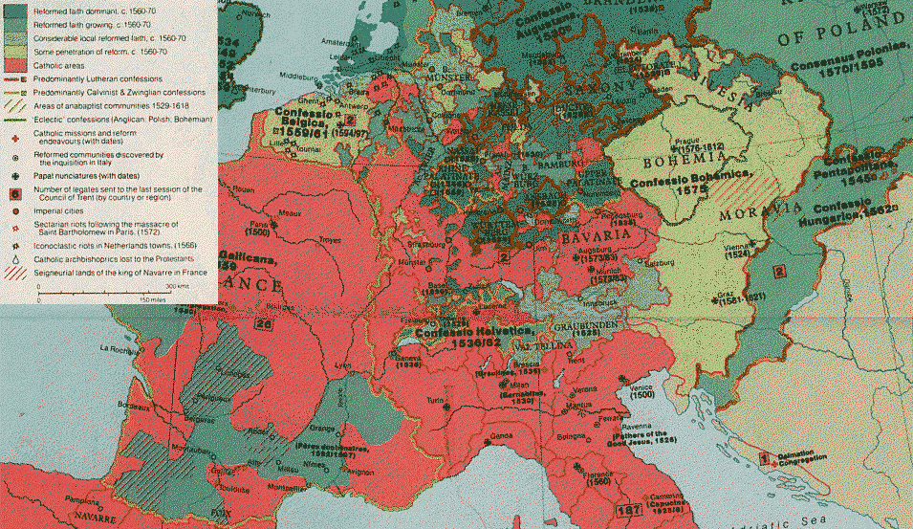

Slide 24
The most significant impact of the Protestant Reformation?
A fundamental and permanent division in Christendom, which exacerbated other political divisions at a time of Europe’s expansion overseas and its conflicts with the Ottoman empire
Changed status of the Church. The Protestant Reformation weakened notions of tithe income and spiritual dues. Princes were no longer anxious about being charged with sacrilege for attacking Church wealth. The Protestant Reformation involved a large transfer of wealth from clerical to lay hands
The recalibration of relationships between church and state. The Church became a matter on which princes and magistrates expected to have a say. The separate jurisdiction of ecclesiastical courts was abolished or attenuated. ‘Erastianism’ [Thomas Lüber (Erastus)] – the notion that rulers exercised sovereignty in their states and that the Church possessed no coercive power, became the norm

