Slide 1
‘The Scientific Revolution’
The European World
Michael Bycroft
30 January, 2018

Slide 2
…we cannot say that essentially new ingredients were introduced into our civilisation at the Renaissance…We know now that what was emerging towards the end of the 17c was a civilisation exhilaratingly new perhaps, but strange as Nineveh and Babylon. That is why, since the rise of Christianity, there is no landmark in history that is worthy to be compared to this.
– Herbert Butterfield, “The Place of the Scientific Revolution in the History of Western Civilisation,” in The Origins of Modern Science, 1949

Slide 3
The scientific revolution needs not so much to be rewritten as written off
– Nicholas Jardine, 1991
We do not want to discuss here the last twenty years or so of attempts to put Humpty Dumpty together again. Our argument here is that such attempts are doomed to failure…
– Andrew Cunningham and Perry Williams, 1993
There was no such thing as the scientific revolution, and this is a book about it
– Steven Shapin, 1996

Slide 4
Ingredients
Reservations
Revival?

Slide 5
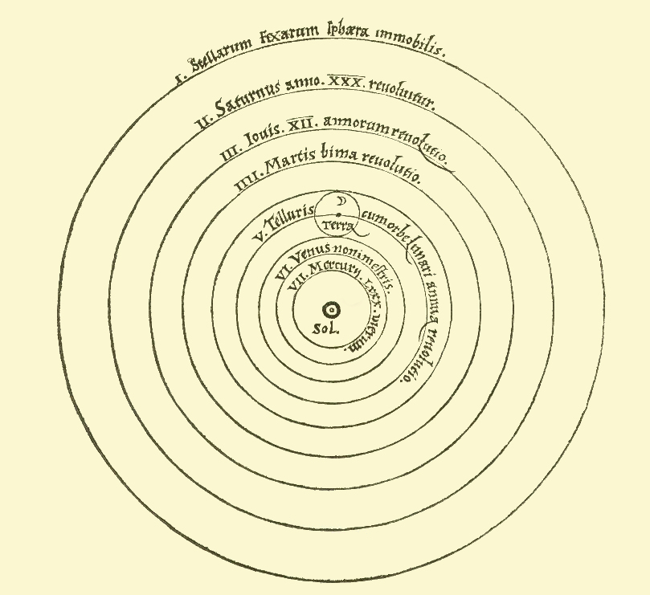
Stars stationary
Sun central and stationary
The earth has three motions –
daily around its axis
annual around the sun
annual around its axis
The universe according to Nicolas Copernicus, Revolutions of the Heavenly Spheres (1543)

Slide 6
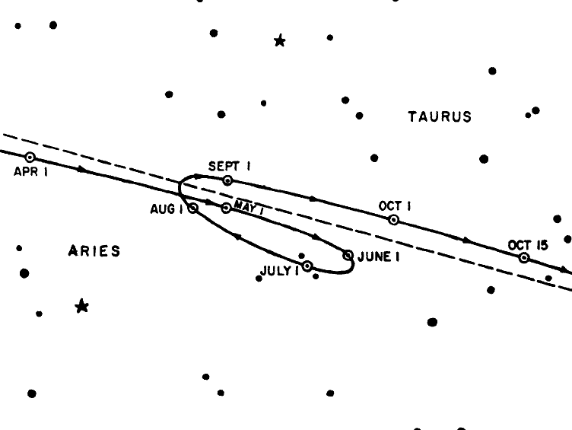
Motion of sun through stars from April to October
Motion of Mars from April to October
South
West (into the screen)
North

Slide 7
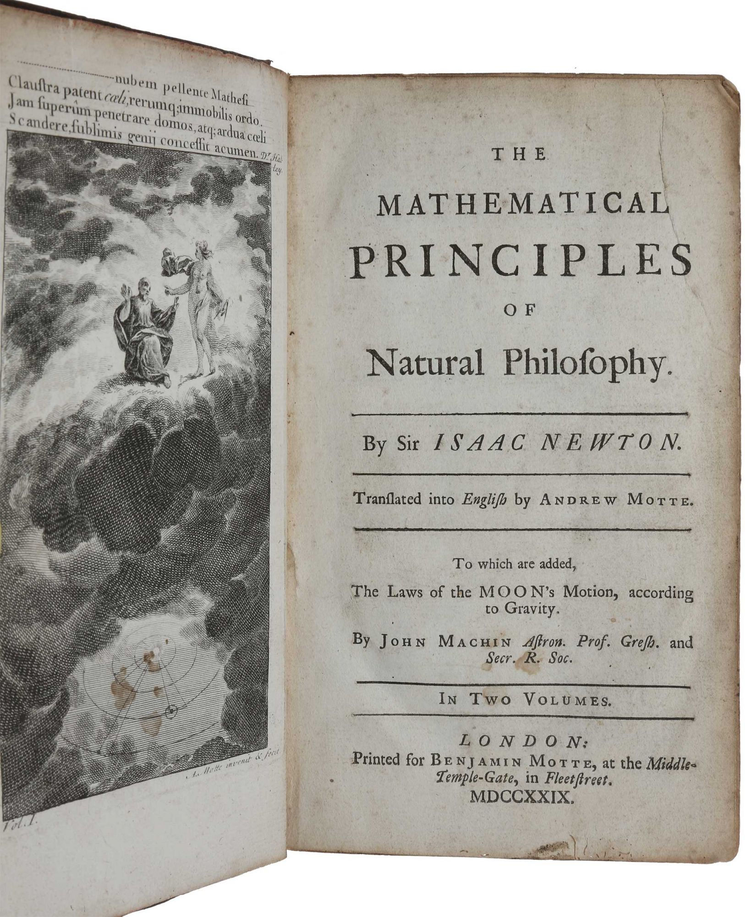
Isaac Newton, The Mathematical Principles of Natural Philosophy (first published in Latin in 1687)

Slide 8
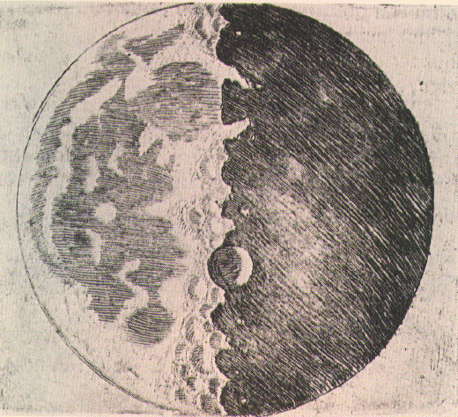
Moon drawing from Galileo, Starry Messenger (1610)

Slide 9
Sublunary realm
Celestial realm
below the moon
general tendencies
generation and decay
earth, air, fire, water
upwards and downwards
the moon and above
exceptionless laws
no real change
quintessence
circular motion only

Slide 10
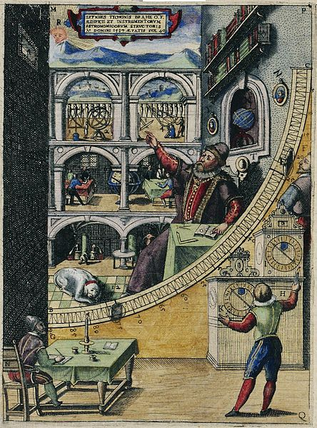
Engraving from Tycho Brahe, Astronomiae instauratae mechanica (1598)
Brahe’s 1.8m mural quadrant – note the 3 assistants, 2 clocks, and grandiose portrait of Tycho
Based on Tycho Brahe’s observatory on the Danish island of Hven (built 1576-1580)

Slide 11
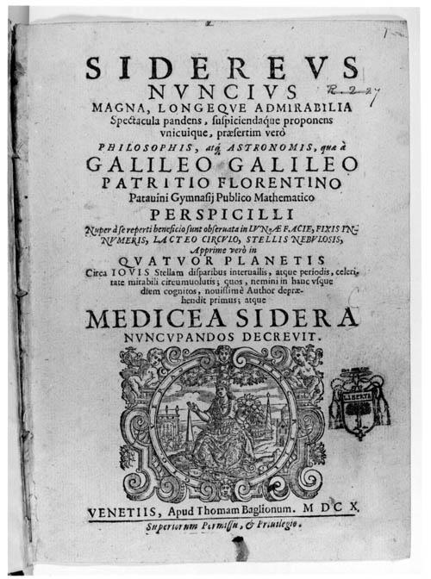
Galileo, Siderius nuncius (= Starry Messenger), 1610

Slide 12
A new Philosophy cals all in doubt,
The Element of fire is quite put out;
The Sunne is lost, and th’earth, and no mans wit
Can well direct him where to look for it.
And freely men confesse, that this world’s spent,
When in the Planets, and the Firmament
They seeke so many new; they see that this
Is crumbled out againe to his Atomis
-- John Donne, An Anatomy of the World, c.1611

Slide 13
[the assertion that] the sun is in the centre of the world and completely devoid of local motion…
…is formally heretical…
Since it explicitly contradicts in many places the sense of Holy Scripture, according to the literal meaning of the words and according to the common interpretation and understanding of the Holy Fathers and the doctors of theology…
[and the assertion is] false and absurd in [Aristotle’s] philosophy
-- report on heliocentrism by papal theologians, Rome 1616

Slide 14
Other examples…
unimpeded bodies slow and stop → unimpeded bodies continue, in a straight line (principle of rectilinear inertia)
blood is converted into flesh at extremities of body → blood continuously circulates (the circulation of the blood)
white light is primitive → white light is composed of coloured light
suction is due to nature’s abhorrence of a vacuum → suction is due to the pressure of the air
fossils are due to ‘seeds’ or ‘sympathies’ → fossils are the remains of once-living organisms

Slide 15
The cumulative force of the scholarship since the 1980s has been to put sceptical question marks after every word of this ringing three-word phrase, including the definite article.
-- Lorraine Daston and Katherine Park 2006

Slide 16
2. Reservations

Slide 17
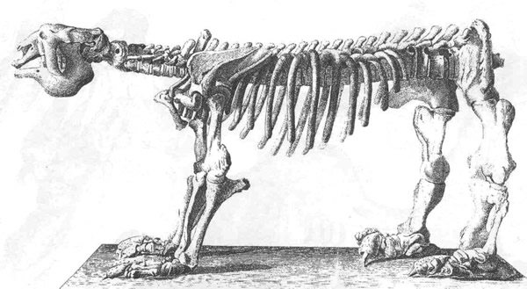
Megatherium (sloth) skeleton – shown to be extinct species in Georges Cuvier, Researches on Fossil Bones, 1812

Slide 18
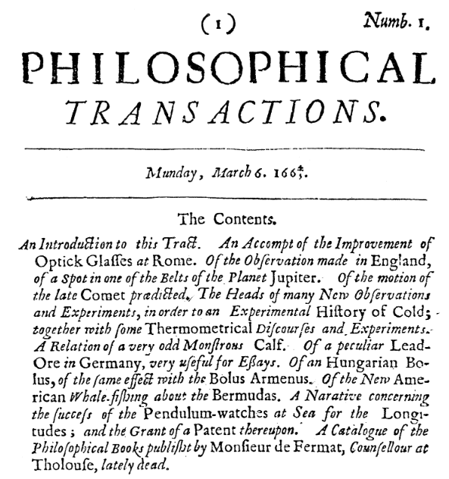
First number of the Philosophical Transactions of the Royal Society of London for Improving Natural Knowledge, 1665

Slide 19
And if natural Philosophy in all its Parts, by pursuing this Method, shall at length be perfected, the Bounds of Moral Philosophy will be also enlarged.
For so far as we can know by natural Philosophy
what is the first Cause, what Power he has over us, and what Benefits we receive from him, so far our
Duty towards him, as well as that towards one another, will appear to us by the Light of Nature
-- second-to-last sentence in Newton’s Opticks, 1704

Slide 20
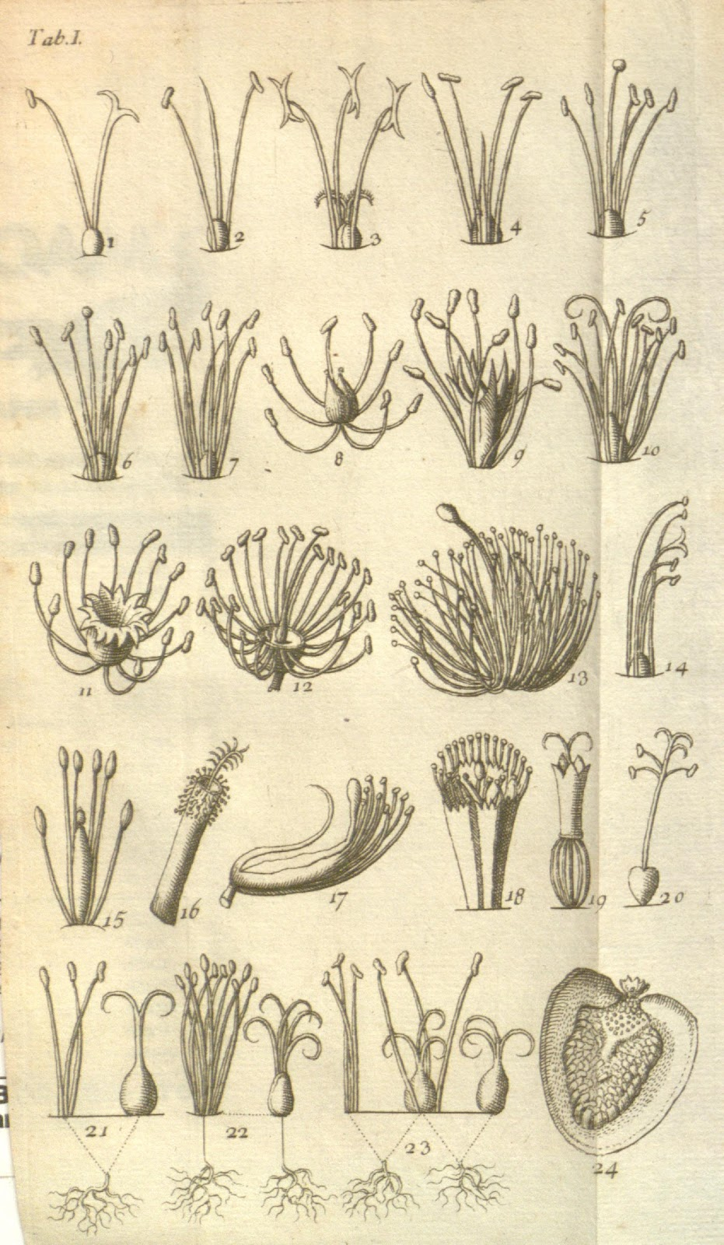
The universe according to Nicolas Copernicus, Revolutions of the Heavenly Spheres (1543)
Diagram of Carl Linnaeus’ sexual system for classifying plants, by Georg Ehret (1736)

Slide 21
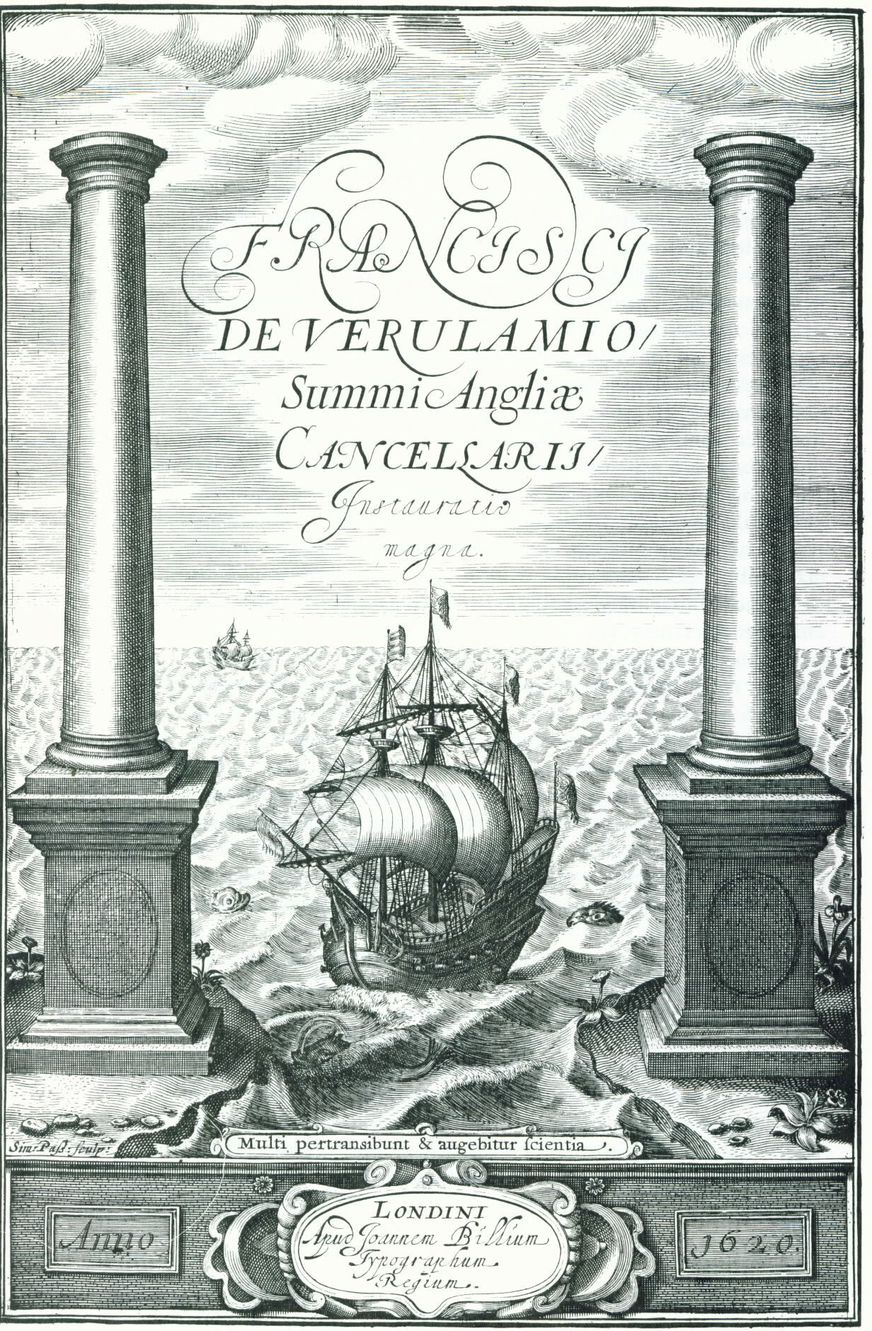
Frontispiece to Francis Bacon, The Great Instauration (including his New Organon) (1620)
Motto: ‘many shall run to and fro, and knowledge shall be increased’
- Book of Daniel, 12:4

Slide 22
The Scientific Revolution is a myth about the inevitable rise to global domination of the West, whose cultural superiority is inferred from its cultivation of the values of inquiry that allegedly produced the breakthrough to modern science…
-- Lorraine Daston and Katharine Park 2006

Slide 23
3. Revival?

Slide 24
Modern science was invented between 1572, when Tycho Brahe saw a nova, or a new star, and 1704, when Newton published his Optics
– Wootton
..we can now see it as the greatest event in human history since the Neolithic Revolution [12-7,000 years ago!]
– Wootton
the advent of modern science [was] a decisive event in world history, really the most outstanding among prime motors of our modern world
– Cohen

Slide 25
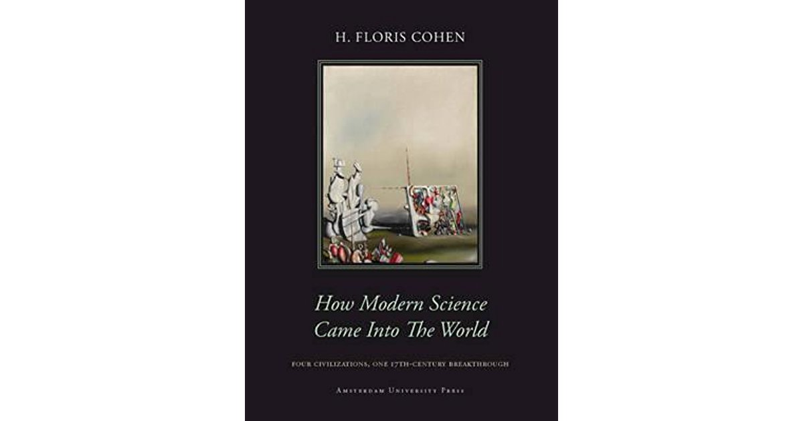
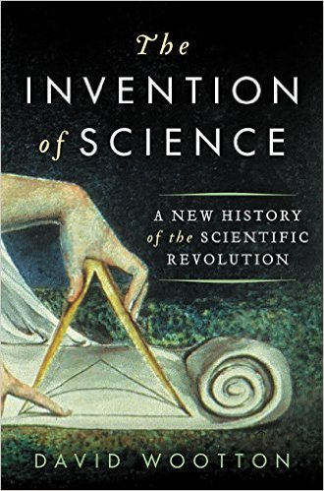

Slide 26
A synthetic and comparative study of the converging strands of science – philosophy, maths, ‘coercive empiricism’
An anti-relativist study in the language of science – ‘science’, ‘hypothesis’, ‘experiment’, etc.

Slide 27
Ingredients
Reservations
Revival?

Slide 28
Works cited
Butterfield, Herbert. 1949. The Origins of Modern Science, 1300-1800. London: Bell
Cohen, H. Floris. 2011. How Modern Science Came Into The World: Four Civilisations, one 17th-century Breakthrough. Amsterdam University Press
Cunningham, Andrew, and Perry Williams. 1993. “De-Centring the ‘Big Picture’: ‘The Origins of Modern Science’ and the Modern Origins of Science.” The British Journal for the History of Science 26 (4): 407–32
Daston, Lorraine, and Katharine Park, ‘Introduction,’ in their The Cambridge History of Science, vol. 3: Early Modern Science. Cambridge University Press.
Jardine, N. 1991. “Writing off the Scientific Revolution.” Journal for the History of Astronomy 22: 311–18.
Shapin, Steven. 1996. The Scientific Revolution. Chicago: Chicago University Press
Wootton, David. 2015. The Invention of Science. London: Penguin

