Slide 1
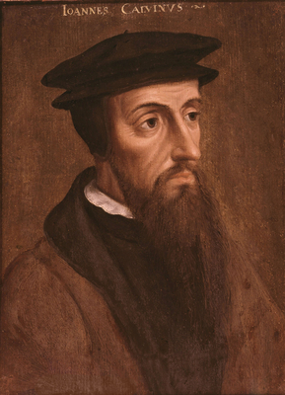
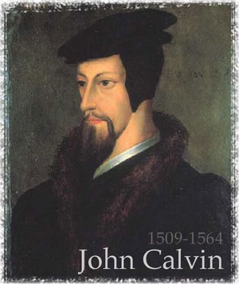
CALVIN AND CALVINISM

Slide 2
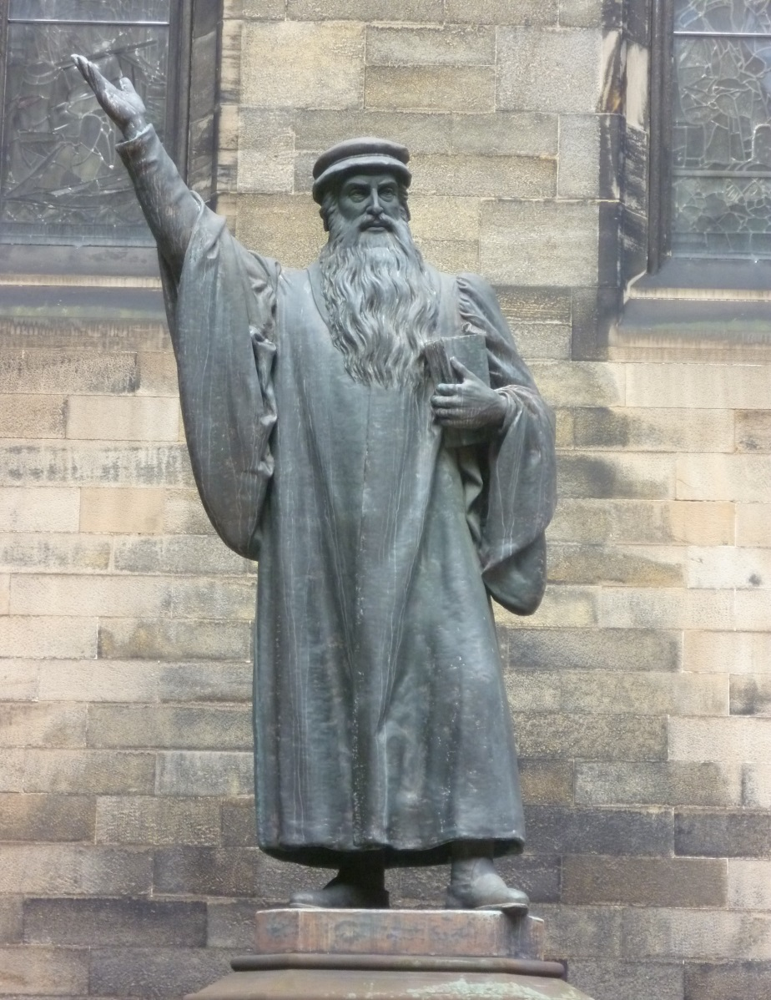
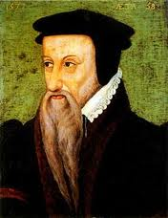
PROPHETIC BEARDS
John Knox (c. 1514-1572)
Theodore Beza (1519-1605)

Slide 3
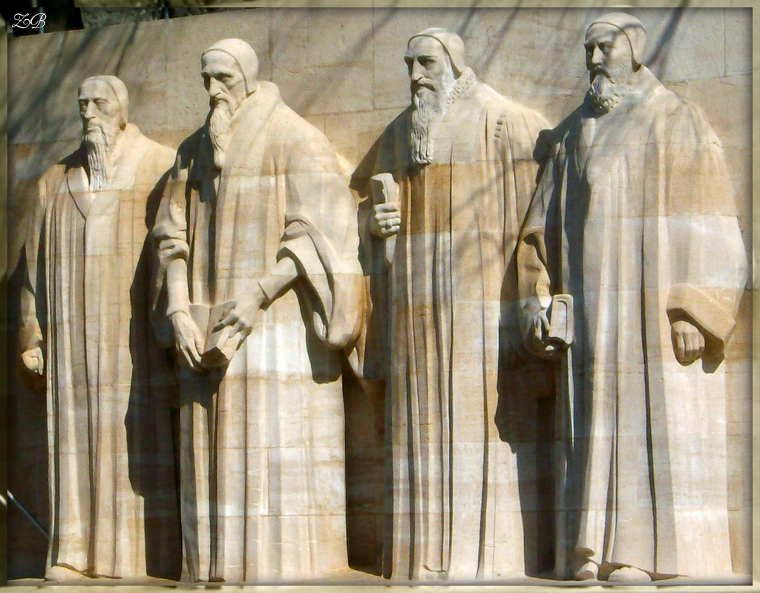
More Prophetic Beards (Reformation Wall)!

Slide 4
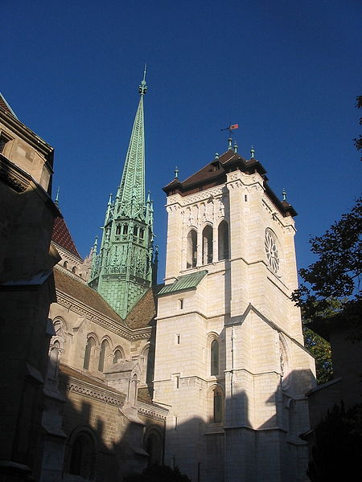
‘The most perfect school of Christ that ever was since the days of the Apostles’ (Knox)
Struggle for Control in Geneva
Expelled after first attempt 1536-38
Worked in Strasbourg with Bucer 1538-41
Political as much as religious struggle 1540s
Disputes over baptismal names, dancing, gambling
Servetus challenged theology, burned 1553
Increasingly French city because refugees
Life in/as exile significant
Became major printing centre in 1550s
Academy to train ministers estab. 1559

Slide 5
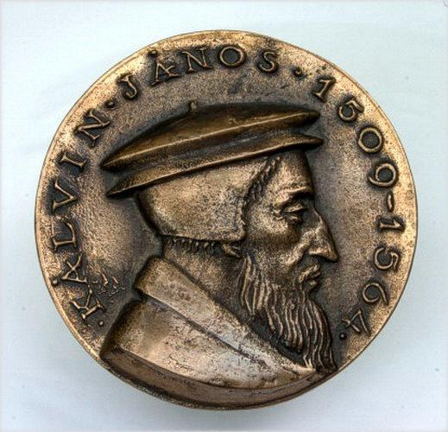
Halted retreat of Protestant Reformation?
Calvin’s Legacy
Importance in churches of Scotland, France, Poland, Netherlands, Hungary, Transylvania, Puritans
More systematic doctrine than Luther (Institutes)
More structured and independent church (Ecclesiastical Ordinances 1541; synods, elders, deacons, poor relief)
Appeal of faith based on discipline and austerity (role of Consistory)
Salvation & Scripture at centre of ministry
Flexibility, exportability, lay officials, ‘work ethic’

Slide 6
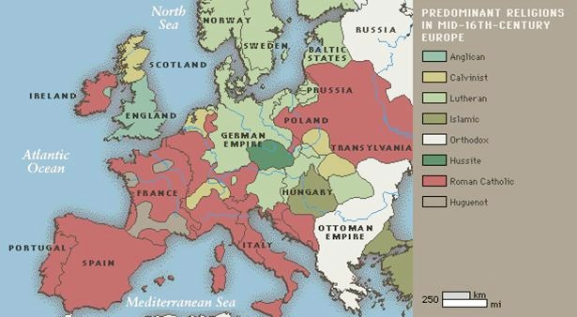
Religious Map of C16th Europe

Slide 7
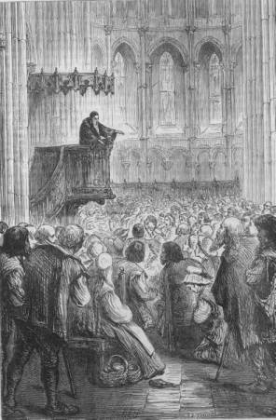
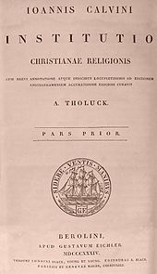
Importance of the Word
Calvin’s Institutes (1536)
Calvin Preaching

Slide 8
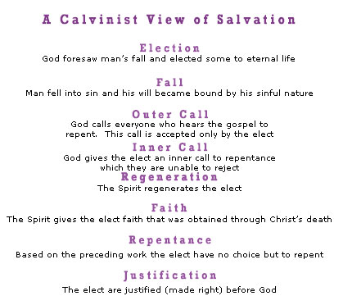
The Appeal of Calvinism

Slide 9
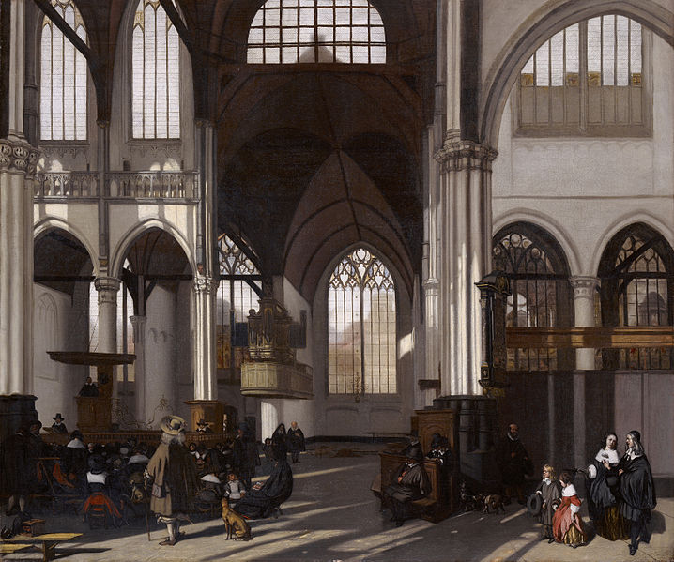
Calvinist Church in Amsterdam

Slide 10
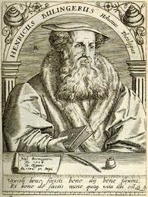
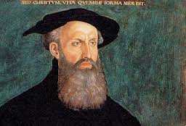
Importance and Influence of Bullinger
Heinrich Bullinger (1504-1575)
Contemporary of Calvin based in Zürich (heir to Zwinglian Reformation)
Major figure in Reformed Church
Second generation focused on unifying movement (1549)
Wrote influential Second Helvetic Confession (1566)
Importance in Germanic territories and re ‘godly magistracy’

Slide 11
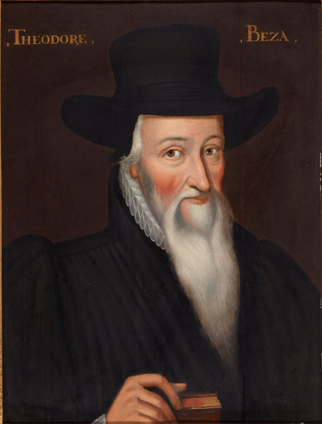
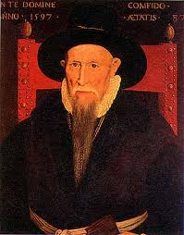
Built on foundations laid by Calvin and headed Calvinist Church for forty years
Theodore Beza (1519-1605)
Fully developed doctrine of double pre-destination
Participated at major events in France (Poissy) and corresponded with key leaders e.g. Henri IV
Also dealt with aftermath of St Bartholomew’s Day Massacre (1572)
Developed theory of resistance which allowed for magistrates to resist an ungodly tyrant
‘Calvinist International’

Slide 12
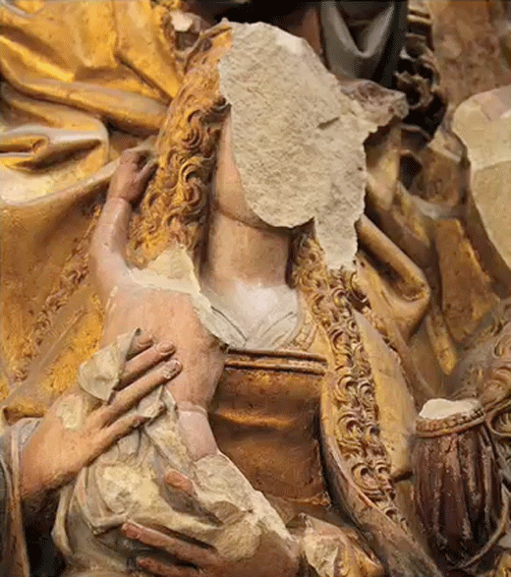
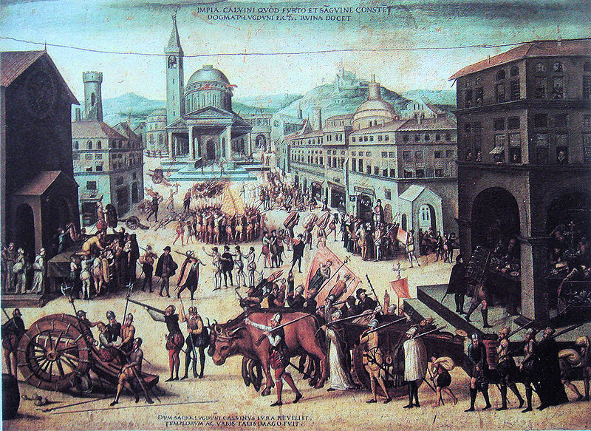
Despite Calvin’s declaration that rulers not be opposed
Calvinism: a creed for rebels?
Iconoclasm (destruction of images): popular & official
Association with political revolt in France, the Netherlands & Scotland
Underground churches (in secret)/ Stranger churches (in exile)
Persecution a sign of election (Calvin condemned covert worship ‘Nicodemism’)
Success > compromise & pragmatism

Slide 13
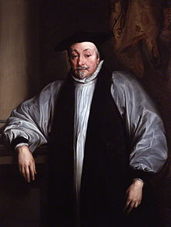
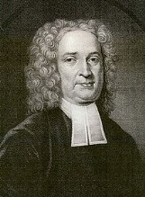
Seventeenth Century
emergence of Arminianism = internal challenge to Reform akin to Jansenist challenge to Catholic Church.
danger of schism over role of free will (cf Jansenist controversy re grace)
Archbishop Laud in England controversial supporter
later influence on Baptists & Methodists
but Puritans remained dominant in New England

