Slide 1
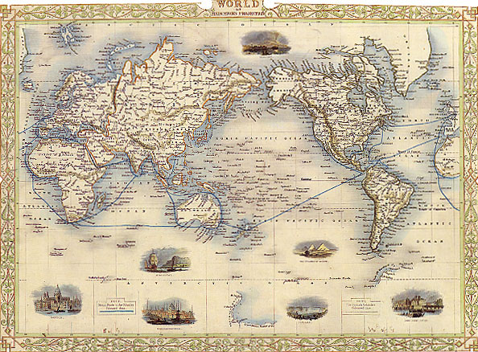
Europe and the World in c. 1750-1800 Giorgio Riello

Slide 2
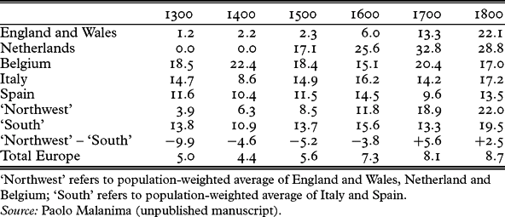
Europe: A. Slow Change

Slide 3
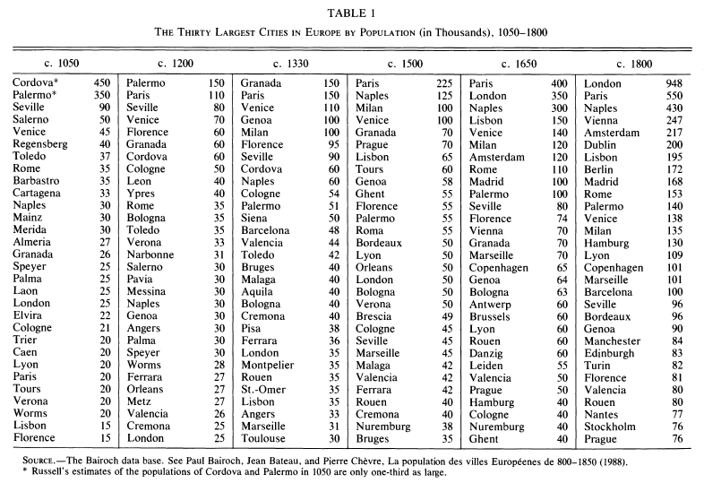

Slide 4
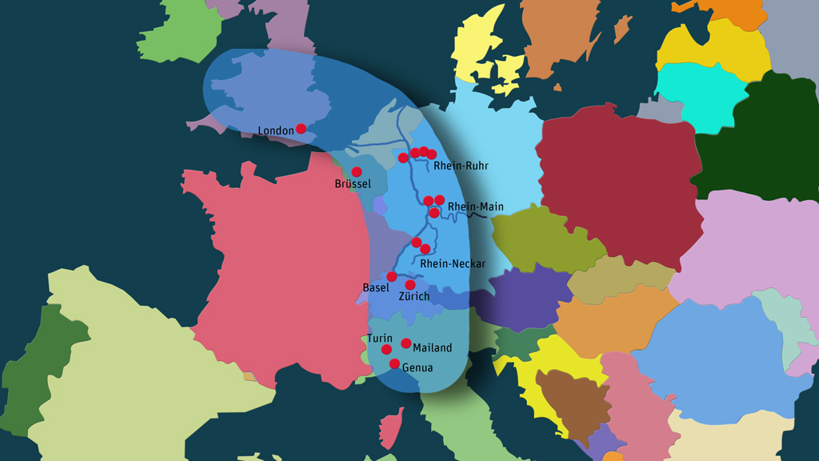
The ‘Blue Banana’

Slide 5
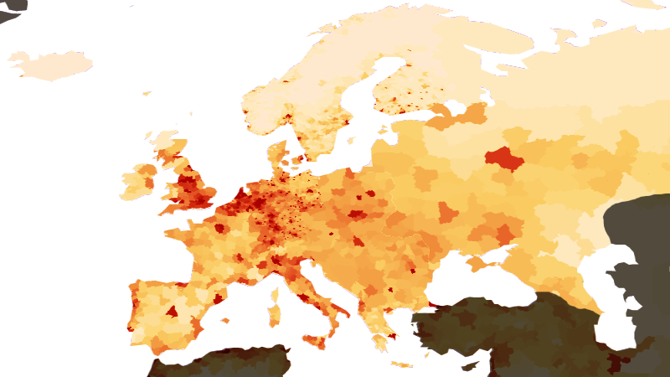

Slide 6
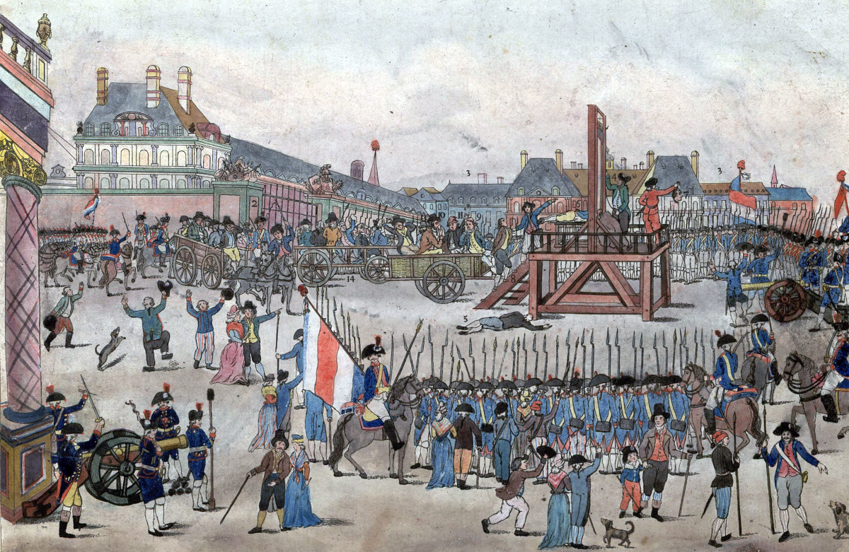
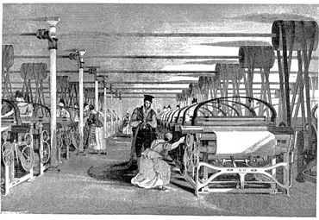
Europe: B. Revolutionary Change

Slide 7
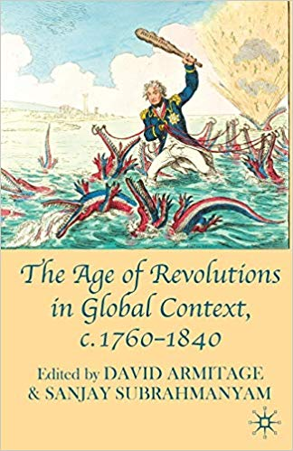
Sparks from Altar of '76: International Repercussions and Reconsiderations of the American Revolution; G.B.Nash
The French Revolution in Global Context; L.Hunt
Revolutionary Exiles: The American Loyalist and French Émigré Diasporas; M.Jasanoff
Iberian Passages: Continuity and Change in the South Atlantic; J.Adelman
The Caribbean in the Age of Revolution; D.C.Geggus
The Dynamics of History in Africa and the Atlantic 'Age of Revolutions'; J.C.Miller
Playing Muslim: Bonaparte's Army of the Orient and Euro-Muslim Creolization; J.Cole
Imperial Repercussions: South Asia and the World, c. 1760-1840; R. Travers
Revolutionary Europe and the Destruction of Java's Old Order, 1808-1830; P.Carey
Their Own Path to Crisis? Social Change, State-Building and the Limits of Qing Expansion, c. 1770-1840; K.Pomeranz

Slide 8
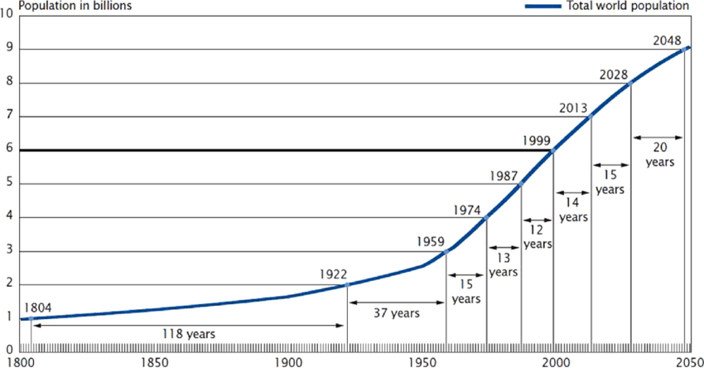
Europe: C. Modernity

Slide 9
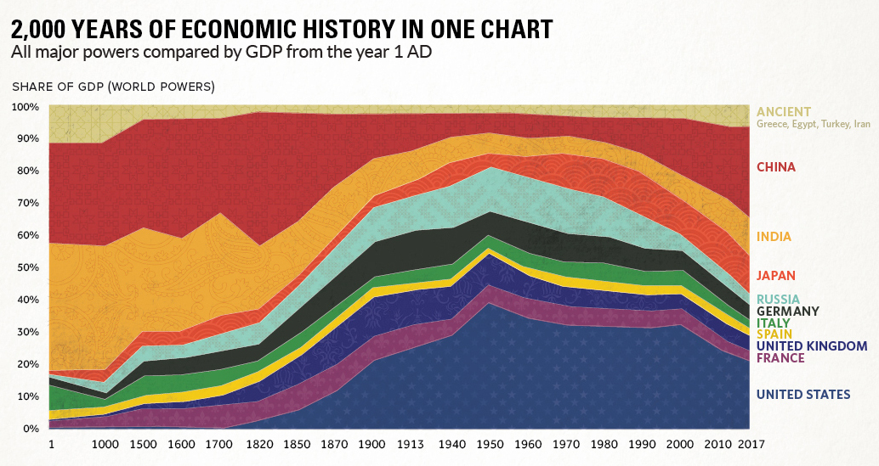

Slide 10
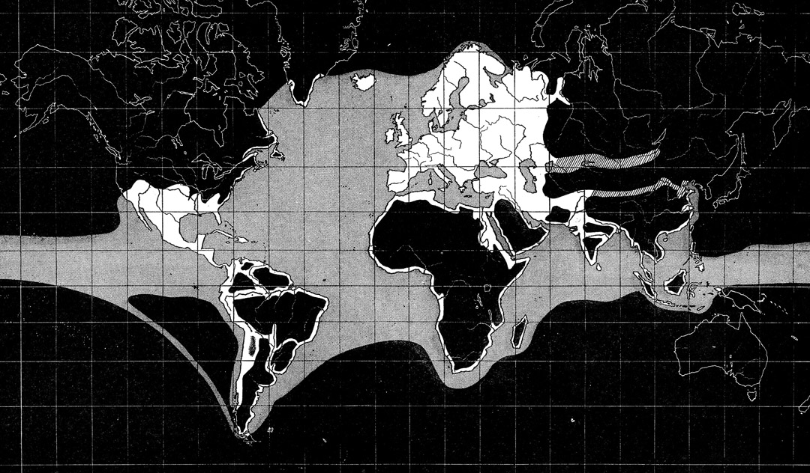
Europe: D. Colonialism, imperialism and Global
The ‘known’ world by Europeans in the early sixteenth century

Slide 11
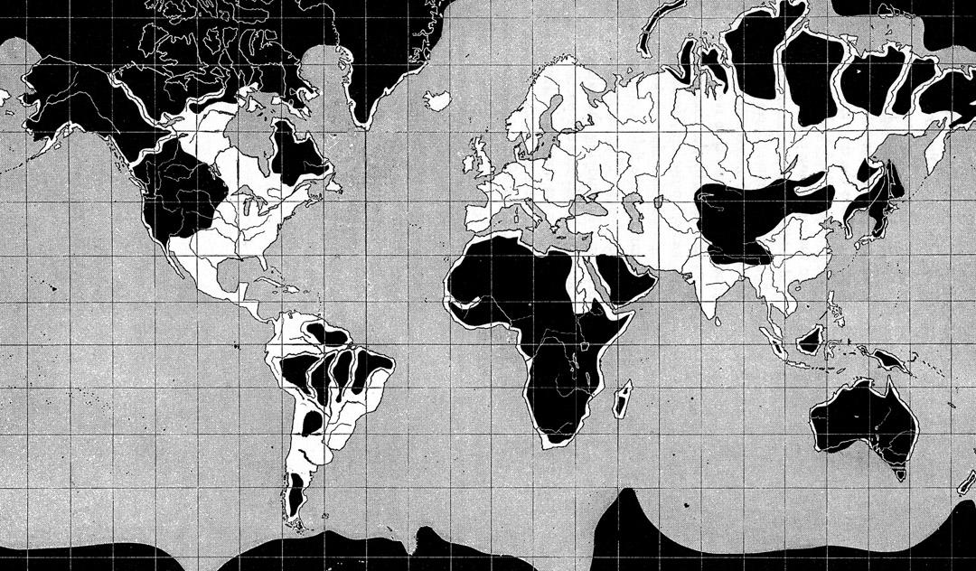
European ‘known’ world in 1800

Slide 12
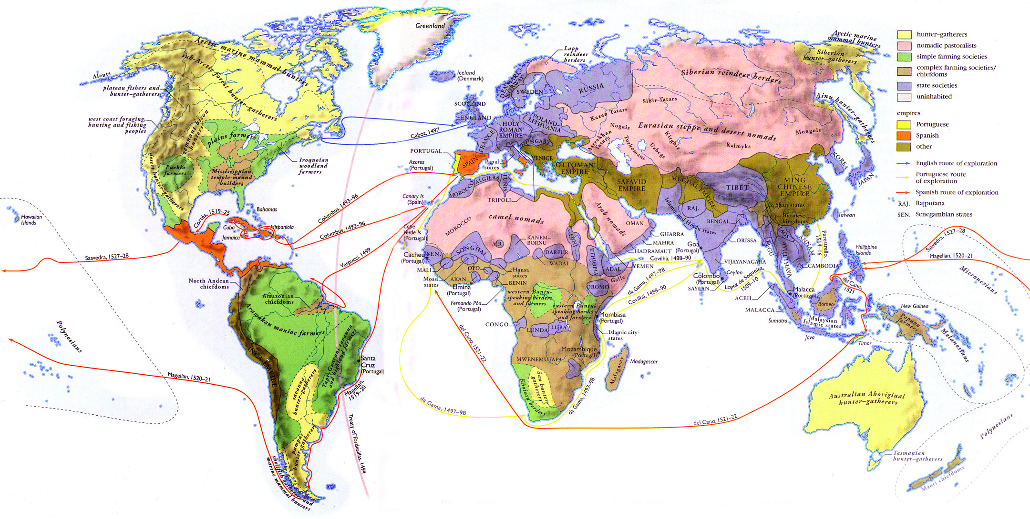
‘Cultures’ in ca. 1530
From: http://iamnotagun.net/iamnotagun.blogspot/Images/2009.01/World%20Maps/Large/1530%20AD%20cultures.jpg

Slide 13
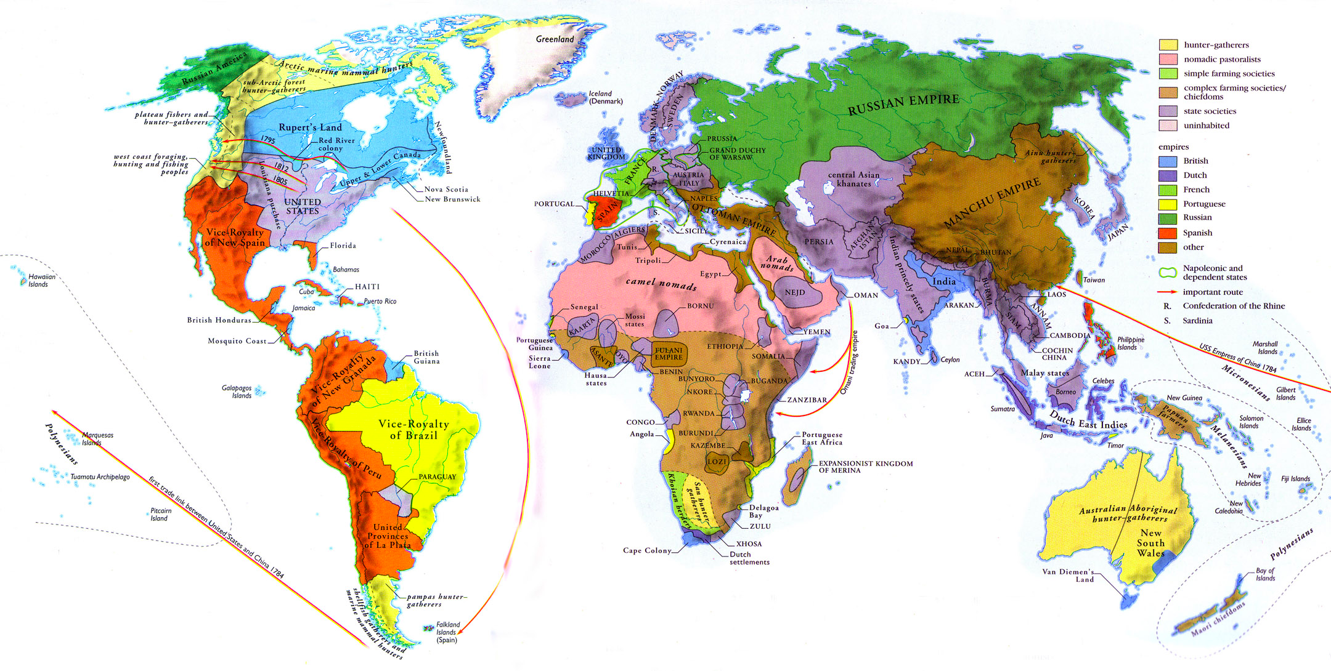
‘Cultures’ in 1820

Slide 14
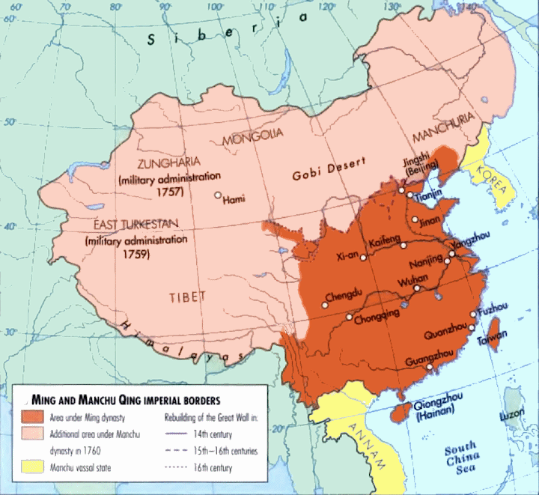
Qing China
(1644-1911)

Slide 15
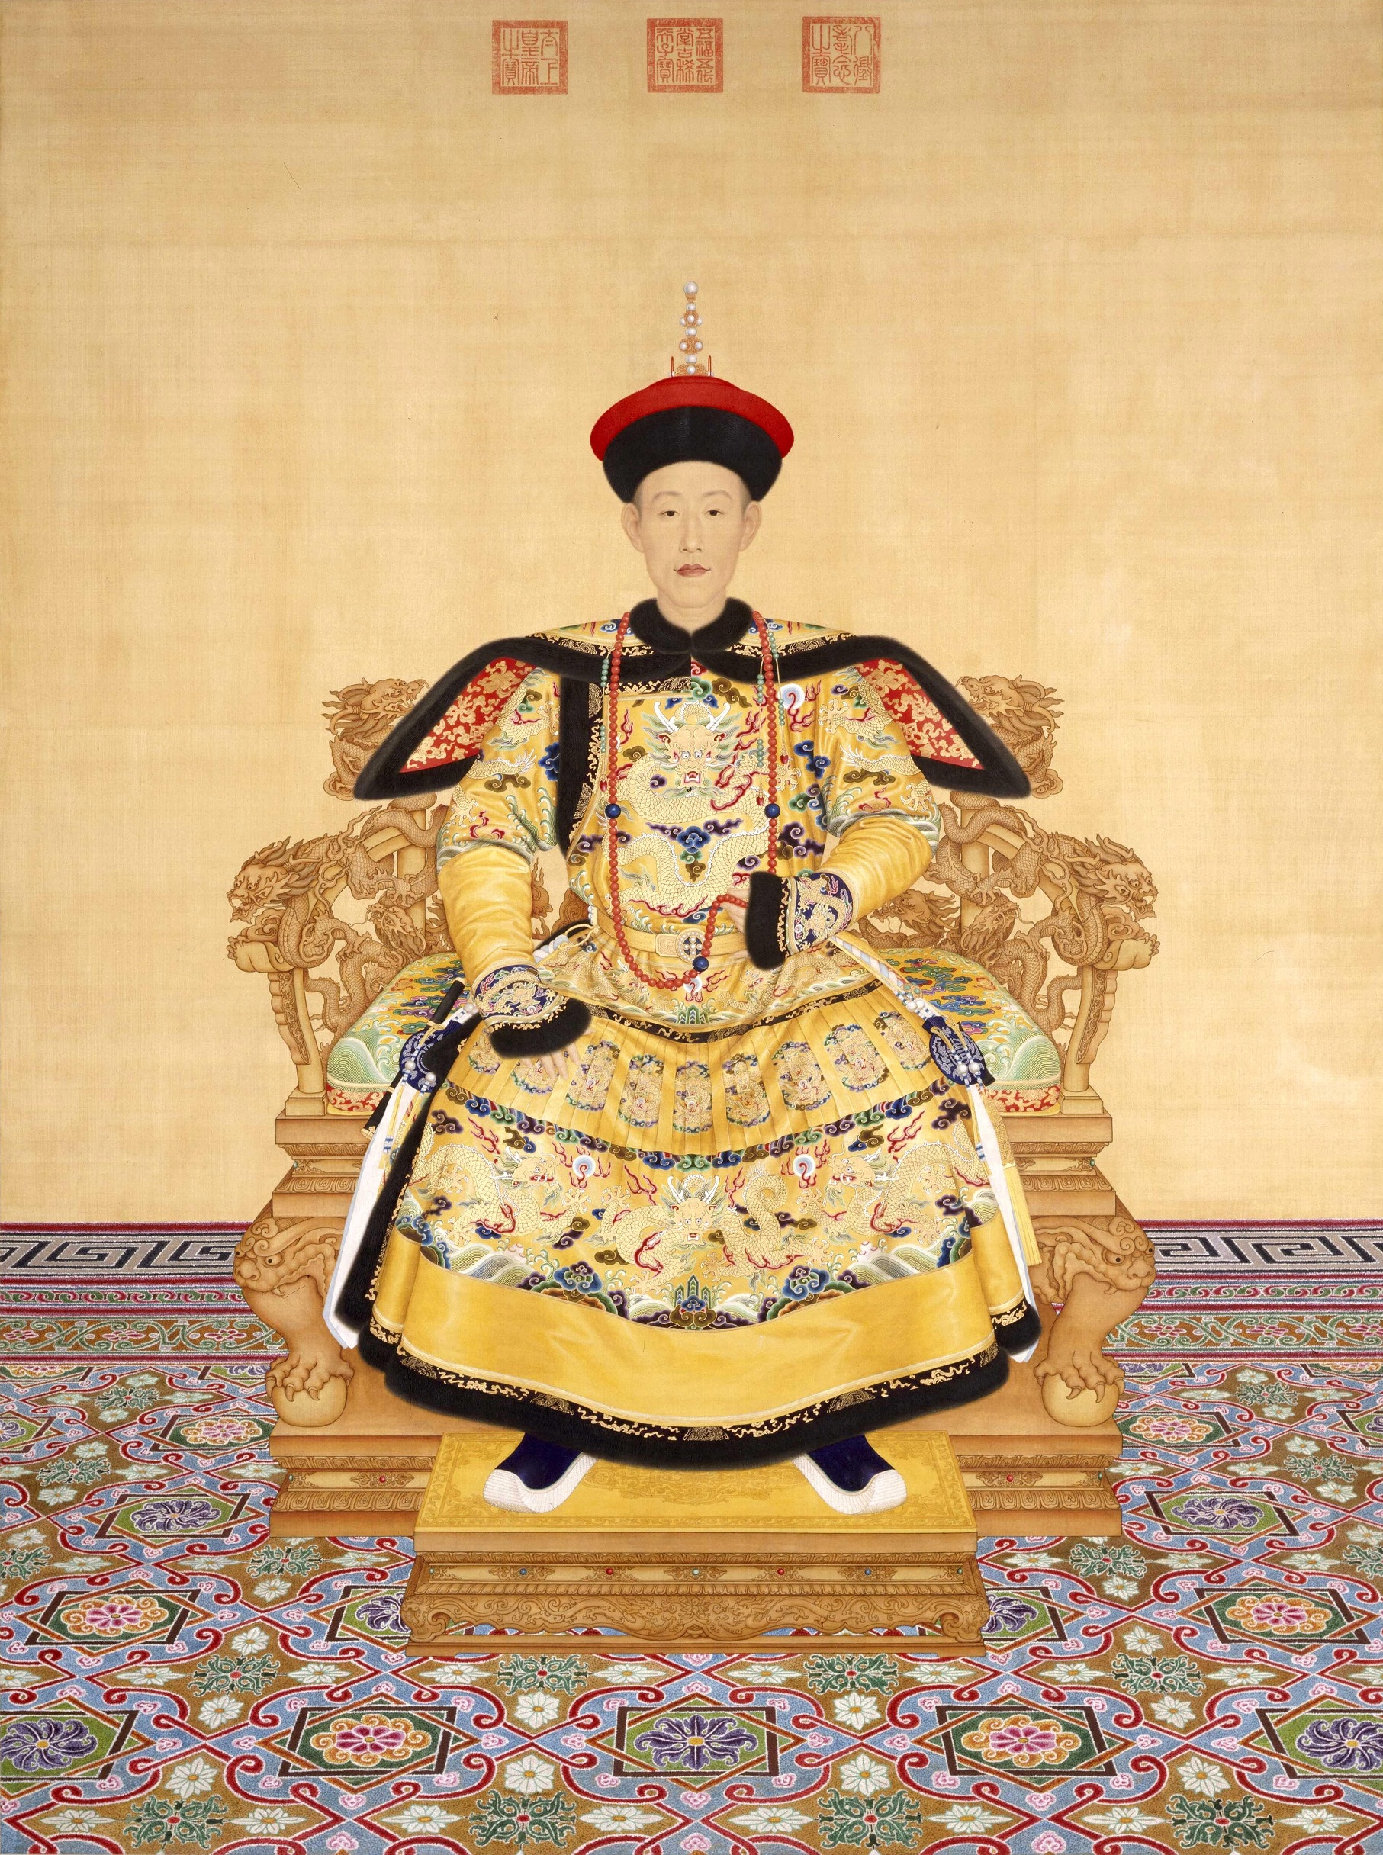
Qing China
Qing dynasty in 1644
Population of 300 million (1 million Manchu)
Trade with the West
No formal ambassadorial relations with West
Turns negative after 1800

Slide 16
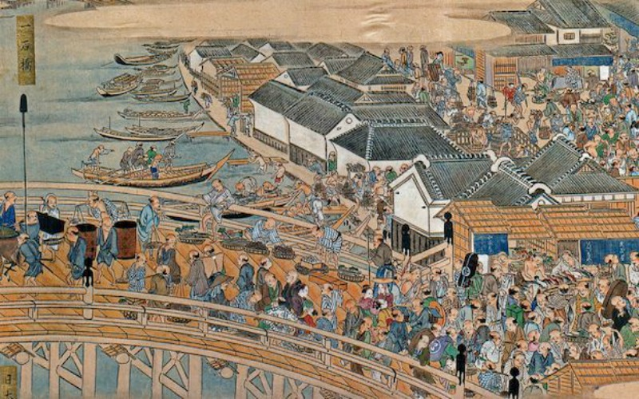
Tokugawa or Edo Japan (1603-1867)
28 million people
Edo and Kyoto
Emperor
Shogun
Daimyo
Deshima and trade with the Dutch
craftsmanship

Slide 17
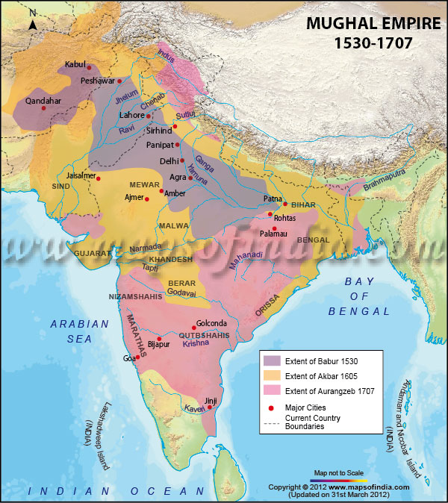
Mughal India (1526-1857)
Various states
All vying for power
EIC in Bengal
opium

Slide 18
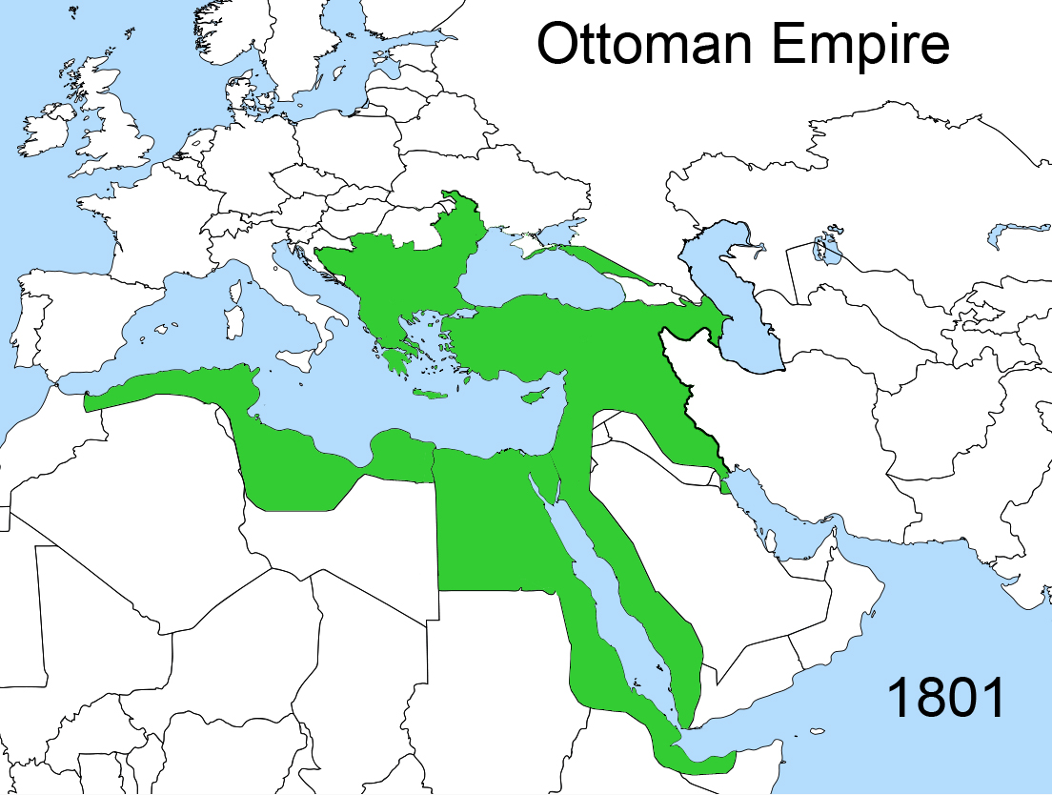
Ottoman empire (1301-1922)
Huge geographical range, but declining
Religious diversity under Muslim authority
Visibility of slaves
Attempt at reforms
Selim III (1761 –1808)
reform-minded Sultan(r. 1789 to 1807)

Slide 19
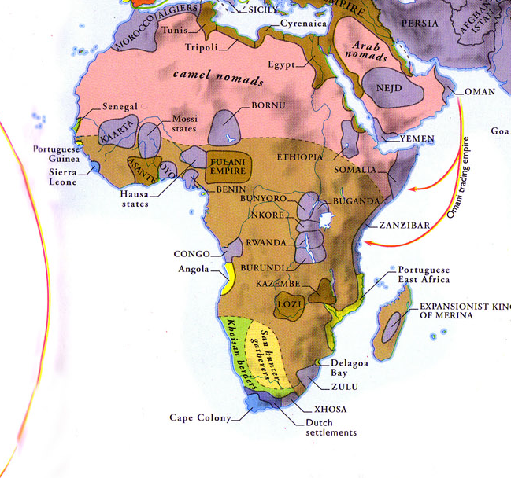
Africa, c. 1820

Slide 20
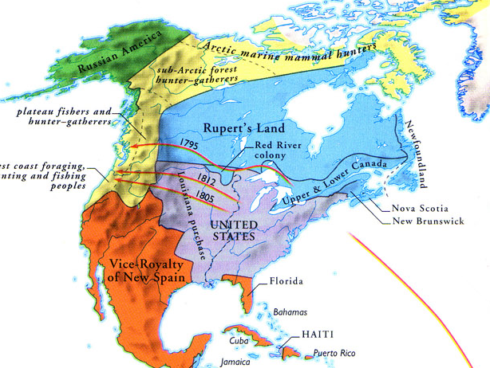

Slide 21
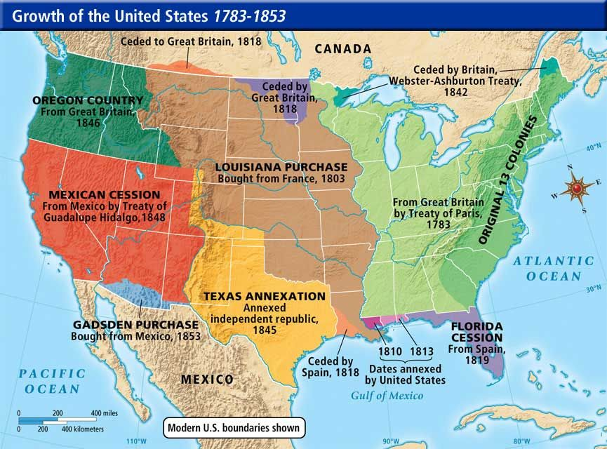

Slide 22
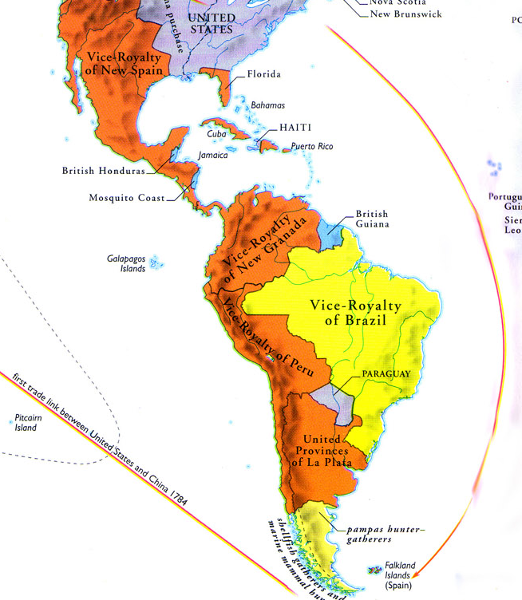

Slide 23
Americas
- most important for Europe
heavily populated by Europeans
continuation of slavery
markets for European commodities
shift from Asia to the Atlantic and the Americas
Change in the 19th century

Slide 24
Europe and the Wider World
impact of Europeans?
Divergence?
Modernity?
exporter of ideas, religion, political forms.

Slide 25


