Slide 1
The European World
European/Global Expansion
Adrianna Catena
Week 4. Tuesday
23 October 2018

Slide 2
Historiography: Old and New
“As the historical record shows, for the last thousand years, Europe (the West) has been the prime mover of development and modernity”
David Landes, The Wealth and Poverty of Nations: Why Some are So Rich and Some are So Poor (London: 1998), p. xxi.
“By emphasizing sea-based empires, historians [… ] have depicted a thriving Europe, future ruler of the world, propelled by an admirable curiosity, building its economic might and displaying its military strength across great oceans”
C. K. Woodworth, ‘Ocean and Steppe: Early Modern World Empires’, Journal of Early Modern History, 11/6 (2007), p. 505.

Slide 3
Afro-Eurasia, c.1500

Slide 4
Ottoman Expansion1300-1683

Slide 5
Giancarlo Casale, The Ottoman Age of Exploration (Oxford: 2010), p. 81.

Slide 6
Russian expansion, 1300-1795

Slide 7
Qing Expansion1644-1760

Slide 8
Safavid and Mughal expansion,1500-1700

Slide 9
Afro-Eurasia, c.1500

Slide 10
Early Atlantic Exploration, 14th-15th Centuries

Slide 11
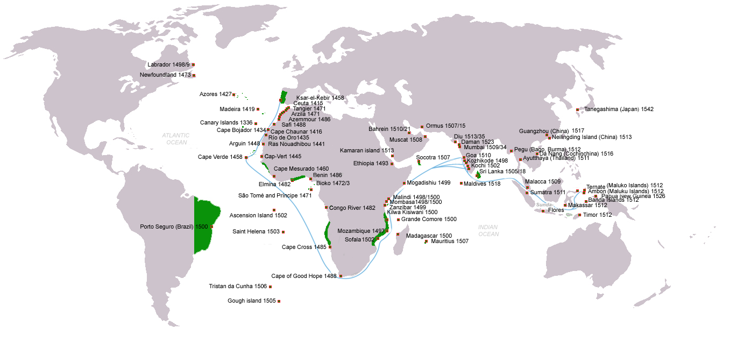
Portuguese Atlantic expansion
1415-1505

Slide 12
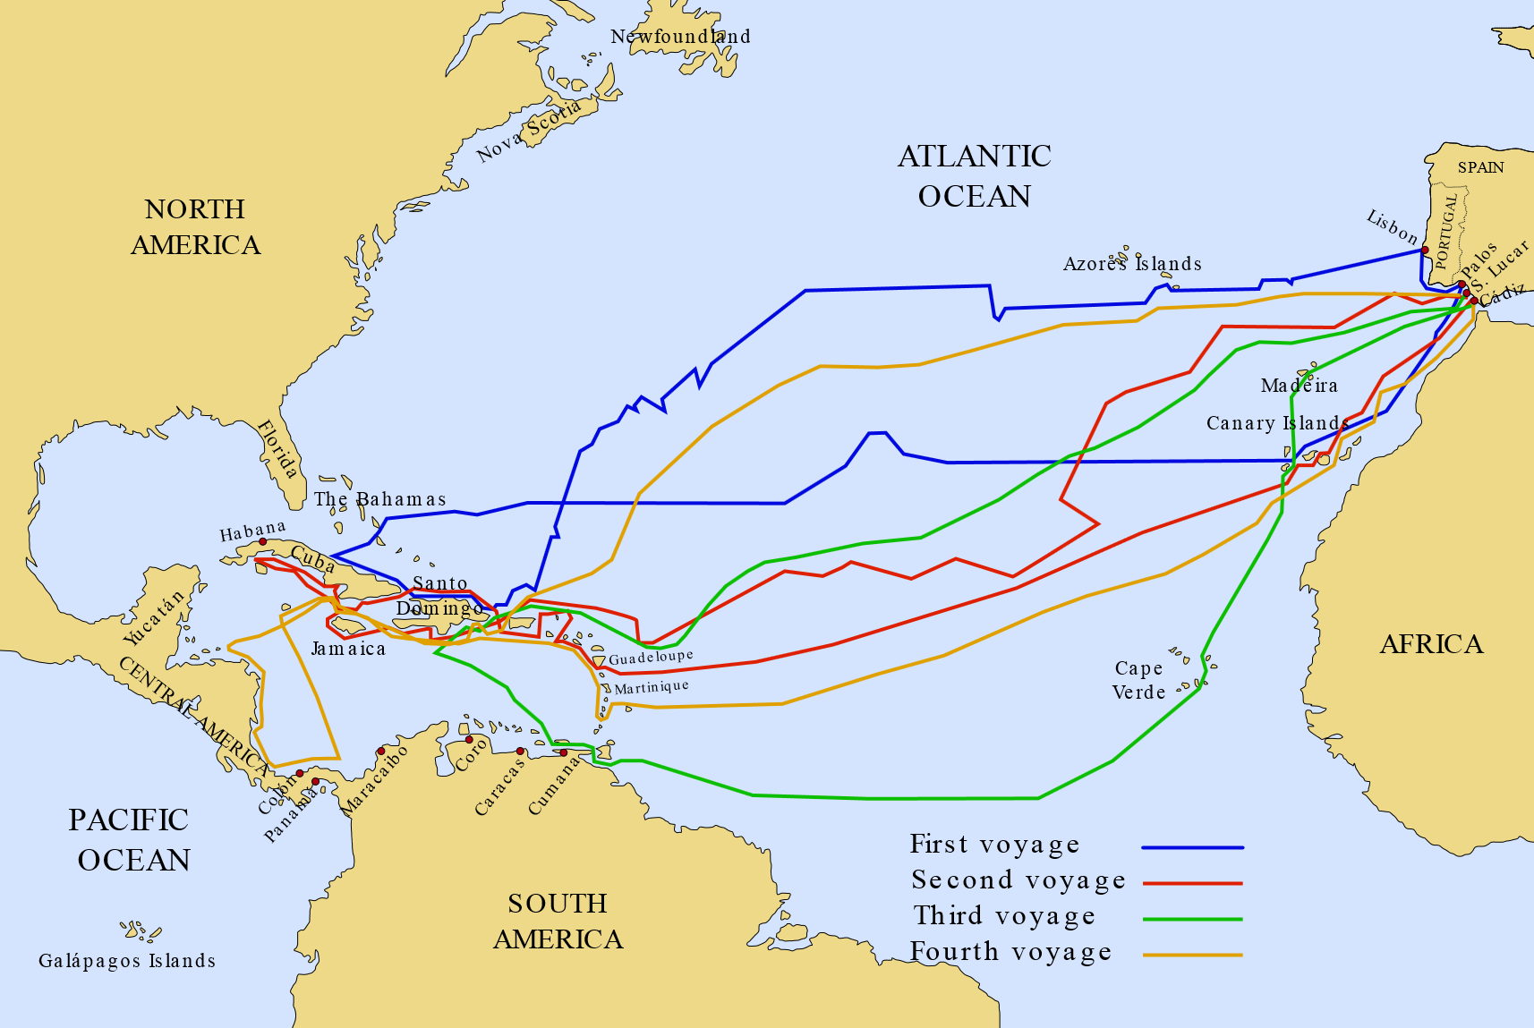
Voyages of Christopher Columbus, 1492-1503

Slide 13
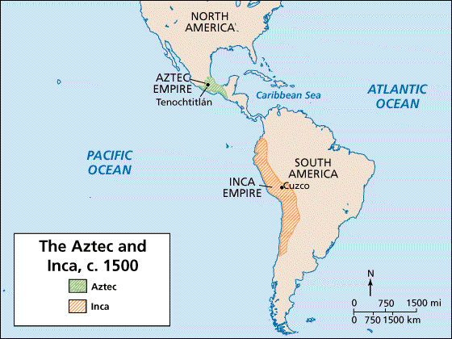
Pre-conquest America

Slide 14
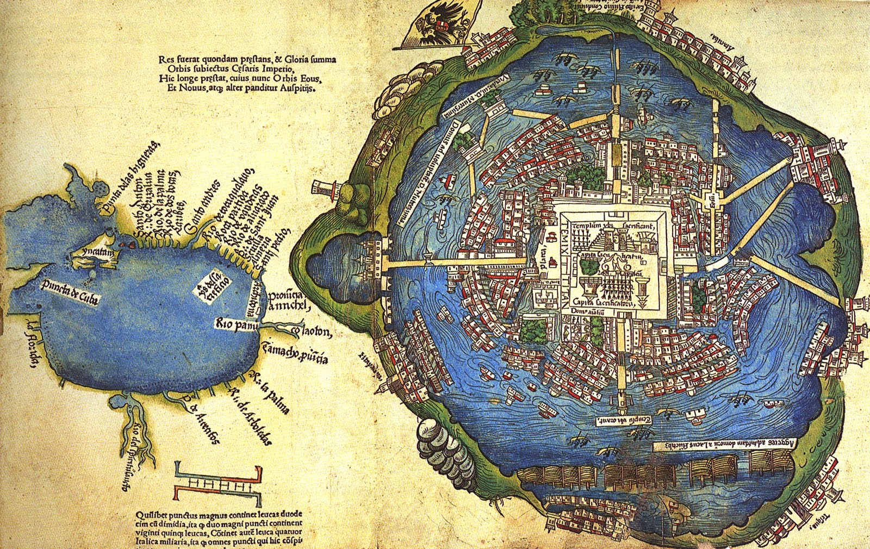
Tenochtitlán and the Gulf of Mexico, unknown artist, 1524 [based on map presented to Cortés by Mexica peoples in 1519-1521. Library of Congress

Slide 15
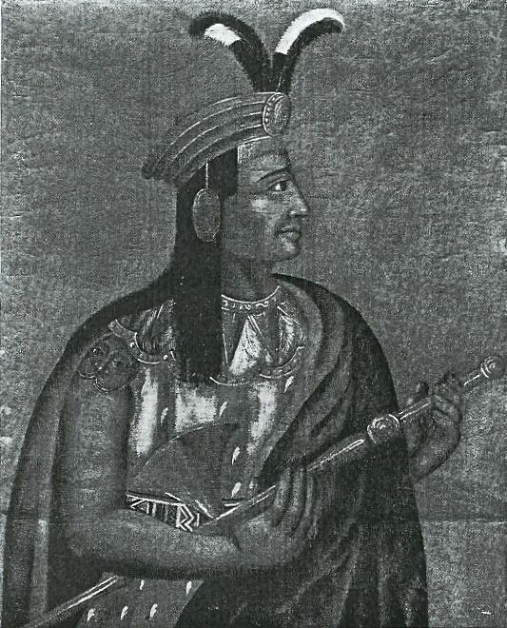
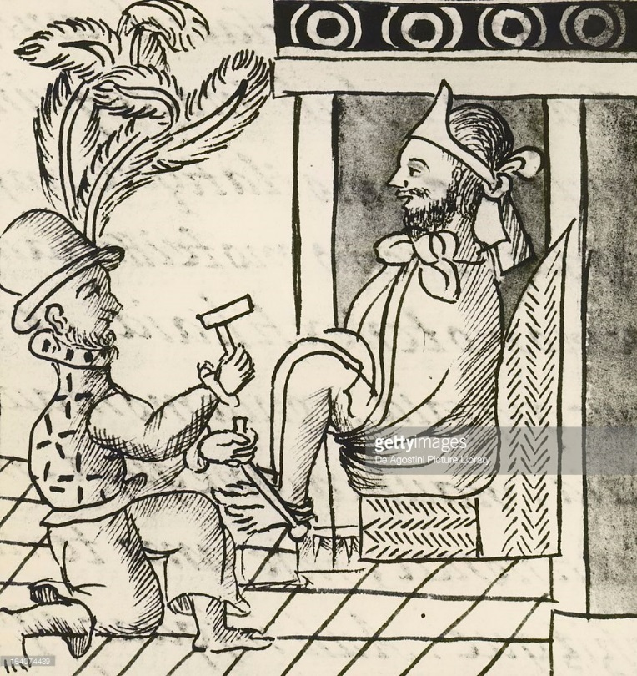
Moctezuma II (c. 1466-1520), last Aztec ruler of Tenochtitlan. Captured and killed during Spanish conquest of Mexico led by Hernán Cortés
Atahualpa (c. 1502-1533), last sovereign Inca emperor. Captured and executed during Spanish conquest of Peru led by Francisco Pizarro

Slide 16
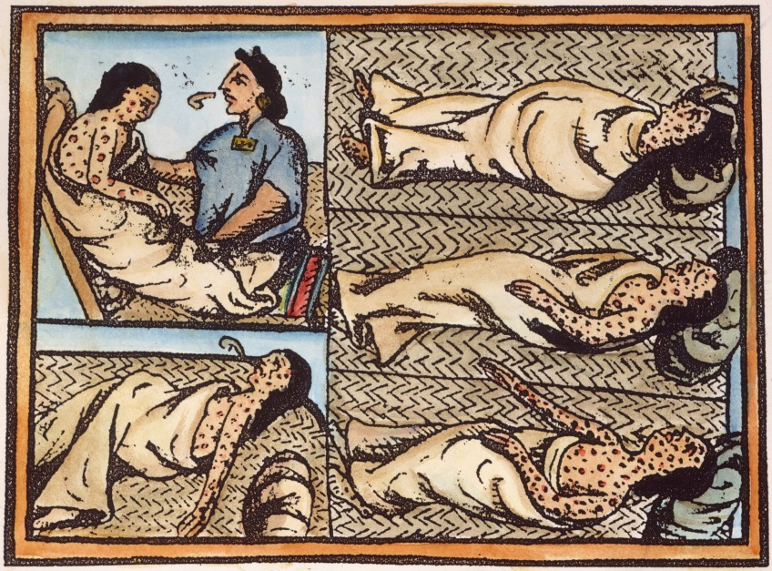
Guns, Germs, and Steel

Slide 17
Manila Galleons (Acapulco-Manila), 1565-1815

Slide 18
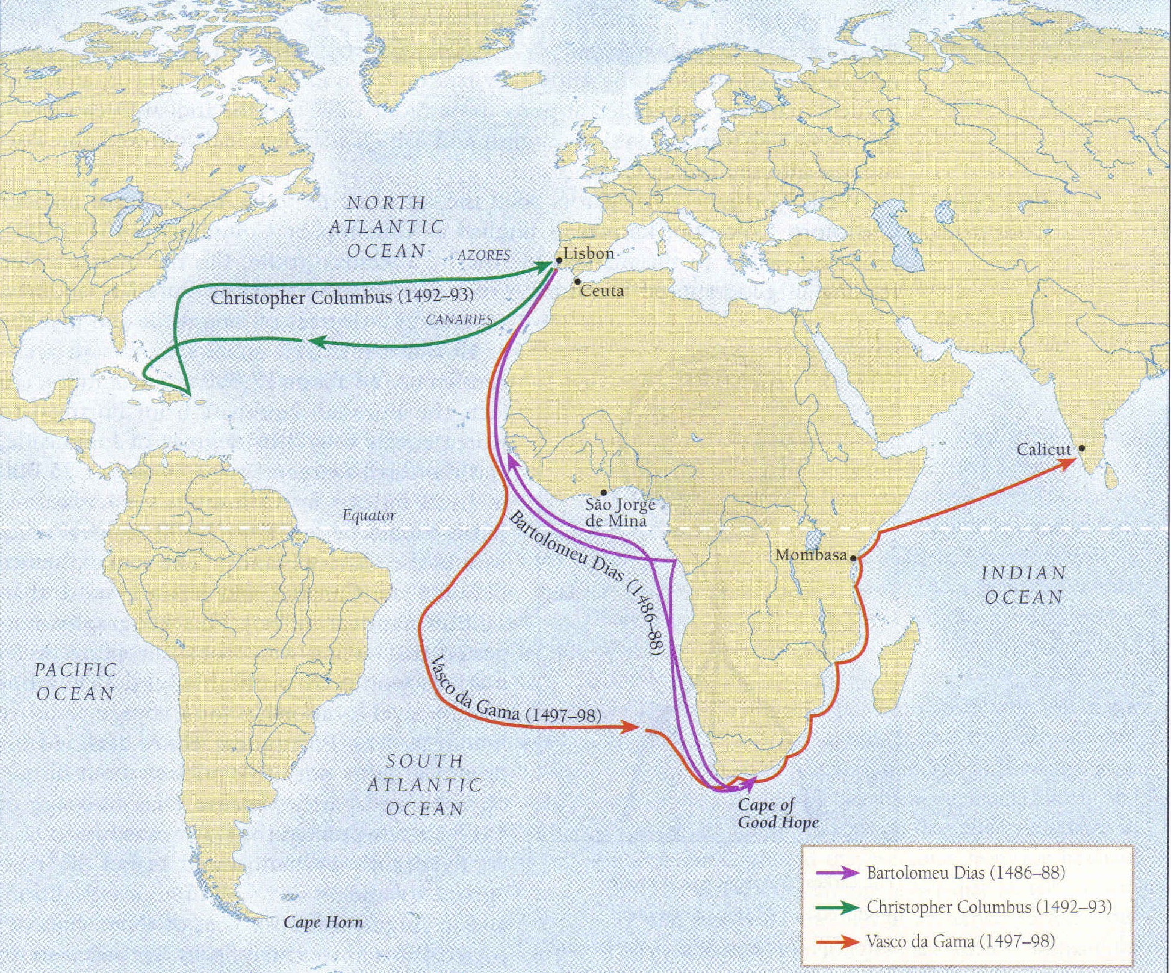
Vasco da Gama’s voyage to India (1497-98)

Slide 19
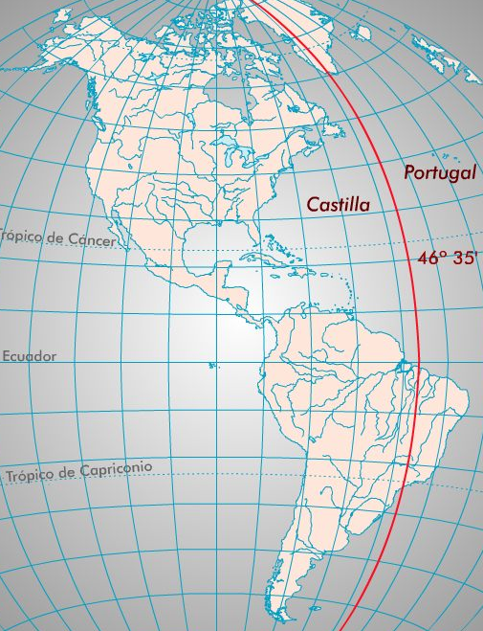
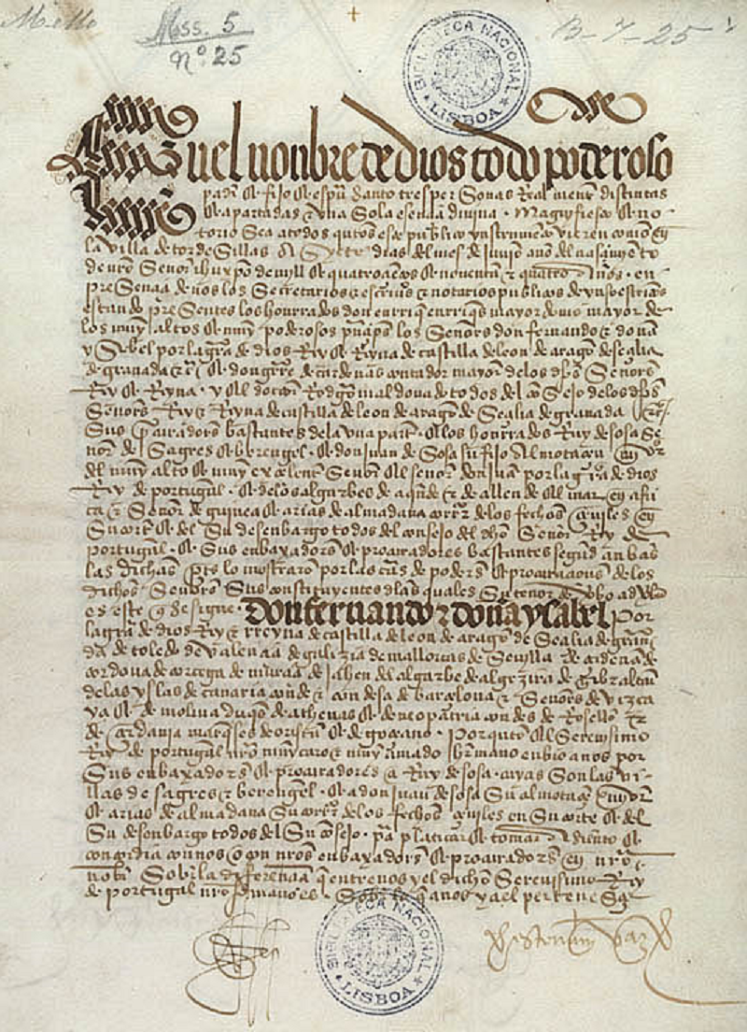
Treaty of Tordesillas (1494)

Slide 20
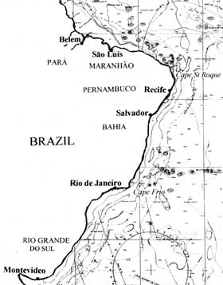
Brazil
(1500-)

Slide 21
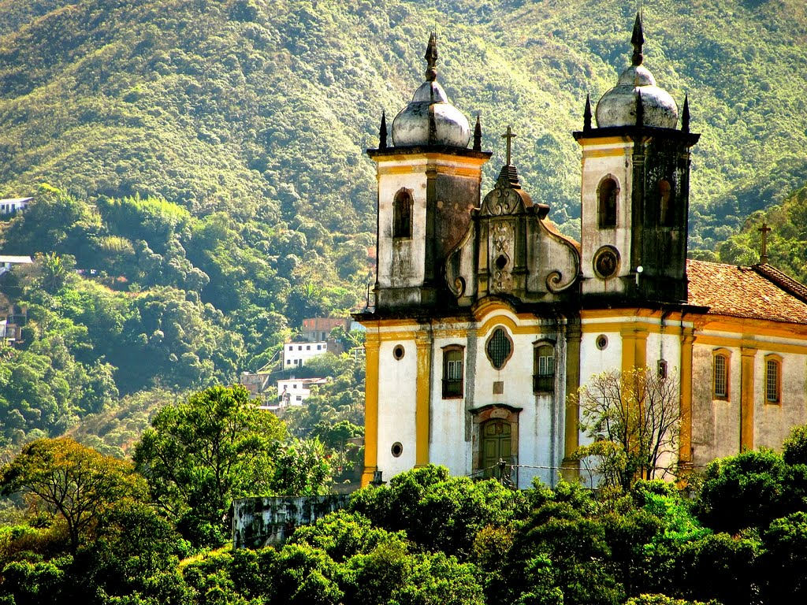
SLAVE IMPORTS | British Caribbean | Spanish Americas | Brazil | Totals
1501-1600 | 0 | 241,917 | 34,686 | 276,603
1601-1700 | 405,117 | 313,301 | 910,361 | 1,628,779
1701-1800 | 2,139,819 | 175,438 | 2,210,931 | 4,526,188
1801-1900 | 218,475 | 860,589 | 2,376,141 | 3,455,205
Totals | 2,763,411 | 1,591,245 | 5,532,119 | 9,886,775

Slide 22
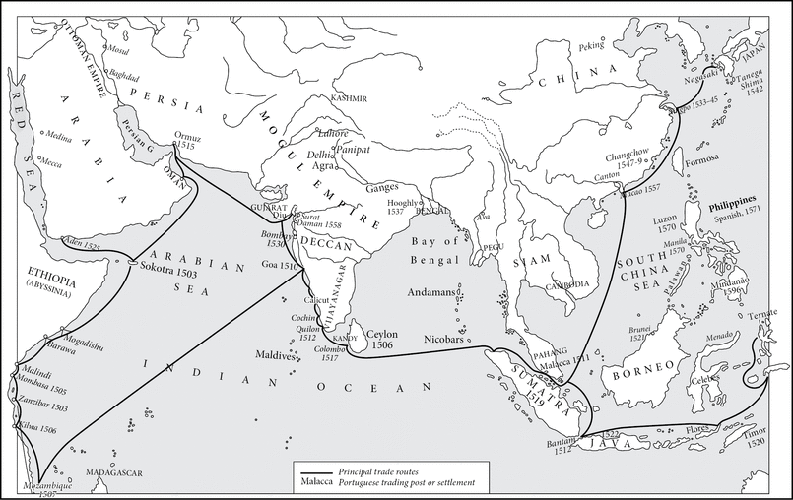
Asia (1498-) - The Estado da Índia
Portuguese Asia c. 1580

Slide 23
The Portuguese Empire

Slide 24
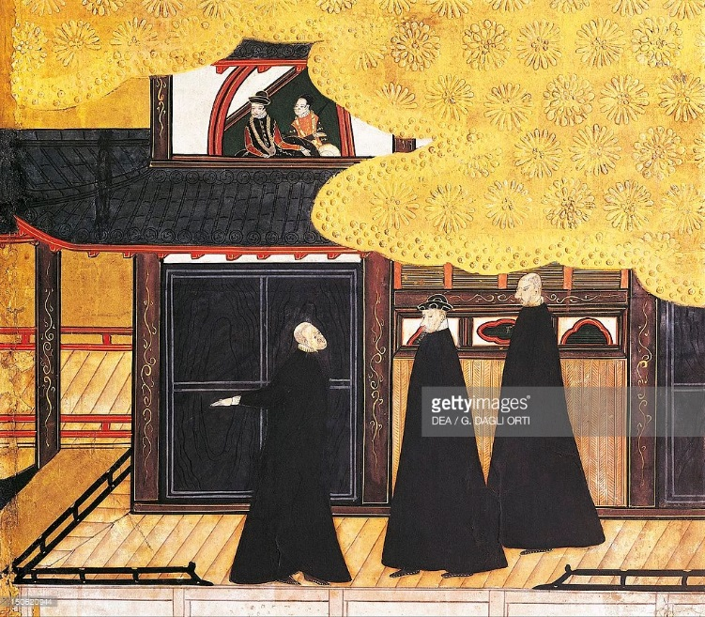
Jesuits in Asia
Detail from ‘The Portuguese arriving in Japan’
Paper screen
Japan, 17th century

Slide 25
17th century Decline of the Estado
Limits of expansion: encounter with expansionist Safavid and Mughal empires (loss of Hormuz 1621)
The Dutch VOC and WIC take over Northeast Brazil (1630-1654), Elmina (1637), Malacca (1641), Sri Lanka (1658)
“The successive loss of many key geographical positions […] eventually led to the gradual degradation of the network and the transformation of the Portuguese Empire in Asia into a handful of disjointed and dispersed territorial holdings”
– Jorge Flores, ‘The Iberian Empires, 1400 to 1800’ (2015)
“[Portuguese empire was] less a territorial empire than an imperial framework within which trade, plunder, settlement and local alliances jostled and interacted with one another’
-J.H. Elliott, ‘Iberian Empires’ (2015)

Slide 26
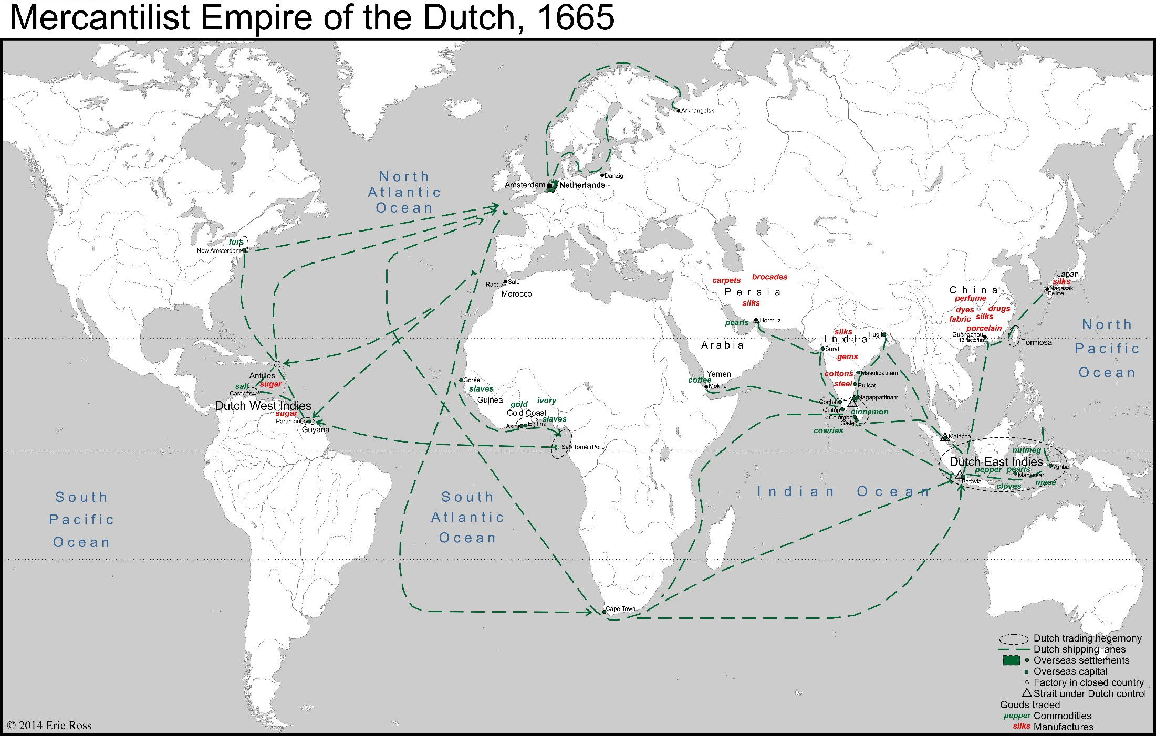
17th century Dutch Expansion

Slide 27
European commercial enterprise in Asia

Slide 28
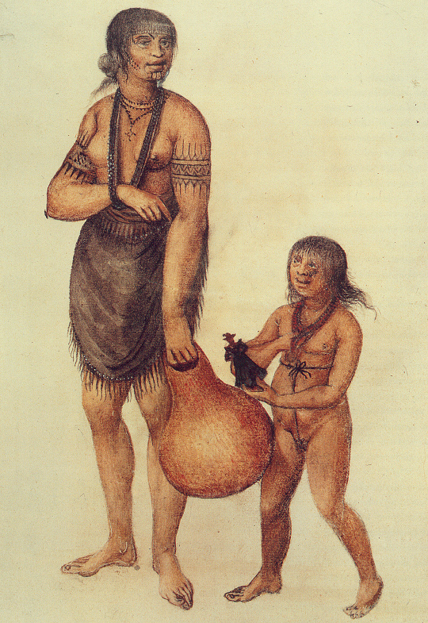
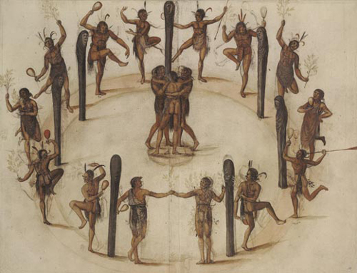
North America
Algonquians as painted by John White in 1585, British Museum

Slide 29
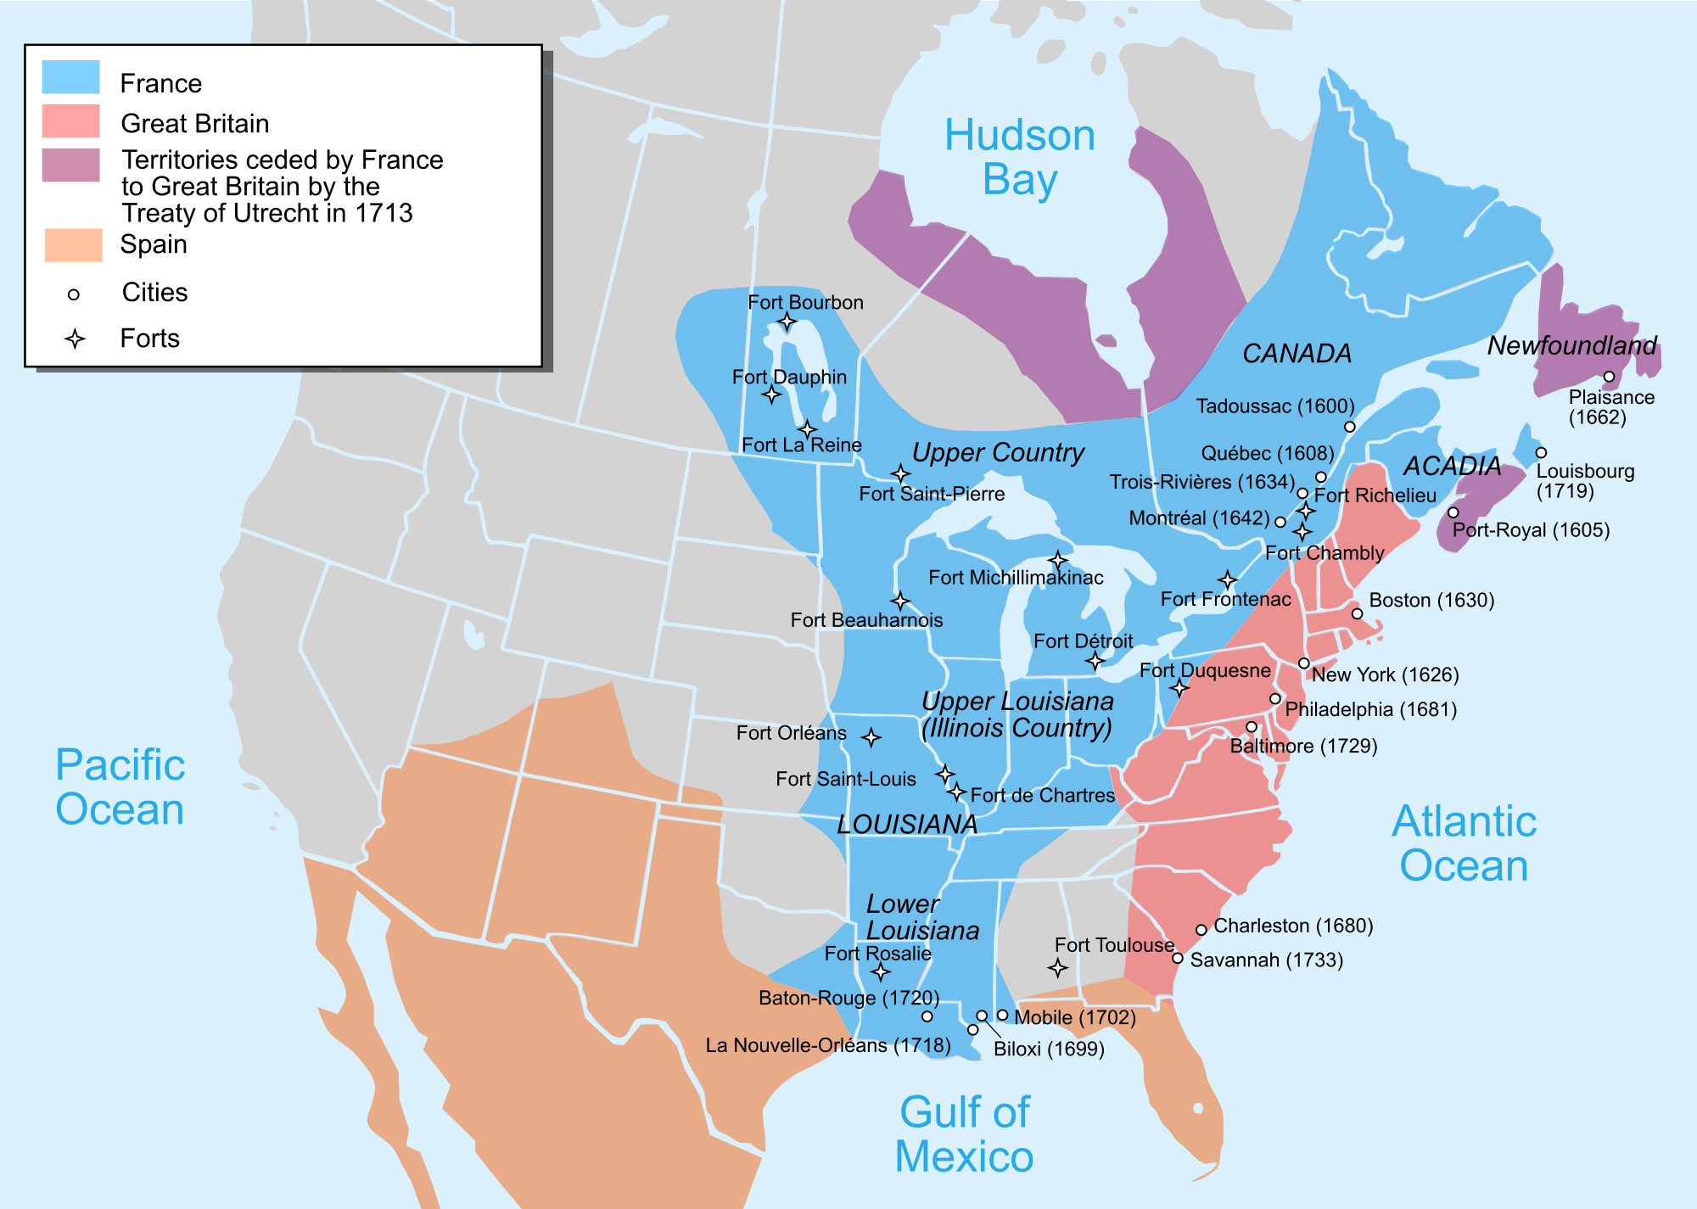
North America ca 1750

Slide 30
Global Connections and Consequences
Creation of global networks of sea-lanes
Global exchange of biological species
Forging of early capitalist global economy
Large-scale migrations
Demographic fluctuations
Intensified exploitation of natural environments
Technological diffusions
Consolidation of centralized states
Imperial expansion
Global cultural exchanges
Jerry H. Bentley, ‘Early Modern Europe and the Early Modern World’ (2007)

Slide 31
Conclusions
Europe shaped and was shaped by the wider early modern world
Early modern expansion multi-centric: not just a western European story
Mix of commerce, proselytization, state and private ventures
Maritime networks of trading stations vs. large territorial domains and colonial plantations
Expansion an uneven process yet with long-lasting consequences for all areas of world

