Slide 1
Global Commodities and Exchange
Anne Gerritsen
1 November 2018

Slide 2
Commodities
Exchange
Global

Slide 3
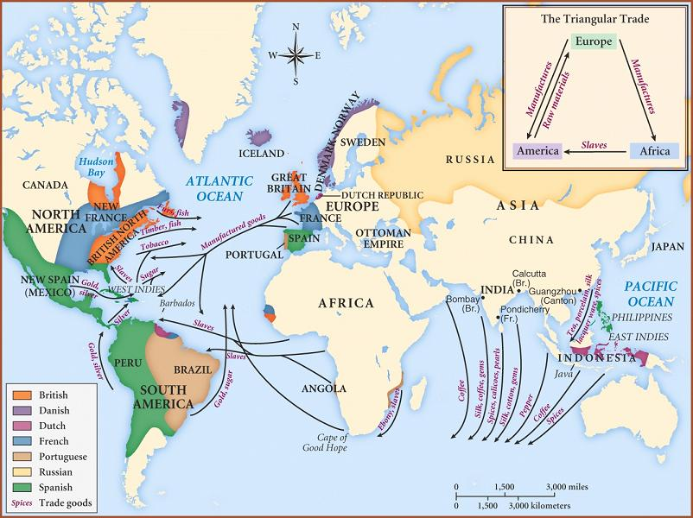

Slide 4
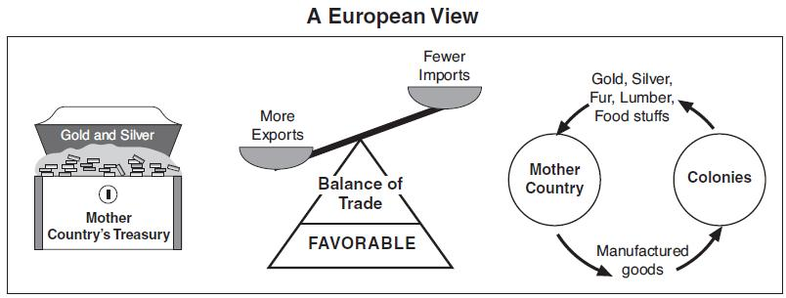

Slide 5
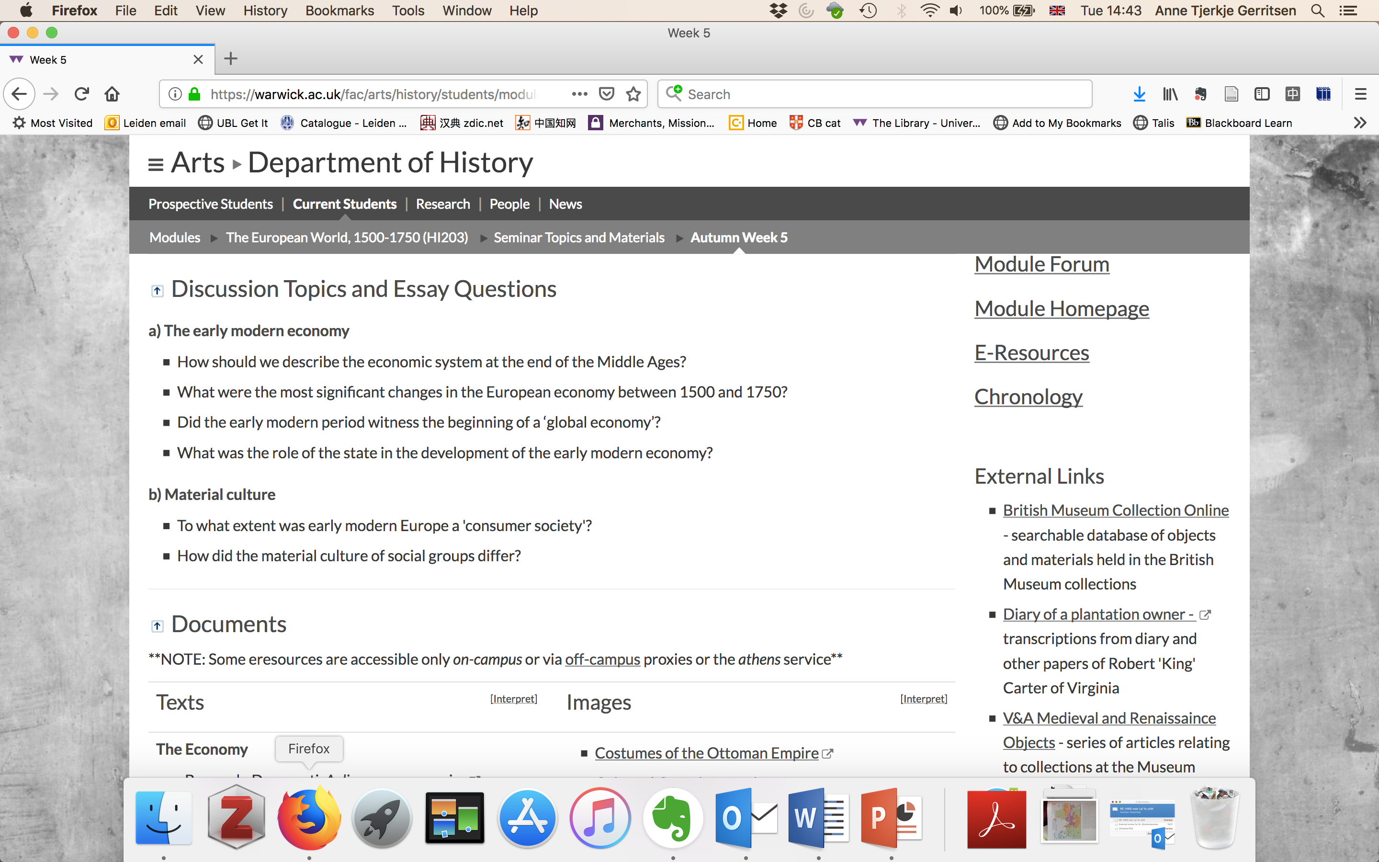

Slide 6
Commodities
Exchange
Global
Material culture
    Material goods?
    Meanings assigned to material objects
Consumer society
The material culture of social groups

Slide 7
Points made in this lecture
  Economy expanded to become global
  as a consequence consumption also became global
  Commodities became global and material culture became global
  Not limited to the elite and not limited to luxuries

Slide 8
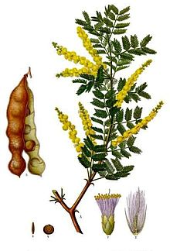
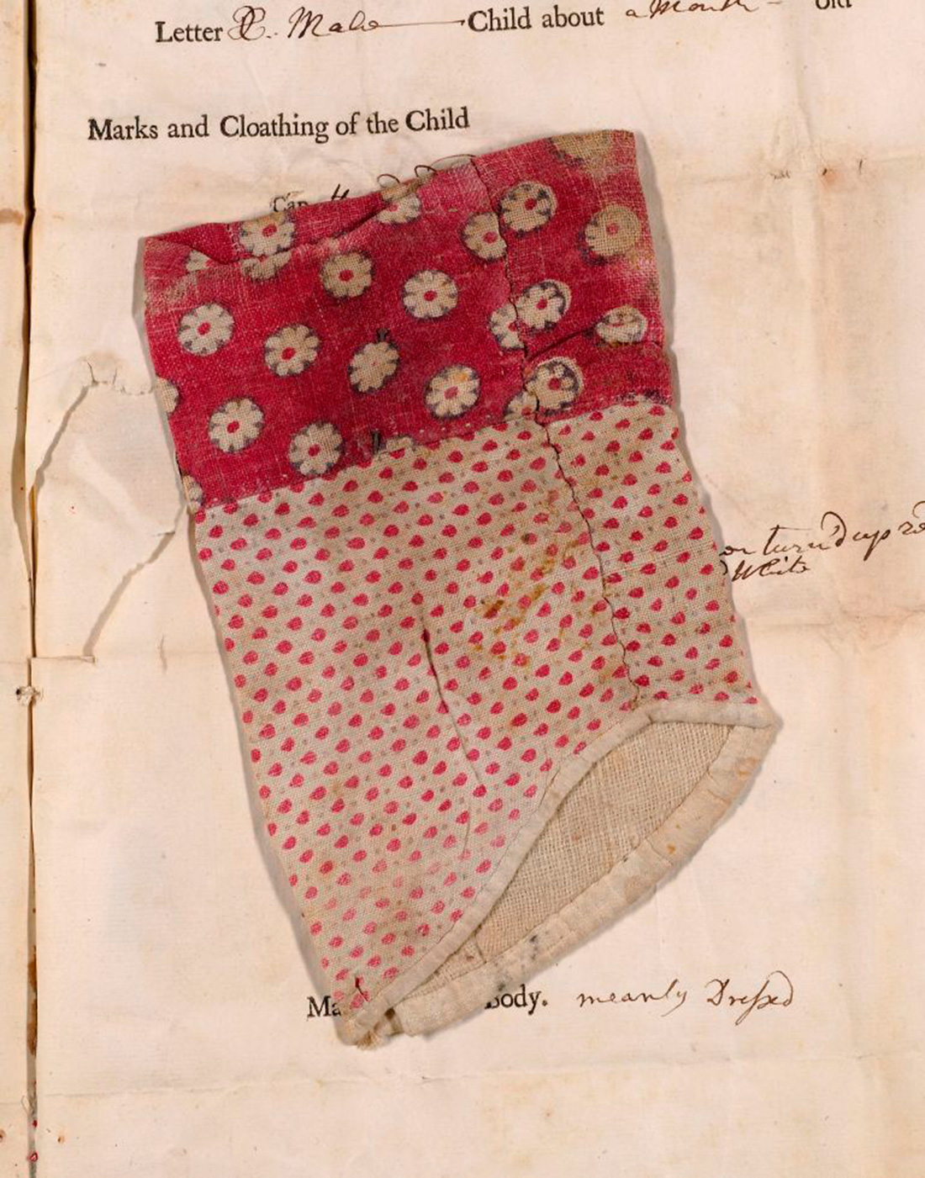
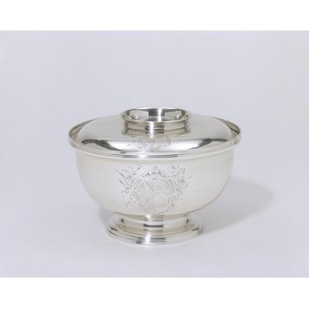

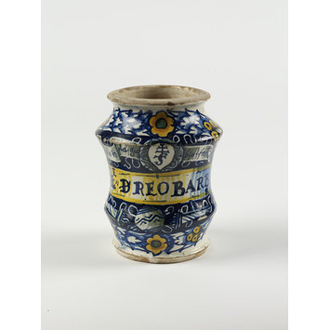
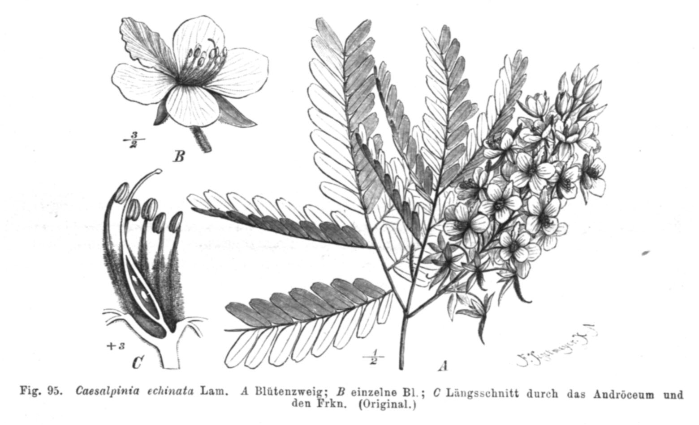

Slide 9
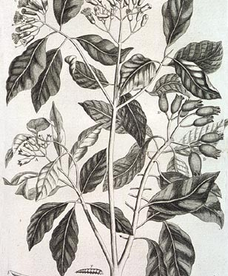
spices
nutmeg

Slide 10
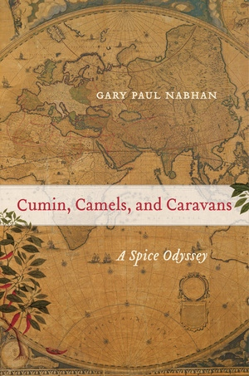


Slide 11
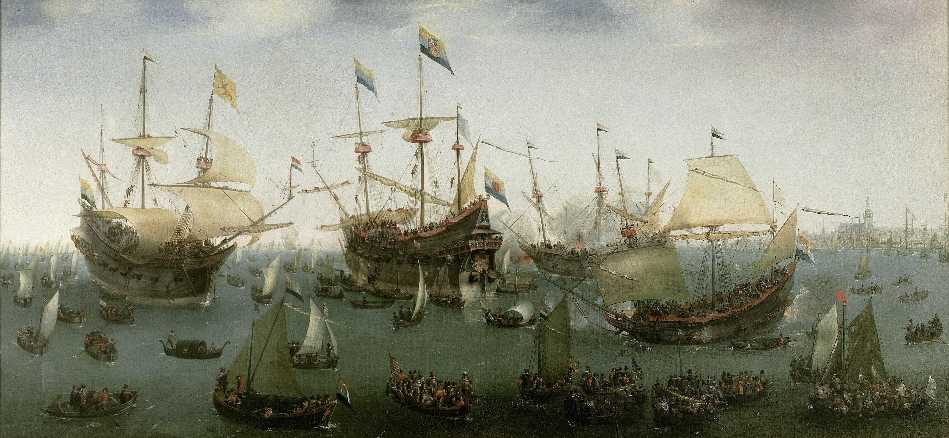

Slide 12
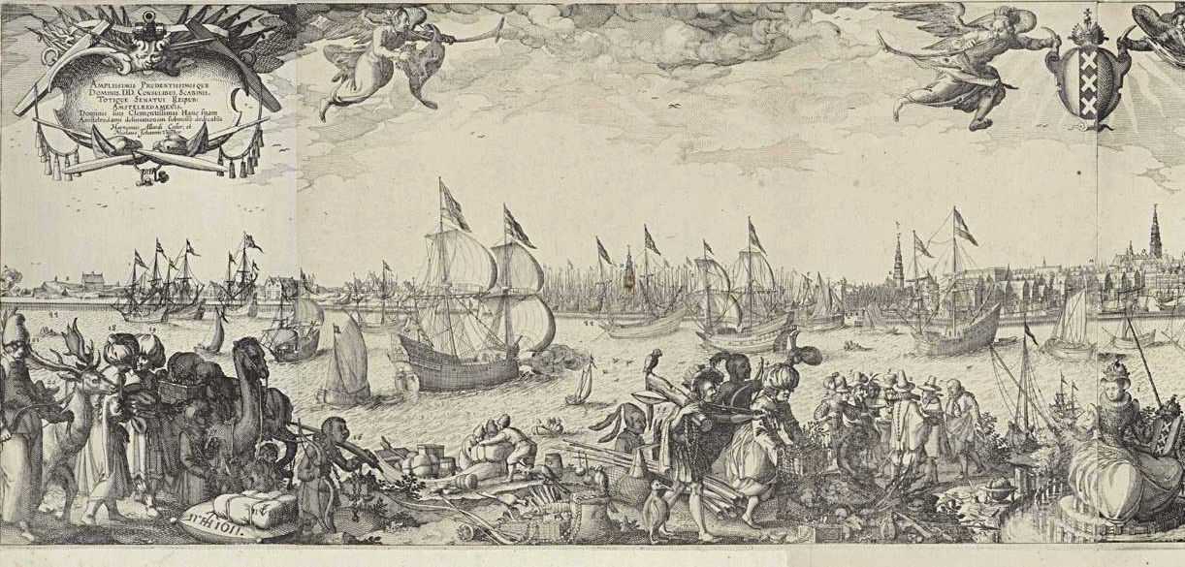

Slide 13
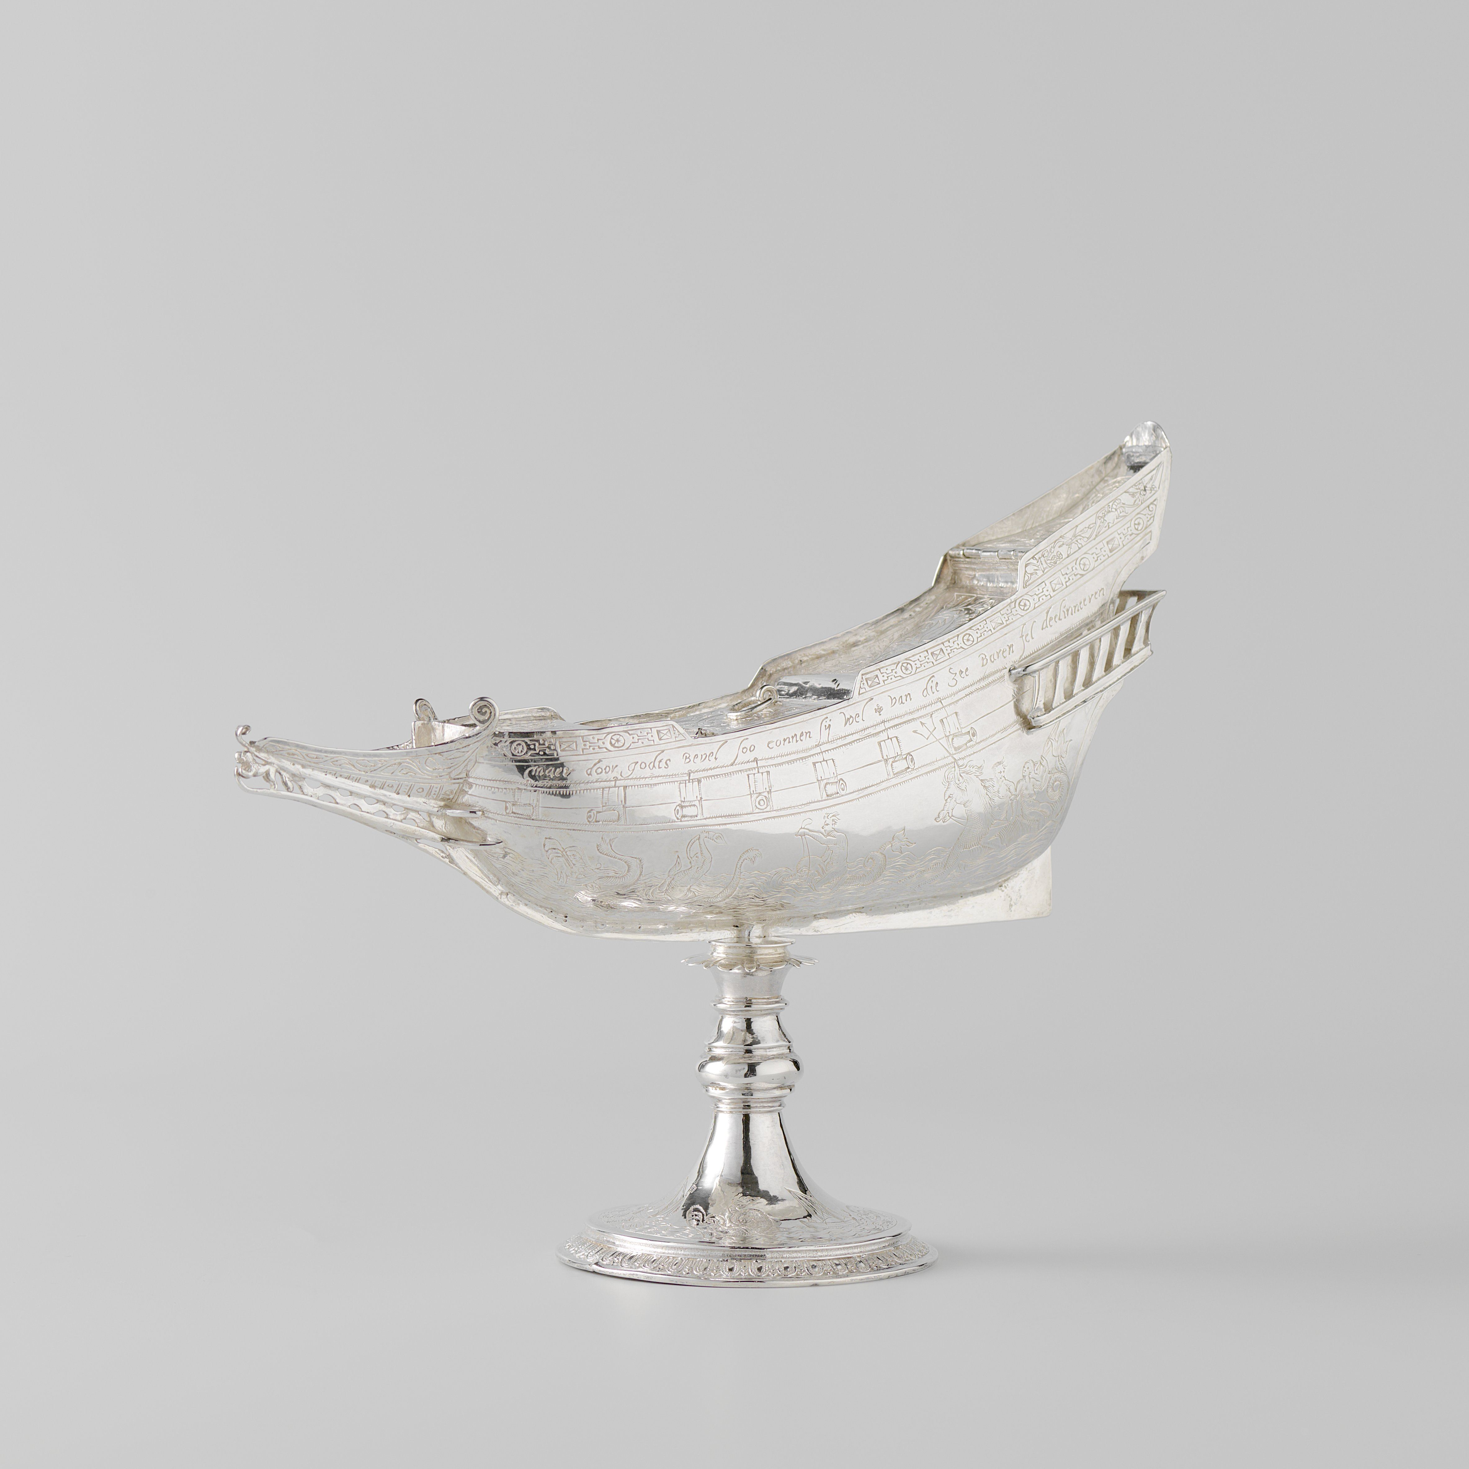
Silver spice box,
Middelburg
Rijksmuseum
BK-NM-4313

Slide 14
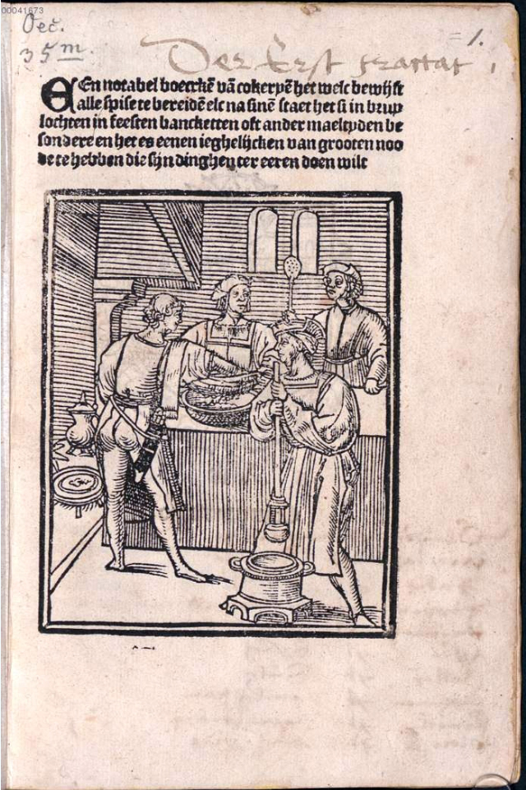
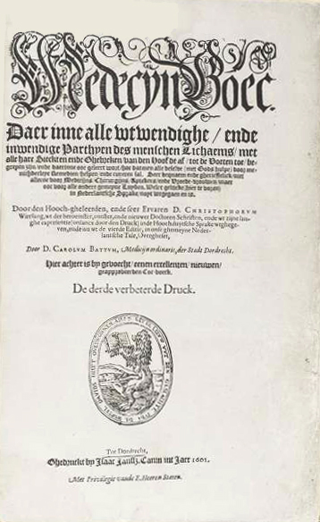
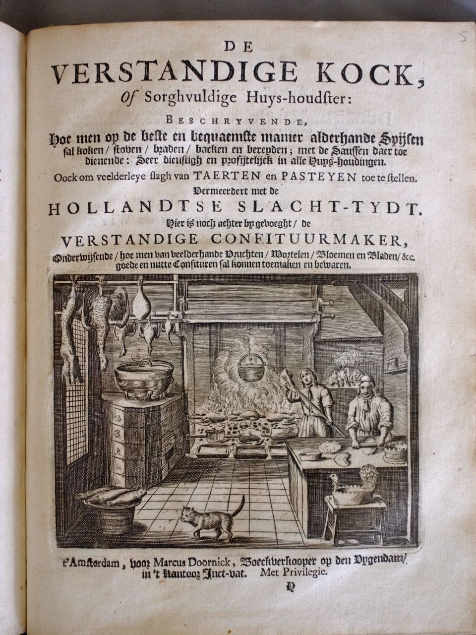

Slide 15
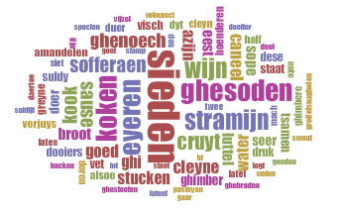
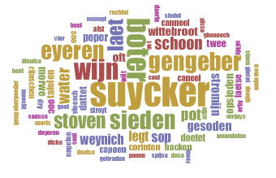
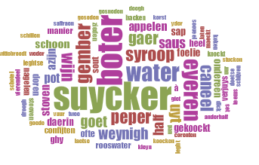
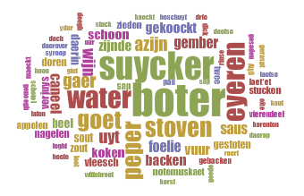
1514
1593
1667
1669

Slide 16
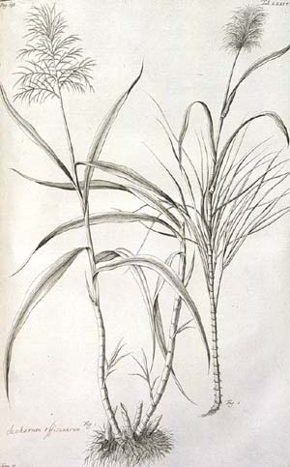
SUGAR
Sugar
G.E. Rumphius,
Amboinsche Kruidboek,
Amsterdam 1741,
Book II, tabula I

Slide 17
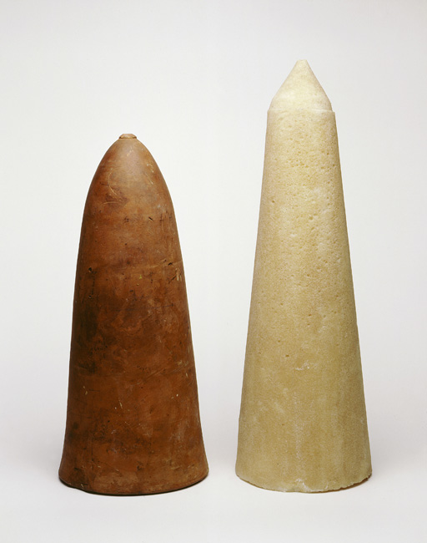
Sugar mould and leaf
Slave plantations of the Caribbean produced sugar, which was then made into sugar loaves by using moulds in London.
Museum of London

Slide 18
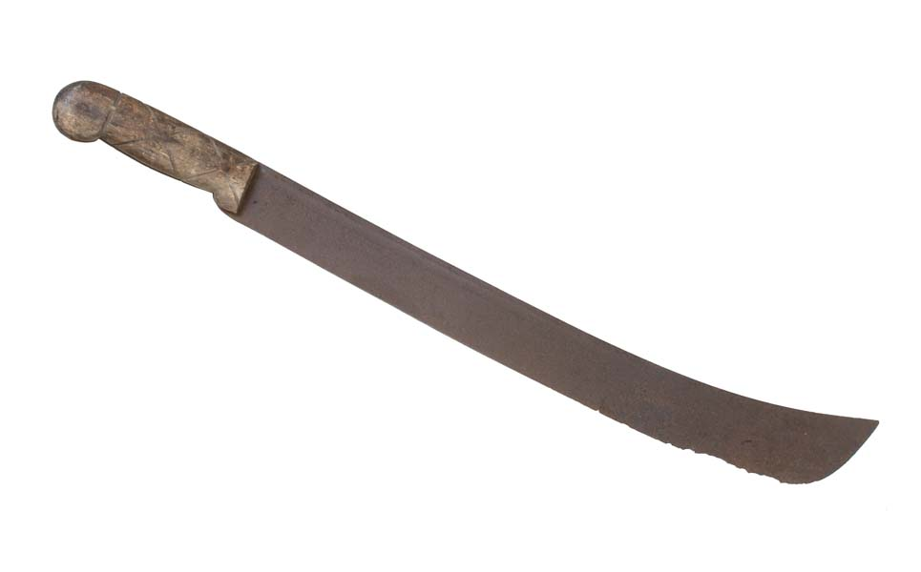
Knife made in Birmingham for use on the slave plantations in the West Indies
Sometimes knives were also used in exchange for slaves

Slide 19
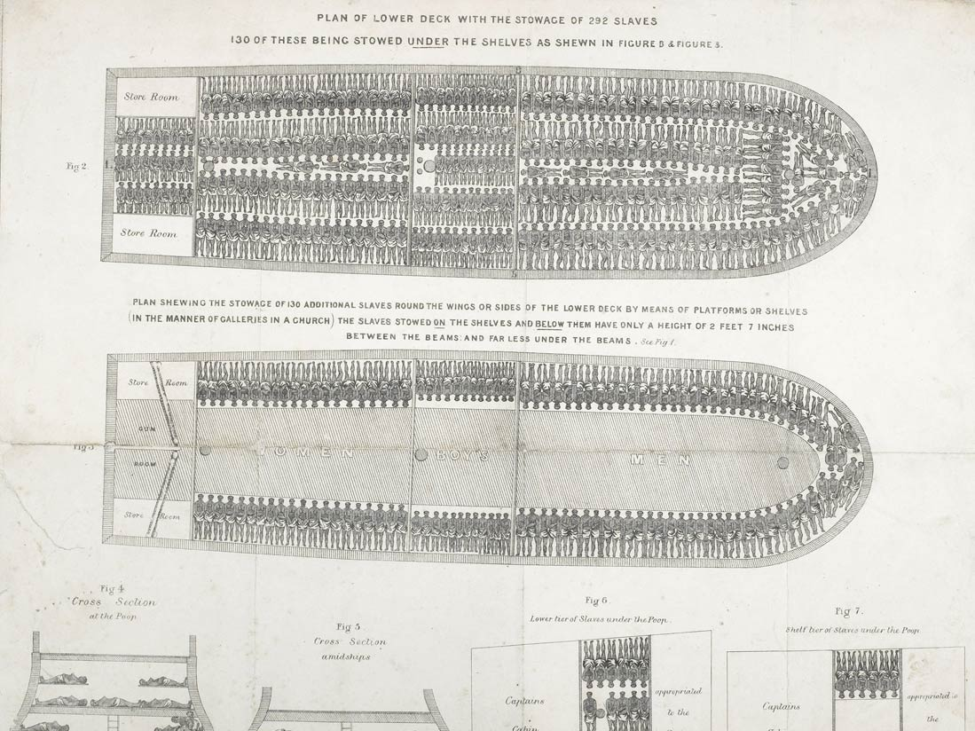
Liverpool slave ship Brookes, transporting 609 men, women and children across the Atlantic

Slide 20
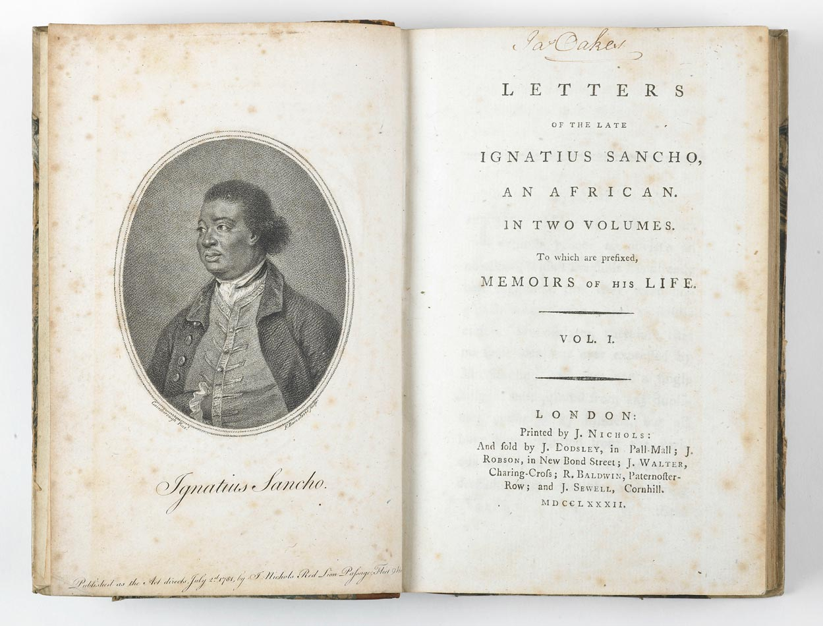

Slide 21
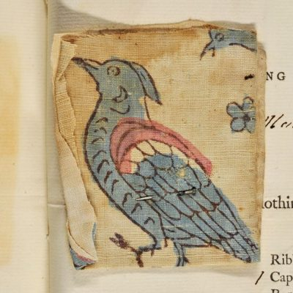
Cotton textiles

Slide 22
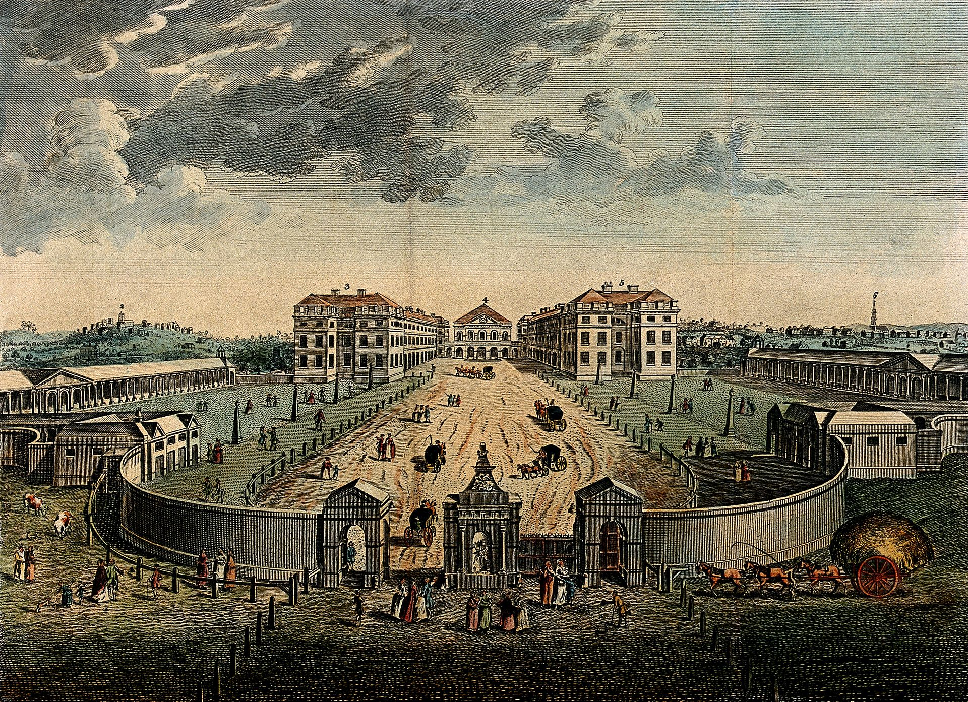
A bird's-eye view of the Foundling Hospital courtyard. Coloured engraving after L. P. Boitard, 1753.

Slide 23
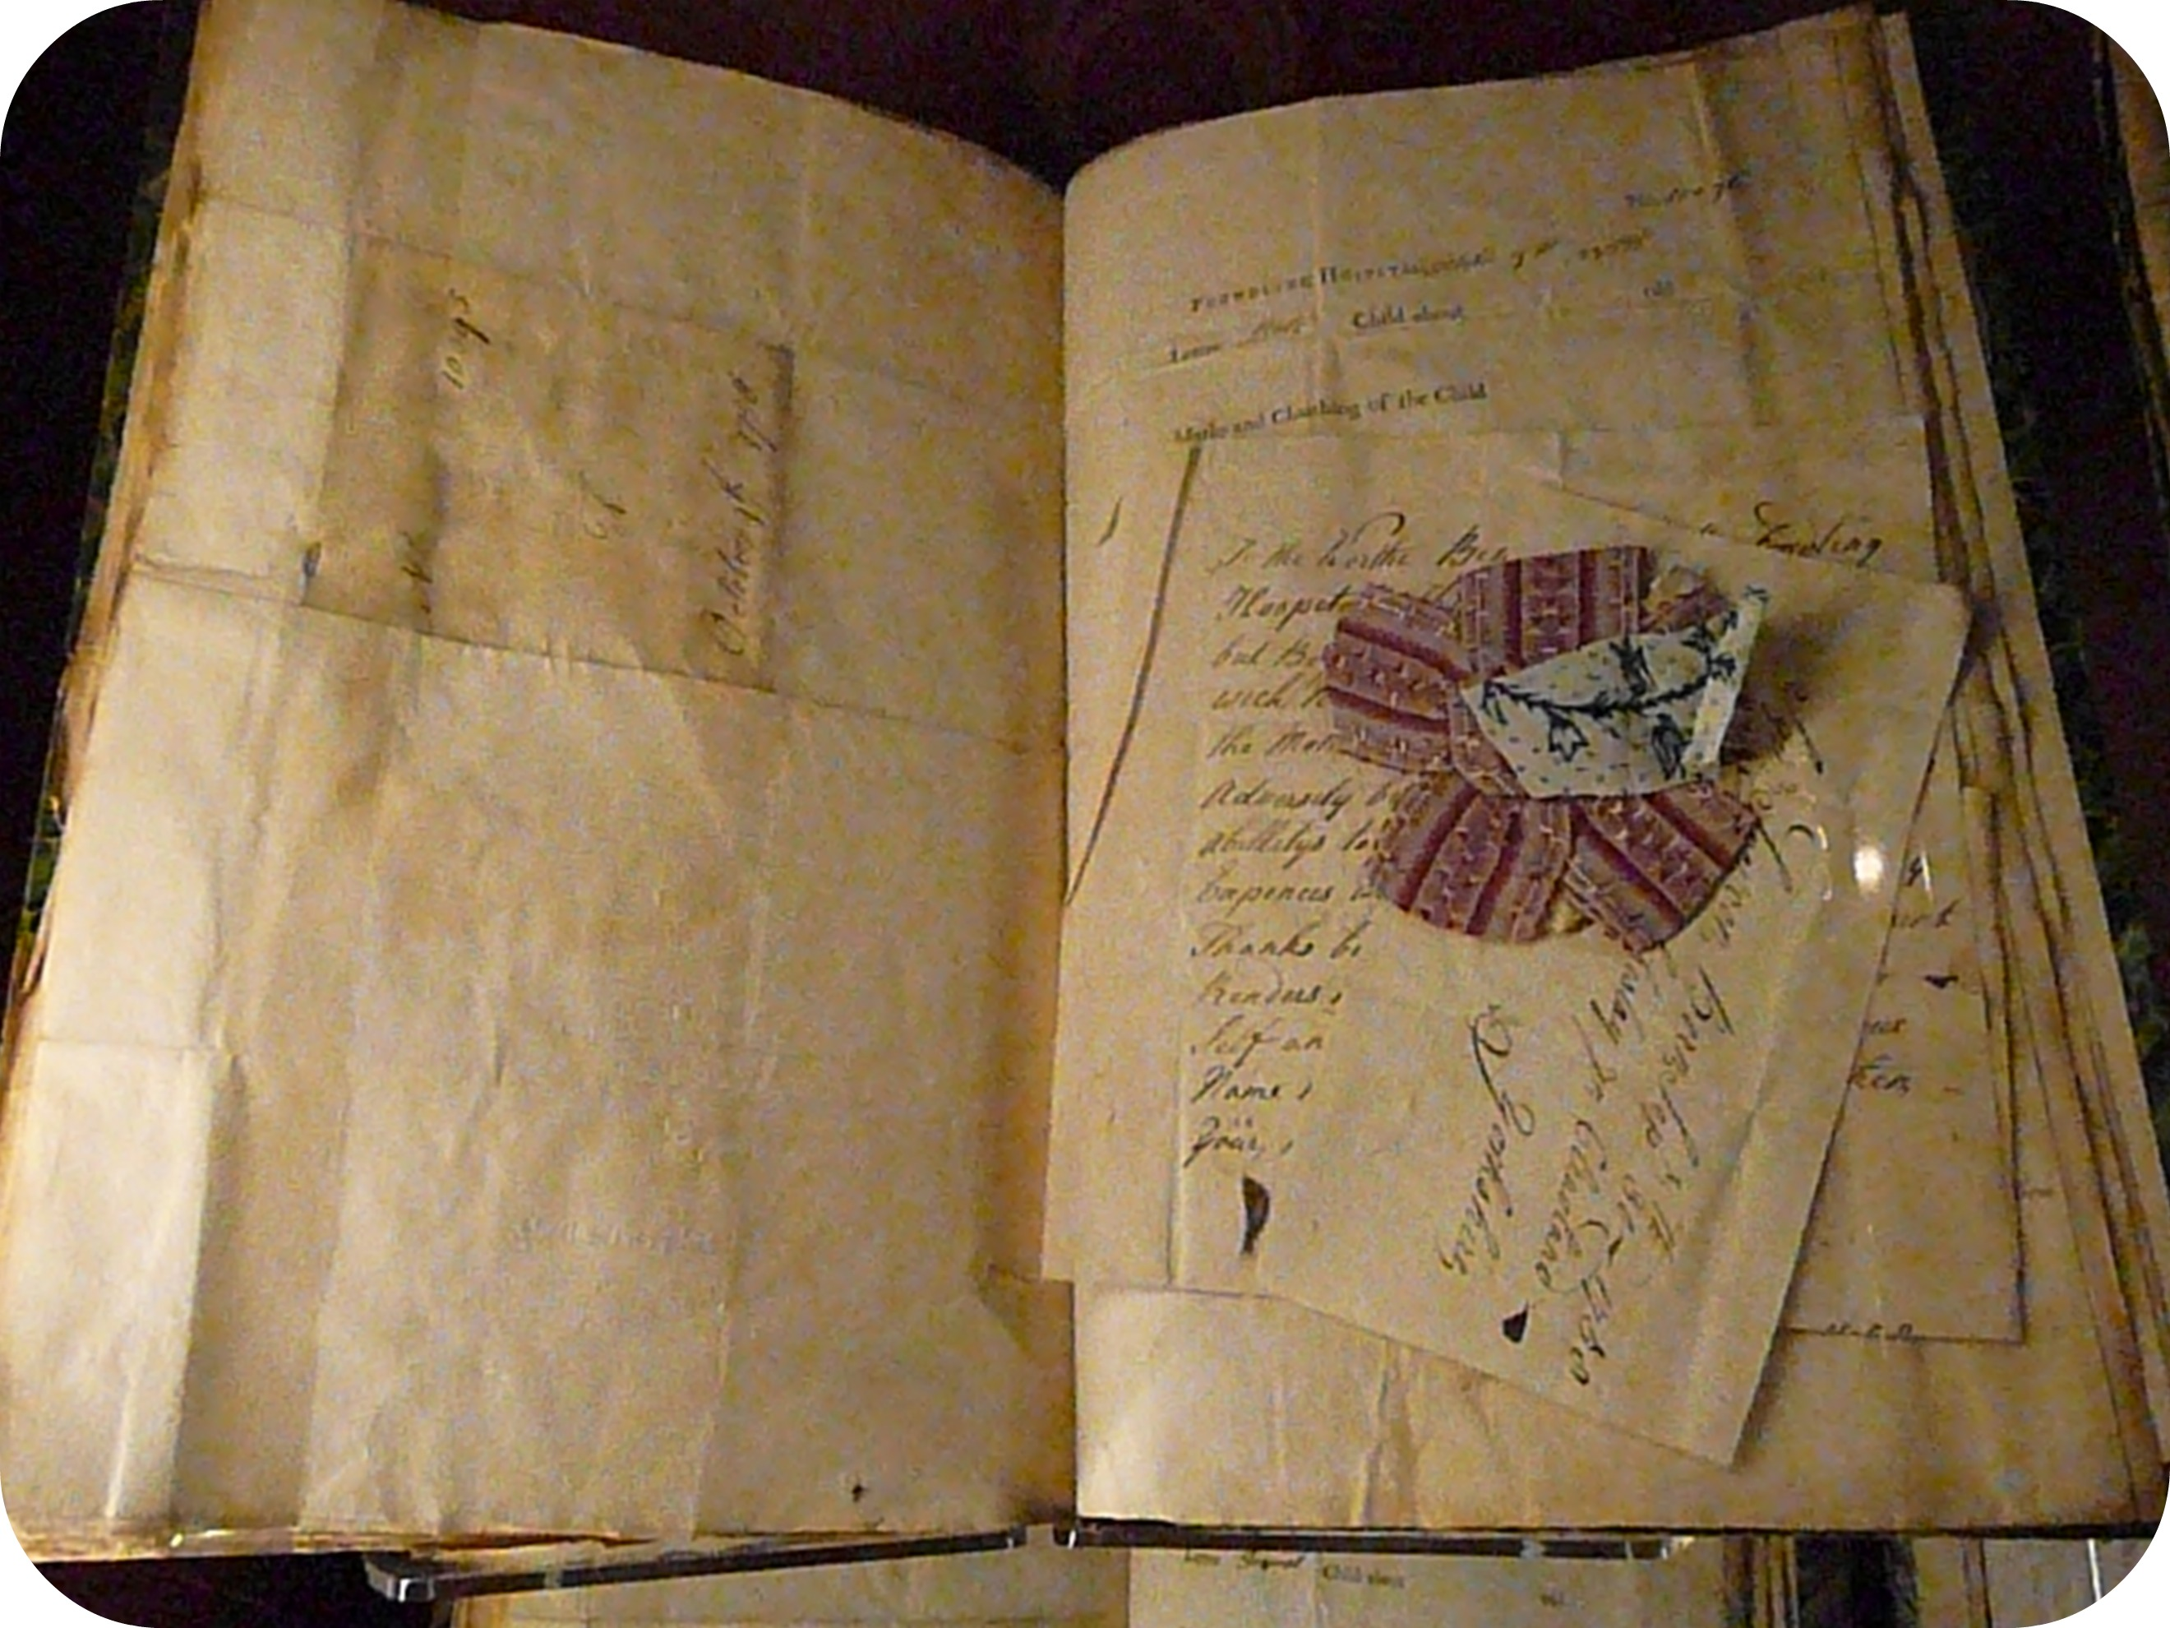

Slide 24
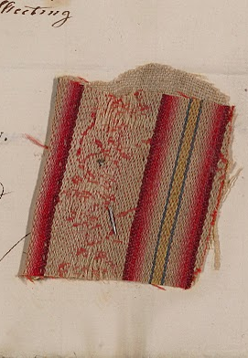

Slide 25
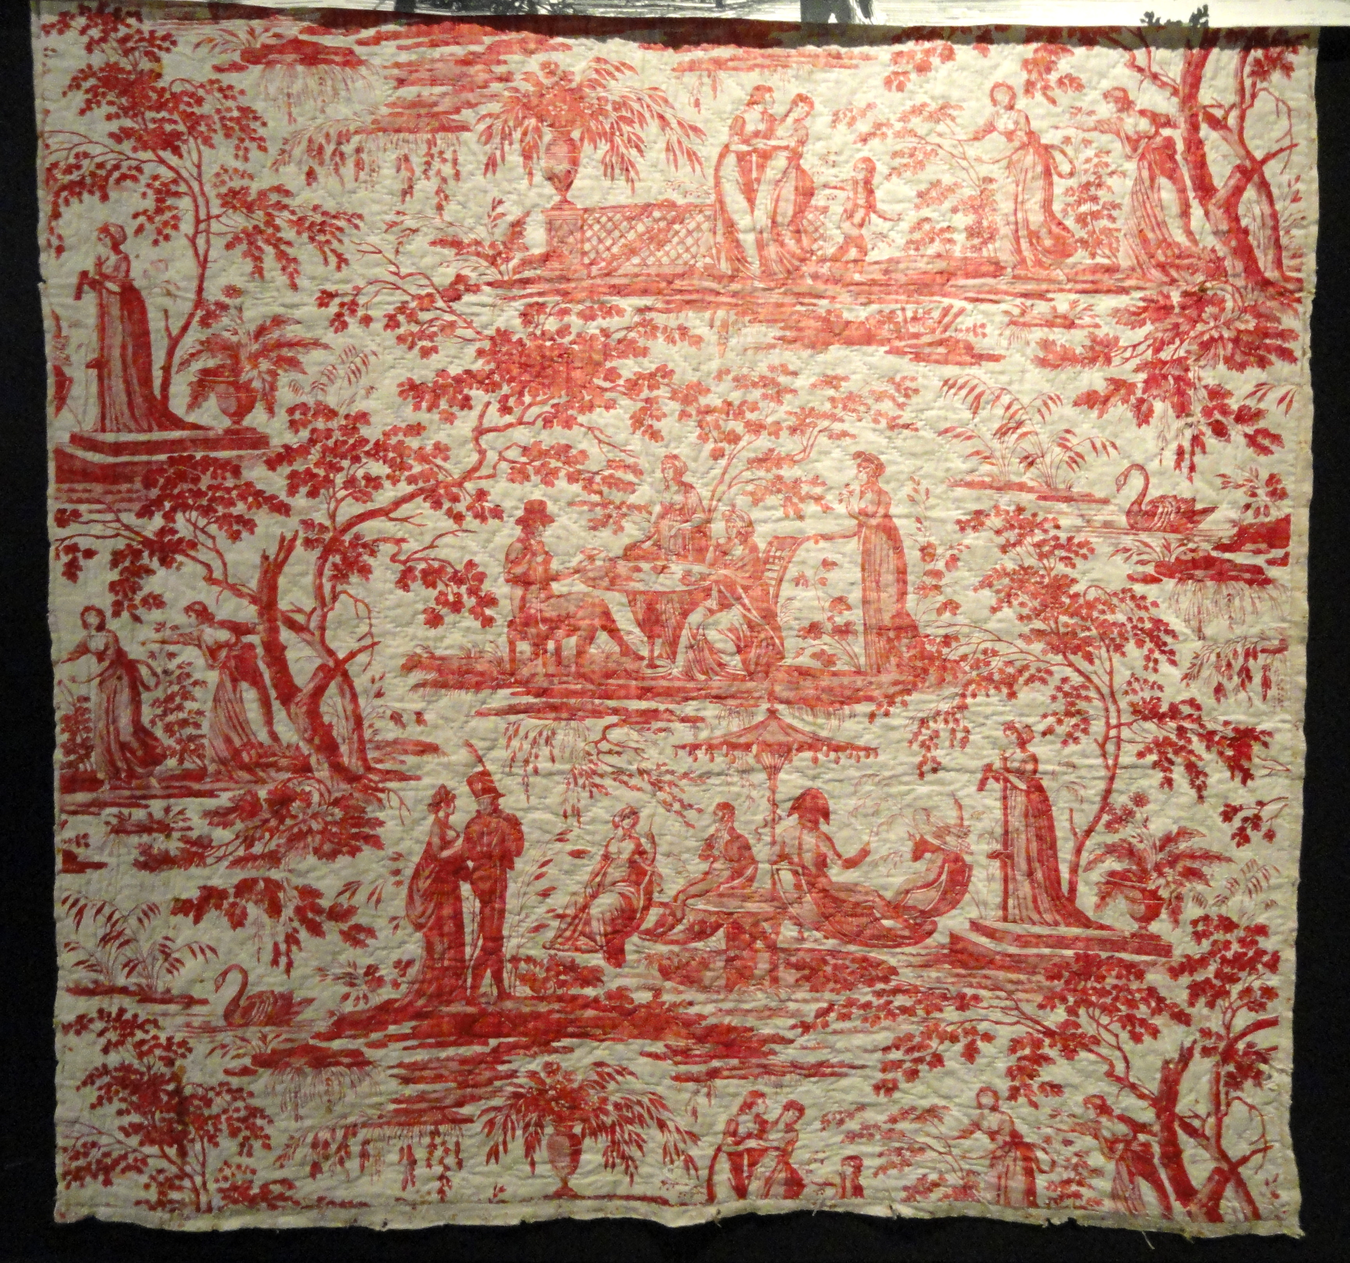
http://www.cambridgeblog.org/2013/05/when-cotton-was-banned-indian-cotton-textiles-in-early-modern-england/

Slide 26
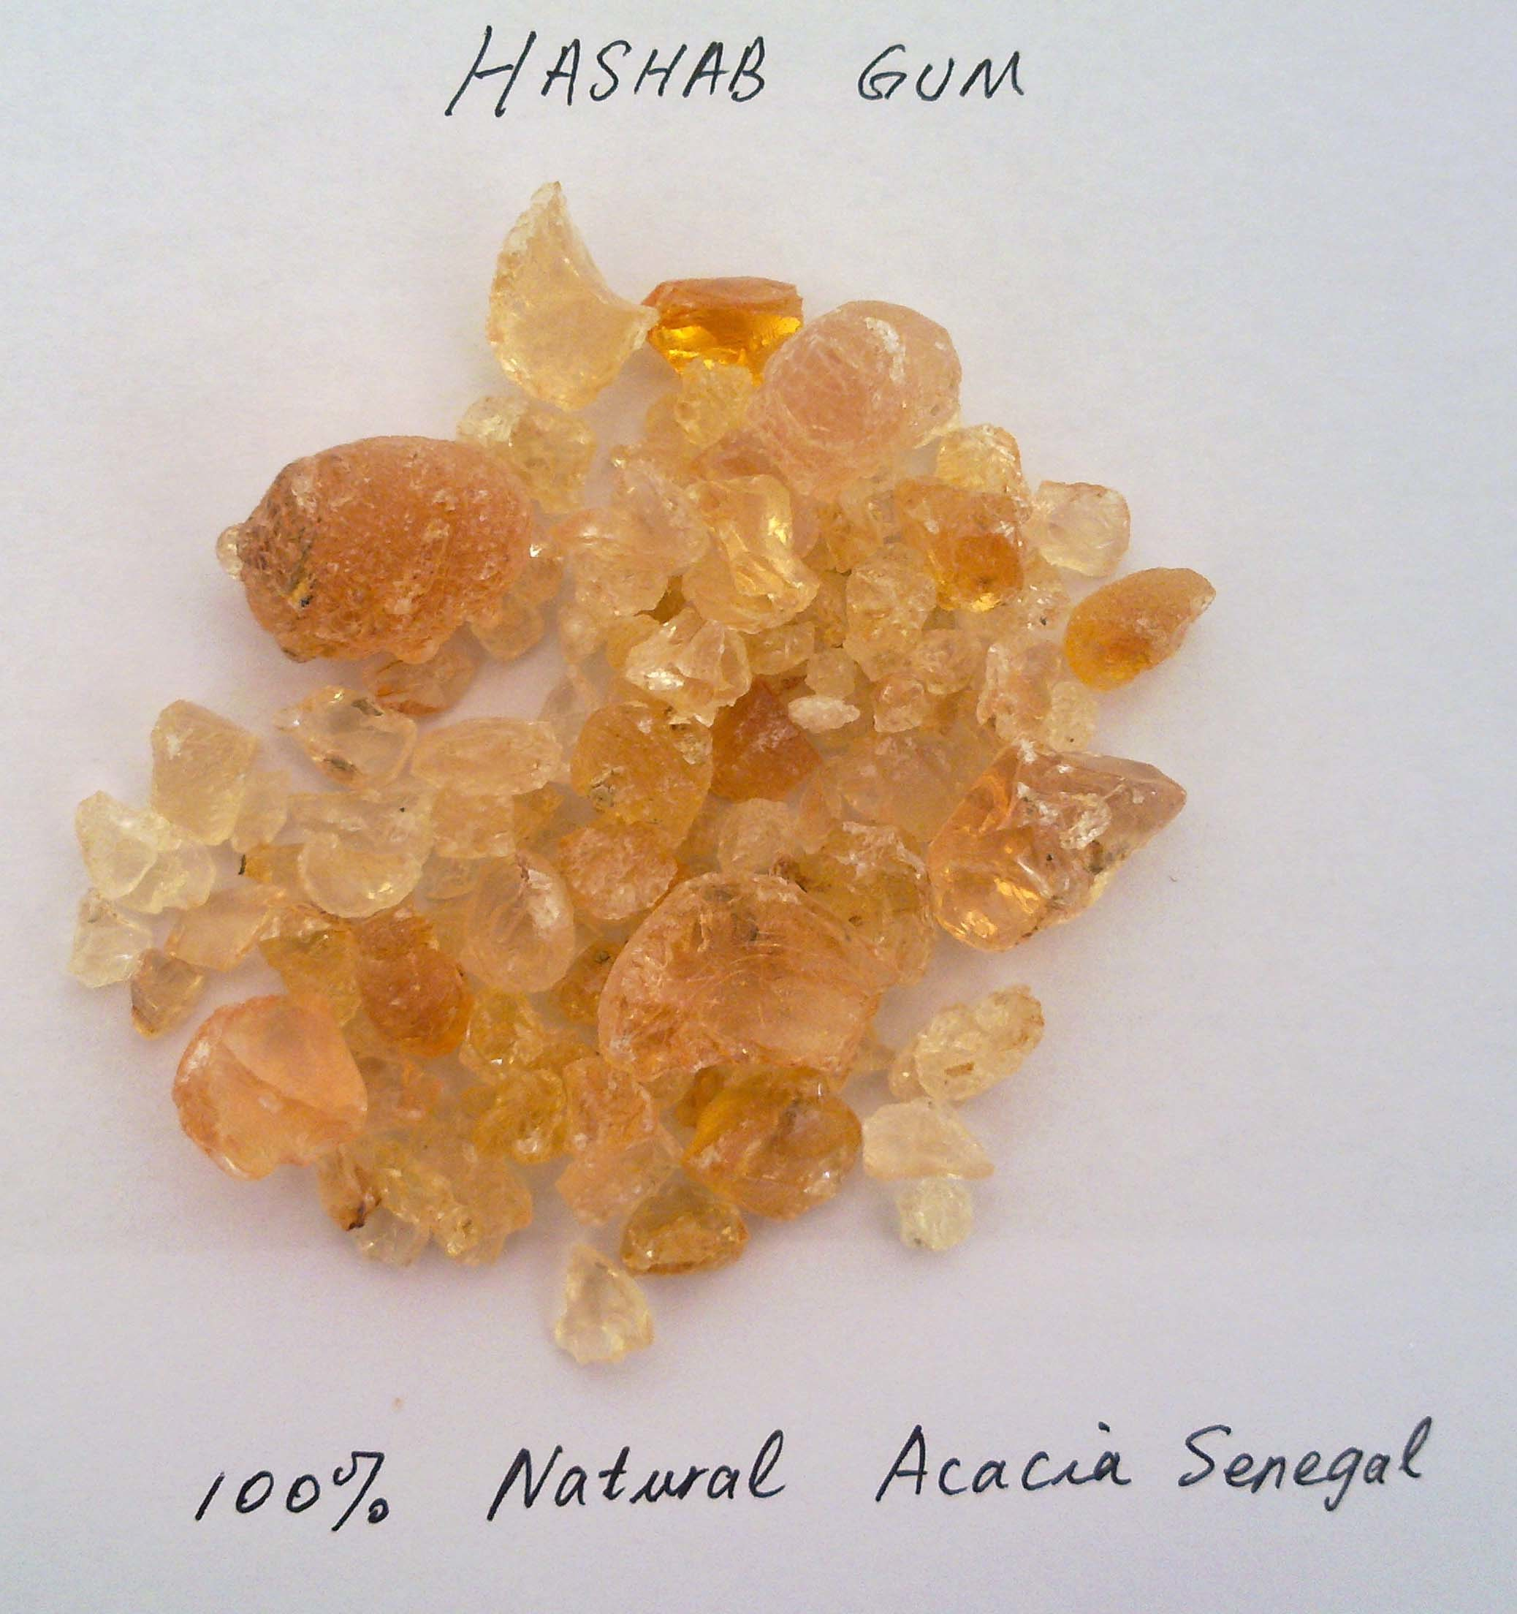
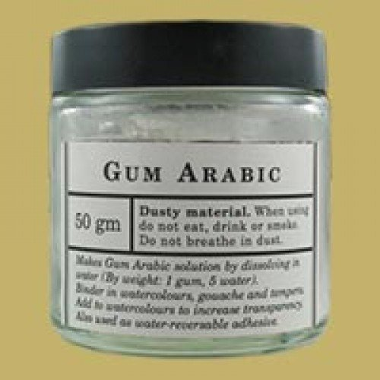
Gum (Gum Arabic)

Slide 27
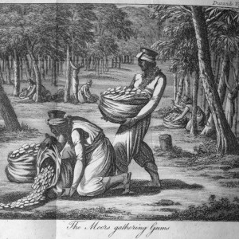
Jean Baptiste Durand, A voyage to Senegal . . . translated from the French, & embellished with numerous engravings (London, 1806), between pp. 140-141.

Slide 28
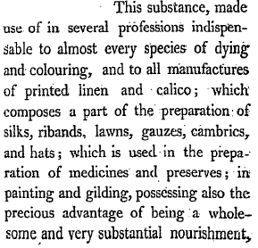
James Curtis’ Observations on the Gum Trade

Slide 29
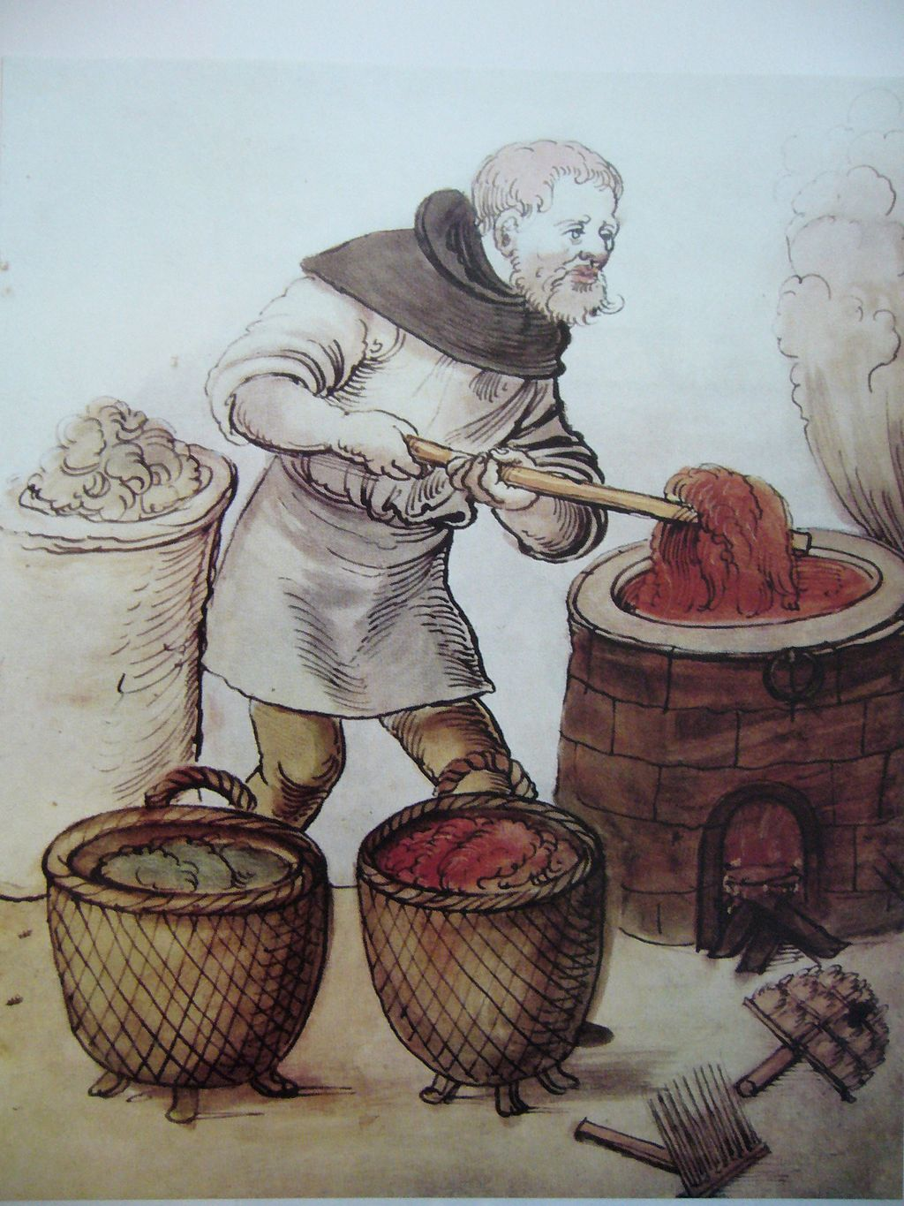
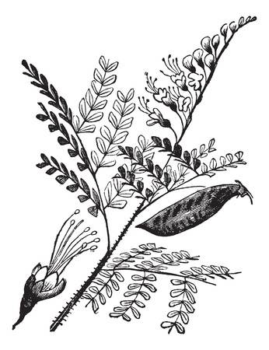
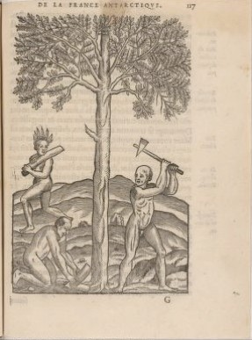
brazilwood

Slide 30
Medicines (rhubarb)

Slide 31
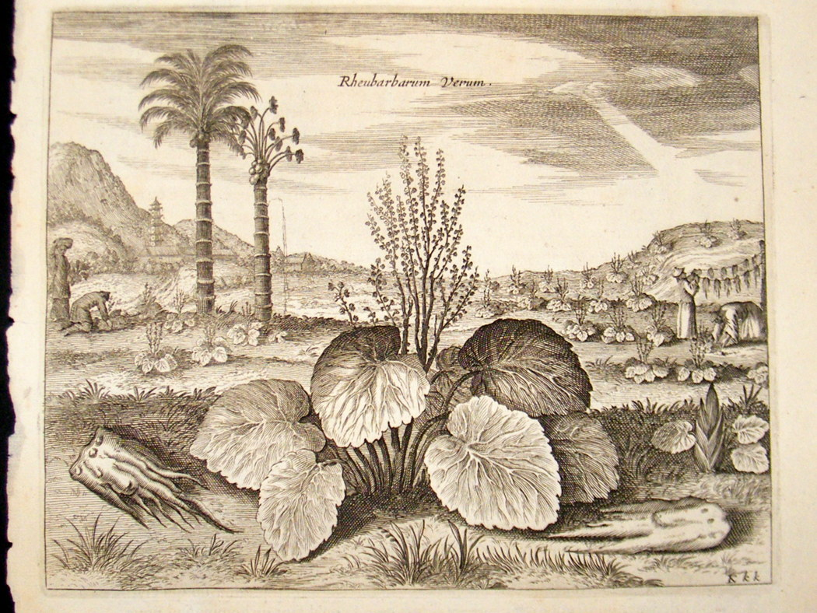

Slide 32
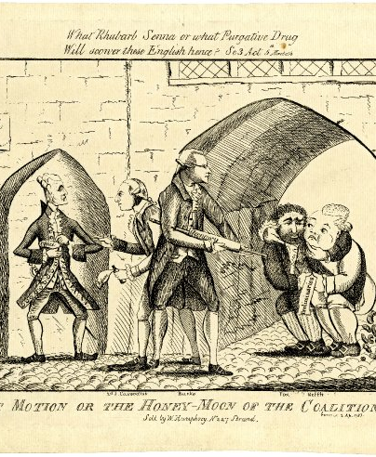
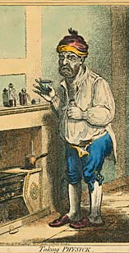

Slide 33
commodity | origin | Sources that show their integration in early modern Europe
Spices | Asia | Recipe books
Sugar | Caribbean | Recipe books
Cotton textile | India | Foundling records
Gum arabic | Africa | Technical handbooks
Wood/dyestuff | Latin America | Technical handbooks
Medicine | Central Asia | Trade records

Slide 34
What does this show?
Commodities flowed into early modern Europe from all over the world (not just from Asia)
Commodities included ordinary and invisible things (not just ostentatious luxuries)
Consumption of global commodities became part of daily experience across the social spectrum (not just the elites)

Slide 35
What are the sites of this global consumption?
SPACES

Slide 36
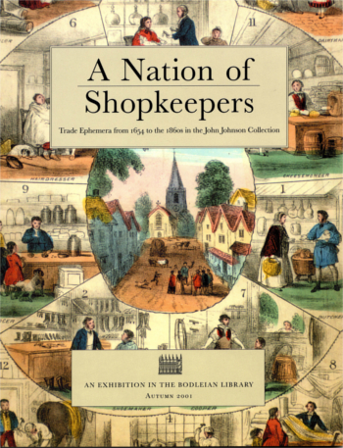
SHOPS
https://www.bodleian.ox.ac.uk/johnson/online-exhibitions/a-nation-of-shopkeepers

Slide 37
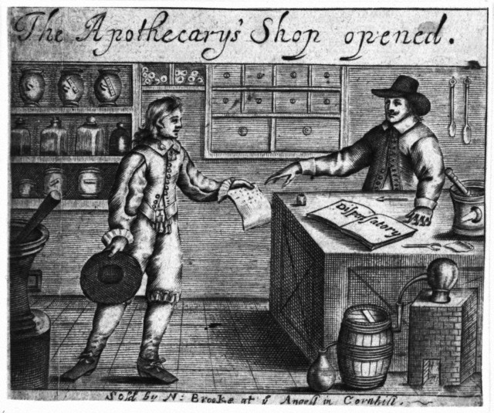

Slide 38
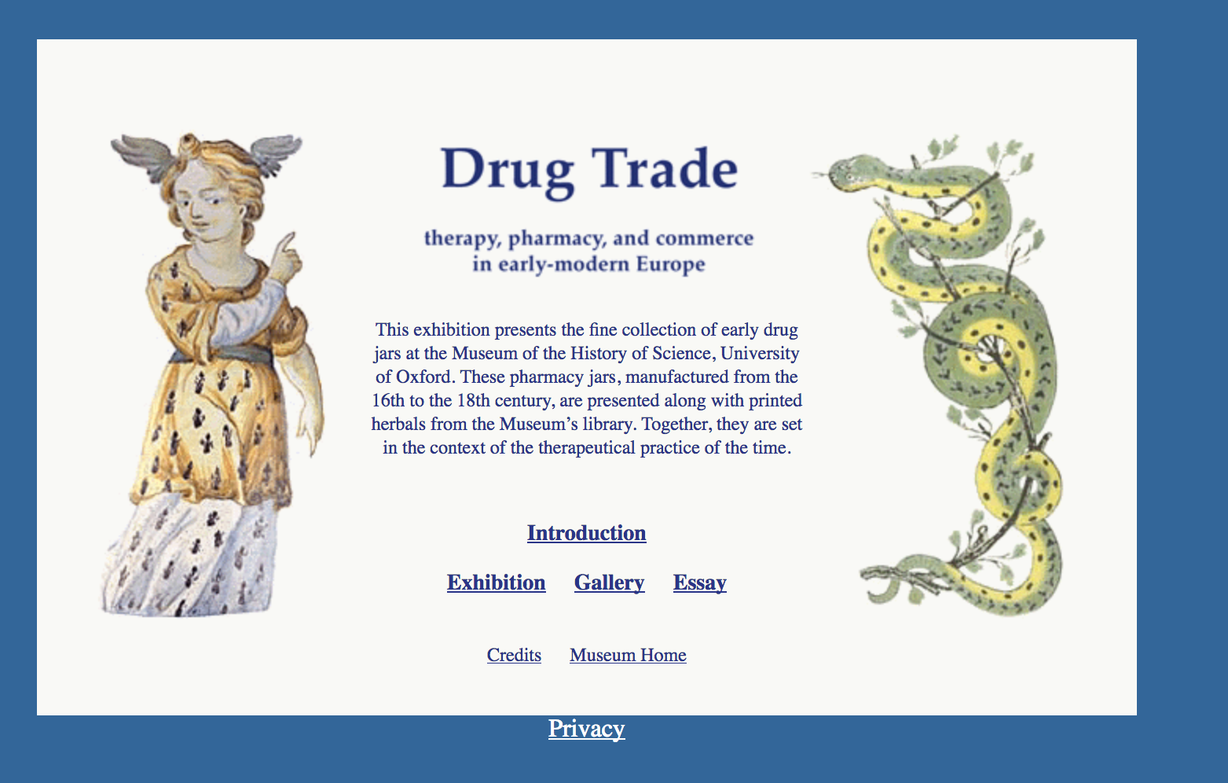

Slide 39
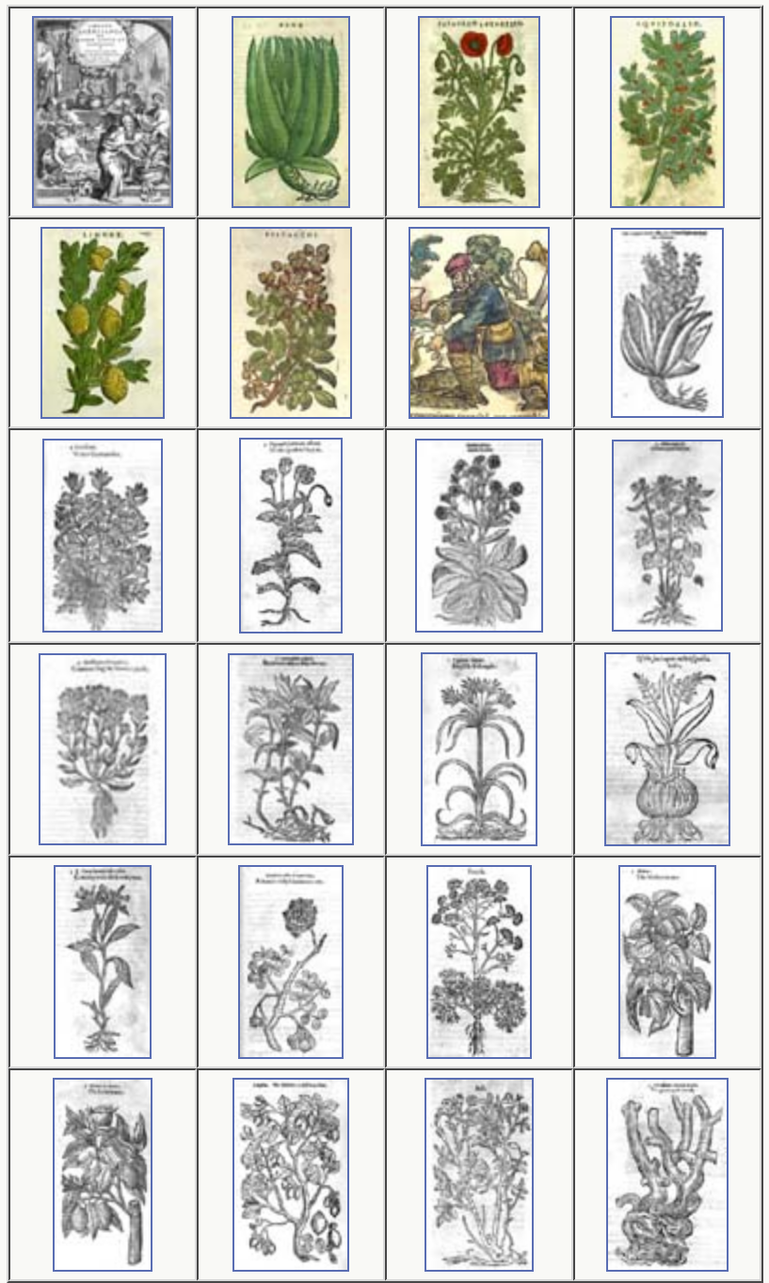
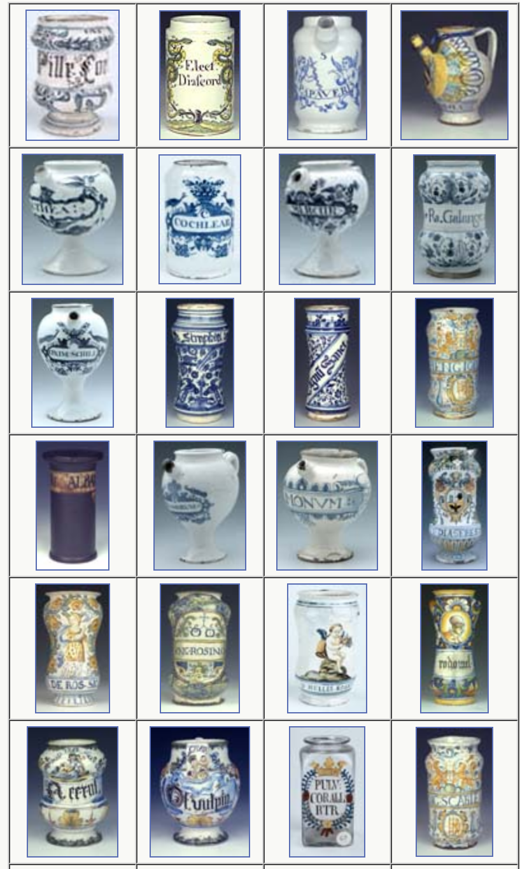

Slide 40

Home and Household

Slide 41
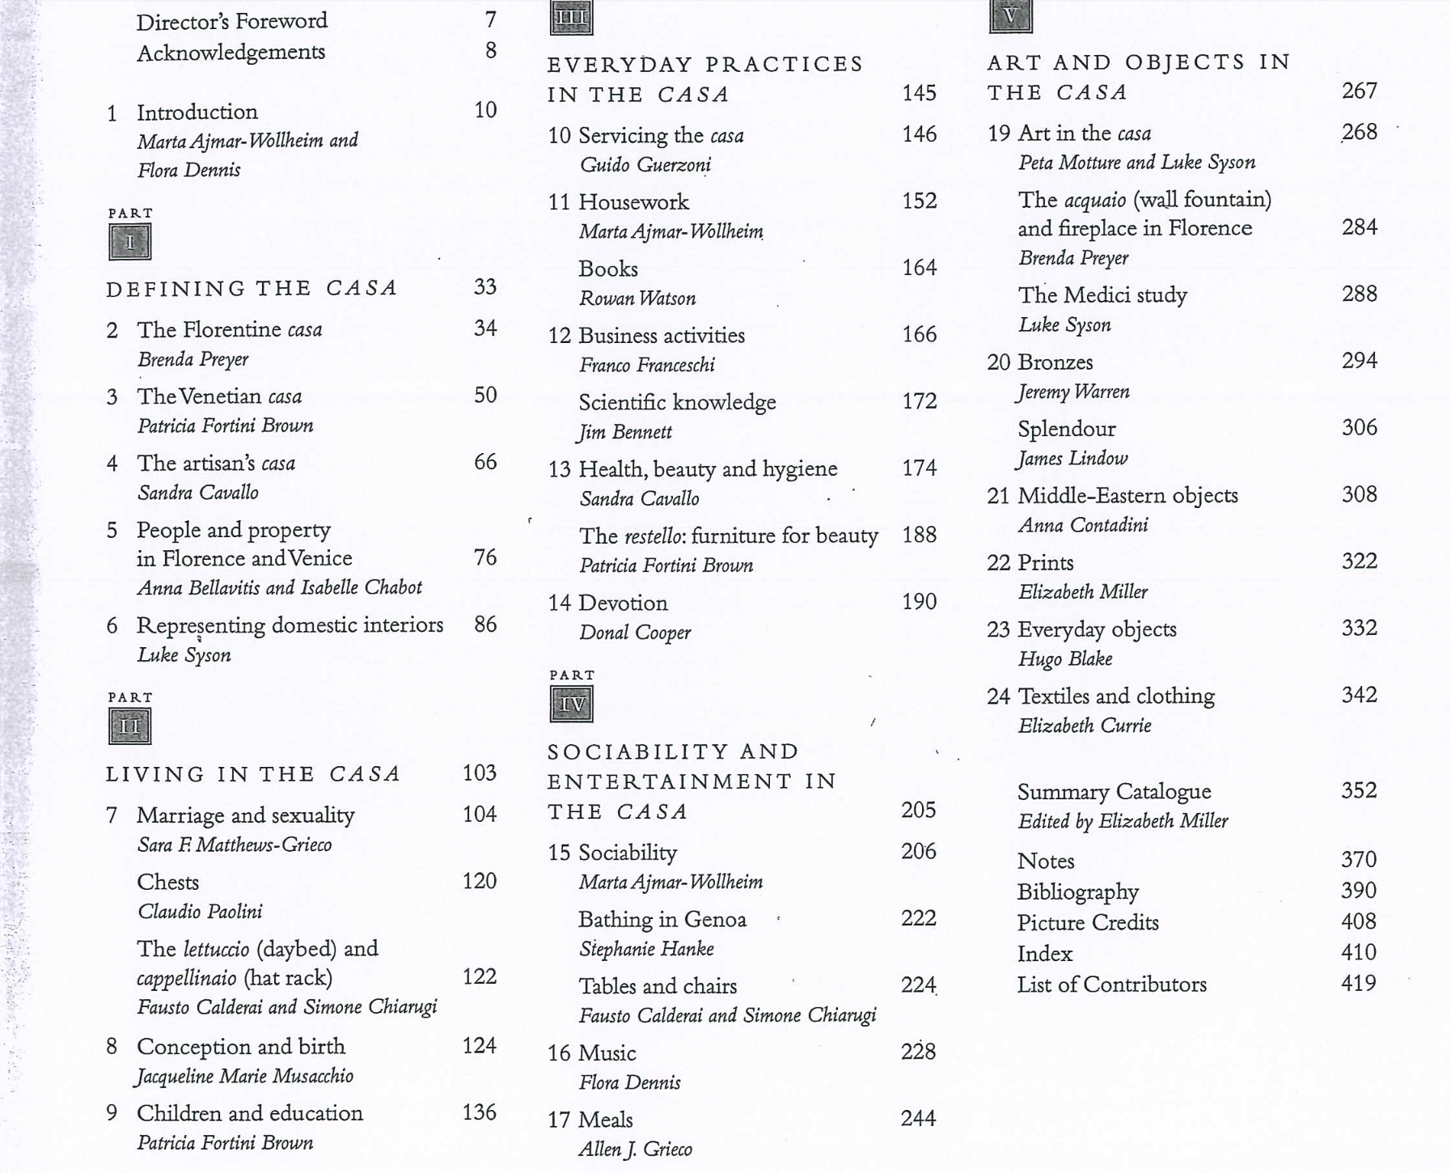

Slide 42
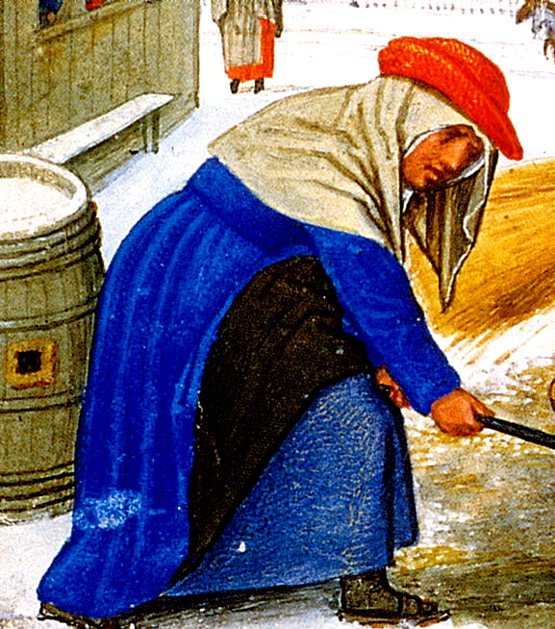
Spaces of work and work clothing
Men's and Women's Work Clothing: A Portfolio of Images
http://www.uvm.edu/~hag/sca/work/index.html

Slide 43
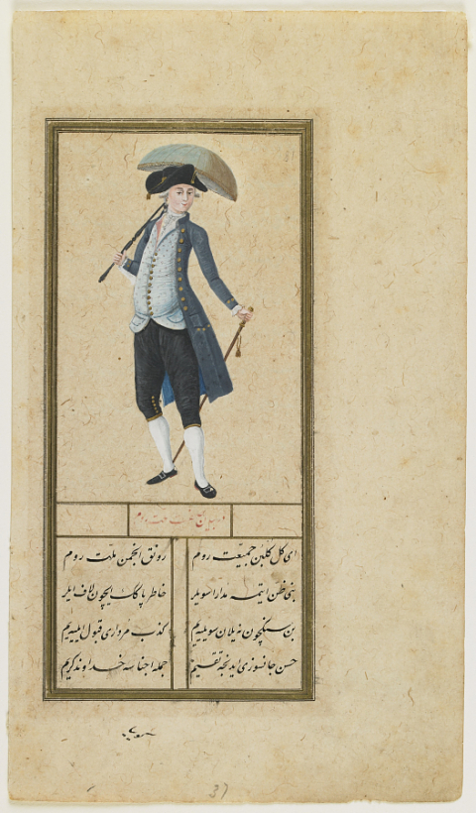
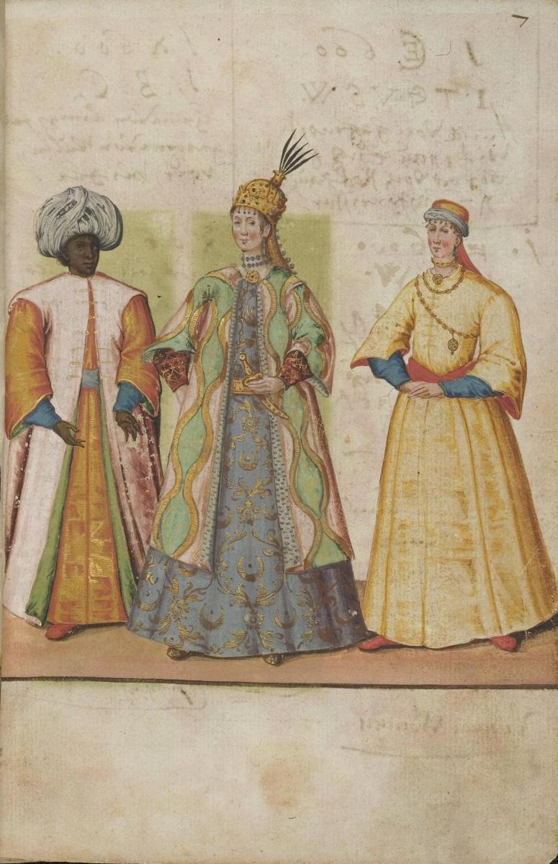
Books and the culture of knowledge
Costume books

Slide 44
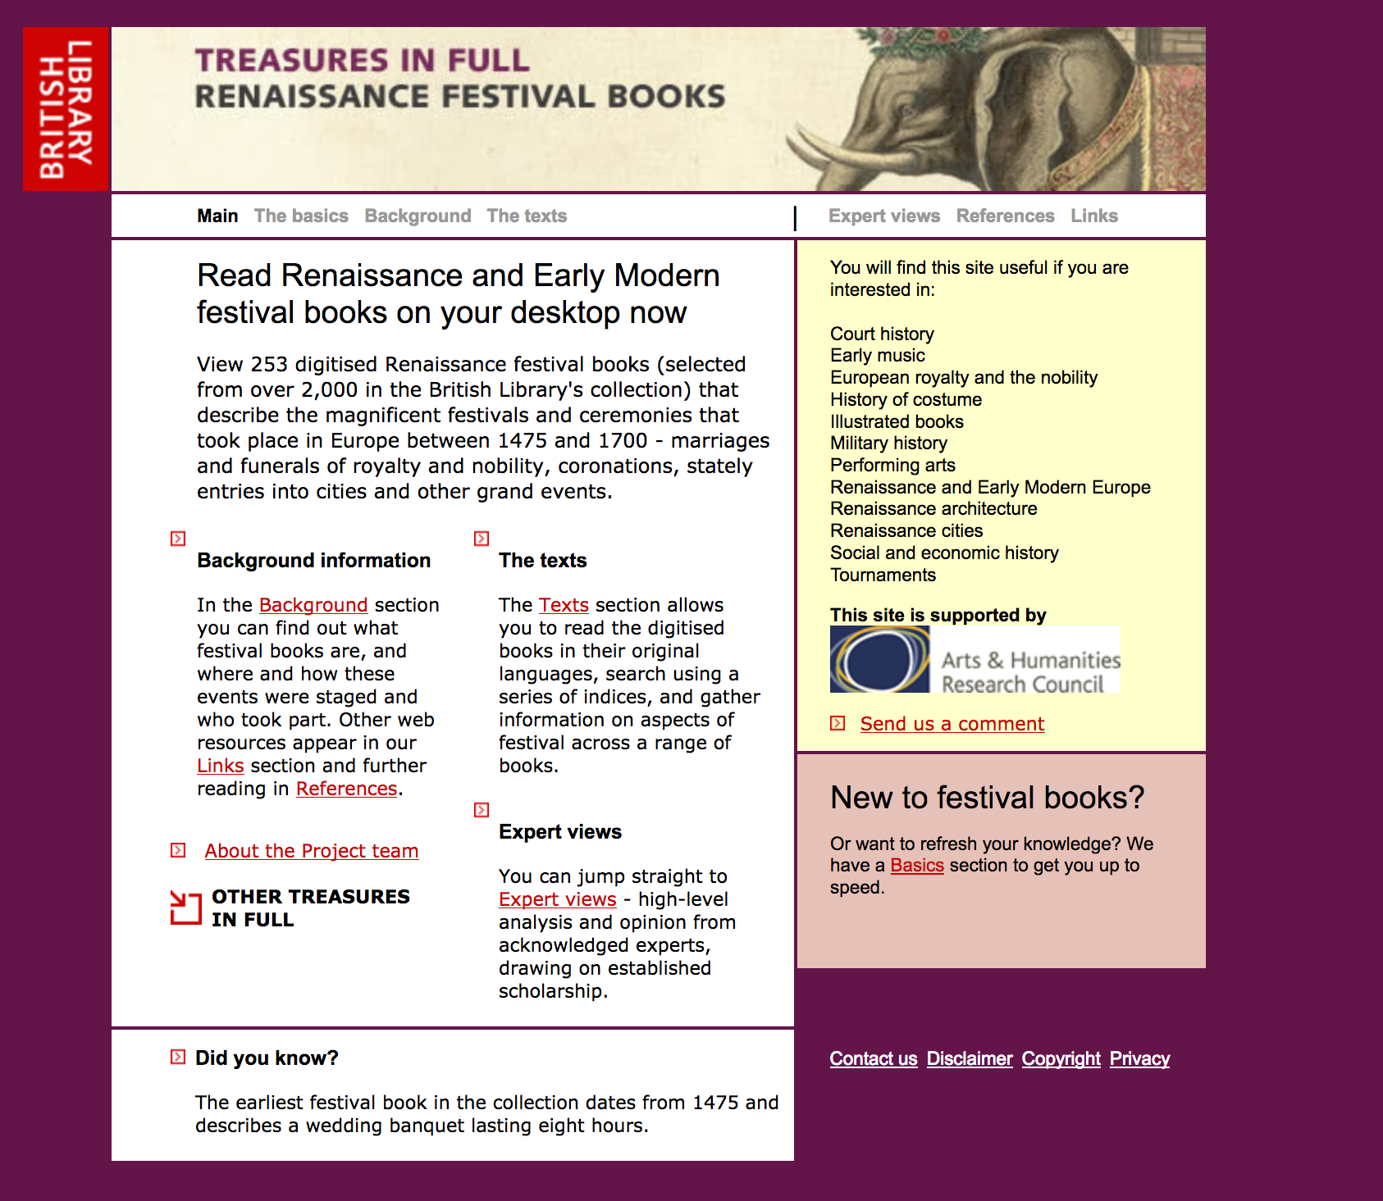
Festivals

Slide 45
Spaces of religion

