Slide 1
Louis XIV and absolute monarchy
HI203 The European World
7/2/2019
Dr. Michael Bycroft

Slide 2
1. Political theory
2. Culture
3. Administration

Slide 3
‘the principle mark of sovereign majesty and absolute power is the right to impose laws generally on all subjects regardless of their consent’
-- Jean Bodin, Les six livres de la République (1576)
‘The prince need account to no-one for what he ordains’
-- Jacques-Benigne Bossuet, Politics Drawn from the Very Words of Holy Scripture (1709), book IV, article 1, prop. 1

Slide 4
‘[God] made the great only to protect the small’
‘Government is a work of reason and intelligence…Wisdom saves states sooner than force’
‘Kings must tremble in using the power that God gives them’
‘Kings are subject to the equity of the laws…but they are not subject to the penalties of the laws’
-- Bossuet, Politics Drawn From Holy Scripture

Slide 5


Headline and image on French news website, Jan 2019

Slide 6
‘no matter how unworthy a king, a revolt by his subjects is always infinitely criminal…It is His will that, whoever is born a subject, must obey without question’
‘…relief of the people’, ‘Enlightened, rational and wise’ advisors, undivided sovereignty…
-- Louis XIV, Memoirs for the Instruction of the Dauphin (completed 1672)

Slide 7
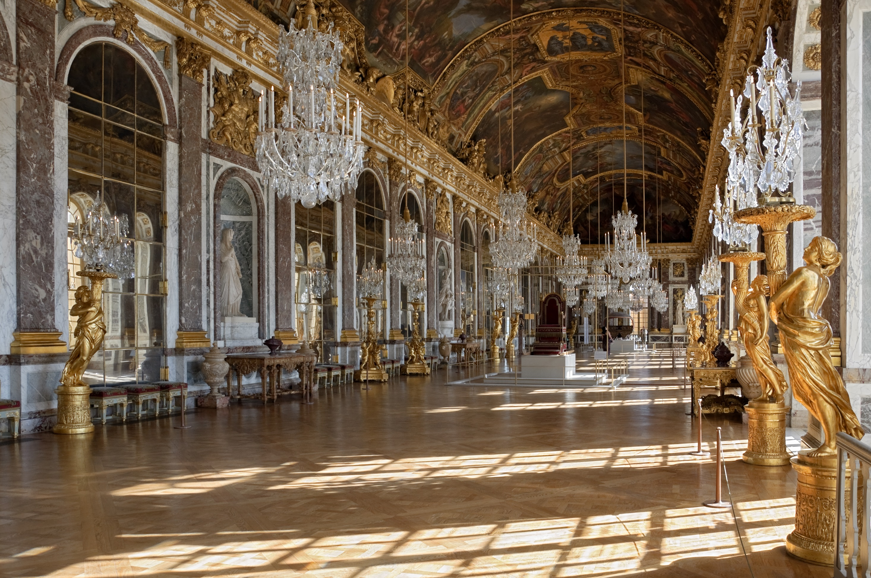
Hall of Mirrors, Palace of Versailles

Slide 8
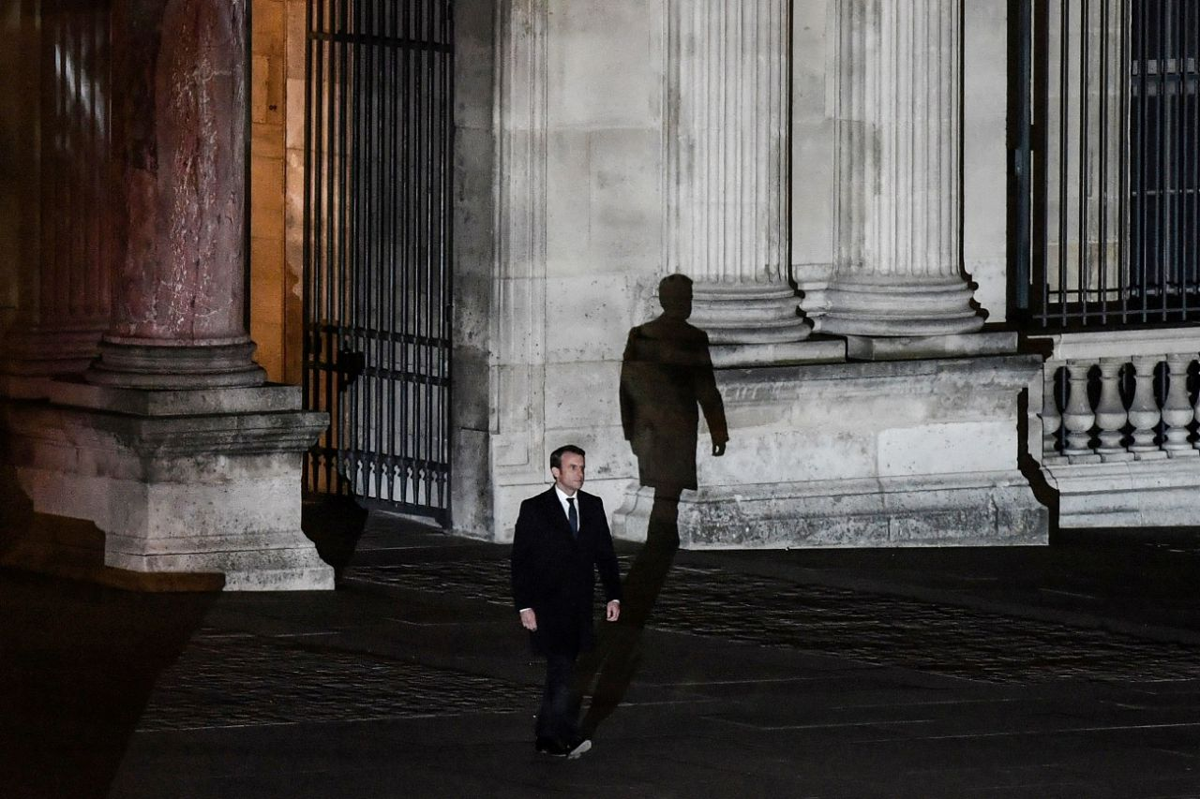
Emmanuel Macron, election night, 7 May 2017, at the Louvre (formerly the royal palace)

Slide 9
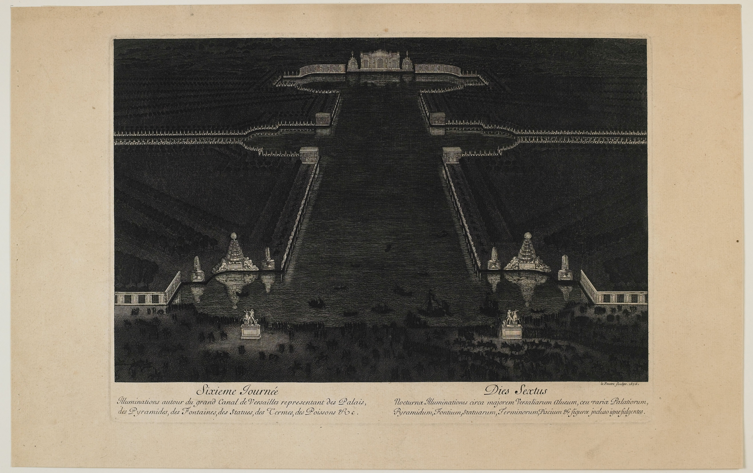
Image from André Félibien, Entertainment at Versailles, upon the king’s return from the conquest of Franche-comté in 1674 (Paris, 1676)

Slide 10
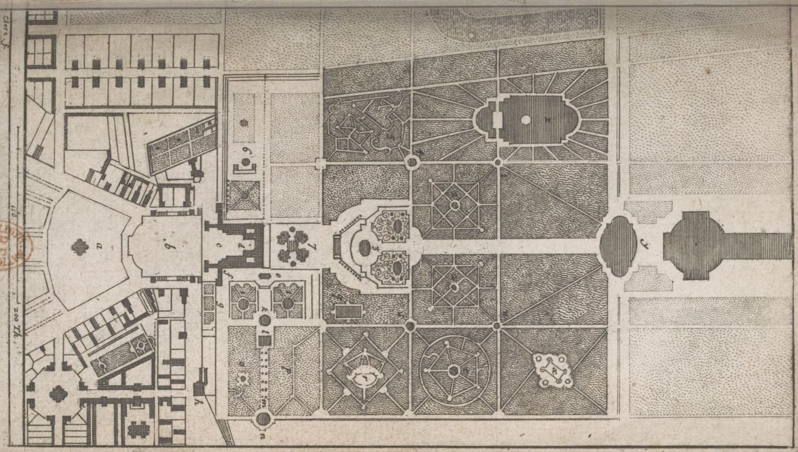
Map of Chateau de Versailles, in André Félibien, Short Description of the Chateau de Versailles (Paris, 1674)

Slide 11
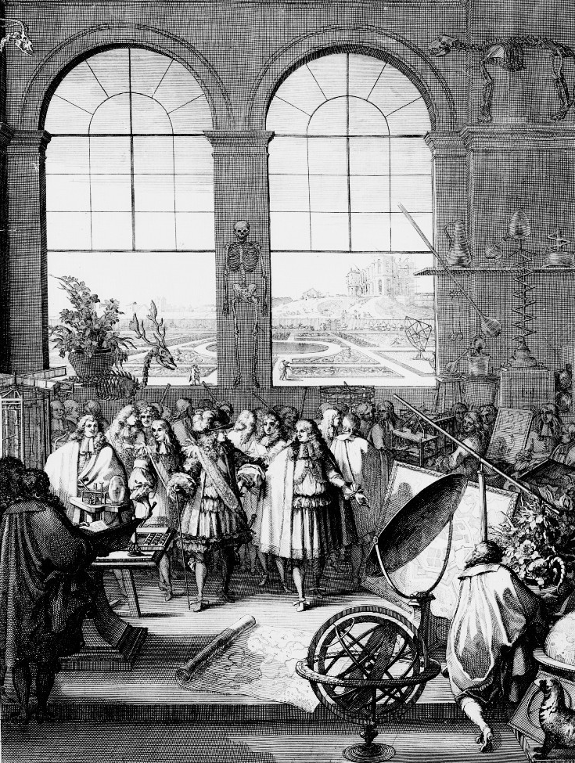
Louis XIV in (fictional) visit to a meeting of the Paris Academy of Sciences, showing King’s Garden, Royal Observatory, and Jean-Baptiste Colbert.
Frontispiece of botanical work published by Academy in 1676

Slide 12
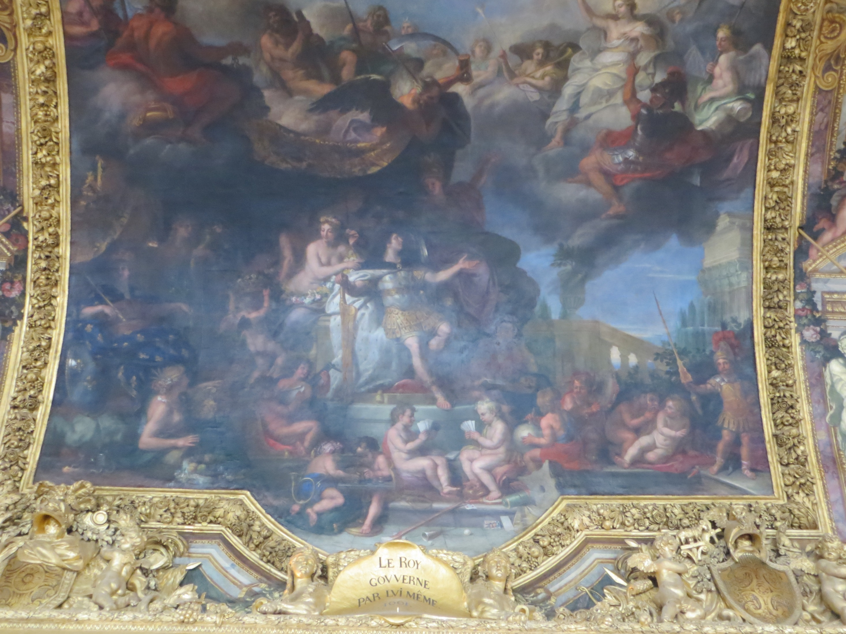
‘The King Governs by Himself, 1661’ – ceiling painting from Hall of Mirrors, Palace of Versailles

Slide 13
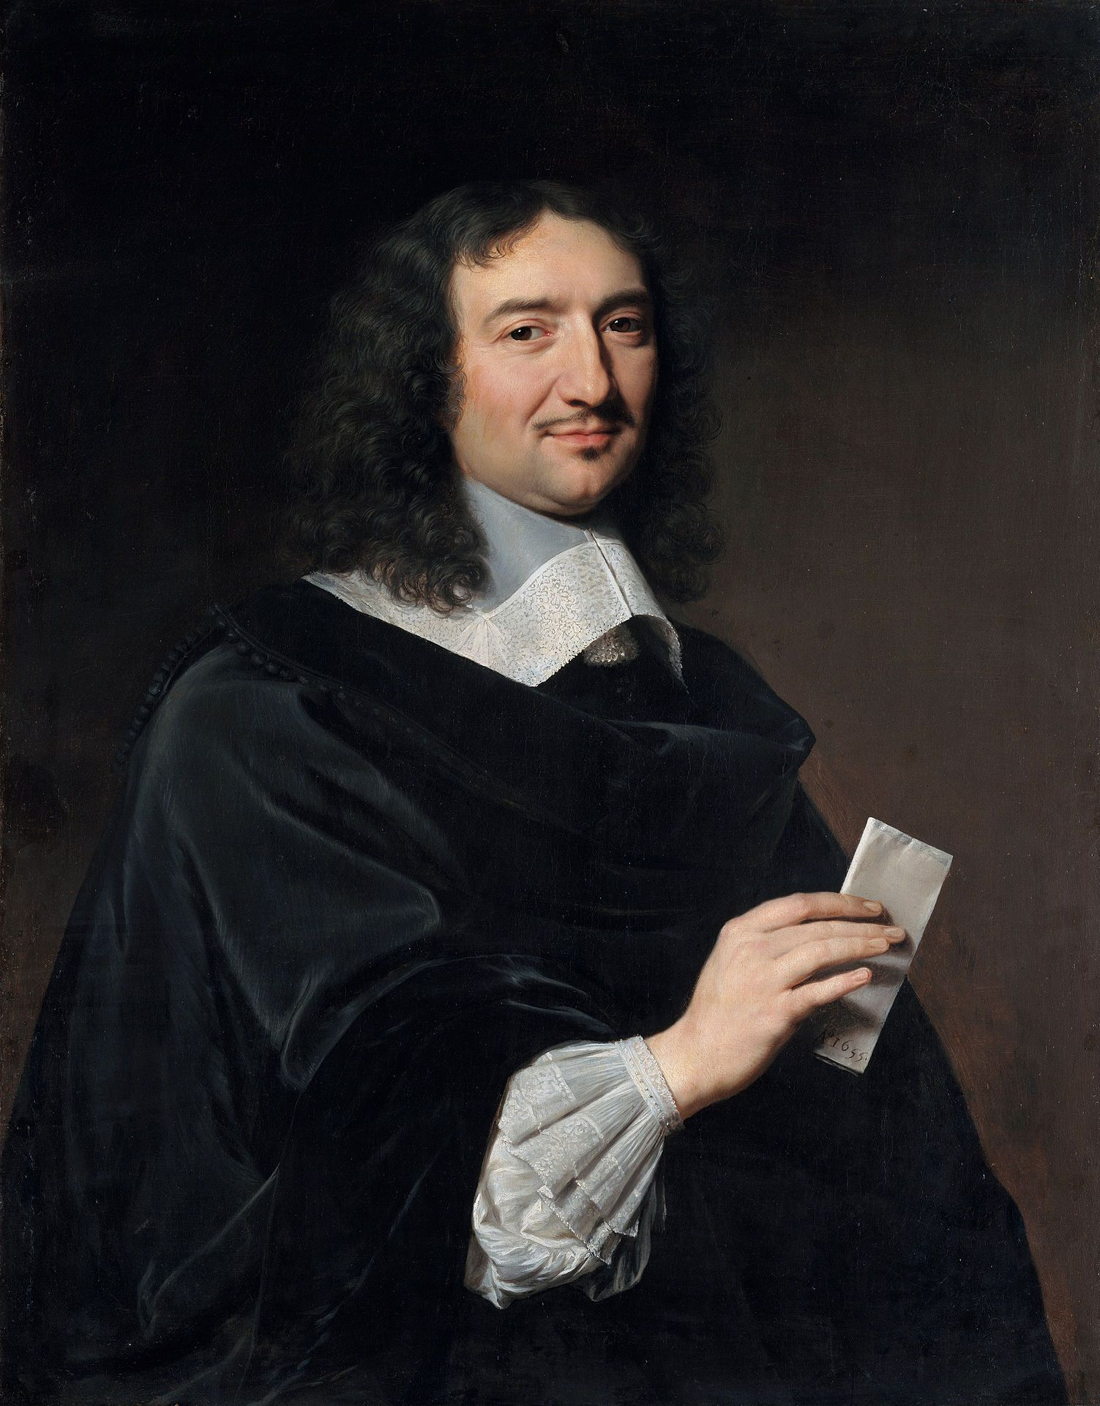
Jean-Baptiste Colbert (aka ‘Le Nord’), painted 1655, while Cardinal Mazarin’s personal accountant

Slide 14
DOUJAT, makes a good show on the outside, but is fundamentally nothing; weak, timid, he is a slave to the court and self-interested; Monsieur de Maupeaou, his son-in-law, has great power over him; Herbinot, a high bailiff, governs him
  -- from Colbert, ‘Secret Notes on the Personnel of all the Parlements and Courts of the Kingdom’

Slide 15
After having made observations of the entire length of the Seine River up to Le Havre, His Majesty wants him to continue the same reconnaissance until Tréport, his intention being to have very exact maps of all the sinuosity of the banks and all the openings of rivers, with precise remarks and measurements of all the places, without telling anyone of the findings, of all the protected bays, high- and low-water marks of the tide, dunes, cliffs, estuary openings, and inlets, and all the possible places where enemies might be able to attack if they are strong enough to make a landing...
-- Colbert to a royal cartographer, the chevalier de Pène

Slide 16
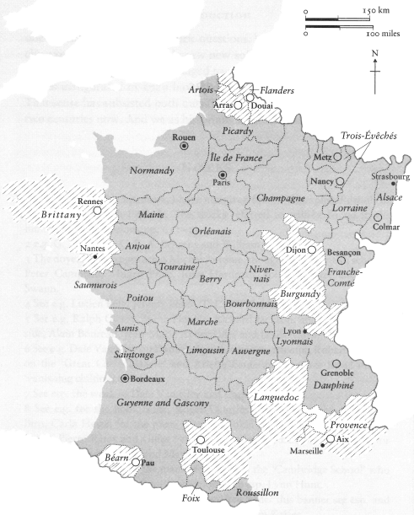
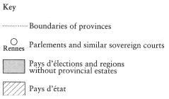
Key administrative boundaries in seventeenth-century France
From Colin Jones, The Great Nation

Slide 17
1. Political theory
2. Culture
3. Administration

