Slide 1
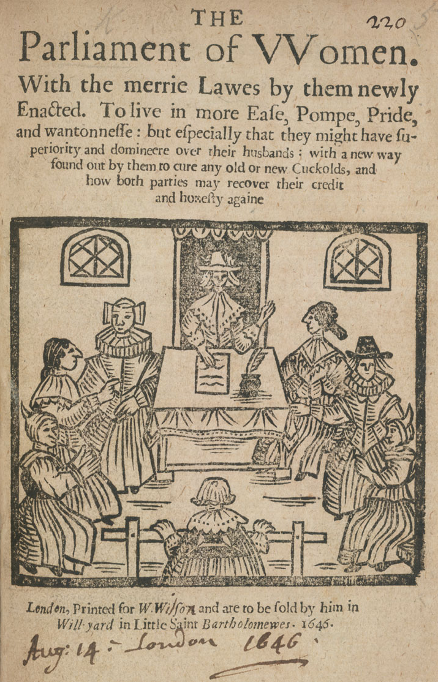
Case study: Female Radicalism and the civil wars
The European World
Naomi Pullin
naomi.wood@warwick.ac.uk

Slide 2
Focus of the case study
Overview of Civil Wars and the effect on women.
The ways in which the religious sects empower women and provide them with opportunities to engage in public/political affairs.

Slide 3
Women and the civil wars

Slide 4
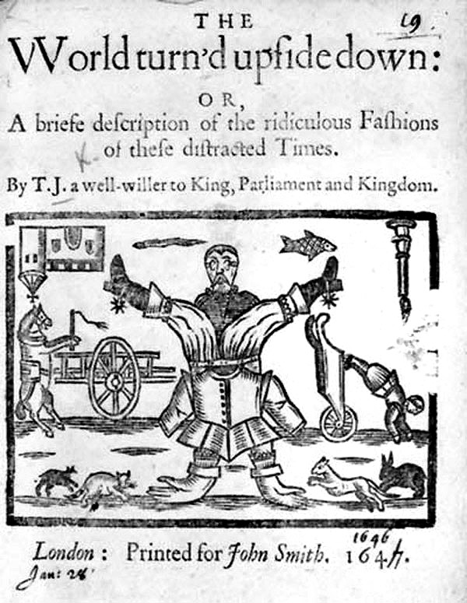
Overview: A world turned upside down
Civil Wars fought in England, Scotland and Ireland between 1642 and 1649
Rebellion against Charles I by his parliament, resulting in his execution in 1649
Two sides: Royalists and Parliamentarians (loyal to Parliament)
World turned upside downs encapsulates unprecedented moment in British history – first time authority of king called into question

Slide 5
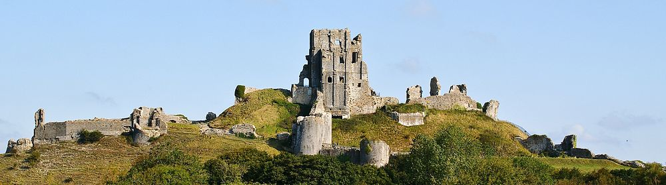
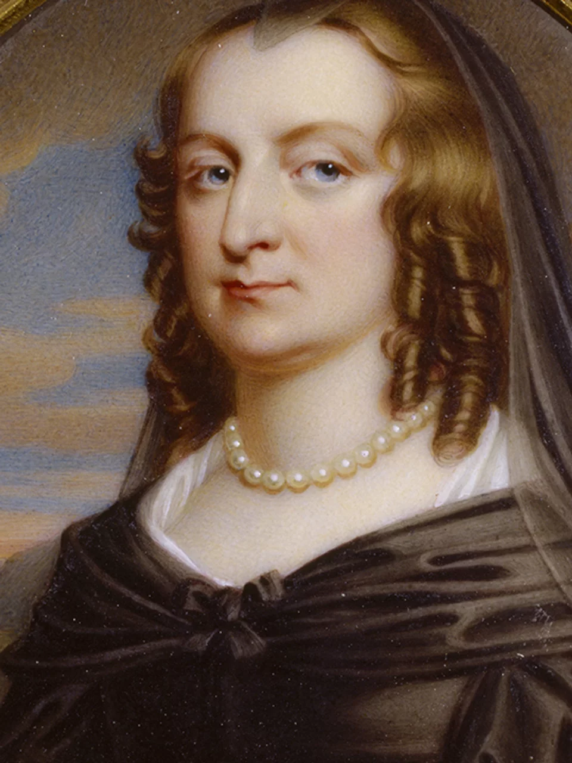
The impact of the wars on women
Concern that political motives might project 20thC values back onto past societies.
Civil Wars not just a conflict at the top of society - women brought into fighting
E.g. Mary Bankes and 5 servants defended Corfe Castle during 3-year siege, whilst husband fighting.
Used canon fire and hot embers to attack 600 parliamentary troops.

Slide 6
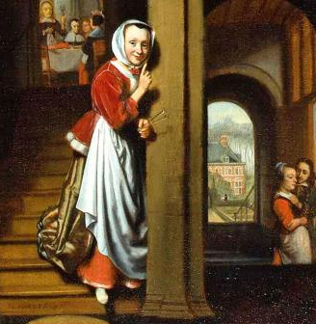
The rise of female spies (1)
Women are more mobile than men and arouse less suspicion.
During Charles I’s captivity, women became conduits of intelligence.
Jane Whorwood, Charles I’s mistress, involved in various escape attempts.
Secret underground postal network at Carisbrooke Castle employed female servants as go-betweens.

Slide 7
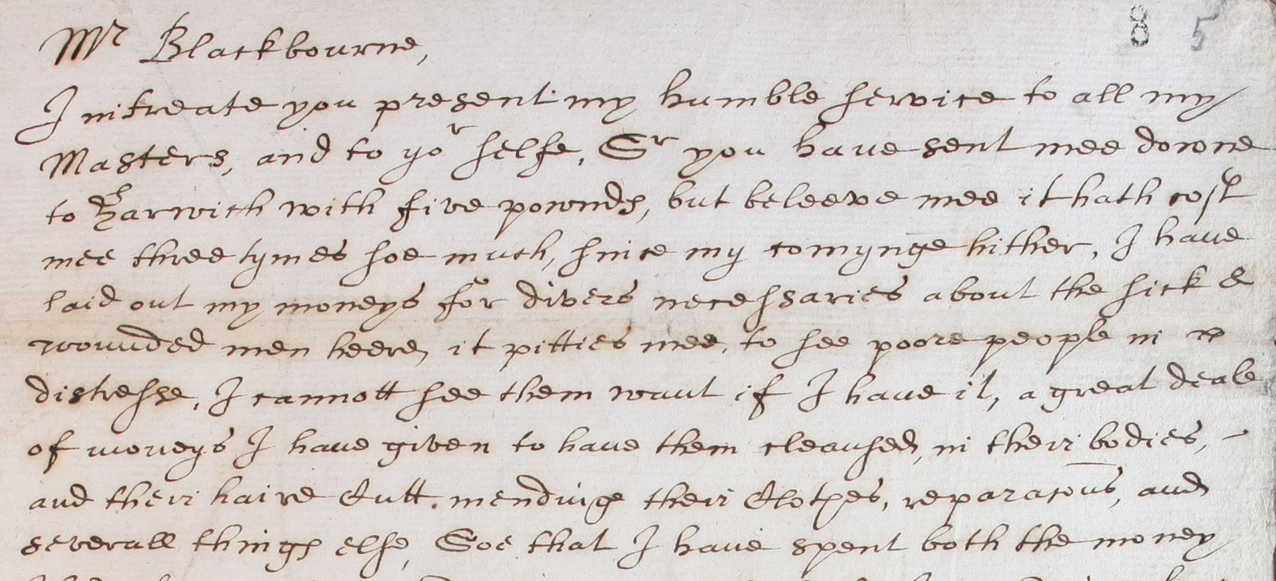
The rise of female spies (2)
Excerpt from Elizabeth Alkin’s petition to Commissioners (1655)
Parliament employed women to gather intelligence against Charles I and his allies.
Elizabeth Alkin identified as spy after she petitions Council of State in 1655 for greater renumeration for intelligence work.
Nadine Akkerman, Invisible Agents (2018): intelligence activities enabled women to play a vital role in EM politics.

Slide 8
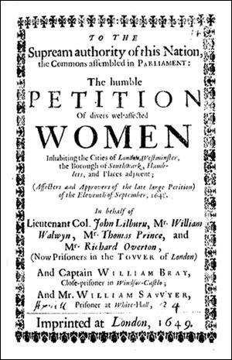
Female petitioners
Widows and poor women disadvantaged by conflict petition magistrates and MPs for assistance or redress grievance
Rise in number of petitions by women during Civil War conflict
Emergence of mass petitions, with thousands of signatures, e.g. 10,000 signed Humble Petition of Women in 1649, defending Leveller values and asking for release of leaders

Slide 9
Women and the radical Religious sects

Slide 10
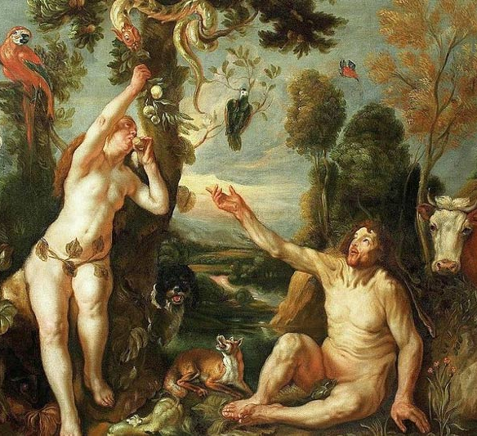
Women and religion
Women are descendants of Eve.
In Protestant and Catholic countries, women were not permitted to have any involvement in the hierarchy of the Church: could not hold official roles and could not preach or minister because not educated in theology.
St Paul: ‘Let your women keep silence in the churches: for it is not permitted unto them to speak’ (1 Corinthians 1:34)

Slide 11
The rise of the Protestant sects
In climate of British Civil Wars in 1640s and 1650s = proliferation of radical Protestant sectarian groups
Included: Ranters, Muggletonians, Seekers, Diggers, Fifth Monarchists, Baptists, Quakers
Many offer women unprecedented place in structure and organisation of their societies = often greater stress on spiritual equality.

Slide 12
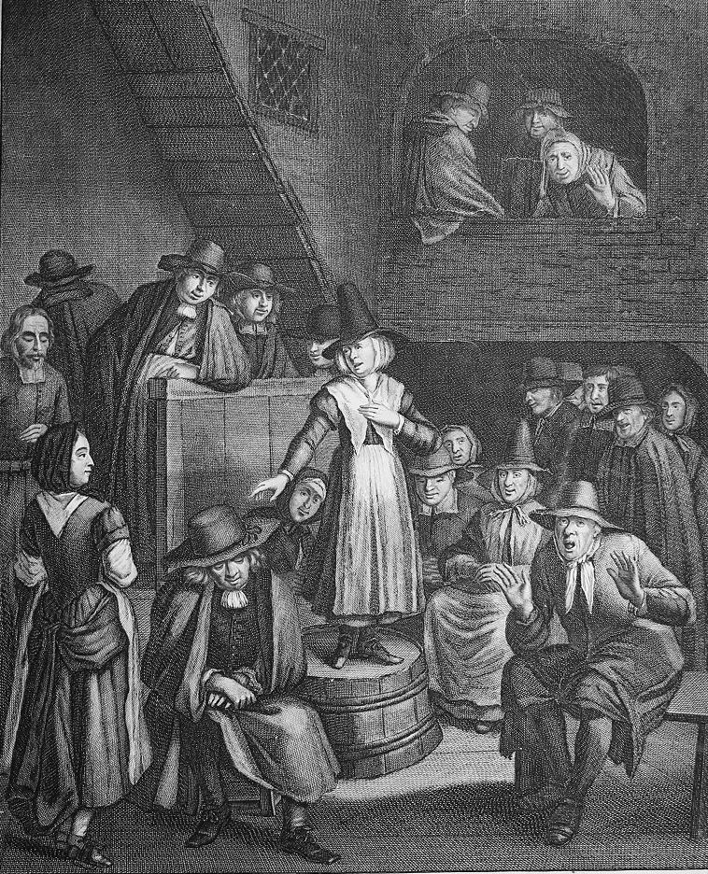
Female prophets
Paradoxically, as weaker vessels women’s bodies were ideal for channelling prophecy
During Civil War conflict, women purported to have visions of great political significance
E.g. Baptist Elizabeth Poole addressed Parliamentary Soldiers in 1648 with vision, which reassured Cromwell of necessity to execute Charles I

Slide 13
Women and the sects
Women often make up the majority of sectarian congregations – often first converts to radical religious movements.
Women, arguably have more time for pious activities
Attracted to join because sects give women considerable concessions in church government, e.g. some Baptist congregations permitted women to debate and vote on church business.
BUT raises issue of conscience: to whom should a woman owe her obedience if she joins a sect without consent of husband or father?

Slide 14
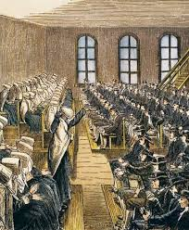
Women and Quakerism
Quakers believe all equal in eyes of God – Quaker doctrine of ‘Inner Light’ meant that anyone could speak or minister
Name ‘Quaker’ derogatory term for physical shaking or trembling of adherents when experiencing divine revelation.
Quakerism = non-hierarchical. Reject education, which meant that anyone could act as preacher in their silent meetings.

Slide 15
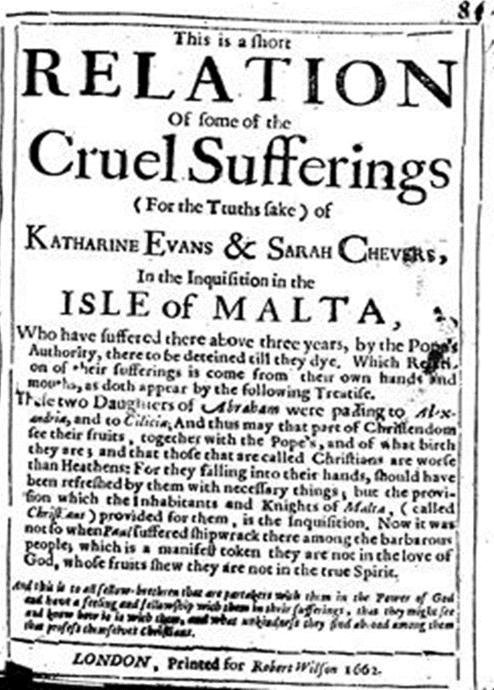
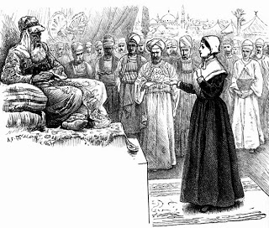
Female Quaker preachers
45% of first Quaker women ministers in the American colonies, 1656-1663 were women
Yorkshire servant Mary Fisher preaching before the ‘Great Turk’ Sultan Mehmed IV in 1658
Katharine Evans and Sarah Cheevers held captive by the Maltese Inquisition 1658-1662

Slide 16
Conclusions

Slide 17
Conclusion
Turbulence of Civil War conflict opens up new spaces and opportunities for women to participate in public and political life.
Women gain legitimacy through their association with female traits, e.g. as ‘weaker vessels’ and as spies.
Religion is not synonymous with repression of women: can be empowering and give them authority in range of settings and contexts. In case of Quakers, gives them a public identity as transatlantic missionaries and preachers.

