Slide 1
Political discourse in early modern Europe
Dr Imogen Peck
University of Warwick

Slide 2
A lecture in 3 parts…
Locating ‘the political’
Texts and contexts: approaches to the study of ‘political thought’
Slavery in early modern political discourse

Slide 3
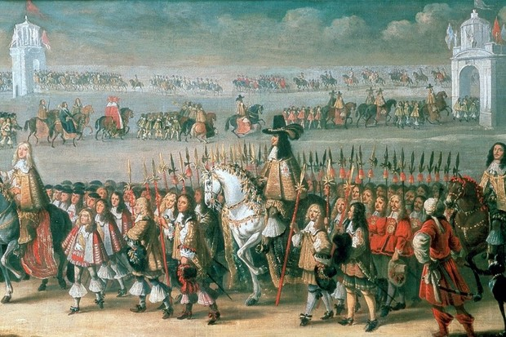
I. LOCATING ‘THE POLITICAL’

Slide 4
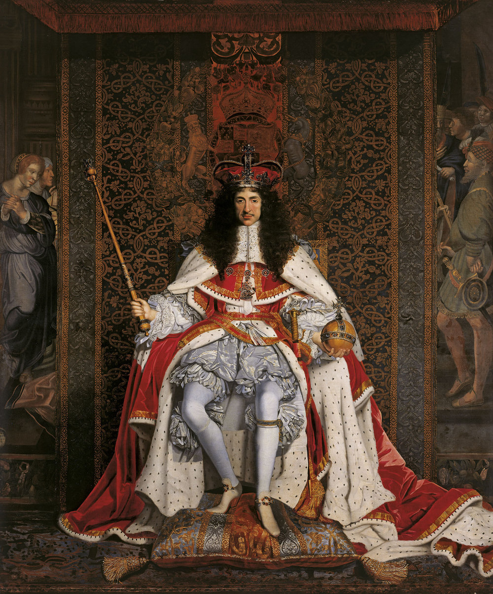
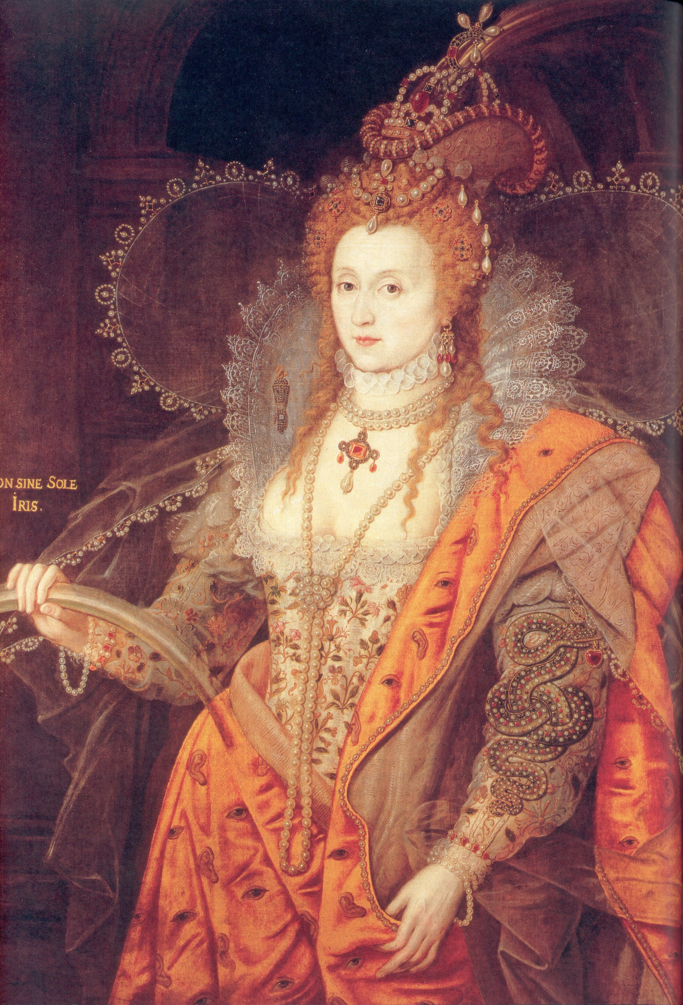
Princes, polities, policies

Slide 5
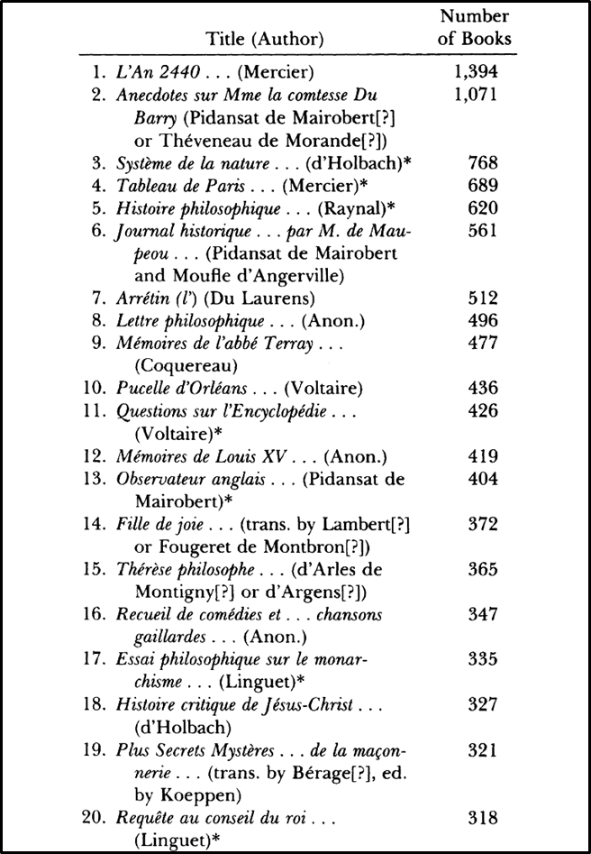
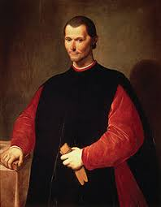
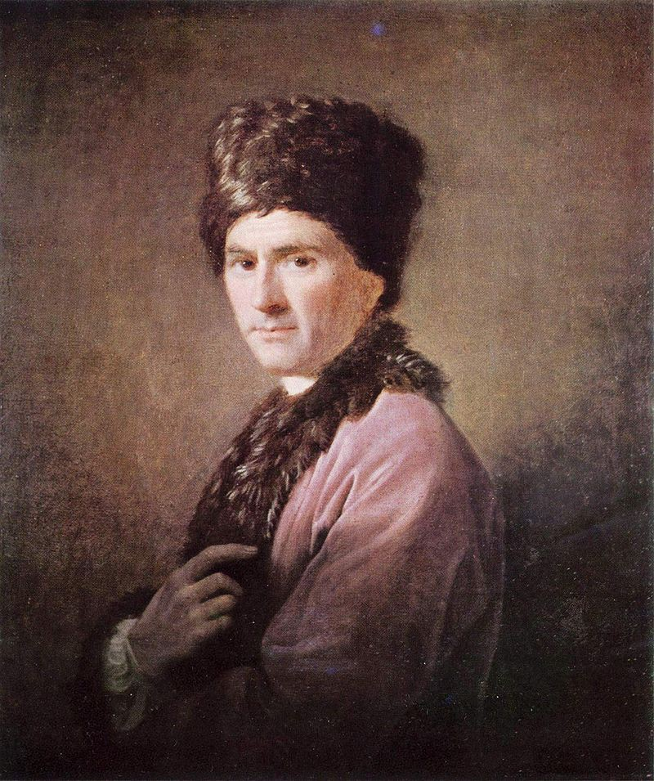
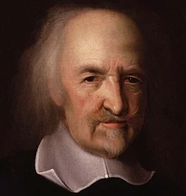
Political thought
Or…
Right from Robert Darnton, The Forbidden Best Sellers of Pre-Revolutionary France (1995)

Slide 6
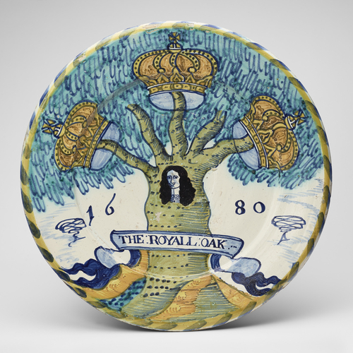
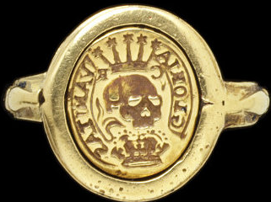
Visual and material culture
Commemorative ring (c. 1649) (left) and charger plate celebrating Charles II’s escape from the battle of Worcester (right)

Slide 7
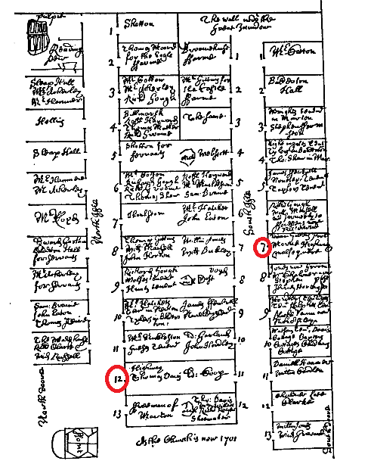
‘popular’ politics
‘The twelfth pew on the south side of the north aisle: was a supernumerary pew at the uniforming of the seats, and no man could claim any right to it. But Margaret, the daughter of Allen Challoner, of Myddle, a blacksmith, did usually sit in it; and now, Thomas Highway, her husband, claims a right to it. But he has another kneeling beside this, and it is not likely, that he being a cottager and paying but a 6d. leawan, should have one whole pew and a kneeling in another pew. Thomas Highway did usually give liberty to other cottagers to sit in this seat, on condition they should pay him money yearly for such liberty. This was a thing never done in this parish before, and therefore Highway was blamed for doing wrong to the parish.’
Richard Gough, A History of Myddle

Slide 8
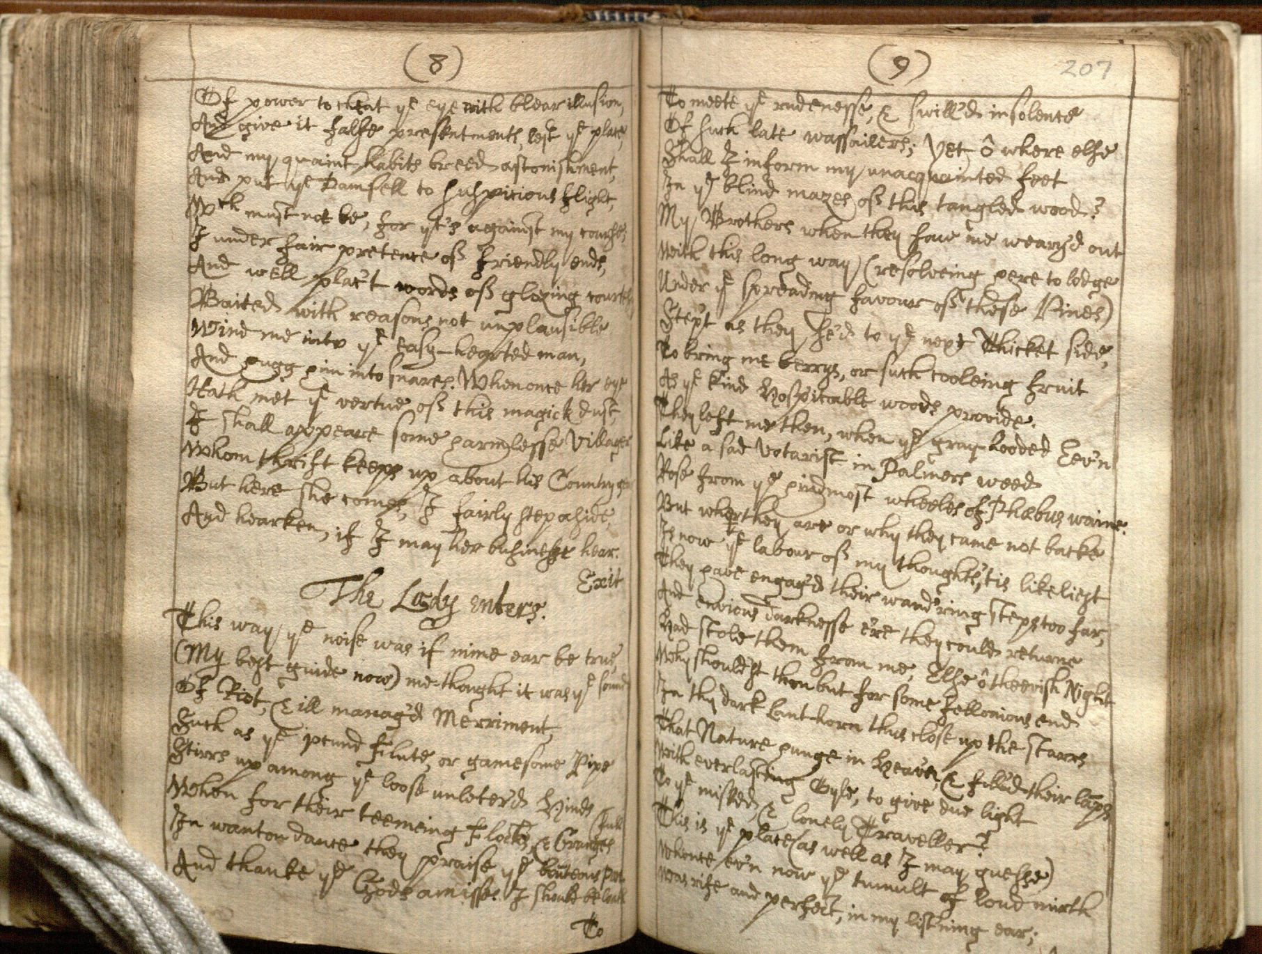
II. Texts and contexts

Slide 9
The meaning of meaning: Skinner and the Cambridge school
Textual meaning – what the words of the text mean.
Semantic meaning – what the text means to someone.
Intentional meaning – what the author was trying to achieve.
Skinner and the ‘Cambridge school’ of the history of political thought emphasise the importance of the third kind of meaning; often known an ‘intentionalism’.
‘Illocutionary force’ - how a text was intended to impact upon a specific historical situation.
See Skinner, ‘Meaning and Understanding in the History of Ideas’, History and Theory (1969).
Quentin Skinner, Visions of Politics I: Regarding Method (Cambridge, 2002), pp. 91-94

Slide 10
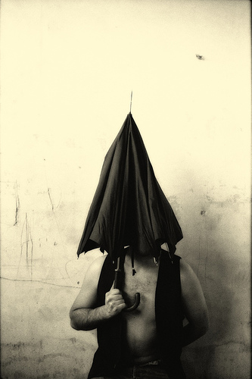
Critiques of intentionalism
Nietzsche's umbrella
‘I have forgotten my umbrella’
Textual meaning
Semantic meaning
X Intentional meaning
Post-modernism
Derrida - the author is fundamentally inaccessible.
Rejects the viability of ever being able to know what an external agent intended by any particular action or speech act.

Slide 11
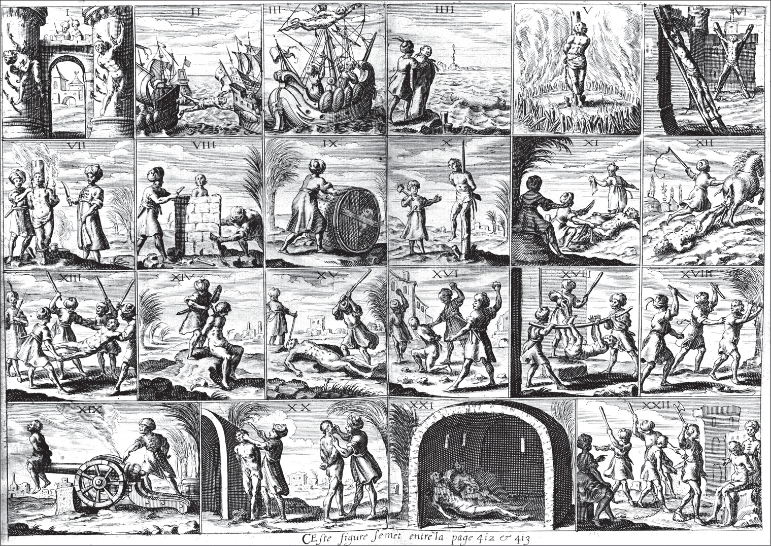
III. Slavery in political discourse
Illustration from Historie de Barbarie (1637) showing the different types of torture inflicted on Christian slaves in North Africa

Slide 12
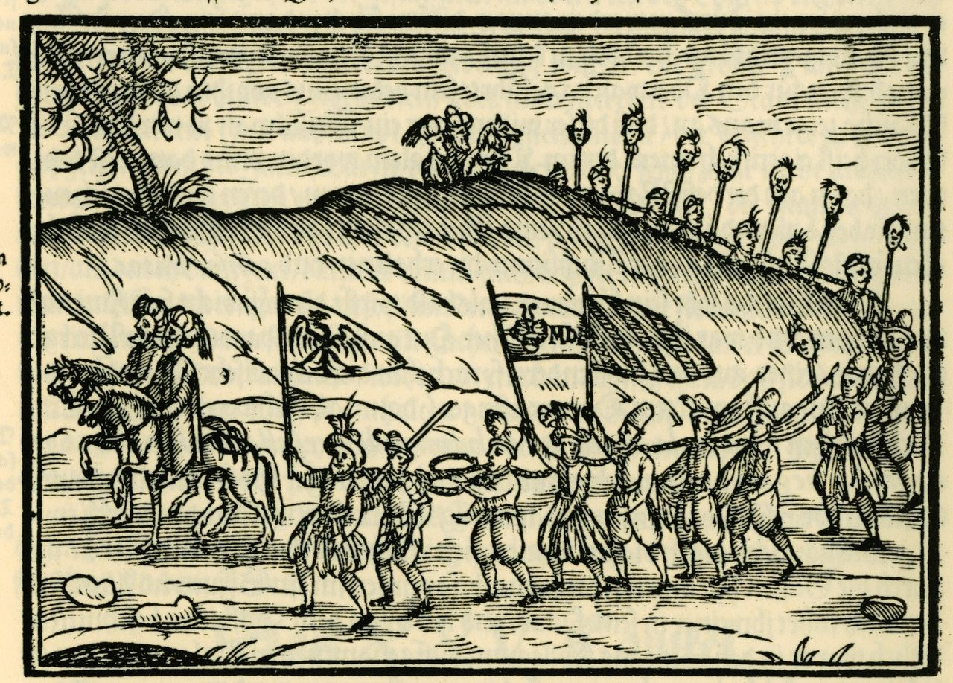
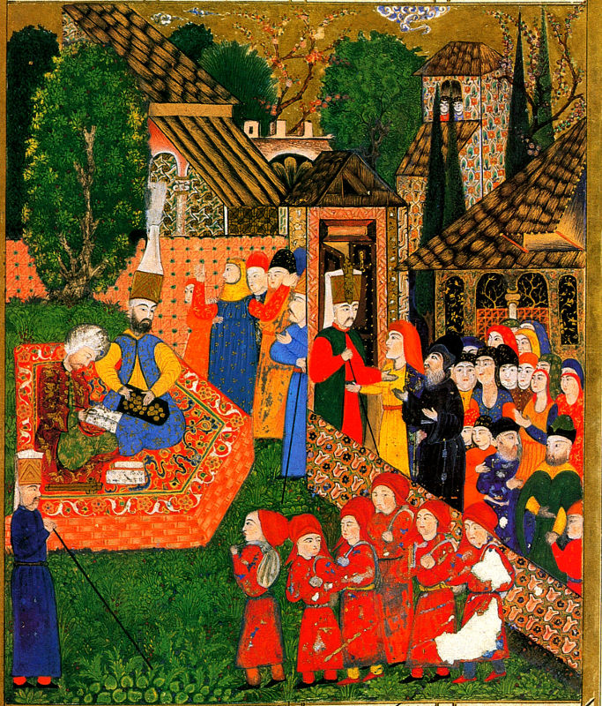
Slavery before the slave trade
Ottomans with Christian slaves depicted in an engraving (1608)
Ottoman painting of Balkan children taken as soldier slaves (1558)

Slide 13
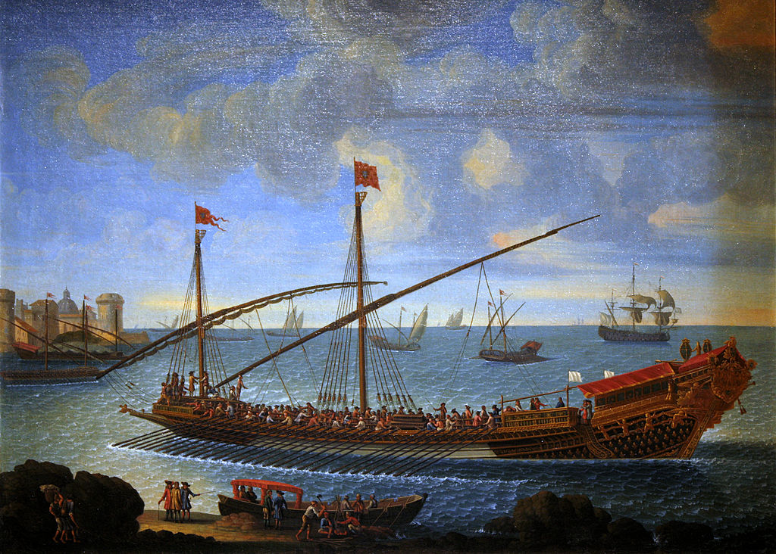
Penal slavery
Thomas More, Utopia (1516)
4 kinds of slavery:
Prisoners of battle.
Convicted criminals, or those from other lands who would otherwise face the sentence of death.
Men from the state of utopia itself who, though ‘being so Godly brought up to vertue in so excelente a commonwealth, could not for all that be refrained from misdoing’.
‘Vile drudges’ from another country, men who chose of their ‘owne free wyl to be a bondman among them’.
A réale galley belonging to the Mediterranean fleet of Louis XIV (1694)

Slide 14
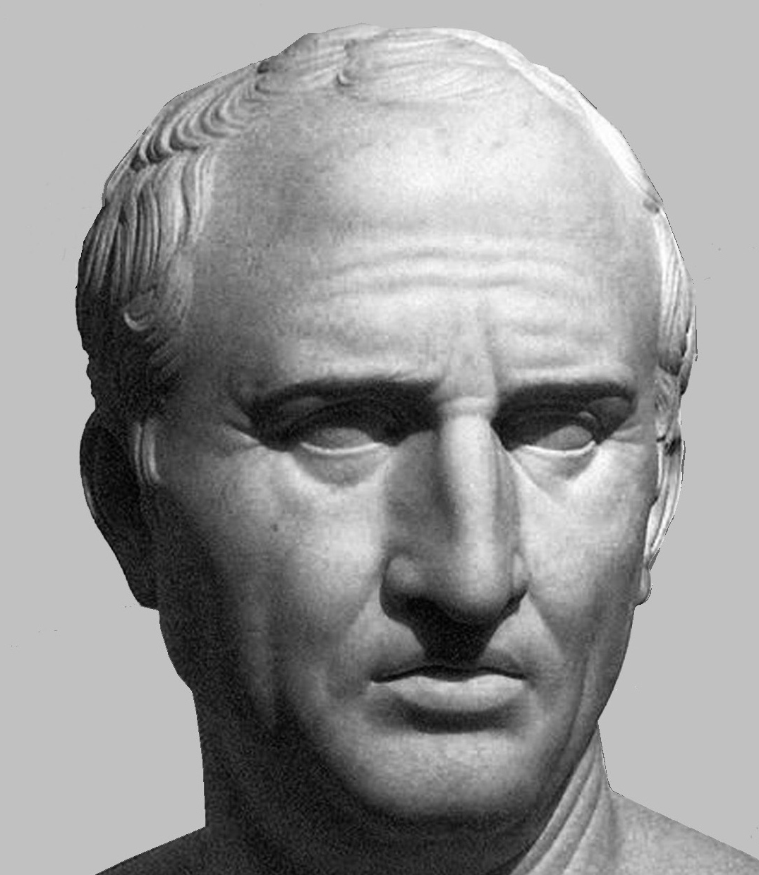
Classical conceptions
‘the fundamental division within the law of persons is that all men are either free or are slaves’.
‘Slavery is an institution […] by which someone is, contrary to nature, subjected to the dominion of someone else’.
Digest of Roman Law
‘Do you call servitude peace? Our ancestosr took up arms not only to be free, but also to win power. You think that our arms should now be thrown away in order that we should becomes slaves. But what cause of waging war can be more just than that of repudiating slavery? For the most miserable future of this condition is that, even if the master happen not to be oppressive, he can be so should he wish’.
Cicero (trans. from Skinner, Visions of Politics vol II, p. 314)

Slide 15
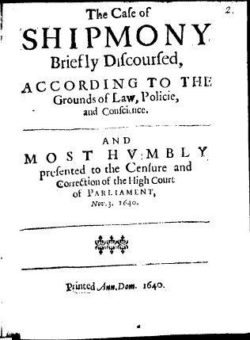
Enslavement and the civil wars
Charles I and his advisers sought ‘to destroy the Parliament, and be masters our religion and liberties, to make us slaves, and alter the Government of this Kingdom, and reduce it to the condition of some other countries, which are not governed by Parliaments, and so by Laws, but by the will of the Prince, or rather of those who are about him’.
The vindication of the Parliament and their proceedings. Or, Their military designe prov'd loyall and legal (1642)
Henry Parker, The Case of Shipmoney Briefly Discoursed (1640)

Slide 16
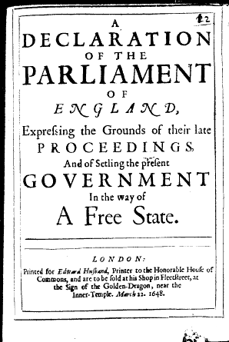
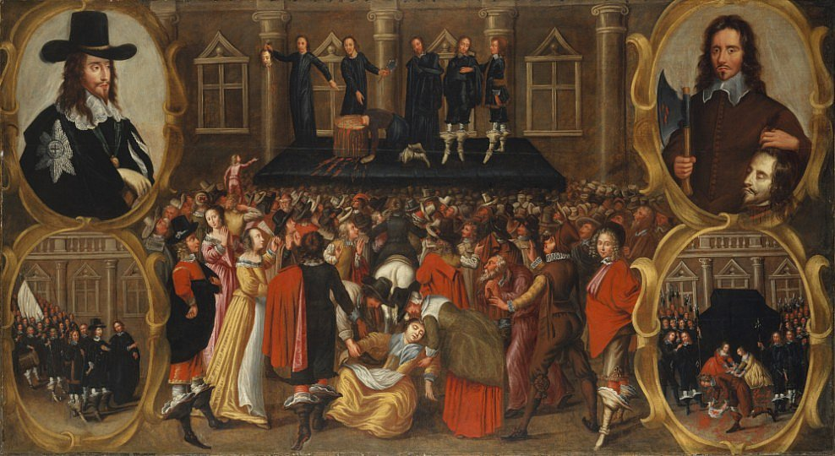
Regicide and republicanism
The execution of Charles I (1649)
A Declaration of the Parliament of England… (1649)

Slide 17
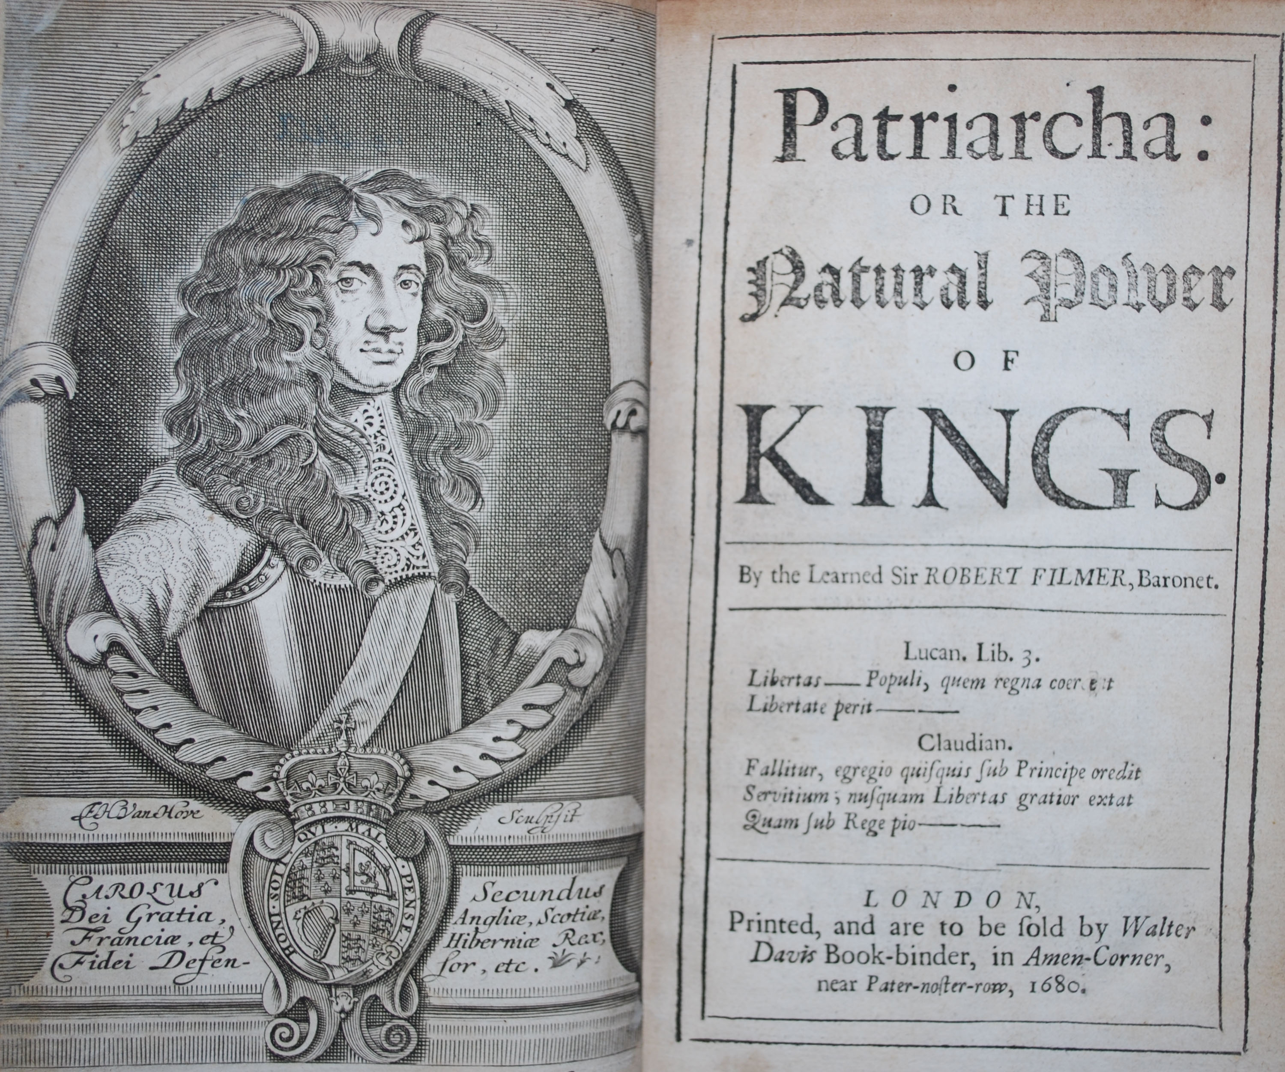
Defences of monarchy
‘Such men must needs take it ill, and be grieved with the state, as find themselves postponed to those in honour, whom they think they excel in virtue and ability to govern. And this is it for which they think themselves regarded but slaves’.
Thomas Hobbes, Elements of Law, Natural and Politic (1650)

Slide 18
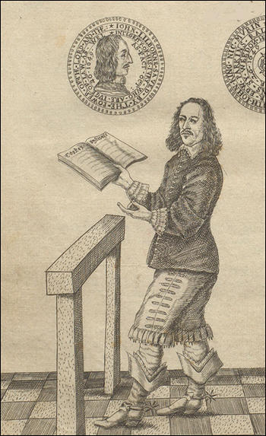
Lilburne and The levellers
John Lilburne, England’s New Chains Discovered (1649)
Criticised the Commonwealth government for:
Failing to call new elections
Establishing a new arbitrary court in the form of the High Court of Justice
Impressing soldiers into service against their will
Called on them ‘to acquit yourselves without fear or dread like the chosen and betrusted trustees of the people, from whom (as yourselves acknowledge and declare) all just power is derived, to free us from all bondage and slavery’.

Slide 19
bibliography
James Davis, ‘Religion and the Struggle for Freedom in the English Revolution’, Historical Journal, 35 (1992): 507–530
Quentin Skinner, Liberty before Liberalism (Cambridge, 1998)
Quentin Skinner, Visions of Politics, 3 vols. (Cambridge, 2002)
Rachel Foxley, The Levellers: Radical Political Thought in the English Revolution (Manchester, 2013)
Michael Guasco, Slaves and Englishmen: Human Bondage in the Early Modern Atlantic World (2011)
Robert Darnton, The Forbidden Best-Sellers of Pre-Revolutionary France (1995)

