Slide 1
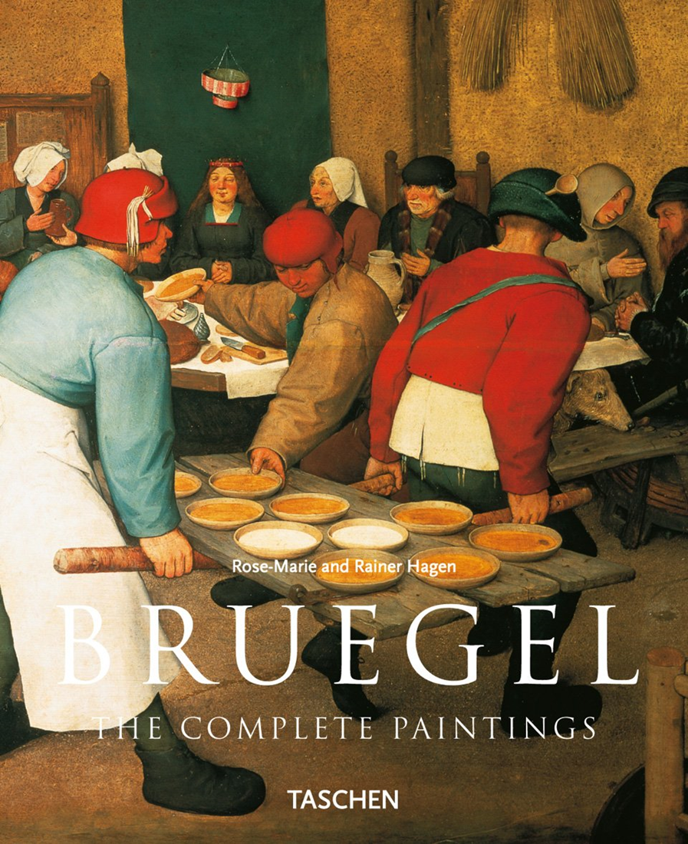
Popular
Culture
Dr Sophie Mann

Slide 2
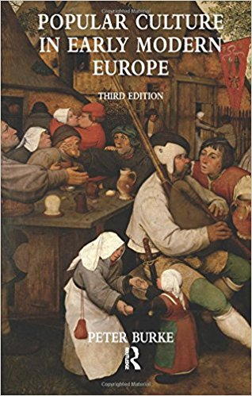
Lecture structure
Definitions: ‘culture’ and ‘popular culture’
Historical approaches to studying ‘popular culture’
How far were there distinct spheres?
Sites and points of overlap?

Slide 3
What is ‘culture’?
Narrow definition: great artworks, literature, performances (Jacob Burkhardt, The Civilization of the Renaissance, 1861)
1960s and 1970s ‘cultural history from below’, influence of sociology and anthropology.

Slide 4
What is ‘Culture’
‘an historically transmitted pattern of meanings embodied in symbols, a system of inherited conceptions expressed in symbolic forms by means of which men communicate, perpetuate, and develop their knowledge about and attitudes towards life.’ (Clifford Geertz, The Interpretation of Cultures: Selected Essays, 1973).
‘“Culture” is a system of shared meanings, attitudes and values, and the symbolic forms (performances, artefacts) in which they are expressed or embodied.’ (Peter Burke, Popular Culture in Early Modern Europe, 1978)

Slide 5
‘Popular Culture’
Whose culture is ‘popular culture’?
‘Popular culture is perhaps best defined initially in a negative way as unofficial culture, the culture of the non-elite, the “subordinate classes”’ (Peter Burke, Popular Culture in Early Modern Europe, 1978)
‘Popular cultures’ refers to widely held and commonly expressed thoughts and actions, structures of feeling and systems of meaning: attitudes and values expressed performatively, symbolically, orally and in writing. Common cultural values spill across tidy social demarcations. The term popular cultures is not intended to imply some firm, exclusive division between popular and elite, high and low, great and little, or learned and unlearned. The ’s’ in cultures represents the subcultural splinterings (or segmentation) of locality, age, gender, religion and class.’ (Barry Reay, Popular Cultures in England 1550-1750, 1998)
‘We could borrow the high/low dichotomizing that marks popular as non-elite … but [I] suggest that what is popular is precisely what is not reducible to such binaries – that popular is common, in the sense of commonly available and commonly espoused’. (Karen Raber, “The Common Body: Renaissance Popular Beliefs”, 2010)

Slide 6
Historical Approaches
Low culture versus high culture:
1970s:
Robert Muchembled, Culture populaire et culture des élites dans la France Moderne (XVe-XVIIIe siècle) - Acculturation in early modern France.
Peter Burke, Popular Culture in Early Modern Europe (1978) - The elite gradually withdrew from popular culture.
Marxist: elite vs plebeian culture. e.g. E P Thompson, “The Moral Economy of the English Crowd in the Eighteenth Century”, Past and Present 50 (1971) - Culture as a nurturing ground for class struggle.
Keith Wrightson and David Levine, Poverty and Piety in an English Village: Terling 1525-1700 (1979) - Attacks on popular culture imposed by the elites and the ‘middling sort’
Key themes: socio-cultural conflict, acculturation, distinct difference

Slide 7
The difficulties of trying to reconstruct long-lost cultural worlds
Available sources: a range of (mostly indirect) legal, administrative, literary and visual records.
Difficulties of looking at popular culture through elite sources, oral culture through written/printed sources
Key methodological questions:
How do historians—heavily reliant, as they are, on written sources produced by the educated elite—actually study the culture of those people who by definition left very few written records?
Our sources provide only indirect access to the ‘popular’, do they tell us more about the producers than about the consumers of these cultural products?
It is possible for popular historians to fall into the trap of assuming too much or reading in a desired outcome. How do we distinguish between a plausible reconstruction of a lost world and an overly imaginative reading of improperly perceived symbols?

Slide 8
Historical Approaches
Historians began to question the conceptual value of a clear elite/popular division.
1980s and 1990s:
C. Ginzburg, The Cheese and the Worms (first English ed. 1980), emphasised circularity and appropriation of culture between different groups eg. the heretical miller Menocchio.
R. Scribner, For the Sake of Simple Folk: Popular Propaganda for the German Reformation (1981), new focus on transmission, exchange within a more unified culture rather than two separate spheres
Barry Reay, Popular Cultures in England 1550-1750, (1998): ‘The people’ encompassed great differences of wealth and education, urban/rural, gender and age, religion. Stressed the plurality of overlapping cultures and the multiplicity and diversity of all cultural activity.
Key themes: interaction, appropriation, plurality, points of contact between the ‘high’ and the ‘low’, the ‘learned’ and the ‘unlearned’.

Slide 9
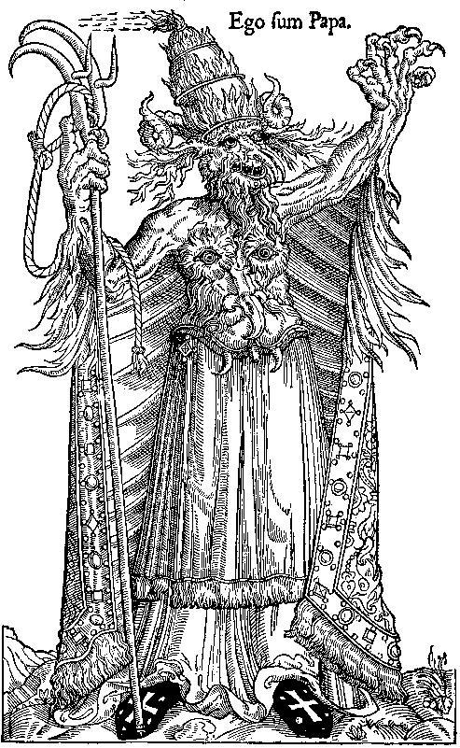
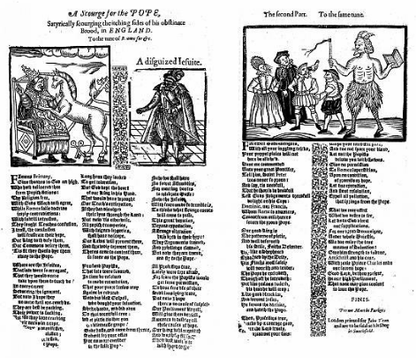
Point of Overlap I: Print
Anti-Catholic English ballad entitled “A Scourge for the Pope”
Anti-papal Satire

Slide 10
Point of Overlap: Print
Popular print was produced in vast quantities and sold for a few pence. Cheap print was circulating widely and penetrating deeply in society.
Historians have sought to study how the written word permeated the fabric of popular culture. How print provided an interface for the unlearned to engage with the learned, and what the significant overlaps were between popular literature and elite literature.
Popular print was in large part produced, and eagerly consumed, by the elite. We therefore find significant overlaps between popular literature and elite literature.
Cheap print helped to disseminate elements of learned culture among the unlearned while at the same time providing points of access for the learned into popular cultures.
This could promote changes in unlearned culture ranging from the promotion of popular engagement with religious and political debate, to the development of popular literacy.

Slide 11
Accessing Print
Increasing literacy offered the lower orders access to the written word, once the preserve of the educated few.
In England at least 60,000 catechisms were published between 1580-1640 and half a million bibles.
Medical advice in the vernacular accounted for only 3 % of total book production between 1485 and 1603, and yet there were probably some 392,000 copies of such words produced in that period.
There were roughly three or four million broadside ballads printed in the second half of the 16th century alone.
By the 1620s they were being complemented by the ‘small book’, or cheap octavo pamphlet. (figures from Adam Fox, Oral and Literate Culture in England 1500-1700)

Slide 12
Print Culture and Oral Culture
The illiterate were still able to engage with print culture. Reading aloud in centres of sociability was a common practice.
Fluid relationship between oral and print culture enabled the written word to permeate the fabric of popular culture.
Printed texts were designed to be read aloud and easily committed to memory (colloquialism, rhyming, alliteration)
““I have observed that many unlearned men have better and more retentive memories that have some schollers [for] such as have not the use of the pen, must use the memory only, which being fed by continuall pondering the things they delight in, becomes as a calendar of their accounts”. John Norder, The Surveyors Dialogue (1610)

Slide 13
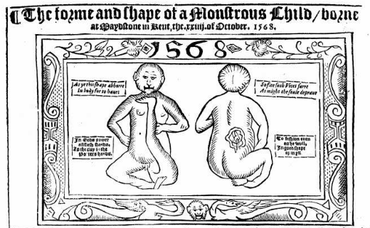
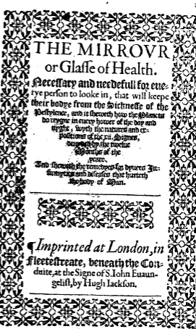
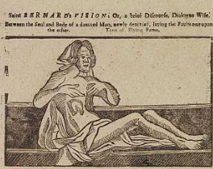
Point of Overlap II: Medicine and the Body

Slide 14
Point of Overlap II: Medicine and the Body
Where the body and illnesses were concerned, the boundaries between learned and popular medicine were porous and blurred.
The assumption that there was a body of superior, medical knowledge accessible only to the educated and a separate popular medicine based on illiterate folk remedies is untenable.
An increasing number of books about the general practice of medicine were published for a lay public. Many of these popular texts became bestsellers, often reaching up to 20 editions.

Slide 15
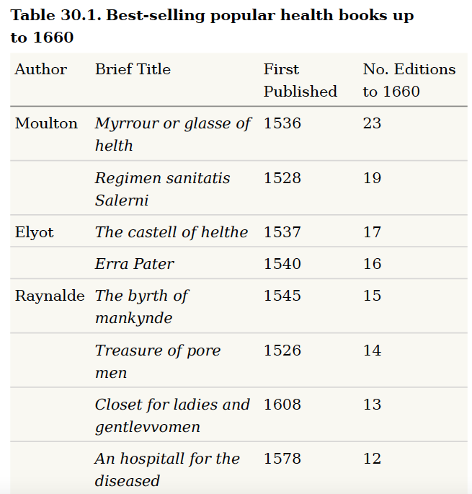
Table from Mary Fissell, “Popular Medical Writing” in The Oxford History of Popular Print Culture, ed. Joad Raymond (2011)

Slide 16
Lay and Learned Medical Views
There was a large degree of agreement between lay and medical views of disease.
Aspects of learned medicine – particularly physiology, regimen and therapeutics- were communicated in medical guidebooks – and evidence from diaries, letters and other literate productions such as plays, poems, broadside and ballads indicate the striking influence learned medicine had on lay medical culture.
There was a tendency for professional physicians to defer to popular attitudes and ideas. Moreover, patients' subjective symptoms were accepted by medical practitioners as real and objective, and the patient's story of disease was often incorporated into elite medical accounts.

Slide 17
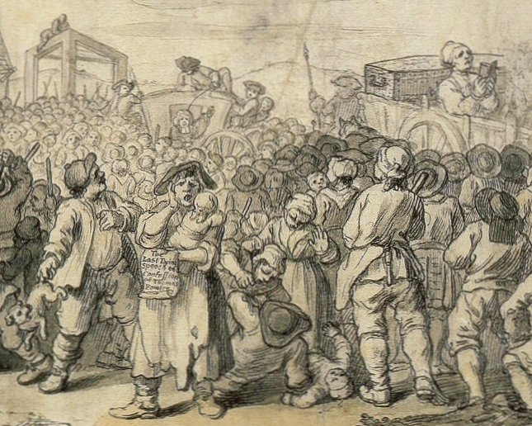
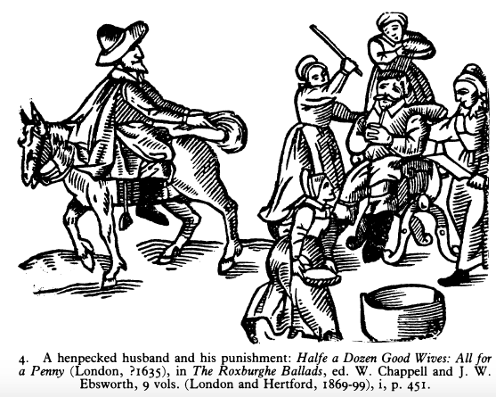
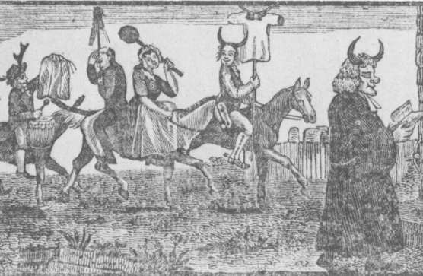
Point of Overlap III: Rituals of Community Censure

Slide 18
Charivari
A noisy, mocking demonstration usually occasioned by a social infraction of community norms (particularly concerning marital relations e.g. adultery, wife dominating husband)
Shaming ritual often involved the transgressor riding backwards on a horse accompanied by ‘rough music’.
Another common motif was the display of animals' horns or horned heads and, sometimes, obscene pictures or other foul objects. Mock proclamations and other legal motifs sometimes appeared, as did parodies of religious rituals.

Slide 19
Charivari – a quasi-judicial punishment?
This shaming ritual has traditionally been conceived as a characteric element of early modern popular culture. However, recently historians have argued that such rituals reflect a combination of popular and institutional sanctions.
The charivari had close affinities with the shame punishments meted out by official tribunals and courts e.g. Star Chamber and the High Court of Parliament in England.
Parallels official forms of exemplary punishment.
See, for example, Martin Ingram, “Ridings, Rough Music and the ‘Reform of Popular Culture’”, Past and Present 105 (1984); Laura Gowing, “The Language of Insult in Early Modern London”, History Workshop 35 (1993).

Slide 20
Charivari – a point of contact with elites?
More substantial members of the community often encouraged the demonstrators and sometimes took active part.
Despite growing social and cultural stratification immersion in high culture did not necessarily entail a repudiation of all folk practices.
The patriarchal ideal was shared across the social spectrum.

Slide 21
‘Popular Culture’ - where do we go from here?
For all the recent emphasis on shared cultures, and on cultural interaction between the high and the low, the learned and less learned, it remains apparent that people’s cultural experiences did vary according to social status and upbringing. Although most people might have participated in a shared print culture, did they participate in it in the same way?
Historians have increasingly focused on popular literature and cheap print. Does this medium reflect or seek to control popular culture?
“culture’ is neither uniform, static nor homogeneous, certainly not in complex societies such as those of pre-industrial Europe. Culture is not only multivalent, but also involves complex processes of inculcation, appropriation, competition, assimilation or rejection of any given set of cultural values or practices”.
“Our working understanding of the subject should now include the notion of popular culture as dynamic, as something not frozen in time but continually changing… we should be aware that popular culture is not something self-generating, but that it is be shaped in both conscious (and unconscious) ways from outside and from within itself, and especially ‘from above’, by hegemonic or dominant elites”. (Robert Scribner, “Is a History of Popular Culture Possible?”, History of European Ideas, 18, 1, 1989)

