Slide 1

Power and Authority
Mark Knights

Slide 2
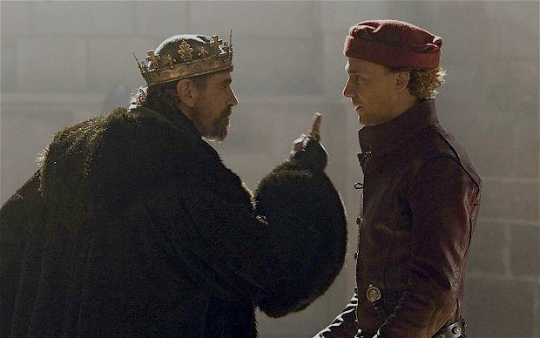
Lecture outline
Overview of our next block of topics: the political landscape
What is a state and what type of state structures characterised early modernity?
Focus in on kingship and its quest for expanded powers
What distinguishes power from authority? What challenges did powers face?

Slide 3
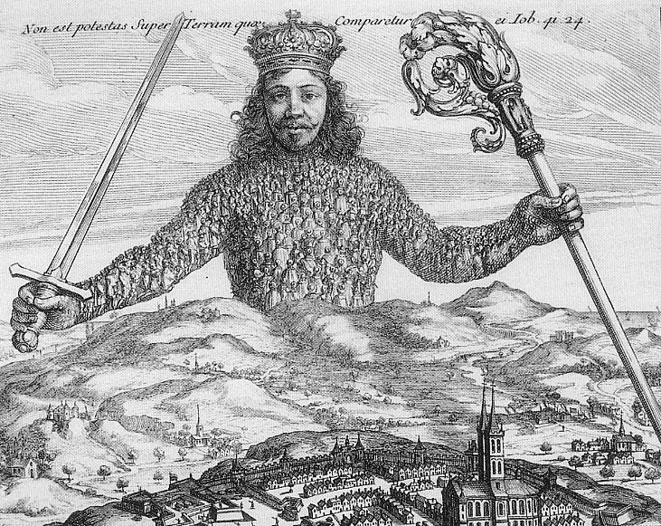
What is a state?
The state emerged as a concept and term in this period (Quentin Skinner, ‘A Genealogy of the Modern State’, Proceedings of the British Academy 2008) – also ‘realm’, ‘body politic’
‘state building’ vs ‘state formation’
Jean Bodin: “It is the distinguishing mark of the sovereign that he cannot in any way be subject to the commands of another”. The state was the union of the people under the same sovereignty’.
Six Books of the Republic (1576)

Slide 4
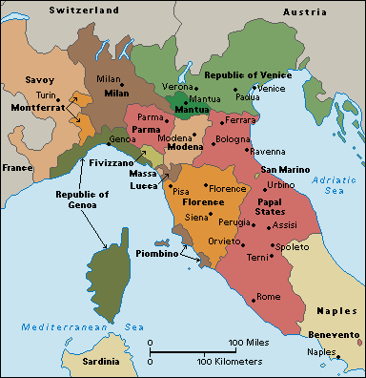
Types of polity
There were different ways of constructing the state
Europe c.1450 comprised 1000+ independent polities (less than 350 by 1700)
Republics
City states Greater civic participation, though still domination of elites/oligarchies eg Venice governed by c. 40 families
Monarchies – with different types
Empires. ‘empire’ / ‘imperium’ = dominion, sovereignty, not territorial conquests – but this changed over time

Slide 5
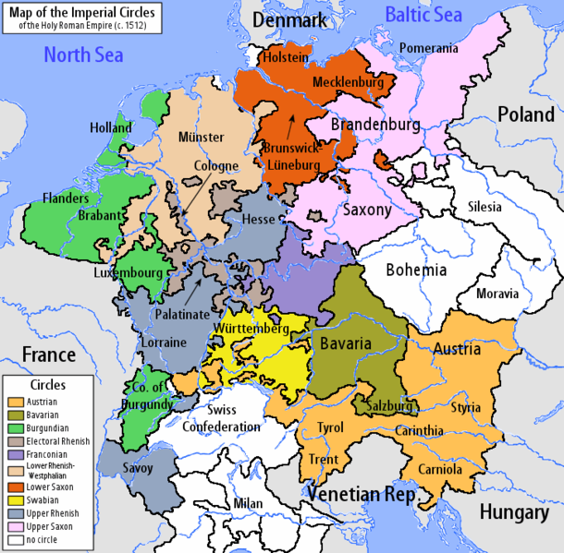
Elective monarchies: Holy Roman EmpireEmpire
Collection of c.300 semi-autonomous states; regional powers; and 66 free cities.
Under control of ‘Holy Roman Emperor’ (e.g. Austrian House of Habsburg)
Elected rather than hereditary monarch
10 Imperial Circles created by 1512 – for defence, taxation, peace-keeping etc.
Parliament of each circle = Kreistag

Slide 6
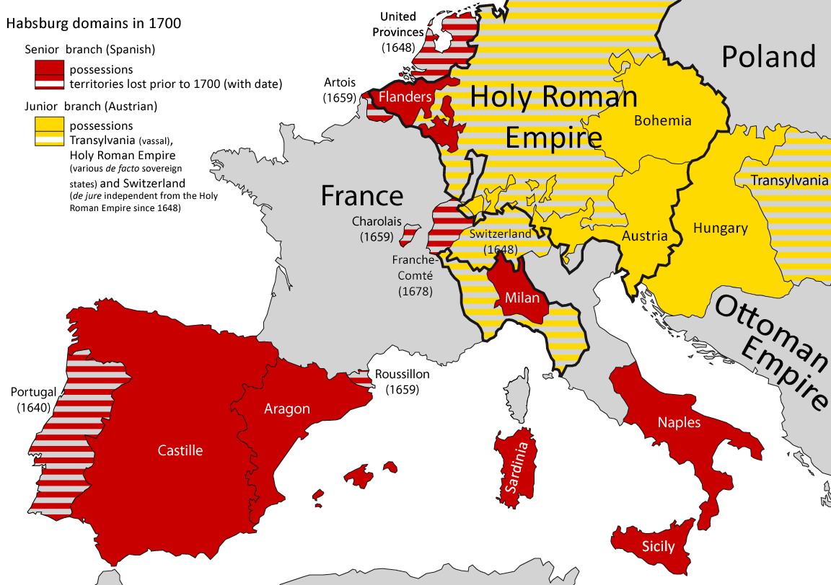
composite monarchies (Elliott).

Slide 7
Kingship
dynastic hereditary monarchies – England, France, Spain
Kings possessed largest armies and bureaucracies
Kingship rested on spiritual and legal claims to power
External ambition proceeded simultaneously with internal centralisationc.1500-1650
Control over the Church – in Catholic as much as Protestant states.
Expansion of the court into a major centre of government.
Expansion of control over the regions – attempt to create legal and political uniformity
‘Absolutism’

Slide 8
Expansion of Monarchical Power (1) Territorial conquest
Driven by better funded imperial armies and better technology
Spain:
Conquer Valencia, Catalonia, the Netherlands and Portugal in C16th, and Mexico and Peru
Italian Wars 1494-1559:
City states fall in face of French, Austrian and Spanish expansion
By 1559 – only Venice and San Marino retain independence

Slide 9
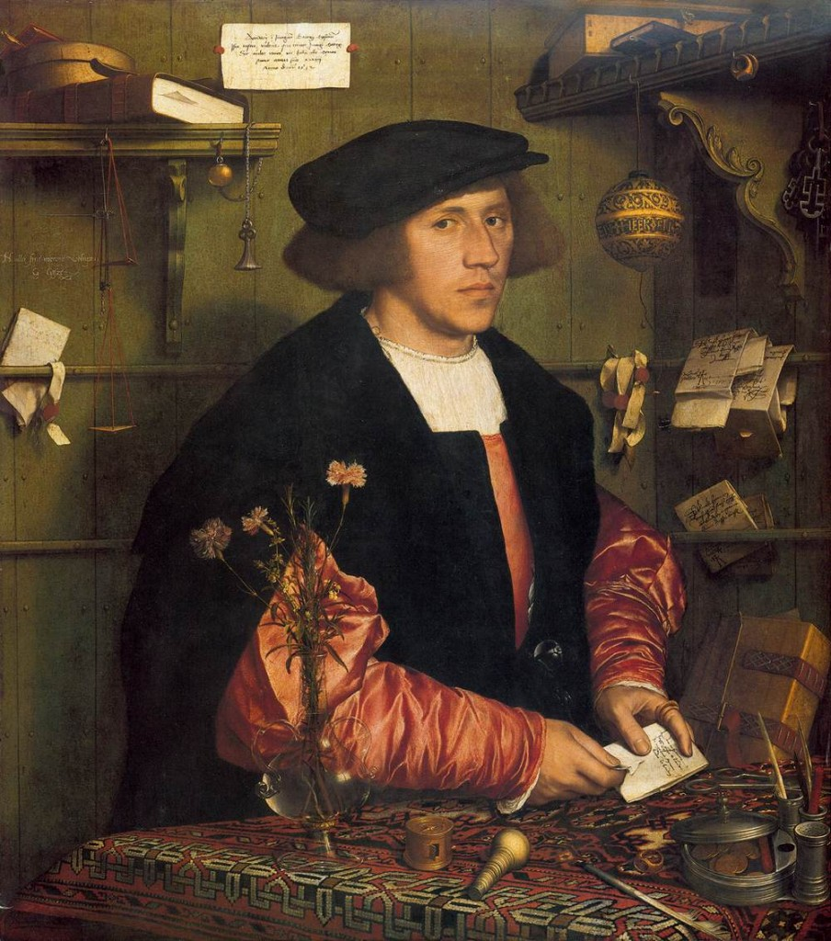
(2) Domestic centralisation: over the Church
Protestant Reformation gives secular rulers ability to limit power of bishops and Popes over territories.
Thomas Cromwell (1533): ‘this realme of England is an Empire ... governed by one supreme head and king having the dignity and royal estate of the imperial crown of the same, unto whom a body politic... be bounden and owe to bear next to God a natural and humble obedience’’
In Catholic as much as Protestant states:
1516 Concordat of Bologna – papal bull giving kings of France given right to nominate appointments of all bishops
1555 Holy Roman Empire states - adopt policy of ‘cuius region, eius religio’ – of him the region, of him the religion
Thomas Cromwell (1485-1540): chief advisor to Henry VIII 1532-40

Slide 10
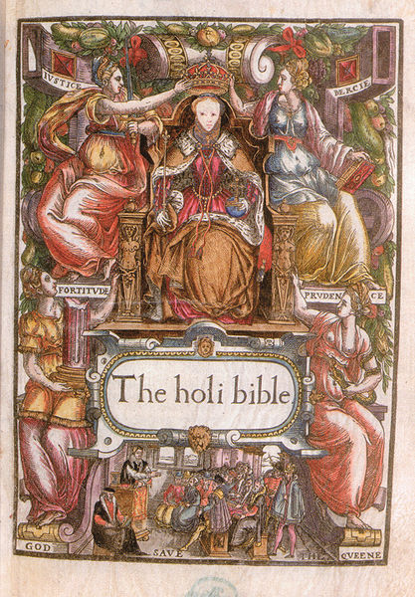
Strong religious ideology underpins dynastic monarchies
Monarchs appointed by God to rule (‘Divine Right’)
Shakespeare - Richard II:
‘Not all the water in the rough rude sea can wash the balm from an anointed king; The breath of worldly men cannot depose the deputy elected by the Lord.’
Cardinal Richelieu (advisor to Louis XIII of France): ‘kings are the living images of God’.
Frontispiece to Bishop’s Bible (1569) from reign of Elizabeth I

Slide 11
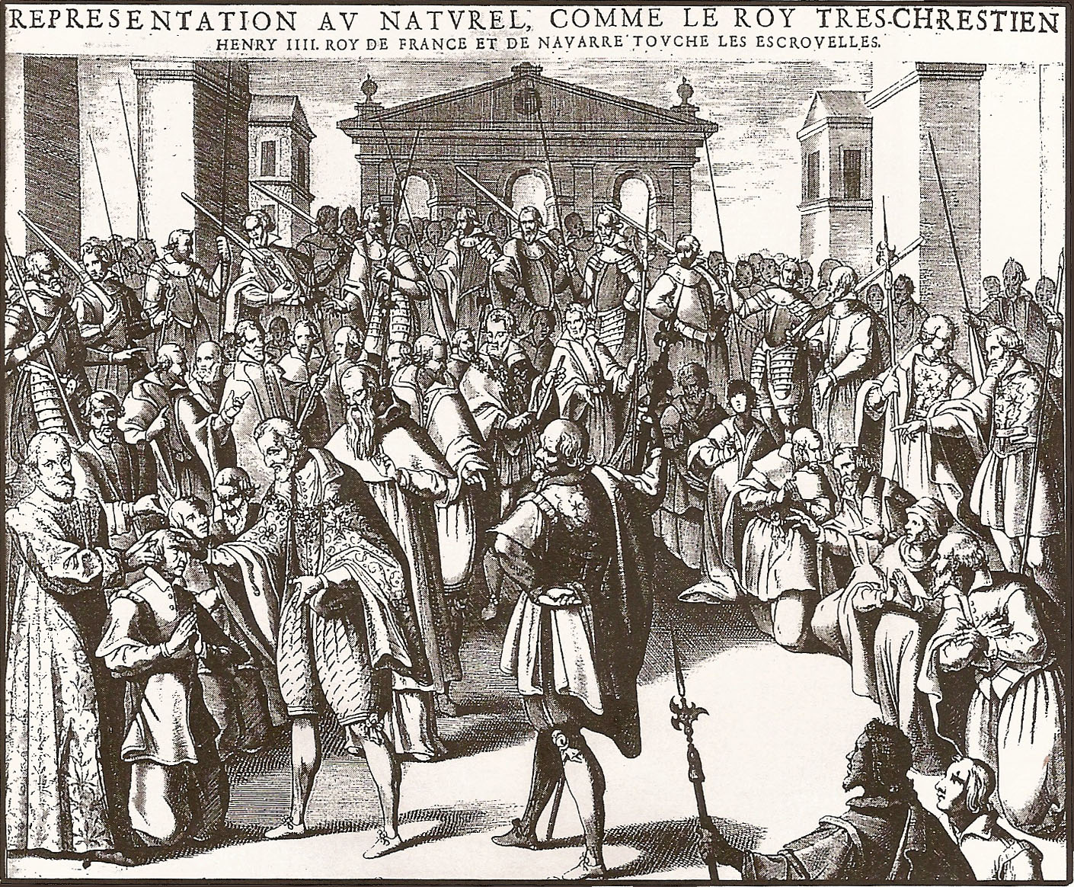
The King’s Evil: Divinely appointed kings have power to heal scrofula through touch touch

Slide 12
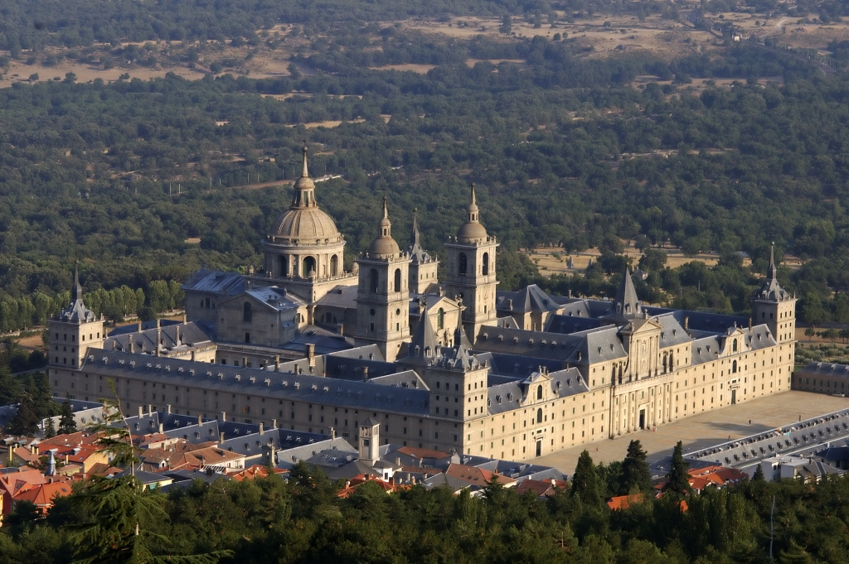
3. Expansion of royal court
Court became a major centre of government
Before 1500 courts = highly mobile and not fixed
1500-1750 = became permanent seats of gov. administration
Escorial Palace, Madrid
Spanish Court: 1561 - permanently established in Madrid becoming lynchpin of central government.
Emergence of new class of royal official and bureaucracy
During Henry VIII’s reign in England - Thomas More and Thomas Cromwell

Slide 13
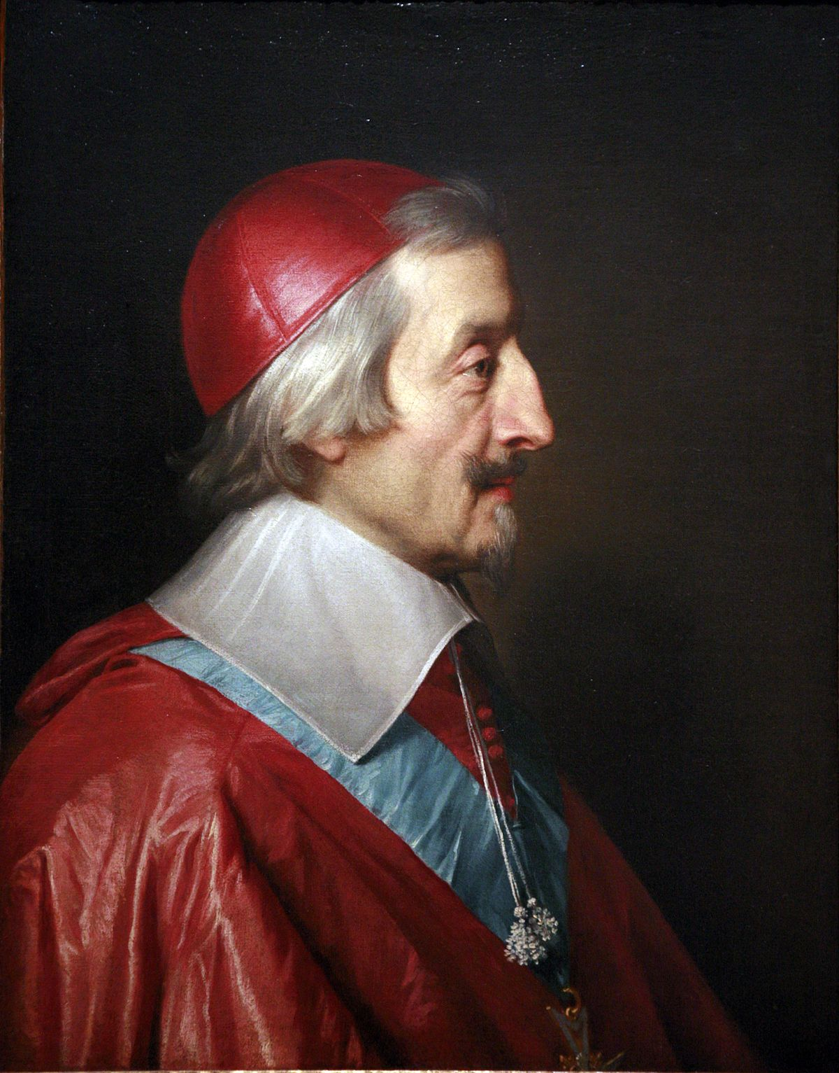
34. Legal and Political uniformity
Spain under Philip IV and Count Olivares, 1620s-40s:
‘one king, one law and one coinage’ across Spanish domains;
1632 - control of cities taken from Castilian Cortes
New military policy called ‘Union of Arms’
Centralisation in France under Cardinal Richelieu from 1610s:
Dilute power of nobility with royal councils and provincial officials called Intendants
Intendants can raise troops, administer justice, raise and collect taxes
1515 1 royal official : 4,700 inhabitants;
1665 1 royal official : 380 inhabitants

Slide 14
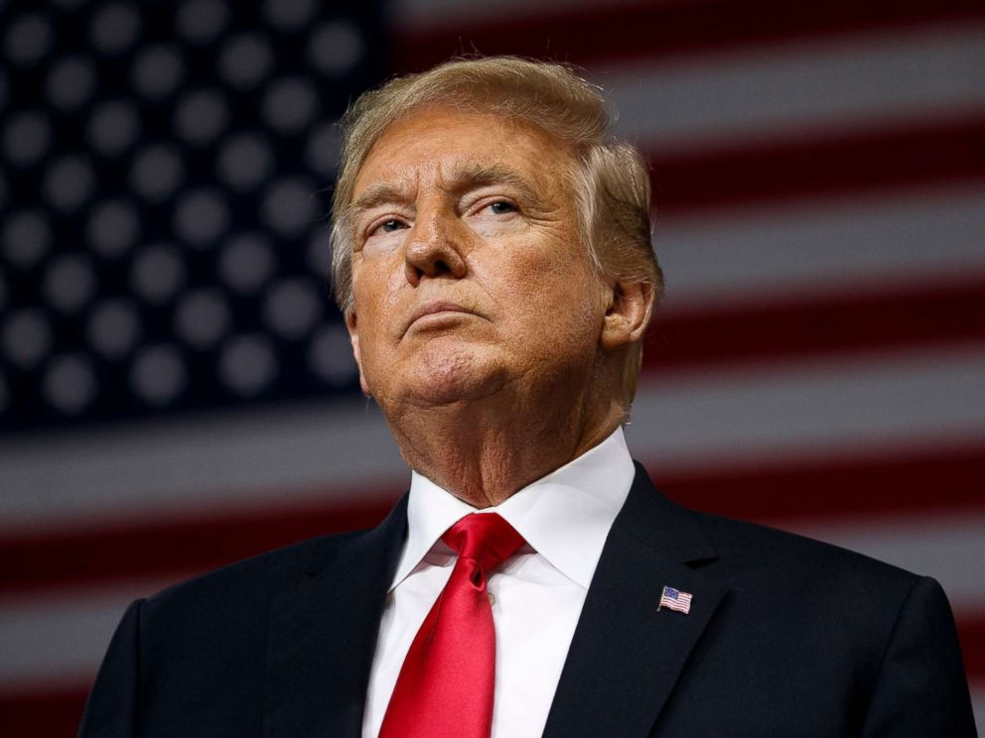
What is the difference between ‘power’ and ‘authority’?
Force – legitimacy
https://youtu.be/1NOjkmkanrc
Trump
Social power is political power?

Slide 15
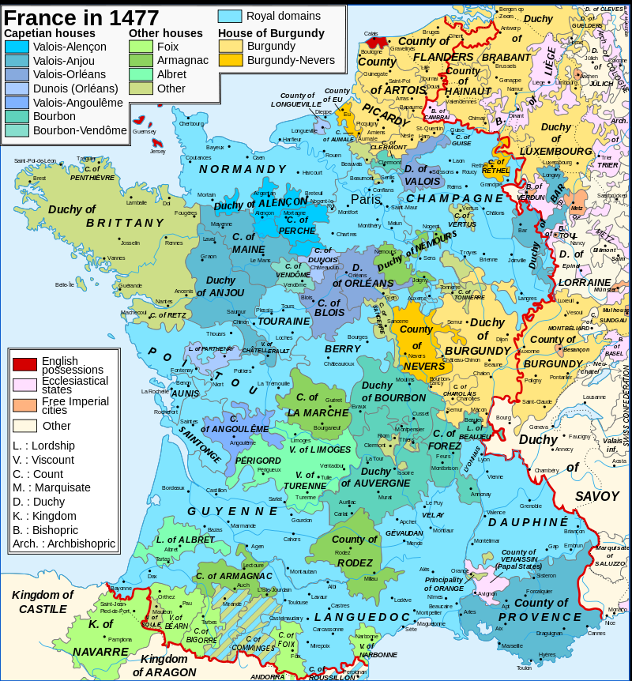
‘Composite monarchies’ (J. Elliott)
2 1. Diversity of languages, institutions, systems of law, regional identities
France
No official language until 1539
Even in 1515 only one royal official for every 4,700 inhabitants.
1620 – Béarn made part of France, but retained rights, privileges and customs.
Collection of states under one ruler, but each state retains their own local traditions and legal structures.
Spain
Forged with houses of Aragon and Castile (marriage of Isabella and Ferdinand in 1469)
C16th absorbs Catalonia, Valencia, Sicily, Naples, provinces of Netherlands (c.1506) and Portugal (1580)
BUT regional political structures retained
Challenges and constraints to royal power

Slide 16
22. The Nobility
Political order in 1500 = feudal
Feudal state composed of overlapping authorities, rather than single sovereign
Power of ruler bound up with regional aristocrats (not king) who have right to wage war, tax subjects, administer and enforce law
Nobility from ancient warrior class – dominate government at all levels.
Nobility most significant check on growth of royal power in Europe

Slide 17
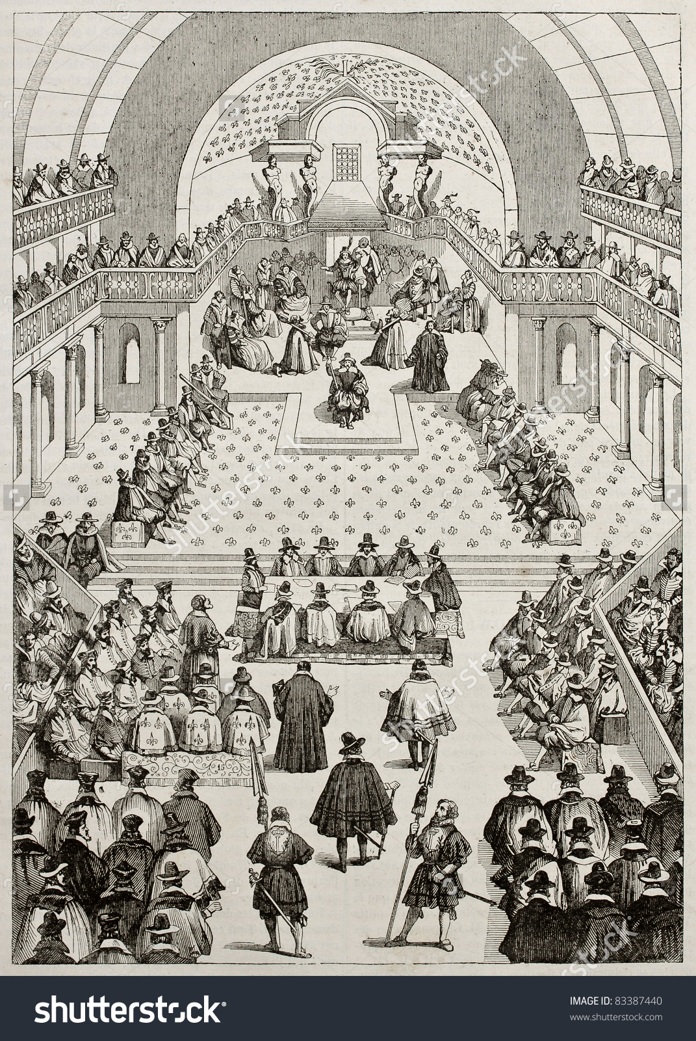
3. Representative institutions
Local and regional assemblies found across Europe, bringing together nobility, church and commons.
e.g.:
Cortes of Aragon and Castile
Parliaments of England, Ireland and Scotland
France: Local Parlements have some power to veto royal decisions; Estates-General esp. during national crisis
Have limited law-making powers
Rights to bring grievances to princes, take charge of taxation, oversee legal cases.
Needed by kings to raise taxes and armies

Slide 18
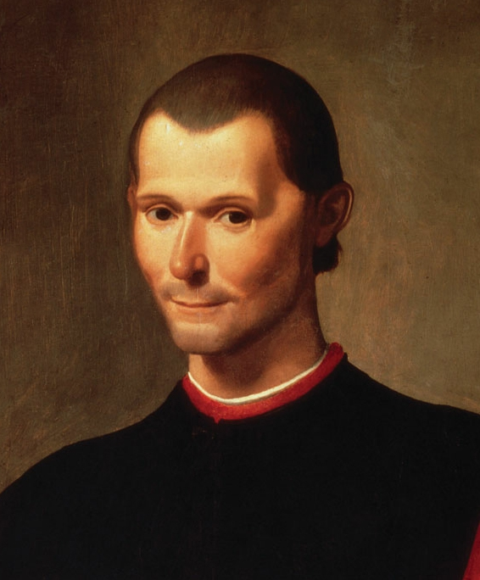
4. Republican tradition
Republicanism – idealisation of classical antiquity; Machiavelli
‘Monarchical republicanism’
Patrick Collinson – ‘monarchical republic of Queen Elizabeth I’.
Mark Goldie – C16th England ‘an unacknowledged Republic’
‘chief inhabitants’ of towns and cities closely involved in their governance.
‘enslavement’
right to resist?

Slide 19
Rebellions
Most rebellions were regional/ national – opposition to central control, officials, courtiers eg 1640s Rebellions in Naples, Catalonia and Portugal against Philip IV of Spain and Count of Olivares > Portuguese independence
Aristocratic-led but with significant elements of popular participation.
Rebels adopted rhetoric of legal and political conservatism
Most explosive rebellions occur when a region had a different religious identity to its prince.
Radical doctrines in both Reformation (e.g. Calvinism) and Counter-Reformation suggest that heretic ruler could be resisted or even overthrown.
Clash between the ideology of the European Reformations (Catholic and Protestant) and the ideology of the Divine Right of Kings.

Slide 20
Conclusions
Variety in types of early modern state: hereditary monarchies, city states, republics, composite monarchies, elected monarchies
Tension between state-building aspirations of monarchs, and existing structures, e.g. parliaments, regional assemblies, nobility.
Transition from feudal to sovereign/imperial state = complex and contingent process
Changes affected by other developments – religious and technological change, and intellectual developments (e.g. humanist thought)

