Slide 1
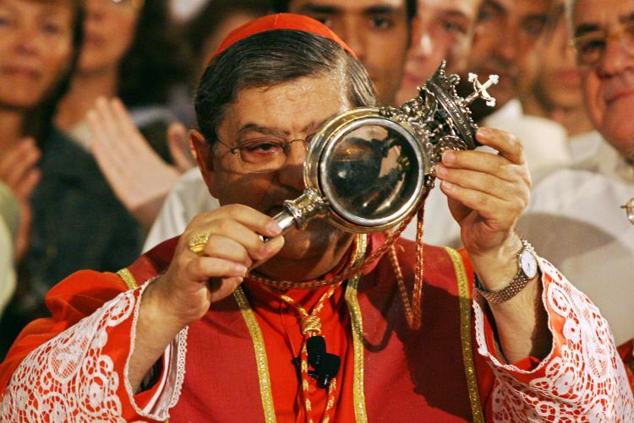
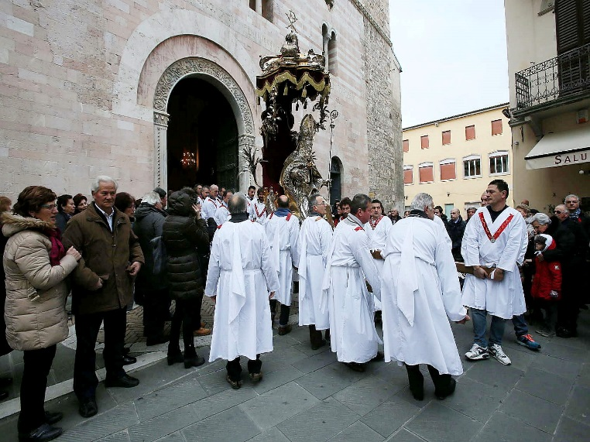
Late Medieval Church
─The Church was solid. Medieval Latin Christianity was an insecure religion surrounded by enemies, threatened by demonic forces -Humanism- anxious about an end always imminent.
─The Catholic Church embraced a variety of standpoints.
─Religion was regionalised.
─Papacy recovered strenght from the Great Schism (1378-1417) and Conciliarism.
─It turned on itself. National churches emerged all over Europe. Composite Monarchies.
The power of Rome was limited.

Slide 2
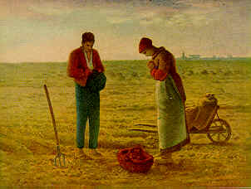
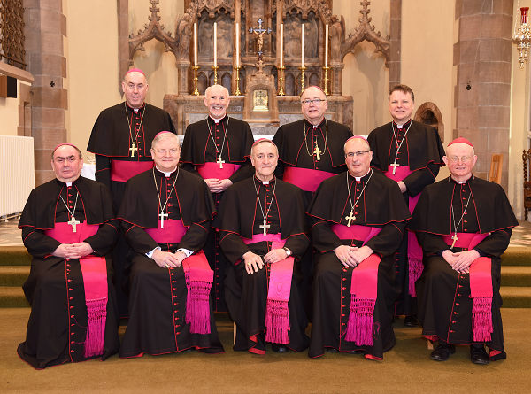
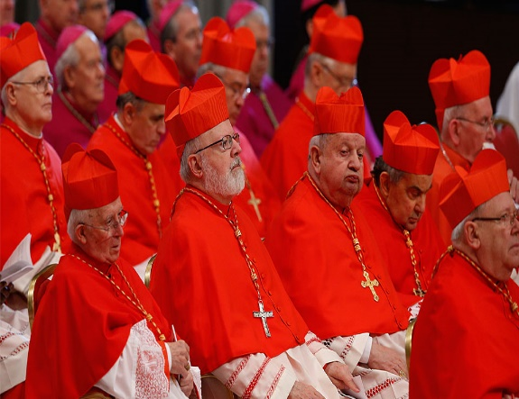
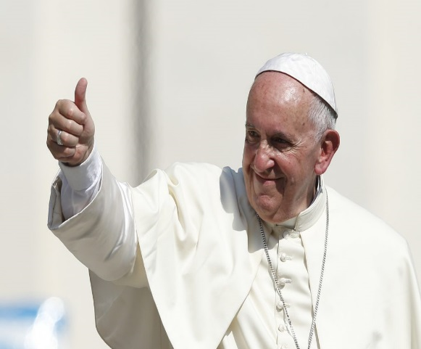
The Hierarchy
Religious services defined time, daily life and dietary requirements.
The Faith shaped a familiar world, provided sense of continuity
and community.
Secular clergy: lived in the world -bishops and priests.
Regulars: observed a rule of chastity and obedience. Mysticism, preached, sheltered pilgrims, offered charity -Nuns, monks and friars.
Pope, successor of the Apostle Peter, Bishop of Rome.
Elected by the cardinals, chosen by previous popes among the bishops (men in charge of regional units known as diocese or bishopric)
Clergy immune from taxation, judged in separate courts.

Slide 3
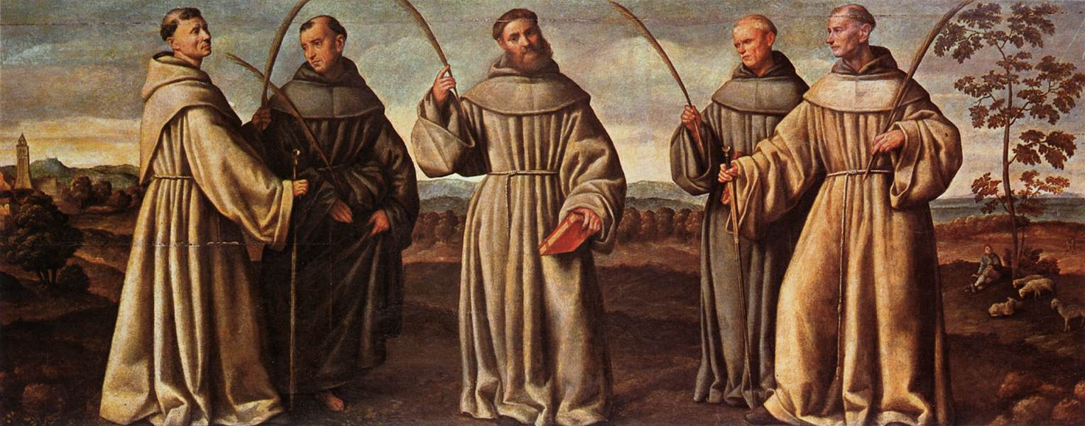
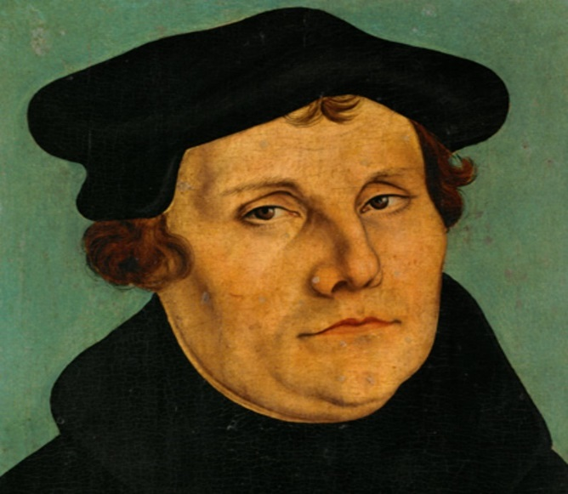
Belief and Practice: Catholicisms
Laity participated. Attention on clerics, (private chaplains).
At the local level there was religious vitality.
Religious orders (Dominicans, Franciscans, Augustinians) religious enthusiatic.
Martin Luther was an Augustinian Monk.
Belief and Practice: Sacraments, 10 Commandements. No sins, attend the 7 works of mercy.
Mass: most important celebration.
Eucharist, presence of the Christ. (Transubstantiation)
Religion flexible and variable.
Catholicism regional and fragmented (local commemorations of saints)
Theology: regional and gradations in spirituality.
But people of pre-Reformation Europe were true Christians.
>The learned theologised and the unlearned believed and prayed.
We can speak of Catholicisms.

Slide 4
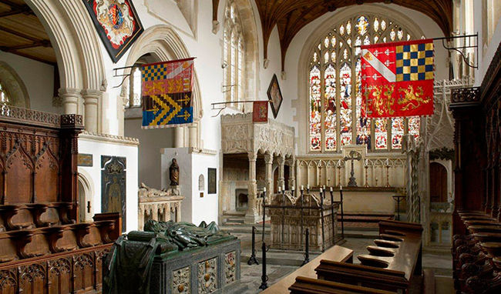
Low and High Spirituality
Printing in vernacular. Debates among the learned
Time of mysticism and Christocentric spirituality.
Guilt culture. Purgatory offered release.
>Speedy transit (at a price) with masses, indulgences or
pilgrimages.
Emphasis on the Mass:
>(Transubstation) re-sacrifice the Son to the Father.
Priest: primary role. laity as spectators, but they did understand and participated in rituals.
Catholic Church sustained religious piety. (gentry financed their parish churches)
Popular and religious beliefs overlapped.
Even Erasmus believed had been healed by a Saint.
No decadence or apathy. The Medieval Church was its own sternest critic.
Arundel Castle

Slide 5
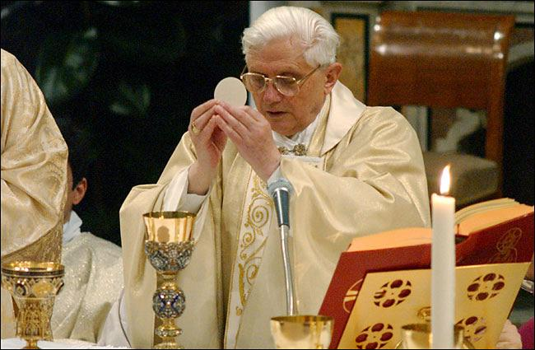
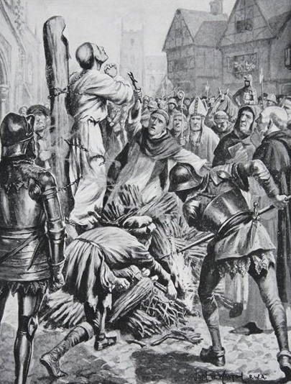
Heresy
Who is the heretic?
Attended the services of the Church
Heresy was a communal activity.
Reads the vernacular.
Sometimes women led the dissent.
More devout, reserved, plain, modest.
A heretic believes badly, not lives badly. Affirmed the disbelief. Hus believed to be the fourth person of the Trinity.
They wanted an Apostolic Church, simple, poor and humble.
Sceptical about pilgrimages, saints and relics. Transubstantion.
Mainly they read the Bible.

Slide 6
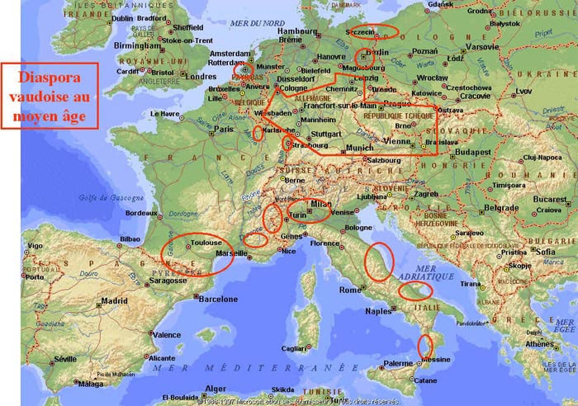
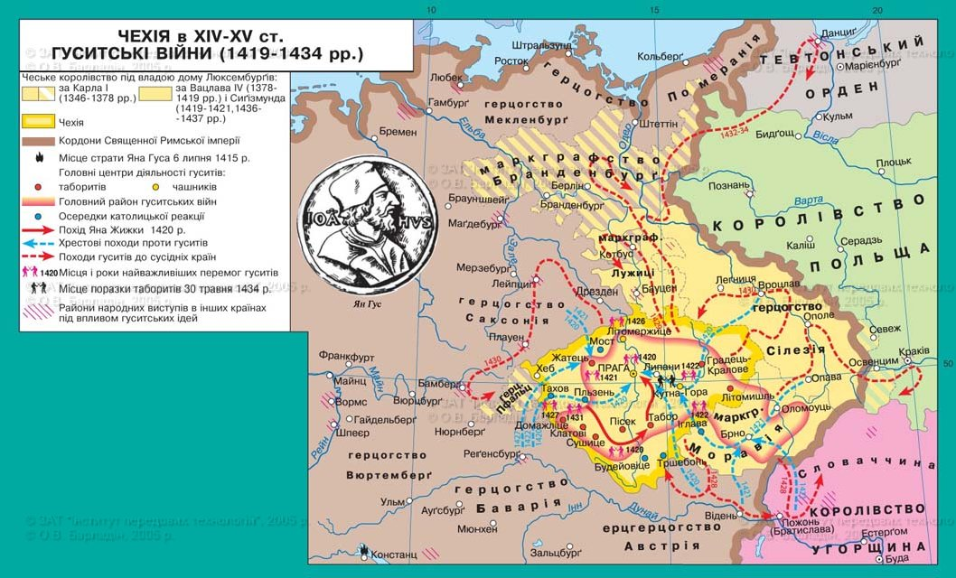
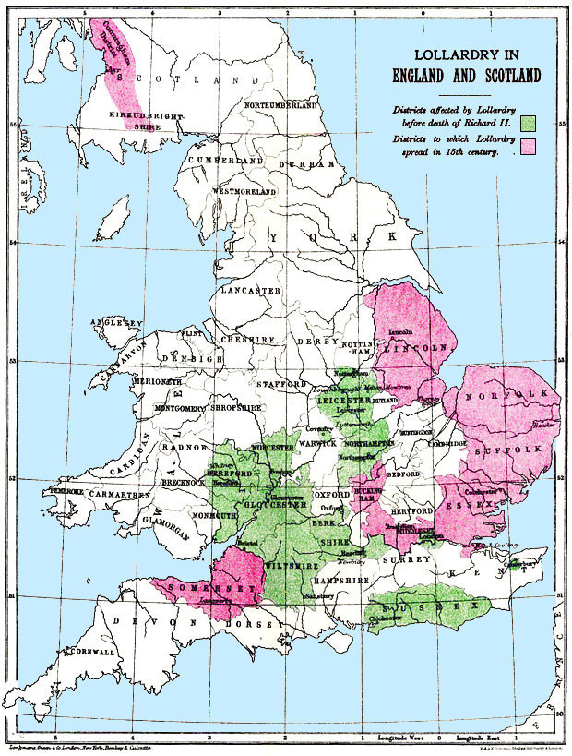
Religious Dissent
Preaching was popular. Some preachers likened to saints.
Theologians debated about free will, predestination and authority of the Church.
Not all medieval clergymen and women were felons and sexual perverts.
Dissent and non conformity, localised and uncoordinated.
Waldensians: (Germany, Italy, France), Valdesius of Lyon, 1170s, self-abnegation, poverty and vernacular preaching.
Lollards: (England) John Wycliffe (1320-1384), critical towards Sacraments and sacerdotalism, appeal the lower orders.
Hussites: (Bohemia), Jan Hus (1370-1415), discipline, against corruption of the Church and sins of the clergy.
Devotio Moderna: Netherlands by the ascetic Geert Grote (1340-1384), fought the decadence of the Church.

Slide 7
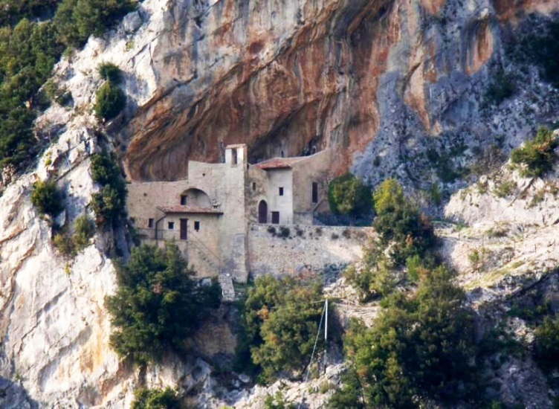
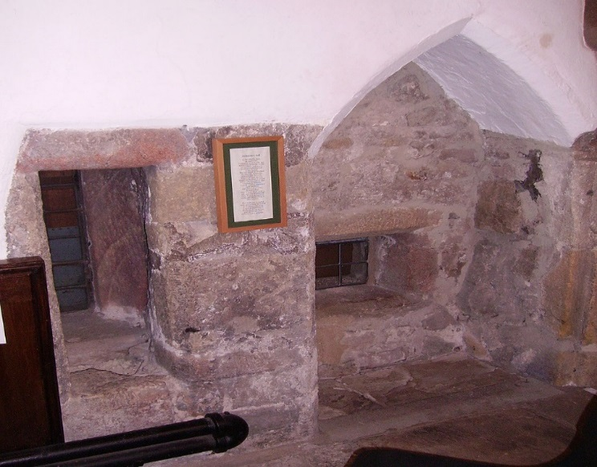
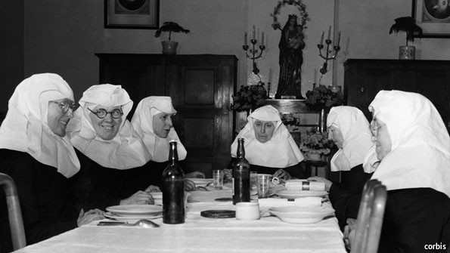
Expressing Belief
Widows, Hermits and Anchorites
Widows: lived by the virtue of humility and discretion, took vows of perpetual chastity, poverty and obedience. But they were no Nuns.
Hermits: mainly men, devotional regime, recluse, begging, sort of medieval hippies (Swanson)
Anchorites: life of total reclusion. Meditation and preparation for death. Lived off private income.
>Church forbade them to preach, various gradations of religious experience.
Humiliati and Beguines, (Italy and the Netherlands), semi-regular, but not bound by a vow, lived by a voluntary rule and in poverty.
The Church was ambivalent, as they were not fully regular, nor straightforwardly lay. Potentially deviants.

Slide 8
Road to the Reformation
Christian Humanism: Tensions about clerical malpractice and exploitation. Calls for reform.
Pre-existent body of dissent provided a useful seed-bed for the Reformation.
Transform the system, not smash it!
−Religion remained vital
−Catholicism united under the Pope
It accomodated diversity without adversity (Swanson)
−The Reformation not necessarily caused by the abuses of the Catholic Church
−Luther seen as an new Wycliffe or Hus, a follower rather than innovator.
The Reformation was an internal transfromation, not external assault.

