Slide 1
Society at the Margins

Slide 2
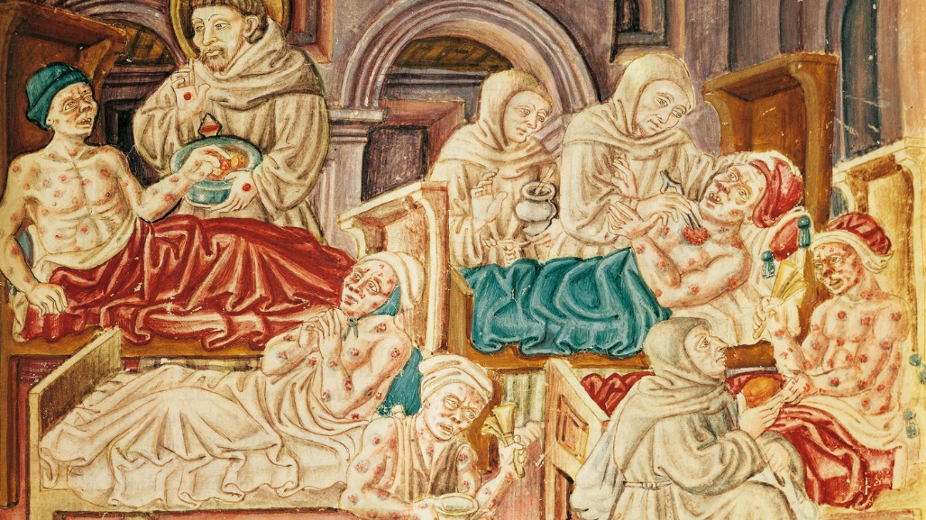
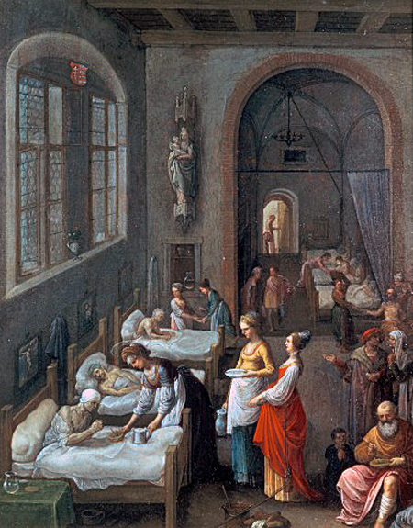
The causes of poverty: Illness Famine Epidemics Warfare Poor economy How many? 2/3 of the population

Slide 3
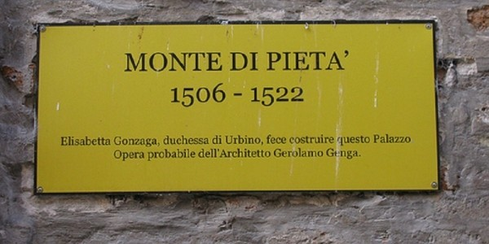
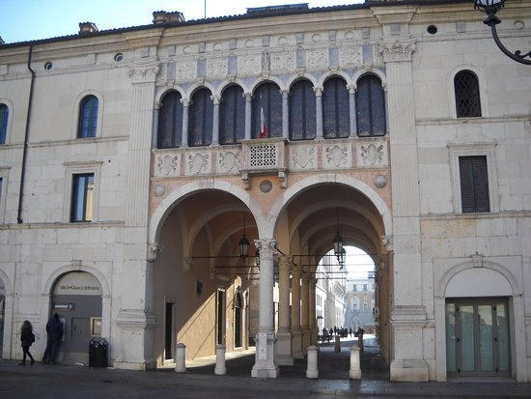
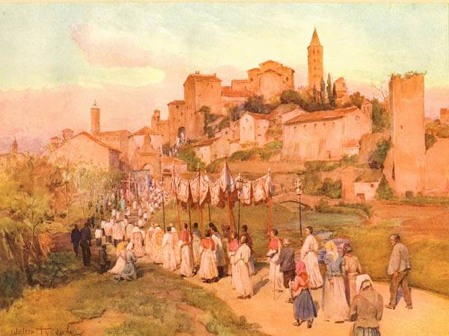
Poor Relief, The deserving poor: (Christlike) Centralised system/state intervention Decentralised: -Confraternities: outdoor relief. -Pawn shops (Monti di Pieta’): give loans. -Hospitals (shelters, not medical care)

Slide 4
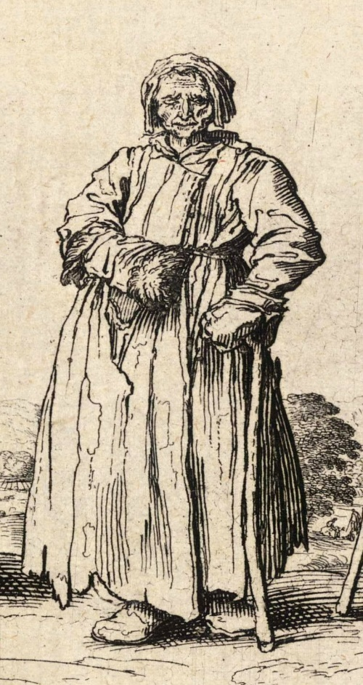
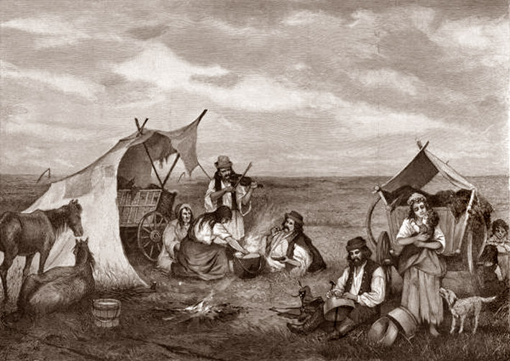
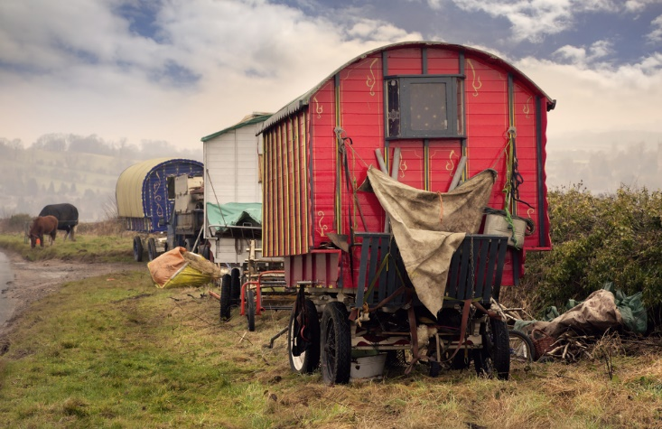
The Undeserving Poor: (Devil in disguise) gypsies (c.100,000 in Europe), prostitutes, sexual deviants, and vagrants/idle/criminals.

Slide 5
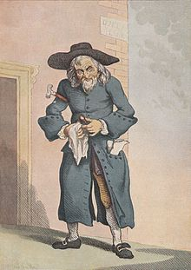
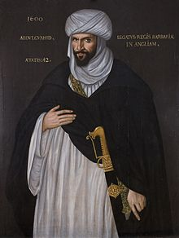
Religious Marginal: Jews and Muslims A deformed image received as true. Infidels, not heretics. Outsiders. Islam and Judaism: perceived threat to Christianity and European Identity. Islam: post-Christian, competing form of monotheism. Judaism: pre-Christian, conversion or exile. Persecution, reception and stereotype, a result of a climate of anxiety. The frontier was porous, mutual influence and conflict.

Slide 6
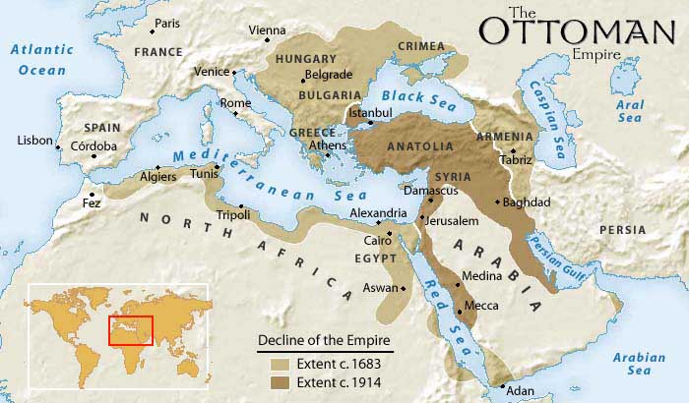
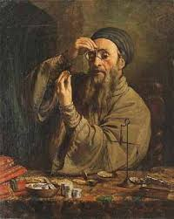
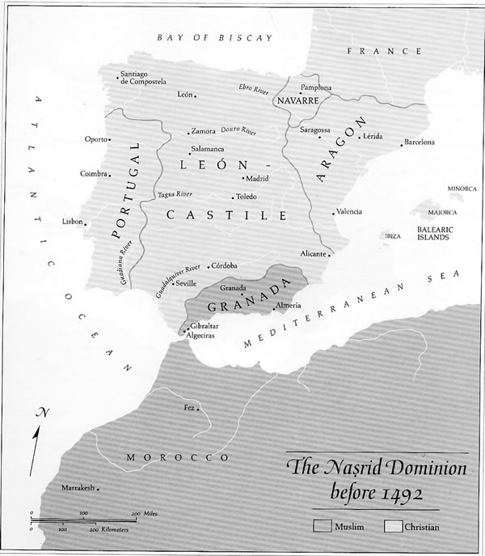
Judaism: a stateless religion, business and financial role. Jewish persecution in Europe since the 13th c., assimilation only in the 18th c. Exiled or converted (conversos or marranos/swine) Muslims: ‘the foe of Christendom’. Persecution since the 13th c. 1614: expulsion from Spain -320,000 religious refugees, largest group in early modern history. They will forever mourn their lost land of Al-Andalus. Conversion: moriscos.

Slide 7
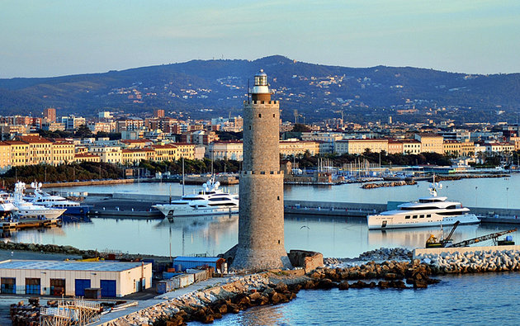
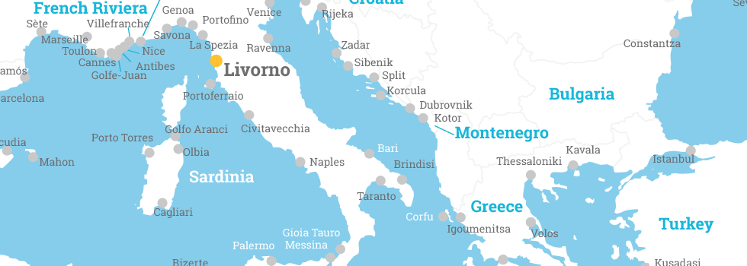
Jews and Muslims in Livorno
Muslim Bagni: communities with rowers and their own leaders.
Jewish community: Livorno hosted 1/3 of the Western Sephardim (Spanish)diaspora.
Jewish commercial networks contributed to the exchange of Mediterranean and Asian goods

Slide 8
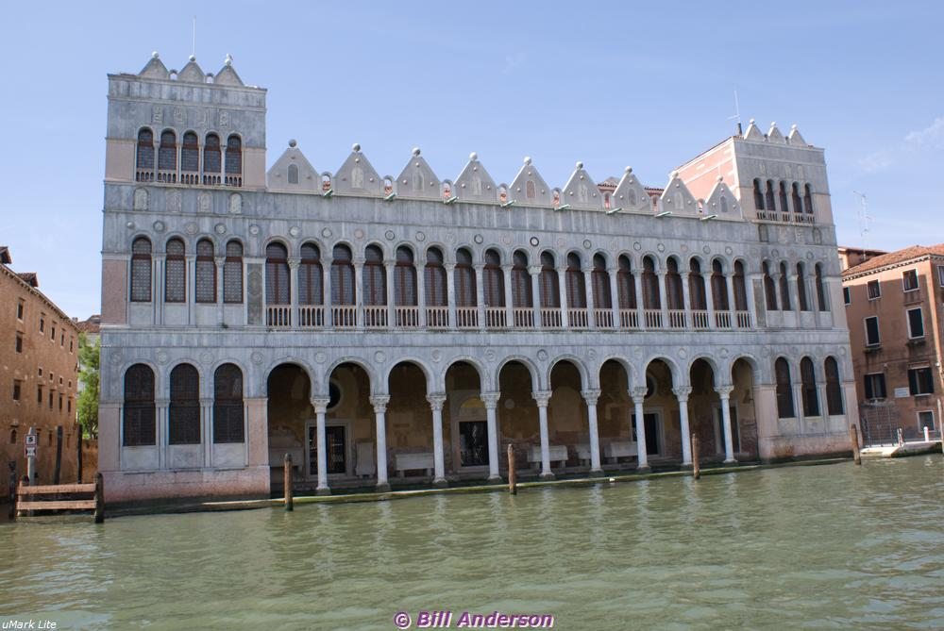
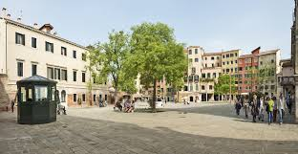
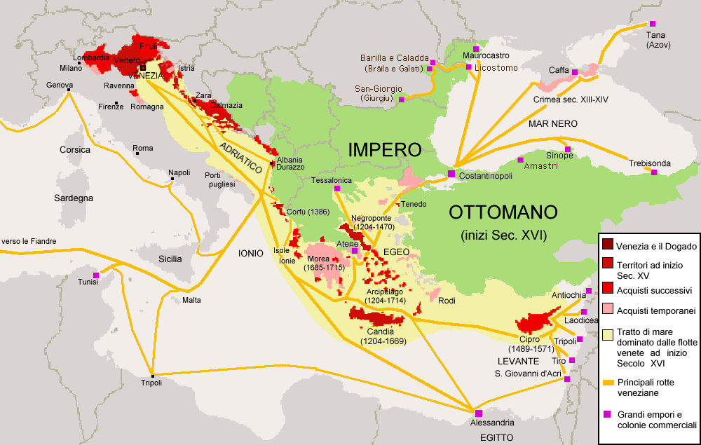
Jews and Muslims in Venice
Good fences make good neighbours
Muslim: 1621, Fondaco dei Turchi. Walled compound.
Pre-1621, Inn called ‘The Angel’ (too small).
Venice cherished trade with the Ottomans.
Jews: 1516 ghetto, in the city, but not part of it.
1555: Ghetto in Rome, Pope Paul IV.
Jews controlled trade with the Balkans and the Levant,
lent money

Slide 9
Concluding thoughts
Deserving and undeserving poor.
Poverty and crime/idleness.
Stereotypes and fear.
-How 'marginal' were marginal groups?
-What impact did the Renaissance, the Reformations and the Enlightenment have on the treatment of and attitudes towards marginal groups?

