Slide 1
The European World
The European World c.1500

Slide 2
1500
The fall of Constantinople to the Ottomans (1453)
The beginning of the Tudor dynasty in England (1485)
Columbus' first voyage to the Americas (1492)
Muslim stronghold of Granada falls to a unified Castile and Aragon (1492)
Jews are expelled from Spain (1492)

Slide 3
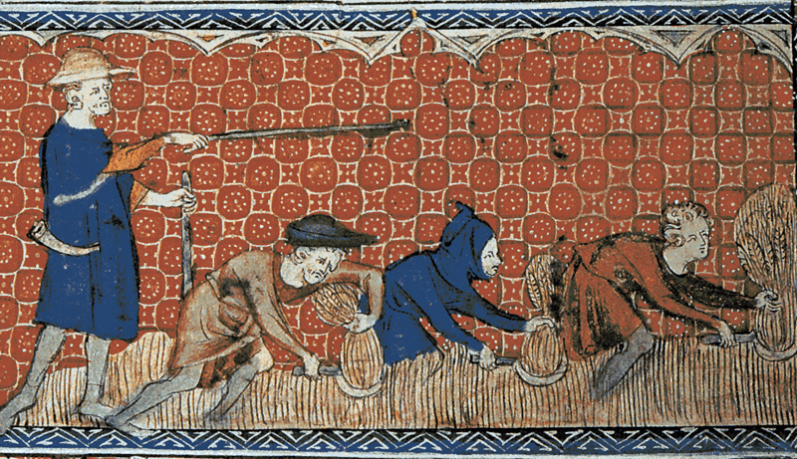
Social structures and economic change
Population:
Black Death of 1348
Social structures:
The household
The countryside: Elements of continuity
an economic system based on agriculture
serfdom?
Higher levels of market involvement

Slide 4
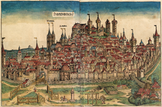
Urban economic and social development
Guilds
Banking
a wider commercial network
administrative centres: responsible for schools, hospitals, provision of welfare (looking after abandoned children, orphans, the elderly and the urban poor)
Printing presses

Slide 5
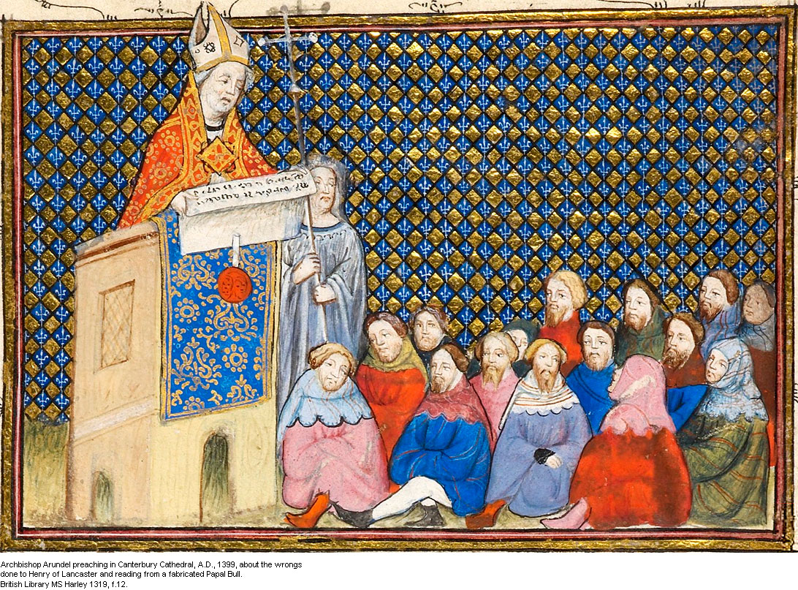
Religious and intellectual life
Religion has a strong presence in everyday life(baptism/marriage/last rites)
Attendance at church; saints, relics, penance, pilgrimages, acquiring indulgences

Slide 6
The Papacy has faced some challenges:
The Great Schism
Heretical movements: the Albigensian (Cathar) heresy, Waldensianism, Lollards (followers of John Wyclif in England) and Hussites (followers of Jan Hus)
Erasmian humanism; radical populism of Girolamo Savonarola in Florence
Clashes between Church and State

Slide 7
Intellectual developments
Renaissance humanism
humanists look backwards, not forward
The medieval legacy? Poggio Bracciolini (1380-1459) - monks and friars contributed nothing to the common good, claiming that ‘Cities are founded on our labours, not by these lazy scarecrows... those hypocrites and strolling scoundrels who preach... contempt of the world to others.’
Continuities in law, philosophy and medicine
Universities
Wider education
humanists promote service of public domain (especially in government e.g. Machiavelli, Thomas More

Slide 8
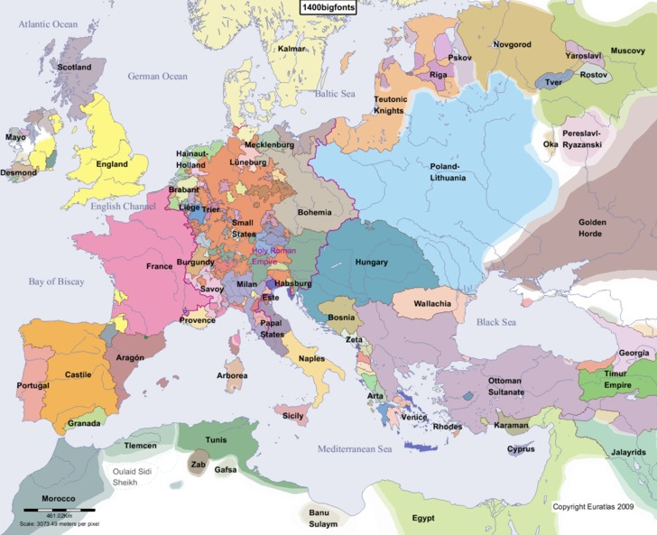
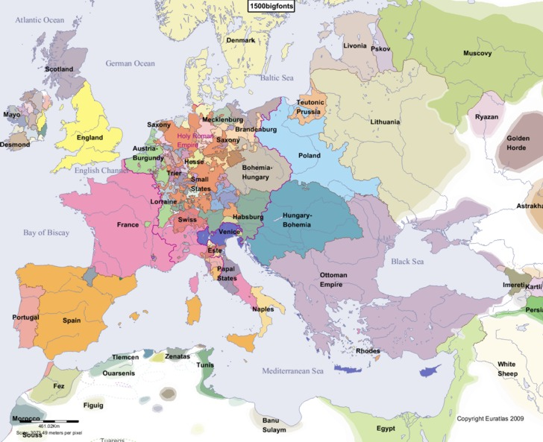
Power and authority in Europe: ‘composite monarchies’

Slide 9
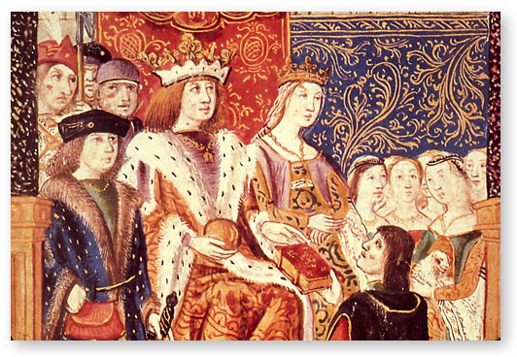
Power and authority in Europe
Importance of ceremony
Move towards centralised states but with a stronger element of negotiation
Professional administration
Warfare
Relatively more efficient tax collection

Slide 10
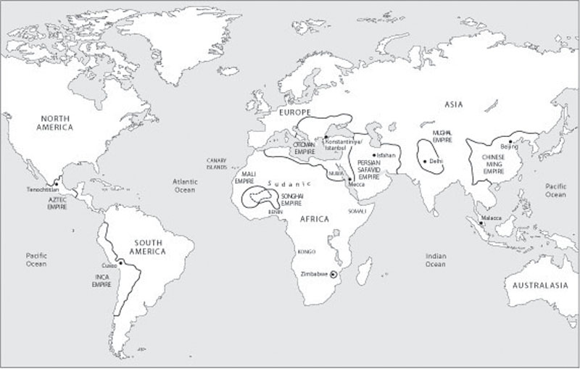
Map of the world c.1500

Slide 11
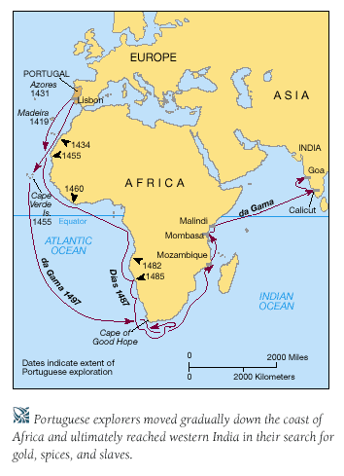
Portuguese expansion
Under crown control
Financed by private ships
Conducted by an international class of merchants
Trade more important than political domination
They reject Columbus’ proposal

Slide 12
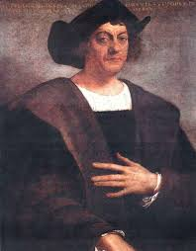
Spanish Expansion in the Americas
Accept Columbus’ proposal
Religious motivations
Territorial control
Primary motivation is not trade
Later on bring in landless knights or shepherds, cattle-breeders etc

Slide 13
Europe c.1500
Peasants: stronger market involvement
Towns: wider trading networks
Catholic church: alive and present
Intellectual developments: printing press, education
Politics: move towards centralisation
The New World

