Slide 1
Trans-cultural Contacts
The Americas

Slide 2
Aims
To think about First Contact between Europeans and Africans in The Americas
To look at the processes at work in the development of early land-based colonial regimes in The Americas.
To draw out some themes about the significance of ‘The New World’ to ‘The Old World’ and vice versa.
To think about how research on ‘The Conquest of the Americas’ has changed.

Slide 3
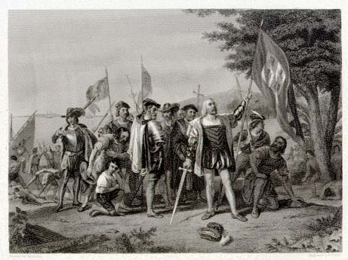
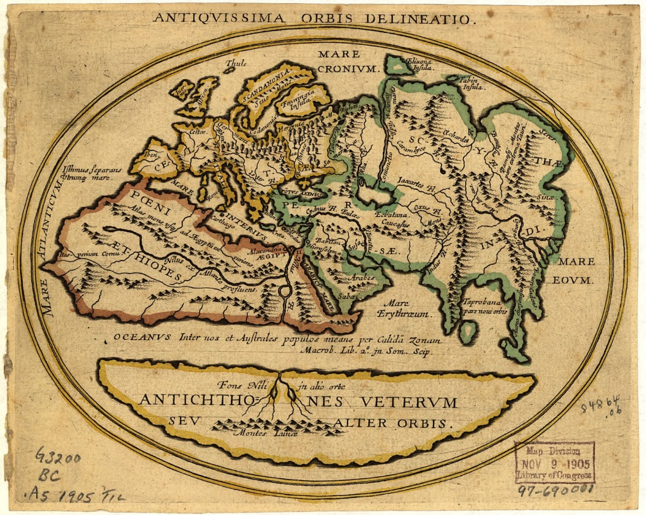
1492

Slide 5
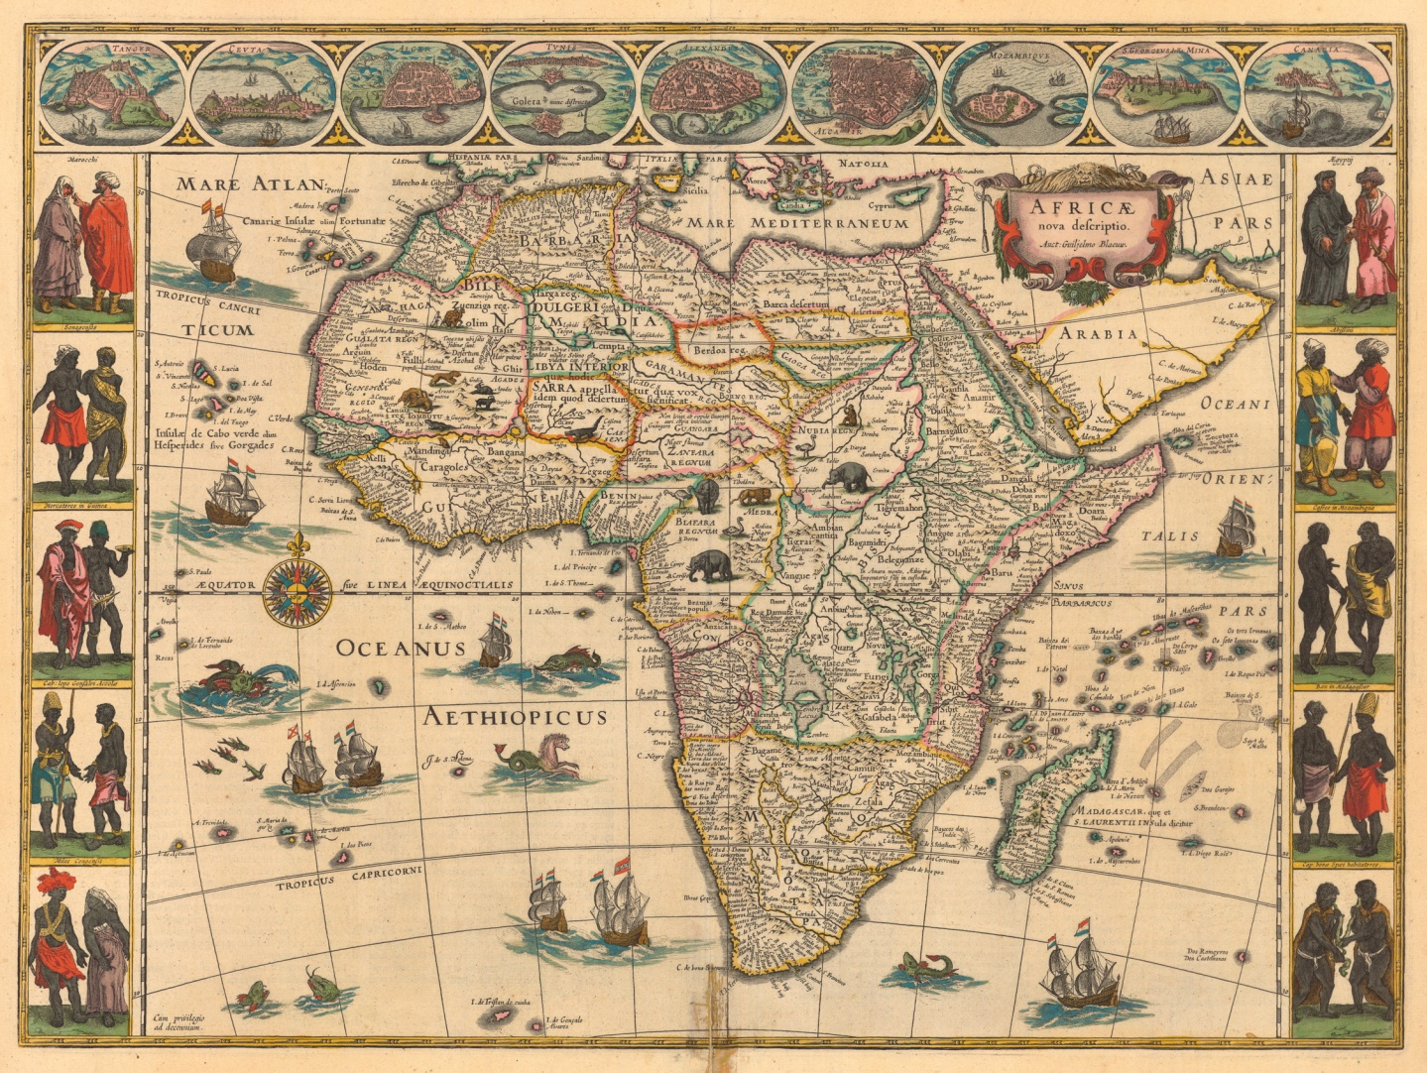
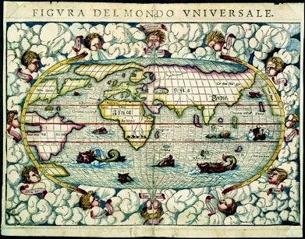

Slide 6
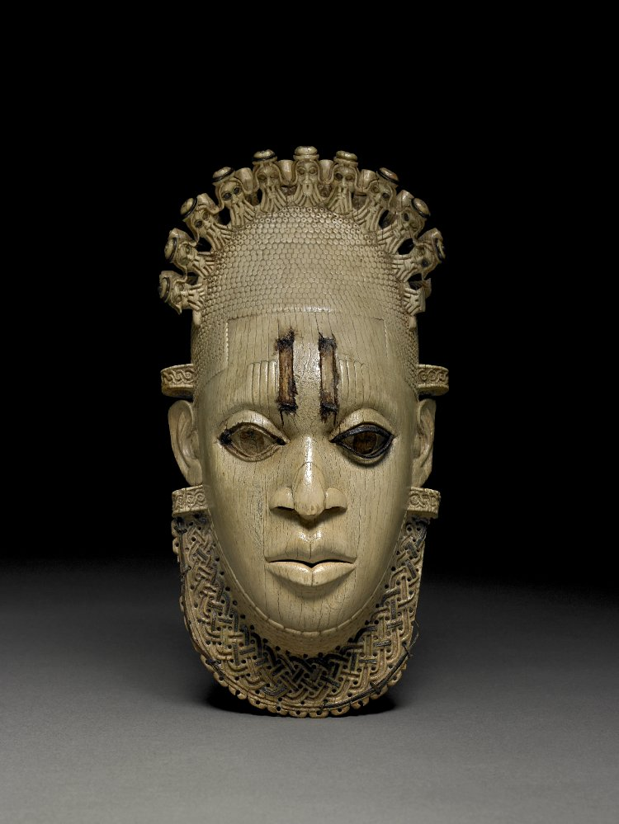
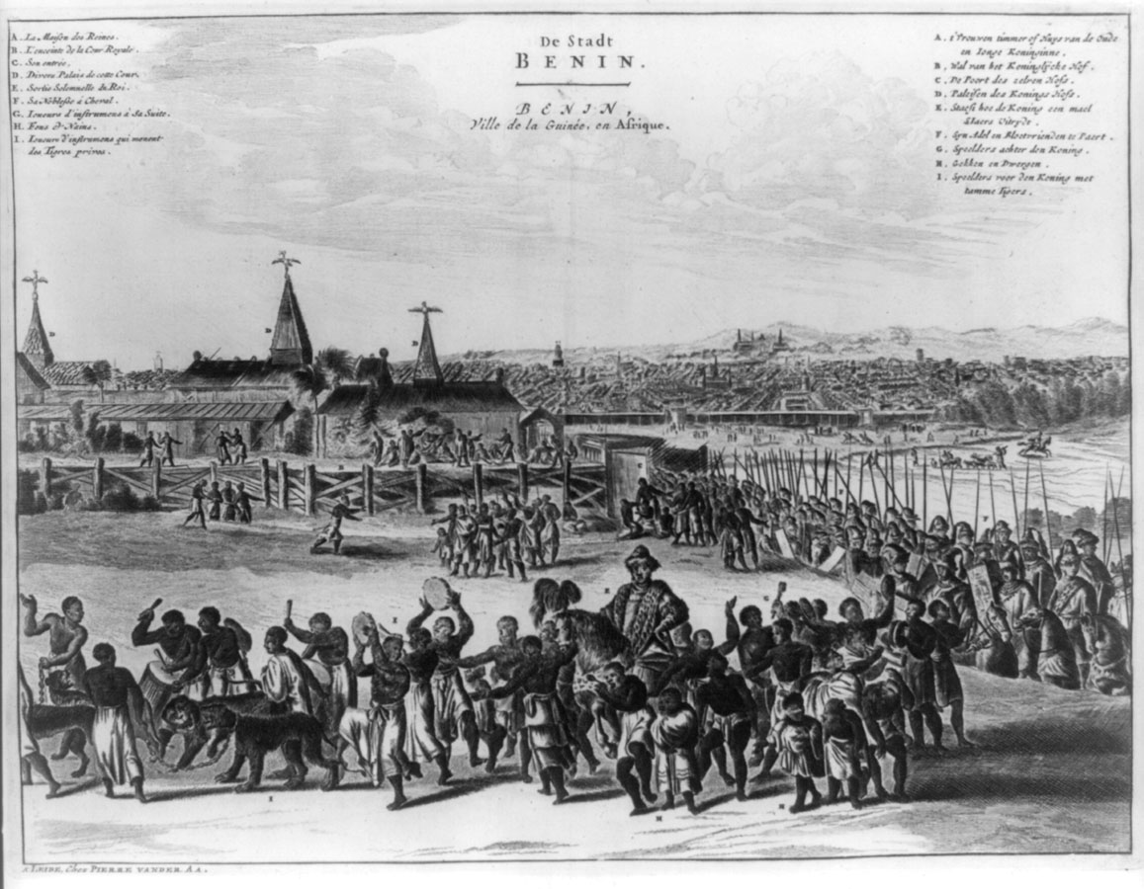
Carved ivory mask-shaped pendant, inlaid with iron and bronze depicting Idia, mother of Oba Esigie who ruled in the sixteenth century. British Museum.
Depiction of Benin City by a Dutch artist
in Description of Africa (1668)

Slide 7
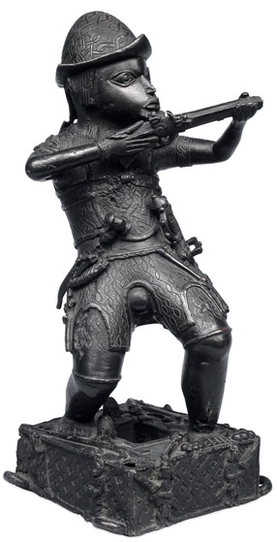
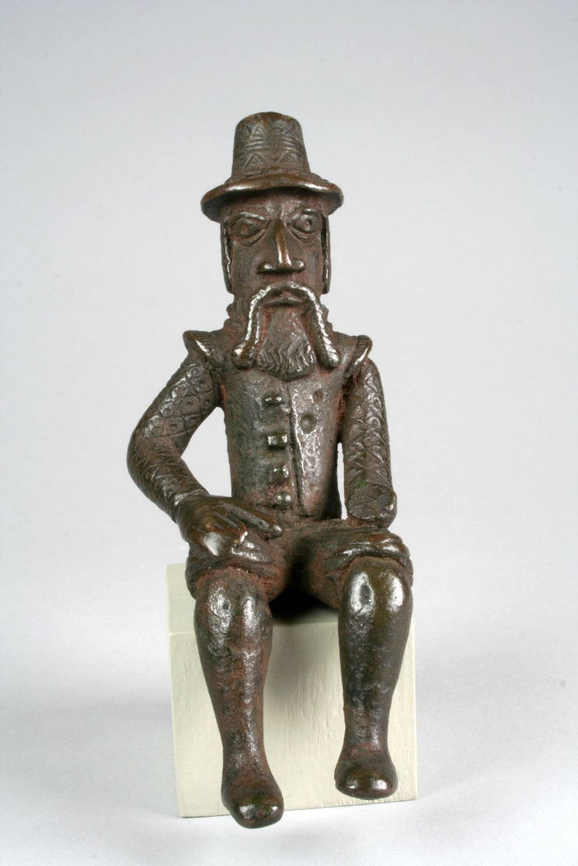
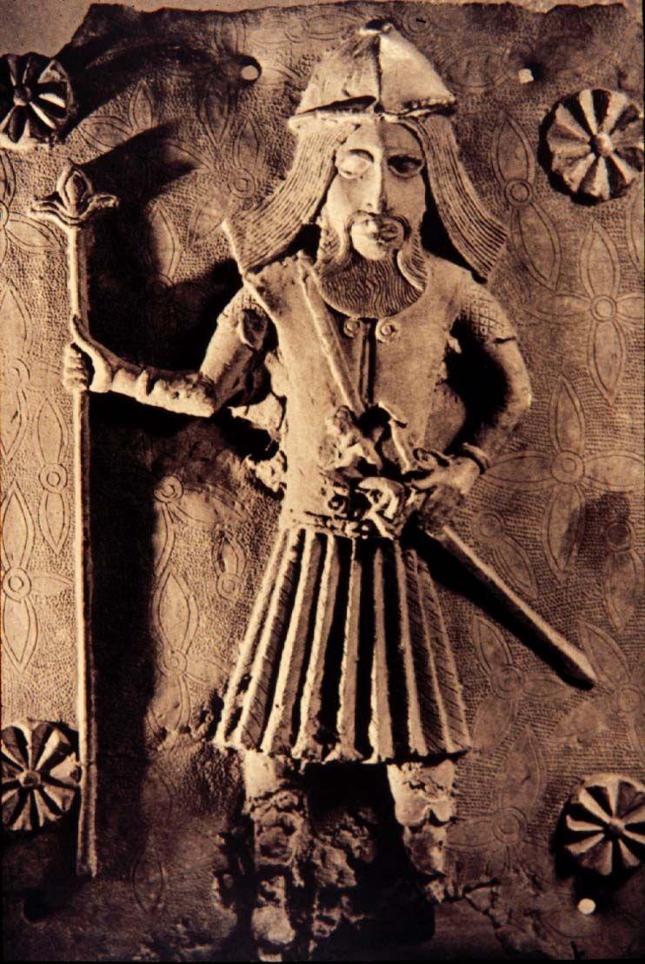
Portuguese soldiers and traders depicted in brass castes made by the Edo people of Benin (Nigeria) c17 and c18

Slide 8
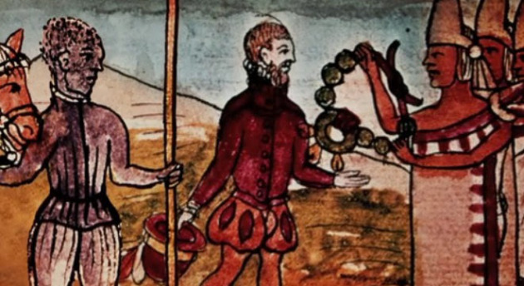
Juan Garrido (c. 1480-c. 1550), the Black Spanish Conquistador
See Peter Gerhard, “A Black Conquistador in Mexico” The Hispanic American Historical Review, 1978

Slide 9
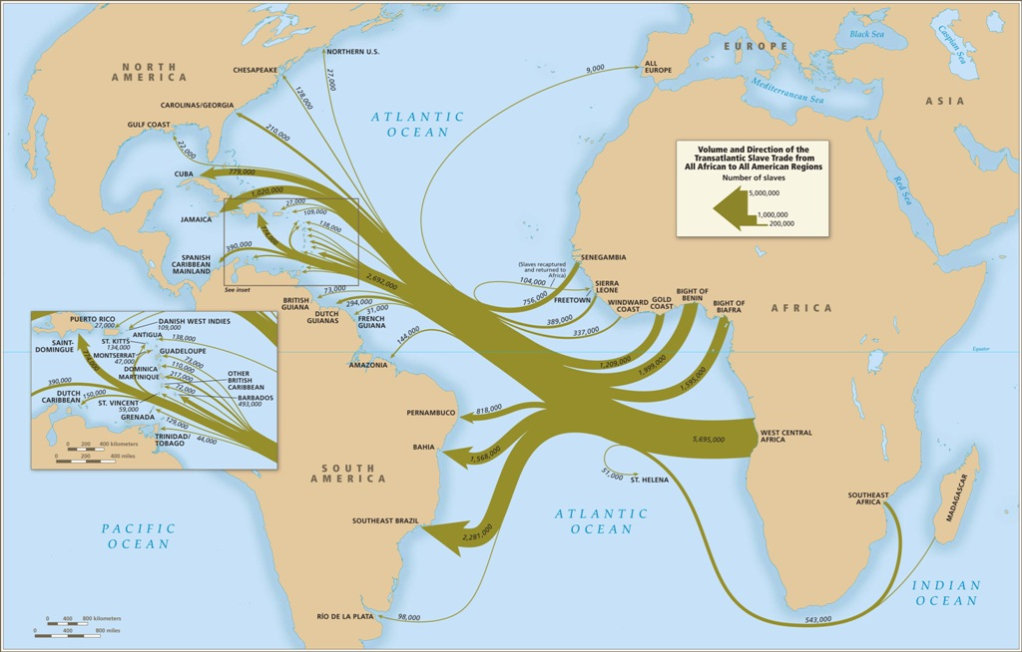

Slide 10
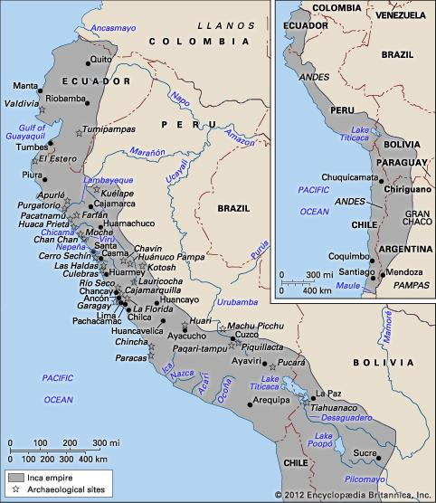
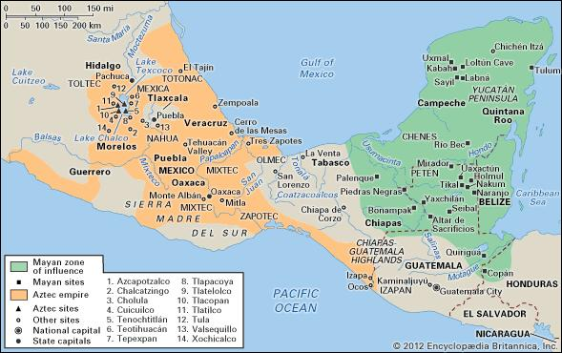
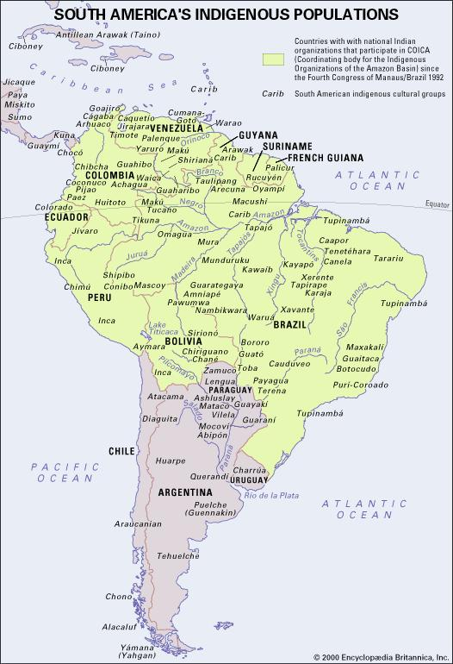
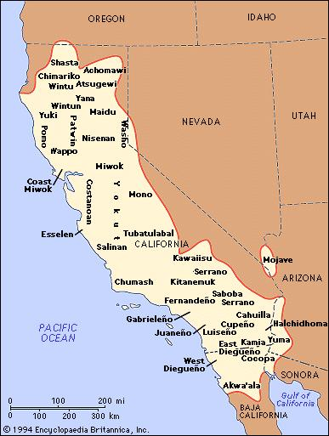
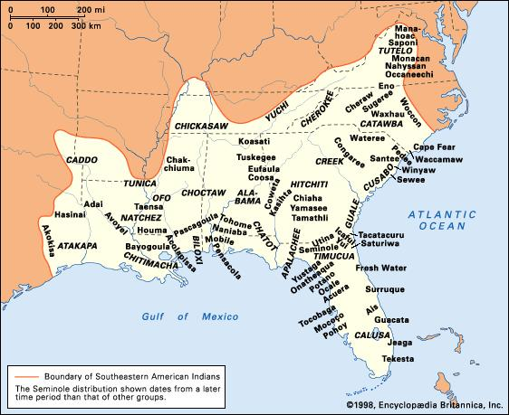
1492 and The Americas
Encyclopædia Britannica
Online. Web. 31 Oct. 2012.
Diverse geographically,
politically, socially,
linguistically

Slide 11
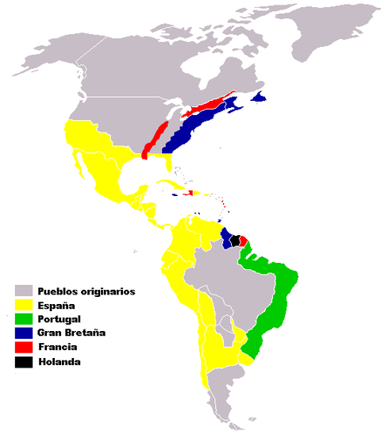
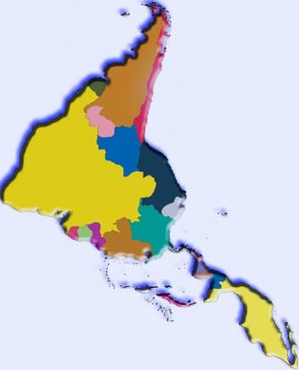
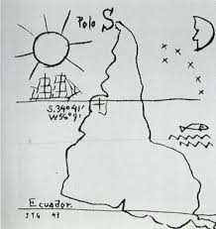
European Claims in The Americas c15-c17

Slide 12
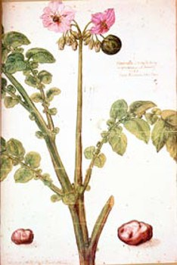
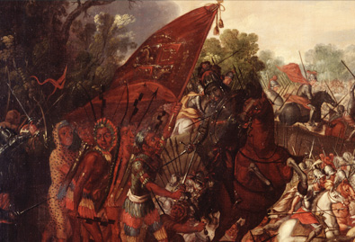
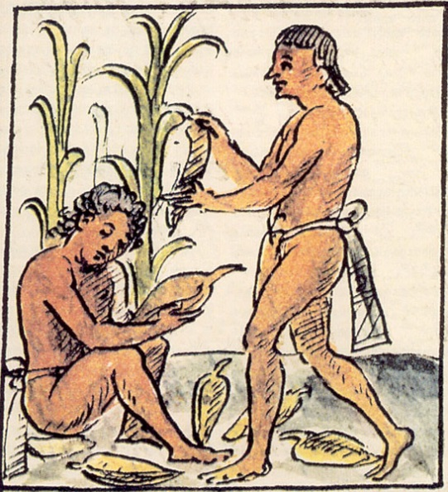
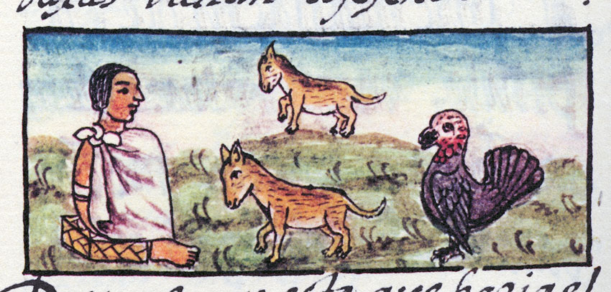
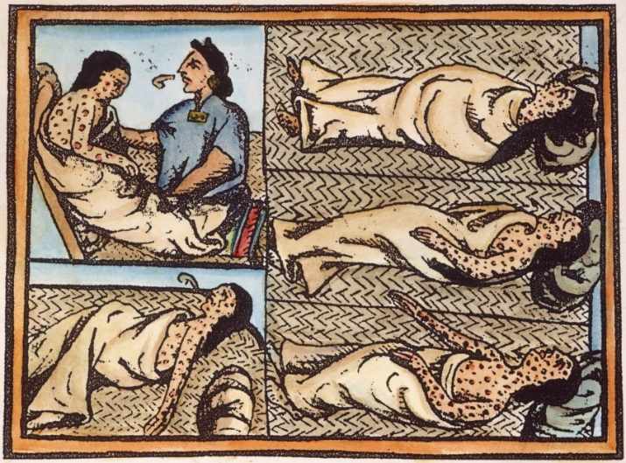
Global Significance of The ‘New’World
Use of horses in conquest
of Tenochtitlán.
Source: Library of Congress
Watercolour by Philippe de Sevres,1589: the first European illustration of the potato. Museum Plantin-Moretus, Antwerp
Turkeys. Source: Florentine Codex
American victims of small pox. Source: Florentine Codex

Slide 13
Terms and Concepts
Meztizaje, Creolization, diasporas in the Atlantic World
‘Conquest’ , ‘Encounter’, ‘Invasion’?
‘New’ World?
‘Spanish’ (or ‘Latin’) America?
‘Fusion’ or ‘Appropriation?
‘New’ World?
Indian (indio)? Native/American?

Slide 14
From Columbus’ first letter, describing the island of Hispaniola (and the Taíno people):
‘This island is to be desired and very desirable’
‘there are great and beautiful mountains, vast fields, groves, fertile plains, very suitable for planting and cultivating’
Hispaniola ‘abounds in different kinds of spices, in gold, and in metals’
All these people lack … every kind of iron; they are also without weapons … they are timid and full of fear’
‘when they perceive that they are safe, putting aside all fear, they are of simple manners and trustworthy, and very liberal with everything they have, refusing no one who asks for anything they may possess’

Slide 15
Columbus on Hispaniola (Now Haiti and Dominican Republic)
‘those people are very amiable and kind, to such a degree that the said king [i.e. chief] gloried in calling me his brother’
‘I promise this, that if I am supported by our most invincible sovereigns with a little of their help, as much gold can be supplied as they will need, indeed as much of spices, of cotton, of mastic gum [a type of resin]… also as much of aloes wood [Asian tree prized for its resin, used in, e.g., medicines], and as many slaves … as their Majesties will wish to demand. Likewise rhubarb and other kinds of spices’
‘Let Christ rejoice on earth, as he rejoices in heaven, when he foresees coming to salvation so many souls of people hitherto lost. Let us be glad also, as well on account of the exaltation of our faith, as on account of the increase of our temporal affairs, of which not only Spain, but universal Christendom will be partaker’

Slide 16
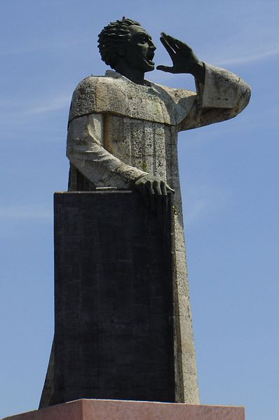
… I who am the voice of Christ crying in the wilderness of this island … it behoves you to listen … this is going to be the strangest voice that you have ever heard, the harshest and hardest … This voice says that you are in mortal sin, that you live and die in it, for the cruelty and tyranny you use in dealing with these innocent people. Tell me, by what right or justice do you keep these Indians in such a cruel and horrible servitude? On what authority have you waged a detestable war against these people, who dwelt quietly and peacefully on their own land? …. For with the excessive work you demand of them they fall ill and die … what do you care that they should be instructed in religion? … Are these not men? Have they not rational souls? Are you not bound to love them as you love yourselves?
Antonio de Montesinos, 1511
Antonio de Montesinos, by Mexican sculptor Antonio Castellanos Basich (in Dominican Republic)

Slide 17
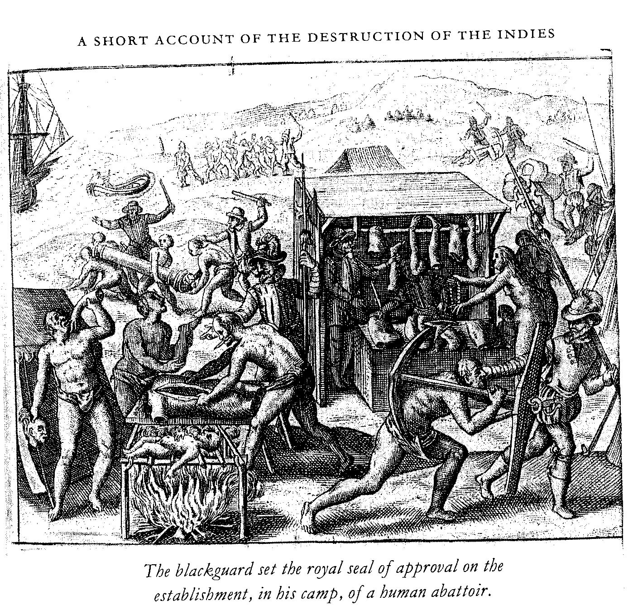
Colonial Legislation:
‘Cannibal Law’ 1503
Law of Burgos
‘The Requirement’ 1513
‘New Laws’ 1492
Valladolid Debates 1550-1551
Bartolomé de las Casas,1542 (published in 1552)

Slide 18
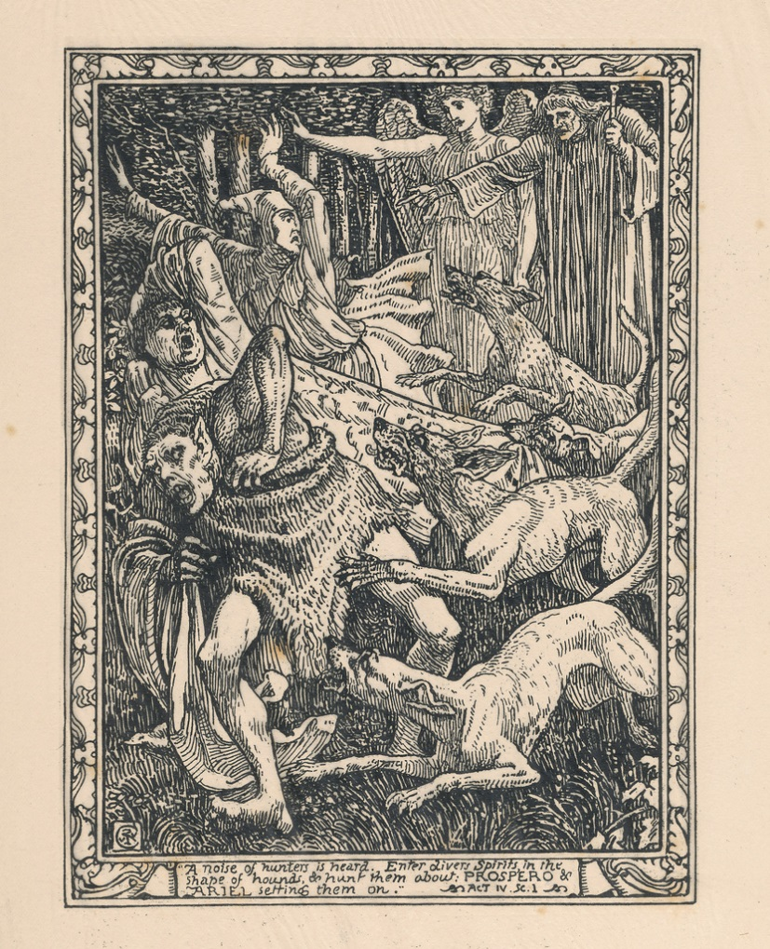
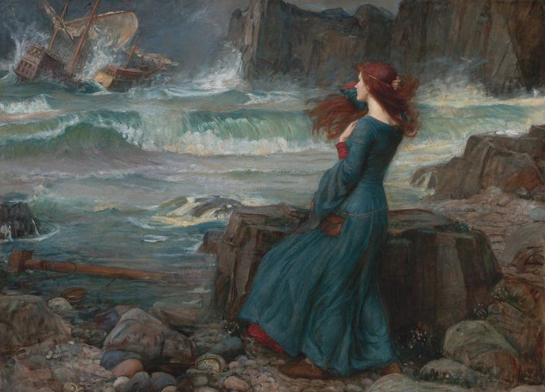
MIRANDA
Oh, wonder!
How many goodly creatures are there here!
How beauteous mankind is! O brave new world,
That has such people in ’t!
William Shakespeare, The Tempest, 1610-11

Slide 19
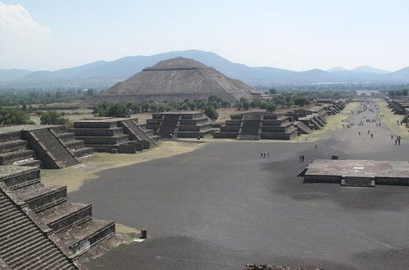
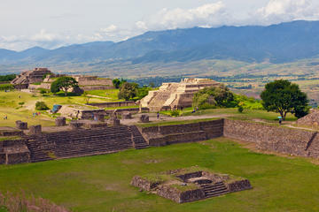
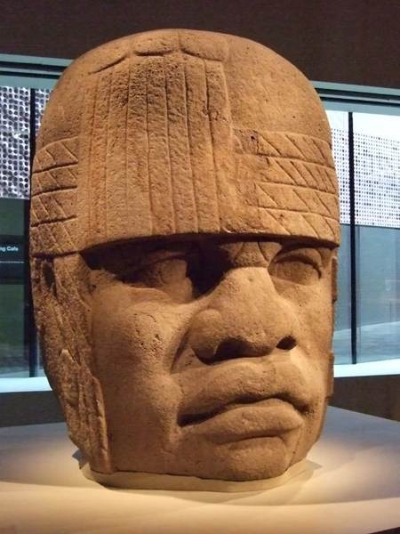
Mesoamerica
Teotihuacan, Valley of Mexico
Monte Alban, Oaxaca
Olmec, Civilization

Slide 20
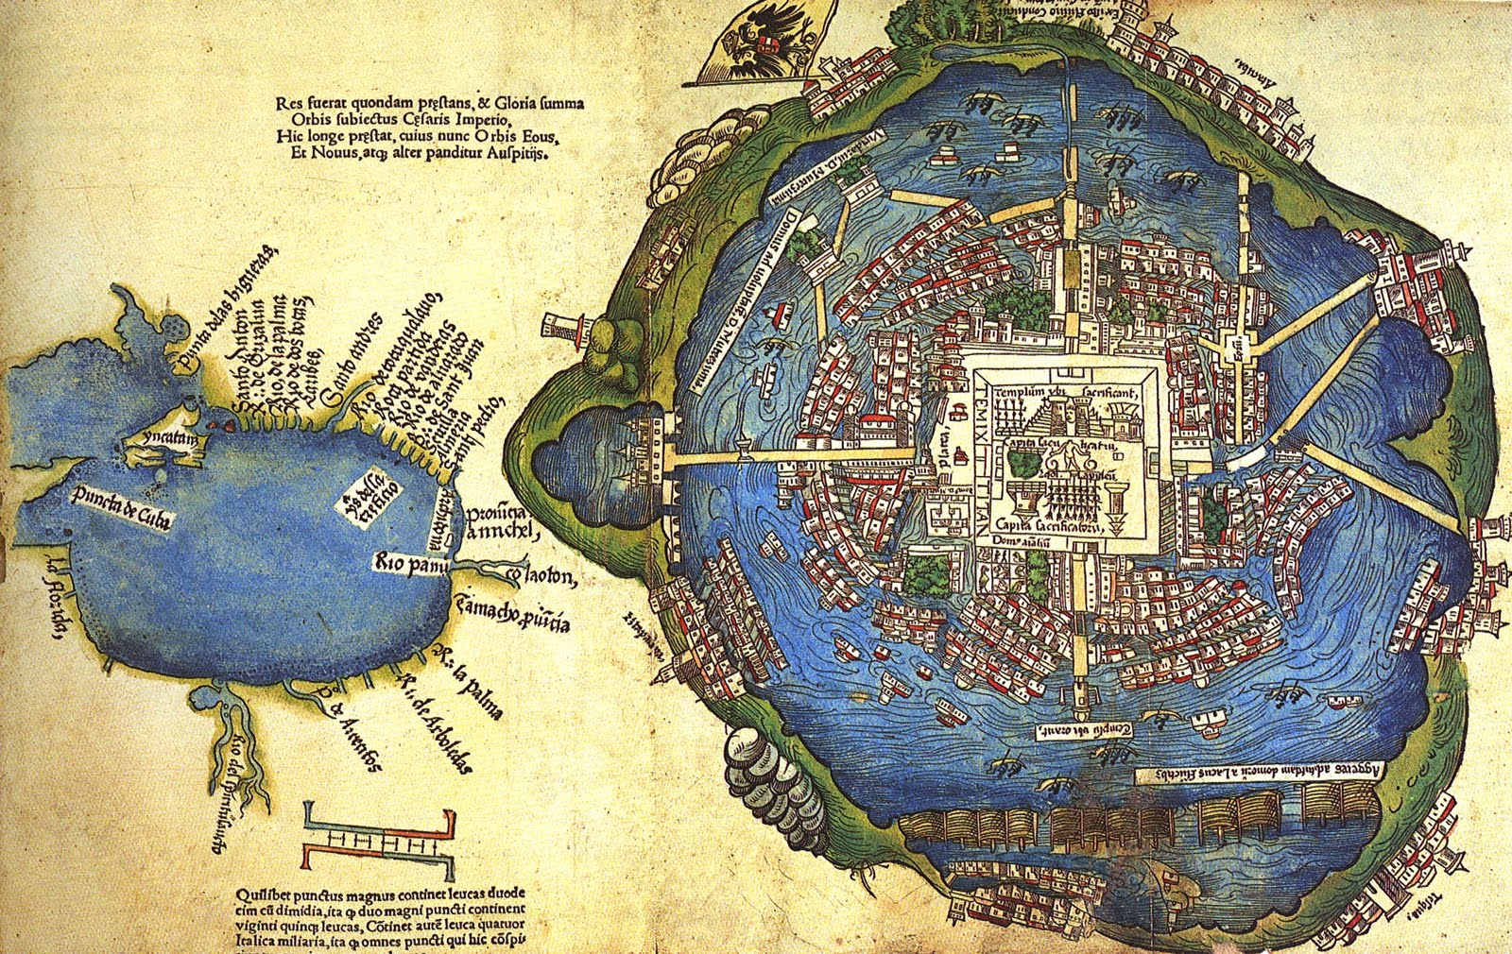
Tenochtitlán and the Gulf of Mexico, unknown artist, 1524 [based on map presented to Cortes by Mexica peoples in 1519-1521. Library of Congress

Slide 21
Tenochtitlan (Mexico 1519)
“When we saw all those cities and villages built in the water, and other great towns on dry land, and that straight and level causeway leading to Mexico, we were astounded. These great towns and temples and buildings rising from the water, all made of stone, seemed like an enchanted vision from [the chivalric ballad of] Amadís. Indeed, some of our soldiers asked whether it was not all a dream.”
Bernal Diaz, True History of the Conquest of New Spain (1576)

Slide 22
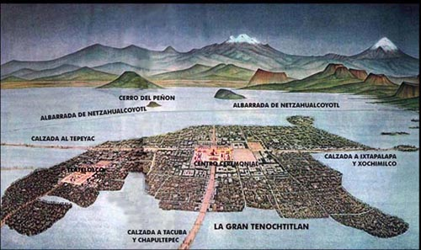

Slide 23
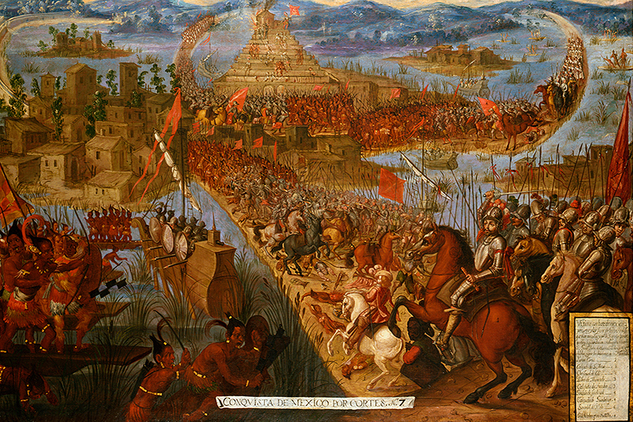
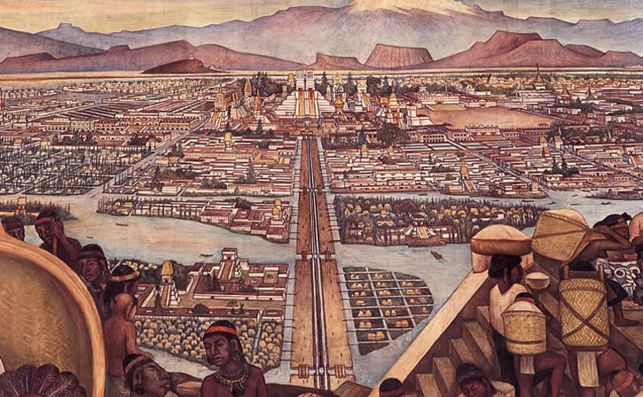

Slide 24
The rise of the Aztecs in central Mexico
Alliance of 3 different peoples
Mexica are dominant: capital at Tenochtitlán on Lake Texcoco, from 1325.
They ally with two of their neighbours: the city states of Texcoco and Tlacopan → Aztecs conquer Valley of Mexico by 1428.
1502 under Montezuma II: huge empire, centred on Tenochtitlán. Several hundred thousand residents in Tenochtitlán alone; 1.5 million in Valley of Mexico.
Some areas and peoples are NOT conquered and become enemies/ rivals: e.g. the Tlaxcalans.

Slide 25
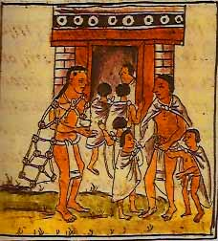
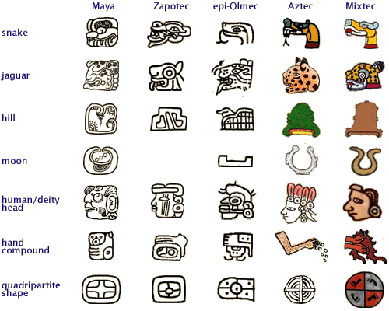
Features of Aztec Empire
Based on village units: calpulli. Empire built by adding these units.
Very stratified society: elite are warriors/ priests etc; live in Tenochtitlán & claim tribute from other parts of the empire
Religion is central and not separable from politics. Descent from god Huitzilopochtli justifies rule
Syncretism: calpulli continue to worship own deities but incorporate Huitzilopochtli
Major cultural achievements. Temples; cosmology, education, writing using pictorial/ glyphs system

Slide 26
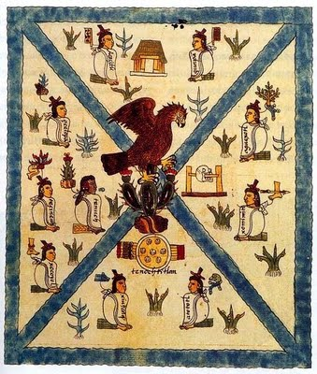
From Codex Mendoza c. 1541
Bodleian Library Oxford

Slide 27
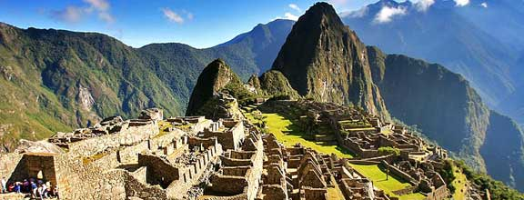
Andean Region

Slide 28
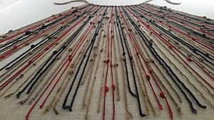
Features of Inca Empire
Based on exacting tribute.
Village units: ayllu; but also, a centralised bureaucratic state.
Redistribution and reciprocity in Andean society to cope with CLIMATE.
Central warehouses for population in times of hunger
Mita – a system of rotational labour service that will be maintained in modified form under the Spanish
Religion intertwines with state. Local people also keep own huacas (shrines) as well as Inca religion.
No writing; knotted strings (quipus)

Slide 29
The Aztec and Inca empires are very different, but they share important common traits:
dense, often urban populations;
settled agriculture;
complex social hierarchies;
a central connection between religious belief and social and political structures;
systems of tribute
Empire-building: subject peoples under a central ruling group; syncretism
Parts of empires only RECENTLY created; local rivalries and tensions

Slide 30
Questions
How did each side interpret the first meetings? What shaped their worldview?
How can we write a history that incorporates the view of the vanquished as well as that of the conquerors? What sources are available to us as historians? What problems do they present?

Slide 31
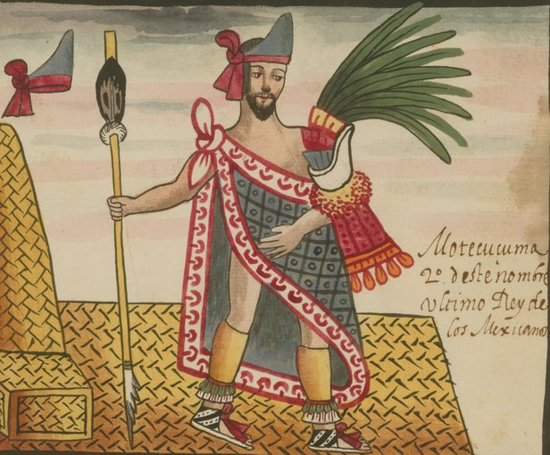
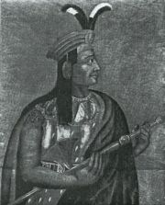
Atahuallpa (Inca)
Moctezuma (Aztec)
From the The Tovar Codex, attributed to the 16th-century Mexican Jesuit Juan de Tovar, contains detailed information about the rites and ceremonies of the Aztecs (also known as Mexica).

Slide 32
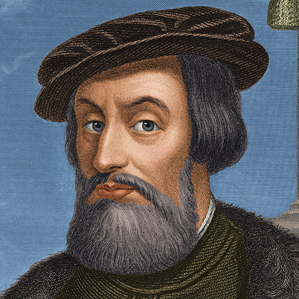
From the The Tovar Codex,
attributed to the 16th-century Mexican Jesuit Juan de Tovar, contains detailed information about the rites and ceremonies of the Aztecs (also known as Mexica).
Hernán Cortés

Slide 33
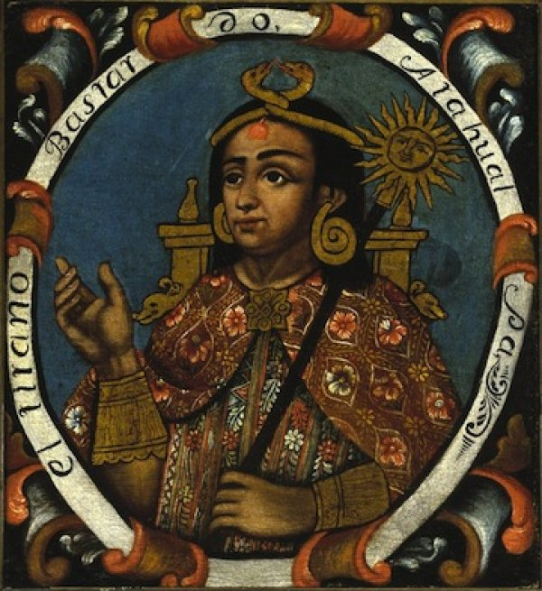
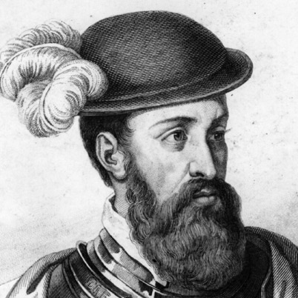
Atahualpa
Mid-C18 Portrait, Brooklyn Museum
Francisco Pizarro

Slide 34
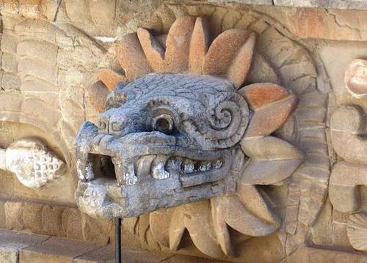
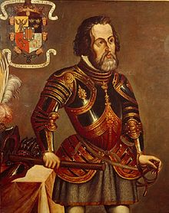

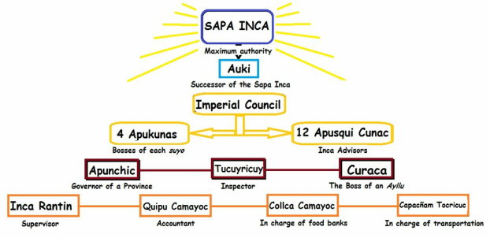
How was it possible for the Spanish to conquer the central areas so quickly? Were they really conquered and colonised so quickly and completely? How have these explanations been revised and reconsidered?
Myth and religious belief
Military technology
Centralised indigenous governments
Divisions and resistance
Disease

Slide 35
Problems with writing the history of conquest and pre-conquest
Power: the “voices of the victors”
Most people in Europe, but especially the Americas, don’t WRITE. Written texts are left mainly by the most powerful (in each culture)
Disproportionate influence of go-betweens/ translators/ acculturated indigenous people
Demographic collapse: who survived to tell the tale? How can we measure pre-conquest populations?
Aims and audience of the person writing
Apparent “translatability” but total misunderstandings in reality; and we tend to get the European interpretations not the indigenous ones
Problem of European preconceptions and imaginings about New World, e.g. chivalric ballad tradition…

Slide 36
Power: the “voices of the victors”
Most people in Europe, but especially the Americas, don’t WRITE.
Written texts are left mainly by the most powerful (in each culture)

Slide 37
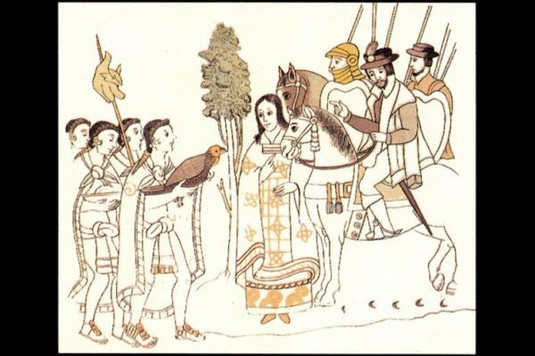
Disproportionate influence of go-betweens/ translators/ acculturated indigenous people
Malintzin
Source: Lienzo de Tlaxcala
See Camilla Townsend, Malintzin’s Choices, 2006

Slide 38
Demographic collapse:
Who survived to tell the tale? How can we measure pre-conquest populations?
American victims of smallpox
Source: The Florentine Codex

Slide 39
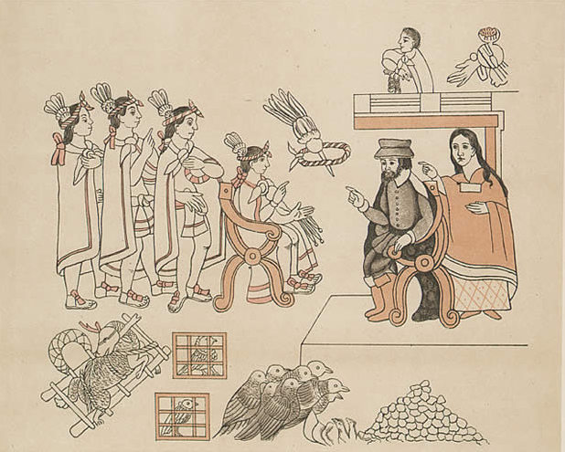
Apparent “translatability” but total misunderstandings in reality;
and we tend to get the European interpretations not the indigenous ones
Hernán Cortés meets Moctezuma. Source: Lienzo de Tlaxcala
Hernán Cortés, Moctezuma and Malintzin

Slide 40

Apparent “translatability” but total misunderstandings in reality;
and we tend to get the European interpretations not the indigenous ones
Atahualpa
Pizarro
Dominican Friar, Fray Vicente Valverde
El Requerimiento 1513, A written document that justifies the conquest of New World
“read to trees and empty huts” (Hanke, 1949)
See Patricia Seed, “Failing to Marvel”: Atahualpa’s Encounter with the Word”, Latin American Research Review, 26:1, 1991.
Atahualpa. From Guaman Poma, Chronicles 1560s 70s

Slide 41

Aims and audience of the person writing
Hernán Cortés
Governor Diego Velázquez

Slide 42
Problem of European preconceptions and imaginings about New World, e.g. chivalric ballad tradition…
Tenochtitlan (Mexico 1519)
“When we saw all those cities and villages built in the water, and other great towns on dry land, and that straight and level causeway leading to Mexico, we were astounded. These great towns and temples and buildings rising from the water, all made of stone, seemed like an enchanted vision from [the chivalric ballad of] Amadís. Indeed, some of our soldiers asked whether it was not all a dream.”
Bernal Diaz, True History of the Conquest of New Spain (1576)

Slide 43
Sources for the ‘Conquest’ of Peru
Francisco de Jerez, Verdadera relación de la conquista de Perú, 1534
Miguel de Estete, Noticia del Peru, 1535
Titu Cusi Yuquapanqui, Relación de la conquista del Perú, 1570
Garcilasco de la Vega, Comentarios reales de los Incas, 1617
Guaman Poma, Nueva crónica de buen gobierno, 1615
Patricia Seed, “Failing to Marvel”: Atahualpa’s Encounter with the Word”, Latin American Research Review, 26:1, 1991. (On how they all interpret the encounter with Atahualpa, Pizarro and Valverde)

Slide 44
‘Conquest History’
Before 1520s-c1990 “triumphalist narrative” “the traditional tale of conquistadors and friars” Restall, 2012 or “The Epic Spanish Conquest” and “The Spiritual Conquest” Susan Schroeder in Matthew, L and M.R.Oudjik, Indian Conquistadors, 2007.
Hernan Cortés
Bernal Diaz del Castillo, 1576
William H. Prescott, 1843
Robert Ricard, The Spiritual Conquest, 1966
1970s and 1980s
James Lockhart, The Men of Cajamarca, (1972), Karen Spalding, Huarochiri, (1984), Inga Clendinnen, Ambivalent Conquests, (1987)

Slide 45



“conquistadors and friars”
The Arrival of Cortés at Veracruz and the Reception by
Moctezuma’s Ambassadors
Source: Library of Congress

Slide 46

James Lockhart,
We People Here: Nahuatl Accounts of the Conquest of Mexico,
1993
Matthew Restall,
Maya Conquistador,
1998
Victoria Bricker,
Indian Christ, Indian King,
1981.
Michel R Oudijk, 2000

Slide 47
New Conquest History
Since 2000 five core approaches:
Revisitation (rereading old sources, motivations etc.)
Paleography (learning to read sources left unread)
Protagonists (forgotten Spaniards, women, settlers of African descent, indigenous people)
Indigenous perspectives (indigenous conquistadors, indigenous diaspora)
Boundaries (a- of space away from centres of empire. b-of discipline-History, Anthropology, Ethno-History to Art History, Geography, Literature)
Matthew Restall, “New Conquest History,” History Compass, 2012

Slide 48
Myths. Restall, Seven Myths of the Spanish Conquest, 2003)
Achievement of great men? (Biographies of more than the exceptional few)
Were all conquistadors soldiers sent to the Americas by the King of Spain? (No-more varied identities and occupations).
Did conquest and colonisation happen rapidly? How ‘complete’ was it?
( Protracted nature, role played by Amerindians)
What about (mis)communication? How much or how little did either side understand?
Did conquest really mean the obliteration of Amerindian culture and civilization?
We need to take issue with the myth of Spanish superiority.

Slide 49

Settlement
‘… the Spaniard does not settle or inhabit deserted lands, however healthy and rich they may be in gold and silver; he inhabits and settles where he finds Indians, though they may be poor and sickly, for without Indians for tribute, one cannot enjoy the fruits of the land …’
Bernardo Vargas Machuca,
1612

Slide 50
Government
República de Indios
República de Españoles
(Spaniards, criollos, enslaved Africans, castas)

Slide 51
Indigenous Government
Indigenous units and authority figures
Oversaw local community, collected tribute, organised labour drafts
Based on pre-Columbian models (repartimiento; mita)
Indigenous elites recognised as most viable for administering Indian towns
Enjoyed privileges, exemptions from labour and tribute
High ranking members of the native nobility retained their titles, much of their land, and authority/status symbols
Indigenous social structure left (relatively) in place
- ‘caciques’ (kurakas in the Andean region) became
intermediaries between Spaniards and Indian commoners
Indigenous elites proved vital to indigenous stability and survival, especially in 16th/17th centuries

Slide 52



Confraternity of Santa Rosa,
1675
Yemayá/
Our Lady of Regla
Virgin of Potosi
‘micropatriotism’ Restall and Lane, 2011
Confraternities, sociability and solidarity

Slide 53






Caste and Status
Casta Paintings 18c
Usually depict a man, a woman and their children.
‘Race’ or caste is labeled.
Most painted in eighteenth-century Mexico.
Individual paintings often form apart of a set.
Painted by well-known colonial artist.
Commissioned by colonial and metropolitan elite.
See Cope,
The Limits of Racial Domination,
1994.

