Slide 1
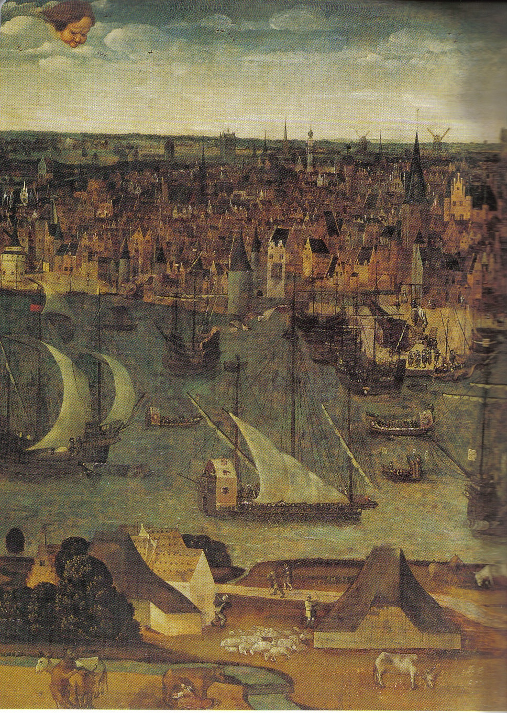
Continuity and Change in the Early Modern Global Economy
European World
Week 4
Tuesday 30 October 2018, 12-1pm
OC 0.03
Tutor: Giorgio Riello
g.riello@warwick.ac.uk

Slide 2
Lecture Structure
The European economy, c. 1500
Rural and urban
Rich and poor
The trade economy
Poles of economic growth
The World beyond Europe
Changes in the economy 1500 – 1750
Population
Manufacture
Trade
The ‘small divergence’
Europe and the wider world divergence

Slide 3
1. The European Economy, c. 1500

Slide 4
Percentage of the entire workforce employed in Agriculture
1600-1700 |  | 2000
Venice | 80 % | Italy | 8 %
Spain | 75 %
France | 73 %
Great Britain | 45 % | Great Britain | 2 %
Low Countries | 40 %
 |  | United States | 2 %
 |  | Third World | 50 %
Billions of Hectars of Land Under Cultivation
1400-1500 |  | 2000
 | 3.6 |  | 13.5

Slide 5
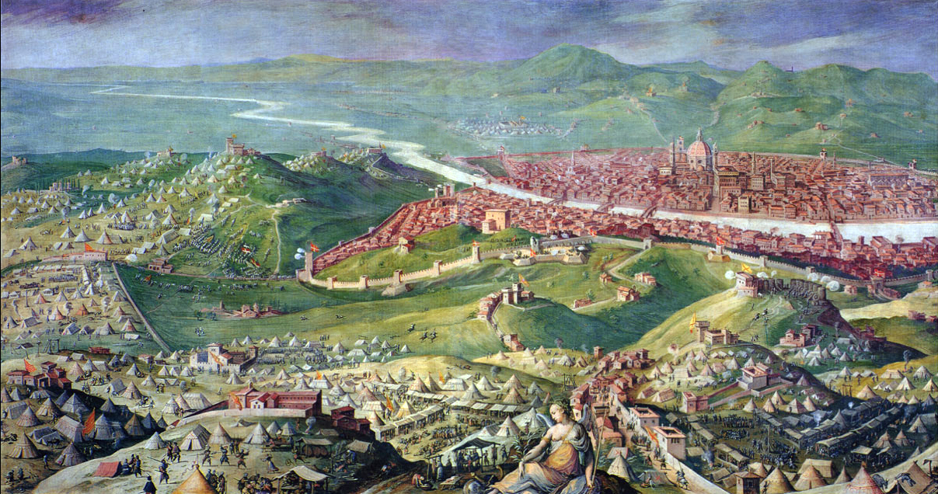
1530 Siege of Florence by Giorgio Vasari, 1558

Slide 6
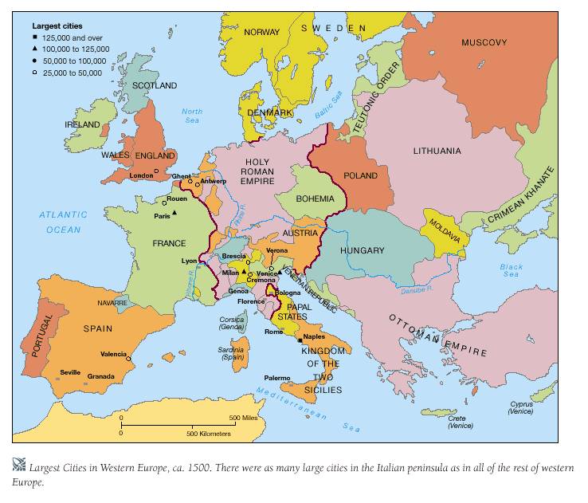

Slide 7
Inequality
The Distribution of wealth in Florence and Lyon
Population | Wealth in Florence (1427) | Wealth in Lyon (1545)
10 | 68 | 53
30 | 27 | 26
60 | 5 | 21
100 | 100 | 100

Slide 8
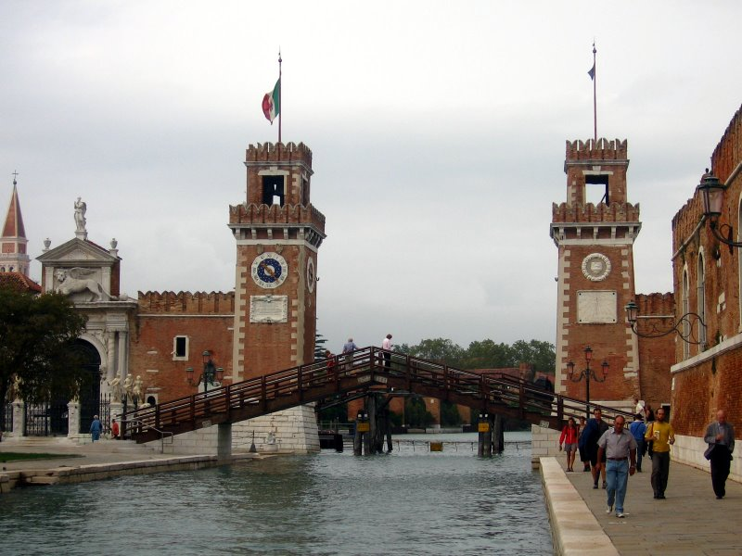
The Arsenale in Venice

Slide 9
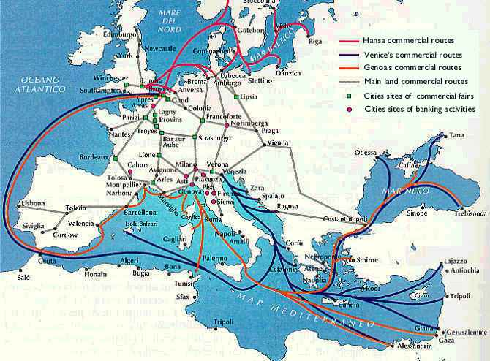

Slide 10
The World Beyond Europe
Polycentric world
Significance of Asia:
Islamic world
Transnational interaction
Mastery of science, navigation and a sophisticated commercial structure
Indian Ocean World
China

Slide 11
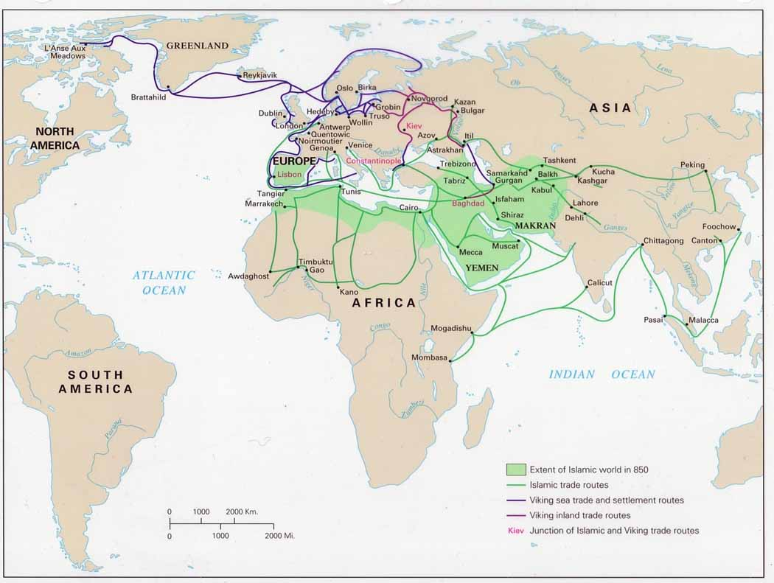

Slide 12
The World Beyond Europe
Polycentric world
Significance of Asia:
Islamic world
Transnational interaction
Mastery of science, navigation and a sophisticated commercial structure
Indian Ocean World
China

Slide 13
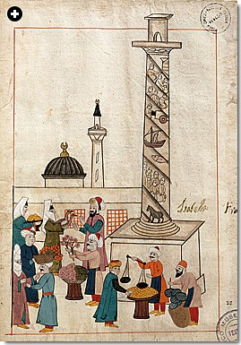
A market scene, Constantinople, sixteenth century

Slide 14
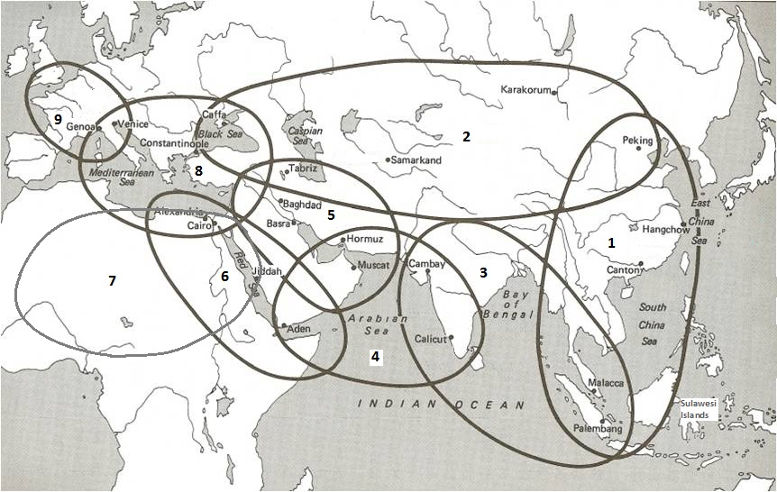

Slide 15
2. Changes in the Economy, 1500-1750

Slide 16
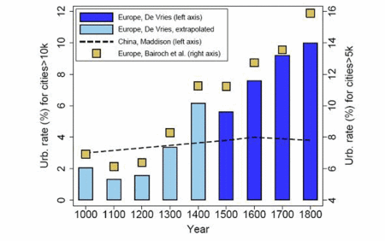
Population and Urbanisation
Dramatic population rise in some areas … increased European population as a whole… 75 million in 1500 and 110 – 120 million in 1700
(De Vries, 1984, p. 36)

Slide 17
Population and Urbanisation
More of this population lived in towns…
The Population of some major Italian cities in 1600 and 1700
 | 1600 | 1700
Bologna | 62,000 | 15,000
Brescia | 24,000 | 11,000
Milan | 130,000 | 65,000
Verona | 54,000 | 31,000
Venice | 140,000 | 46,000
Italy | 13.2 m | 10.8 m

Slide 18
Population and Urbanisation
Rising prices as demand increased
Production (agricultural and manufacture) appears to keep pace
Economic trends in Europe, 1100-today
 | Land under cultivation | Population
1000-1350 | ↑ | ↑
1350-1450 | ↓ | ↓
1450-1630 | ↑ | ↑
1630-1740 | ↓ | ↓
1740- | ↑ | ↑

Slide 19
Manufacturing
1. Large Scale manufacturing
Development of large industries in certain industries and areas such as
Mining
Iron
Shipbuilding
Paper making

Slide 20
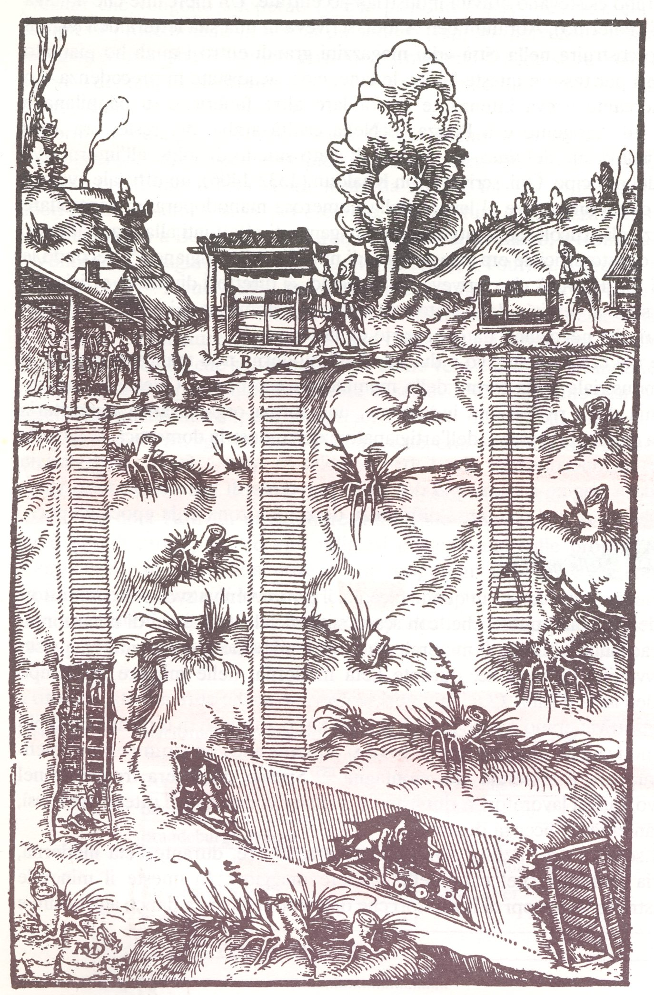

Slide 21
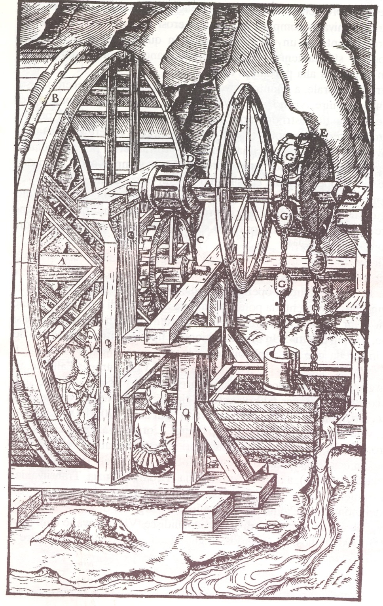

Slide 22
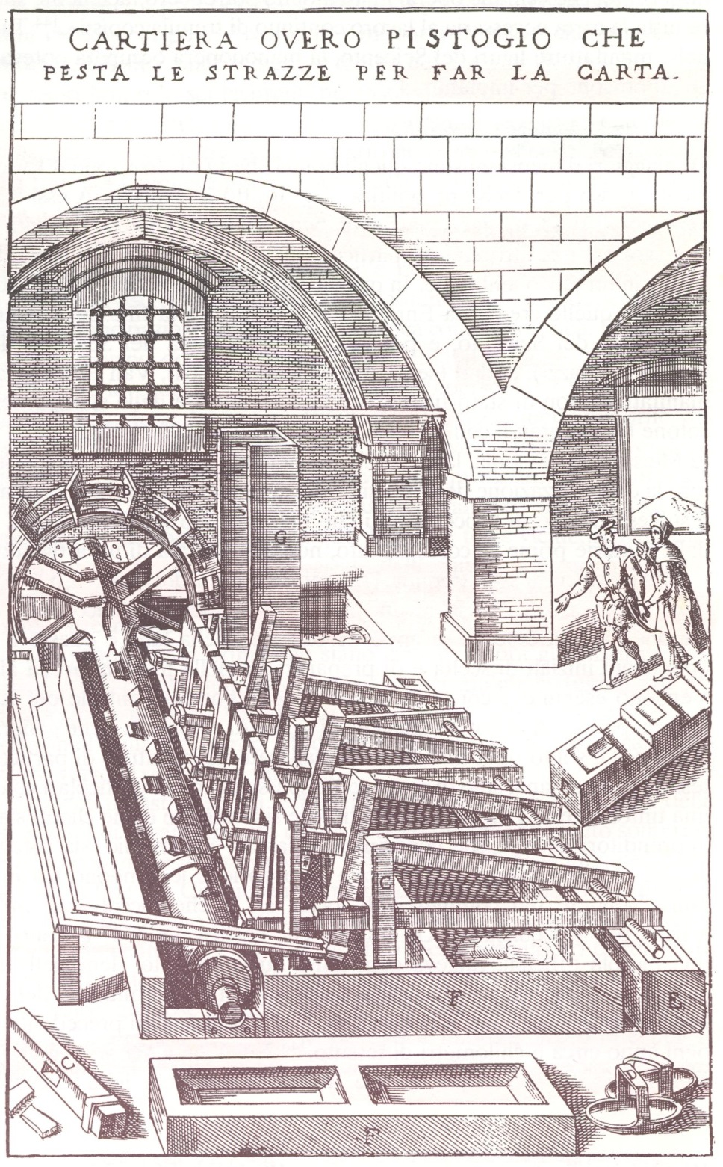

Slide 23
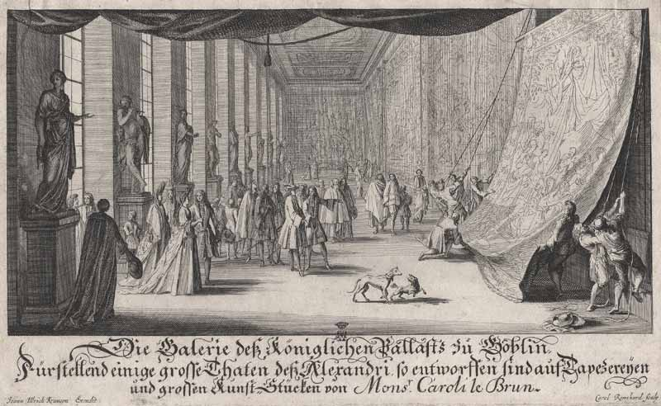
Gallery of the Manufacture at Gobelins, c. 1735

Slide 24
2. Proto-Industrialisation
Manufacturing
F. Mendels, 'Proto-industrialisation: the First Phase of the Industrialisation Process', JEconH, 32 (1972)
P. Kriedte, H. Medick and J. Schlumbohm, Industrialization before Industrialization (Cambridge, 1981)
a strong link between agriculture and industry.
a production that was co-ordinated by so-called merchant-entrepreneurs.
an industry dependent on long-distance markets.

Slide 25
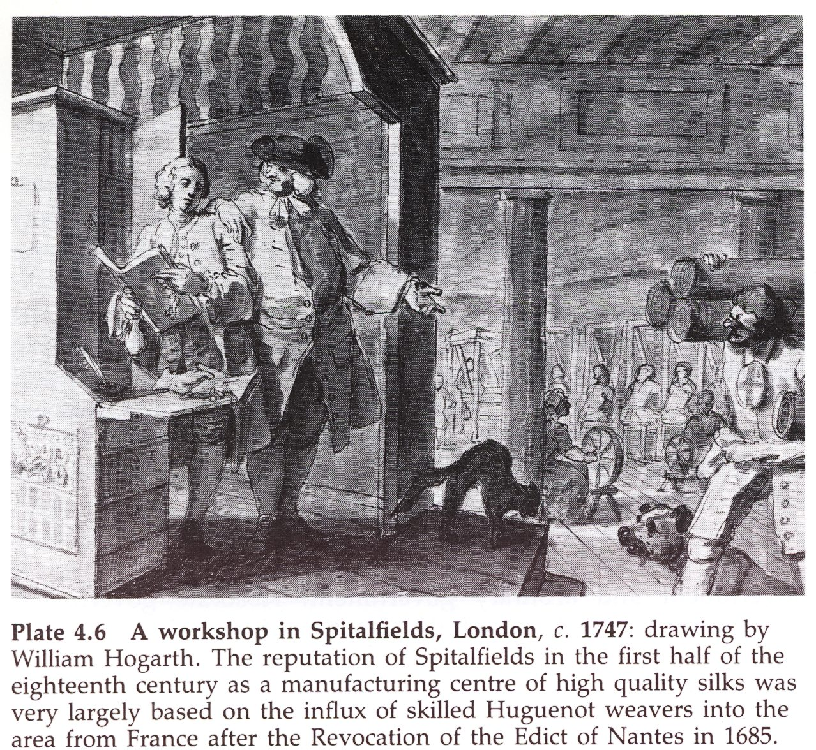
Manufacturing
3. Urban
Guilds

Slide 26
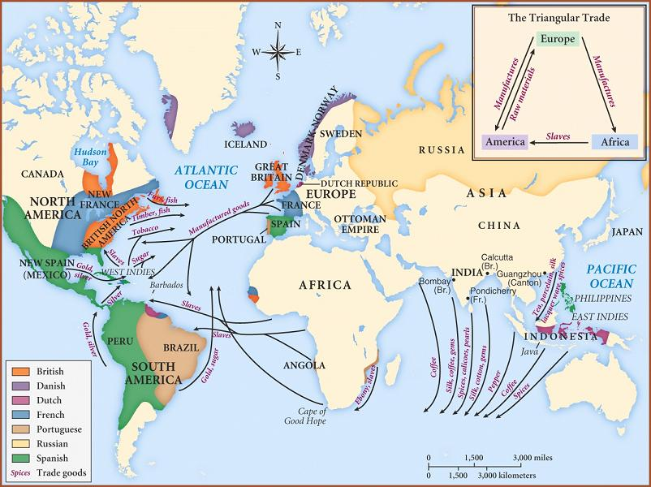
Trade

Slide 27
The European Chartered Companies in Asia
After 1500 the Portuguese Carreira da India and after 1600 the Dutch (VOC) and the English East India Companies
1. They were joint stock companies: financed by a multitude of small shareholders
2. They enjoyed forms of privilege or monopoly over the routes to Asia given through a charter of patent.
3. They traded in a variety of commodities such as cottons, silks, porcelain.
4. They conquered key trading ports across Asia (start of Empire)

Slide 28
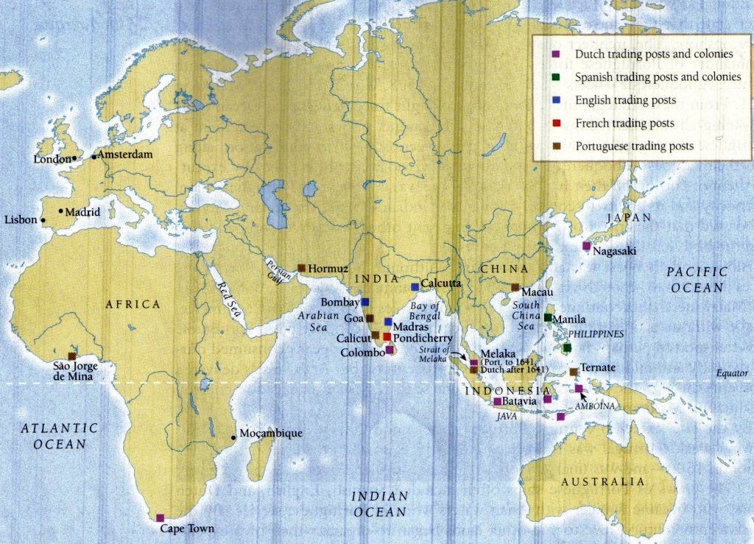

Slide 29
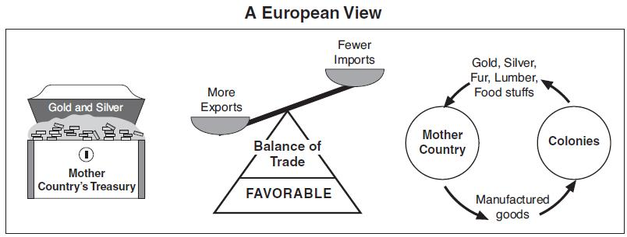

Slide 30
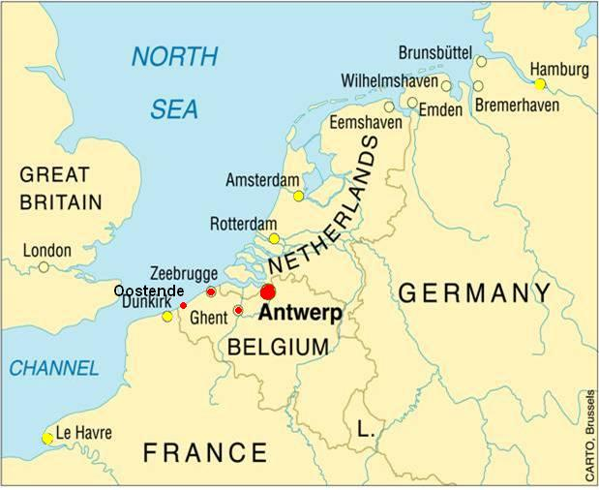

Slide 31
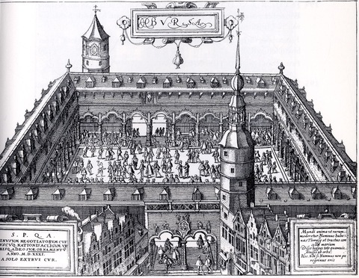
Antwerp Stock Exchange, 1650

Slide 32
3. Europe and the wider world ‘divergence’
trade expanded, urbanisation intensified, population expanded…
Externally, Europe came to be better linked with the rest of the world.
‘Divergence’, i.ee Europe went on a path of economic growth that was not undertaken by Asia for a long time.
Kenneth Pomeranz, The Great Divergence (2000).
Prasannan Parthasarathi, Why Europe Grew Rich and Asia did Not (2010).

