Slide 1
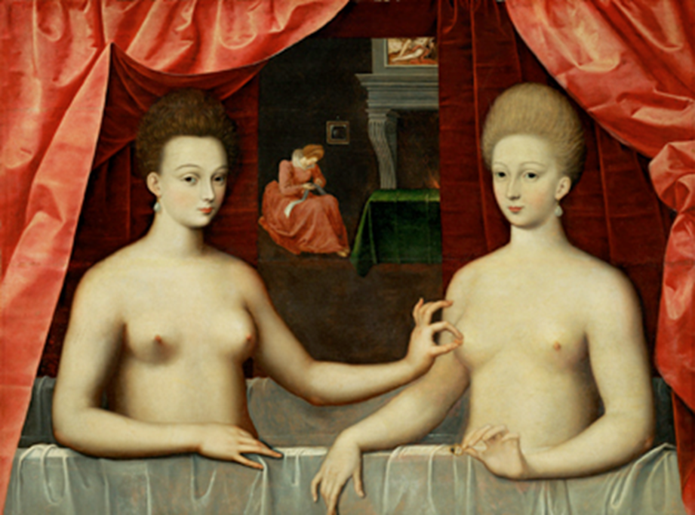
Gender in early modern Europe
The European World
Naomi Pullin
naomi.wood@warwick.ac.uk

Slide 2
Focus of this lecture
What gender means and significance as a historical category in its own right.
Notions that governed early modern ideals of gender. Will question the utility of ‘patriarchy’ as historical concept.
Some ways in which certain women accrue agency in early modern daily life.
Ways in which gender categories were/could be transgressed

Slide 3
What is gender?

Slide 4
Women’s Studies
Gender = was/is a social or historical creation and is very different from sex, which is generally fixed.
Laura Lee Downs: ‘Women (and men for that matter) were made and not born’.
Women’s Studies
Emerged in 1960s and 1970s with second wave feminism
Aimed to recover women from historical obscurity: to tell ‘herstory’
Stress on subordination and inequality of women in past societies
Emphasis on patriarchy as a historical constant in oppression of women = social system where men have more power than women.

Slide 5
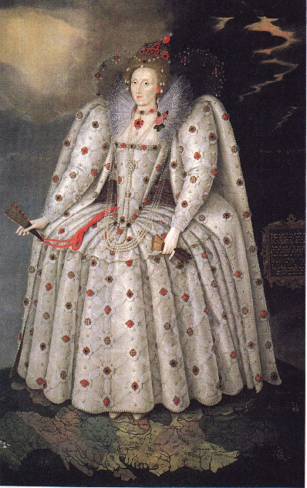
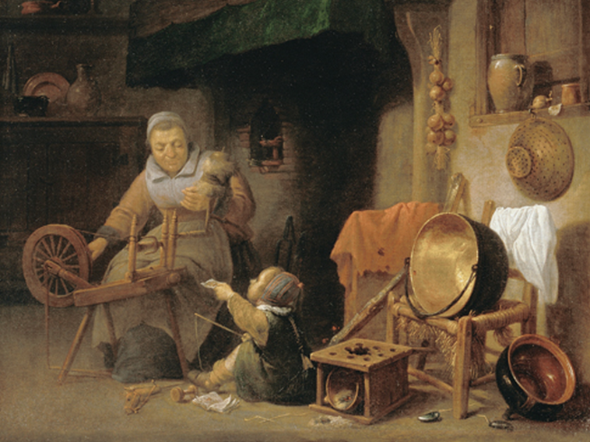
The challenge to feminist perspectives
Concern that political motives might project 20thC values back onto past societies.
Increasing awareness of complexities of studying women’s experiences – experiences varied depending on social status, race, age, nationality, religious background etc.

Slide 6
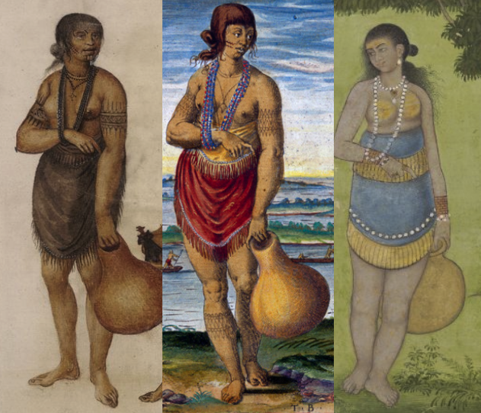
Native American culture
Culture in many Native American tribes = matrilineal.
Inheritance and power determined by mother.
Respected older tribeswomen served as elders, council members, religious figures and diplomats.

Slide 7
Gender History (late-1980s and 1990s)
Joan Scott, Gender as ‘a useful category of historical analysis’ (1986)
‘Women’ and ‘men’ were cultural constructs: identified in relation to each other or to the culture around them.
Gender ‘means knowledge about sexual difference … Such knowledge is not absolute or true, but always relative. It is produced in complex ways … Its uses and meanings become contested politically and are the means by which relationships of power – of domination and subordination – are constructed’.

Slide 8
Men’s Studies (1990s and 2000s)
‘Gender’ is not just a shorthand for ‘women’- men’s experiences also mattered.
Men’s and women’s relationships must be explored in relation to one another [Natalie Zemon Davis, Elizabeth Foyster, Alex Sheppard].
Double-meaning to patriarchy – a society in which some men are dominant over other men.
E.g. [Helen Berry and Elizabeth Foyster]: childless men viewed as weak because unable to procreate > inability to please wife sexually brought ability to engage in politics and economic credit into question.
Is there a danger that men’s studies might return historical gaze to men?

Slide 9
EARLY MODERN NOTIONS OF GENDER

Slide 10
1. Domestic and Political Order
Household was described as a ‘Little Commonwealth’ – husband and father was supreme head of the household.
William Gouge, Of Domesticall Duties: ‘Such duty as the subject owes the prince, / Even such a woman oweth to her husband’.
Gendered nature of the law for killing spouse – husband would be hanged for murder; wife burned for petty treason.
Husbands and wives had particular responsibilities – day-to-day domestic management was undertaken by women. Symbolised by the tortoise or snail who carried home on its back.
Breakdown of domestic order affected men’s reputations and honour (e.g. scolding wife)

Slide 11
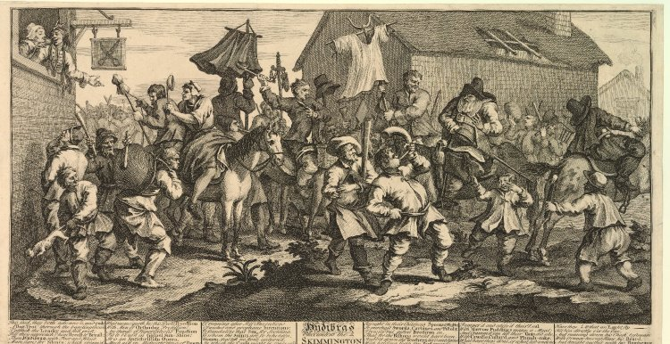
Charivari (also known as skimmington or rough music) = shaming ritual that mocked gendered inversion of the household

Slide 12
2. Gender and the Law
Woman legally defined as femme covert (covered woman) – legal identity is the same as their husband, father or other male relative
Could not incur debts, make contracts, sue in court, barred from office and could not vote
femme sole (single woman) – only possible with widowhood
Man’s word carried greater weight that woman’s in the court – ‘testimony’ from Greek testis.

Slide 13
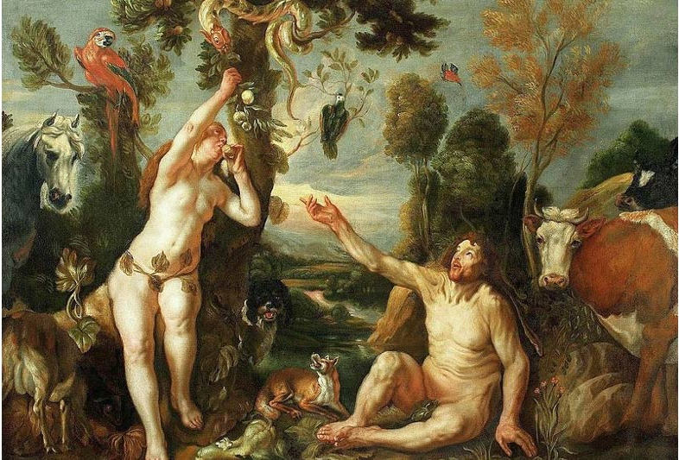
3. Gender and the Church
Eve made from Adam’s rib: ‘Thy desire shall be to thy husband and he shall rule over thee’ (Genesis 3:16)
Her weakness brought about the Fall of mankind – her uncontrollable passions came to represent those of all women

Slide 14
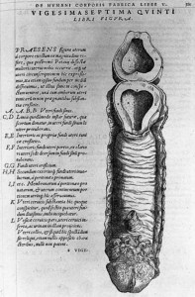
4. Physiological make-up / scientific theories
Galenic medicine held that body was made up of 4 humours, with a different balance in men and women
Women were more emotional, less rational and more passionate than men.
BUT male and female bodies physiologically the same
Thomas Lacquer (1990), Making Sex: up until C18th = one-sex model. Woman is imperfect version of man.
Diagram of a vagina from Vesalius, Fabrica (1544)

Slide 15
5. Honour and Reputation
‘Double Standard’ (Keith Thomas): encapsulates imbalance of attitudes towards sexual honesty:
- for men, sexual relations before or outside marriage was a mild offence;
- for women it constituted loss of whole character and brought shame on family.

Slide 16
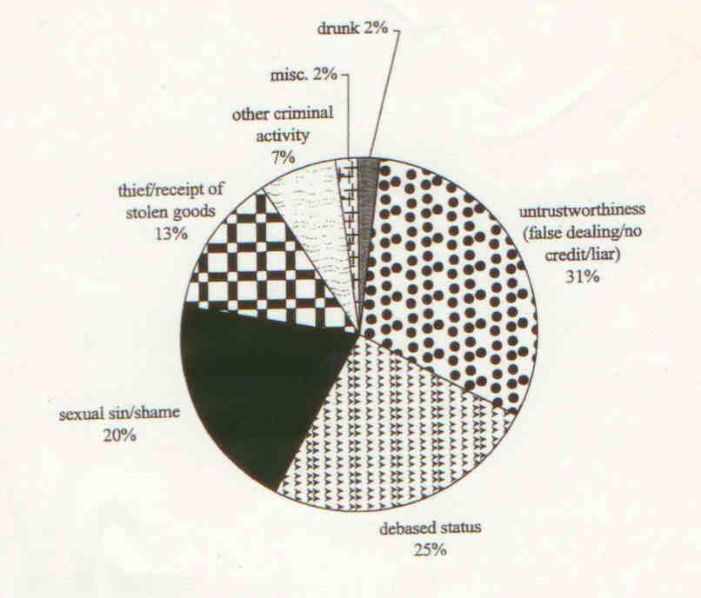
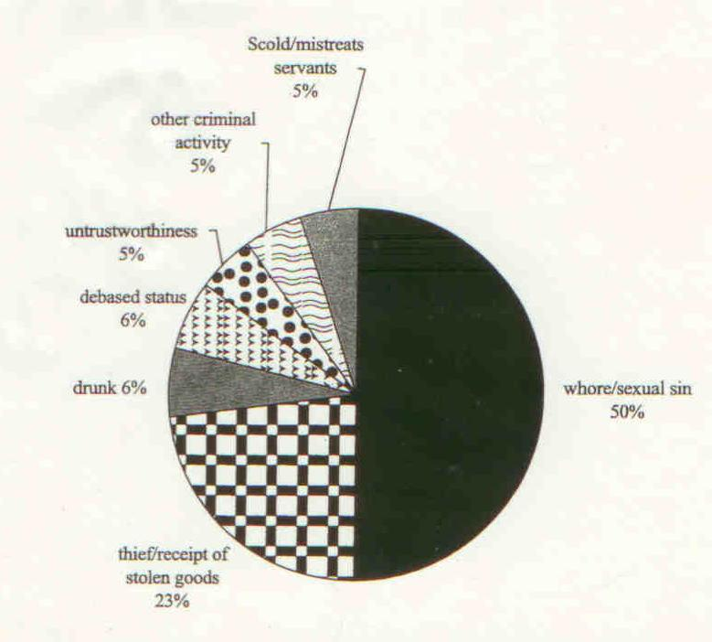
Insults against men (left) and women (right) in Cambridge 1581-1640

Slide 17
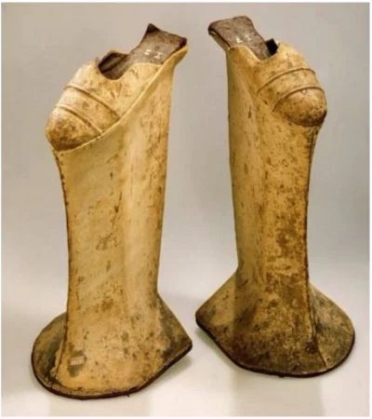
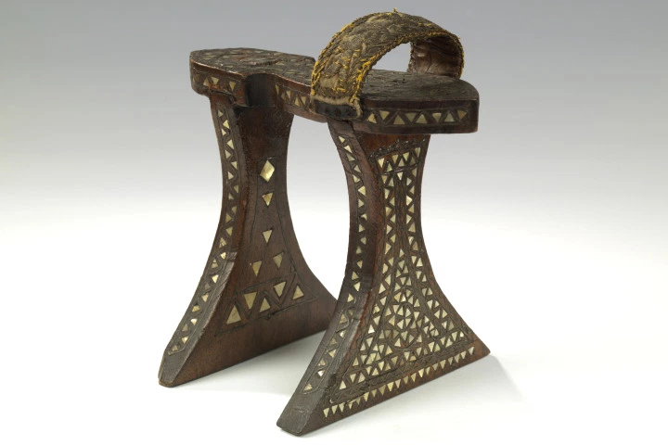
To safeguard sexual honour - platform shoes (Chopines) worn by patrician women in Renaissance Venice would physically inhibit them leaving the home without the aid of a male consort.

Slide 18
ACQUIRING AGENCY

Slide 19
Widows and singlewomen
Large number of widowed women because of high death rate and young age at which women married.
Amy Froide: widows and singlewomen make up approx. 14.9% and 30.2% respectively of adult female population in early modern England.
Widowhood gave women independent legal status and offered opportunities as heads of households.
10% of women in some European towns are unmarried – contribute to economic life of their communities: property holders, creditors, tax payers and philanthropists.

Slide 20
Widows and singlewomen
Russia:
Marfa Boretskaia became ‘mayoress’ of city of Novogord at close of 15thC.
Husband was former mayor and son was also a current mayor in another town.
Marfa was the city’s wealthiest citizen.
Denmark
Knud Gyldenstjerne acted as royal knight after husband dies.
Expected to fulfil same obligations as other landholders: to supply cavalry and men to defend territories.

Slide 21
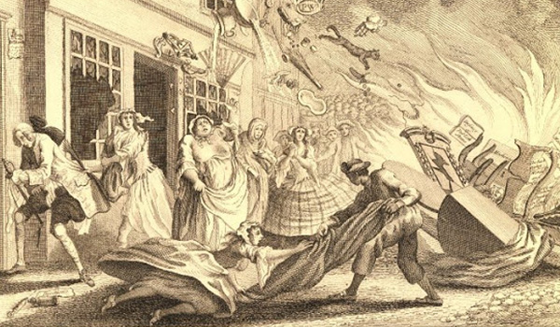
Riots
Women involved in almost every food riot of the period.
John Walter argues that women formed 1/3 of the participants in English food riots in 18thC
Women sensitive to increase in food prices.
Marketplaces = good place to gather recruits for protest.
Inferior legal status meant it was less dangerous for women to be involved in popular uprisings.

Slide 22
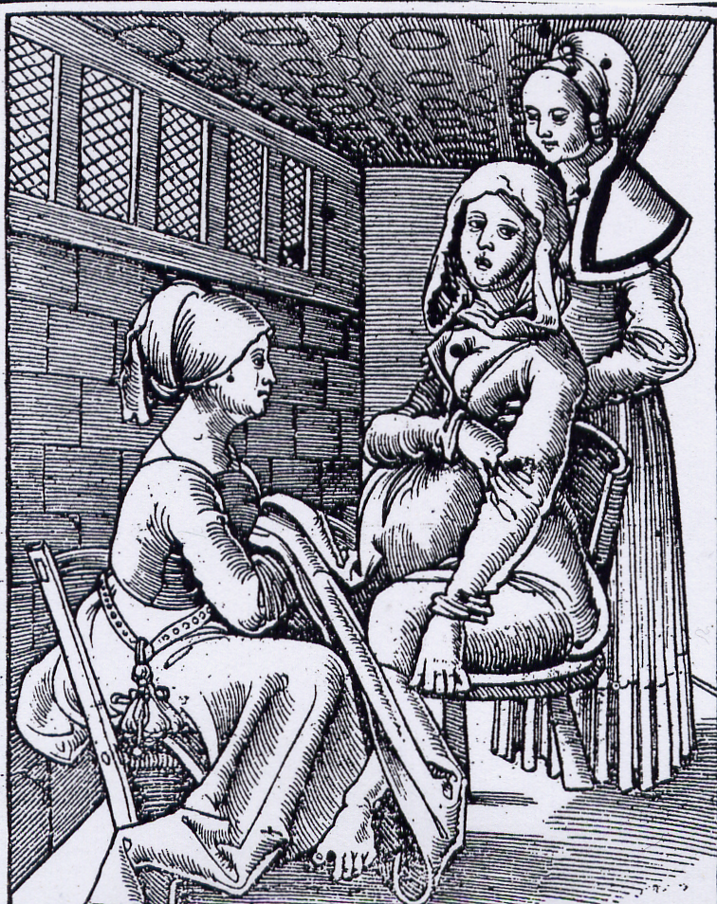
Gossip
Childbirth = exclusive gathering of female neighbours to support mother and midwife.
New baby was carried to church by mother’s friends for Christening.
Gossip originally denoted godparent.
Gossip networks were essential to households – necessary for advice, assistance, and to exchange goods and money.

Slide 23
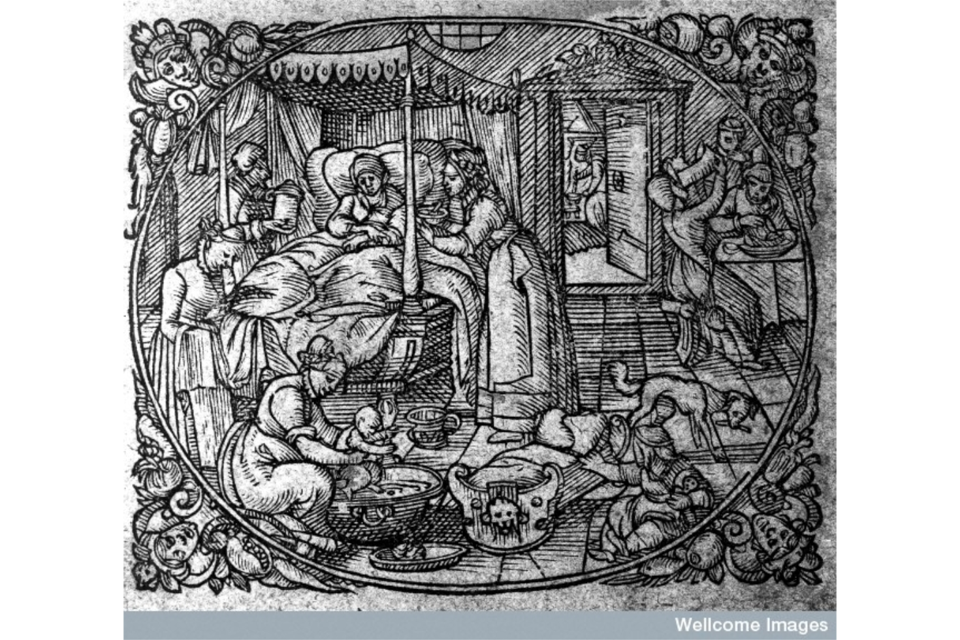
Gossip
Potential threat to male authority in birthing chamber
German lying in room showing attendant, child being bathed and a midwife drinking beer, by Jacobus Rueff (1616)

Slide 24
Body searchers and juries of matrons
Patriarchy = dependent on distinctions between women > some had more authority over others.
Female neighbours often looked for signs of illegitimate pregnancy to safeguard communities.
Would initiate physical searches of neighbours’ bodies (esp. breasts) who they suspected might be pregnant or had been pregnant.
When women of illegitimate children went into labour – would force them over the parish boundaries to avoid burden of poor relief for community.
Midwives were to interrogate unmarried women during labour to identify father.

Slide 25
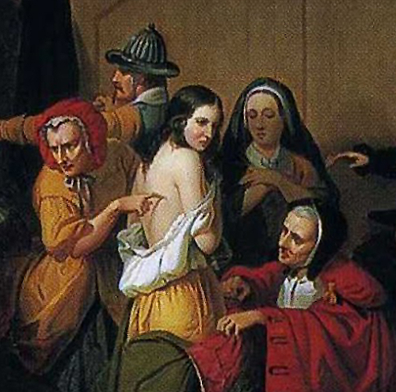
Juries of matrons employed to search for the witches ‘mark’

Slide 26
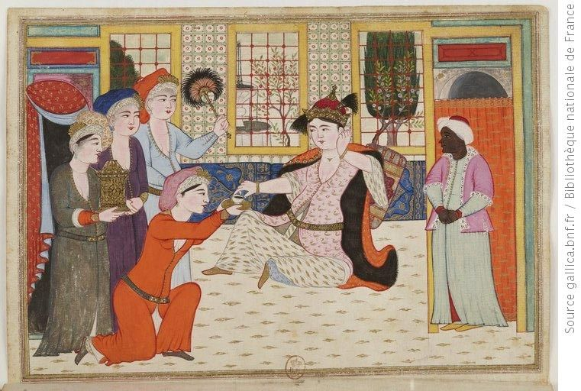
The Imperial Harem
Power = male-dominated in Islamic tradition –reinforced with female slaves, concubines and wives living in households.
Leslie Pearce: survival of Ottoman dynasty depended on women, esp. through institution of the Imperial Harem (female consorts attached to the sultan)
Following rule of Suleman the Magnificent the Imperial Harem became a coherent institution that exerted significant political influence over state matters.

Slide 27
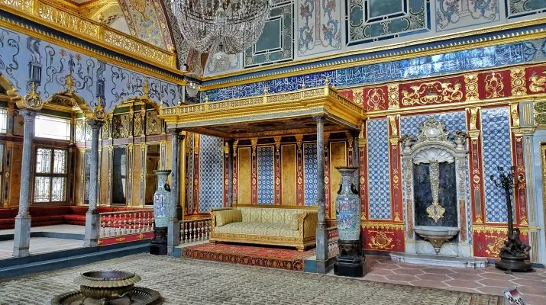
The Imperial Harem
Increased power of Harem evidenced in architecture of the royal household in the Topkapi Palace. Domestic side of the royal household integrated into the imperial residence.

Slide 28
Sexual deviance

Slide 29
Themes for the rest of the course
Problems caused by centralisation – as monarchs try to exert control over the outlying regions of their kingdoms.
The Game of Thrones – English and Scottish monarchs claim each other’s thrones until 1603.
Religion – Impact of the European Reformations from 1517.
Influence of Europe – competition between rulers. Some people maintain ‘European’ identities (esp. religion)
Atlantic Expansions – 1585 expansionist programme in North America begins; British history includes American colonies.

