Slide 1
Women, Health and Healing
Dr Sophie Mann

Slide 2
Women in the Sphere of Medicine
Women played a substantial role in health and healing in early modern Europe.
They have been undercounted in studies that rely on occupational labels, but when we look at healing in the community we can see women provided a strikingly broad range of medical services.
Women, in other words, were central to health and healing before 1800.

Slide 3
Women in the ‘Medical Marketplace’
Although women often practised medicine in domestic settings, female practitioners should not be considered in isolation from larger intellectual, cultural and market forces that shaped men’s healing work.
The purchase and use of medicines integrated female consumers into broader processes of commercialisation and commodification.
Medical expertise were widespread across society. Therapeutic practices and, to a large extent, medical theories of qualified and lay healers often overlapped
Women were active consumers of a new and ever-increasing genre of popular medical literature.

Slide 4
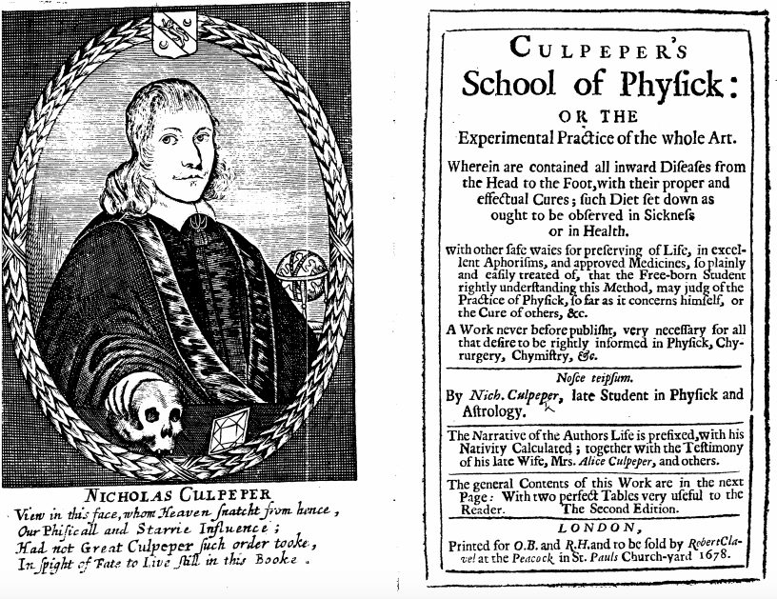
Nicholas Culpeper, Culpeper’s School of Physick (1678)

Slide 5
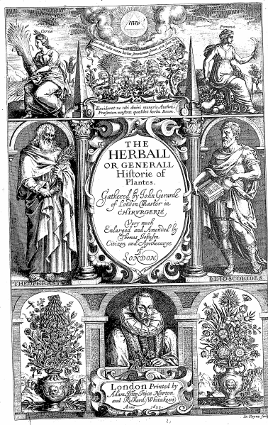
John Gerard,
The herball or Generall historie of plantes. Gathered by Iohn Gerarde of London Master in Chirurgerie (1633)

Slide 6
Domestic Medicine
There was a widespread practice of self-treatment, of family-based treatment and lay treatment offered by neighbours. And it was female members of the family especially who were seen as sources of medical knowledge and treatment.
The primary arena for medical treatment in the pre-modern era was the household.
Women as cultivators and communicators of medical information.

Slide 7
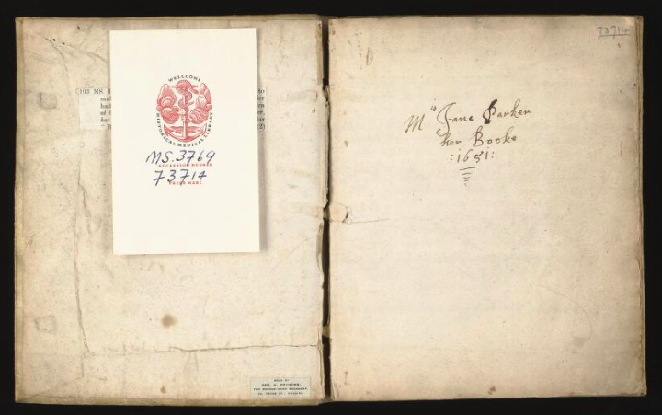
Jane Parker’s Medical Recipe Book (1651), Wellcome Library, MS. 3769

Slide 8
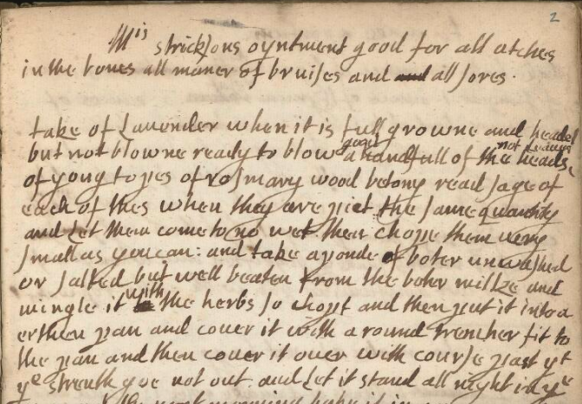
An ointment used for aches in the bones, bruises and sores

Slide 9
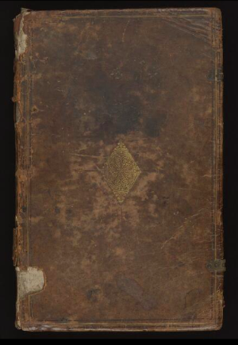
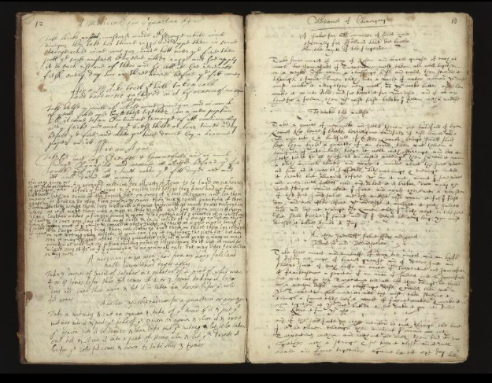
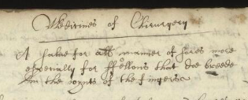
Anne Brumwich, Medical Recipe Book (1625), Wellcome Library MS. 160
Pages detailing a number of surgical remedies

Slide 10
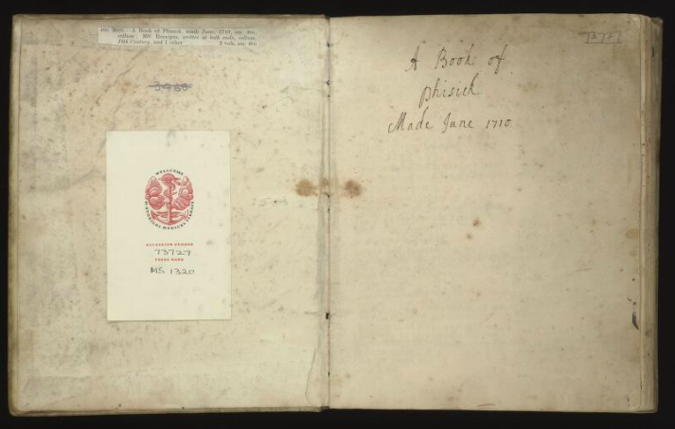
A Book of Phisick (1710), Wellcome Library MS 1320

Slide 11
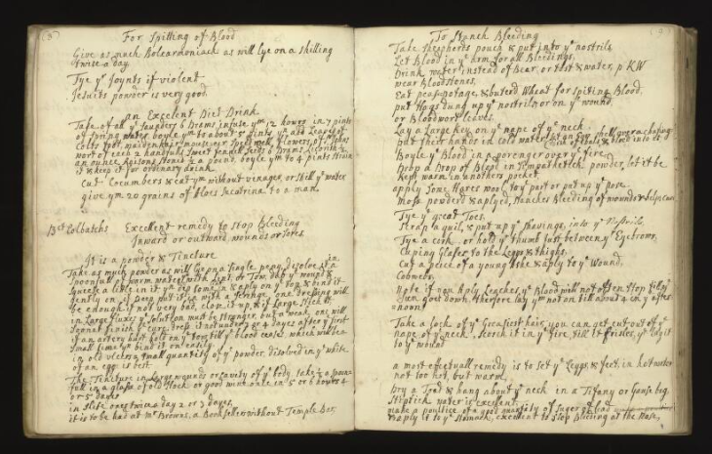
A series of remedies for staunching ‘outward’ and ‘inward’ bleeding

Slide 12
Medicine in the Community: Surgical Shops
We have evidence of women’s managerial involvement in London’s surgical shops, dressing patient’s wounds, helping to prepare surgical remedies, and taking an acting role in training up surgical apprentices.
Records of the Barber Surgeon’s Company demonstrate that women affiliated with the company through marriage could participate in the operation of family surgical shops, provided their behaviour did not explicitly compromise patriarchal authority within the household or threaten the company’s public reputation, corporate social status, or the privileging of male occupational authority.

Slide 13
Medicine in the Community: Pregnancy and Childbirth
The experience of marital relations and childbirth gave married women a unique knowledge and authority: wives and widows claimed to be able to detect the signs of pregnancy, to calculate the maturity and paternity of newborn children, and to differentiate stillbirths from infanticides.
Knowing the body gave some women a stake in the judicial system. Expert matrons, who generally included midwives, were appointed to examine women seeking annulments on the grounds of non-consummation.
Midwives might also be given the task of searching women for signs of pregnancy, which could save a convicted woman, temporarily, from execution. Their findings were not always consistent with medical probability. For example, sometimes convicted women continued to be found pregnant for a year.

Slide 14
Medicine in the Community: Medical Charity
Medicine was couched in notions of divine favour, Christian duty and Christian charity.
Women were particularly active practitioners of medical charity, confirming their reputation as knowledgeable and accomplished healers.

Slide 15
Examples of Medical Charity
Margaret Hoby (1571-1633) often distributed free medicines to her workmen and servants, and paid regular visits to the sick and needy in her local community of Hackness in Yorkshire.
Lady Joan Barrington (1558-1641) of Essex was highly regarded for her medical knowledge and skill, and was frequently consulted for advice on the treatment of sick children. She also supplied poor neighbours with free medicines.
Mary Rich (1624-1678), a gentlewomen from Leighs, Essex, produced medicines on a large scale for poor neighbours. She was also visited by them due to her reputed skills in surgery and physic.

Slide 16
Medical Charity and Religious Instruction
Illness was often seen as a teachable moment, a time when the healer could encourage the sufferer to greater acts of piety.
Tending to the sick body was a religious as well as a medical act, and when practiced amongst religious rivals, this could open up opportunities to instruct, proselytise and even convert your patients.

Slide 17
The case of Sister Dorothea
A member of the Catholic Catholic Institute for the Blessed Virgin Mary, and widely regarded for her healing skills.
“I went for three weeks to live with a gentlewoman who was newly become a Catholic.
“I soon gained their affections, by serving and tending them both, and making medicines and salves, and teaching them to do the same”
“The gentlewoman was earnest for my stay, and I perceiving much good there to be done, in particular aiming at the conversion of four there, I was content to stay”.
Case study relayed in Henry James Coleridge, ed., The Life of Mary Ward 1585-1645 (1885).

