Slide 1



Slide 2
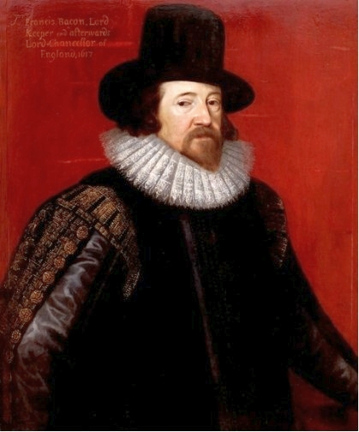

Slide 3
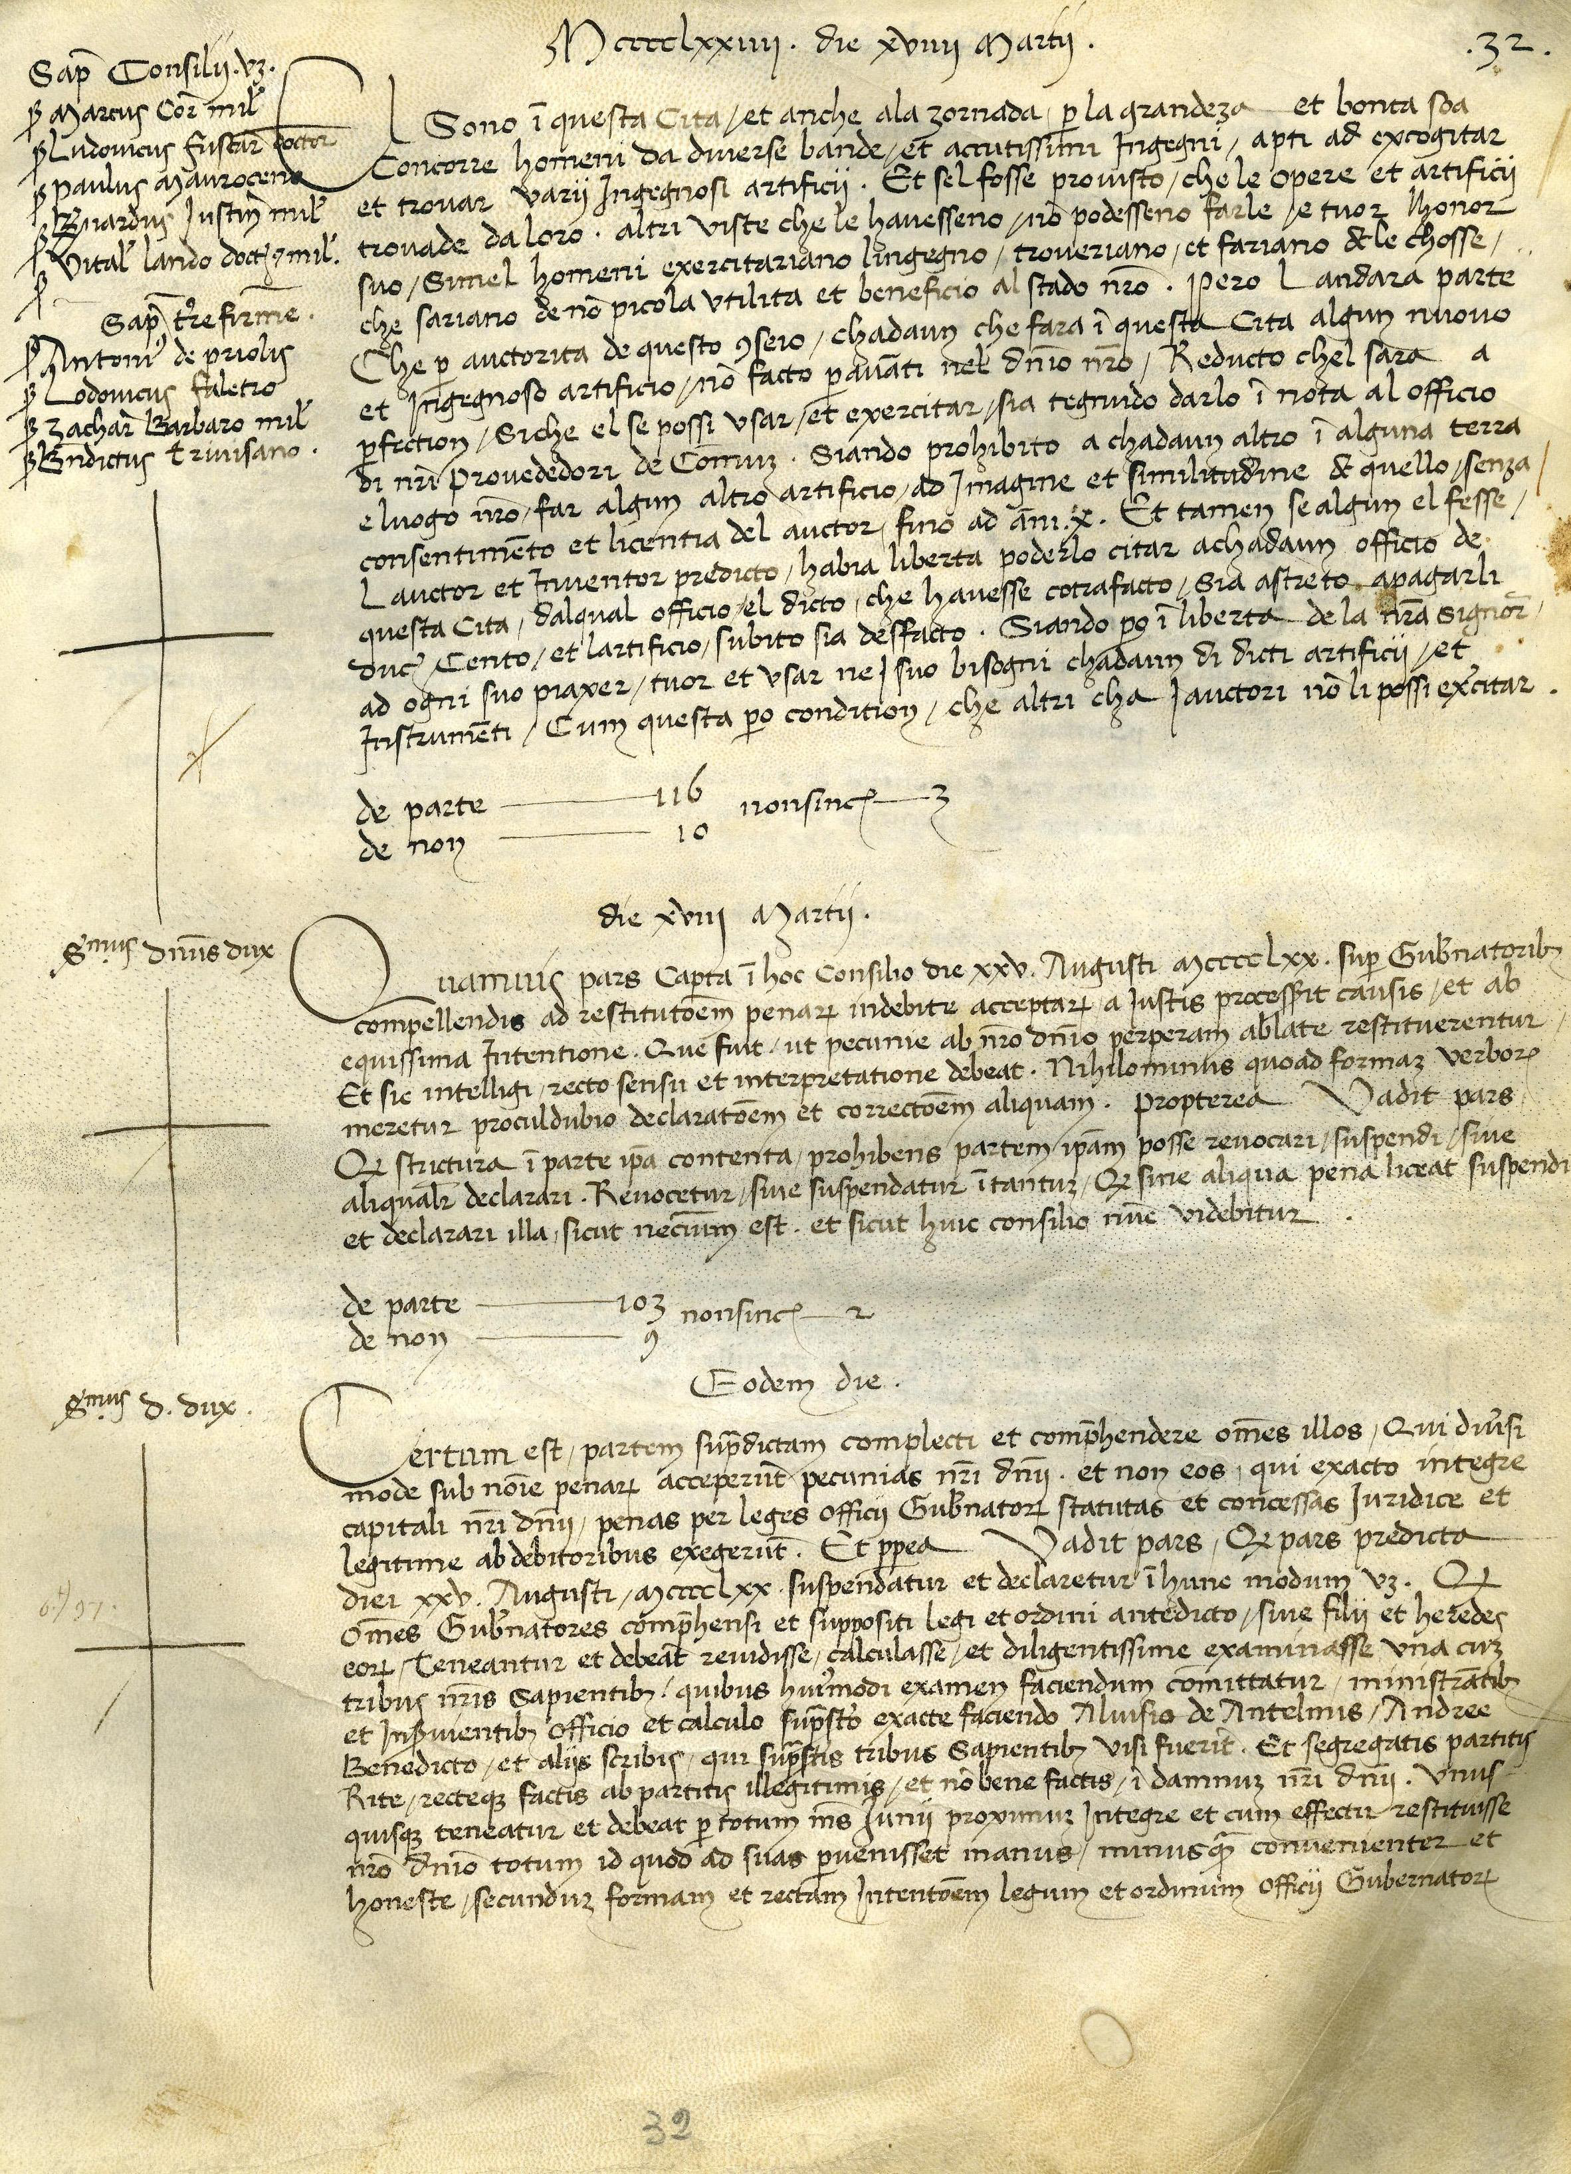

Slide 4
19 March 1474
There are men in this city, and also there come other persons every day from different
places by reason of its greatness and goodness, who have most clever minds, capable
of devising and inventing all kinds of ingenious contrivances. And should it be
legislated that the works and contrivances invented by them could not be copied and
made by others so that they are deprived of their honour, men of such kind would
exert their minds, invent and make things that would be of no small utility and benefit
to our State. Therefore, the decision has been made that, by authority of this Council,
any person in this city who makes any new and ingenious contrivances not made
heretofore in our Dominion, shall, as soon as it is perfected so that it can be used and
exercised, give notice of the same to the office of our Provveditori di Comun, having
been forbidden up to ten years to any other person in any territory and place of ours to make a contrivance in the form and resemblance of that one without the consent and license of the author. And if nevertheless someone should make it, the aforesaid
author and inventor will have the liberty to cite him before any office of this city,
which office will force the aforesaid infringer to pay him the sum of one hundred
ducats and immediately destroy the contrivance.

Slide 5
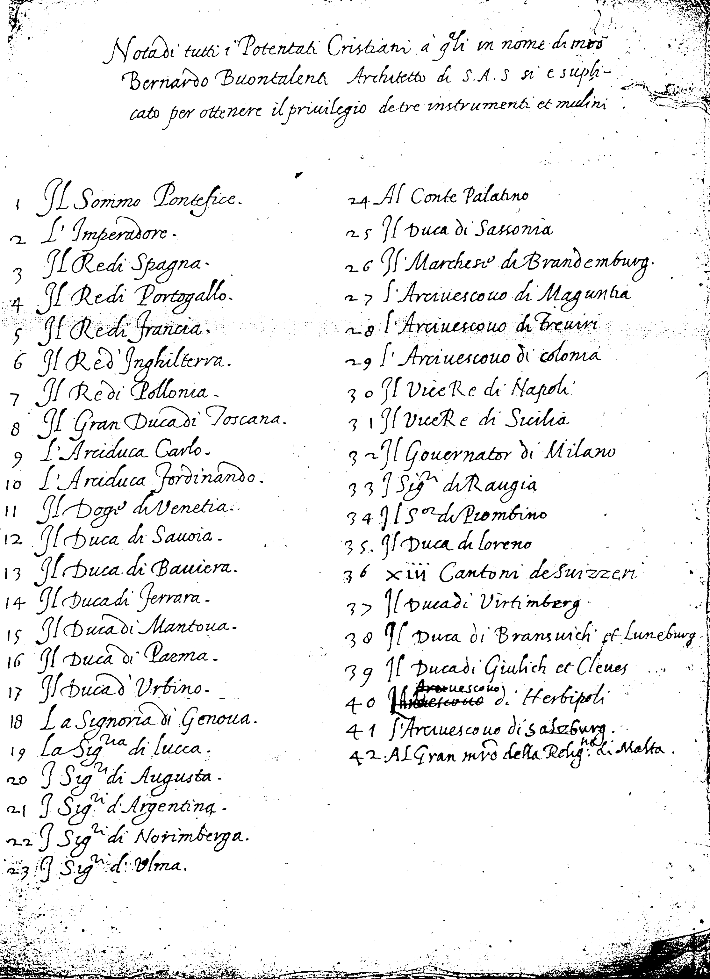

Slide 6
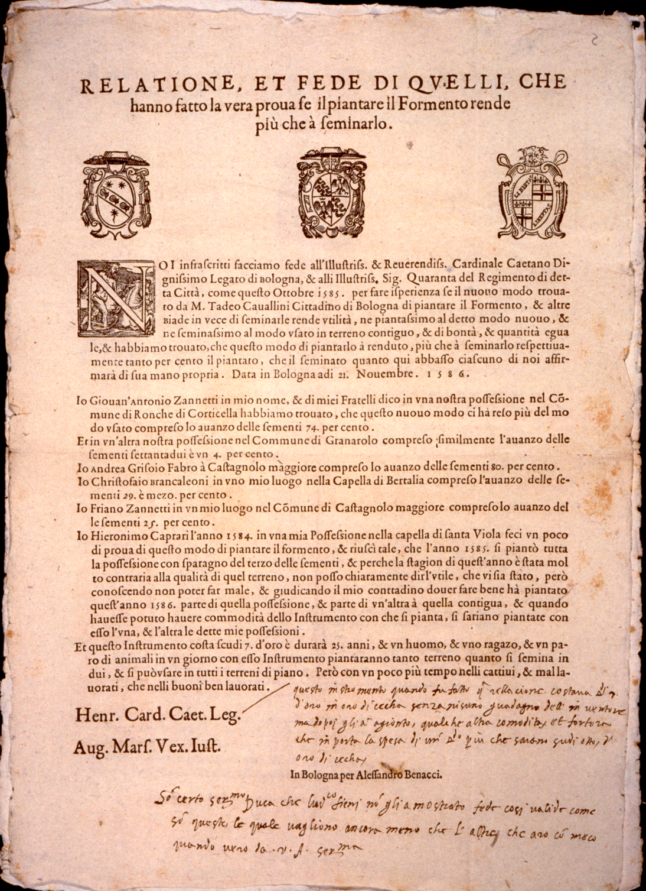

Slide 7
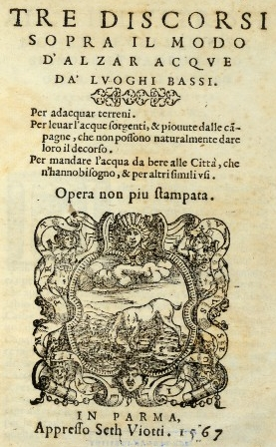

Slide 8
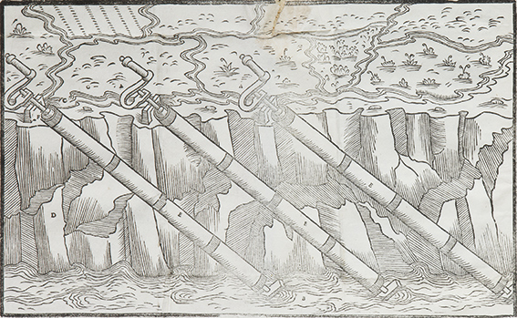

Slide 9


Slide 10
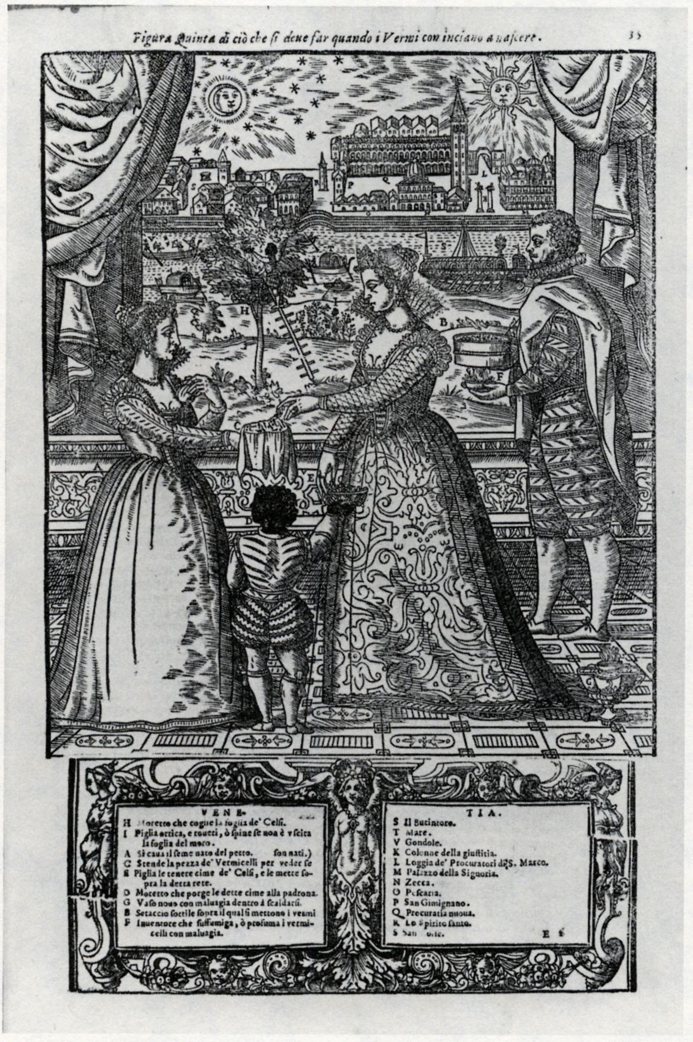

Slide 11
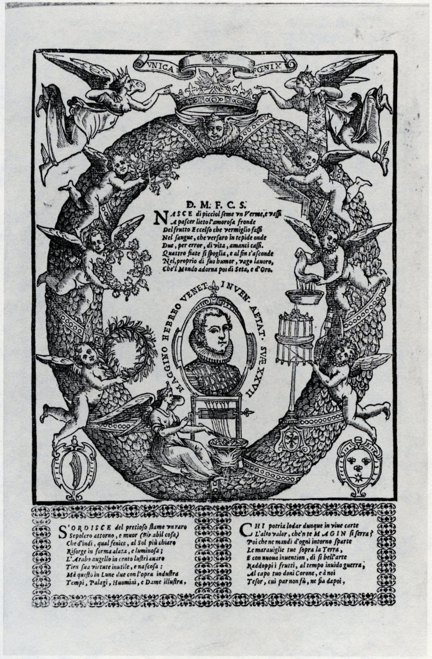

Slide 12
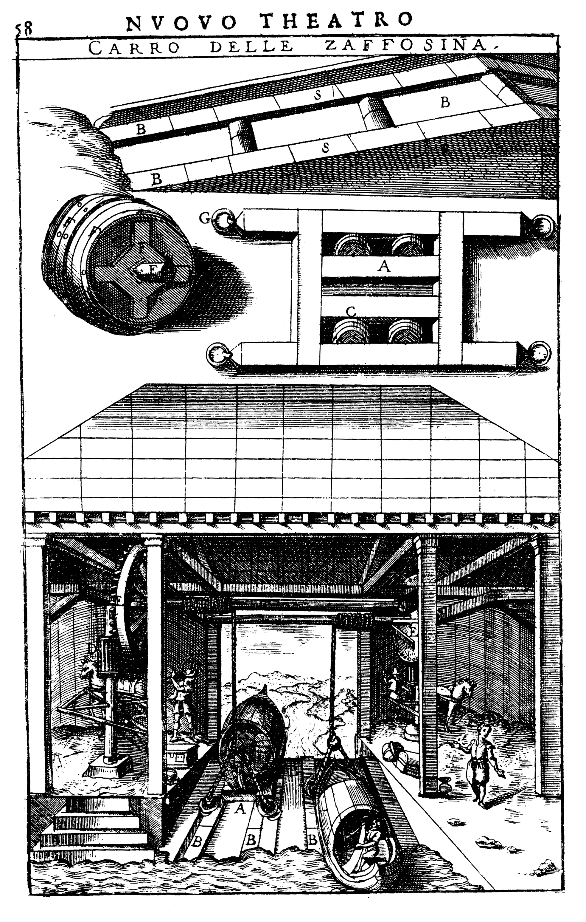

Slide 13
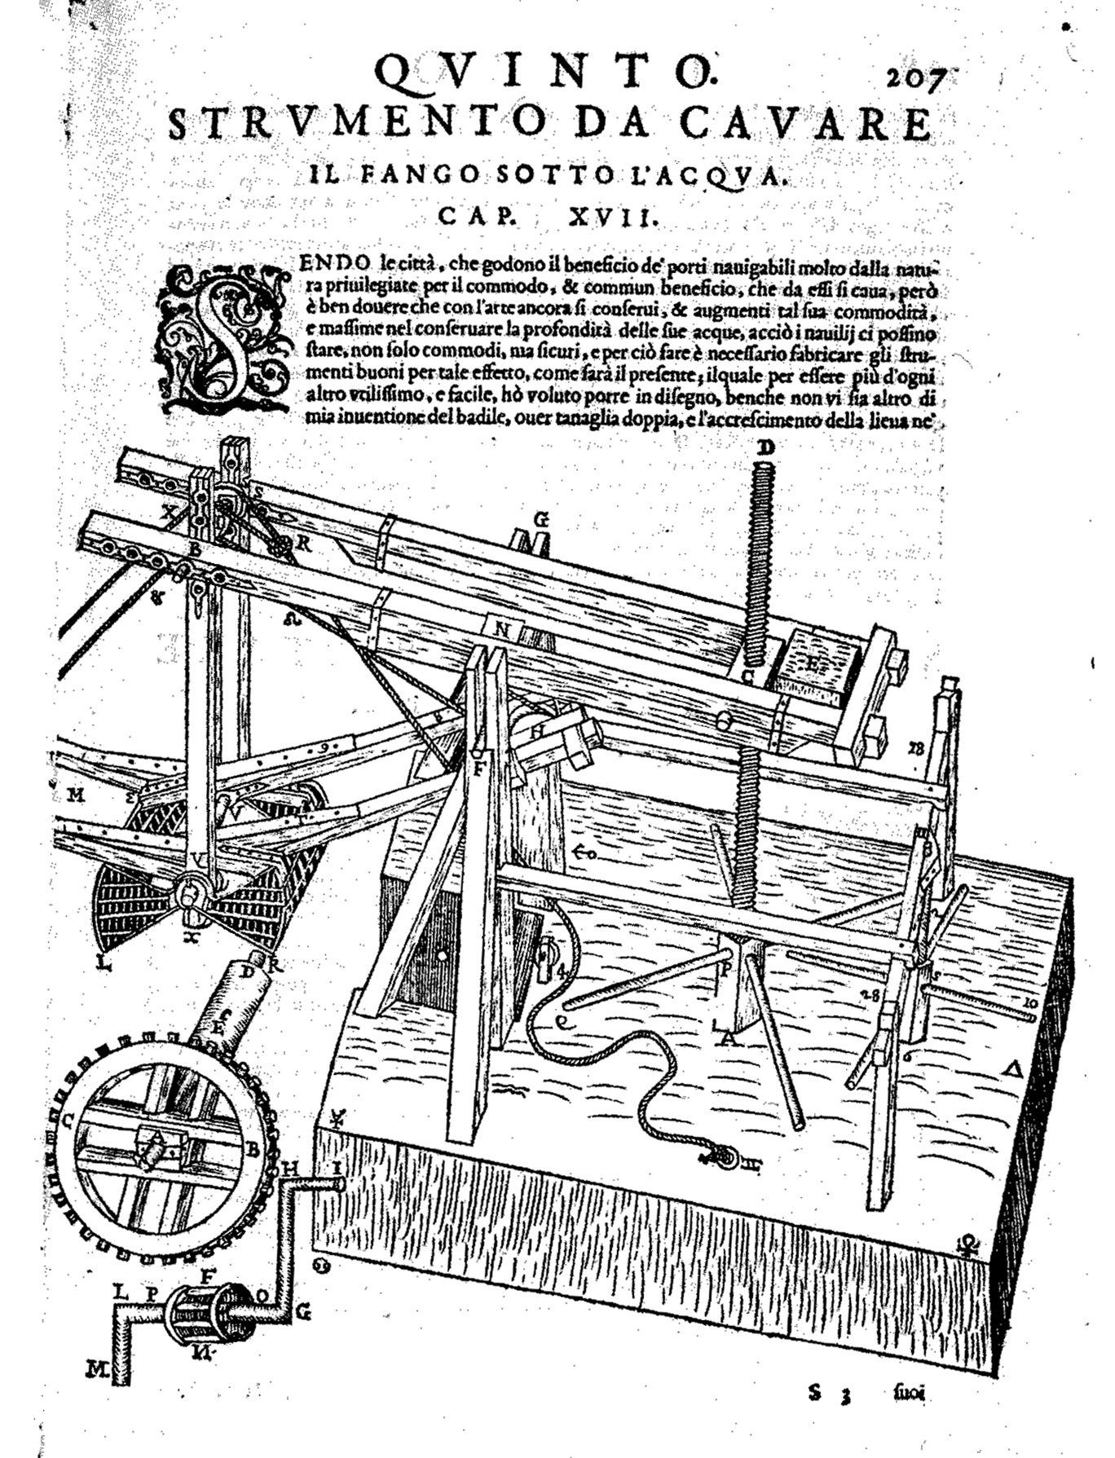

Slide 14
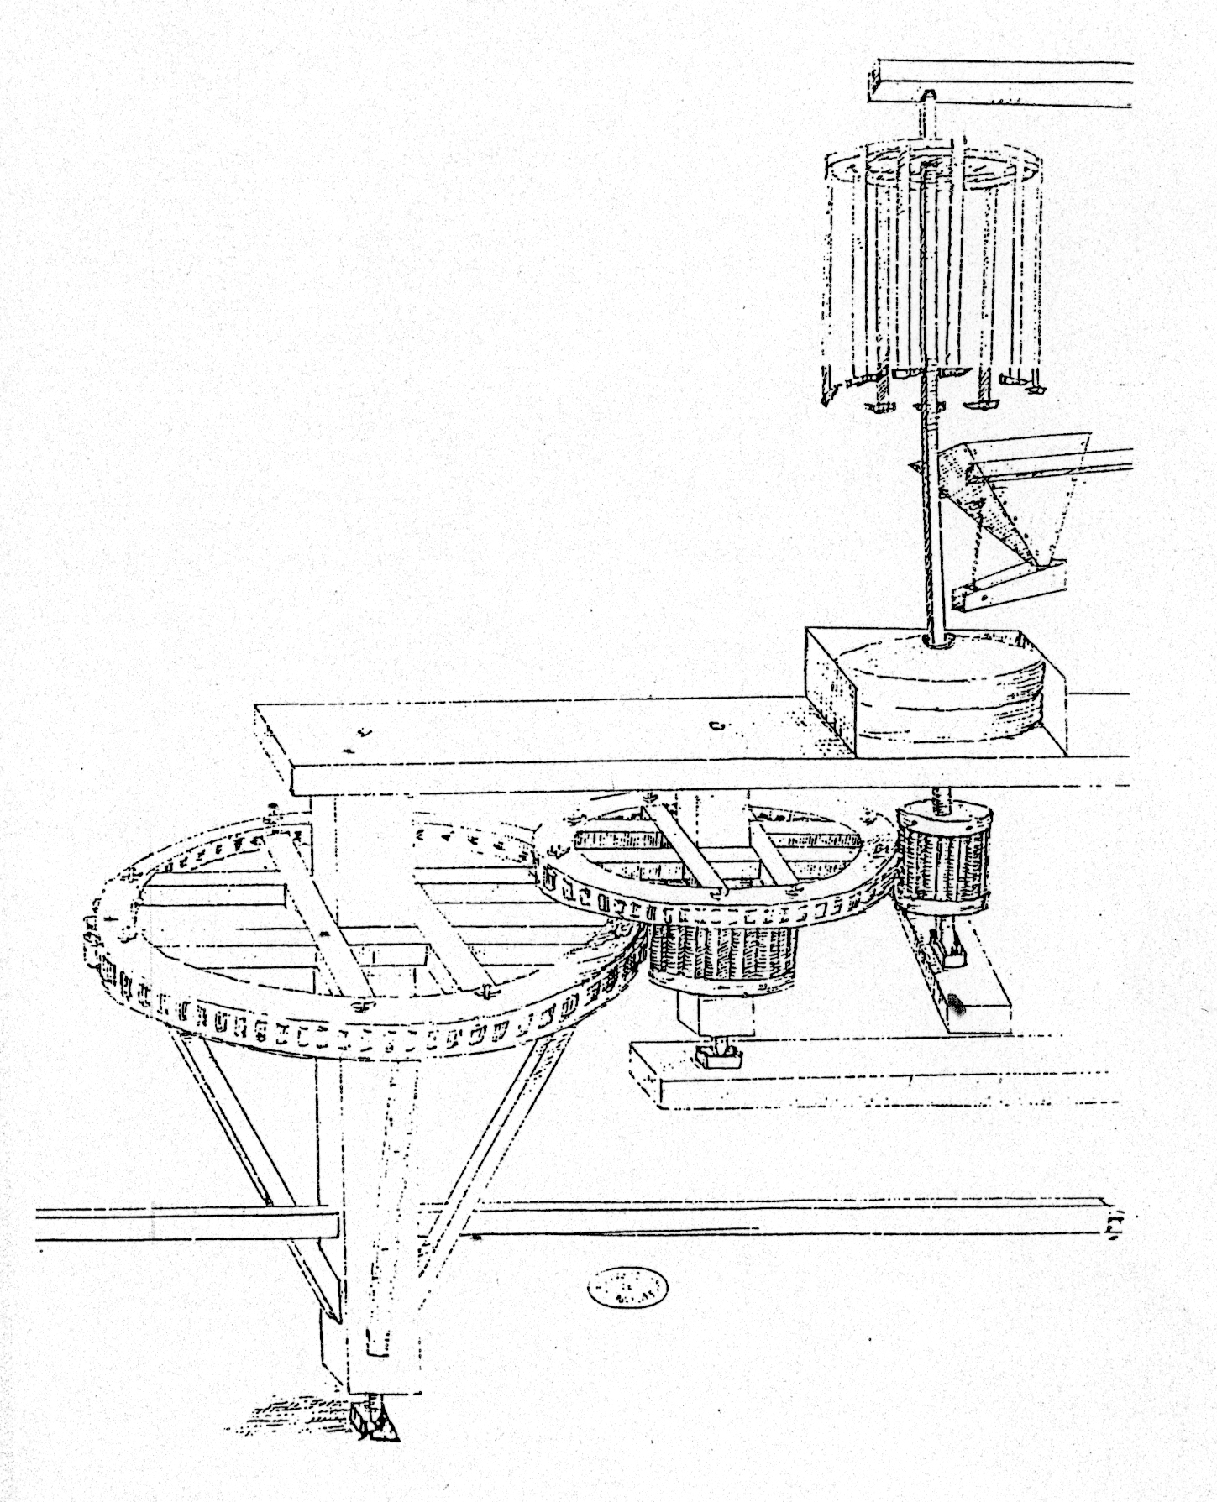

Slide 15
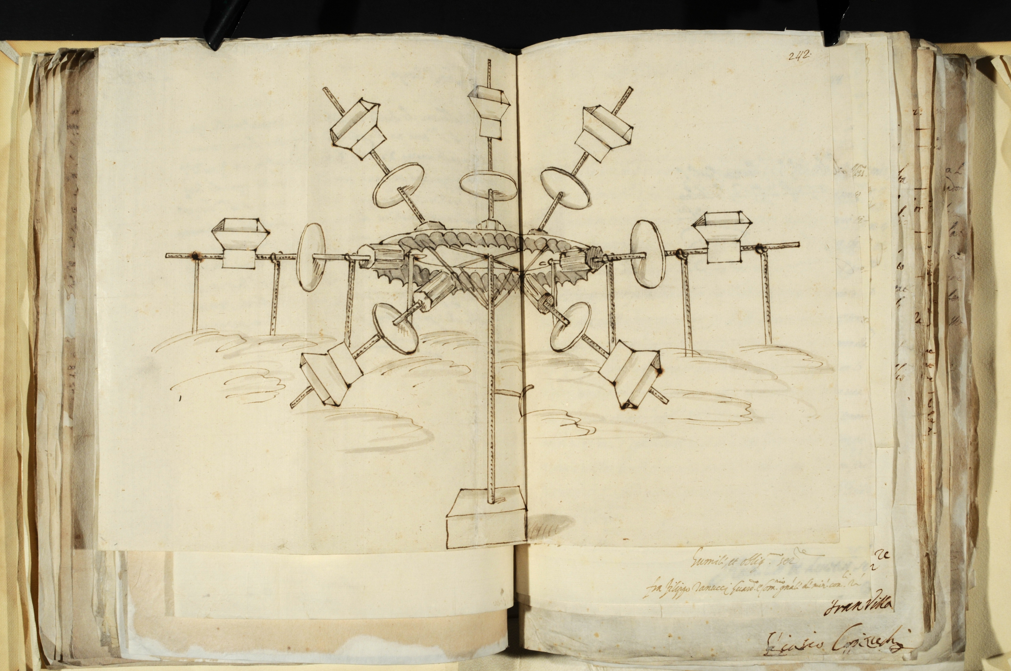

Slide 16
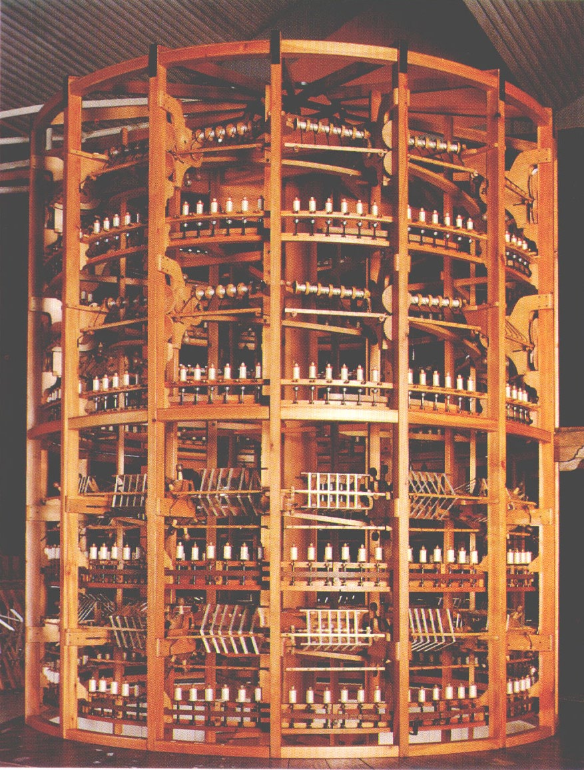

Slide 17
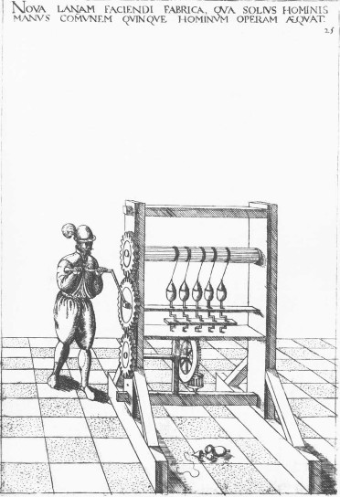

Slide 18
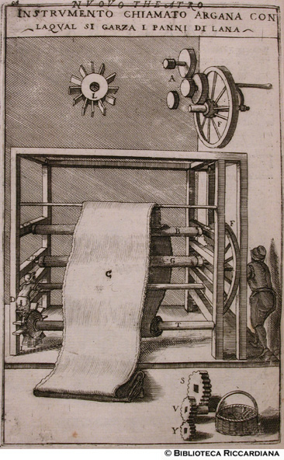

Slide 19
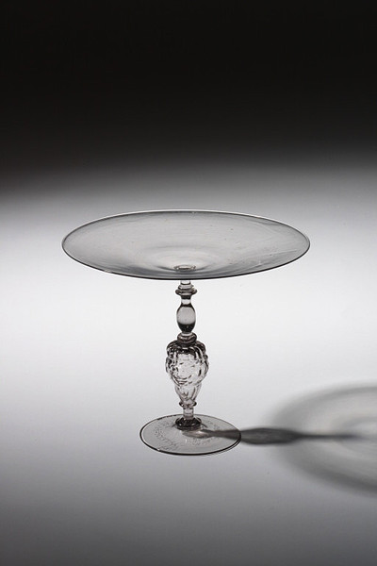

Slide 20
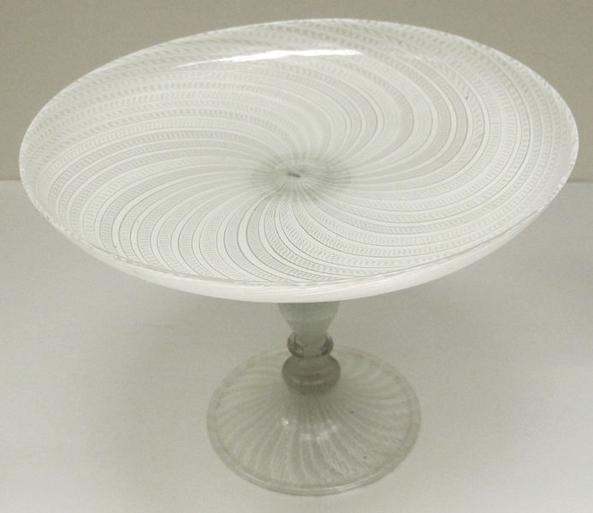

Slide 21
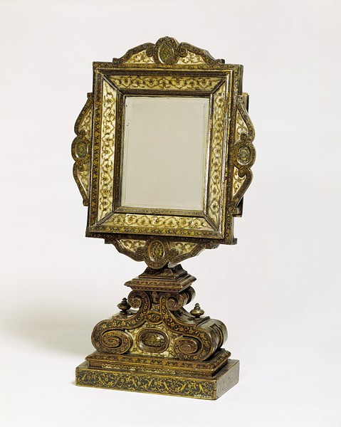

Slide 22


Slide 23
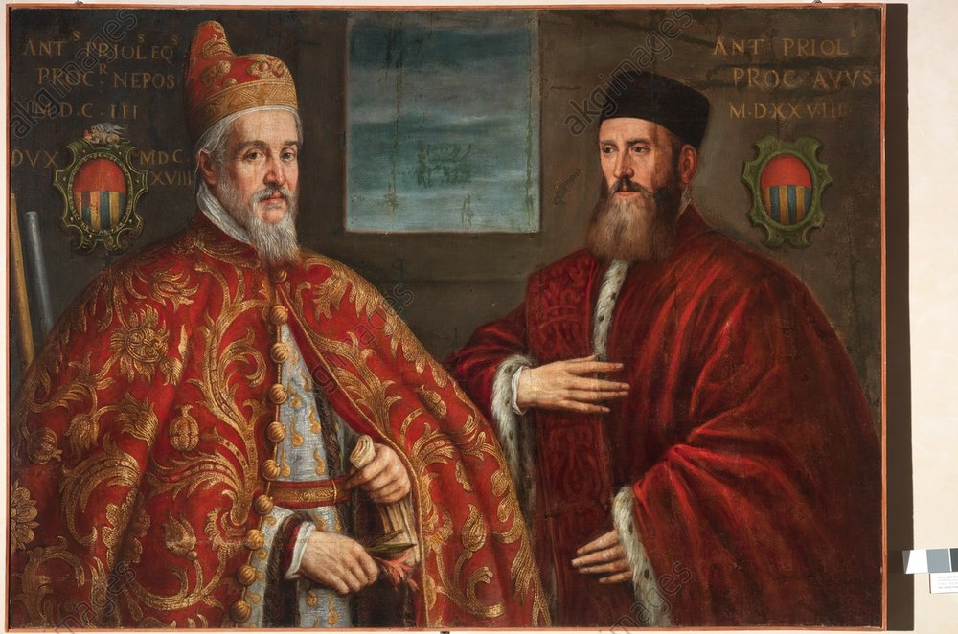

Slide 24


Slide 25
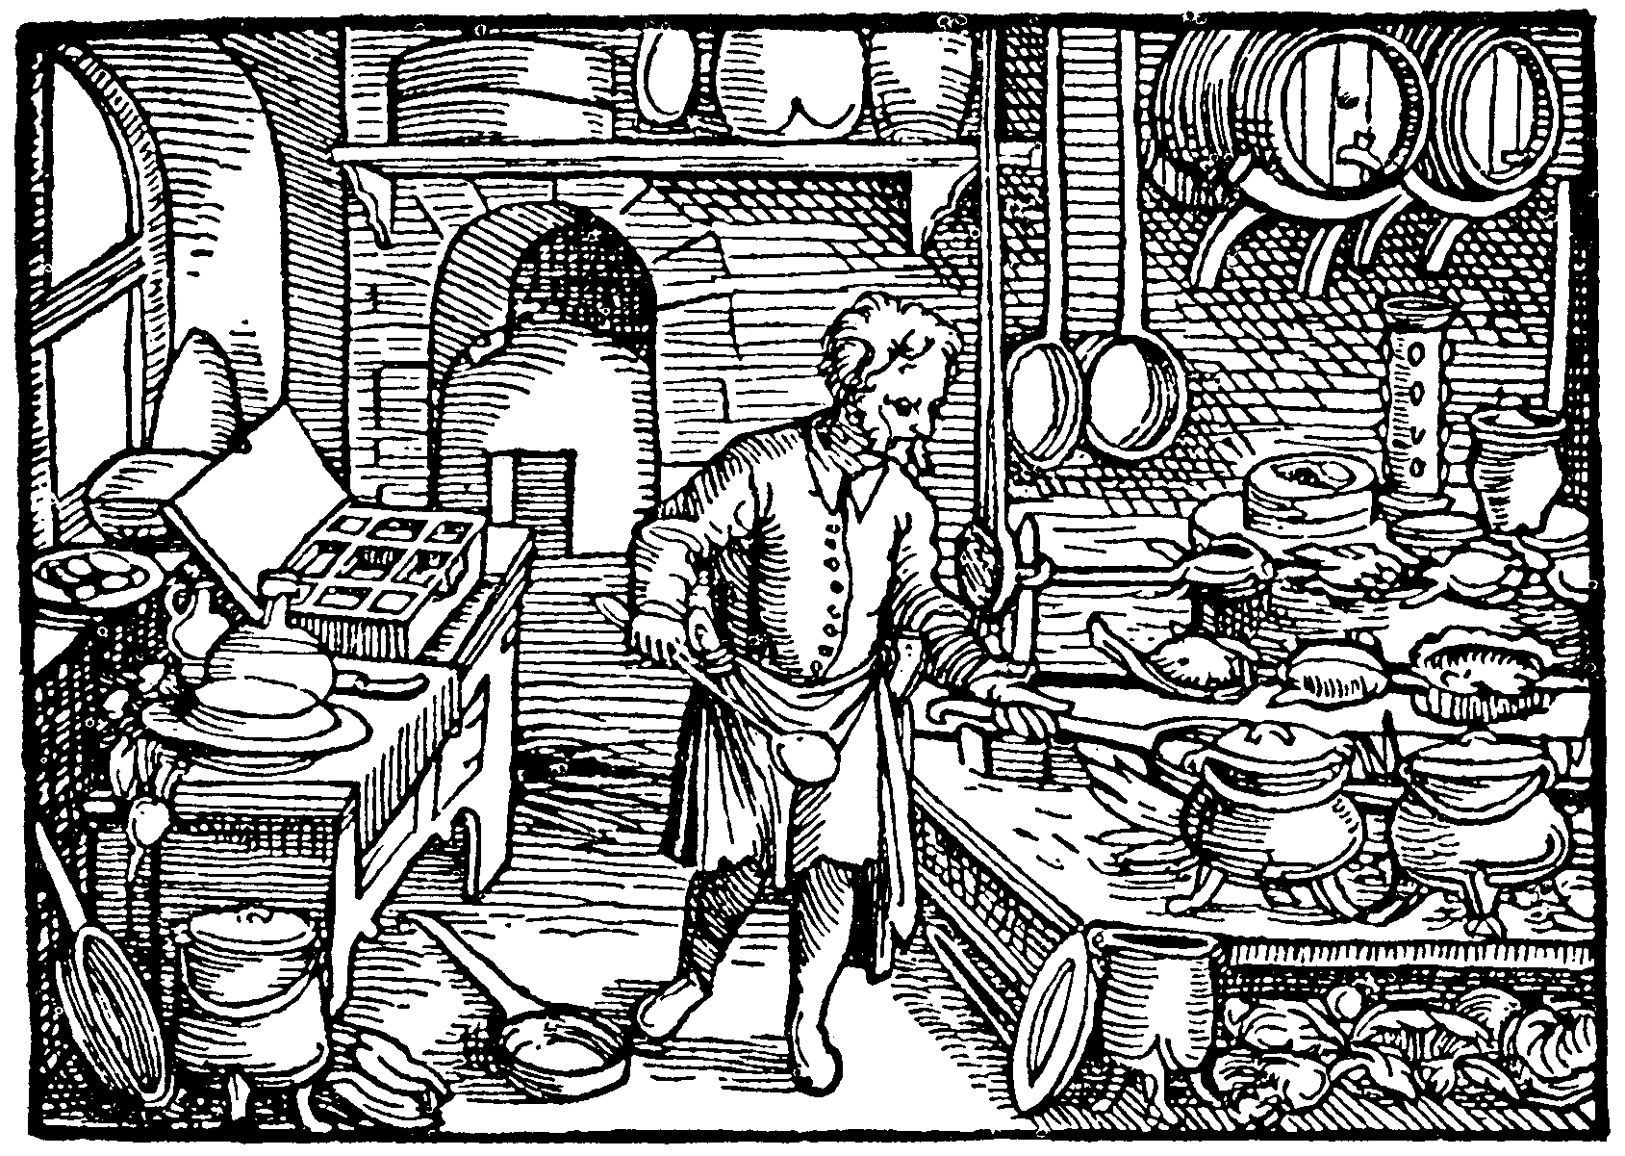

Slide 26
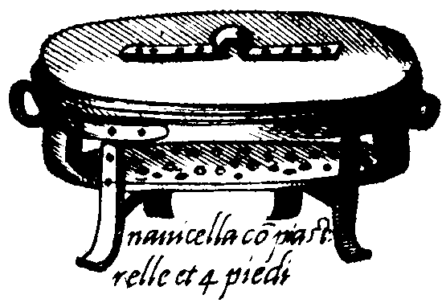

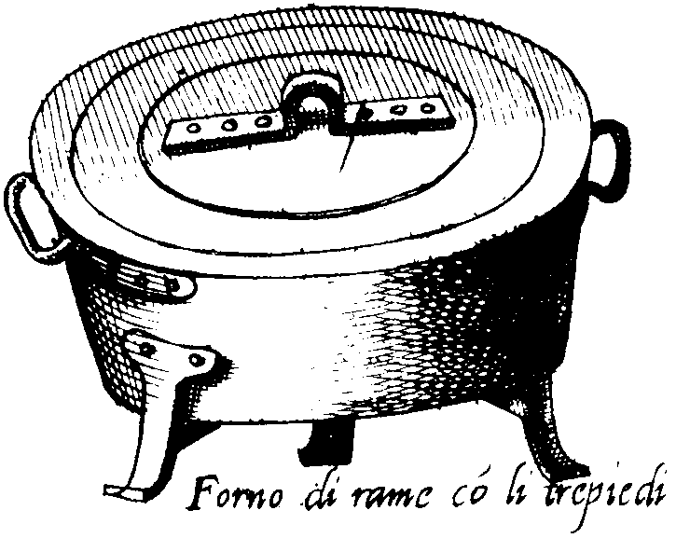

Slide 27
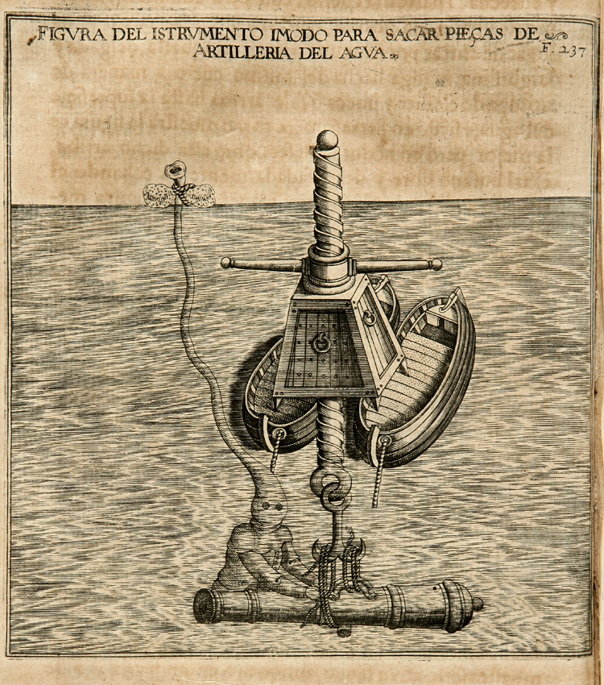

Slide 28
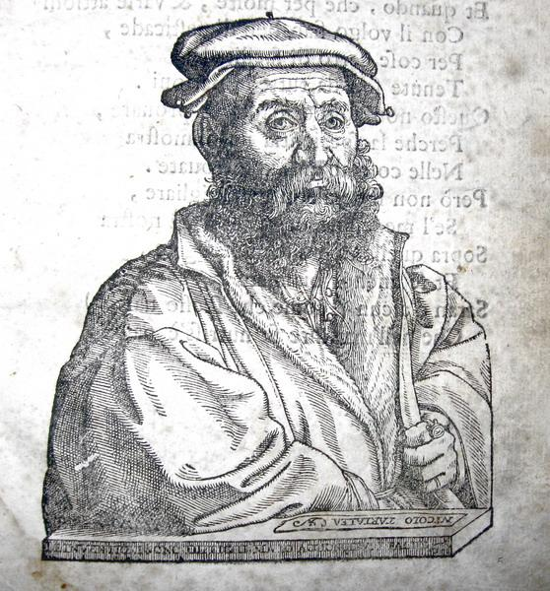

Slide 29
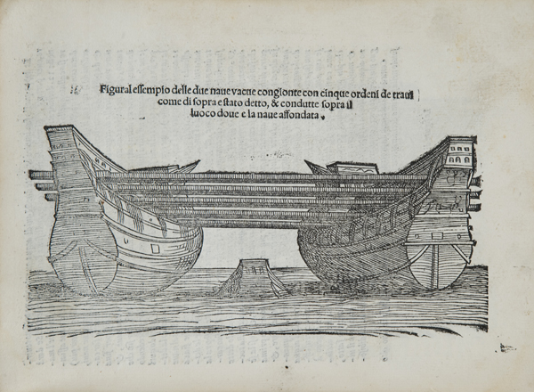

Slide 30
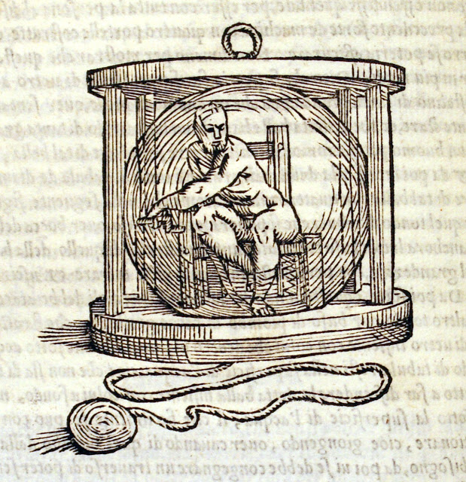

Slide 31
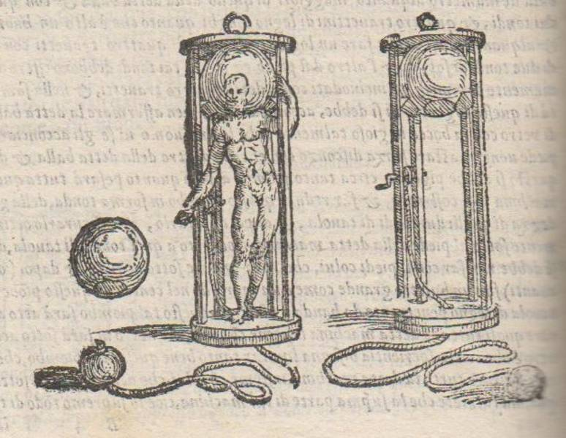

Slide 32
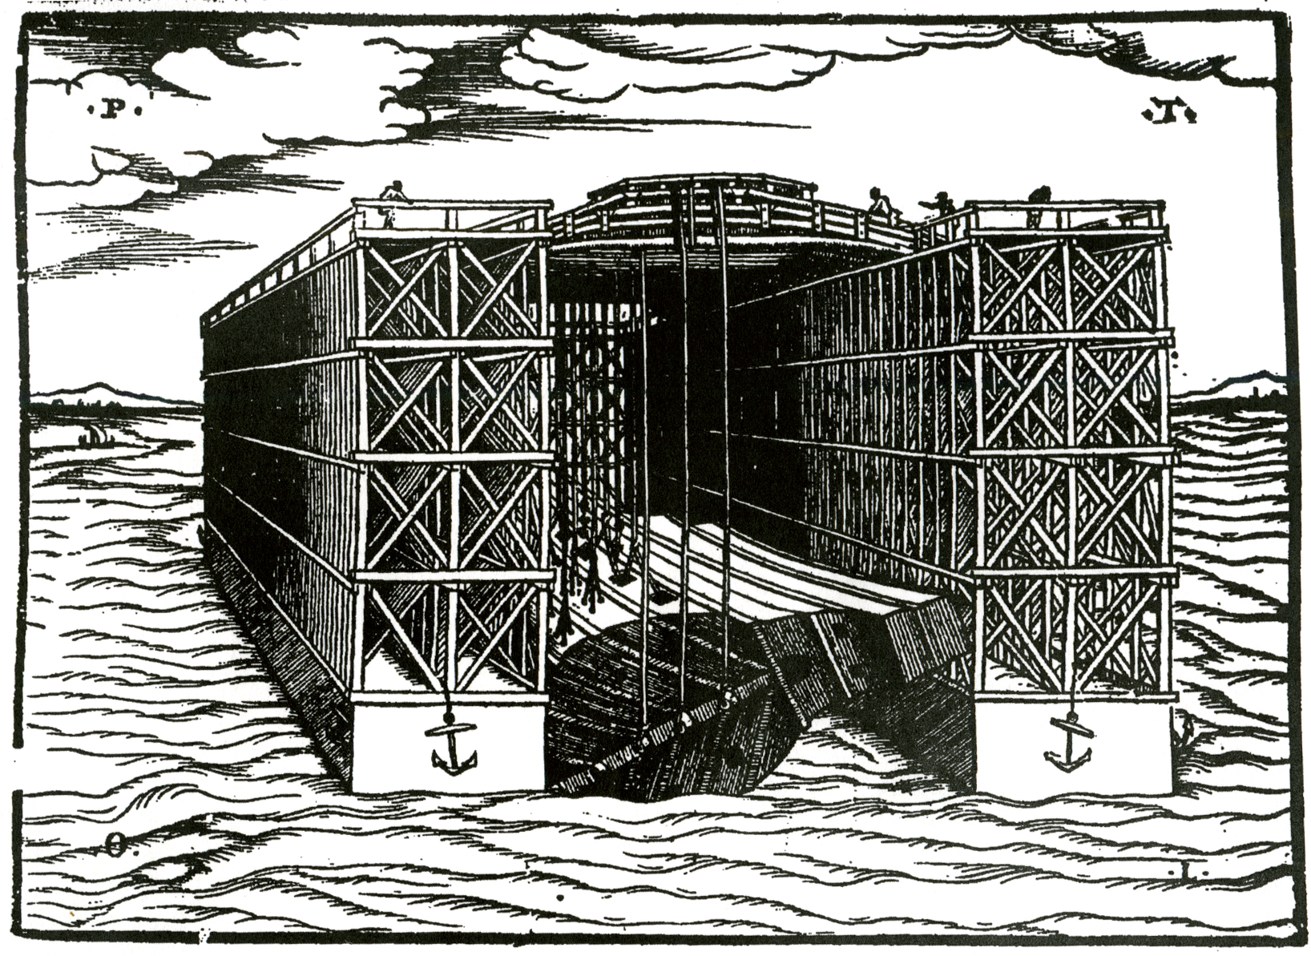

Slide 33
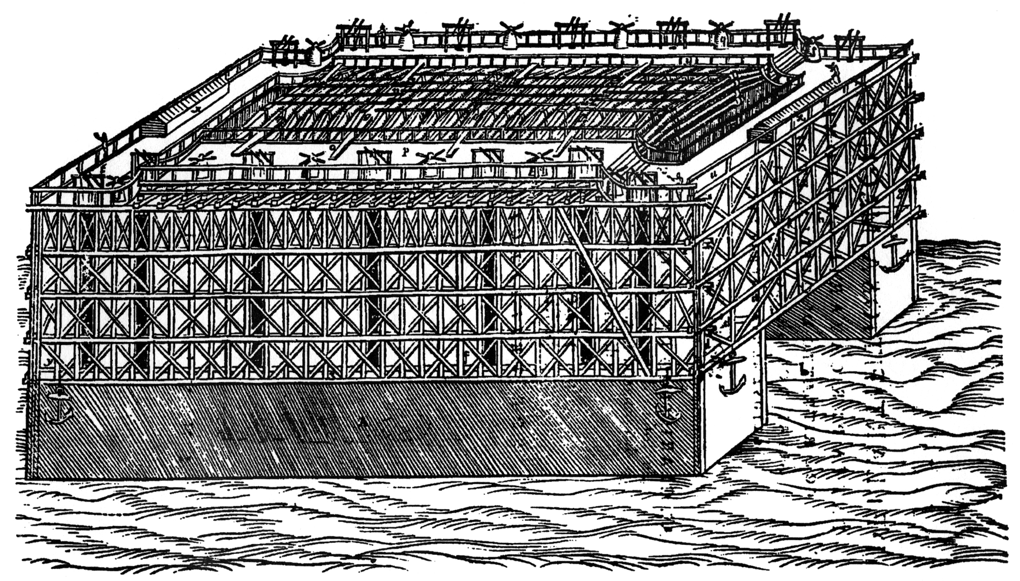

Slide 34
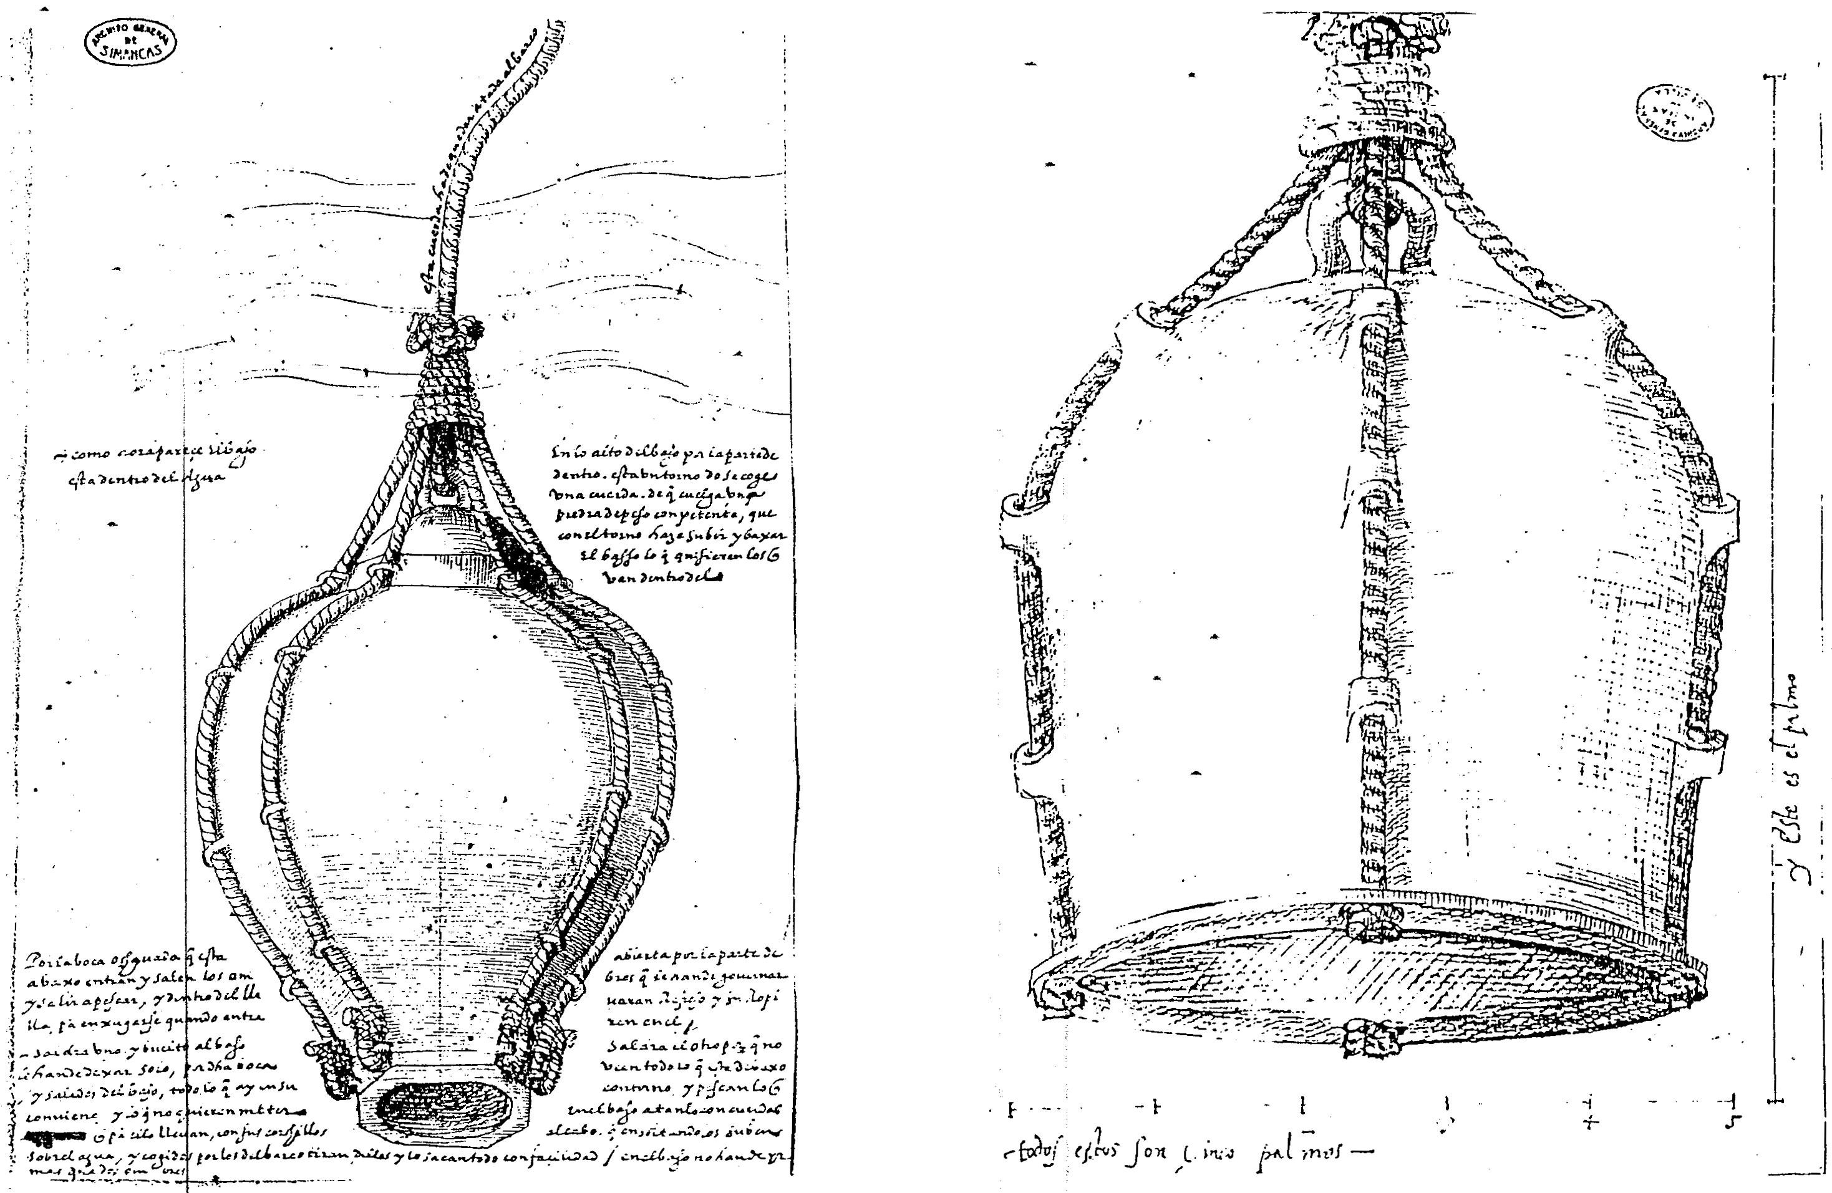

Slide 35
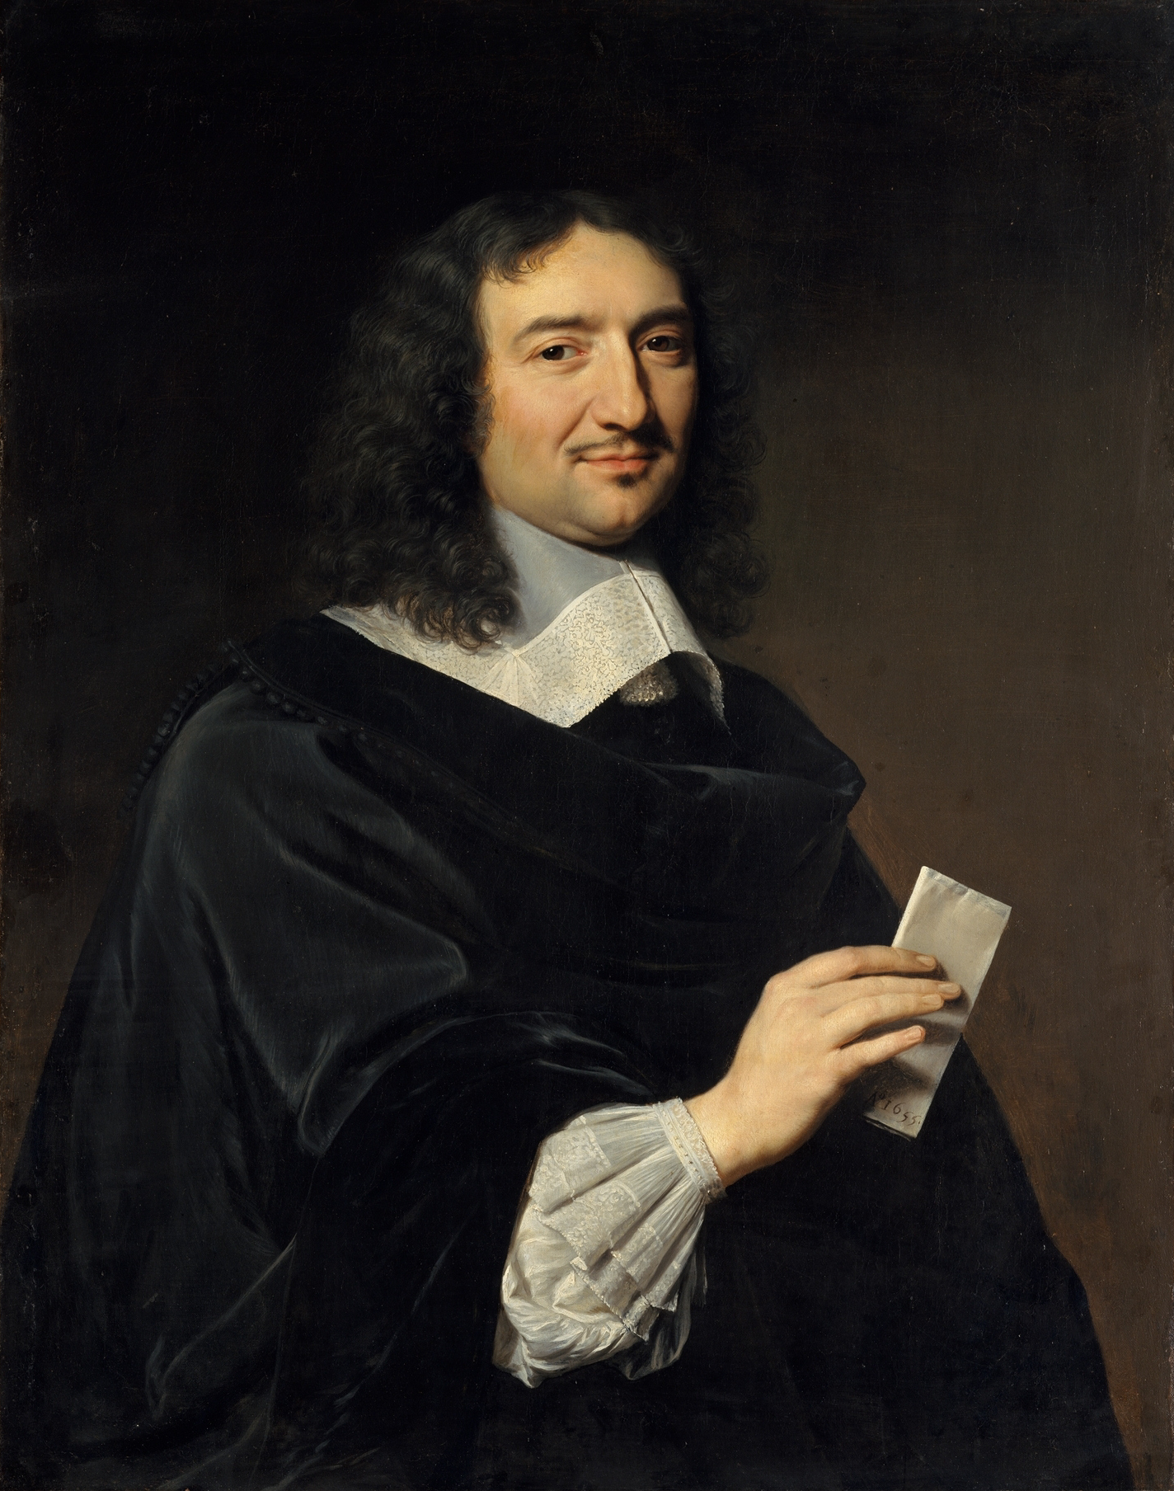

Slide 36
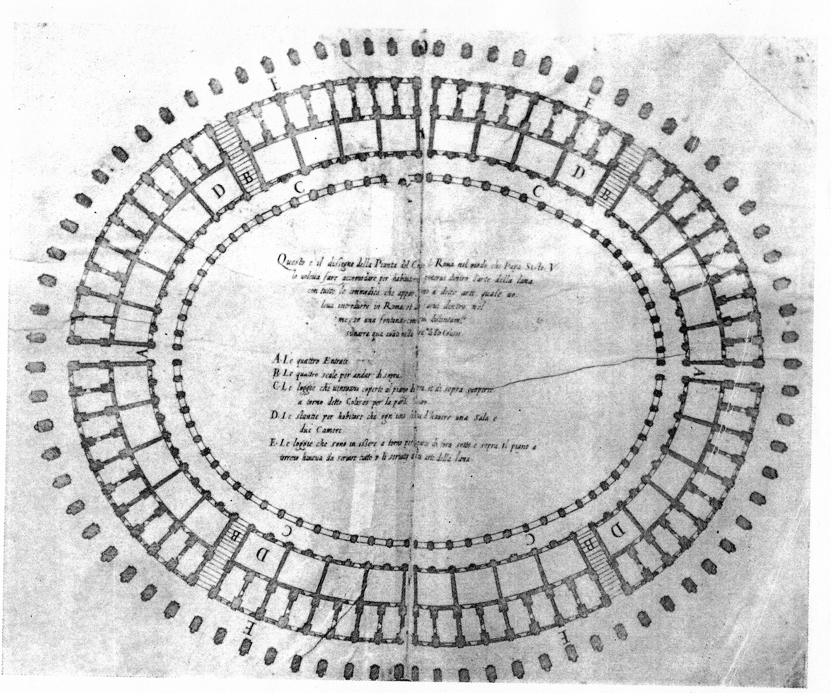

Slide 37
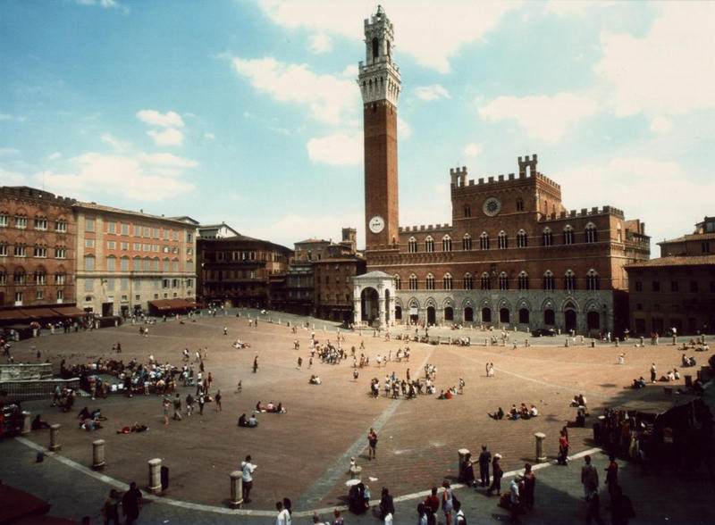

Slide 38
Republic of Siena, 1459 Eighteen Citizens on Crafts
Opening declaration that they are acting “considering the great utility that every republic draws from having an abundance of trades and skills in its city, by means of which the poor men find work and earnings, and goods are obtained at the best price, the city becomes more populated and in the end wealthy, because foreign money comes in and its own money does not go out”

Slide 39
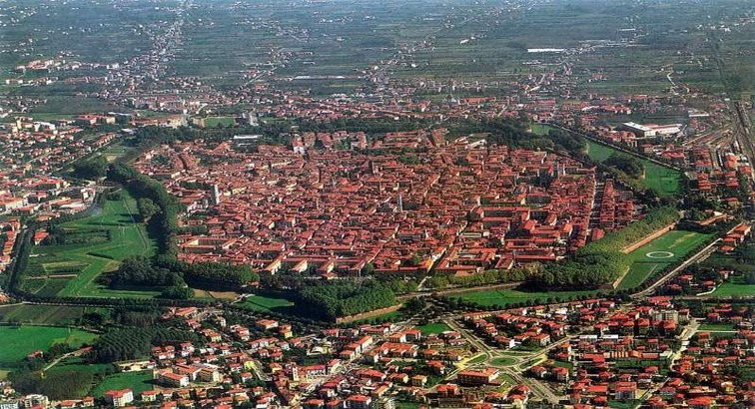

Slide 40
Archivio di Stato di Lucca, Consiglio Generale, Riformagioni Pubbliche, 42
8 January 1544
Auctoritas data tribus civibus inveniendo homines aptos pro introducendo in civitate novas artes
Quod auctoritate et pro bono publico et utilitate civium nostrorum intelligatur et sit data auctoritas, cura et in cunctum onus infrascriptis tribus speciali civibus examinandi modum et viam quomodo introduci possit in civitate nostra nove artes, qui cives curam particularem et spetialem habeant vigilandi et inveniendi homines actos et expertos circa predicta. Et quando eis necessarium et oportunum videbitur referre debeant magnificis D. Antianis quid egerint, quam relationem prefati magnifici D. Antiani teneatur proponere in presenti magnifico Consilio, ut super predictis deliberet prout ei videbitur. Duratura dicta auctoritate toto presenti anno. Qui sunt
Franciscus Burlamacchi
Bernardinus Cenami
Martinus Bernardini

Slide 41
State Incentives Pro Arte Introducenda
1. Monopoly right for the new craft, as a protective measure against internal competition
2. Protective measures against foreign competition, with prohibition of imports, either immediately or after the new industry had grown enough to satisfy the local market
3. Variable set of fiscal benefits, with a partial or total exemption from customs duties for the raw materials imported and the finished products sent abroad
4. Concession of a house and/or a shop where the innovator could live and work, free of charge or at a reduced rent, plus other working premises
5. Financial help from the government for starting production - loan at a special interest rate / gift / capital in a joint venture with the local ruling family
6. Special provisions for the exploitation of energy sources (e.g. right to use public water)
7. Legal privileges, including the permission to carry arms for the men involved in the enterprise

Slide 42
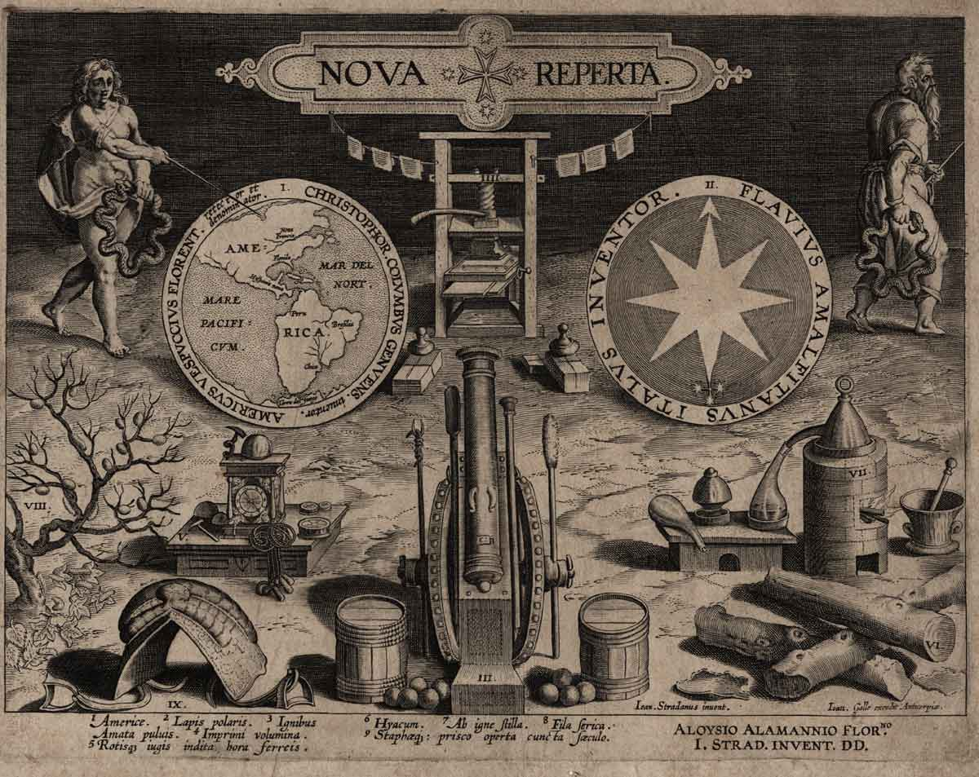

Slide 43
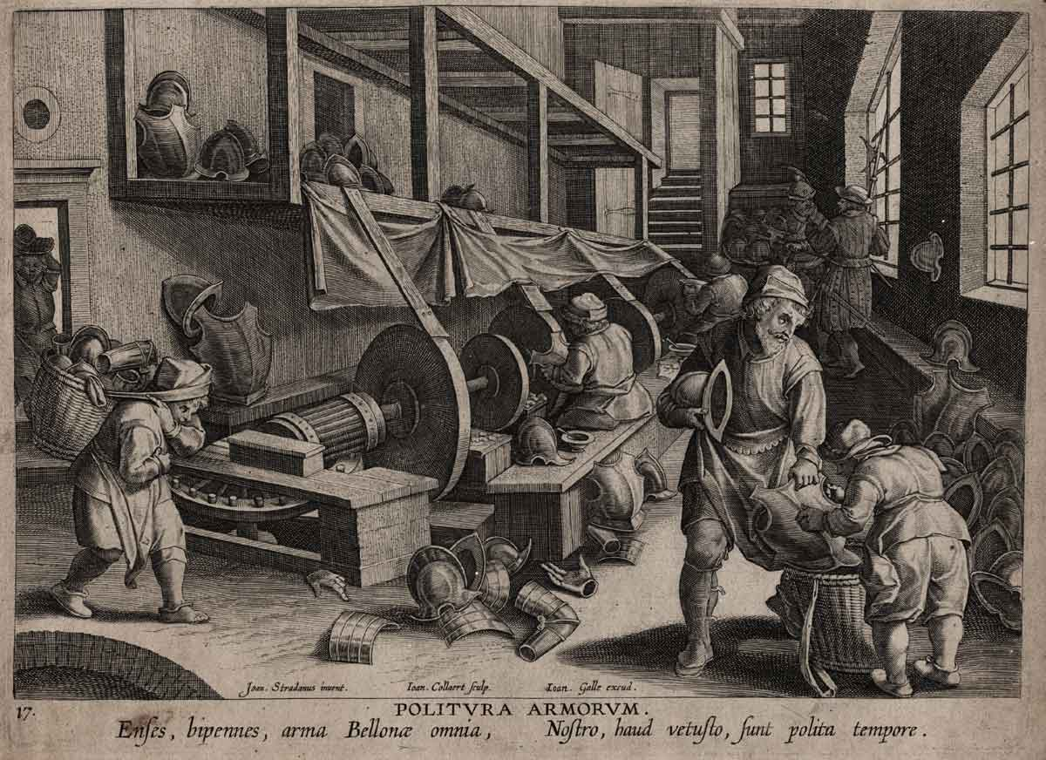

Slide 44
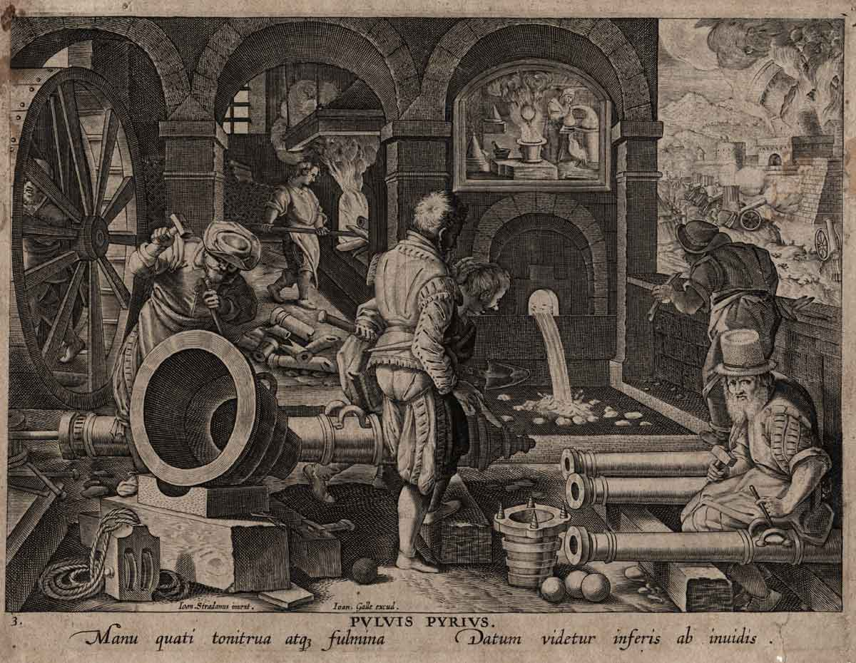

Slide 45
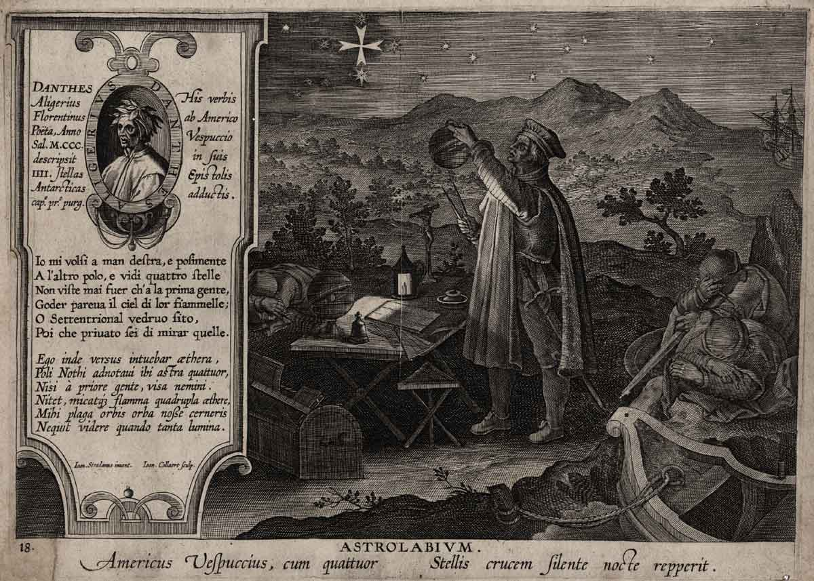

Slide 46
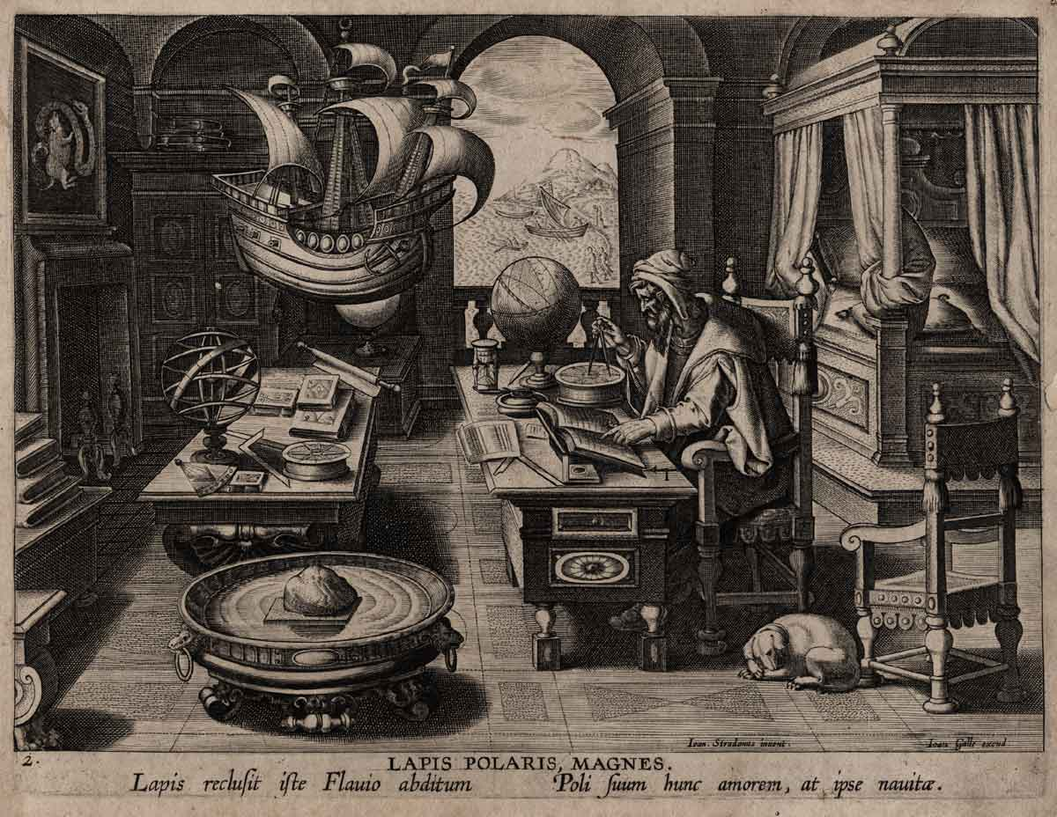

Slide 47
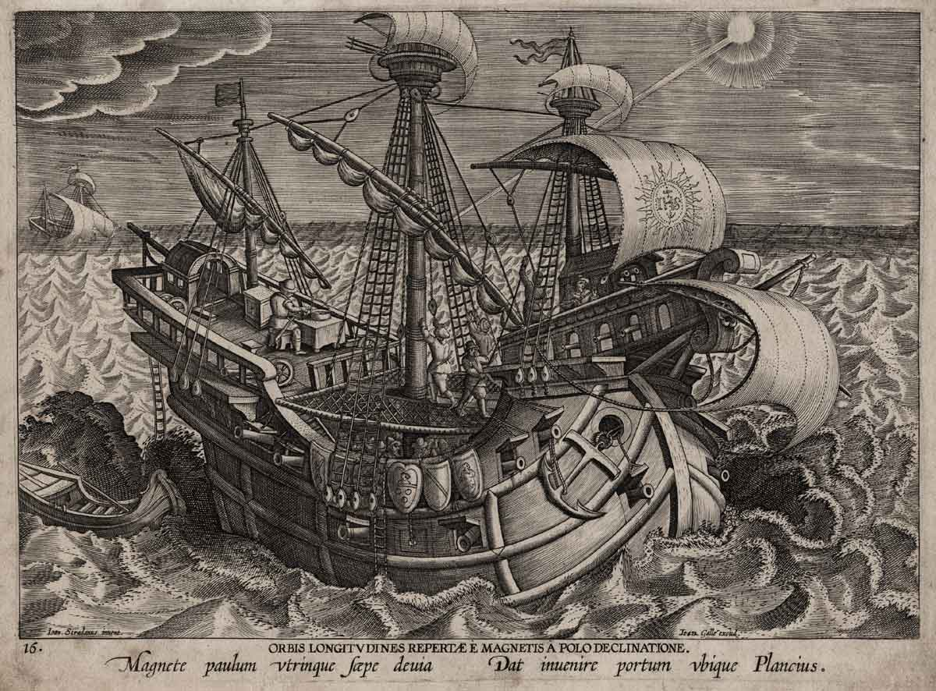

Slide 48
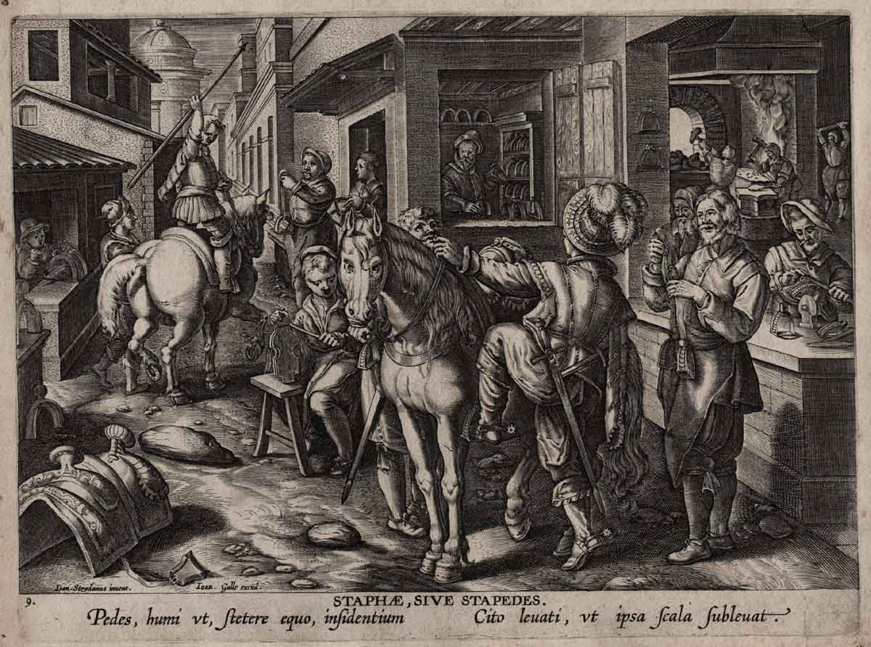

Slide 49
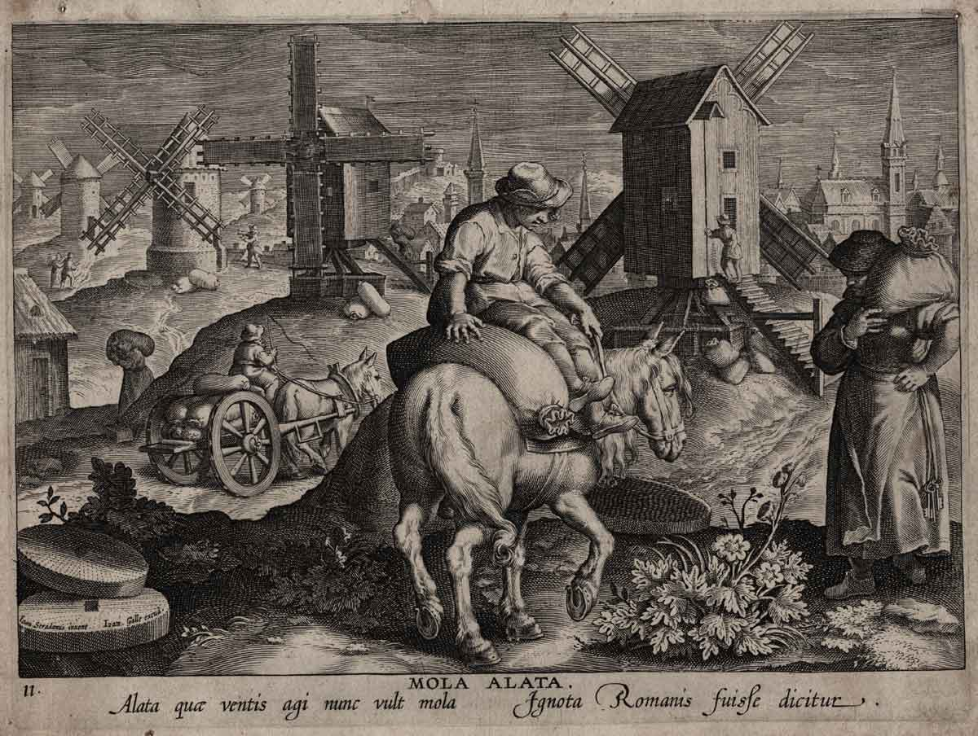

Slide 50
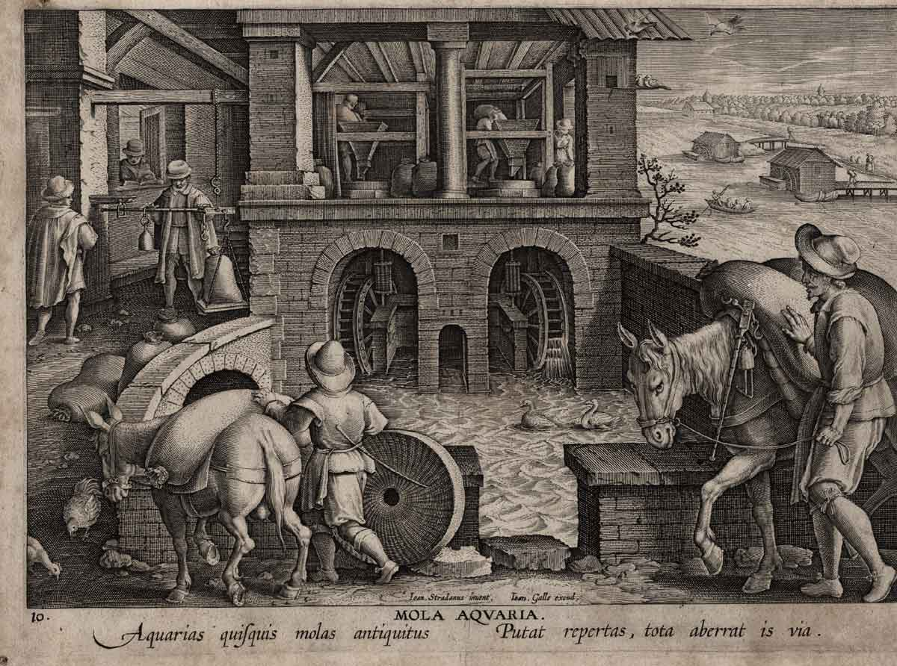

Slide 51
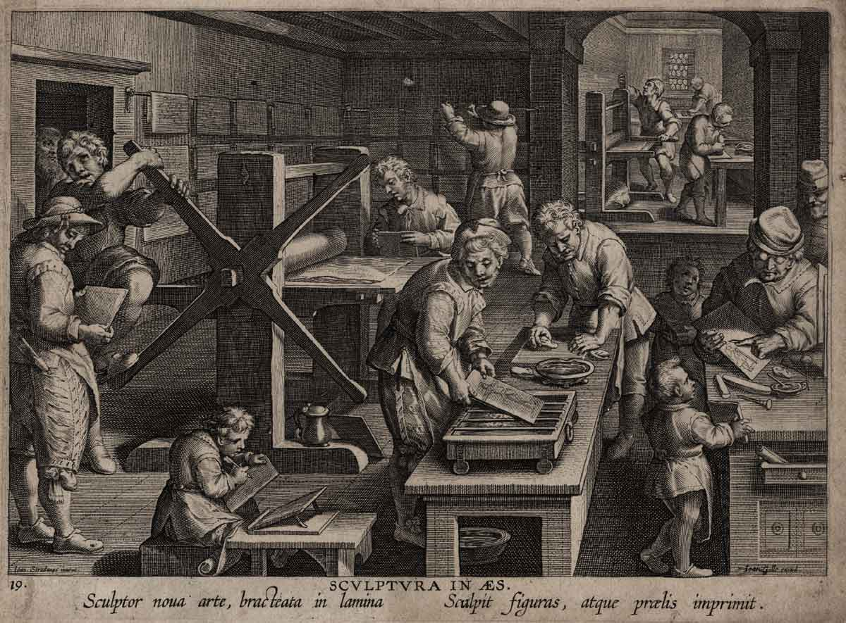

Slide 52
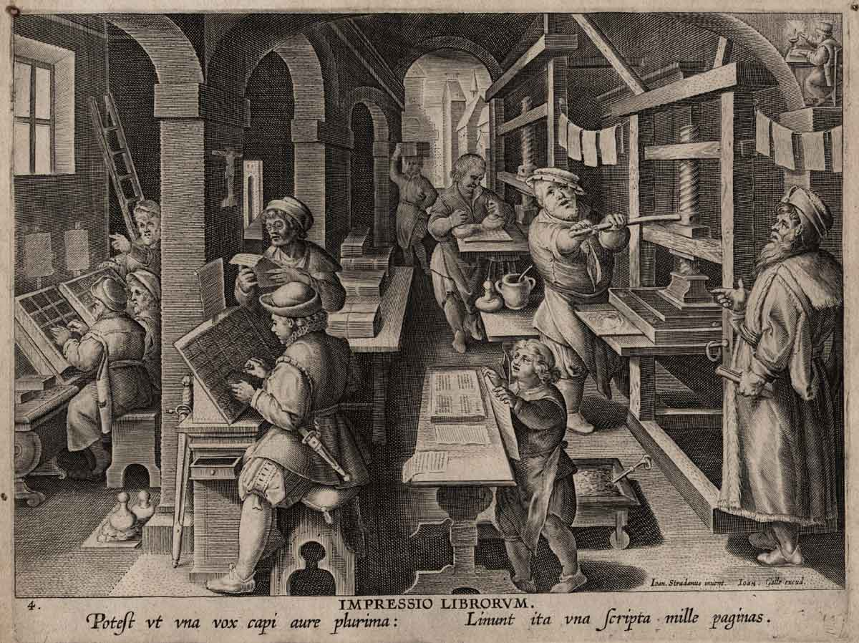

Slide 53
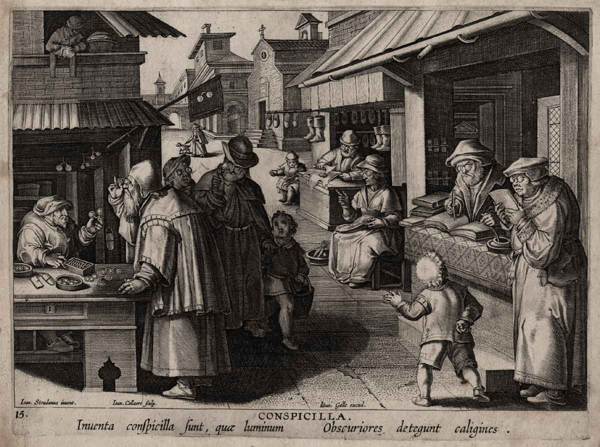

Slide 54
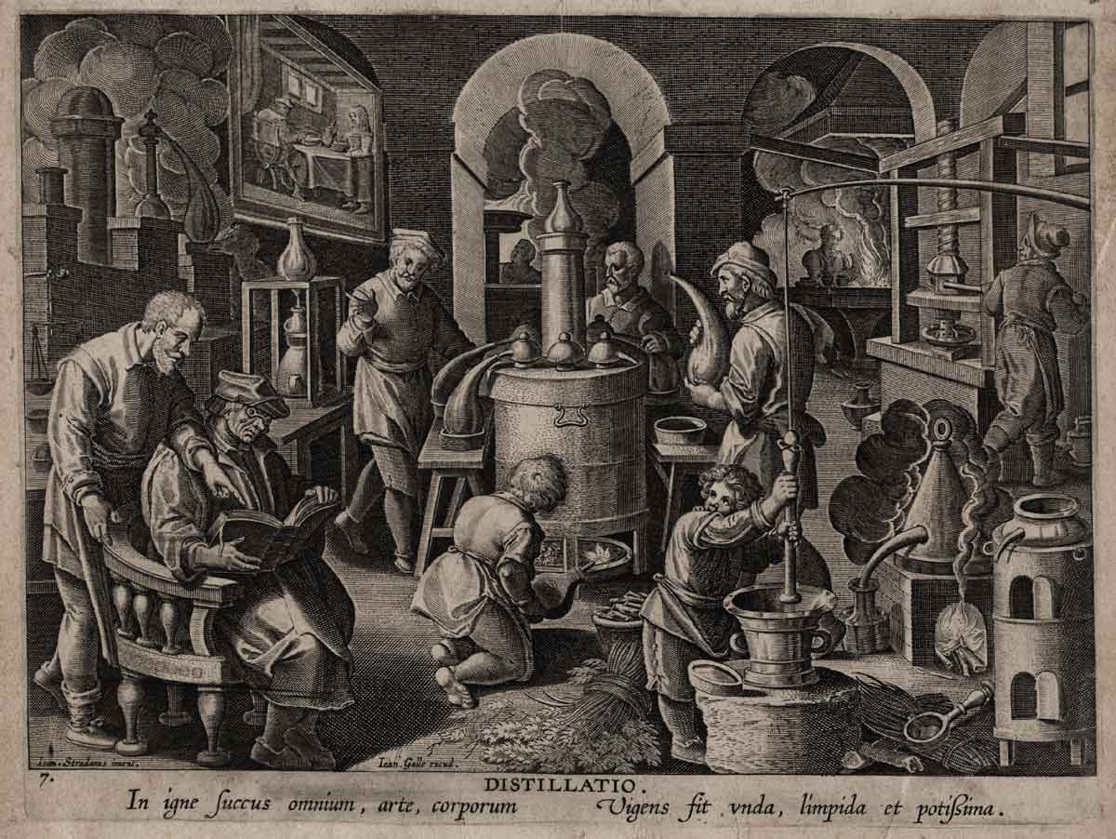

Slide 55
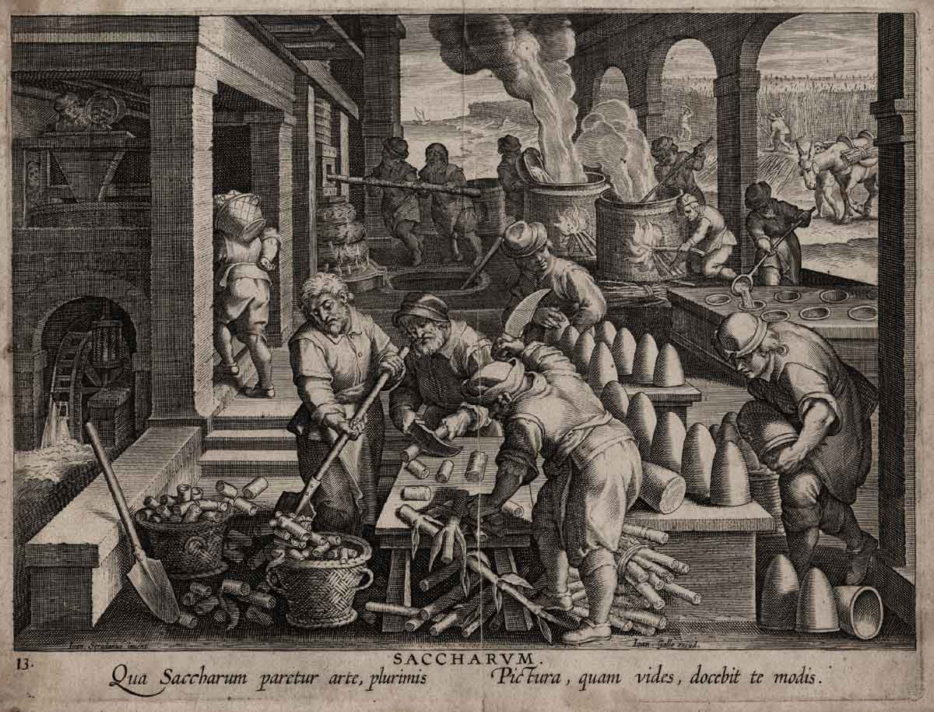

Slide 56
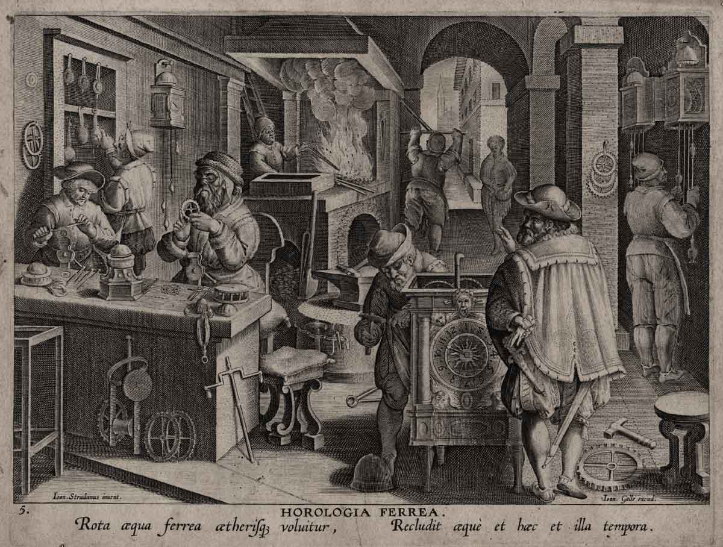

Slide 57
