Slide 1
Martin Luther: Reactionary or Revolutionary?
Peter Marshall

Slide 2
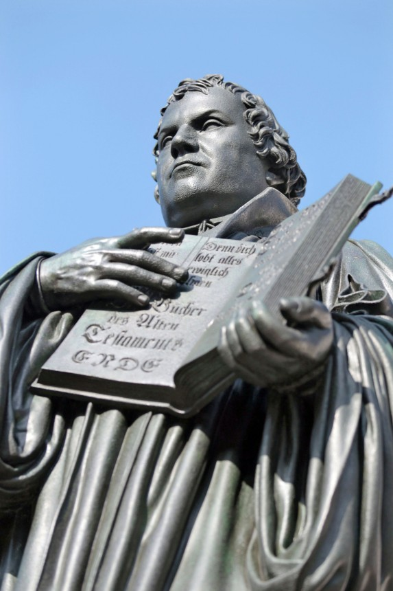
“Great Man” Luther
Luther memorial in Wittenberg, Germany

Slide 3
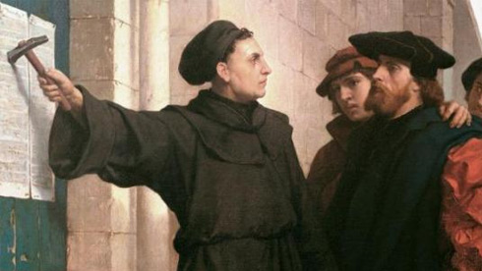
Luther posts the 95 Theses: a Romantic 19th century view…

Slide 4
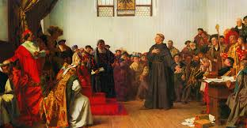
Luther at the Diet of Worms: another Romantic 19th century view!

Slide 5
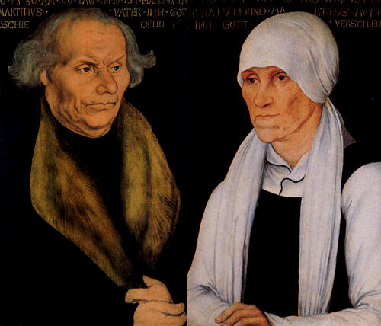
Luther’s parents, Hans and Margarethe

Slide 6
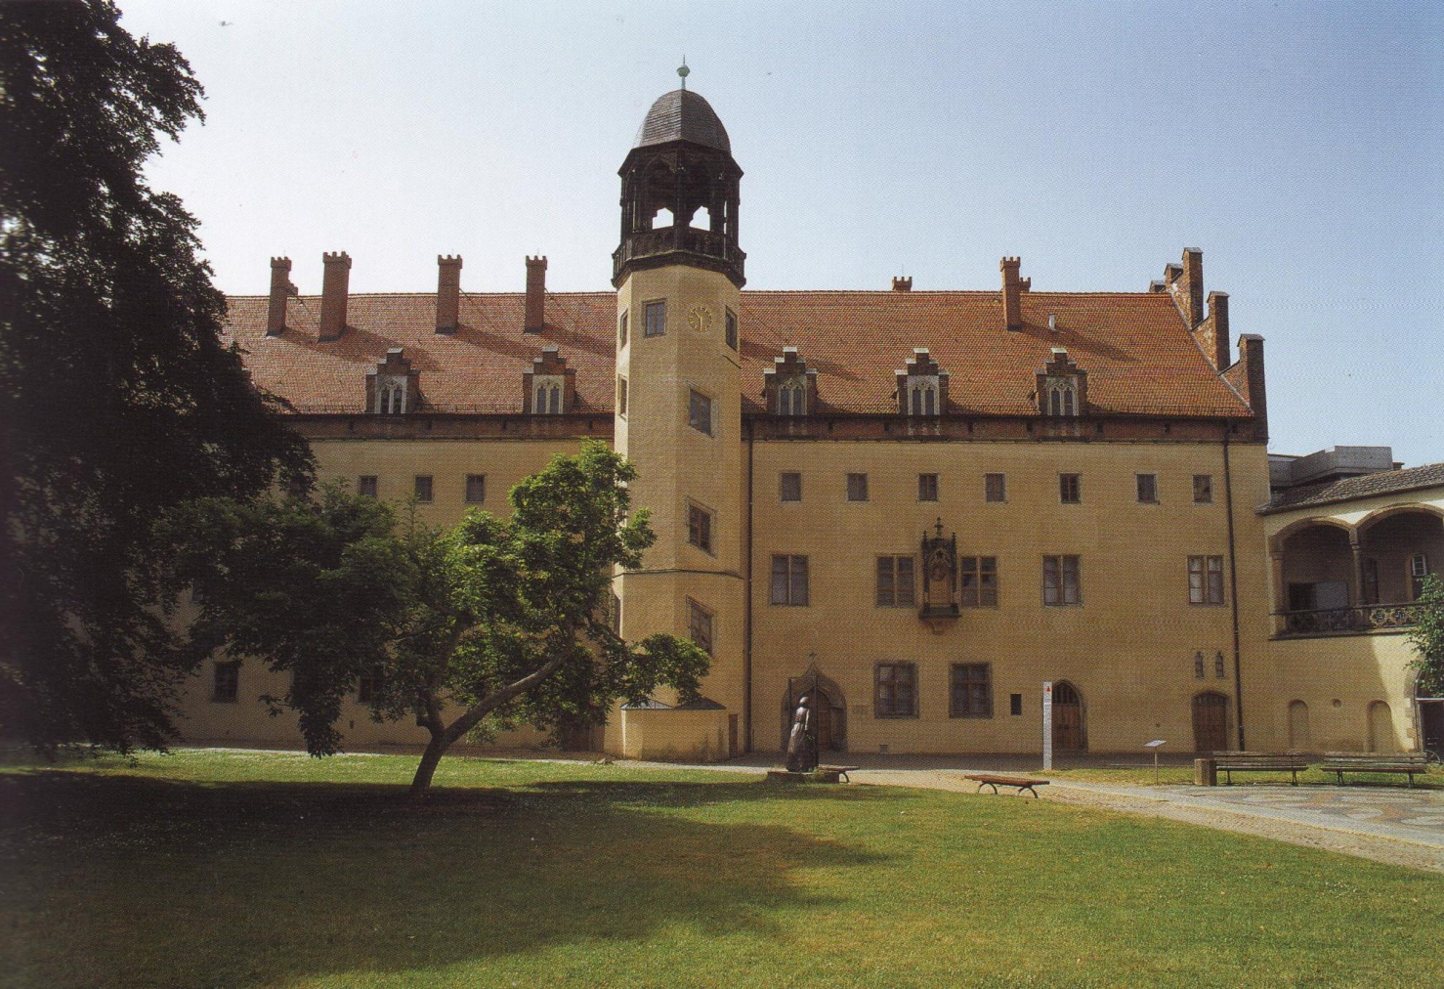
The Augustinian monastery, Wittenberg

Slide 7
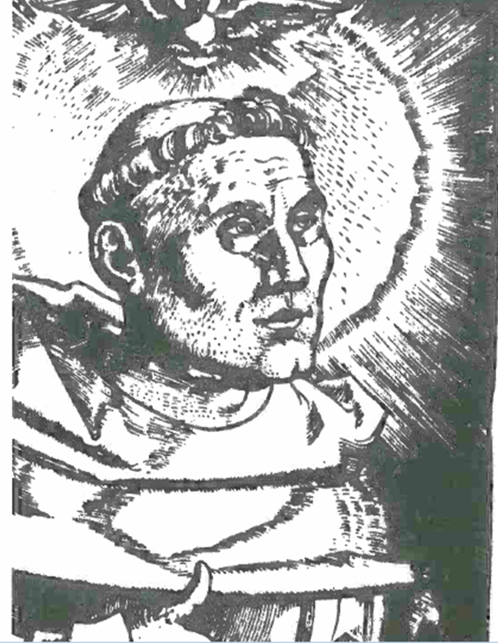
Luther the Catholic friar

Slide 8
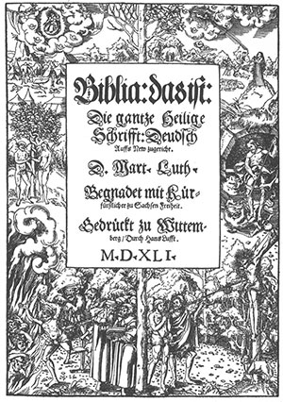
Luther’s new insight:
“the righteous shall live by faith [alone]” (Letter of St Paul to the Romans, 1:17)

Slide 9
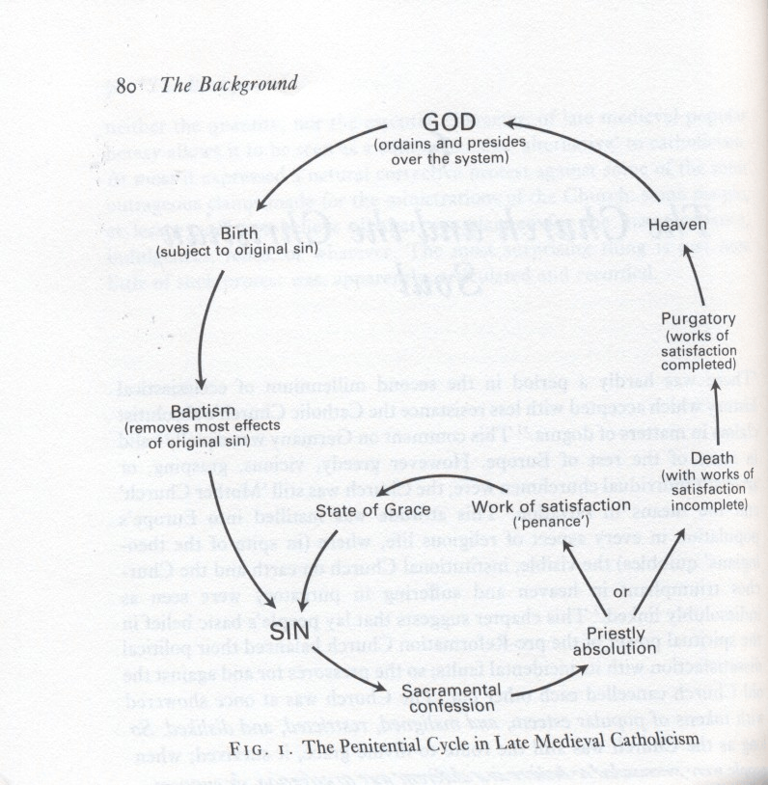
The Penitential Cycle:

Slide 10
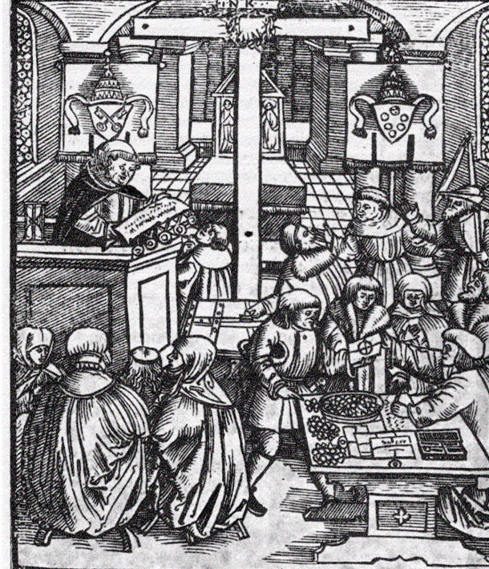
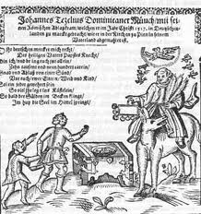
“As soon as the coin in the coffer rings…”Tetzel’s Indulgence campaign

Slide 11
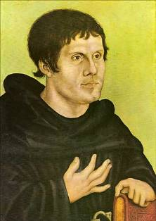
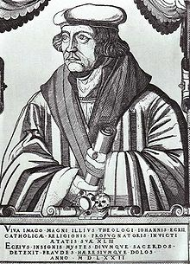
Confrontation at Leipzig, June-July 1519
Luther
Johan Eck

Slide 12
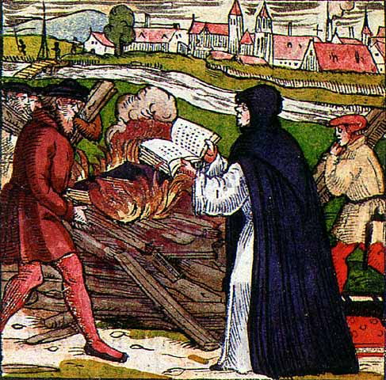
Point of no return? Luther burns the bull of excommunication, 1520

Slide 13
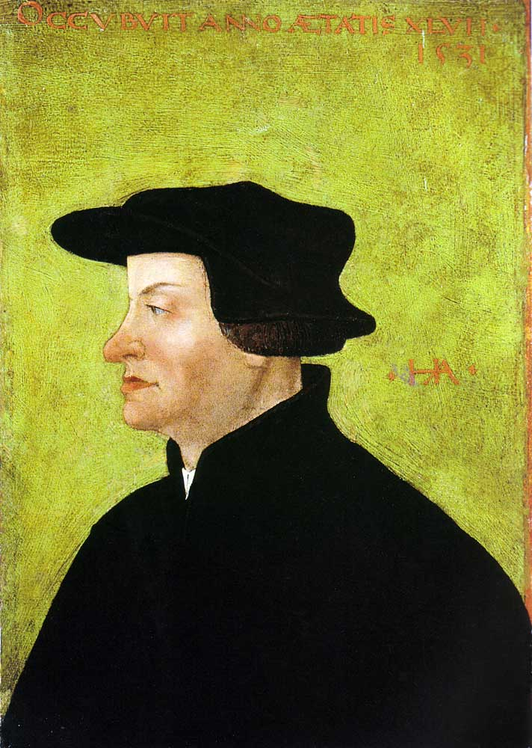
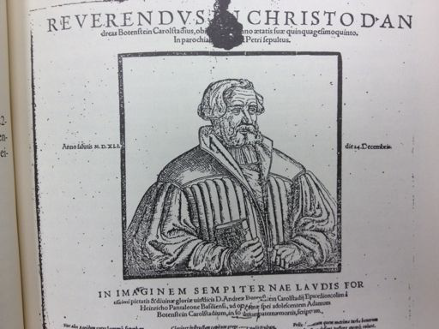
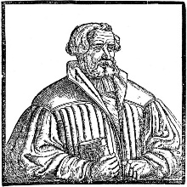
More opponents – evangelical ones!
Andreas von Karlstadt
Ulrich Zwingli

Slide 14
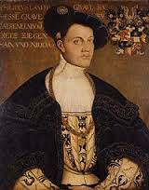
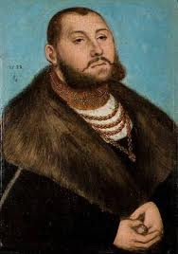
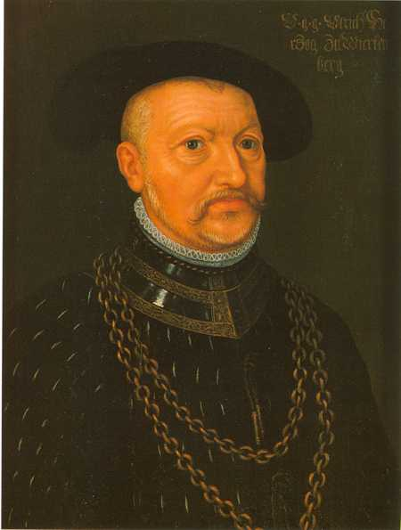
The Faces of Princely Reformation
Philip of Hesse John Frederick
of Saxony
Ulrich of Wurttemberg

Slide 15
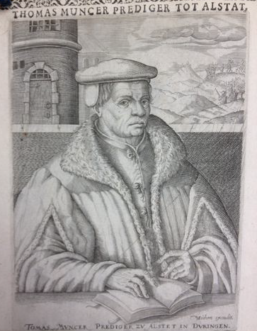
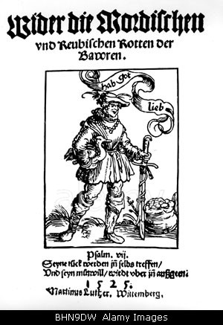
“Therefore let everyone who can, smite, slay, and stab, secretly or openly, remembering that nothing can be more poisonous, hurtful, or devilish than a rebel…”
Radical Leader, Thomas Muntzer
Luther’s tract of 1525

Slide 16
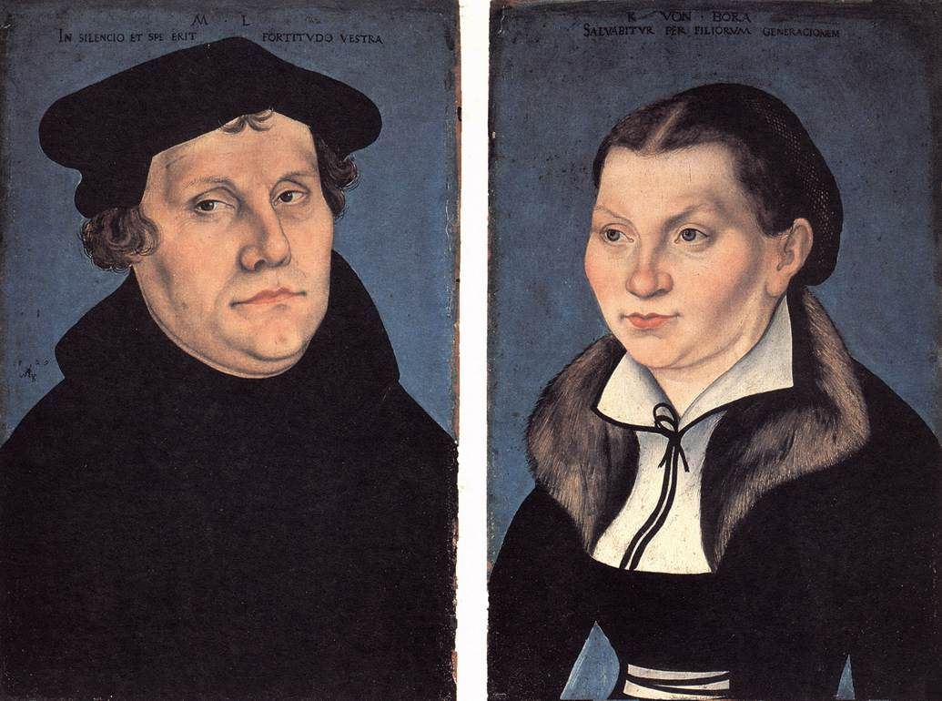
Mrs and Mrs Luther: Martin and Katharina von Bora

Slide 17
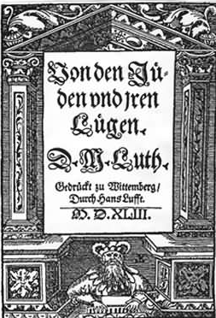
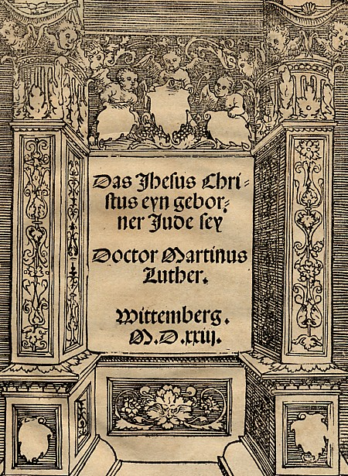
Luther’s anti-Semitic slide, from That Jesus Christ was Born a Jew (1523) to On the Jews and Their Lies (1543)

Slide 18
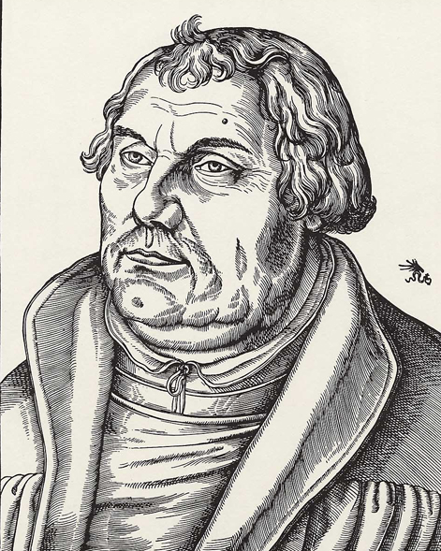
Which Luther?

Slide 19
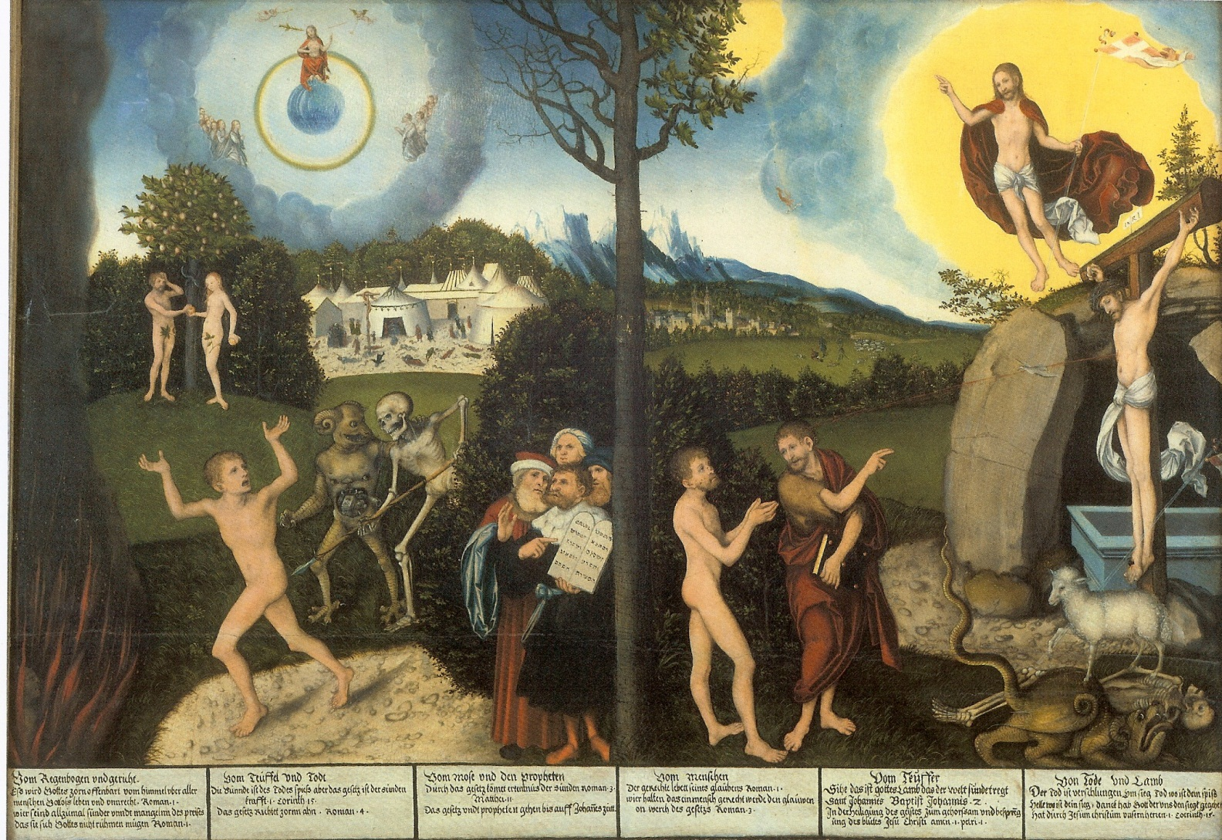
The paradoxes of Luther(anism) (Lucas Cranach’s Allegory of Law and Grace, 1525)

